Slide 1
Effects of β-hydroxy β-methylbutyrate (HMB) supplementation on muscle mass, function, and other outcomes in patients with cancer: a systematic review
Carla M. Prado^{1*}, Camila E. Orsso¹, Suzette L. Pereira², Philip J. Atherton³, Nicolaas E. P. Deutz⁴
¹ Human Nutrition Research Unit, Department of Agricultural, Food and Nutritional Science, University of Alberta, Canada
² Research and Development, Abbott Nutrition, United States
³ Centre of Metabolism, Ageing & Physiology (COMAP), Medical Research Council (MRC) Versus Arthritis Centre for Musculoskeletal Ageing Research (CMAR) and National Institution for Health Research (NIHR) Biomedical Research Centre (BRC), University of Nottingham, United Kingdom
⁴ Center for Translational Research in Aging & Longevity, Department of Health & Kinesiology, Texas A&M University, United States
*Corresponding author
Professor Carla M. Prado, PhD, RD
2-021 Li Ka Shing Centre for Health Innovation
University of Alberta
Edmonton, AB, Canada T6G 2E1
Tel: 780.492.7934 / Fax: 780.492.9555
Email: Carla.prado@ualberta.ca

Slide 2
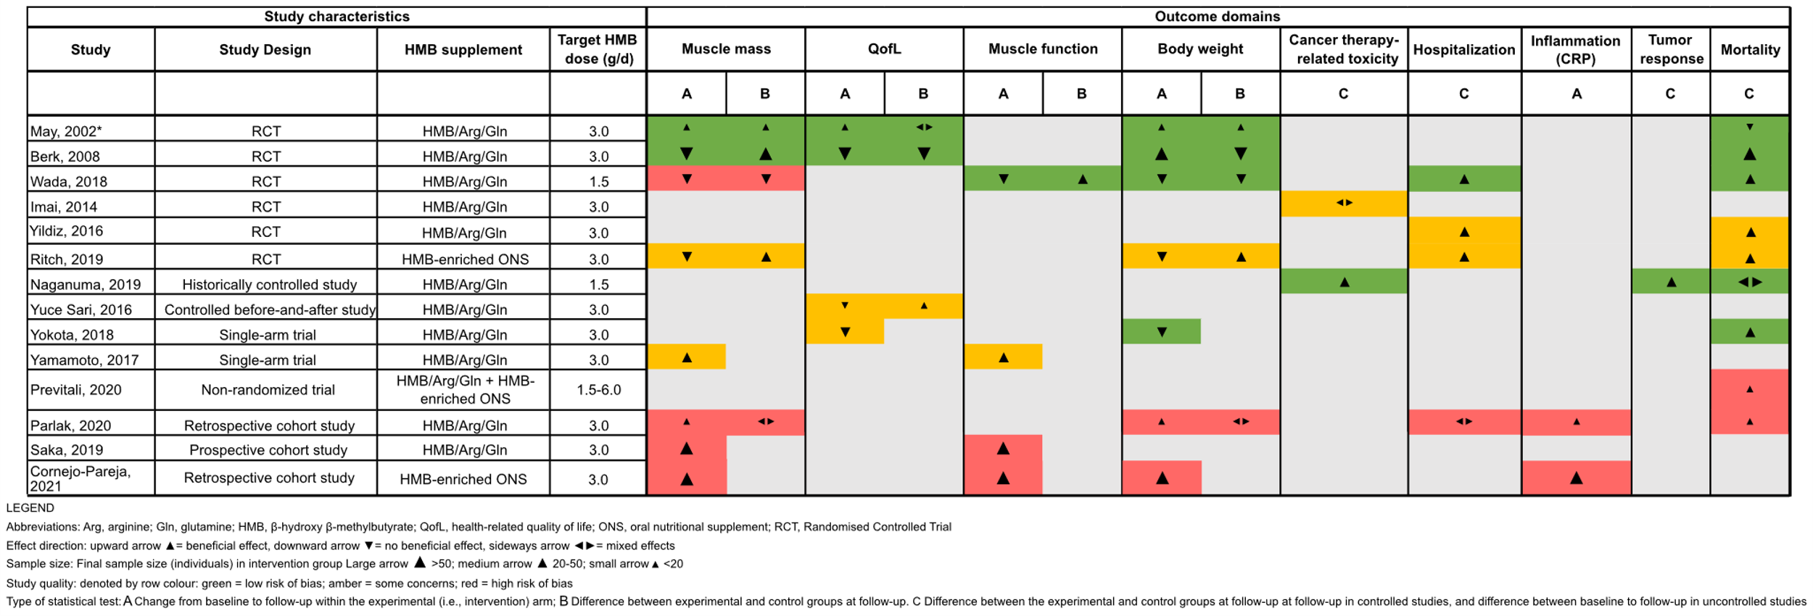
Figure S1
Notes:
Figure S1 Effect direction plot summarizing direction of health impacts from studies administering β-hydroxy β-methylbutyrate (HMB) supplements in patients with cancer. Effect direction: upward arrow ▲= beneficial health impact, downward arrow ▼= no beneficial health impact, sideways arrow ◄►= mixed effects. Sample size: Final sample size (individuals) in intervention group as large arrow ▲ >50; medium arrow ▲ 20-50; small arrow ▲ <20. Study quality: denoted by row colour: green = low risk of bias; amber = some concerns; red = high risk of bias. Type of statistical test: A = change from baseline to follow-up within the experimental (i.e., intervention) arm; B = difference in change between experimental and control groups; C = difference between experimental and control groups at follow-up in controlled studies, and difference between baseline to follow-up within the experimental group in uncontrolled studies. * May et al. 2002 and Rathmacher et al. 2004 described findings from the same study. Abbreviations: Arg, arginine; Gln, glutamine; HMB, β-hydroxy β-methylbutyrate; QofL, health-related quality of life; ONS, oral nutritional supplement; RCT, Randomised Controlled Trial.

Slide 3
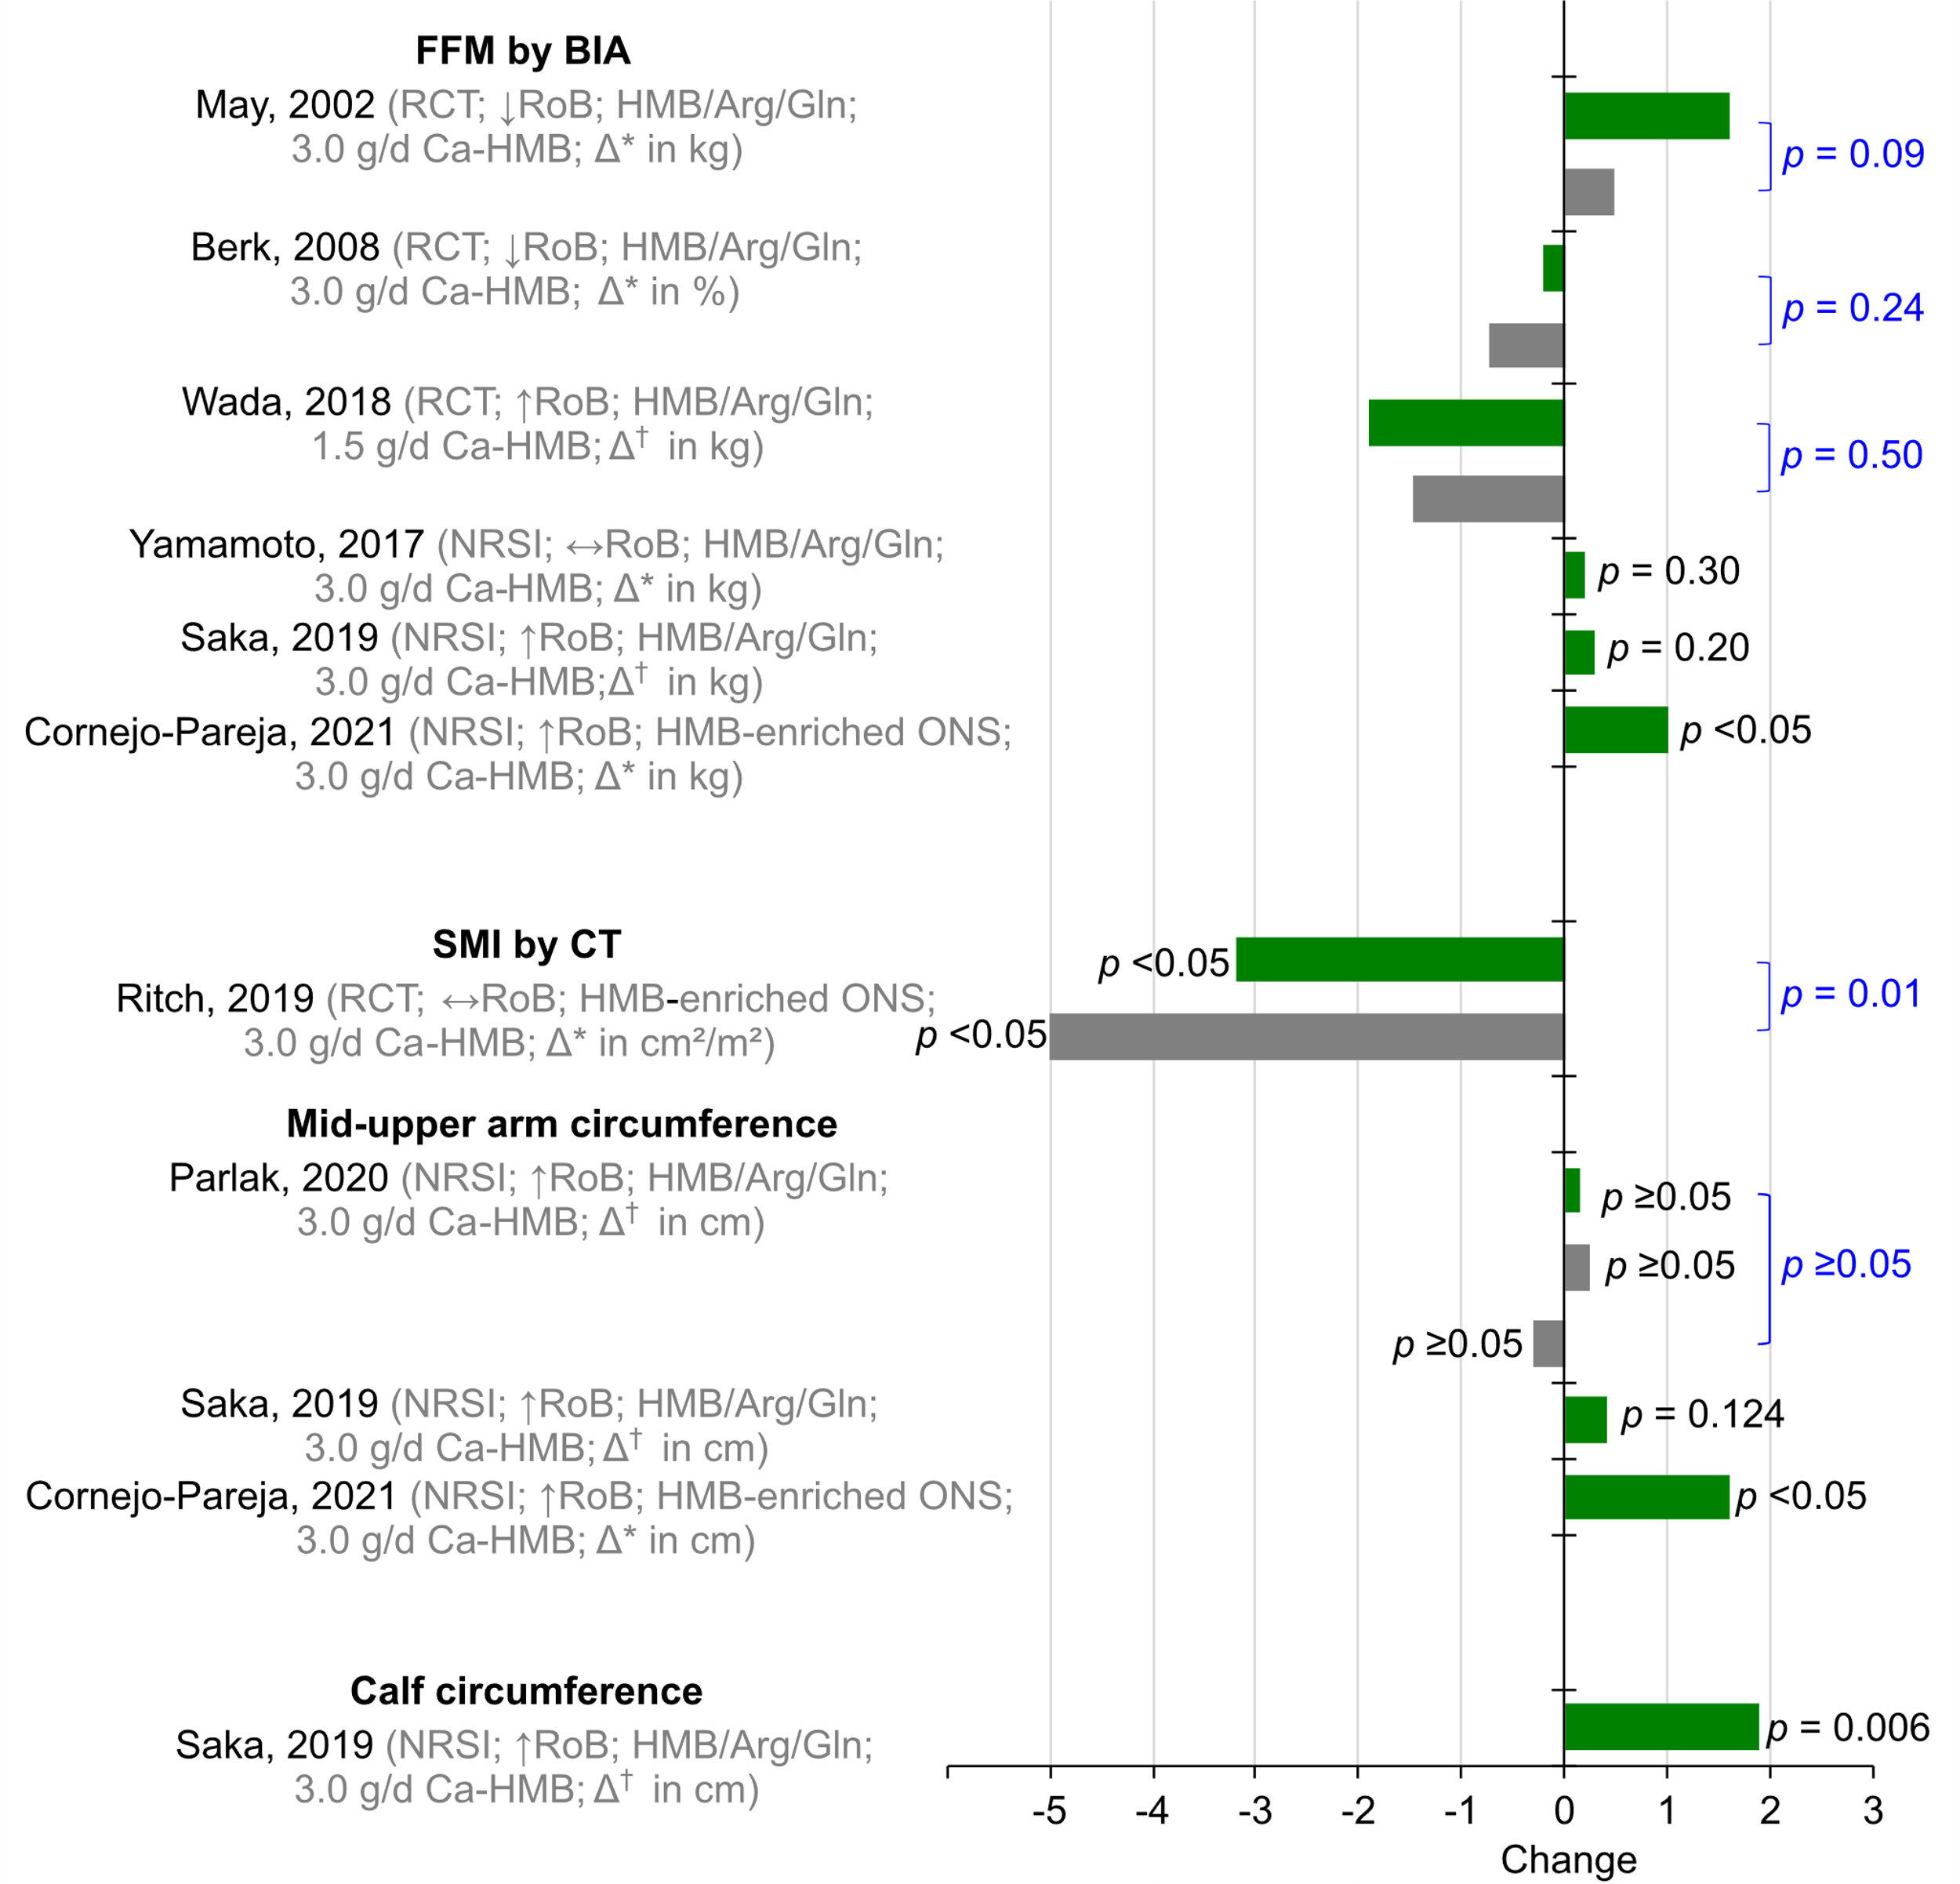
Figure S2
Notes:
Figure S2 - Changes in muscle mass parameters from baseline to follow-up within experimental (green bar) and control (gray bar) groups. Δ* indicates absolute or percent mean change, and Δ† represents absolute or percent median change. P-values reported in black correspond to testing of changes from baseline to follow-up. P-values reported in blue and positioned on the right side of figure represent testing of differences between experimental and control groups. Abbreviations: Arg, arginine; BIA, bioelectrical impedance analysis; CT, computed tomography; FFM, fat-free mass; Gln, glutamine; HMB, β-hydroxy β-methylbutyrate; NR, not reported; NS, not significant; ONS, oral nutritional supplement; ↓RoB, low risk of bias; ↔ RoB, moderate risk of bias; ↑ RoB, high risk of bias.

Slide 4
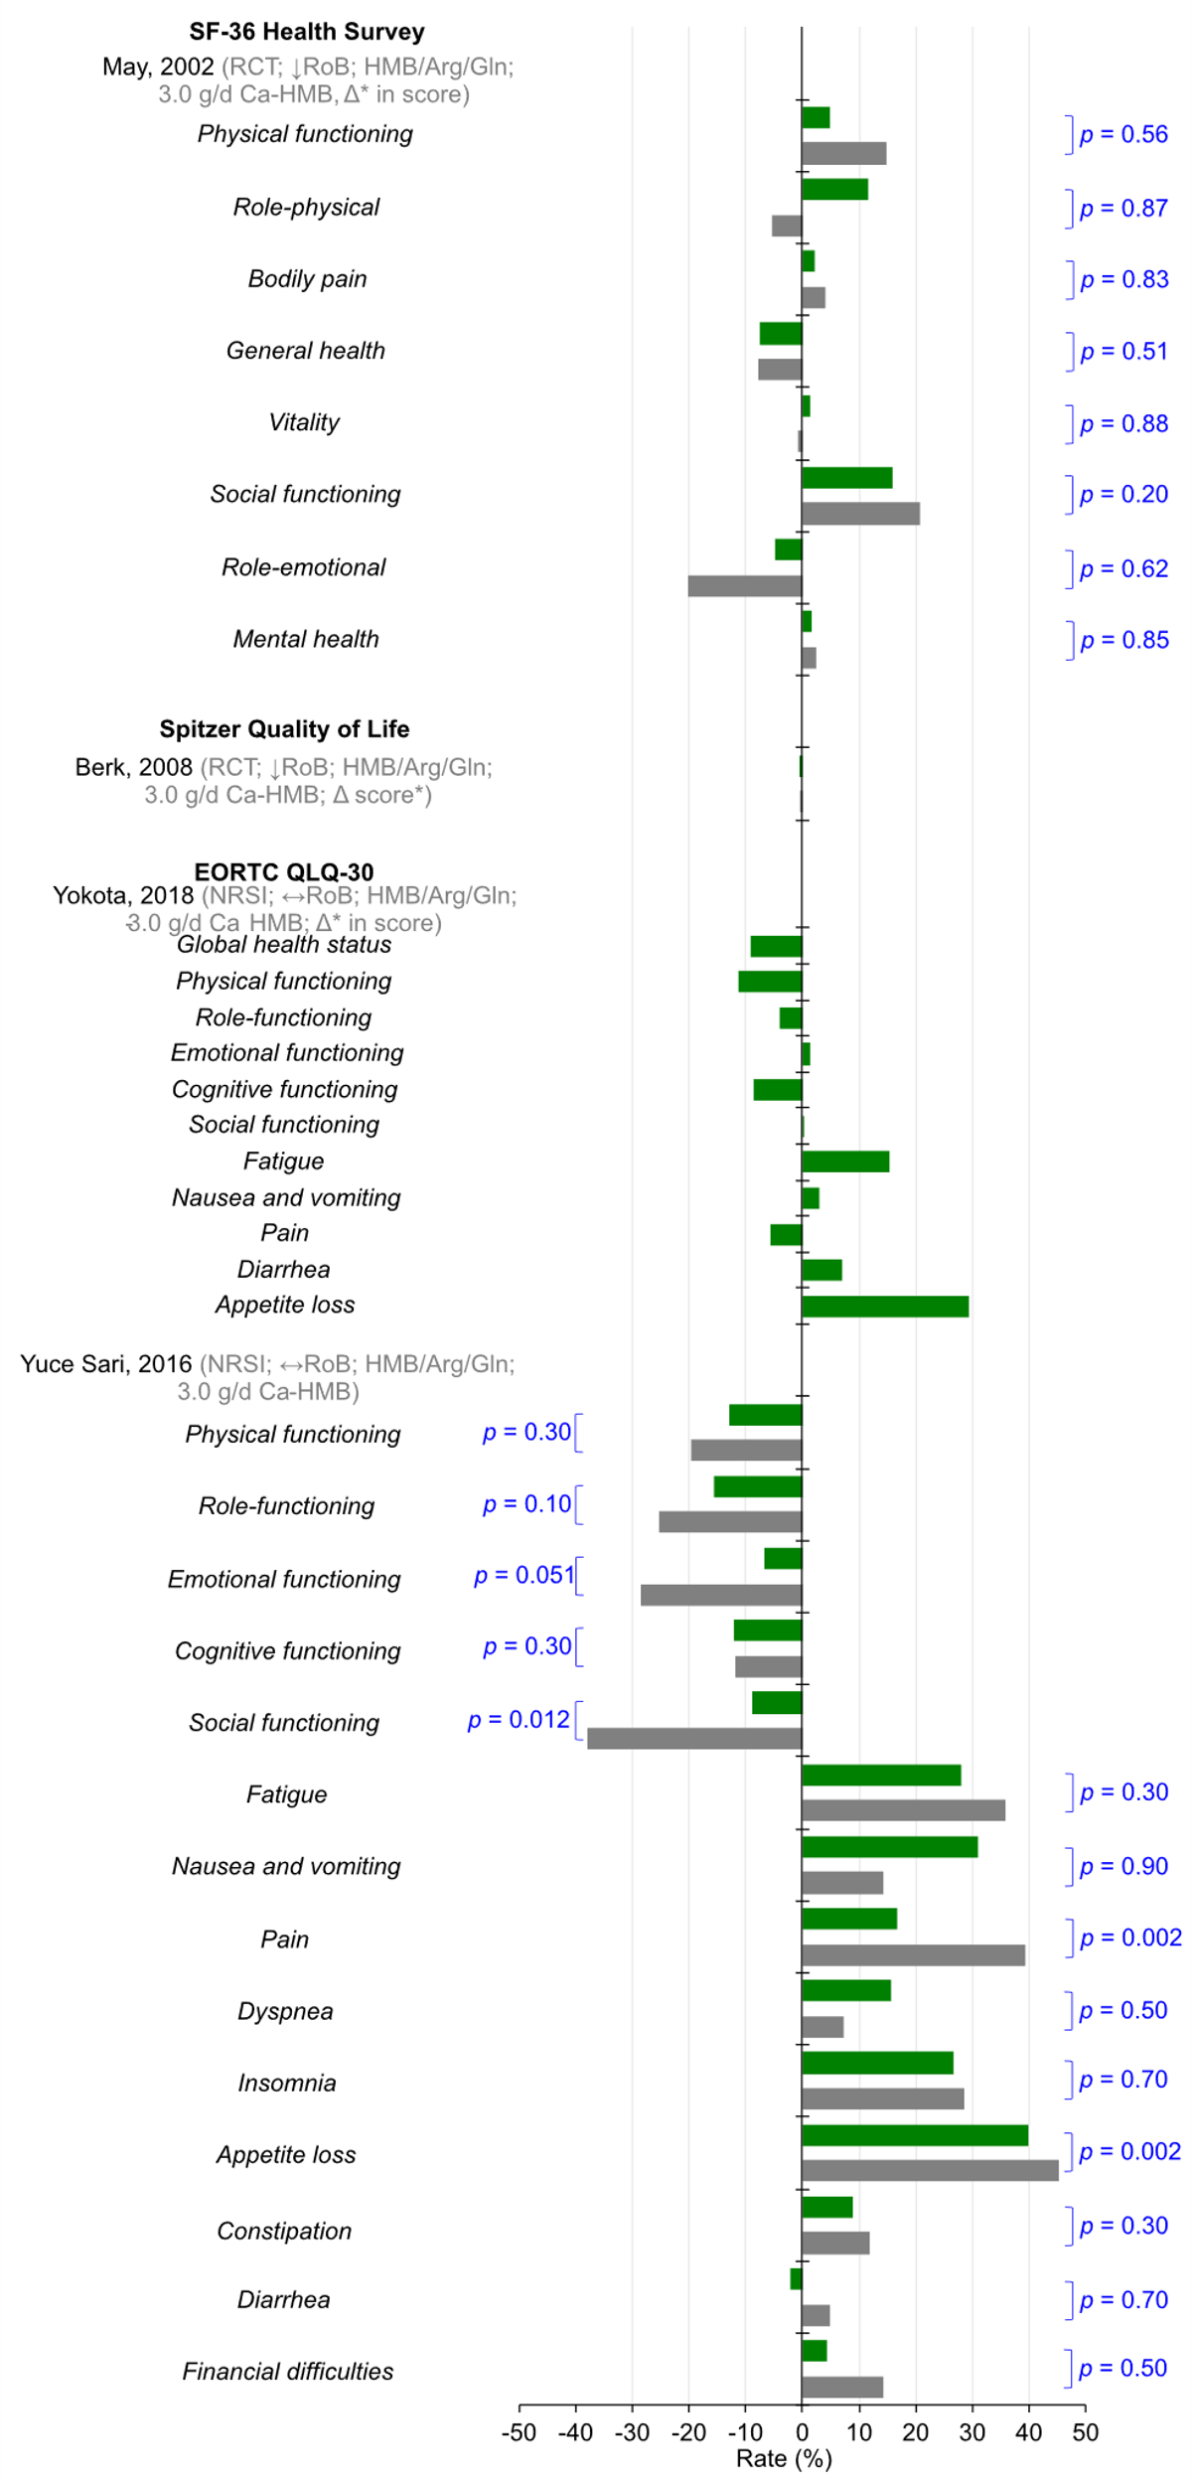
Figure S3
Notes:
Figure S3 Changes in quality of life scores from baseline to follow-up within experimental (green bar) and control (gray bar) groups. Δ* indicates absolute or percent mean change, and Δ† represents absolute or percent median change. P-values reported in black correspond to testing of changes from baseline to follow-up. P-values reported in blue represent testing of differences between experimental and control groups. Abbreviations: Arg, arginine; Gln, glutamine; HMB, β-hydroxy β-methylbutyrate; ONS, oral nutritional supplement; ↓RoB, low risk of bias; ↔ RoB, moderate risk of bias; ↑ RoB, high risk of bias.

Slide 5
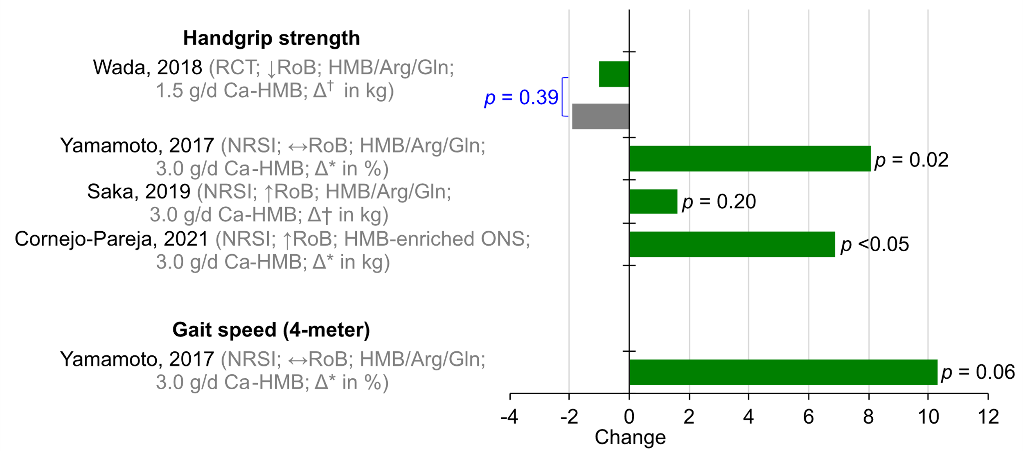
Figure S4
Notes:
Figure S4 Changes in measures of muscle function from baseline to follow-up within experimental (green bar) and control (gray bar) groups. Δ* indicates absolute or percent mean change, and Δ† represents absolute or percent median change. P-values reported in black correspond to testing of changes from baseline to follow-up. P-values reported in blue represent testing of differences between experimental and control groups. Abbreviations: Arg, arginine; Gln, glutamine; HMB, β-hydroxy β-methylbutyrate; ↓RoB, low risk of bias; ↔ RoB, moderate risk of bias; ↑ RoB, high risk of bias.

Slide 6
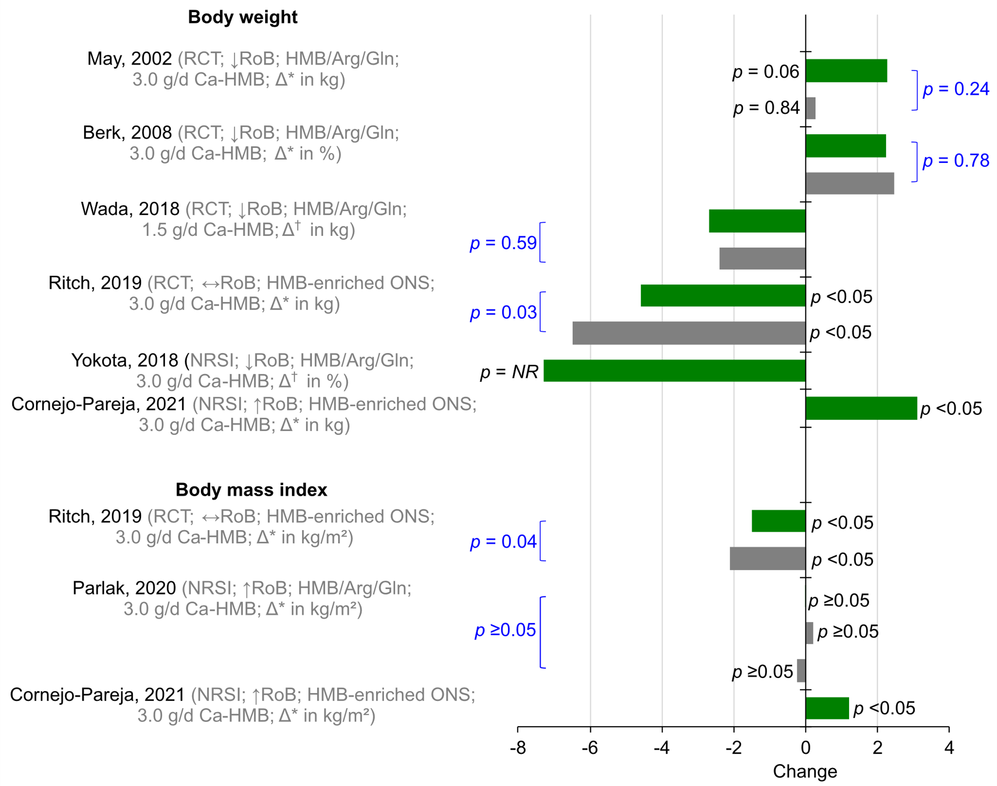
Figure S5
Notes:
Figure S5 Changes in measures of body weight and body mass index (BMI) from baseline to follow-up within experimental (green bar) and control (gray bar) groups. Δ* indicates absolute or percent mean change, and Δ† represents absolute or percent median change. P-values reported in black correspond to testing of changes from baseline to follow-up. P-values reported in blue represent testing of differences between experimental and control groups. Abbreviations: Arg, arginine; Gln, glutamine; HMB, β-hydroxy β-methylbutyrate; NR, not reported; ONS, oral nutritional supplement; ↓RoB, low risk of bias; ↔ RoB, moderate risk of bias; ↑ RoB, high risk of bias.

Slide 7
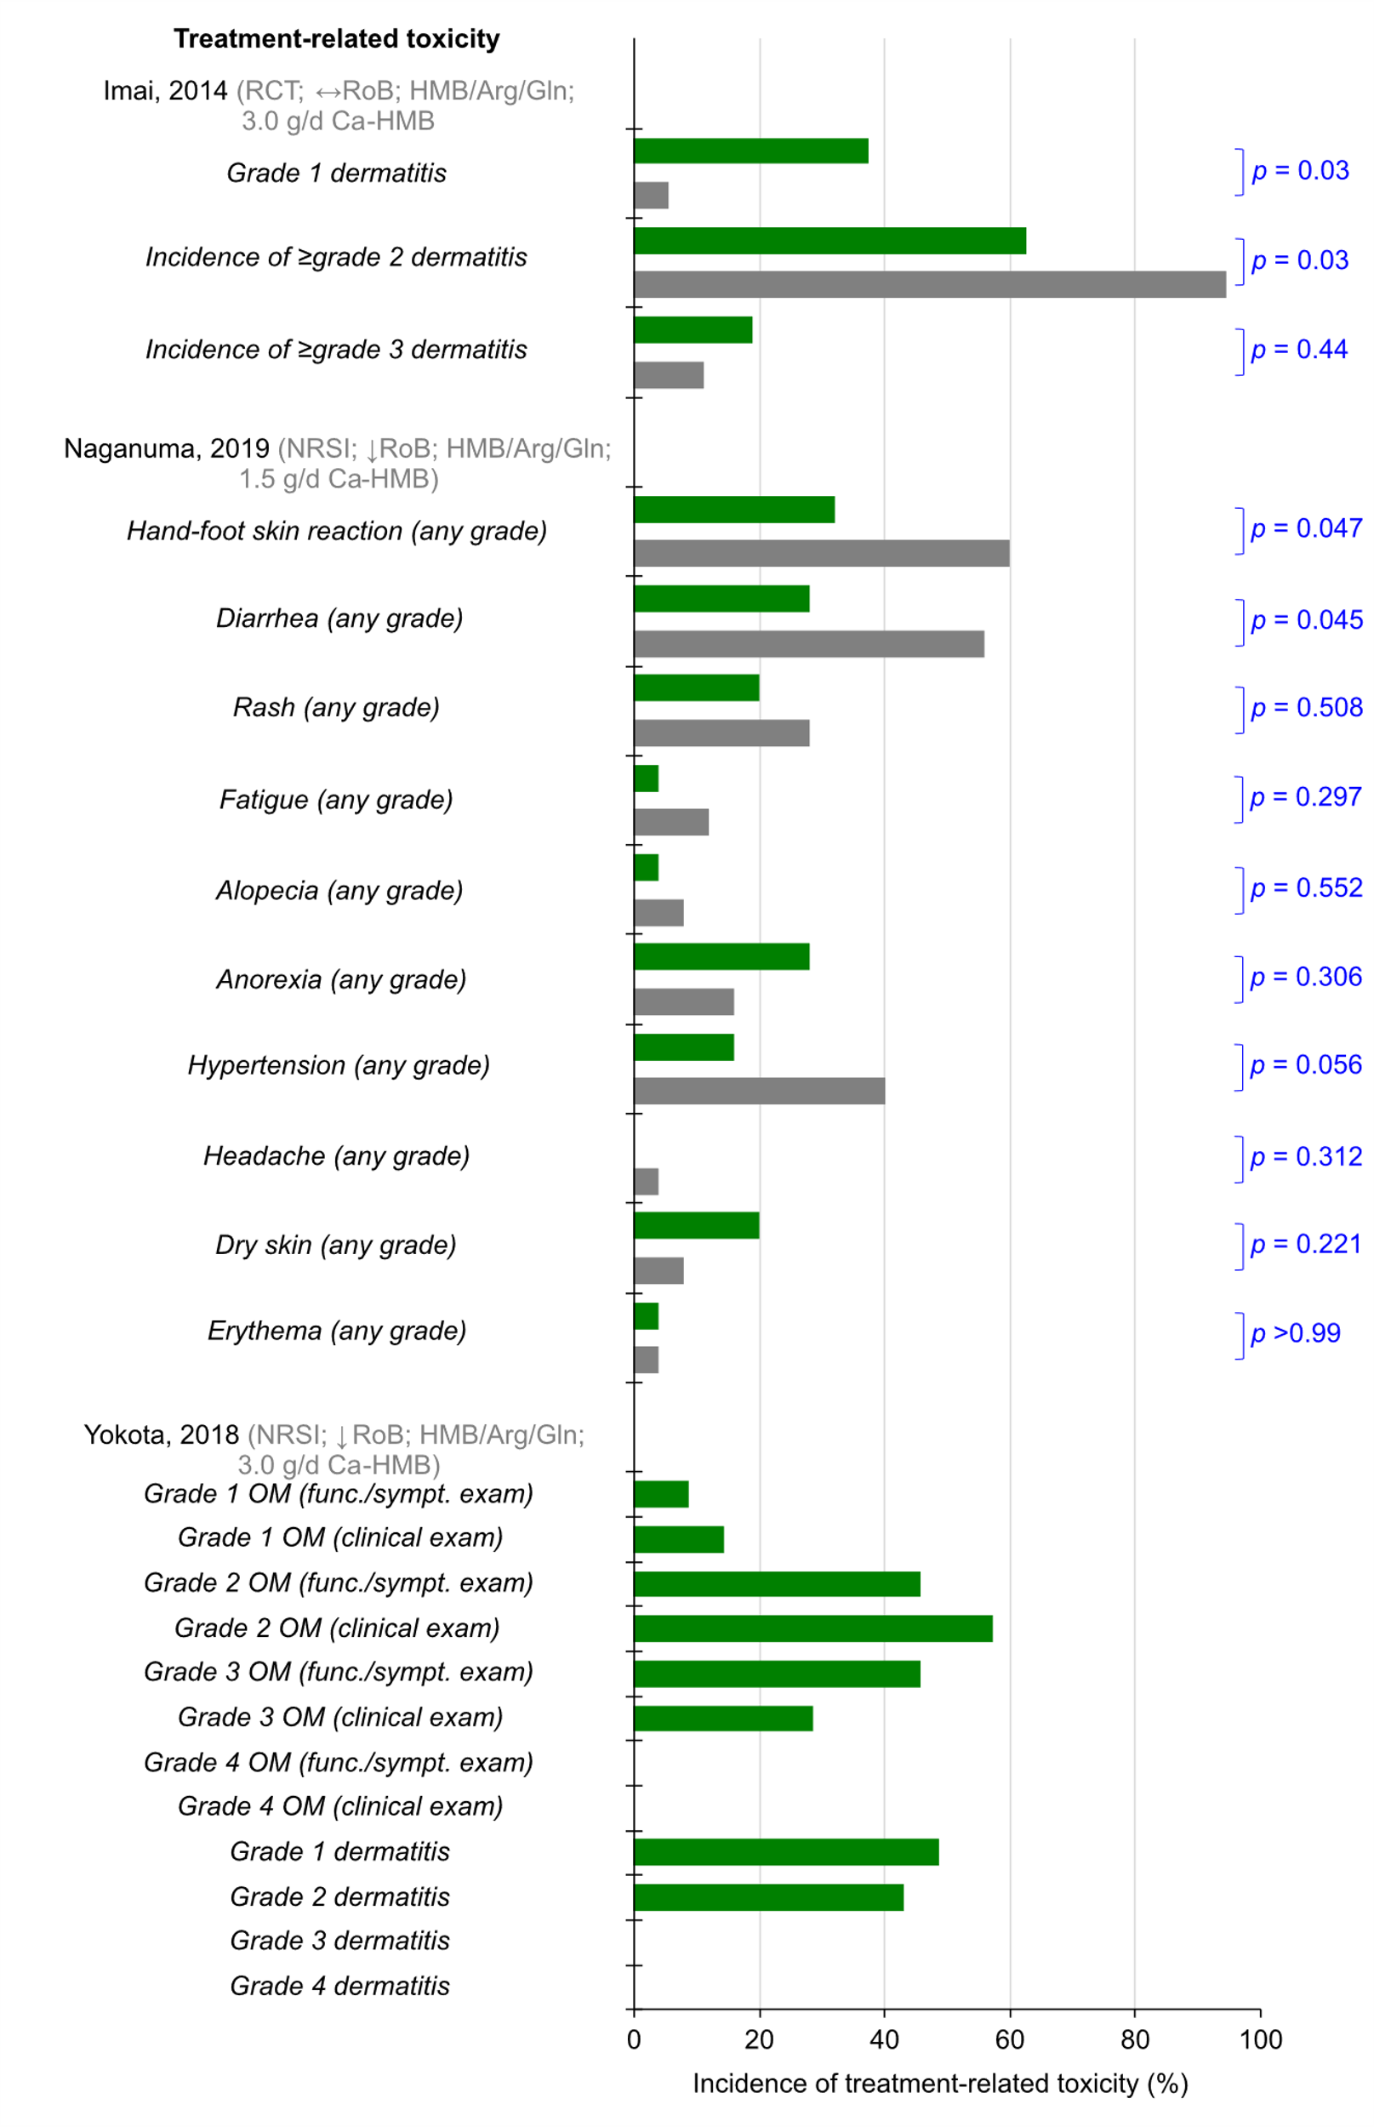
Figure S6
Notes:
Figure S6 Incidence (in percent) of cancer therapy-related toxicities at follow-up within experimental (green bar) and control (gray bar) groups. P-values represent testing of differences between experimental and control groups. Abbreviations: Arg, arginine; Gln, glutamine; HMB, β-hydroxy β-methylbutyrate; ONS, oral nutritional supplement; ↓RoB, low risk of bias; ↔ RoB, moderate risk of bias; ↑ RoB, high risk of bias.

Slide 8
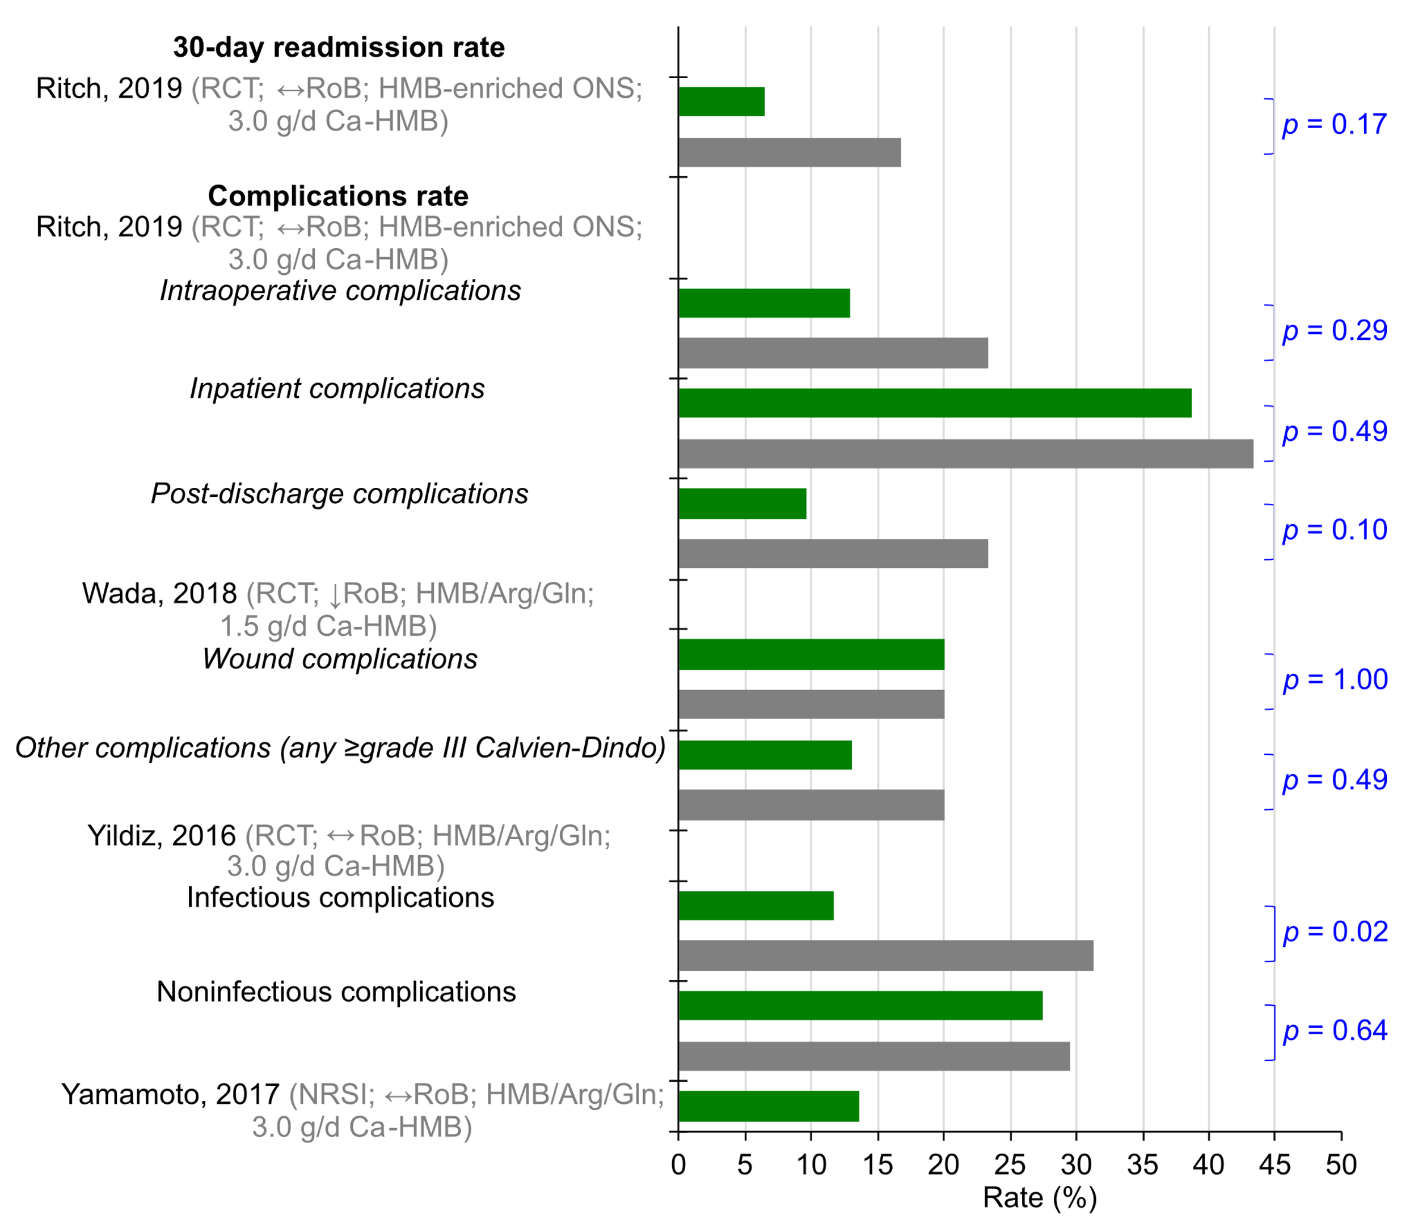
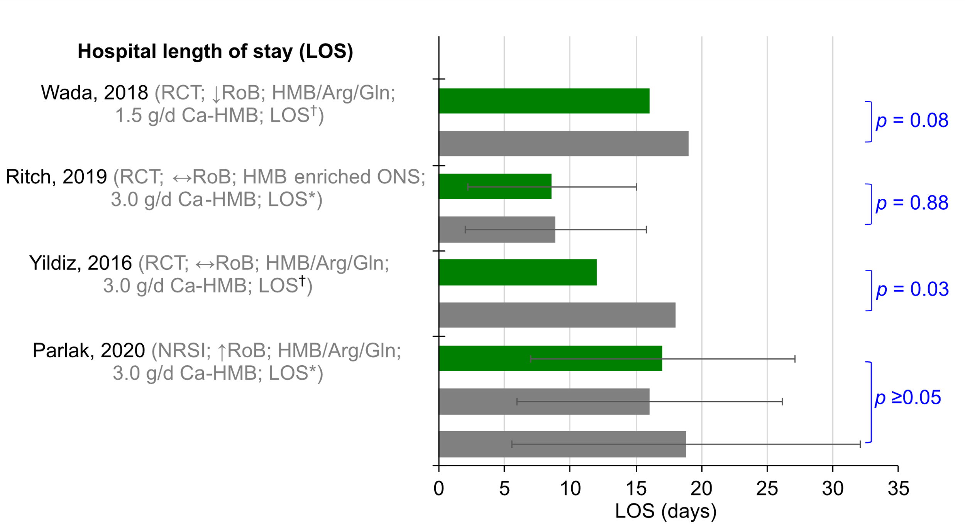
Figure S7
Notes:
Figure S7 Hospital length of stay and rate of readmissions and complications at follow-up within experimental (green bar) and control (gray bar) groups. P-values represent testing of differences between experimental and control groups. Abbreviations: Arg, arginine; Gln, glutamine; HMB, β-hydroxy β-methylbutyrate; ONS, oral nutritional supplement; ↓RoB, low risk of bias; ↔ RoB, moderate risk of bias; ↑ RoB, high risk of bias.

Slide 9
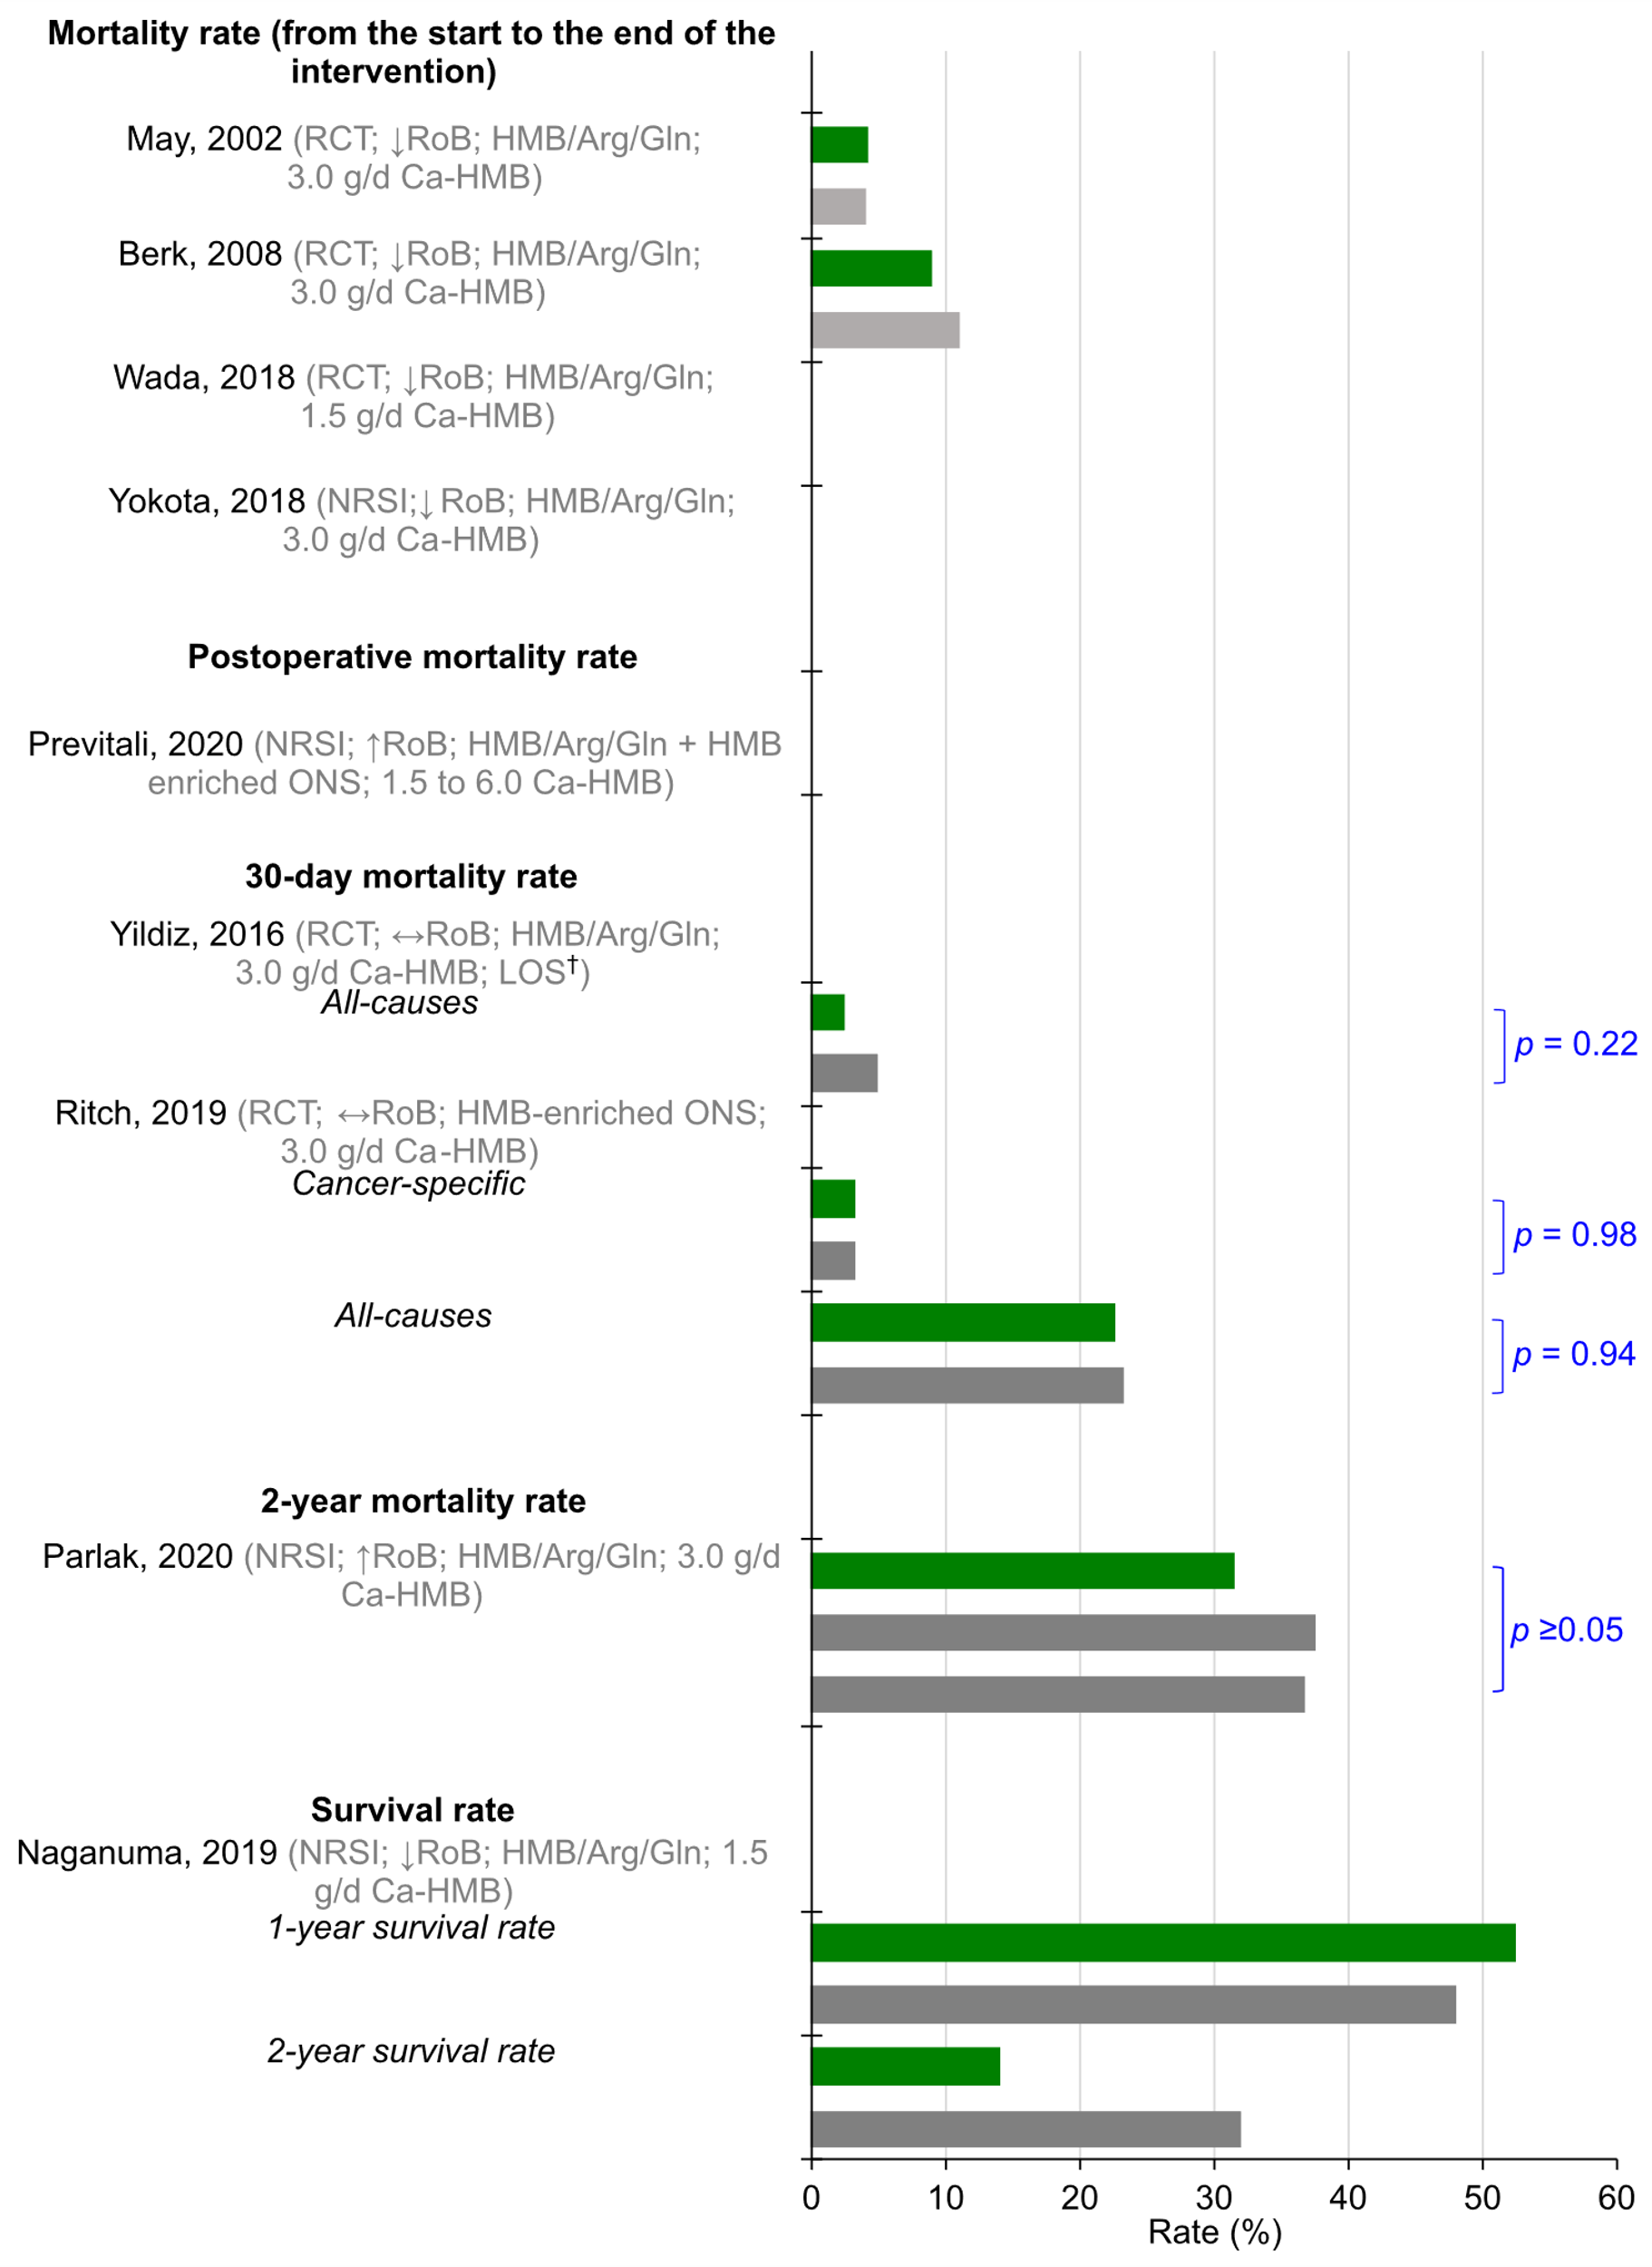
Figure S8
Notes:
Figure S8 Mortality and survival rates at follow-up within experimental (green bar) and control (gray bar) groups. P-values represent testing of differences between experimental and control groups. Studies with data not shown reported zero deaths during the period described in the graph. Abbreviations: Arg, arginine; Gln, glutamine; HMB, β-hydroxy β-methylbutyrate; ONS, oral nutritional supplement; ↓RoB, low risk of bias; ↔ RoB, moderate risk of bias; ↑ RoB, high risk of bias.

Slide 10
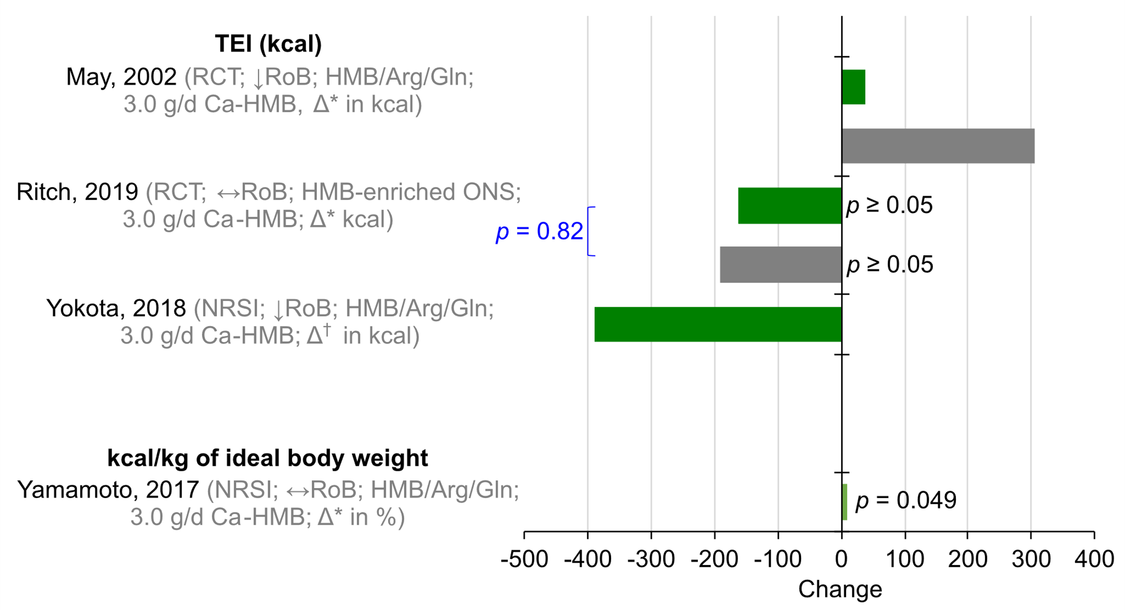
Figure S9
Notes:
Figure S9 Changes in energy intake from baseline to follow-up within experimental (green bar) and control (gray bar) groups. P-values represent testing of differences between experimental and control groups. Δ* indicates absolute or percent mean change, and Δ† represents absolute median change. Abbreviations: Arg, arginine; Gln, glutamine; HMB, β-hydroxy β-methylbutyrate; ONS, oral nutritional supplement; ↓RoB, low risk of bias; ↔ RoB, moderate risk of bias; ↑ RoB, high risk of bias.

Slide 11
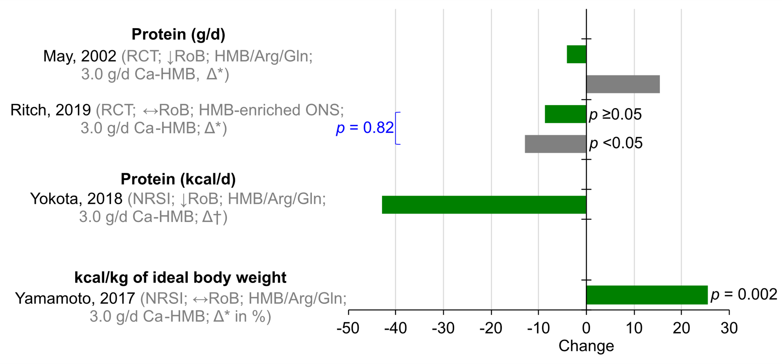
Figure S10
Notes:
Figure S10 Changes in protein intake from baseline to follow-up within experimental (green bar) and control (gray bar) groups. P-values represent testing of differences between experimental and control groups. Δ* indicates absolute or percent mean change, and Δ† represents absolute median change. Abbreviations: Arg, arginine; Gln, glutamine; HMB, β-hydroxy β-methylbutyrate; ONS, oral nutritional supplement; ↓RoB, low risk of bias; ↔ RoB, moderate risk of bias; ↑ RoB, high risk of bias.

Slide 12
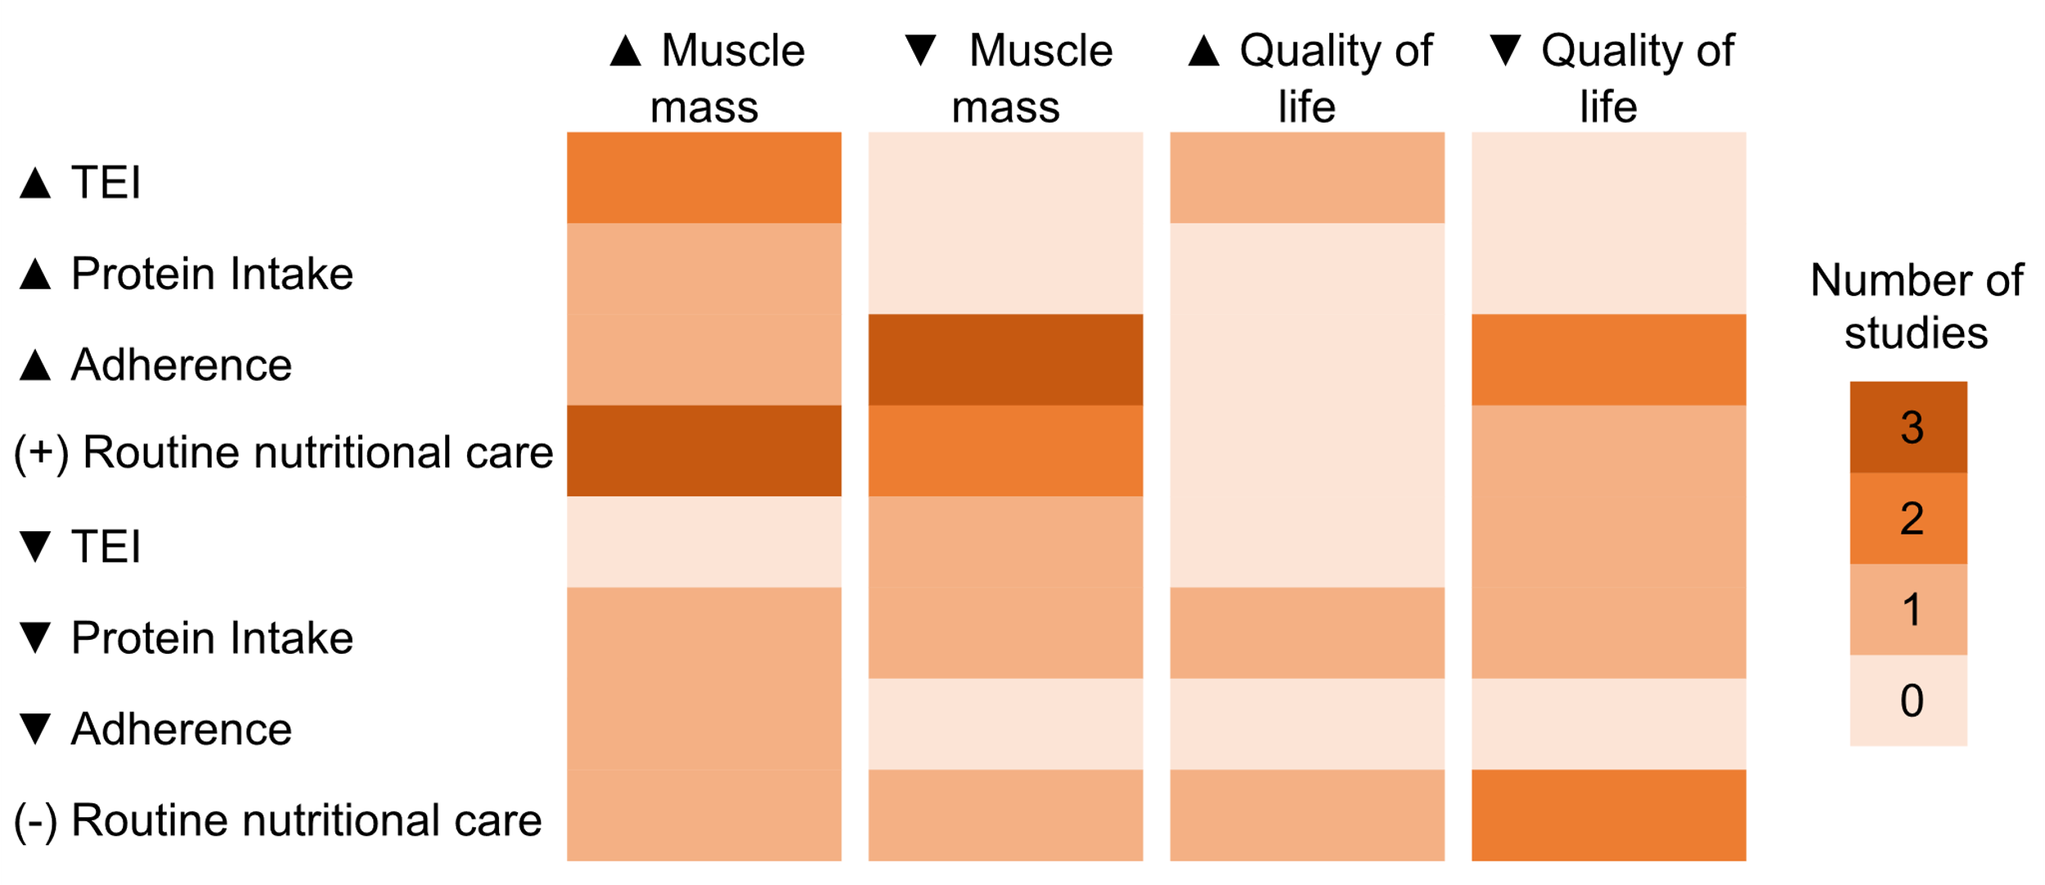
Figure S11
Notes:
Figure S11 Colormap depicting the number of studies reporting the effects of β-hydroxy β-methylbutyrate (HMB) supplementation on muscle mass and quality of life according to changes in total energy and protein intakes, adherence to the intervention protocol, and presence of nutrition co-intervention (i.e., routine nutritional care). Effect direction: upward arrow ▲= beneficial effect, downward arrow ▼= no beneficial effect.

Slide 13
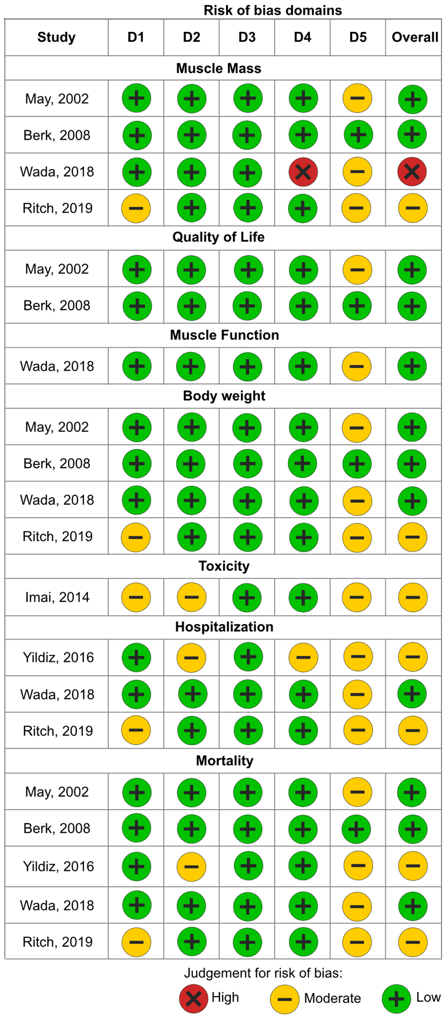
Figure S12
Notes:
Figure S11 Risk of bias assessment of randomized controlled trials, stratified by study, outcomes, and domains. D1: Bias arising from the randomization process; D2: Bias due to deviations from intended intervention; D3: Bias due to missing outcome data; D4: Bias in measurement of the outcome; D5: Bias in selection of the reported result.

Slide 14
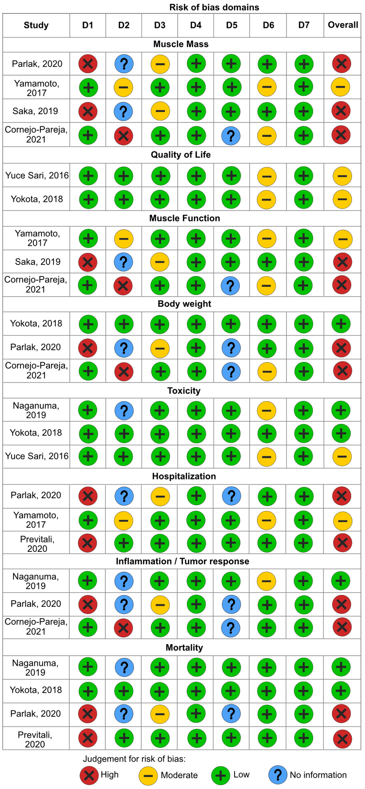
Figure S13
Notes:
Figure S12 Risk of bias assessment of non-randomized studies of intervention, stratified by study, outcomes, and domains. D1: Bias due to confounding; D2: Bias due to selection of participants; D3: Bias in classification of interventions; D4: Bias due to deviations from intended interventions; D5: Bias due to missing data; D6: Bias in measurement of outcomes; D7: Bias in selection of the reported result.

