Slide 1
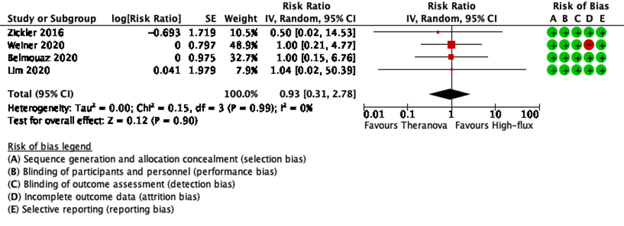
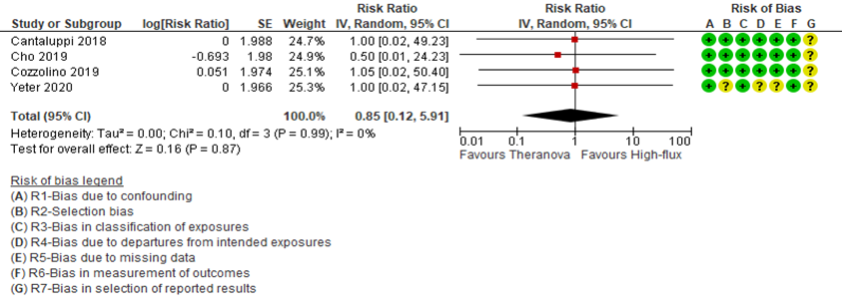
Figure 1a. Forest plot – all-cause mortality (number of deaths from any cause) - RS.
Figure 1b. Forest plot – all-cause mortality (number of deaths from any cause) - NRS.

Slide 2
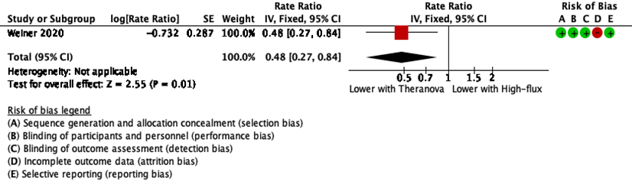
Figure 2a. Forest plot – Hospitalization – any cause; rate ratio (number of episodes of hospitalization for any reason) - RS
Figure 2b. Forest plot – Hospitalization – any cause; rate ratio (number of episodes of hospitalization for any reason) - NRS

Slide 3
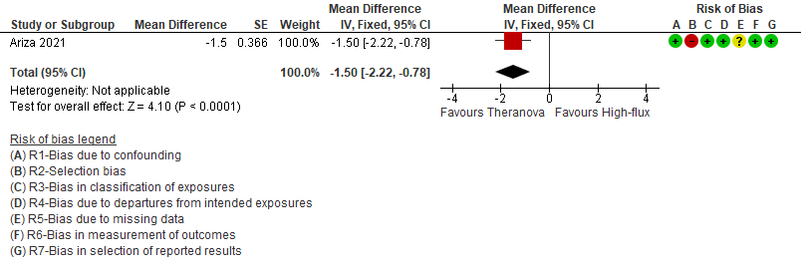
Figure 3. Forest plot – Hospitalization days / length of stay (number of days in hospital) - NRS

Slide 4
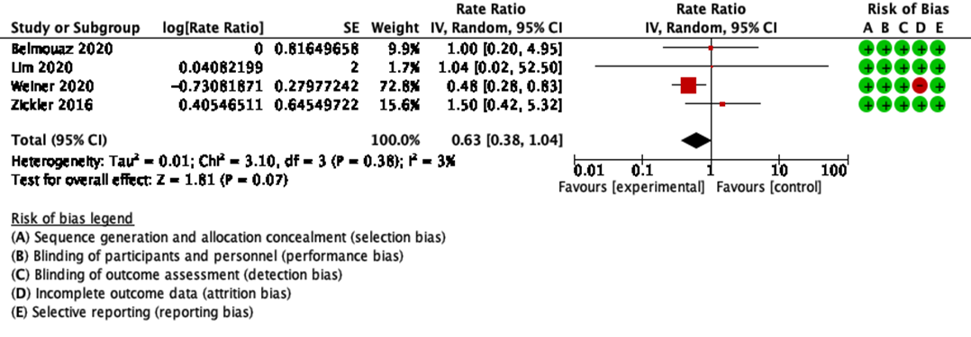
Figure 4. Forest plot – Serious adverse events (SAE) (a lower rate is better) - RS

Slide 5
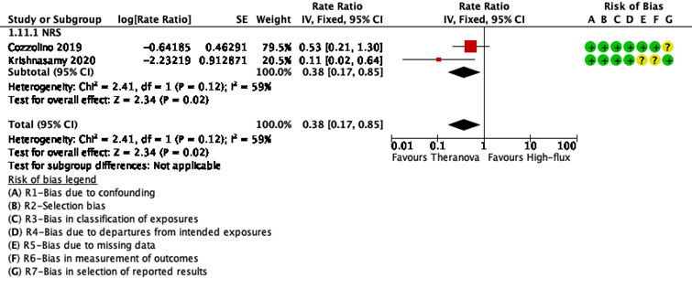
Figure 5. Forest plot – Any infection (a lower rate is better) - NRS

Slide 6
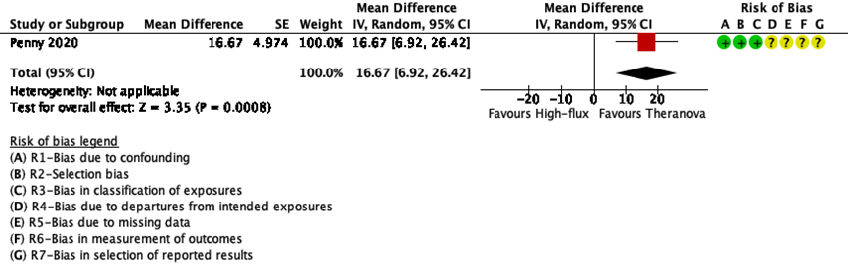
Figure 6. Forest plot – Quality of life (overall score - a higher score is better) - NRS

Slide 7
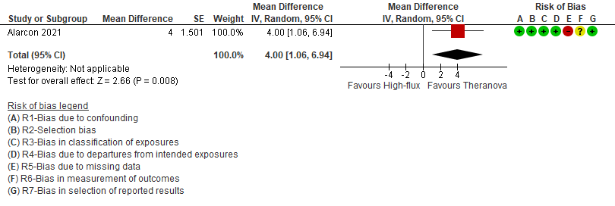
Figure 7. Forest plot – KDQOL – Burden of Kidney Disease (a higher score is better) - NRS

Slide 8
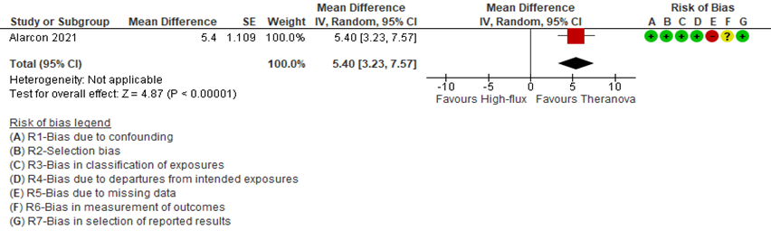
Figure 8. Forest plot – KDQOL – Effects of Kidney Disease (a higher score is better) - NRS

Slide 9
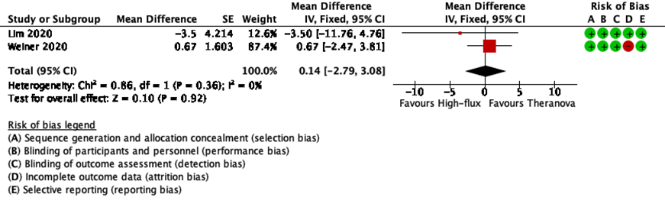
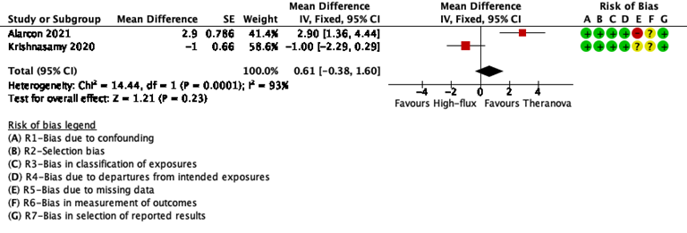
Figure 9a. Forest plot – KDQOL – Symptoms/Problem List (a higher score is better) - RS
Figure 8b. Forest plot – KDQOL and E-SAS – Symptoms/Problem List (a higher score is better)- NRS

Slide 10
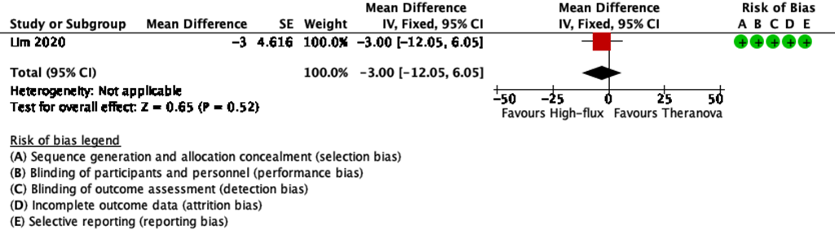
Figure 10. Forest plot – KDQOL – Pain (a higher score is better) - RS

Slide 11
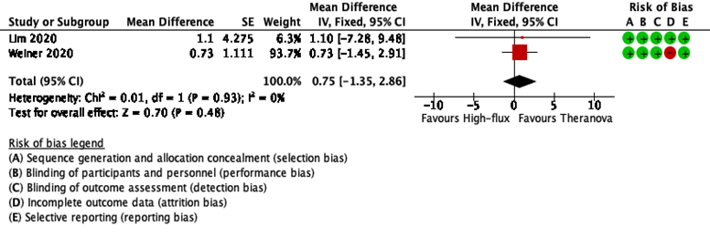
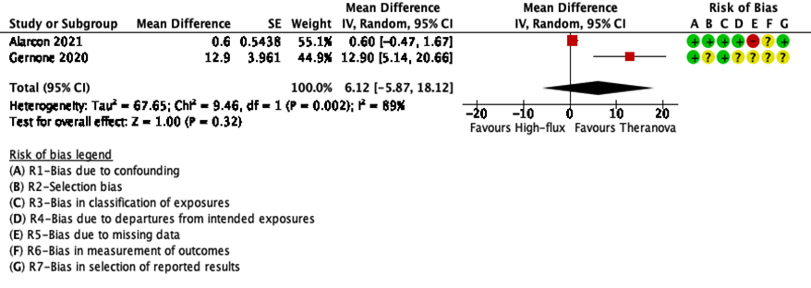
Figure 11a. Forest plot – KDQOL – Physical health (a higher score is better) - RS
Figure 11b. Forest plot – KDQOL – Physical health (a higher score is better)- NRS

Slide 12
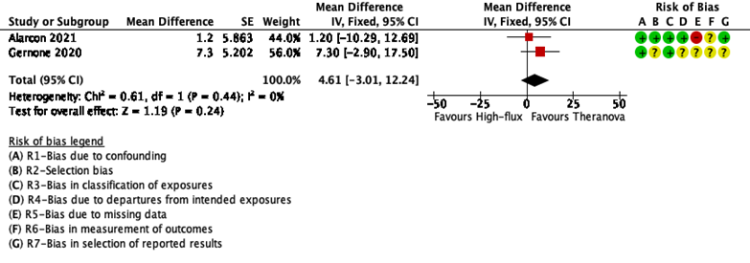
Figure 12. Forest plot – KDQOL – Mental health (a higher score is better) - NRS

Slide 13
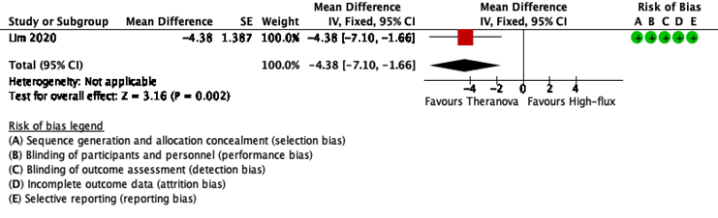
Figure 13. Forest plot – Pruritus (a lower score is better) - RS

Slide 14
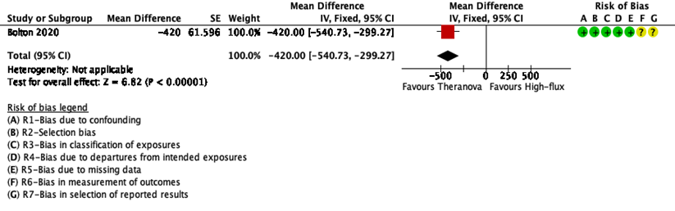
Figure 14. Forest plot – Recovery time (a lower score is better) - NRS

Slide 15
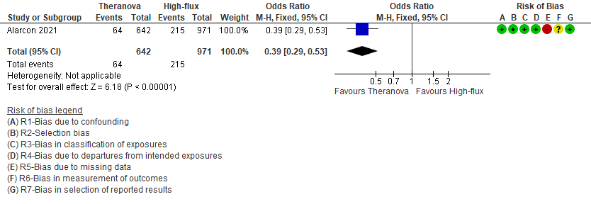
Figure 15. Forest plot – Restless Legs Syndrome (NIH Diagnostic Criteria) - NRS

Slide 16
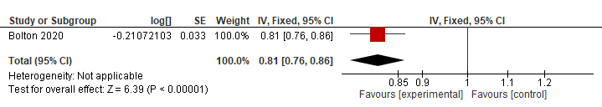
Figure 16. Forest plot – Symptom Severity (Proportion of patients with 1 or more symptoms rated "severe" or "overwhelming") - NRS

Slide 17
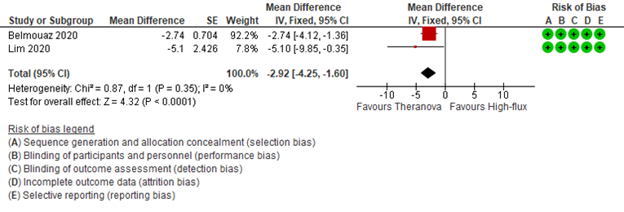
Figure 17. Forest plot – Erythropoiesis resistance index - RS

Slide 18
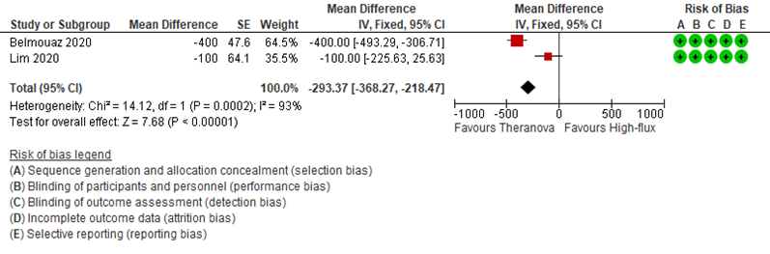
Figure 18. Forest plot – Iron utilization - RS

