Slide 1




Brenier Meets Adversarial Training Optimal Transport Geometry for Robust Learning
Alireza Abdollahpoorrostam,¹⁾ Ehsan Sharifian,¹⁾ Buse Şen,¹⁾ Marco Cuturi,²⁾ Daniel Kuhn¹⁾
1) Ecole Polytechnique Fédérale de Lausanne
https://www.epfl.ch/labs/rao/
2) Apple
https://machinelearning.apple.com/

Slide 2
Adversarial Training

Slide 3

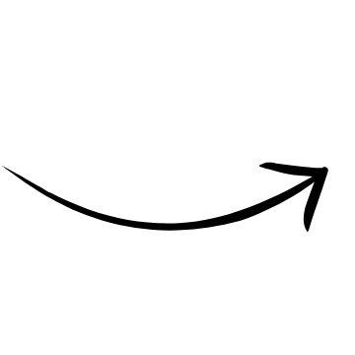
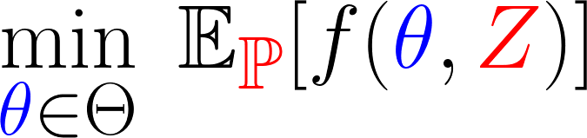
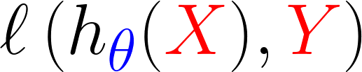


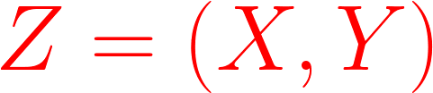

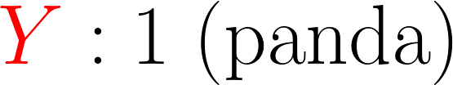
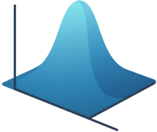


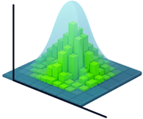

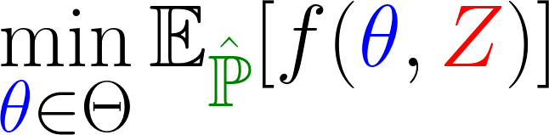

Adversarial Training
Stochastic Programming:
Training Data
ERM:

Slide 4


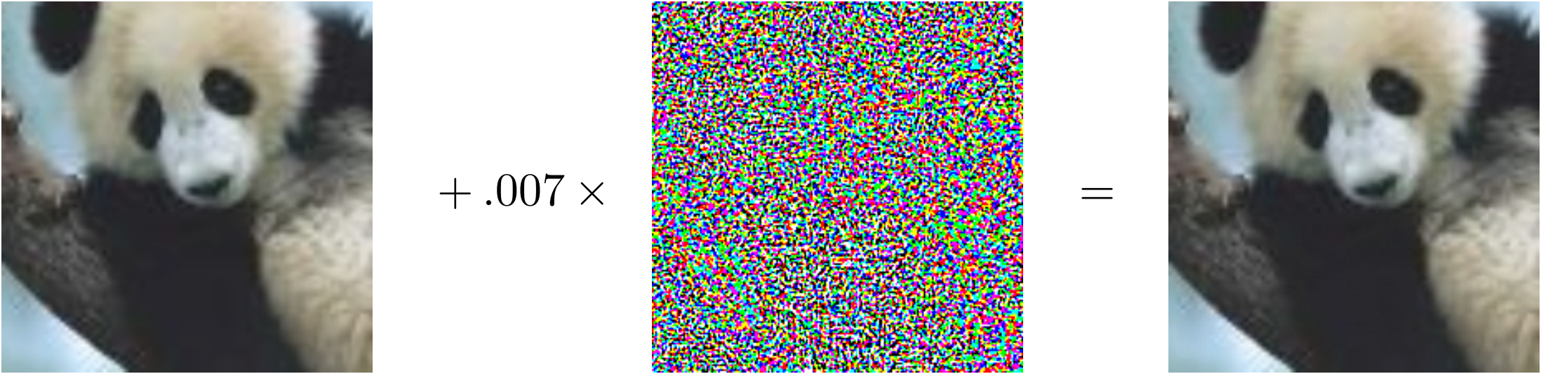
Adversarial Training: Incentives
Post-decision disappointment:
Changes in environment:
Adversaries:
Training Data
Test Data
“panda”
“gibbon”
57.7 % confidence
99.3 % confidence

Slide 5
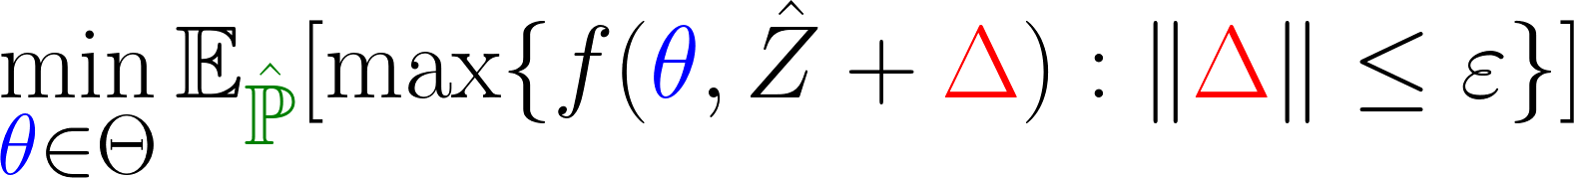
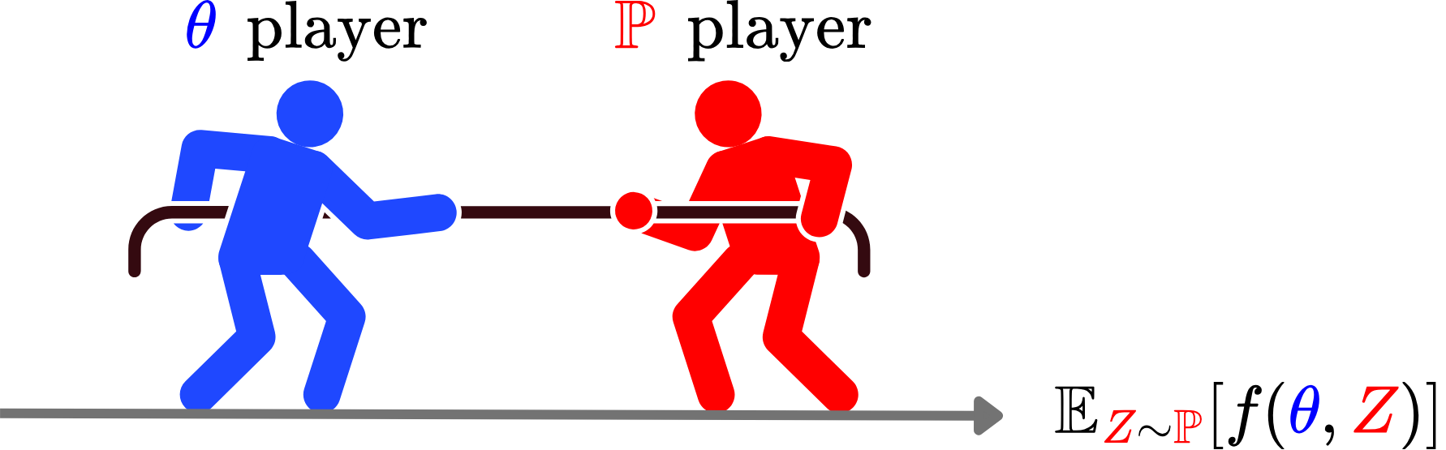
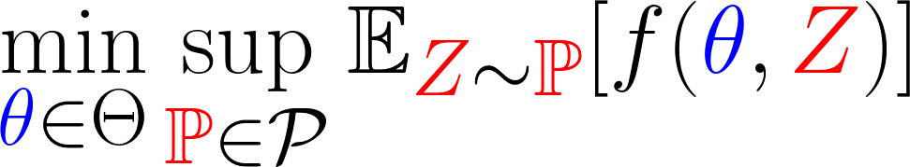
Adversarial Training: Formulation
ERM:
Robust Optimization (RO):
Distributionally Robust Optimization (DRO):
Aleksander Madry et al., ICLR, 2018.

Slide 6
Optimal Transport (OT)

Slide 7
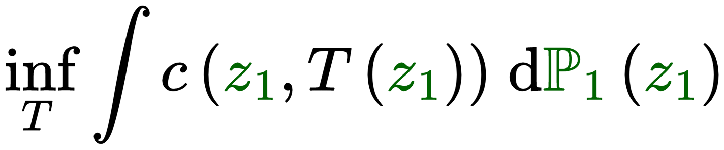
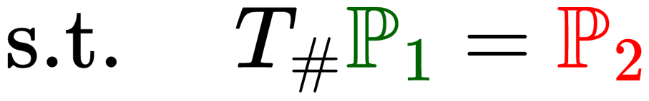
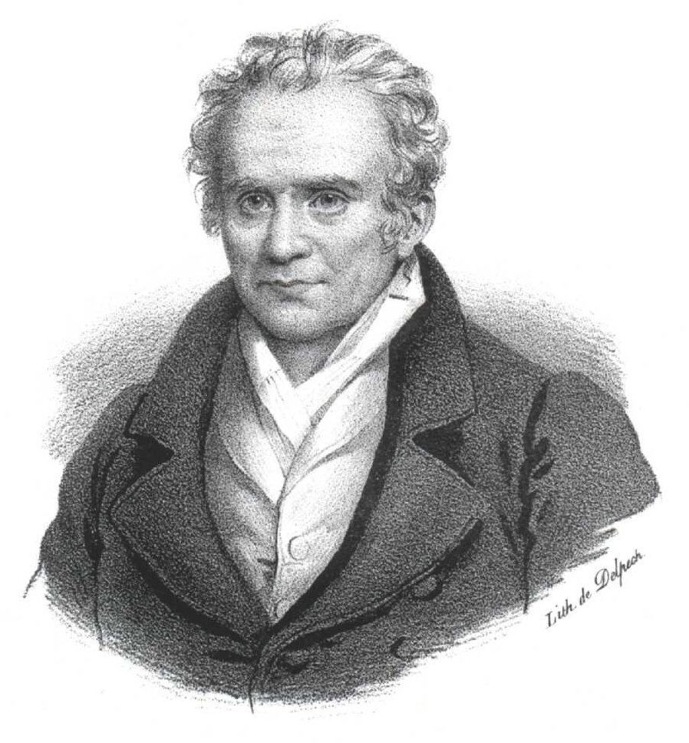
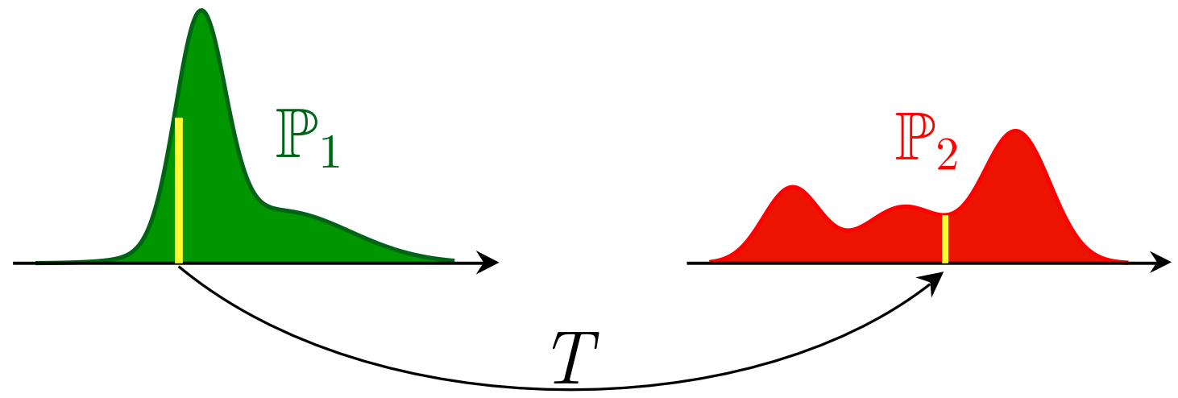
Monge’s OT Problem
Gaspard Monge, 1781

Slide 8
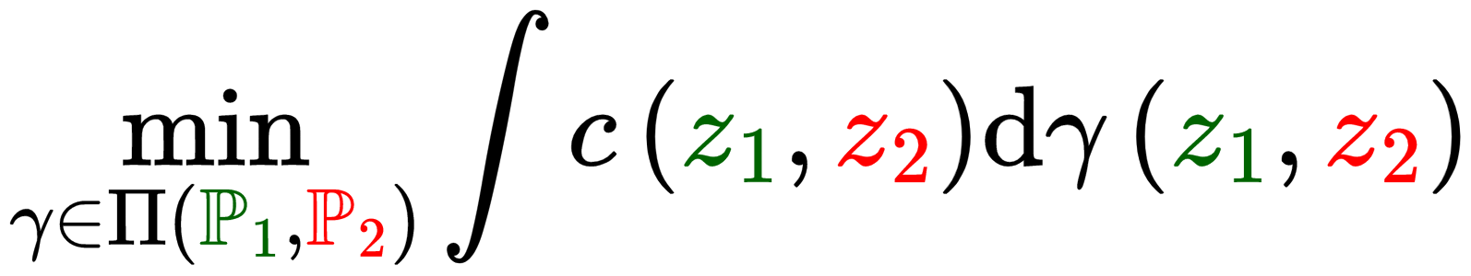
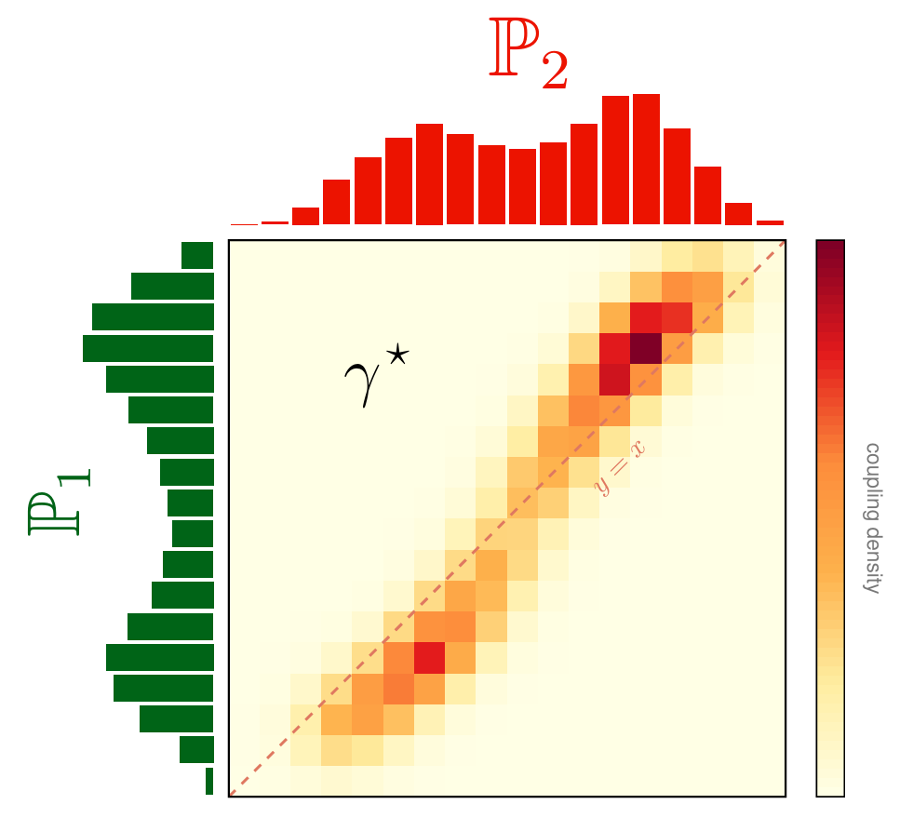
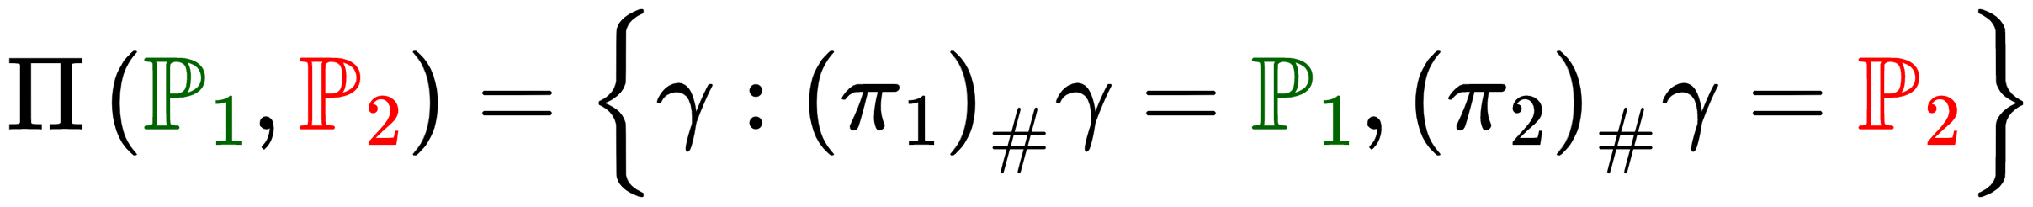
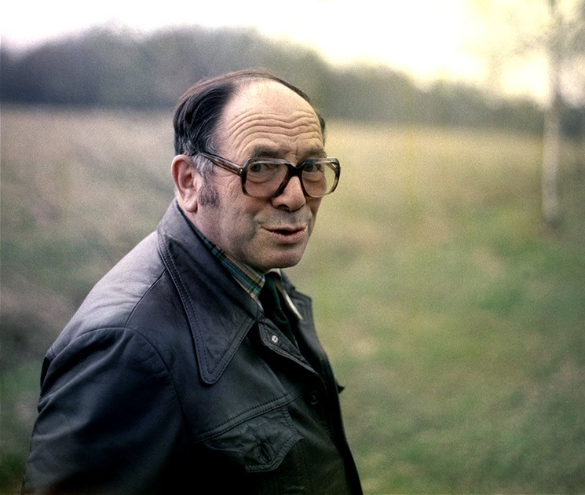
Kantorovich’s Relaxation
Relax maps to couplings, mass may split. The problem becomes a linear program, always feasible.
Leonid Kantorovich

Slide 9
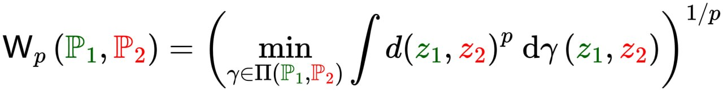
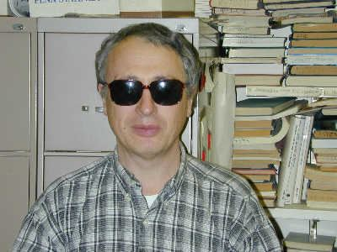
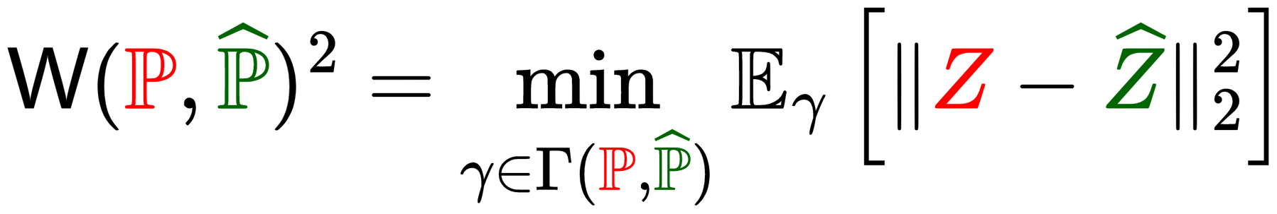
The Wasserstein Distance
This paper: squared-Euclidean cost
Leonid Vaseršteĭn

Slide 10
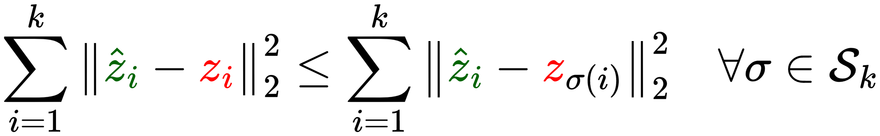
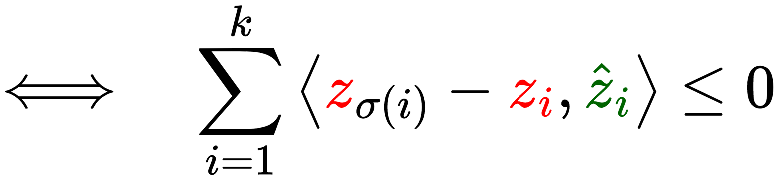
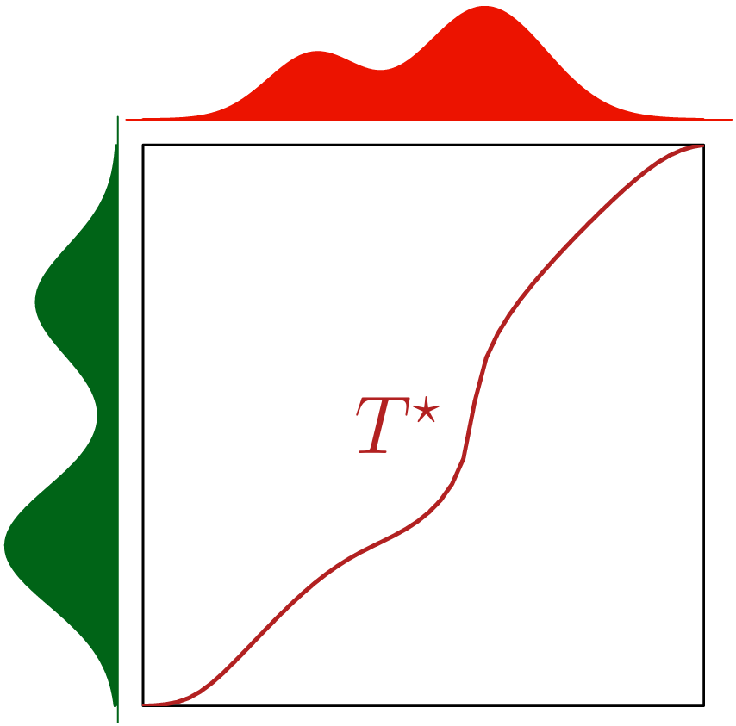

Optimality: Cyclical Monotonicity & Brenier
When is a coupling optimal? Its support must be cyclically monotone.
no profitable reassignment
Brenier’s Theorem (1987)

Slide 11
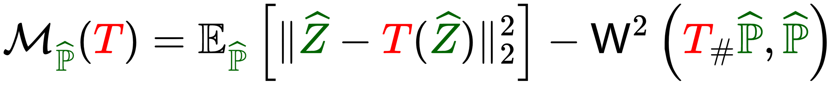
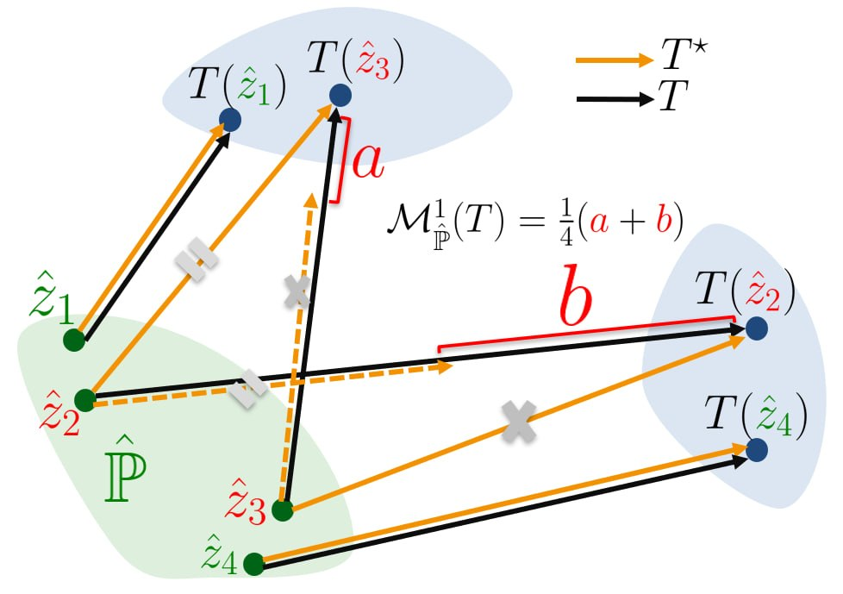
The Monge Gap: Wasteful Transport
Any feasible map that is not cyclically monotone wastes transport budget. The wasted transport budget is the Monge gap.

Slide 12
Adversarial Risk

Slide 13
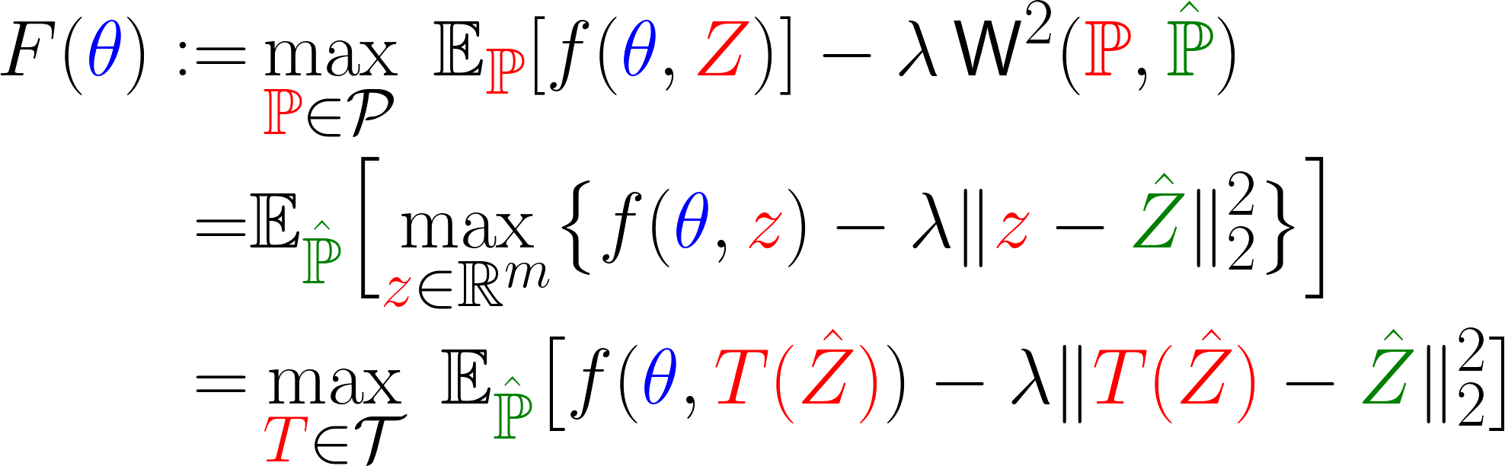
DRO: Constrained vs. Regularized
Constrained DRO:
Regularized DRO:
Tractable if the loss function is pointwise maximum of finite concave functions … Not tractable for Deep NNs.
Peyman Mohajerin Esfahani and Daniel Kuhn, Math. Program., 2018.
Point-wis Form
Map-based Form

Slide 14
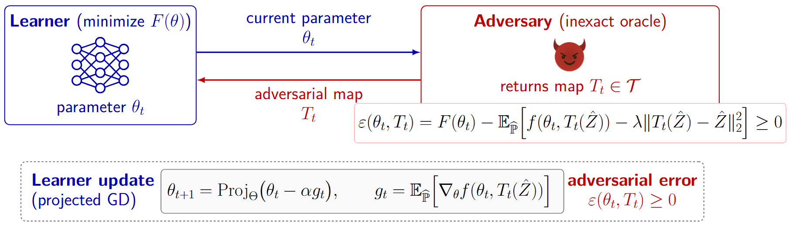
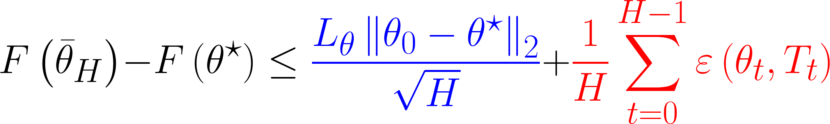
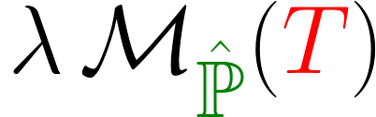
General Recipe for Adversarial Training
Convergence Guarantee:

Slide 15
Implicit Adversarial Maps

Slide 16
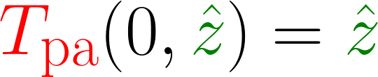
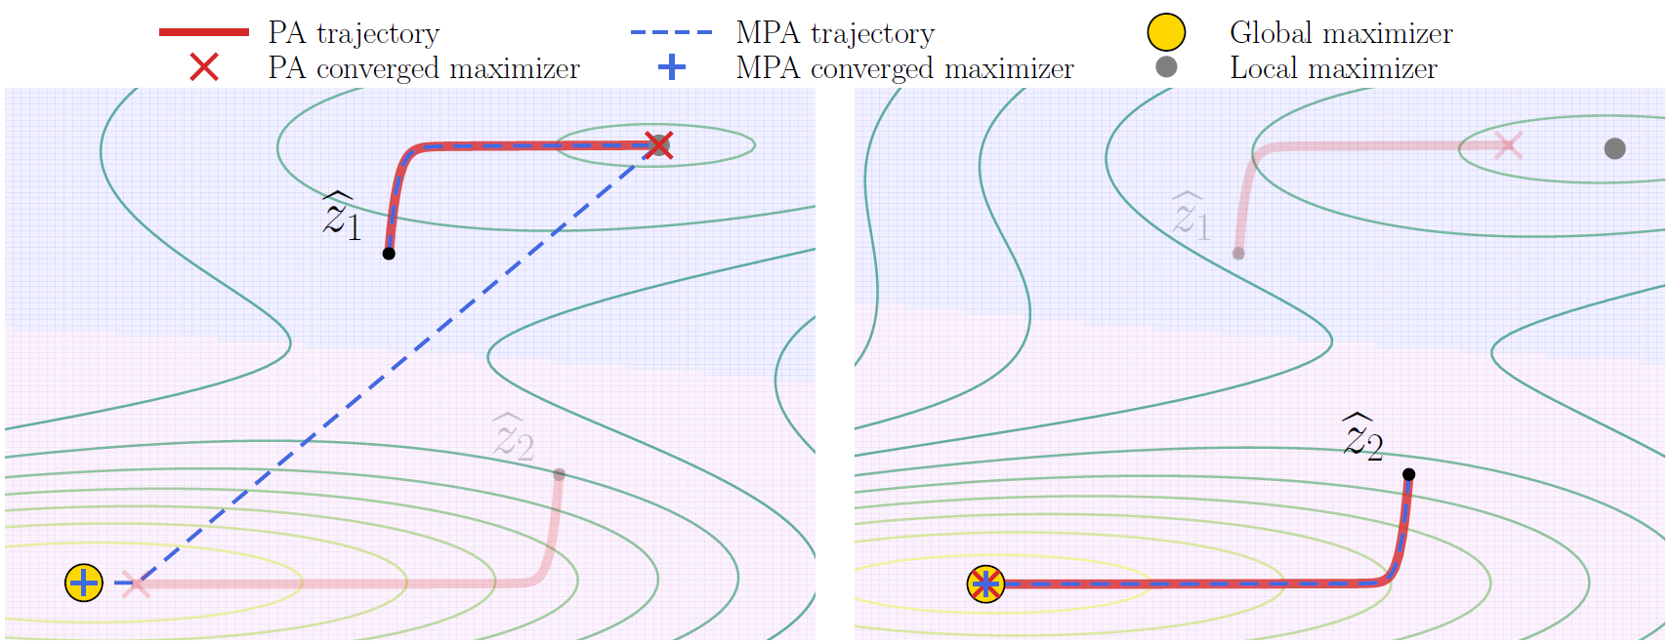
Particle Ascent (PA)
Lemma:

Slide 17
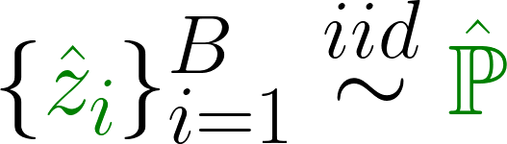
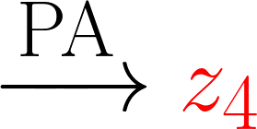
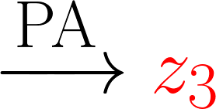
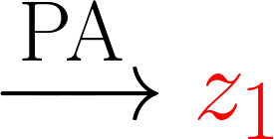
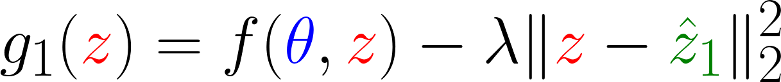
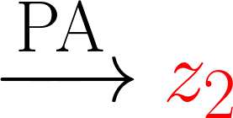
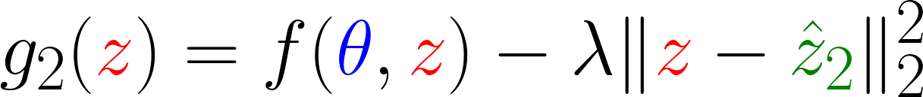
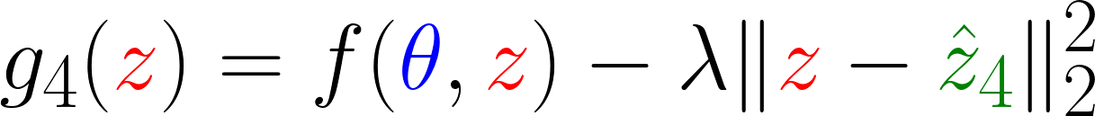
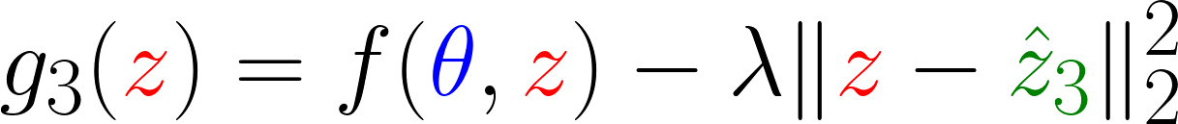
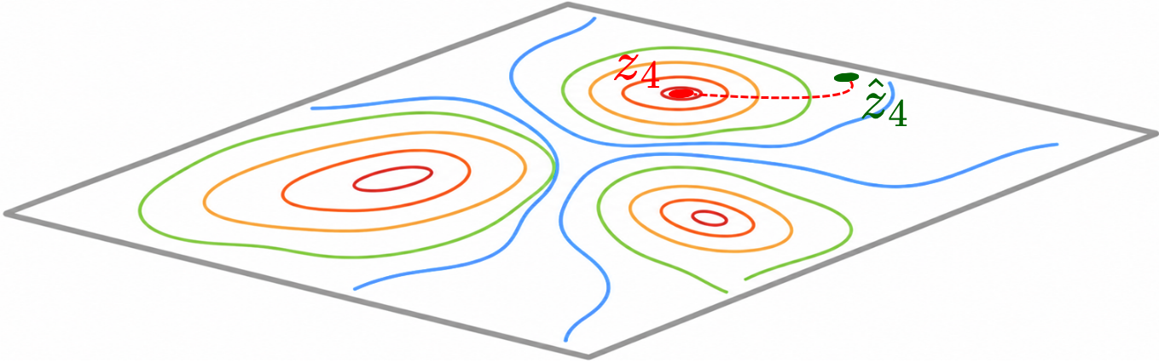
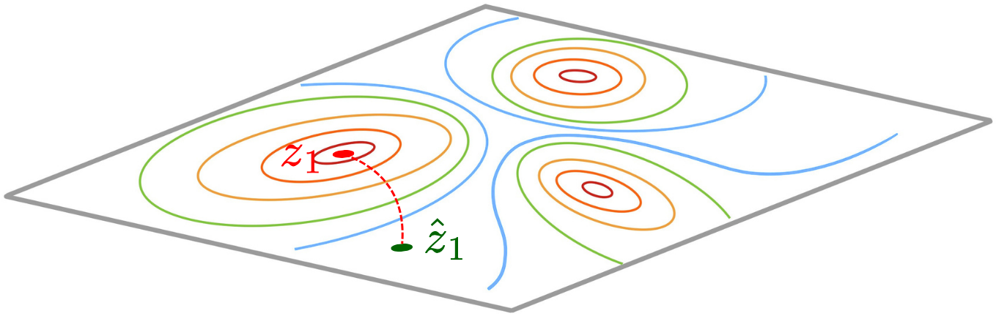
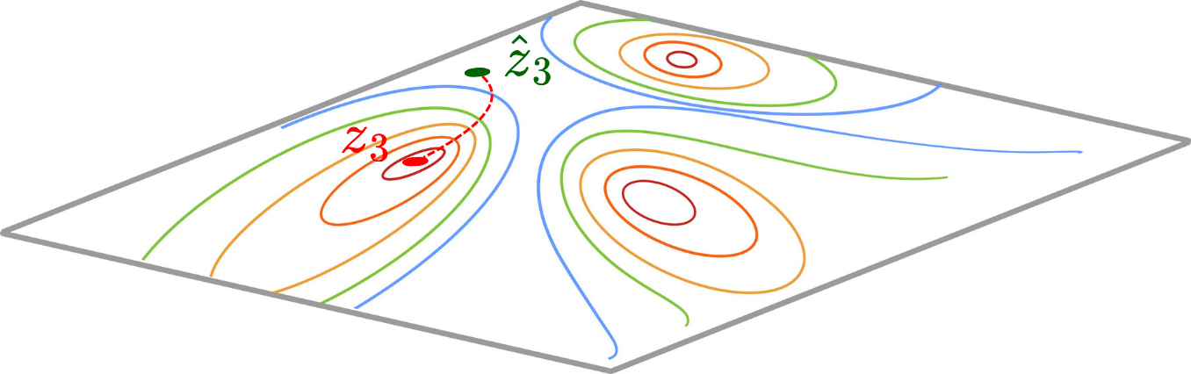
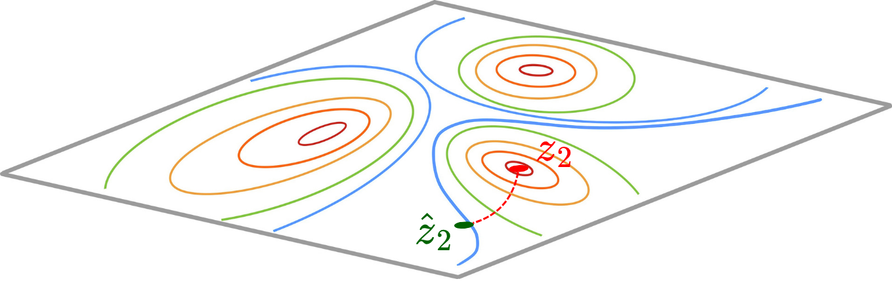
Multi-Start Particle Ascent (MPA)

Slide 18
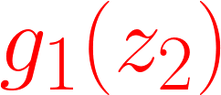
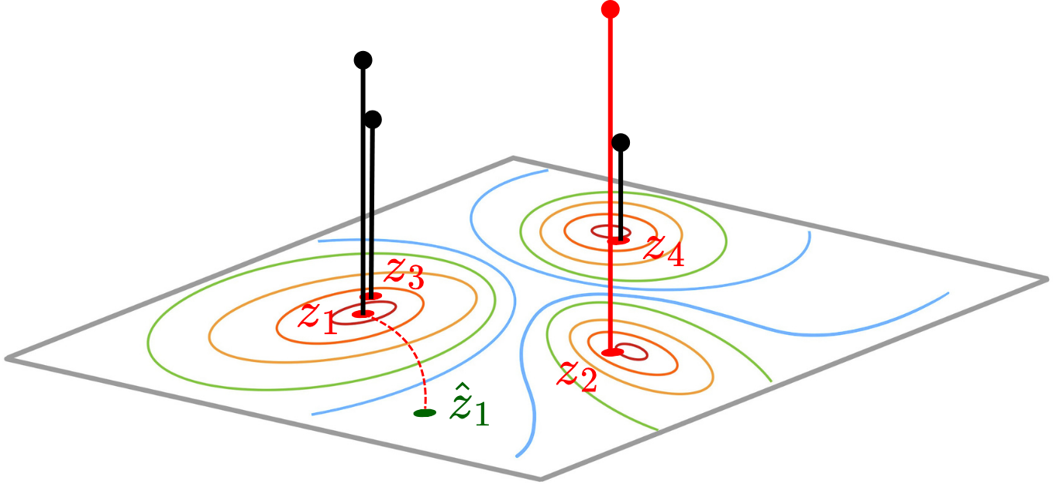
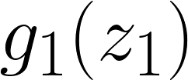





Multi-Start Particle Ascent (MPA)

Slide 19

Multi-Start Particle Ascent (MPA)
Lemma:

Slide 20




Multi-Start Particle Ascent (MPA)
Three regimes:
: MPA is equivalent to PA and can find the global maximizer.
: MPA behaves like a multi-start heuristic in global optimization.
moderate : MPA may fail to
find the globally optimal adversarial map.

Slide 21
Explicit Adversarial Maps

Slide 22





Explicit Adversarial Maps
1
Restrict the Adversary to an explicit parametric family
2
alternate: ascend the map ( ), descend the model ($θ$)

Slide 23











Input Convex Neural Networks (ICNNs)
Model a scalar convex potential

Slide 24
Experiments

Slide 25





Adversarial Logistic Regression on CIFAR-10
Setup
Features from a frozen ResNet-50 (ImageNet),
Multi-class logistic regression with the NLL loss
Adversary perturbs only the features ; labels stay fixed
Evaluate with an ℓ₂-PGD attack, sweeping budget Δ ∈ [0, 0.08]
ICNN-DRO gives the lowest test error
Clean Accuracy, NN-DRO degrades, ICNN-DRO preserves
Test error vs. relative $ℓ2$-PGD attack budget Δ

Slide 26


Image-Space Robustness on CIFAR-10
Adversarial attacks
Unseen domains
Image corruptions
PGD (57.4%) and AutoAttack (56.7%). The tight 0.71% PGD–AA gap signals genuine robustness, not gradient masking; clean accuracy stays within 1.75% of ERM.
Best on both CIFAR-10.1 (82.5%) and 10.2 (79.3%), unseen during training, so the gains reflect real OOD generalization. MPA is a close second.
Best CIFAR-10-C average (82.8%), exceeding even ERM. The margin widens at the harshest severity 5: 74.0% vs 69.7% for PA.
25

Slide 27

Runtime vs. Robust Accuracy / Monge Gap
Monge gap ↔ robustness
One Pareto frontier
PA → MPA → ICNN-DRO-LQ → ICNN-DRO
ICNN-DRO-LQ: cheaper
Keeps the quadratic injection only at the readout layer (none in the hidden layers). It matches ICNN-DRO's robustness at ≈ half the per-epoch runtime (216s vs 357s).
26

Slide 28





Robust Control: Cart-Pole
Setup
Balance a pole on a cart; uncertain pole mass & length drawn uniformly from Policy trained with PPO
Loss = negative expected return (episode length, max 1000):
What the radar shows ( )
ICNN-DRO (red, filled) achieves the longest episode on every variant
Largest gains on the extrapolative harder shifts (Heavy, Short, Strong Gravity) that lie outside the training box
MPA is the consistent runner-up and clearly beats PA; WFR leads the rest but degrades on the hard variants
27

Slide 29
Thanks for your attention!

