Slide 1
New Years Resolution
How to extend what you can’t commit to.

Slide 2
What if I was to tell you I found a way that you wont break them anymore?
How many of you have made a new years resolution?
How many of you have already broken them?
Notes:
How many of you have broken a new year resolution?

Slide 3
Celebrate another New Year!
There are over 50 different new years around the world.
Different new years are celebrated throughout the calendar year!
Some New Year Celebrations last 14 days to over month.
Notes:
There are 46 different new years around the world.
They are spread out through out the year and are based on several different calendars.

Slide 4
Chinese New Year
Based on the lunar calendar
7 day celebration(longest Chinese holiday)
Each year is based on the Chinese Zodiac
Chinese Zodiacs have two different starts
1) Solar calendar which has 24 fifteen-day solar’s terms
2) Lunar calendar has 12 or 13 months and starts on Chinese New Year.
Notes:
Celebrations traditional run from the evening preceding the first day, to the latern festival on the 15th day of the first calendar month.

Slide 5
India New Years
16 numerous types of Indian New Year’s day celebrated in various regions at various times of the year.
Holi – celebration of the last day of the Hindu month Phalguna Purnima
2 day celebration
Night before starts with a bonfire
Next morning is RangWali Holi – free for all carnival of colours
Ugadi – celebration of the on the first day of the Hindu month Chaitra
2 day celebration
Major deep cleaning of the house (starts the new year of fresh)
Shops for new clothes to wear
Notes:
Holi – end of winter- 2 day celebration night before starts with a bonfire, the next morning is RangWali Holi – free for all carnival of colours
Ugadi – start of spring “Yuga Adi”

Slide 6
Balinese New Years
Based on the Balinese calendar
Has two different calendars
Pawukon – 210 numeric calendar days per year
Saka - luni-solar calendar starts every Nyepi
Day of silence, fasting, and mediation
Omed_omedan or the “The Kissing Ritual to celebrate the new year.
Unmarried singles (17-30) starts off with a prayer then face each other on the streets and a religious Hindu leader approaches the center of the road and the singles start kissing while elders pour buckets of water all over them.

Slide 7
Iranian New Year
Persian new years fall on the first day of spring. Celebration is 14 - 19 days longs.
Preparation starts about 2 weeks before with a deep clean of the house and the creation of a Half-Seen
Notes:
Haft-seen
Sabzeh – wheat grass- that you start to grow – symbolizing rebirth
Samanu – Sweets – symbolizing affluence
Senjed – Wild Olive Fruit – symbolizing love
Seer – Garlic – symbolizing medicine & health Seeb – Garlic – symbolizing beauty
Somaq – sumac fruit – symbolizing – sunrise and fresh beginings
Serkeh – Vinegar – symbolizing – patience

Slide 8
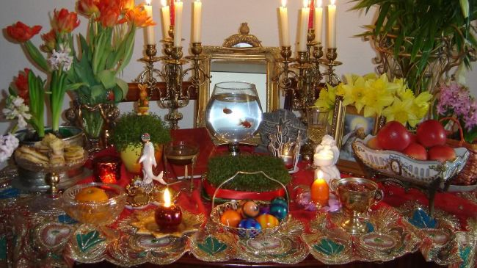
Haft-Seen
Sabzeh – Wheat Grass – symbolizing rebirth
Samanu – Sweets – symbolizing affluence
Senjed – Wild Olive Fruit – symbolizing love
Seer – Garlic – symbolizing medicine & health Seeb – Garlic – symbolizing beauty
Somaq – Sumac fruit – symbolizing sunrise and fresh beginnings
Serkeh – Vinegar – symbolizing patience

Slide 9
Iranian New Year
Persian new years fall on the first day of spring. Celebration is 14 - 19 days longs.
Preparation starts about 2 weeks before with a deep clean of the house and the creation of a Half-SeenHaft-Seen
Celebration starts the last Wednesday of the new year with a bonfire
Everyone wears a new piece of clothing for new years
Elders give their youths money.
Notes:
Haft-seen
Sabzeh – wheat grass- that you start to grow – symbolizing rebirth
Samanu – Sweets – symbolizing affluence
Senjed – Wild Olive Fruit – symbolizing love
Seer – Garlic – symbolizing medicine & health Seeb – Garlic – symbolizing beauty
Somaq – sumac fruit – symbolizing – sunrise and fresh beginings
Serkeh – Vinegar – symbolizing – patience

Slide 10
New Years Resolution
So the next time you think you can’t keep your new years resolution
Just extend it to another year.

