Slide 1

Chapter 10
TUPLETS

Slide 2
10.1 Tuples are immutable
Tuplets are a sequence of values and are similar to the lists. The values stored in a tuple can be any type (integer, float, list, string, etc.), and they are indexed by integers.
Tuplets are:
Immutable
Comparable
Hashable

Slide 3
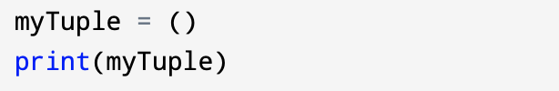
Creating a Tuple
A tuple is created by placing all the items (elements) inside parentheses (), separated by commas.
Although it is not necessary, it is common to enclose tuples in parentheses to help us quickly identify tuples when we look at Python code.
Example of empty tuple:

Slide 4
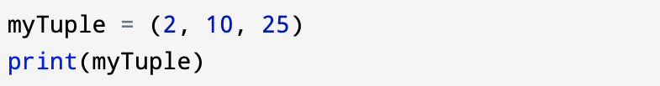
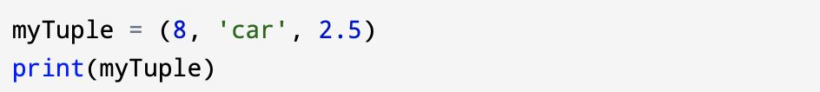
Tuple having integers:
Tuple with mixed data types:

Slide 5
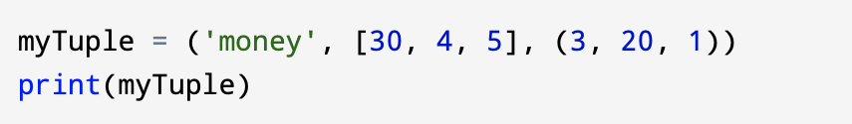
Example of nested tuple:

Slide 6
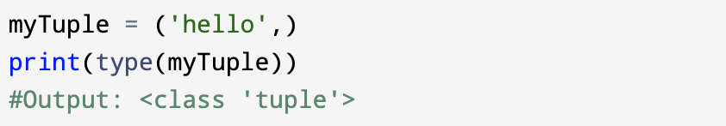
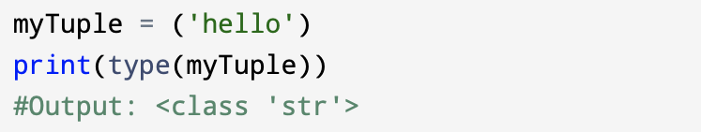
To create a tuple with a single element, you have to include the final comma:
Creating a tuple having one element:
Without the comma Python treats ('hello') as an expression with a string in parentheses that evaluates to a string:

Slide 7
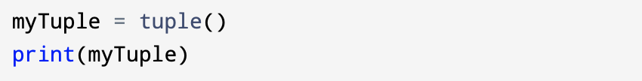
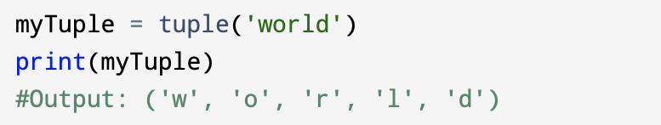
Built-in function tuple it the another way to construct a tuple. With no argument, it creates an empty tuple:
If the argument is a sequence (string, list, or tuple), the result of the call to tuple is a tuple with the elements of the sequence:

Slide 8
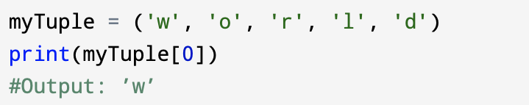
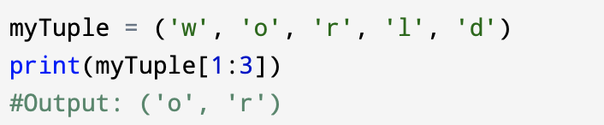
Tuple is also the name of a constructor that's why you should avoid using it as a variable name.
Most list operators also work on tuples. The bracket operator indexes an element:
You can access a range of items in a tuple by using the slicing operator colon : .

Slide 9
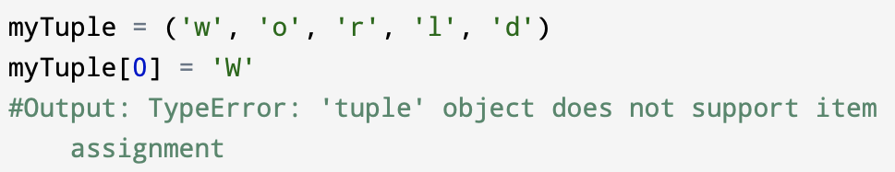
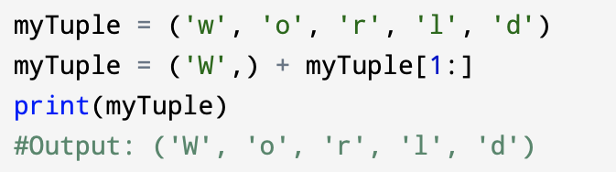
If you try to modify one of the elements of the tuple, you get an error:
You can’t modify the elements of a tuple, but you can replace one tuple with another:

Slide 10
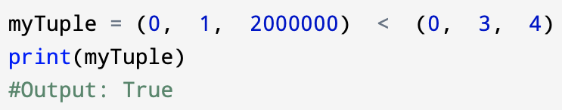
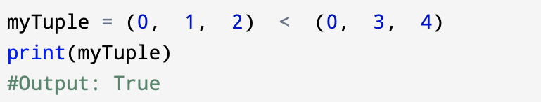
10.2 Comparing tuples
The comparison operators work with tuples and other sequences. Python starts by comparing the first element from each sequence. If they are equal, it goes on to the next element, and so on, until it finds elements that differ.
Subsequent elements are not considered (even if they are really big).

Slide 11
The sort function works the same way as comparison. It sorts primarily by first element, but in the case of a tie, it sorts by second element, and so on.
This feature lends itself to a pattern called DSU for:
Decorate a sequence by building a list of tuples with one or more sort keys preceding the elements from the sequence,
Sort the list of tuples using the Python built-in sort, and
Undecorate by extracting the sorted elements of the sequence.

Slide 12
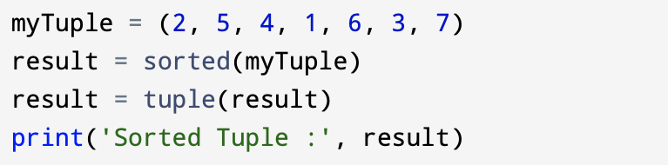
Example of sorted() function:

Slide 13
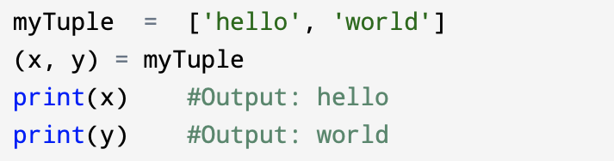
10.3 Tuple assignment
Tuple assignment - a statement that assigns a value to a name (variable). To the left of the assignment operator, =, is a name. To the right of the assignment operator is an expression which is evaluated by the Python interpreter and then assigned to the name.
In the example below you have a two-element list (which is a sequence) and assign the first and second elements of the sequence to the variables x and y in a single statement.

Slide 14
Tuple assignment allows us to swap the values of two variables in a single statement:
a, b = b, a
Both sides of this statement are tuples, but the left side is a tuple of variables; the right side is a tuple of expressions. Each value on the right side is assigned to its respective variable on the left side. All the expressions on the right side are evaluated before any of the assignments.
It is important to remember that the number of variables on the left and the number of values on the right must be the same.

Slide 15
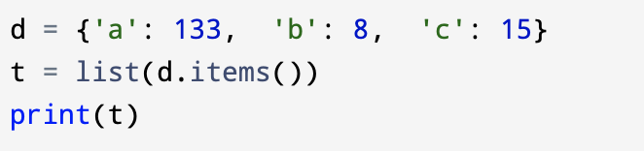
10.4 Dictionaries and tuples
Dictionaries have a method called items that returns a list of tuples, where each tuple is a key-value pair:
The items in the example above will be in no particular order.

Slide 16
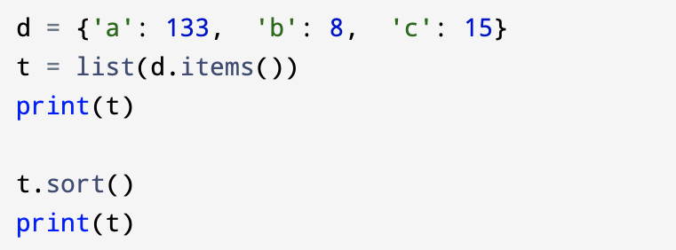
However, since the list of tuples is a list, and tuples are comparable, you can now sort the list of tuples. You just have to convert a dictionary to a list of tuples and you will get a dictionary sorted by key:
The new list is sorted in alphabetical order by the key value.

Slide 17
Advantages of Tuple over List
Lists are more common than tuples, mostly because they are mutable. But, there are certain advantages of implementing a tuple over a list.
Below listed are some of the main advantages:
We generally use tuples for heterogeneous (different) data types and lists for homogeneous (similar) data types.
Tuples are immutable, iterating through a tuple is faster than with list. So there is a slight performance boost.
Tuples that contain immutable elements can be used as a key for a dictionary. With lists, this is not possible.
If you have data that doesn't change, implementing it as tuple will guarantee that it remains write-protected.

