Slide 1
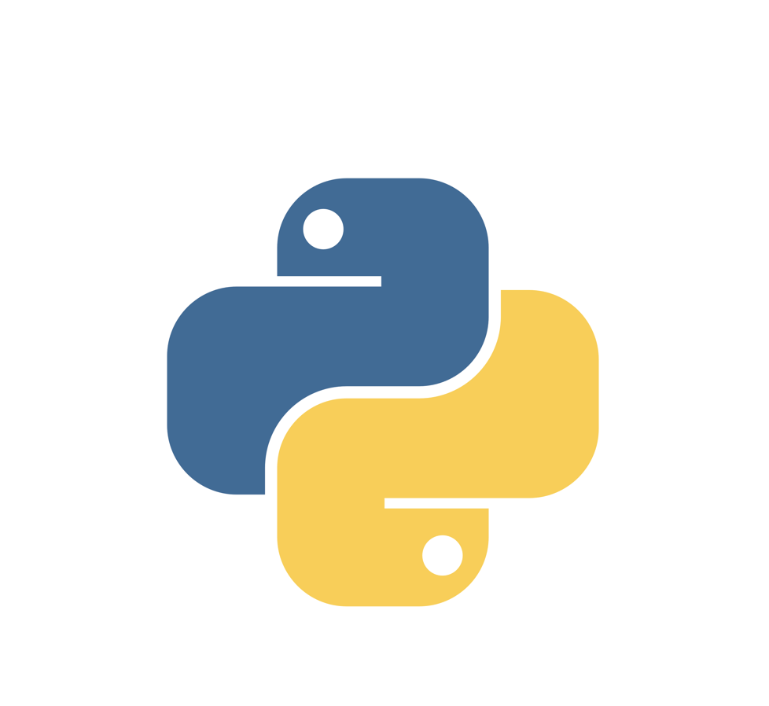
Chapter 4
FUNCTIONS

Slide 2

4.1 Function calls
Function is a named sequence of statements that performs a computation
When you define a function, you specify the name and the sequence of statements. Later, you can “call” the function by name. We have already seen one example of a function call:
The name of the function is type. The expression in parentheses is called the argument of the function. The argument is a value or variable that we are passing into the function as input to the function. The result, for the type function, is the type of the argument.
It is common to say that a function “takes” an argument and “returns” a result. The result is called the return value.

Slide 3
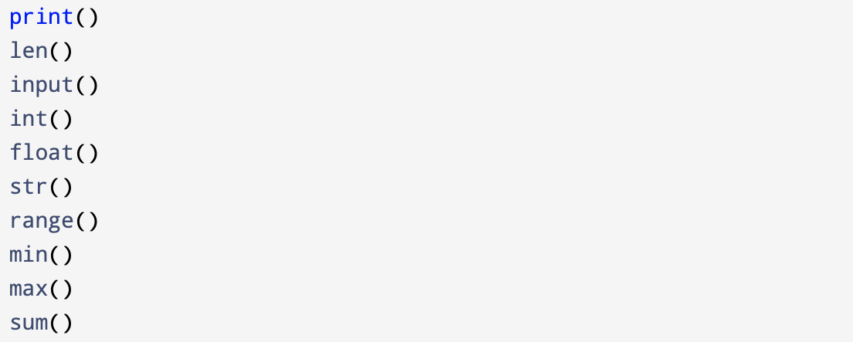
4.2 Built-in functions
Python provides a number of important built-in functions that we can use without needing to provide the function definition.
Python creators wrote a set of functions to solve common problems and included them in Python for us to use. For example:

Slide 4
For example, now we can describe built-in function print(): “The print() function prints its arguments on the screen, separating them with spaces if there are multiple arguments.” We now have the word arguments to describe the values we’ve been passing into the print() function.
Another example, where we can describe a familiar function in terms of its return value and argument: “The len() function returns the number of items in its argument.”
It is important to remember to treat the names of built-in functions as reserved words (i.e., avoid using “max” as a variable name).
Technically, Python will allow you to “override” their built-in definitions, but this will likely lead to confusion.

Slide 5
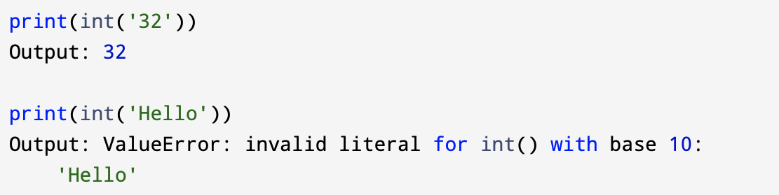
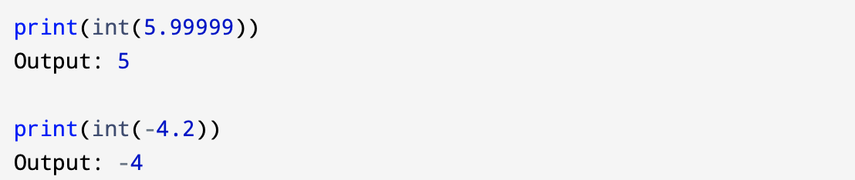
4.3 Type conversion functions
Python also provides built-in functions that convert values from one type to another. The int function takes any value and converts it to an integer, if it can, or complains otherwise:
int can convert floating-point values to integers, but it doesn’t round off; it chops off the fraction part:

Slide 6
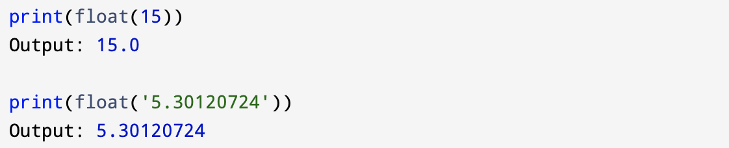
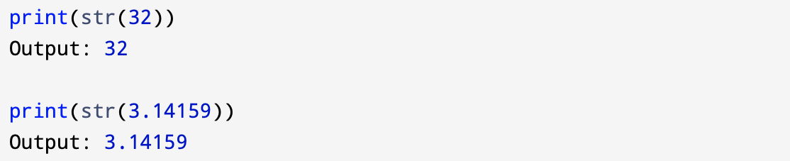
float converts integers and strings to floating-point numbers:
str converts its argument to a string:

Slide 7
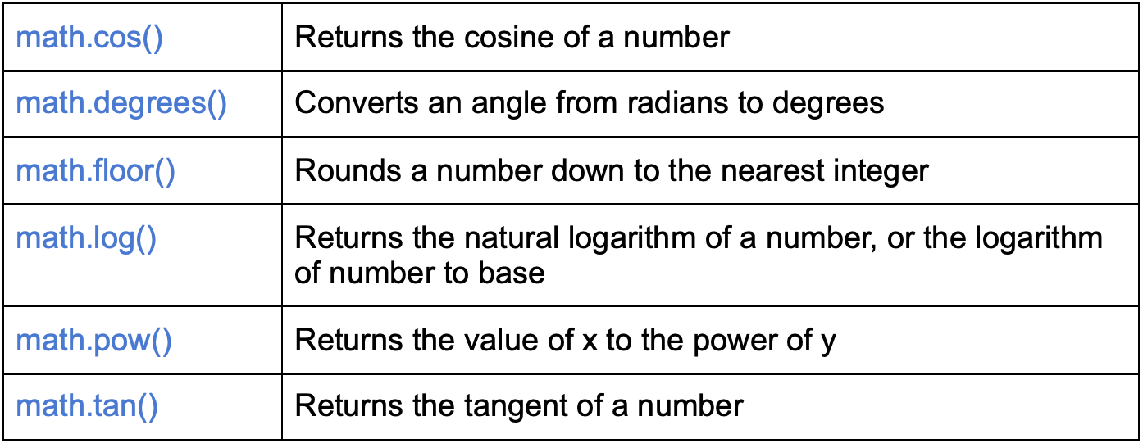
4.4 Math functions
Python has a built-in module that you can use for mathematical tasks. You have to import the module if you want to use it.
Examples of the math methods:

Slide 8
4.5 Random numbers
Given the same inputs, most computer programs generate the same outputs every time, so they are said to be deterministic. Determinism is usually a good thing, since we expect the same calculation to yield the same result. For some applications, though, we want the computer to be unpredictable. Games are an obvious example, but there are more.
Making a program truly nondeterministic turns out to be not so easy, but there are ways to make it at least seem nondeterministic. One of them is to use algorithms that generate pseudorandom numbers. Pseudorandom numbers are not truly random because they are generated by a deterministic computation, but just by looking at the numbers it is all but impossible to distinguish them from random.

Slide 9
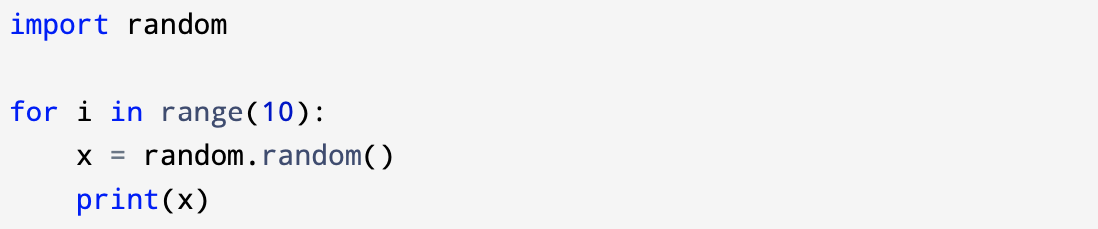
The random module provides functions that generate pseudorandom numbers (which we will simply call “random” from here on). If you want to use that module you just have to write import random at the top of your code.
The function random () returns a random float between 0.0 and 1.0 (including 0.0 but not 1.0). Each time you call random (), you get the next number in a long series. To see a sample, run this loop:
The program that we see above, produces the following list of 10 random numbers between 0.0 and up to but not including 1.0. Every time you run it, it produces a different set of numbers.

Slide 10
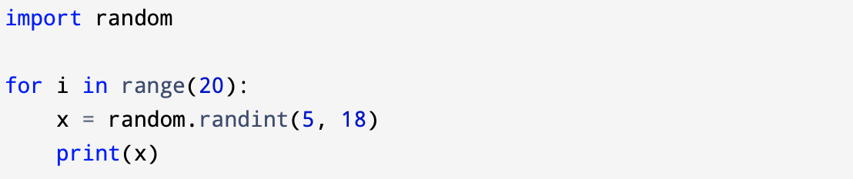
The random module has many functions and random() is one of them.
Another function for example is the function randint() takes two arguments, a low value and a high value (in that order), and it returns an integer from the range between the two values (including both).

Slide 11
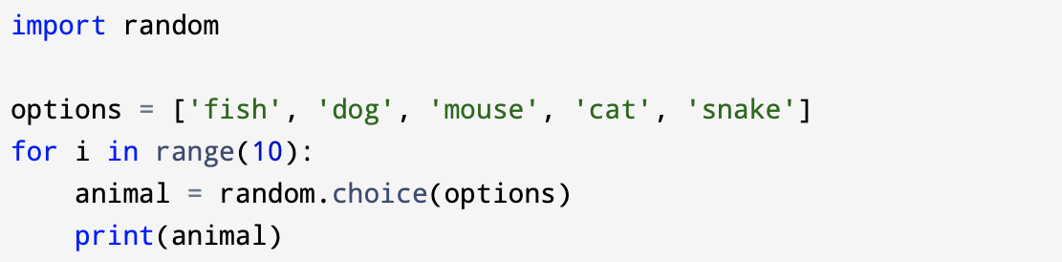
To choose an element from a sequence at random, you can use choice():

Slide 12
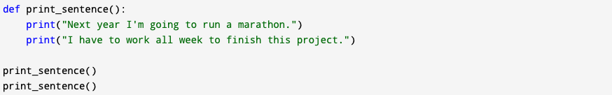
4.6 Adding new functions
When you write your program you can use built-in functions but often you need to add new functions that you will write by yourself.
A function definition specifies the name of a new function and the sequence of statements that execute when the function is called.
Once you define a function, you can reuse the function over and over throughout your program.
Below is an example of defining a function, followed by calling it twice:

Slide 13
Def is a keyword that indicates that this is a function definition. The name of the function is print_sentence.
The rules for function names are the same as for variable names: letters, numbers and some punctuation marks are legal, but the first character can’t be a number. You can’t use a keyword as the name of a function, and you should avoid having a variable and a function with the same name to avoid confusion.
The empty parentheses after the name indicate that this function doesn’t take any arguments. Later we will build functions that take arguments.
The first line of the function definition has to end with a colon and the body has to be indented. The body can contain any number of statements. Notice that this is the same pattern (a colon followed by an indented body) as we’ve seen in for loops, while loops, and if statements. It’s consistent across the language.

Slide 14
4.7 Flow of execution
The flow of execution refers to the order in which statements are executed during a program run. In other words the order in which statements are executed during a program run called flow of execution.
Execution always begins at the first statement of the program. Statements are executed one at a time, in order from top to bottom.
Function definitions do not alter the flow of execution of the program, and also it is important to remember that statements inside the function are not executed until the function is called.

Slide 15
A function call is like a detour in the flow of execution. Instead of going to the next statement, a function call does the following:
The flow jumps to the body of the function,
The flow proceeds through all the statements there, executing them in order,
When the end of the function is reached, the flow jumps back to the line after the original function call to pick up where it left off.

Slide 16
That sounds simple enough, until you remember that one function can call another. While in the middle of one function, the program might have to execute the statements in another function. But while executing that new function, the program might have to execute yet another function!
Fortunately, Python is good at keeping track of where it is, so each time a function completes, the program picks up where it left off in the function that called it. When it gets to the end of the program, it terminates.
It is important to remember when you read a program you need to follow the flow of execution. You don’t always want to read a program from top to bottom.

Slide 17
4.8 Parameters and arguments
Some of the built-in functions require arguments.
For example, when you call:
range() - you have to pass it a number as an argument,
len() - you have to give it a string, list, or other sequence as an argument.
Some functions take more than one argument:
math.pow() in the math module takes two, the base and the exponent.

Slide 18
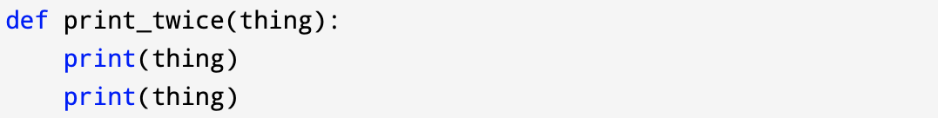
When a function is called, any arguments given in the function call are assigned to variables in the function body called parameters.
Here is an example of a user-defined function that takes an argument:

Slide 19
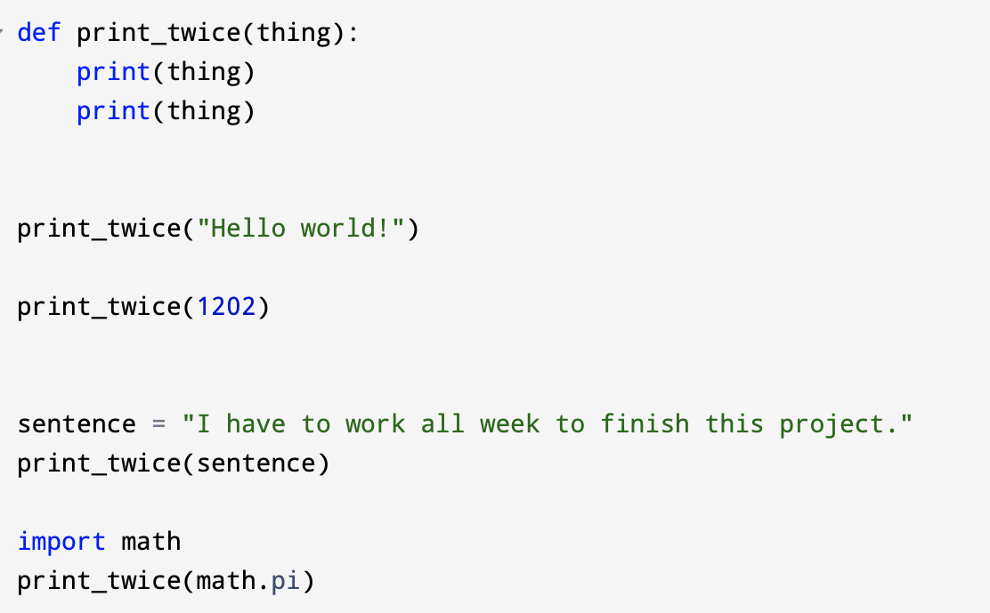
This function assigns the argument to a parameter named thing. When we call the function, it prints the value of the parameter twice.

Slide 20
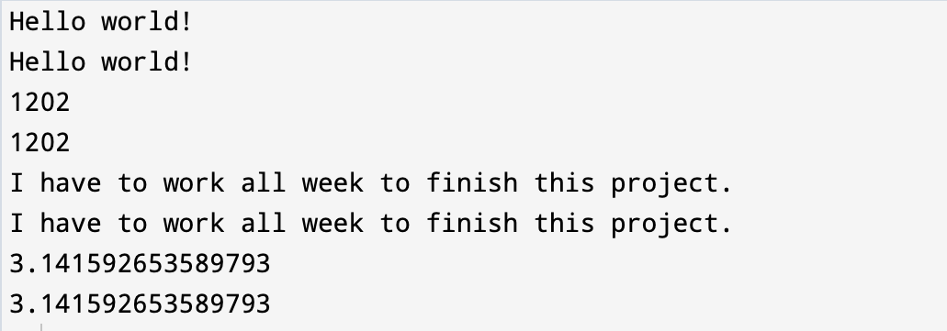
Output:

Slide 21
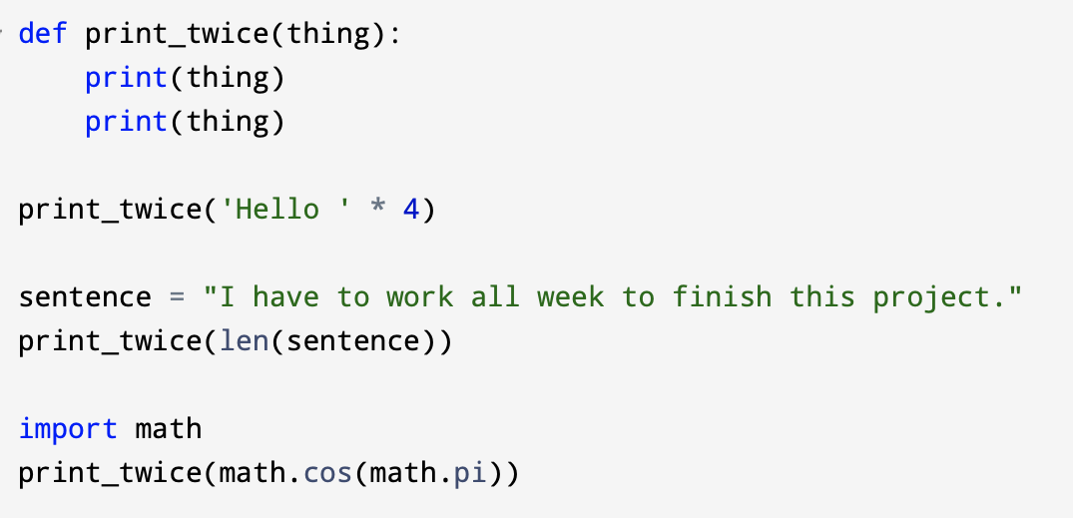
The same rules of composition that apply to built-in functions also apply to user-defined functions, so we can use any kind of expression as an argument for print_twice.

Slide 22
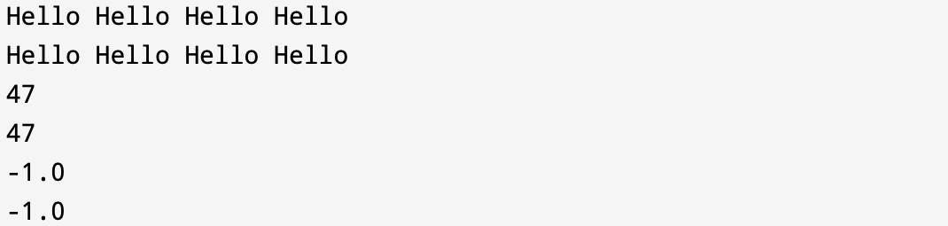
Output:
The argument is always evaluated before the function is called, so in the examples above the expressions 'Hello '*4 and math.cos(math.pi) are only evaluated once.

Slide 23
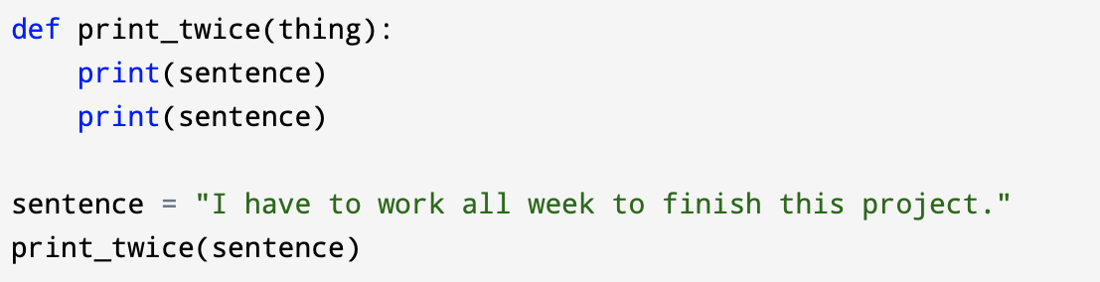
Also, you can use a variable as an argument:
The name of the variable you pass as an argument (sentence) has nothing to do with the name of the parameter (thing). It doesn’t matter what the value was called back home (in the caller); here in print_twice, we call it thing.

Slide 24
4.9 Fruitful functions and void functions
In almost every programming language there are two types of functions:
Fruitful Functions
Void Functions
Fruitful Functions:
Are the functions that return a value after their completion,
Must always return a value to where it is called from,
Can return any type of value may it be string, integer, boolean, etc.,
A function can return the value of one variable but also the value to be returned can be an array or a vector,
Can also return multiple values.

Slide 25
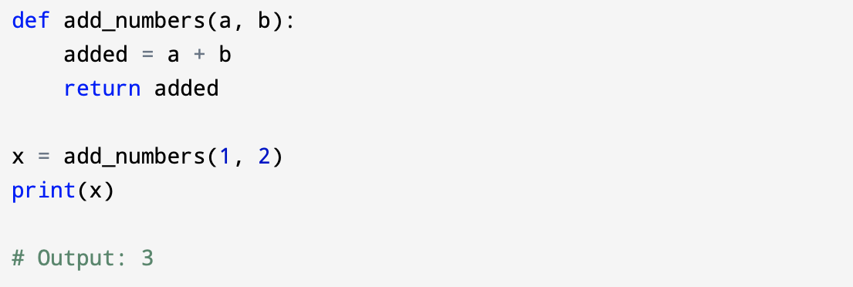
Example of fruitful function:

Slide 26
Void Functions
Void functions do not return any value after their calculation is complete,
Are used when the calculations of the functions are not needed in the actual program,
Perform tasks that are crucial to successfully run the program but do not give a specific value to be used in the program.
Example of void function.

Slide 27
4.9 Why functions?
The reasons why we are creating functions:
Testing and Debugging: Creating functions in a long program can help you to test and debug the parts individually, one at a time and then assemble them into a working whole.
Code Reuse (within a program): Functions can make a program smaller by eliminating repetitive code. Later, when you want to make a change you just only make it in one place.
Code Maintenance: If you have to update, fix, or change code that is defined in a function, you only have to make changes in one place, and those changes will take effect everywhere the function is called.
Code Reuse (across programs): Well-designed functions are often useful for many programs. You can reuse functions in other programs that you write and debug earlier.

Slide 28
4.10 Exercises
Exercise 1
Design and implement a function with no input parameters. The function keeps receiving a number from input (user) and adds the numbers together. The application keeps doing it until the user enters 0. Then the application will stop and print the total sum and average of the numbers the user had entered.
Exercise 2
Design and implement a function with an input parameter which is a positive number and prints and returns the sum of the number’s digits. For instance if the number is 123 the algorithm returns 6 which is the result of 1+2+3.

Slide 29
Exercise 3
Design and implement a function with one parameter which is an integer and finds the next prime number which is bigger than the given input parameter and returns it. Reuse (call) the function you have defined for Exercise 3.
Exercise 4
Design and implement a function with two input parameters, A and B. The function then calculates the result of the floor division of A over B (A//B). You are not allowed to use the floor division operator. Look at here: https://simple.wikipedia.org/wiki/Division_(mathematics)
For instance the function for 20 and 6 will return 3.

Slide 30
Exercise 5
Design and implement a function with no input parameter which reads a number from input (like 123). Only non-decimal numbers are valid (floating points are not valid). The number entered by the user should not be divisible by 10 and if the user enters a number that is divisible by 10 (like 560), it is considered invalid and the application should keep asking until the user enters a valid input. Once the user enters a valid input, the program calculates the reverse of the input number (for 153, the reverse is 351) and prints the result and returns the results.

Slide 31
Exercise 6
Write a function called printSubLists which receives two number A and B as its parameters:
First prints all numbers between A and B (A and B not included), which are divisible to both 3 and 5.
Then prints all numbers between A and B (A included by B not included), which are divisible by either 6 or 7.
Finally prints all numbers between A and B (A and B both included), which are not divisible by 3.
Hint: Design a function for each sub problem and then call them inside the printSubLists function.

Slide 32
Exercise 7
Write a function with a parameter which is a positive number in base 10 (any positive, non-decimal number, like 452), and convert it to binary and print the results. (Please research yourself on how to convert a number in base 10 to a binary number). The function does not return anything.
Exercise 8
Write a function with no input parameter which keeps asking the user to enter positive numbers until the user enters an invalid input. (An invalid input is an input which includes at least one alphabet, like 123d4). The program should print the Max and Min of the numbers the user had entered as well as the distance between the Max and Min. (Remember to calculate the absolute distance). The function does not return anything.

Slide 33
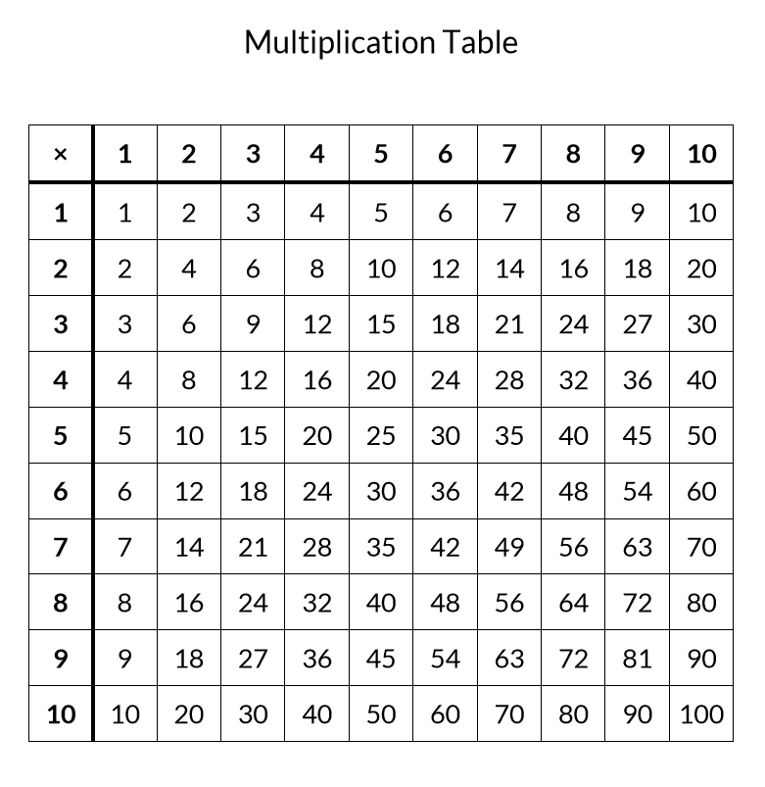
Exercise 9
Write a function with a parameter called A (which is between 1 and 10) and print the multiplication table for 1 to A.
Note: Do not need to draw the horizontal and vertical lines.
Example for A = 10

Slide 34
Exercise 10
Write a function with one input parameter which is a string and does the following:
Checks whether the input string and its reverse is the same (like BaBa), if yes it returns 1 and if false, it returns 0. It considers case-sensitivity which means (Baba and BaBa are not the same).

Slide 35
Exercise 11
Write A function with an input parameter which is a string arithmetic statement which contains only alphabet variables and binary operations including +, -, *, / and % and checks whether the statement is a valid arithmetic statement or not. If the statement is valid, the function returns true, otherwise returns false.
The statement might contain parenthesis as well. For instance:
a+b*a+c/c%y
(a+b)*(a/d-(a/b))
You can make this assumption that the variable names contain only one alphabet (like a, b, c) and cannot have more than one alphabet (like ab, temp, sum, …)

