Slide 1

Chapter 5
ITERATION

Slide 2
5.1 Updating variables
A common pattern in assignment statements is an assignment statement that updates a variable, where the new value of the variable depends on the old value of the variable.
The computer will first evaluate the expression on the right, x + 1 , and then assign that value to x. So the statement means “get the current value of x, add 1 to it, and then update x with the new value.”

Slide 3
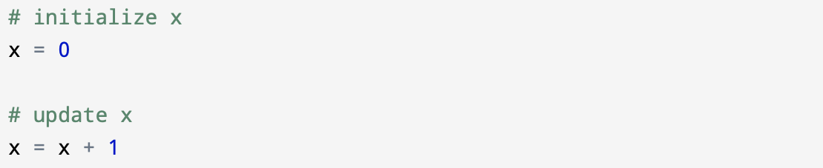
If x doesn’t exist yet and has no value this statement will give you an error. Python will evaluate the right side and be unable to proceed.
To update variable you have to first initialize it, and then you can update a variable usually with a simple assignment:
Updating a variable by adding 1 is called an increment, and subtracting 1 is called a decrement.

Slide 4
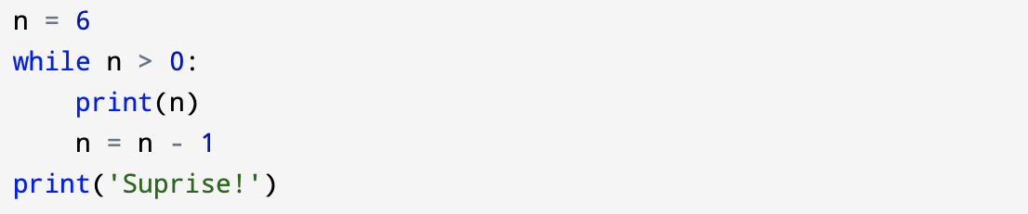
5.2 The while statement
While loop is a control structure.
The while loop can repeatedly execute a sequence of instructions, but instead of repeating a set number of times based on a sequence of values, the while loop repeats as long as some condition is True.
Example:

Slide 5
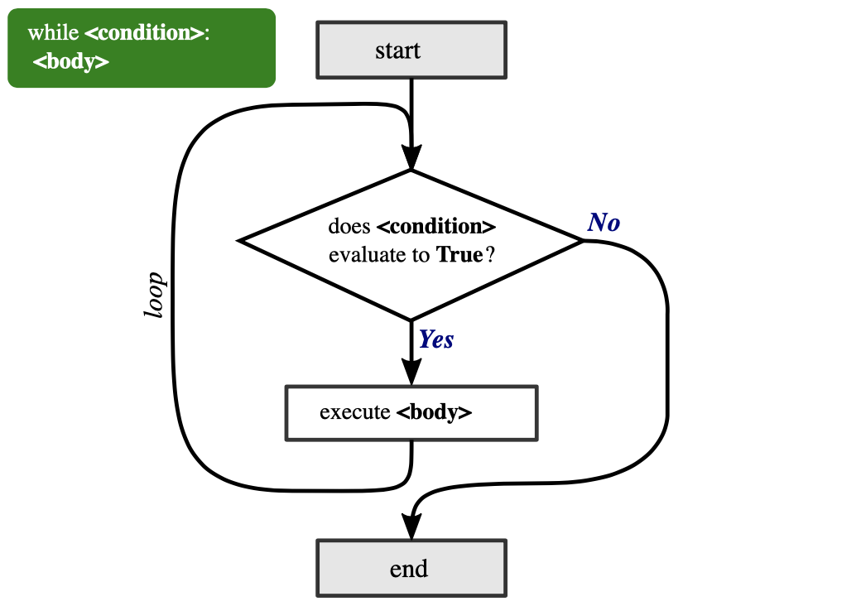
Flowchart of execution for a while statement:
Figure 1: Flowchart illustrating the execution of a while loop.

Slide 6
Step by step how the flow of execution for a while statement works:
Evaluate the condition, and checking if condition is True or False.
If the condition is False, exit the while loop and continue execution at the next statement.
If the condition is True, execute the body and then return to step 1.
This type of flow is called a loop because the third step loops back around to the top.
Repetitive execution of the same block of code over and over is referred to as iteration.

Slide 7
5.3 Infinite loops
An Infinite Loop in Python is a continuous repetitive conditional loop that gets executed until an external factor interferes in the execution flow, like insufficient CPU memory, a failed feature/ error code that stopped the execution, or a new feature in the other legacy systems that needs code integration.
In most programming environments, you will be able to stop a program if it gets stuck in an infinite loop. In some cases, like running your code in an integrated development environment, there will be a “stop” button of some sort.
Or if you are running your program on the command line, pressing Ctrl and C together (often written as Ctrl+C) can ends its execution.

Slide 8
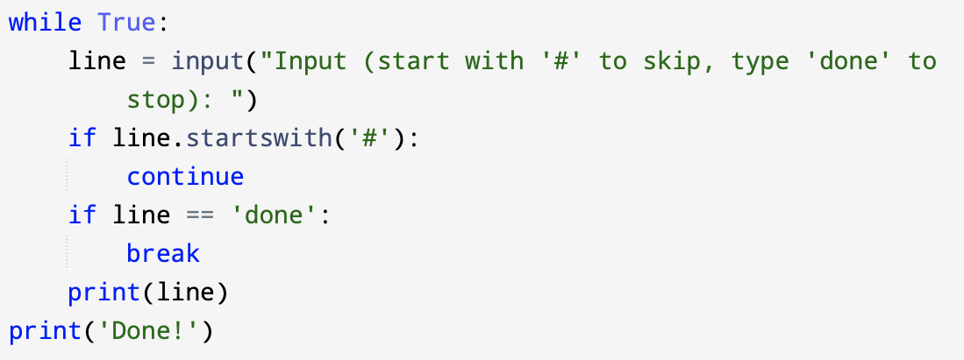
5.4 Finishing iterations with continue
With the continue statement we can stop the current iteration, and continue with the next:

Slide 9
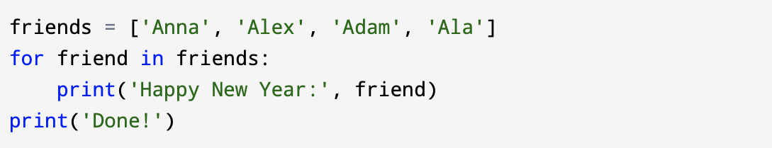
5.5 Definite loops using for
A for loop is used for iterating over a sequence (that is either a list, a tuple, a dictionary, a set, or a string). This is less like the for keyword in other programming languages, and works more like an iterator method as found in other object - oriented programming languages. With the for loop we can execute a set of statements, once for each item in a list, tuple, set etc.
When we have a list of things to loop through, we can construct a for loop using a for statement. A for loop starts with a for statement and includes one or more indented lines below it that make up the loop body. For example:

Slide 10
5.6 Loop patterns
We often use a for or while loop to go through a list of items or the contents of a file looking to compute something from that data.
These loops are generally constructed by:
Initializing one or more variables before the loop starts.
Performing some computation on each item in the loop body, possibly changing the variables in the body of the loop.
Looking at the resulting variables when the loop completes.

Slide 11
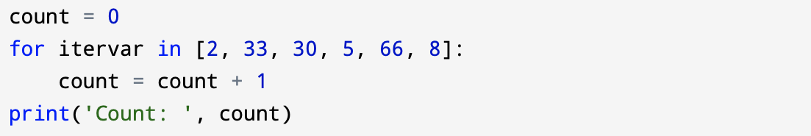
5.7 Counting and summing loops
For example, we would write the for loop to count the number of items in a list:
We set the variable count to zero before the loop starts, next we write a for loop to run through the list of numbers.
Our iteration variable is named itervar and while we do not use itervar in the loop, it does control the loop and cause the loop body to be executed once for each of the values in the list.

Slide 12
In the body of the loop, we add 1 to the current value of count for each of the values in the list. While the loop is executing, the value of count is the number of values we have seen “so far”.
Once the loop completes, the value of count is the total number of items. The total number “falls in our lap” at the end of the loop. We construct the loop so that we have what we want when the loop finishes.

Slide 13
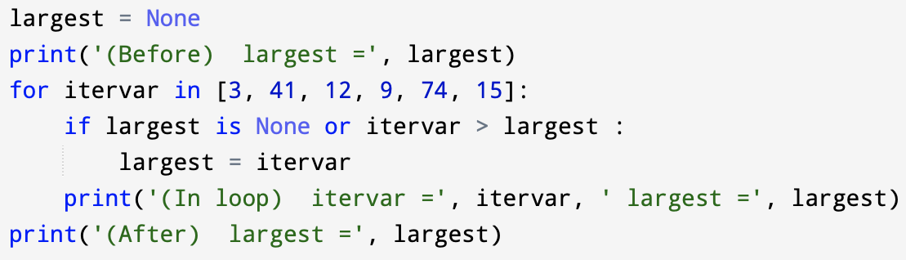
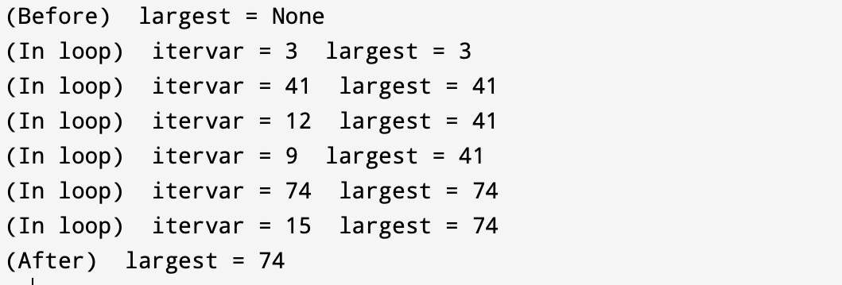
5.8 Maximum and minimum loops
Another common use of loops is to find a value in a sequence with a particular property. For example, we may need to find the largest or smallest number in a sequence.
The output is as follows:

Slide 14
The variable largest is best thought of as the “largest value we have seen so far.” Before the loop, we set largest to the constant None. None is a special constant value which we can store in a variable to mark the variable as “empty.”
Before the loop starts, the largest value we have seen so far is None since we have not yet seen any values. While the loop is executing, if largest is None then we take the first value we see as the largest so far. You can see in the first iteration when the value of itervar is 3, since largest is None, the condition of the if statement evaluates to True, and we immediately set largest to be 3.
After the first iteration, largest is no longer None, so the second part of the compound logical expression that checks itervar > largest evaluates to True only when we see a value that is larger than the “largest so far.” When we see a new “even larger” value we take that new value for largest. You can see in the program output that largest progresses from 3 to 41 to 74.

