Slide 1

Chapter 6
STRINGS

Slide 2
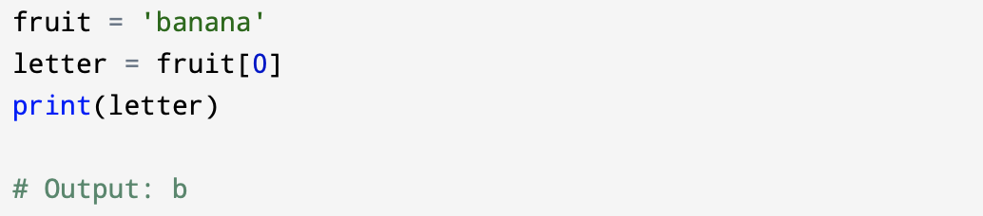
6.1 A string is a sequence
A string is a sequence of characters. You can access the characters one at a time with the bracket operator:
The expression in brackets is called an index. The index indicates which character in the sequence you want (hence the name).
Python and most other programming languages, an index is an offset from the beginning of the string, and the offset of the first letter is zero.

Slide 3
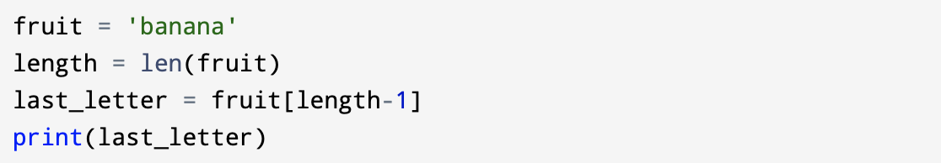
6.2 Getting the length of a string using len
len() is a built-in function that it always returns the number of elements in a sequence:
Since we started counting at zero, the six letters are numbered 0 to 5. To get the last character, you have to subtract 1 from length:

Slide 4
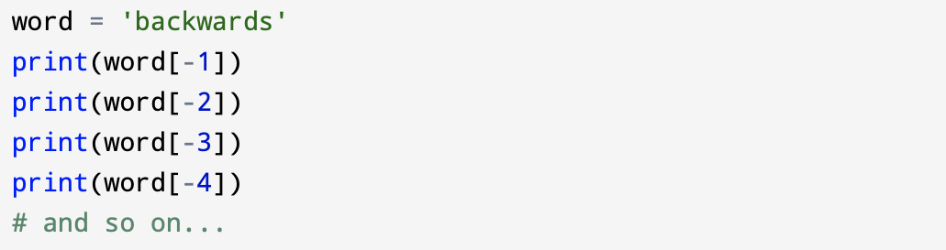
Alternatively, you can use negative indices, which count backward from the end of the string. The expression fruit[-1] yields the last letter, fruit[-2] yields the second to last, and so on.

Slide 5
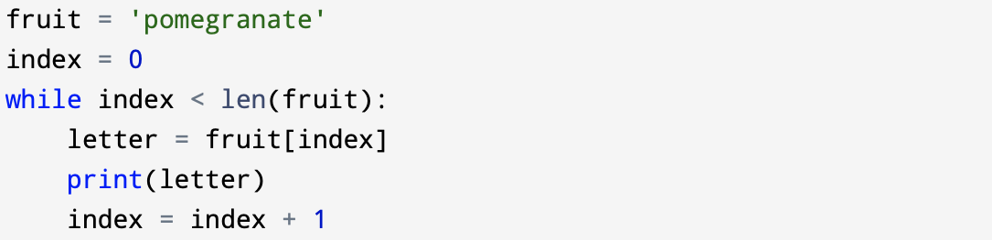
6.3 Traversal through a string with a loop
A lot of computations involve processing a string one character at a time. Often they start at the beginning, select each character in turn, do something to it, and continue until the end. This pattern of processing is called a traversal. One way to write a traversal is with a while loop:

Slide 6
This loop traverses the string and displays each letter on a line by itself. The loop condition is index < len(fruit), which can be considered to be saying, “As long as index is still a valid index of fruit” because all valid indexes are less than the length of the string. So when index is equal to the length of the string, the condition is false, and the loop stops executing.
With each value for index counting up from 0, the body of the loop uses indexing to get the character at that index from the string, and it prints it out.

Slide 7
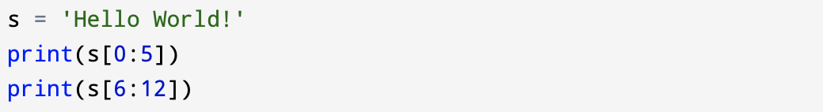
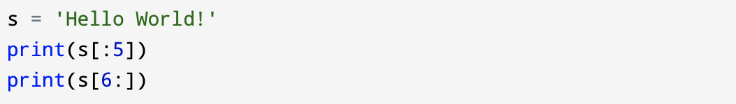
6.4 String slices
A segment of a string is called a slice. Selecting a slice is similar to selecting a character:
The operator returns the portion of the string from the first index up to but not including the second index.
If you omit the first index (before the colon), the slice starts at the beginning of the string. If you omit the second index, the slice goes to the end of the string:

Slide 8
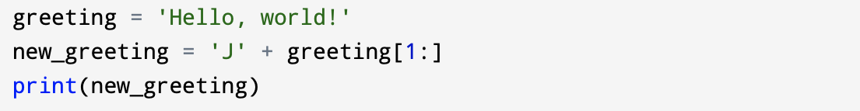
6.5 Strings are immutable
In Python, a string is immutable. You cannot overwrite the values of immutable objects. However, you can assign the variable again. It's not modifying the string object; it's creating a new string object.
This example concatenates a new first letter onto a slice of greeting. It has no effect on the original string.

Slide 9
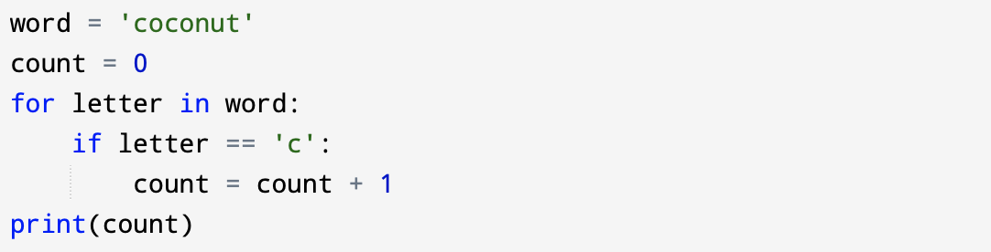
6.6 Looping and counting
Program below demonstrates another pattern of computation called a counter. The variable count is initialized to 0 and then incremented each time an “c” is found. When the loop exits, count contains the result: the total number of c’s.

Slide 10
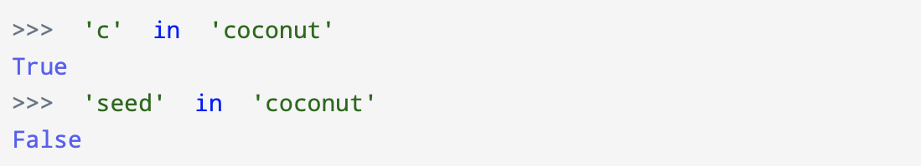
6.7 The in operator
The word in is a boolean operator that takes two strings and returns True if the first appears as a substring in the second:

Slide 11
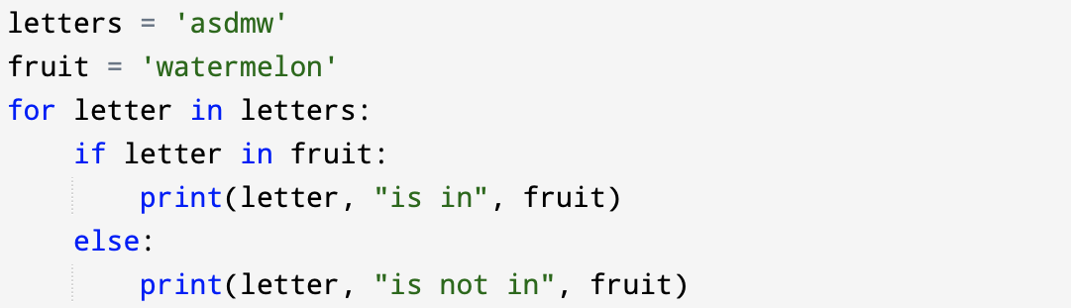
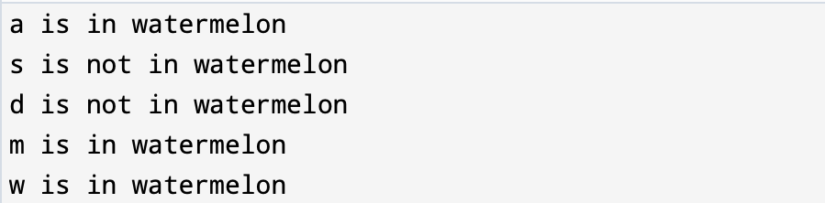
The in operator is commonly used in conditionals, example below:
Output:

Slide 12
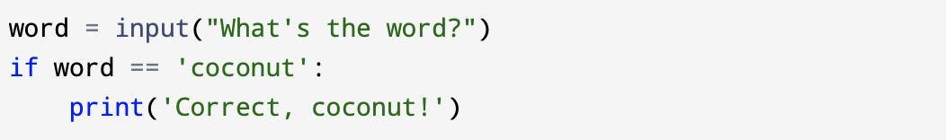
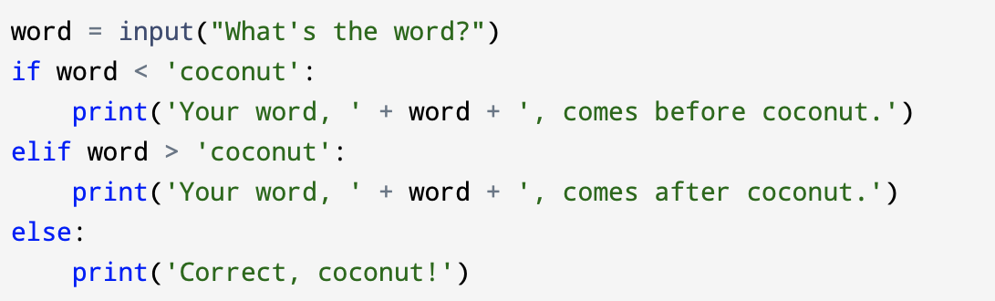
6.8 String comparison
If you want to see if two strings are equal you have to use comparison operators:
Other comparison operations are useful for putting words in alphabetical order:

Slide 13
Python does not handle uppercase and lowercase letters. All the uppercase letters come before all the lowercase letters, so if you enter “Coconut” for example, the output you will get:
A common way to address this problem is to convert strings to a standard format, such as all lowercase, before performing the comparison. This topic will be presented in the next section.

Slide 14
6.9 String methods
Strings in Python can do a lot more than just hold a sequence of characters. Strings are an example of Python objects.
An object contains both data (the actual string itself) and methods, which are effectively functions that are built into the object and are available to any instance of the object.
Python has a function called dir() which lists the methods available in an object. The type() function shows the type of an object and the dir() function shows the available methods.

Slide 15
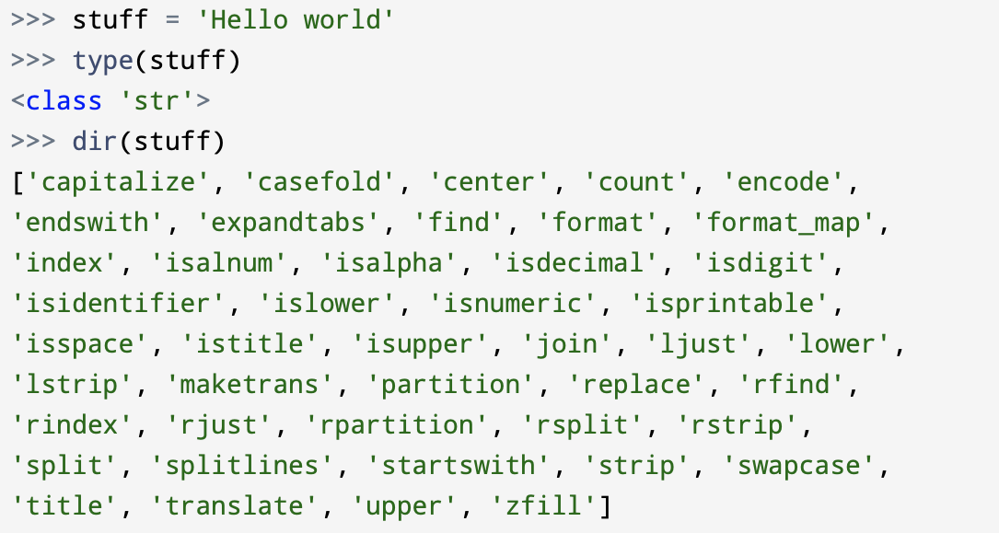
Better source of documentation for string methods is the official Python documentation:
https://docs.python.org/3/library/stdtypes.html#string-methods.

Slide 16
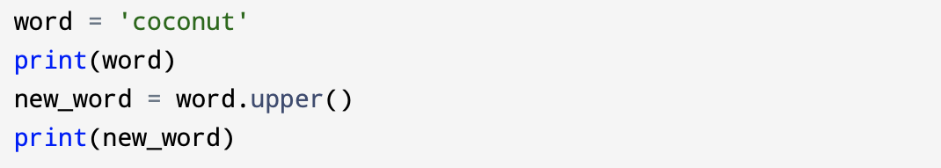
Methods, like any other function, can be called to execute them. Calling a method is similar to calling a function (it takes arguments and can return a value), but to access a method within an object is different.
We call a method by appending the method name to the variable name using the period as a delimiter.
For example, the method upper() takes a string and returns a new string with all uppercase letters:
This form of dot notation specifies the name of the method, upper(), and the name of the string to apply the method to, word. The parenthese are empty because this method takes no arguments.

Slide 17
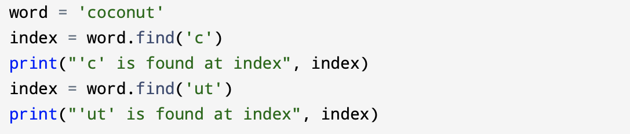
The find() string method searches for the position of one string within another:
In this example, we invoke find() on word and pass in the string we are looking for as a parameter.

Slide 18
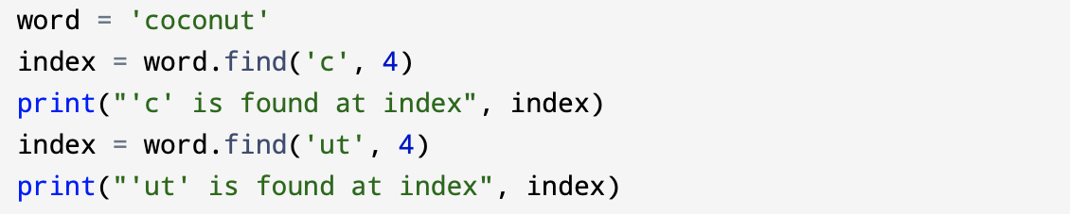
The find() method can optionally take a second argument: the index where it should start searching.
The strip() method is used to remove white space (spaces, tabs, or newlines) from the beginning and end of a string.

Slide 19
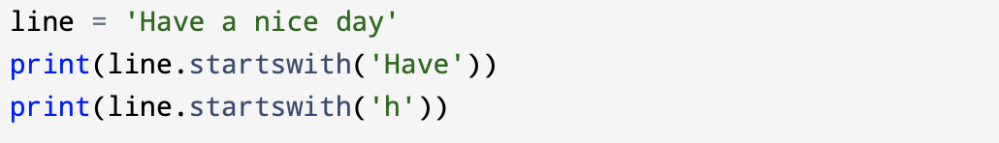
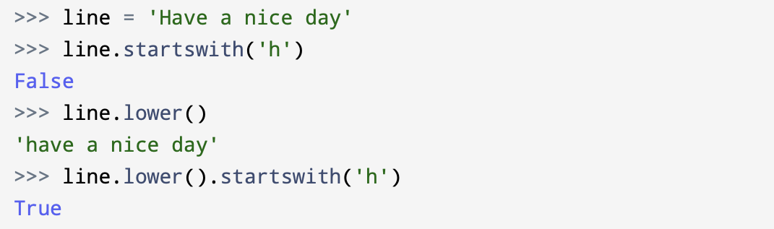
Some methods such as startswith() return Boolean values.
Note that startswith() requires case to match, so sometimes we take a line and map it all to lowercase before we do any checking using the lower() method.

Slide 20
6.10 Parsing strings
Often, we want to look into a string and find a substring. For example if we were presented a series of lines formatted as follows:
and we wanted to pull out only the second half of the address (i.e., uct.ac.za) from each line, we can do this by using the find() method and string slicing.
First, we will find the position of the at-sign in the string. Then we will find the position of the first space after the at-sign. And then we will use string slicing to extract the portion of the string which we are looking for.

Slide 21
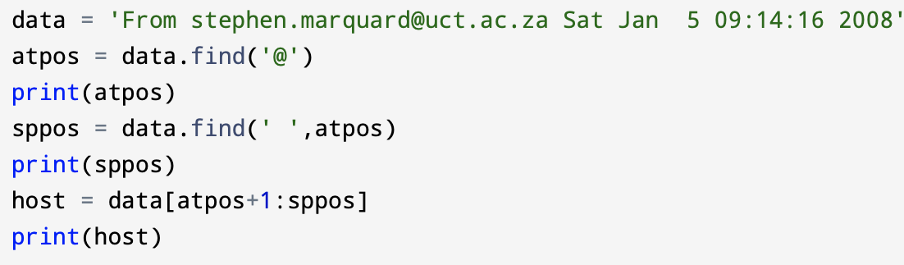
We use the optional arguments for the find() method that allow us to specify the position in the string where we want find() to start searching. When we slice, we extract the characters from “one beyond the at-sign” and up to but not including the index of the next space character.
The documentation for the find method is available at: https://docs.python.org/library/stdtypes.html#string-methods.

Slide 22
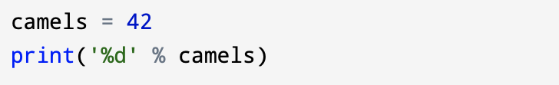
6.11 Format operator
The format operator, % allows us to construct strings, replacing parts of the strings with the data stored in variables. When applied to integers, % is the modulus operator. But when the first operand is a string, % is the format operator.
The first operand is the format string, which contains one or more format sequences that specify how the second operand is formatted. The result is a string.
For example, the format sequence %d means that the second operand should be formatted as an integer (“d” stands for “decimal”):

Slide 23
The type can be used with format codes:
‘d’ for integers
‘f’ for floating-point numbers
‘b’ for binary numbers
‘o’ for octal numbers
‘x’ for octal hexadecimal numbers
‘s’ for string
‘e’ for floating-point in an exponent format

