Slide 1

Chapter 7
FILES

Slide 2
7.1 Persistence
Secondary Memory (or files).
Secondary memory is not erased when the power is turned off.
Or in the case of a USB flash drive, the data we write from our programs can be removed from the system and transported to another system.

Slide 3
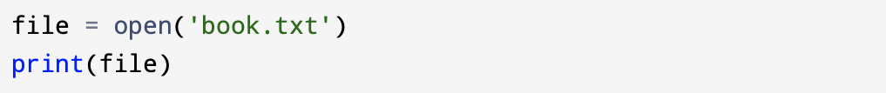
7.2 Opening files
If you want to read or write a file in a program, first you must open the file.
When you open a file, you are asking the operating system to find the file by name, make sure the file exists, and prepare it to be read from or written to.
To open a file, we can use the open() function. In its simplest form, it takes one argument: a string containing the name of the file to open.
If the call to open() is successful, it returns a file object.
If the file does not exist, open() will fail with a traceback and you will get OSError.

Slide 4
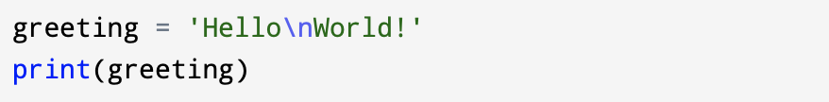
7.3 Text files and lines
A text file can be thought of as a sequence of lines, much like a Python string can be thought of as a sequence of characters.
To break the file into lines, you have to use a special character which represents the “end of the line” called the newline character.
In Python, we represent the newline character as \n in string constants. (That’s a “backslash,” because it is leaning backwards.)
This looks like two characters, but it is understood by Python as a single character.

Slide 5
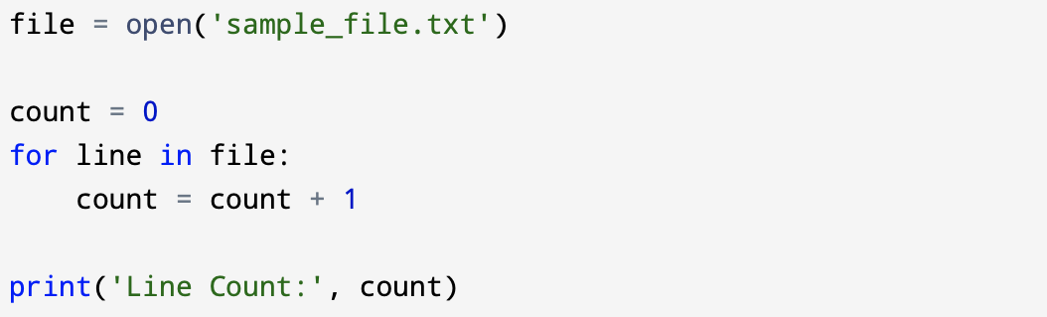
7.4 Reading files
If the file object does not contain the data for the file, it is easy to construct a for loop to read through and count each of the lines in a file:
The for loop in the example above counts the number of lines in the file and prints the count. The rough translation of the for loop into English is, “for each line in the file represented by the file object, add one to the count variable.”

Slide 6
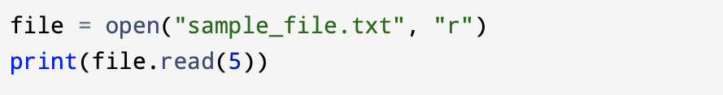
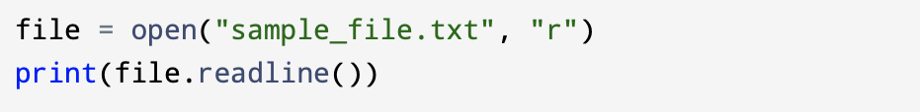
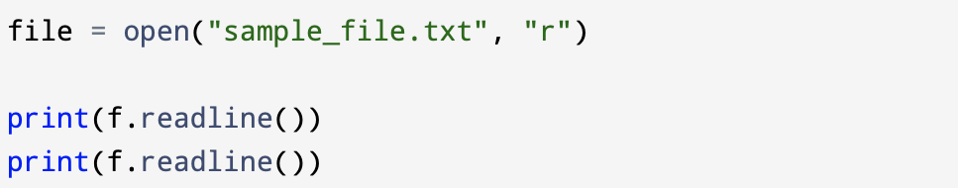
Python has built - in read() method. That method returns the whole text, but you can also specify how many characters you want to return:
You can return one line by using the readline() method:
By calling readline() method two times you can return the first two lines:

Slide 7
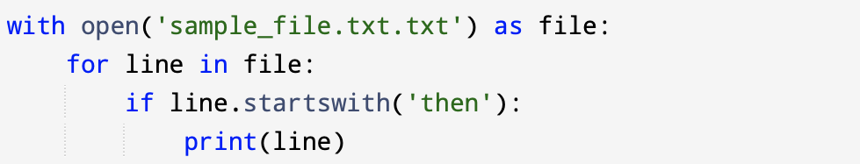
7.5 Searching through a file
If you want to read a file and only print out lines which started with the prefix ‘then’, you can use the string method startswith() to select only those lines with the desired prefix:

Slide 8
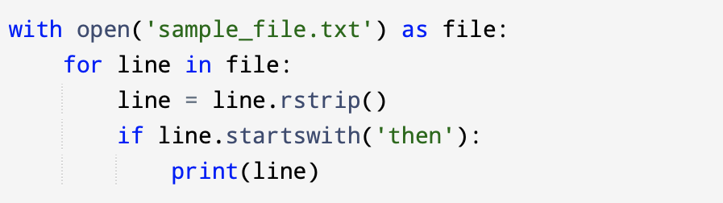
You can use string slicing to print all but the last character, but other and simpler aproach is to use the rstrip() method, which strips whitespace (including newline characters) from the right side of a string:

Slide 9
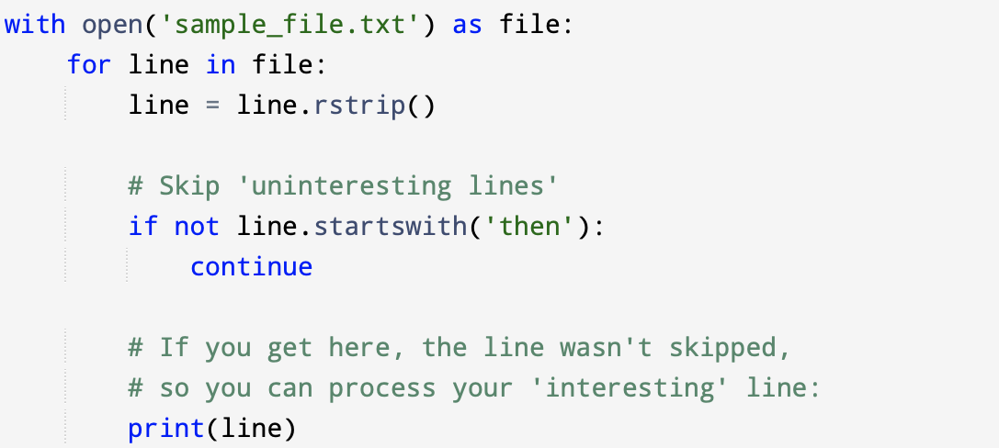
When your file processing programs get more complicated, you may want to structure your search loops using continue.
The continue keyword skips the rest of a loop body and goes to the next iteration. When processing a file in a loop, you can use continue in cases where you don’t want to process a line. The idea of the search loop is that you are looking for “interesting” lines and effectively skipping “uninteresting” lines.
You can structure the loop to follow the pattern of skipping uninteresting lines as follows:

Slide 10
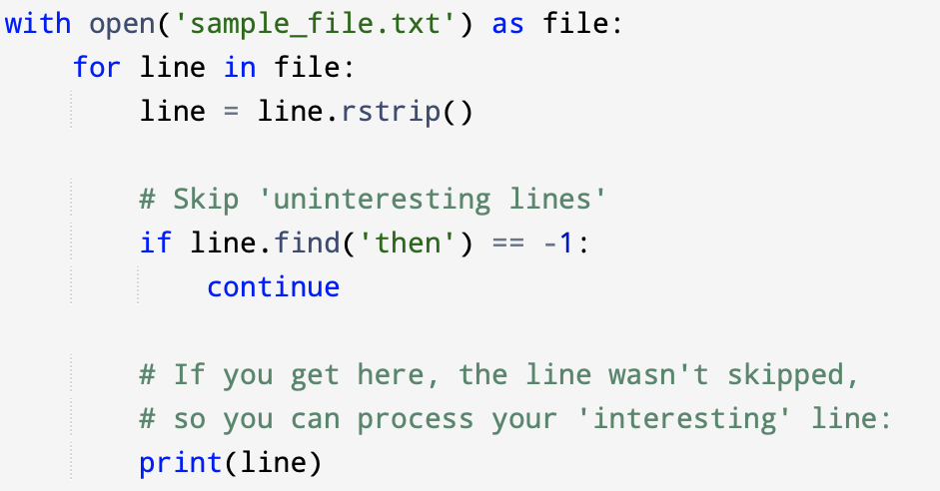
You can use the find() string method to find lines where a search string is anywhere in the line.
Since find() looks for an occurrence of a string within another string and either returns the position of the string or -1 if the string was not found, you can write the following loop to show lines which contain the string 'then':

Slide 11

7.6 Writing files
To write data into a new file or to overwrite an old file, you have to open the file with a mode value ‘w’ (for ‘w’rite mode) as the second argument to the open() function call:
If the file doesn’t exist, a new one will be created and opened. If the file already exists, opening it in write mode deletes the old data and starts fresh, remember about that!

Slide 12
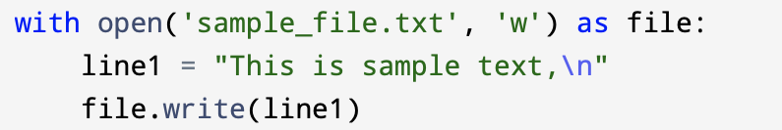
Once the file is opened you can use the write() method of the file object to put data into the file.
The write() methods writes characters into the file and then returns the number of characters written, though the return value is rarely used or important.
The new data will be added to the end of the file. The file object keeps track of where it is, so if you call write() again.

Slide 13
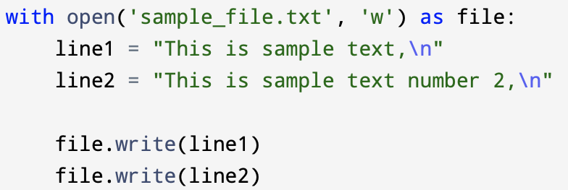
You must make sure to manage the ends of lines as you write to the file by inserting the newline character when you want to end a line.
The print() statement automatically appends a newline, but the write() method does not add the newline automatically.
If you write strings into a file without adding newline characters, they will all end up as one long line, which is hard to read.

Slide 14
It is very important to close files after writing data into them.
Data might not be physically written to the secondary memory until close() is called, and it remains in danger of being lost if the computer loses power.
Using the with syntax ensures the file is closed automatically.
Otherwise, be sure to add a call to the close() method when the program is done writing to the file.

