Slide 1

Chapter 8
LISTS

Slide 2
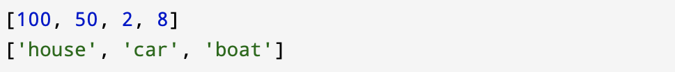
8.1 A list is a sequence
List is a sequence of values. Values In a list can be any type. The values in the list are called elements or sometimes items.
There are several ways to create a new list; the simplest is to enclose the elements in square brackets
[ and ]:
The first example is a list of four integers. The second is a list of three strings. The elements of a list don’t have to be the same type.

Slide 3
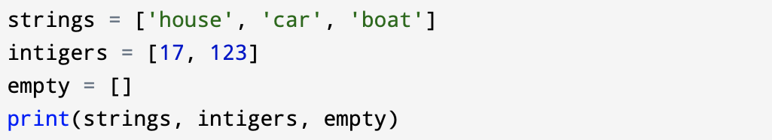
The example below shows list contains a string, a float, an integer, and another list:
A list within another list is nested.
Empty list - a list that contains no elements and you can create one with empty brackets, [ ].
Also, you can assign list values to variables:

Slide 4
The in operator also works on lists in a similar way to how it works with strings.

Slide 5
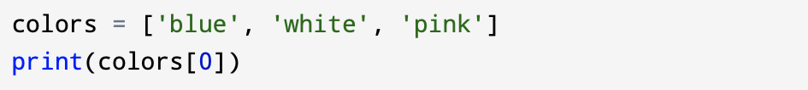
8.2 Lists are mutable
The syntax for accessing the elements of a list is the same as for accessing the characters of a string: the bracket operator. The expression inside the brackets specifies the index. It is important to remember that the indices start at 0:

Slide 6
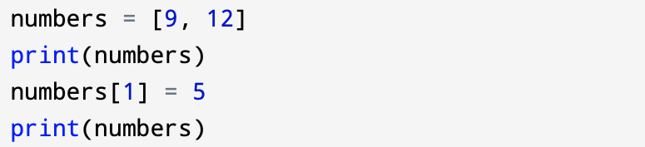
Lists are mutable: it means that you can change the order of items in a list or reassign an item in a list. When the bracket operator appears on the left side of an assignment, it identifies the element of the list that will be assigned.
In the example above the second element numbers (at index 1), which used to be 9, is changed to 5.

Slide 7
Mapping - is a relationship between indices and elements; each index “maps to” one of the elements.
Indexing in a list works the same way as indexing in a string:
Indexes start from 0.
Any integer expression can be used as an index.
If you try to read or write an element that does not exist, you get an IndexError.
If an index has a negative value, it counts backward from the end of the list.

Slide 8
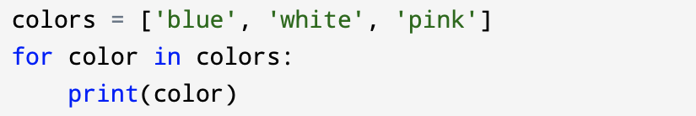
8.3 Traversing a list
The most common way to traverse the elements of a list is with a for loop:
This works great if you only need to read the elements of the list. But if you want to write or update the elements, you have to use indexing.

Slide 9
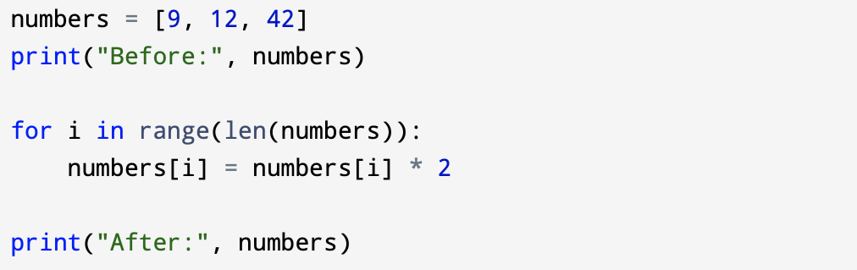
The for loop gives you a copy of each value in the list, but it provides no way to alter them. A common way to do that is to combine the functions range and len:
The sequence in this loop is the sequence of all valid indexes into the list. The expression range(len(numbers)) gives the length of the list to range(), which produces a sequence of values starting at 0 and going up to, but not including, the length of the list itself. This is always going to be the valid indexes into the list!

Slide 10
The loop traverses the list and updates each element. Each time through the loop, i gets the index of the next element. The assignment statement in the body uses i to read the old value of the element and to assign the new value.
Although a list can contain another list, the nested list still counts as a single element. The length of this list is four:

Slide 11
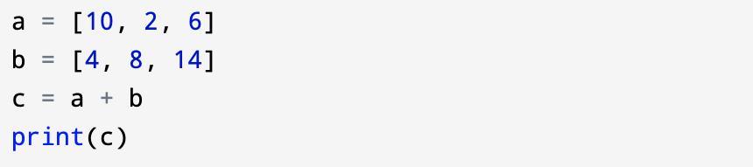
8.4 List operations
Most of the operators will work with lists just the same as with strings.
You can expand your understanding of them as “list operators” to be “sequence operators,” working on sequences of values whether they be strings or lists.
The + operator concatenates lists:

Slide 12

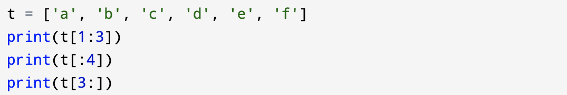
And the * operator repeats a list a given number of times:
The slice operator also works on lists:

Slide 13
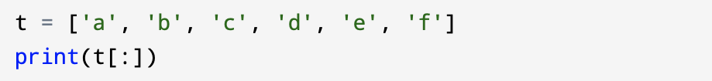
As with strings, if you omit the first index, the slice starts at the beginning.
If you omit the second, the slice goes to the end. So if you omit both, the slice is a copy of the whole list. This seems pointless, but it is often useful when applied to lists.
You have to remember that lists are mutable. It is often useful to make a copy before performing operations that modify lists.

Slide 14
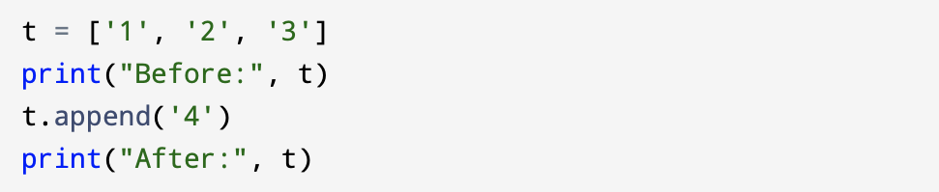
8.5 List methods
Lists are objects and this means that lists contain useful built-in methods that we can call using dot notation.
List method append() adds a new element to the end of a list:

Slide 15
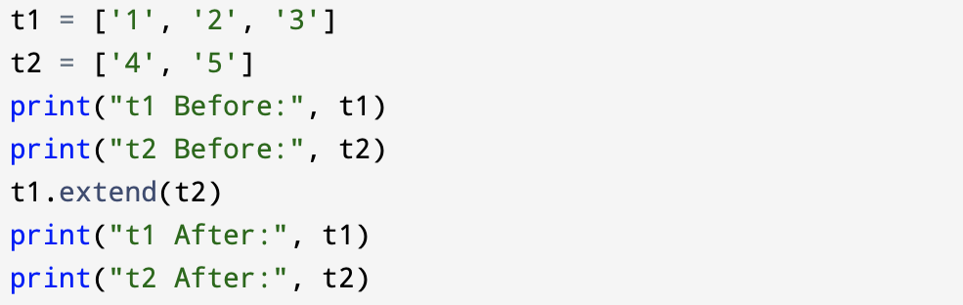
The extend() list method takes a list as an argument and appends all of the elements:
This example leaves t2 unmodified.

Slide 16
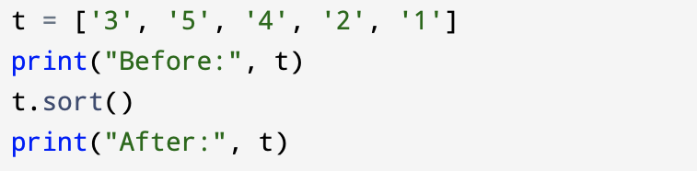
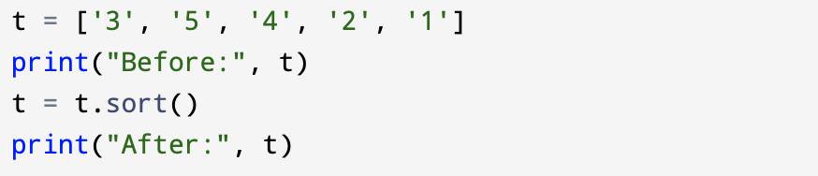
The sort() method rearranges the elements of the list from low to high:
Most list methods are void methods; they modify the list and return None. If you accidentally write t = t.sort(), you will be disappointed with the result:

Slide 17
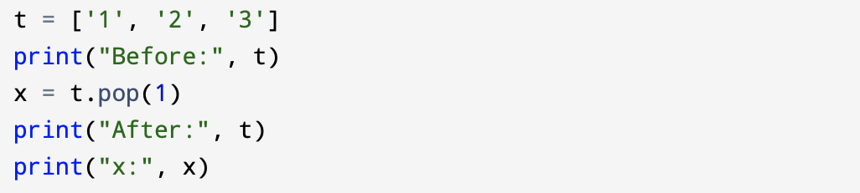
8.6 Deleting elements
If you know the index of the element you want, you can use the list method pop() but also there are other ways to delete elements from a list.
The pop() method modifies the list and returns the element that was removed. If you don’t provide an index, it deletes and returns the last element.

Slide 18
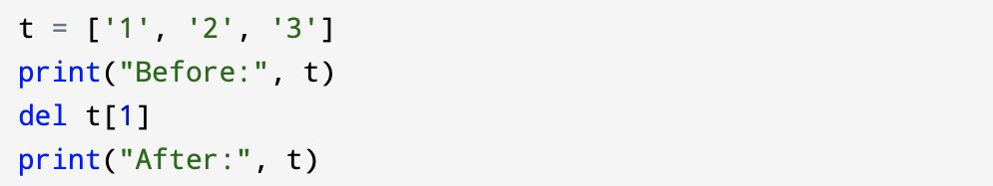
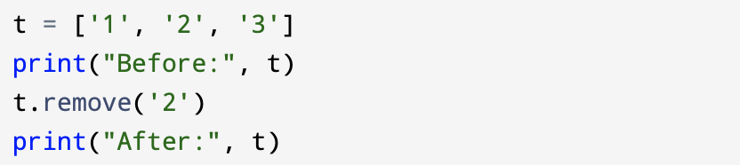
If you don’t need the removed value, you can use the del operator:
If you know the value of the element you want to remove (but not its index), you can use remove():

Slide 19
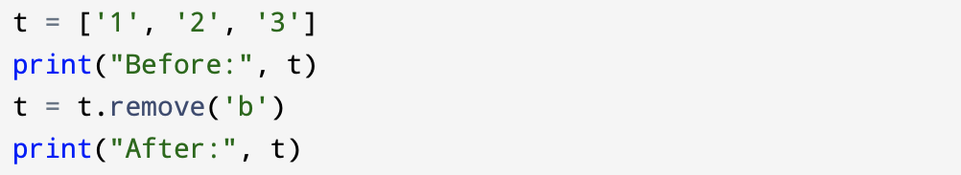
The return value of remove() is None; it is a void function.
It is important to remember to don’t write something like t = t.remove('b'):

Slide 20
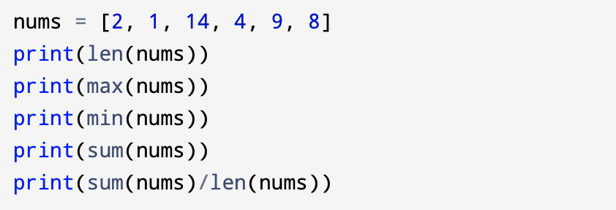
8.7 Lists and functions
Before we saw built-in functions that can be applied to lists that allow you to quickly compute something from a list without writing your own loops:
These functions accept a list as an argument. None of these functions are methods; we do not call them with dot notation.

Slide 21
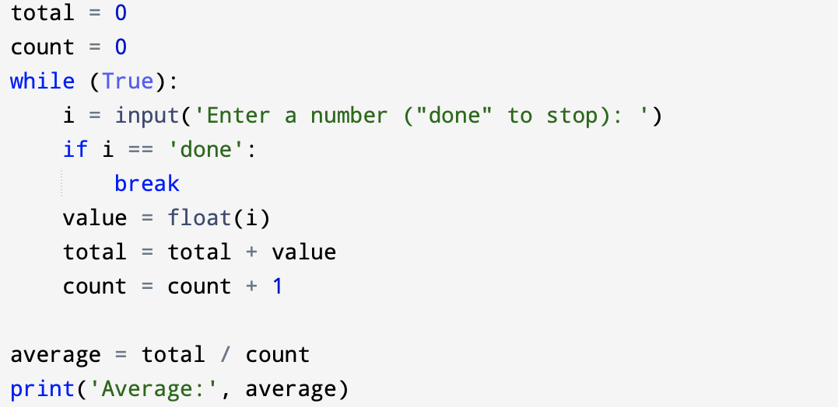
The functions (max(), len(), etc.) work with lists of strings and other types as well. The sum() function only works when the list elements are numbers.
We can rewrite an earlier program that computed the average of a list of numbers entered by the user using a list.
First, the program to compute an average without a list:

Slide 22
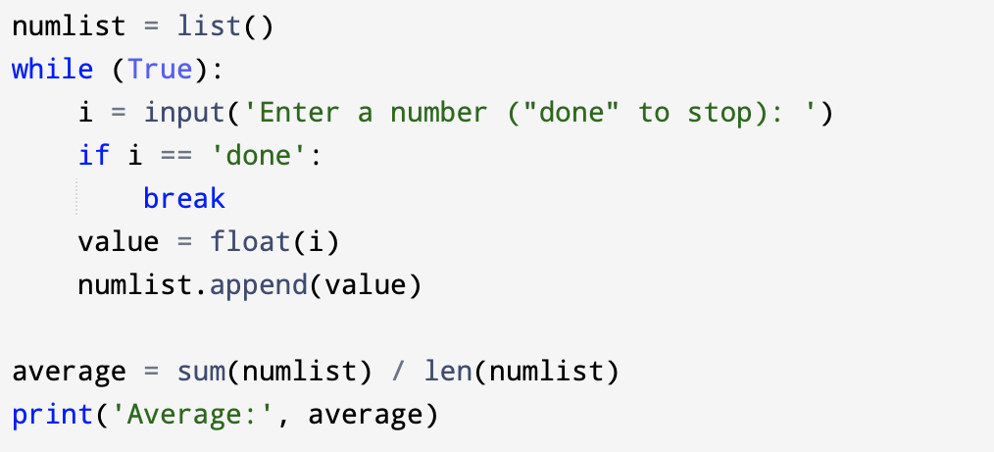
In this program above, we have count and total variables to keep the number and running total of the user’s numbers as we repeatedly prompt the user for a number.
We could simply remember each number as the user entered it and use built-in functions to compute the sum and count at the end.
We make an empty list before the loop starts, and then each time we have a number, we append it to the list. At the end of the program, we simply compute the sum of the numbers in the list and divide it by the count of the numbers in the list to come up with the average.

Slide 23
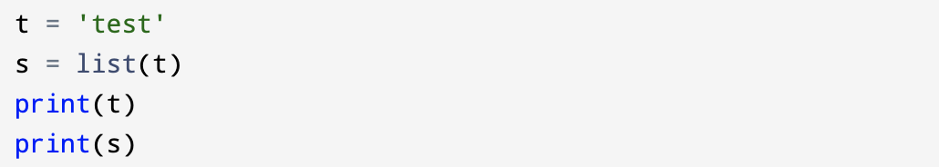
8.8 Lists and strings
A list is a sequence of values and a string is a sequence of characters but a list of characters is not the same as a string. To convert from a string to a list of characters, you can use list( ):
The list function breaks a string into individual letters.

Slide 24
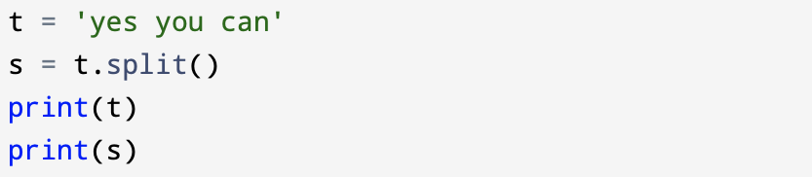
If you want to break a string into words, you can use the split() string method:
When you used split() to break the string into a list of words, you can use the index operator [ ] to get a particular word in the list.

Slide 25
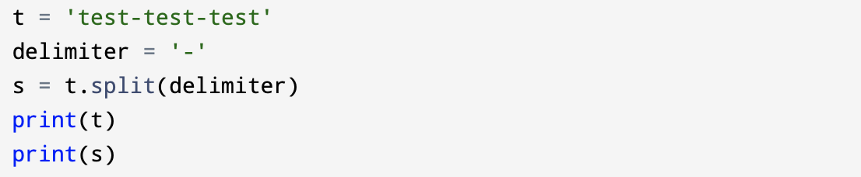
You can call split() with an optional argument called a delimiter that specifies which characters to use as word boundaries. The following example uses a hyphen as a delimiter:

Slide 26
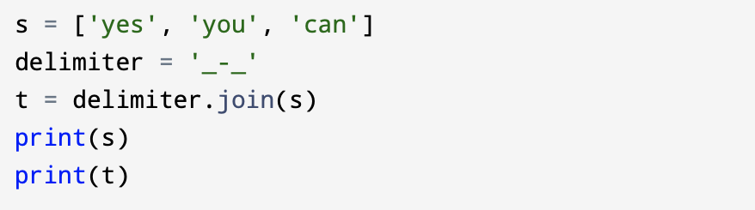
join() is the inverse of split(). It takes a list of strings and concatenates the elements. join() is a string method, so you have to invoke it on the delimiter and pass the list as a parameter:
In this case the delimiter is the string '_-_', so join() puts a copy of that between each word.

Slide 27
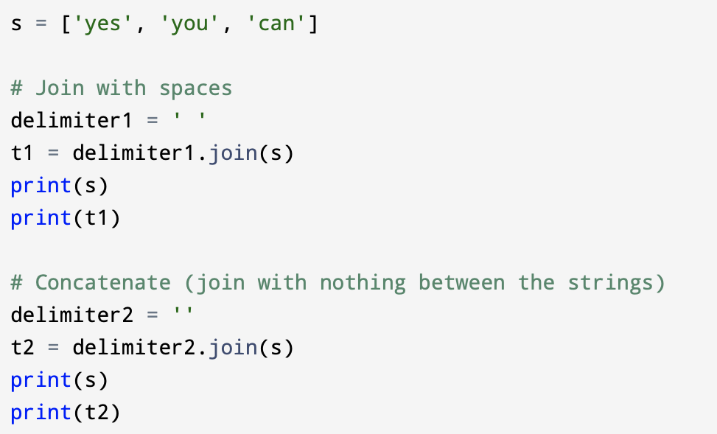
To join strings with spaces, you can use ' ' as the delimiter. To concatenate strings (join them with nothing in between), you can use the empty string, '', as a delimiter.

Slide 28

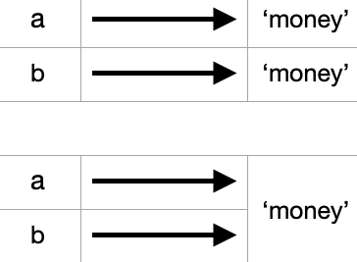
8.9 Objects and values
If we execute these assignment statements:
We know that a and b both refer to a string, but it might not be clear whether they refer to the same string. There are two possible states:

Slide 29
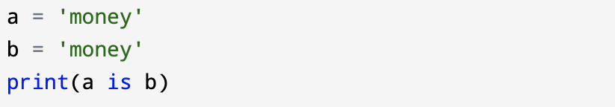
In one case, a and b refer to two different objects that have the same value. In the second case, they refer to the same object.
To check whether two variables refer to the same object, you can use the is operator.
In example above, Python only created one string object, and both a and b refer to it.

Slide 30
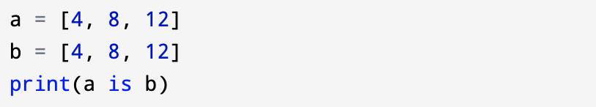
When you create two lists, even with the same elements in each, you get two objects:
That two lists are equivalent, because they have the same elements, but not identical, because they are not the same object.
If two objects are identical, they are also equivalent, but if they are equivalent, they are not necessarily identical.
Until now, we have been using “object” and “value” interchangeably, but it is more precise to say that an object has a value. If you execute a = [4,8,12], a refers to a list object whose value is a particular sequence of elements. If another list has the same elements, we would say it has the same value.

Slide 31
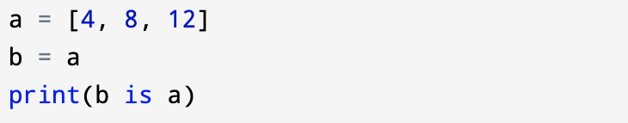
8.10 Aliasing
If a refers to an object and you assign b = a, then both variables refer to the same object:
The association of a variable with an object is called a reference. In the example above, there are two references to the same object.
An object with more than one reference has more than one name, so we say that the object is aliased.

Slide 32
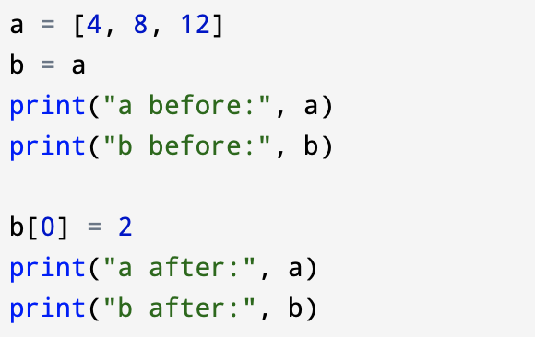
If the aliased object is mutable, changes made with one alias affect the other:
Although this behavior can be useful, it is error-prone. In general, it is safer to avoid aliasing when you are working with mutable objects.

Slide 33

For immutable objects like strings, aliasing is not as much of a problem. In example below:
It almost never makes a difference whether a and b refer to the same string or not.

Slide 34
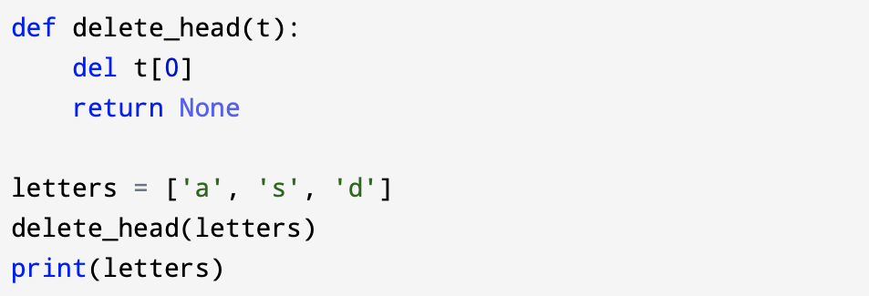
8.11 List arguments
When you pass a list to a function, the function gets a reference to the list. If the function modifies a list parameter, and the caller sees the change.
For example, delete_head removes the first element from a list:

Slide 35
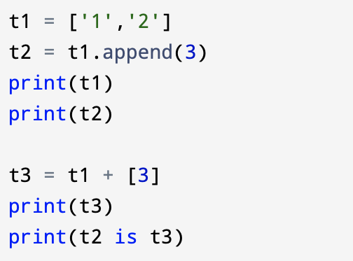
The parameter t and the variable letters are aliases for the same object.
It is important to distinguish between operations that modify lists and operations that create new lists. For example, the append method modifies a list, but the + operator creates a new list:
This difference is important when you write functions that are supposed to modify lists.

Slide 36
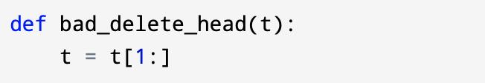
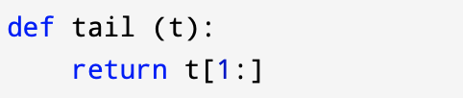
For example, this function below does not delete the head of a list:
The slice operator creates a new list and the assignment makes t refer to it, but none of that has any effect on the list that was passed as an argument.
An alternative is to write a function that creates and returns a new list. For example, tail returns all but the first element of a list:

Slide 37
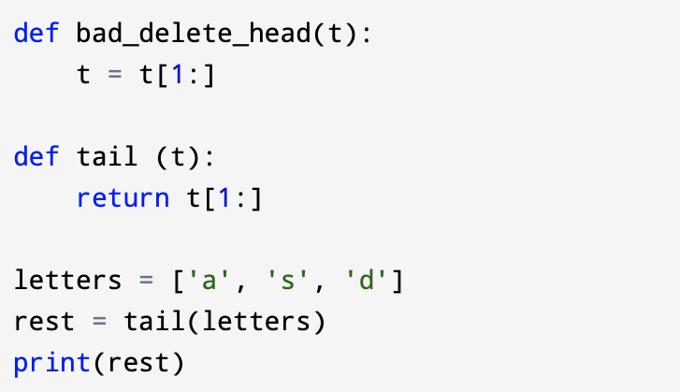
This function leaves the original list unmodified. Here’s how it is used:

