Slide 1

Chapter 9
DICTIONARIES

Slide 2
9.1 Dictionaries
Dictionaries are used to store data values in key : value pairs.
A dictionary is a collection which is:
ordered*,
changeable,
does not allow duplicates.
*As of Python version 3.7, dictionaries are ordered. In Python 3.6 and earlier, dictionaries are unordered.

Slide 3

The function dict creates a new dictionary with no items.
The curly brackets, { }, represent an empty dictionary:

Slide 4
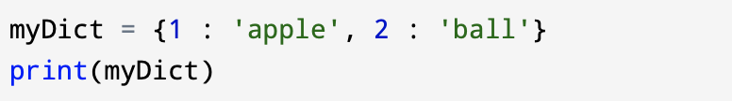
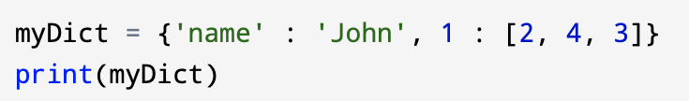
Dictionary with integer keys:
Dictionary with mixed keys:

Slide 5
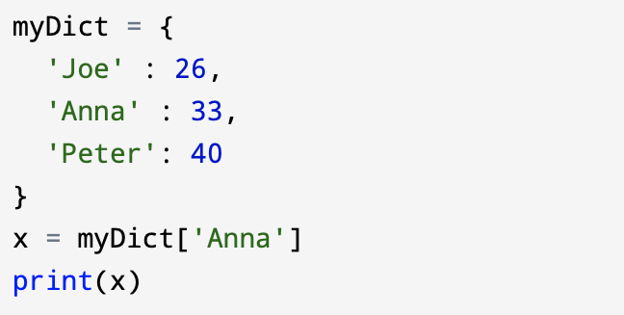
Accessing Elements from Dictionary
A dictionary uses keys to access values. Keys can be used either inside square brackets [ ] or with the get( ) method. If you use the square brackets [ ], KeyError is raised when a key is not found in the dictionary. On the other hand, the get( ) method returns None if the key is not found.
Example to get the value of the ‘Anna’ key:

Slide 6
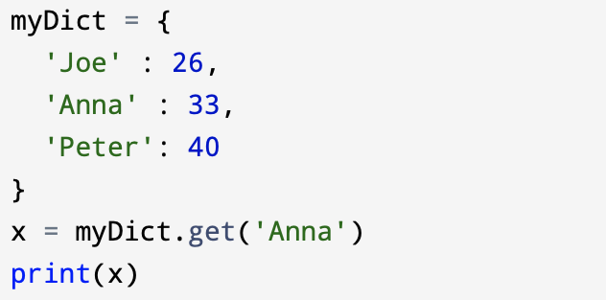
There is also a method called get( ) that will give you the same result:

Slide 7
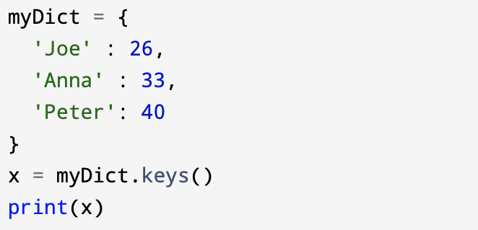
If you use keys( ) method will return a list of all the keys in the dictionary.

Slide 8
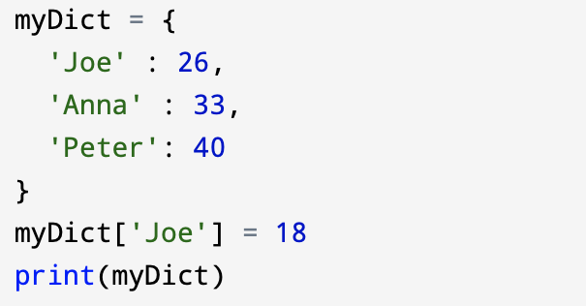
Changing and Adding Dictionary elements
Dictionaries are mutable. You can change the value of existing items or add new items by using an assignment operator. If the key is already present, then the existing value gets updated. In case the key is not present, a new (key : value) pair is added to the dictionary.
Update value in dictionary:

Slide 9
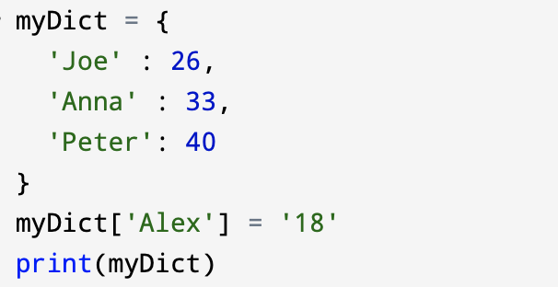
Adding new item to the dictionary:

Slide 10
Removing elements from Dictionary
You can remove item in a dictionary by using the pop() method. This method removes an item with the provided key and returns the value.
The popitem( ) method can be used to remove and return an arbitrary (key, value) item pair from the dictionary.
By using the clear( ) method you can remove all items at once.
You can also use the del keyword to remove individual items or the entire dictionary itself.

Slide 11
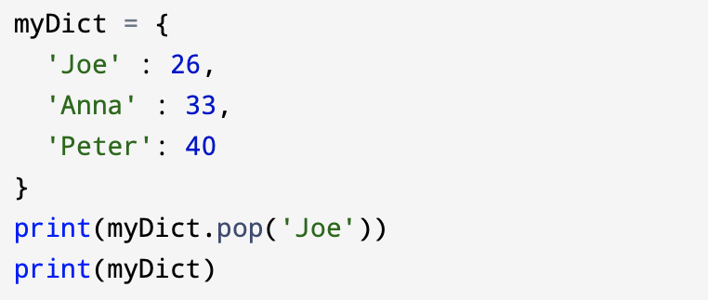
Example of pop( ) method remove a particular item, returns its value:

Slide 12
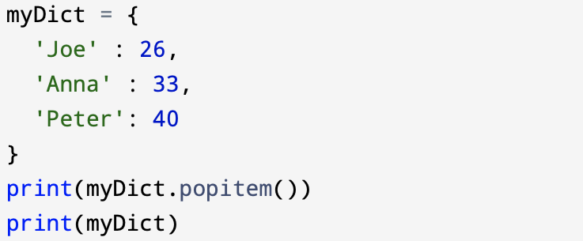
Example of popitem( ) method to remove an arbitrary item, return (key,value):

Slide 13
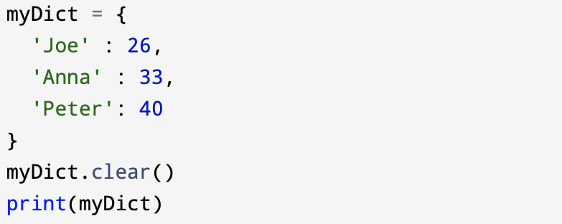
Example of clear( ) method to remove all items:

Slide 14
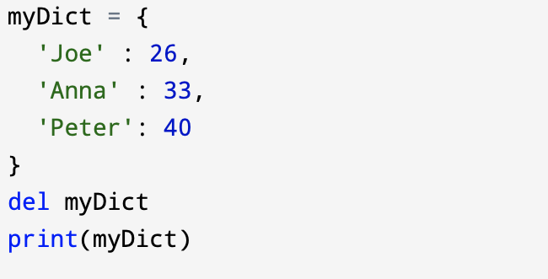
Example of del keyword to delete the dictionary itself:

Slide 15
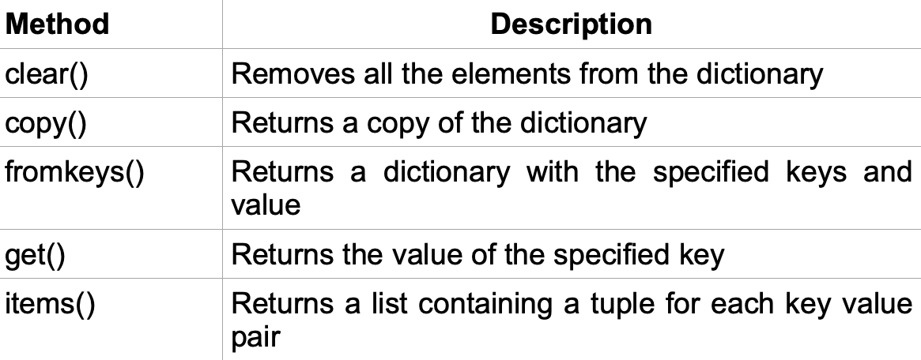
9.2 Dictionary Methods
Python has a set of built-in methods that you can use on dictionaries.

Slide 16
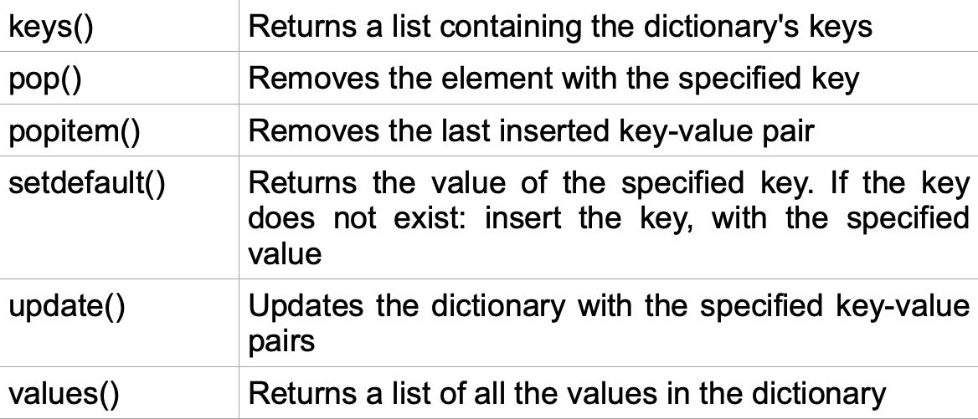

Slide 17
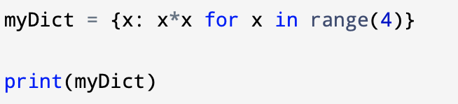
Dictionary Comprehension
Dictionary comprehension consists of an expression pair (key : value) followed by a for statement inside curly braces { }. Dictionary comprehension is an elegant way to create a new dictionary from an iterable in Python.
Below is an example to make a dictionary with each item being a pair of a number and its square.

Slide 18
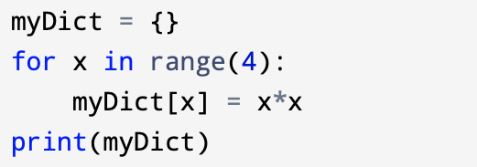
The code above is equivalent to:

Slide 19
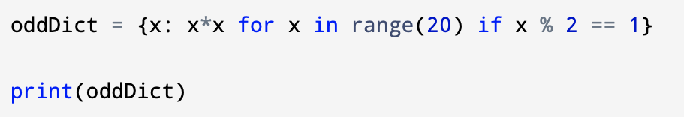
A dictionary comprehension can optionally contain more for or if statements. An optional if statement can filter out items to form the new dictionary.
Below is an example to make a dictionary with only odd items.

Slide 20
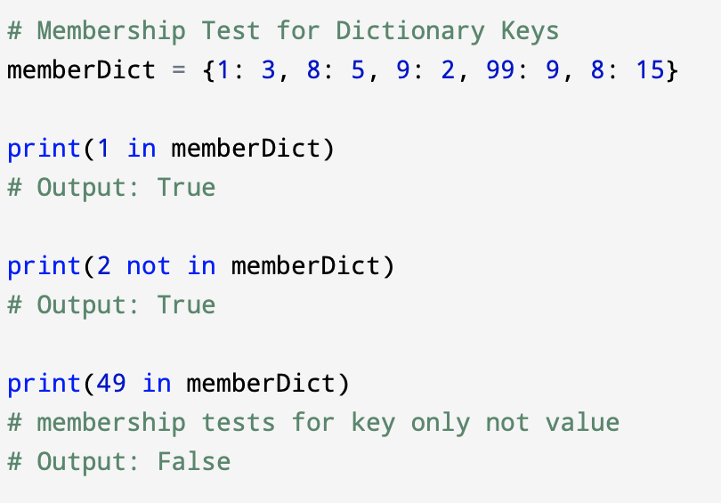
Dictionary Membership Test
We can test if a key is in a dictionary or not using the keyword in. Notice that the membership test is only for the keys and not for the values.

Slide 21
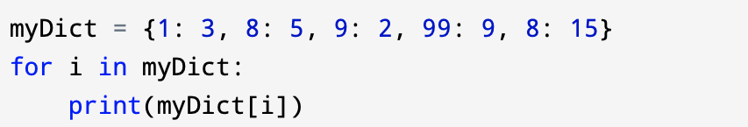
Iterating Through a Dictionary
Using a for loop you can iterate through each key in a dictionary.

Slide 22
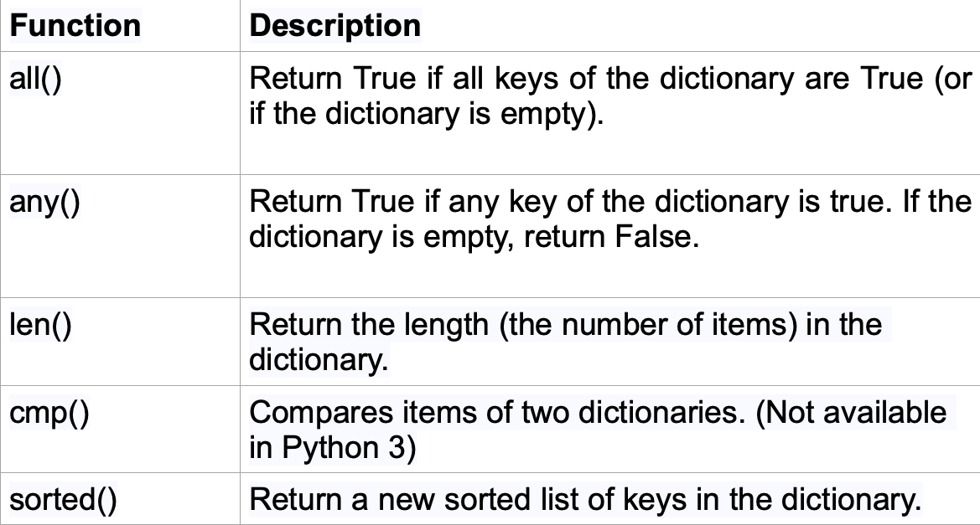
9.3 Dictionary Built-in Functions
To perform different tasks in python we are using built-in functions like all(), any(), len(), cmp(), sorted(), etc.

