Slide 1
Making The HVN easy to trust and easy to buy
Evidence-backed strategy review for management
15 October 2026 · Version 2.0
Built on a live audit of the-hvn.com, a competitor review and six MiroFish simulations. Simulated agents are fictional and are used only to generate hypotheses, not as customer evidence.
Notes:
Purpose: agree a 90-day plan. The headline: the offer is distinctive but the website undersells and in places contradicts it. Most first actions are cheap, verified fixes; bigger bets follow a small real-world validation.

Slide 2
Executive summary
A distinctive offer, undersold by the website. Fix first, then validate, then position.
Strongest findings (verified)
Still unverified
Do first (30 days)
• Menopause, PCOS and PMDD pages list acne treatments
• 2 menu links return 404 on every page; 19 broken links
• Plan step unpriced; old programme pages 404
• CQC badge links nowhere; same 4 names on every page
• Price conflicts; credit rule only on £350 consultation
• IV claim wording; tap-to-call on 1 of 212 pages
• The HVN's CQC inspection status and scope
• Every competitor price, membership and rating
• All customer reactions (simulated, partly primed)
• Booking flow, response times, consultation output
• Conversion, retention and reviews (no data access)
• Approve the fix list (R01, R02, R06, R10)
• Verify CQC status; link the badge (R05)
• Decide the programme tier (R03)
• Commission the claims review (R04)
• Start measurement + low-cost validation (R07; ≈£1.0–1.8k)
Source: strategic-intelligence-report.md §1 | The HVN strategy review · 15 Oct 2026 · 2
Notes:
Three columns: what we know for certain (verified on the live site), what we do not know yet, and what to do first. Stress that competitor facts and CQC status are Unknown.

Slide 3
How to read the evidence
Every statement carries a source label and a confidence level
Label | Meaning | Decision use
[V] Verified | Loaded from the-hvn.com (crawl + re-check 15 Oct) | Yes
[Reg] Regulator | ASA/CQC material found via search | Context; confirm
[R] Reported | Press, PR, directories (all competitor facts) | No: treated as Unknown
[S] Simulated | Fictional LLM agents (MiroFish) | No: hypothesis
[?] Unknown | No data available | Must be checked
What we could and could not see
• Could: all 216 website URLs; prices; links; claims
• Could not: competitor sites, CQC/ASA registers, Pabau booking
• Had no: analytics, bookings, CRM, reviews, staff input
• Simulations: 6 runs, 57 interviews, $0.713 total
• No new simulations or paid API calls for this review
Source: strategic-intelligence-report.md §0; evidence/sources.md | The HVN strategy review · 15 Oct 2026 · 3
Notes:
Explain why competitor data is Unknown: their sites and the CQC/ASA registers were blocked from the research environment, so only press and directories were available. Simulations cost $0.71 in total.

Slide 4
The offer is genuinely distinctive
Verified differentiators that rivals are not reported to combine
One doctor-led team
Published prices
No membership
Doctor check before IV
Women's-health capability
GP-trained Medical Director; women's-health doctor; acupuncture; osteopathy; nursing
Prices on ~98% of service pages; 342 price points
Pay per visit; no joining fee (rivals reportedly sell memberships)
'a brief 10 minute consultation with one of our doctors'
Doctor + extensive TCM women's-health content
Positioning candidate [H, to test]: "Doctor-led care for skin, energy and long-term health: one Knightsbridge team, clear prices, no membership."
Source: the-hvn.com crawl 15 Oct 2026; competitor-benchmark.md | The HVN strategy review · 15 Oct 2026 · 4
Notes:
All five points are verified on the live site. Whether buyers value them, especially 'no membership', is a hypothesis to test (H06, H13).

Slide 5
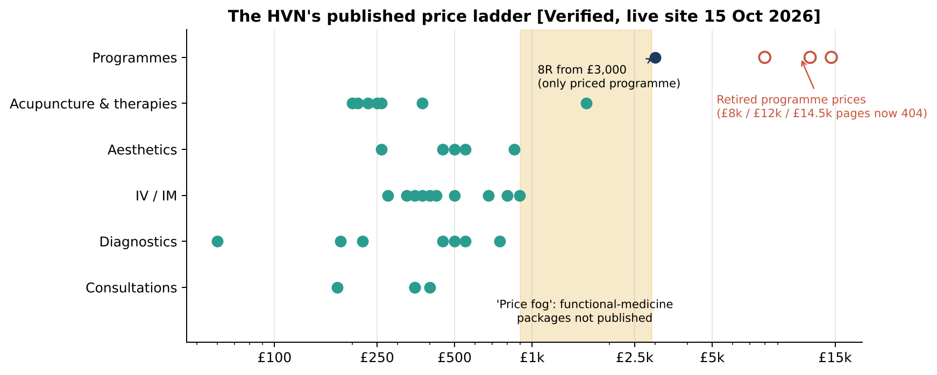
The biggest commercial gap: 'price fog' after the first step
Transparent up to ~£750, then nothing priced except 8R 'from £3,000'
What to do
• Decide which programmes exist (R03)
• One fees-and-credits table (R08)
• Fix NAD and fertility price conflicts (R10)
• Publish typical ranges from real Pabau data, after testing the wording (R11)
• Simulated buyers asked for a written range, but the question was primed
Source: evidence/hvn-price-register-2026-10-15.csv; live re-check | The HVN strategy review · 15 Oct 2026 · 5
Notes:
The £350 Discovery Consultation offers £100 credit against 'Functional Medicine Packages' that are not published. The £8k/£12k/£14.5k programmes have been retired or unpublished; their URLs return 404. Market anchor: Pillar's 12-week programme from £15,500 (reported, official PR Jan 2026).

Slide 6
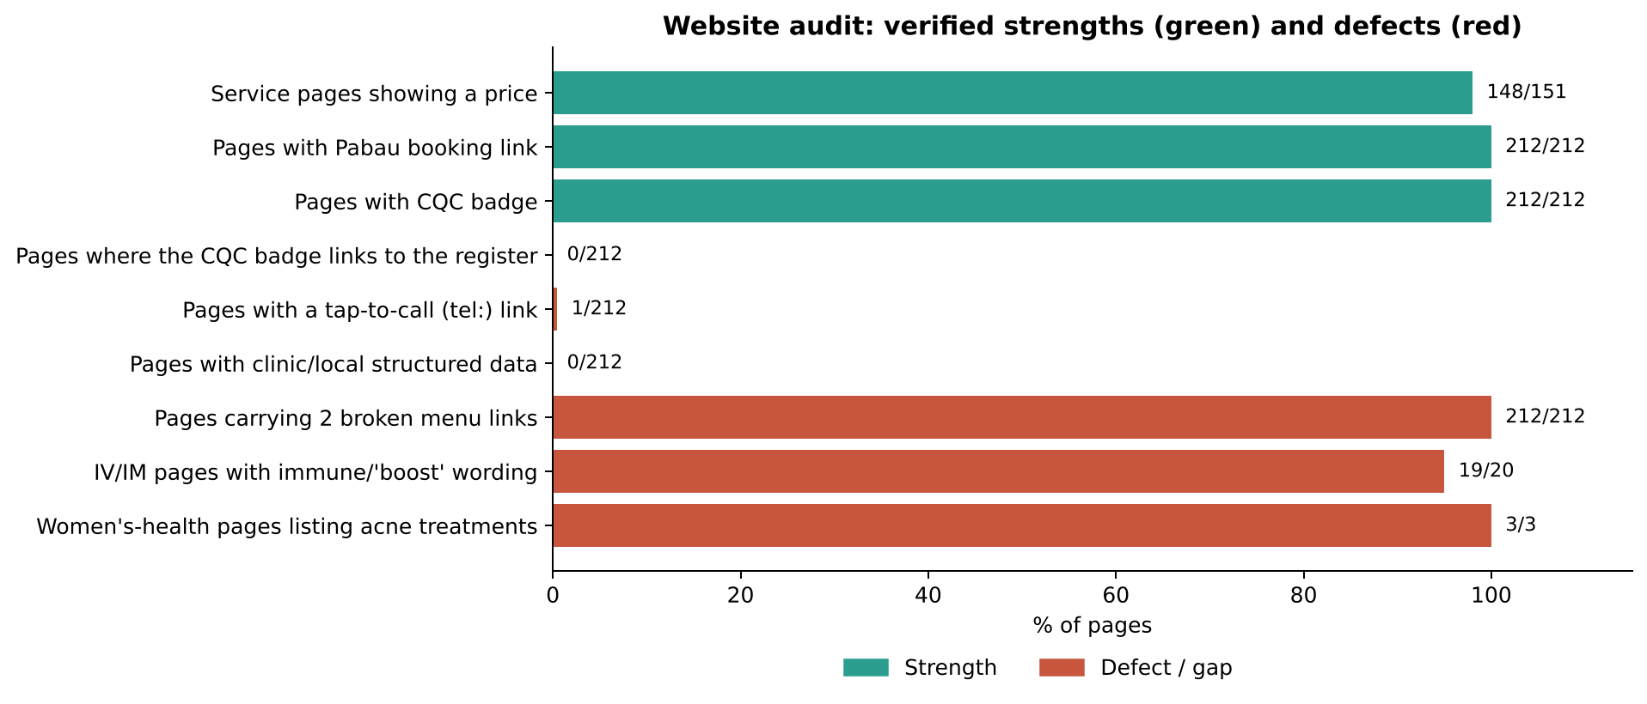
Website: strong foundations, avoidable defects
Also verified
• H1 'HOW THE HVN CAN HELP'; Contact/Booking titles say 'Skin & Hair'
• Two phone numbers
• No clinic/local structured data
• Median page: 713 KB HTML, 55 images
• Mobile and booking flow untested (blocked)
Source: website-audit.md; evidence/*.csv; re-check 15 Oct 2026 | The HVN strategy review · 15 Oct 2026 · 6
Notes:
Green bars are strengths (booking link everywhere, prices nearly everywhere). Red bars are defects verified on the live site. The 'London's leading' superlative is visible on the home page and present in the site-wide search description.

Slide 7
Three things to fix this month
All verified live on 15 October 2026; all low effort
1 · Women's-health pages
2 · Broken navigation
3 · Dead-end plan step
• /menopause/, /pcos/, /premenstrual-dysphoric-disorder/
• Block reads: 'Explore our specialised solutions for rosacea, acne, and acne scarring'
• Replace with the doctor + acupuncture + tests pathway (R01)
• 'Clinical Treatments' and 'Holistic Rituals' menu links return 404 on all 212 pages
• 19 broken internal links; a sitemap URL redirects into a 404
• Fix and add 301s (R02)
• Programme pages return 404
• 'Functional medicine' lands on an unfinished 'Updated' page
• Decide, publish or redirect (R03)
Source: Live re-check; website-audit.md W1–W3 | The HVN strategy review · 15 Oct 2026 · 7
Notes:
These need no customer research. They need your approval to change the website (gate G4) and a clinical sign-off for the women's-health content.

Slide 8
Trust: proof exists but cannot be verified from the page
Buyers can't see who treats them, what the CQC covers, or the review rating
Signal | Today [V] | Fix
Who will treat me | Same 4 names on every page | Clinician per treatment (R13)
CQC | Badge on 212/212, linked on 0 | Verify; link; accurate line (R05)
CQC status | UNKNOWN (not re-verifiable) | Registered manager checks at source
Reviews | Widget on 157 pages; rating not in HTML | Check rating; show it (R21)
IV safeguard | 10-minute doctor check, unexplained | 'Before your IV' explainer (R14)
Claims | Immune/boost on 19/20 IV/IM pages | CAP-code review (R04)
Simulated signal [S]
• 'Who will treat me?' raised in all five full runs
• 'Registered is not inspected': primed by the seed
• Treat as hypotheses H04 and H05
• A nearby aesthetics rival shows a CQC 'Good' rating (2023, via search)
Source: Crawl; competitor-benchmark.md B5; report-audit.md U1 | The HVN strategy review · 15 Oct 2026 · 8
Notes:
CQC status: v1 said 'registered, not yet inspected' from a search result. It could not be re-verified and is now Unknown. CQC does not regulate some non-surgical cosmetic work, so a badge alone can imply more than it covers. Check at source before publishing any status line.

Slide 9
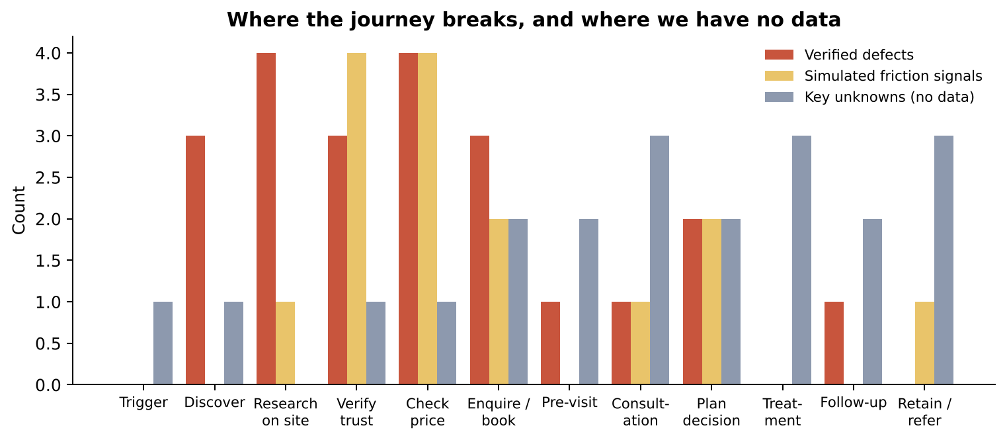
Customer journey: where it breaks, and where we are blind
17 verified defects before booking; almost no data after it
Moments that matter
• Women's-health visitor lands on the wrong page
• 'What will it cost overall?'
• 'Who treats me; is it regulated?'
• Broken menu links
• Calling from a phone
• What a client leaves the consultation with
Source: customer-journey-map.md | The HVN strategy review · 15 Oct 2026 · 9
Notes:
Red = verified defects, sand = simulated friction, grey = unknowns. Consultation, treatment and retention are unknown because we had no Pabau/CRM access. The validation plan fills that gap.

Slide 10
Segments: each has a verified blocker
Segment existence is evidenced by The HVN's own pages; behaviour is hypothesis
Segment | Entry point (verified) | Biggest verified blocker | Validate
Burnt-out executive | Fatigue page; NAD; Discovery £350 | Plan unpriced; NAD price conflict; no tap-to-call | H01, H10
Longevity optimiser | 8R; blood profiles £450/£550; HRU £750 | Only 8R priced; test list/lab not stated | H02
Aesthetics regular | £175 consultation; injectables from £260 | Generic practitioner block; no credit rule | H04
Women's health | Menopause, PCOS, PMDD; acupuncture from £200 | Acne treatments shown | H08
Fertility / IVF | Fertility acupuncture; panel £500 | Conflicting start prices; sessions unstated | H01
International visitor | Jet Lag IV £375; Hydrobed | No tap-to-call; no visitor package | H10
Gatekeeper (PA) | Contact; terms; CQC badge | Unlinked badge; two numbers | H12
Source: customer-journey-map.md §4; personas.md | The HVN strategy review · 15 Oct 2026 · 10
Notes:
Use this to brief the content owners. Each blocker is verified; what each segment values is to be validated.

Slide 11
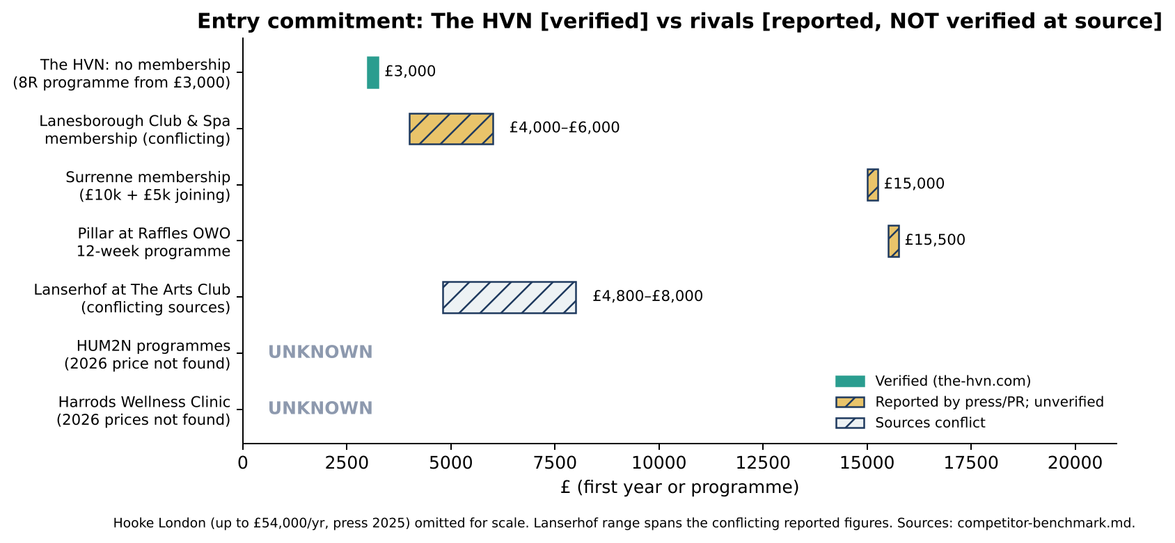
Competitors: reported landscape, nothing verified at source
All rival prices, memberships and ratings are UNKNOWN until checked on their own sites
Reading [H]
• Rivals reportedly sell membership and belonging
• The HVN's verifiable edges: price transparency + one team
• Its gaps: plan pricing, visible quality proof, single-need depth
• New 2026 supply: HUM2N at Six Senses; Four Seasons memberships
Source: competitor-benchmark.md; evidence/competitor-benchmark-2026-10-15.csv | The HVN strategy review · 15 Oct 2026 · 11
Notes:
Hatched bars are reported figures (press, PR) shown only for context. Pillar's £15,500 12-week programme is the most recent (official PR, Jan 2026). HUM2N and Harrods 2026 prices could not be found.

Slide 12
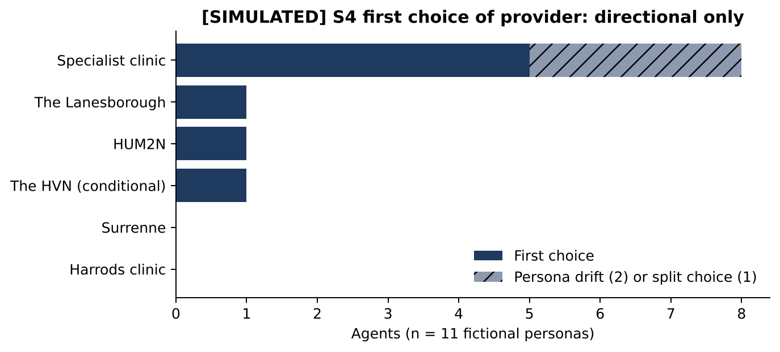
Where The HVN can win, and where it probably loses
Hypotheses to test, not conclusions
Dimension | The HVN (verified) | Rivals (reported)
Access model | Pay per visit | Membership clubs
Price transparency | High (single services) | Fees / on request
Clinical breadth, one team | Yes | Operators or partners
Visible quality signal | Badge unlinked; status ? | Some rated (e.g. CQC Good)
Setting and belonging | Clinic + rituals | Heritage hotels, clubs
Single-need depth | Doctor + TCM; page defect | Specialists
[SIMULATED] fictional personas; seed primed 'no membership' and 'not inspected'. Use only to choose what to test.
Source: competitor-benchmark.md §4–5 | The HVN strategy review · 15 Oct 2026 · 12
Notes:
Simulated S4 choices (n=11 fictional agents): specialists 5 (+3 drift or split), Lanesborough 1, HUM2N 1, The HVN 1 (conditional). Directional only: the seed foregrounded 'no membership' and 'not inspected'.

Slide 13
SWOT, with confidence
Strengths
Weaknesses
• Doctor-led team, one address [V]
• Prices on ~98% of service pages [V]
• No membership or joining fee [V]
• Doctor check before IV [V]
• Open 7 days [V]
• Plan step unpriced; 404 programmes [V]
• Women's-health pages wrong [V]
• Broken links; tap-to-call on 1 page [V]
• Unlinked CQC badge; status unknown
• Claim wording; no measurement [V]
Opportunities
Threats
• Transparent alternative to clubs [Low]
• One team for multi-need clients [Low]
• Women's health and fertility [Low–Med]
• Evidence-honest positioning [Med]
• Cheap SEO wins [High]
• New 2026 hotel longevity supply [R]
• £15.5k programme anchors [R]
• Lower-priced specialists [R, Low]
• ASA scrutiny; licensing pending [Reg/R]
• Rivals' visible ratings [Reg via search]
Source: strategic-intelligence-report.md §8 | The HVN strategy review · 15 Oct 2026 · 13
Notes:
Each item carries its evidence label and confidence in the report. Opportunities are mostly hypotheses.

Slide 14
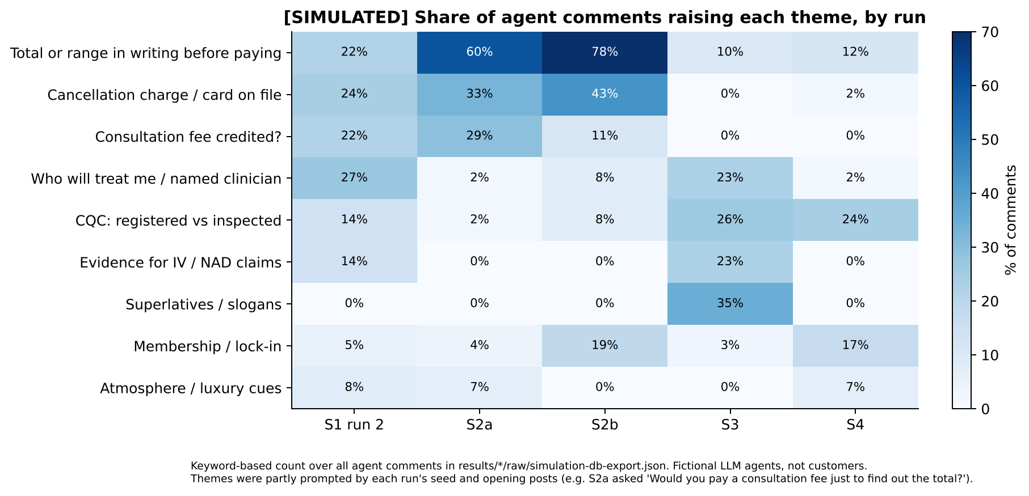
What the simulations are worth
Useful for generating hypotheses; not evidence of customer behaviour
Limits
• One model plays every persona; cautious voice
• Seeds and opening posts primed key themes
• S3 never tested the alternative taglines
• Fabricated 'experiences' excluded
• No demand, conversion or WTP measured
Source: results/*/raw/simulation-db-export.json; report-audit.md D1–D6 | The HVN strategy review · 15 Oct 2026 · 14
Notes:
The heatmap is a keyword count over all agent comments. High numbers often reflect what the seed or opening post asked: S2a literally asked 'Would you pay a consultation fee just to find out the total?'. Runs share facts, personas and one model, so they are not independent.

Slide 15
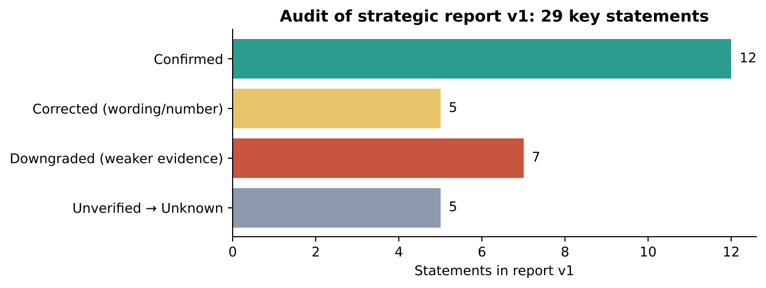
We audited our own v1 report
29 key statements re-checked: 12 confirmed, 5 corrected, 7 downgraded, 5 now Unknown
What changed in v2
• CQC status and all competitor figures → Unknown
• Simulation counts labelled 'primed' where the question led
• Positioning and starter pathway: validate, then adopt
• Added benchmark, journey map, register, roadmap, validation plan
Source: report-audit.md | The HVN strategy review · 15 Oct 2026 · 15
Notes:
Corrections: 'London's leading' is visible on the home page and in the schema description rather than visible on every page; priced pages are 148 (not 149); IV-evidence theme absent in S2a; luxury cues were raised (rarely). Downgrades: several simulation counts were echoes of leading questions.

Slide 16
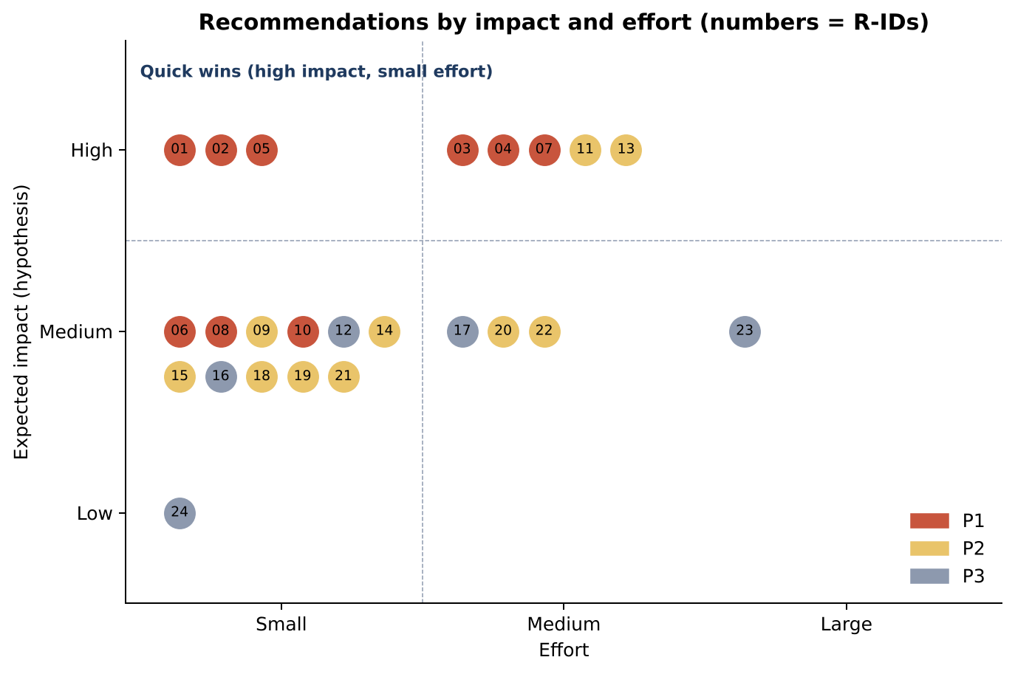
24 recommendations by impact and effort
Most high-impact items are small or medium effort
Quick wins
• R01 Women's-health pages
• R02 Broken links
• R05 CQC check + link
• R06 Tap-to-call
• R08 Fees and credits
• R10 Price conflicts
Source: recommendations-register.md | The HVN strategy review · 15 Oct 2026 · 16
Notes:
Numbers are R-IDs. Red = P1 (days 0–30), sand = P2 (31–60), grey = P3 (61–90 or gated). Impact is a hypothesis until measured against the baseline (R07).

Slide 17
Priority 1: the first 30 days
ID | Action | Evidence · confidence | Effort | Owner (role) | KPI
R01 | Fix Menopause/PCOS/PMDD pages | Live re-check · High | Small | Marketing + women's-health doctor | 3/3 fixed; booking clicks
R02 | Repair menu and internal links | Broken-links CSV · High | Small | Web developer | 0 internal 404s
R03 | Decide programme tier; redirect | Crawl · High | Medium | CEO + Medical Director | Decision; 0 retired 404s
R04 | CAP-code claims review | Crawl + ASA · High | Medium | CEO + adviser | 100% items resolved
R05 | Verify CQC; link badge; status line | Crawl · High; status ? | Small | Registered manager | 100% linked; signed off
R06 | One number; tap-to-call; mobile bar | Crawl · High | Small | Developer + Ops | tel: 100%; call clicks
R07 | Analytics + funnel baseline | Study gap · High | Medium | Marketing + agency | Baseline captured
R08 | Fees and credits table | Re-check · High | Small | CEO + Finance | Credit queries ↓
R10 | Remove price conflicts; sessions | Price register · High | Small | Marketing + Ops | 0 conflicts
Source: recommendations-register.md | The HVN strategy review · 15 Oct 2026 · 17
Notes:
Every website change needs your approval (gate G4). R04 needs budget approval for an external adviser.

Slide 18
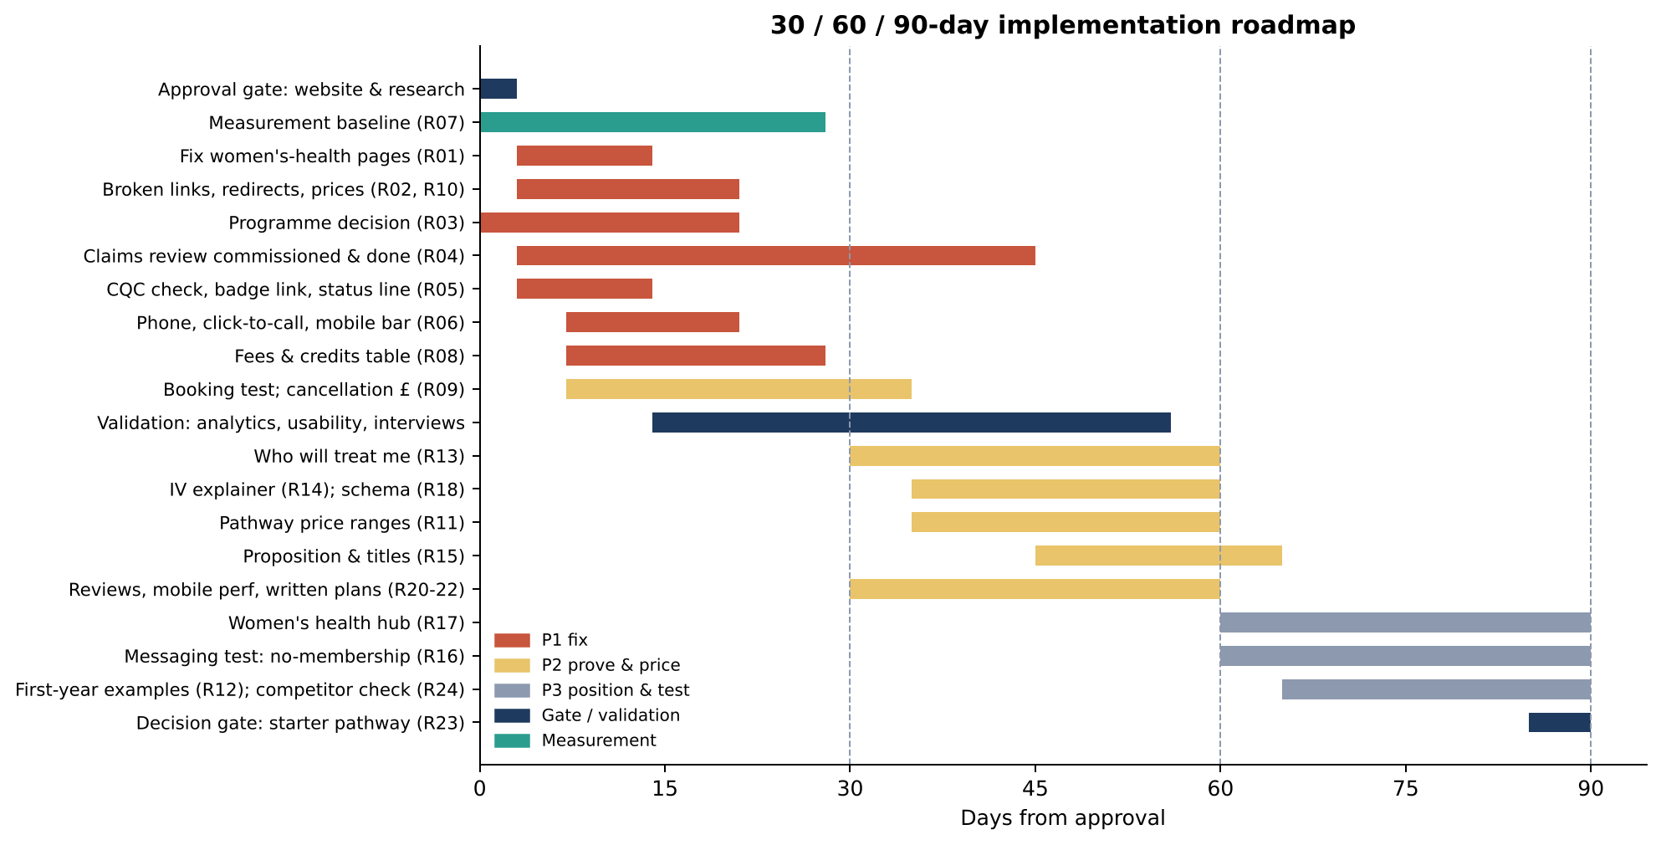
30 / 60 / 90-day roadmap
Fix and measure → prove and price → position and test
Checkpoints
• Day 30: baseline; 0 internal 404s; women's-health fixed; CQC line accurate
• Day 60: who-treats + IV explainer; ranges decided; validation read-out
• Day 90: positioning decided on evidence; pathway go/no-go
Source: implementation-roadmap.md | The HVN strategy review · 15 Oct 2026 · 18
Notes:
Checkpoints: day 30 baseline and fixes; day 60 trust proof, ranges, validation read-out; day 90 management review against baseline and go/no-go on the starter pathway.

Slide 19
How we will measure progress
Baseline first (weeks 1–4), then targets
Stage | KPI | Source
Discover | Organic clicks to service and concern pages | Search Console
Research | 404 page views; engaged sessions | GA4
Price check | % enquiries tagged price / total / credit | Enquiry log
Book | Booking-intent rate (book + call + WhatsApp + form) / sessions | GA4 events
Book | Booking completion; median first-response time | Pabau; enquiry log
Consultation | Consultation-to-plan conversion within 30 days | Pabau
Retain | 90-day repeat rate; reviews per month and rating | Pabau; Business Profile
Source: customer-journey-map.md §5 | The HVN strategy review · 15 Oct 2026 · 19
Notes:
Targets are deliberately not set yet: without a baseline any target would be a guess.

Slide 20
Validation: small, cheap, real
≈ 6 weeks · ≈ £1,000–£1,800 external · no simulated agents counted as respondents
Workstream | What | Cost
A Analytics baseline | GA4 events, Pabau funnel, enquiry log | Staff time
B Booking test | Staff test, mobile and desktop, no payment | ½ day
C Usability | 5–6 non-clients, 5 tasks on the live site | £400–£600
D Interviews | 8–12 clients, lapsed enquirers, gatekeepers | £400–£600
E Copy tests | After claims review and approval | Later
Approval gates
• G1 booking test + tagging
• G2 non-client panel + incentives
• G3 contacting clients/enquirers
• G4 any website change or A/B test
• G5 any competitor enquiry
Source: validation-plan.md | The HVN strategy review · 15 Oct 2026 · 20
Notes:
Interviews use open questions first. The simulation showed that leading questions produce echoes. The HVN does recruitment under UK GDPR with consent; incentives are neutral (gift card or donation).

Slide 21
Hypotheses the simulations raised, and how to test them
ID | Hypothesis | Prior | Method | Changes
H01 | Unknown plan totals stop people booking a paid consultation | M/L | Interviews, usability, enquiry log | R11, R12
H02 | A published range is enough | L | Interviews, usability | R11
H04 | Naming the clinician raises trust and intent | M | Usability mock-up, interviews | R13
H05 | Prospects check CQC status (after verifying it) | L | R05, then interviews | R05
H06 | 'No membership' is a positive differentiator | L | Interviews, later A/B | R15, R16
H07 | Concrete safeguards beat superlatives | L–M | Usability (two heroes) | R14, R15
H08 | Integrated route can win single-need women's health | L | Search Console, interviews | R17
H13 | Verifiability matters more than setting | L | Interviews | Positioning
Source: validation-plan.md §2 | The HVN strategy review · 15 Oct 2026 · 21
Notes:
Prior confidence is low for most because they come from simulation. Decision rules in validation-plan.md §5 say what each result changes.

Slide 22
Risks and how we manage them
Risk | Mitigation
CQC status differs from the earlier assumption | Verify at source before any wording is published (R05)
Claims review takes longer than 30 days | No new IV/longevity copy or paid media until done
Price ranges anchor clients wrongly | Base on 12 months of Pabau data; test wording first
Simulation-derived messaging misleads | Validation gates H06, H07, H13 before any proposition change
Competitor facts are stale | Quarterly verification at source (R24)
Website changes break booking links | QA checklist; re-crawl after every release
Source: implementation-roadmap.md; strategic-intelligence-report.md §13 | The HVN strategy review · 15 Oct 2026 · 22
Notes:
The main risk is acting on simulated conclusions as if they were customer evidence; the gates prevent that.

Slide 23
Decisions requested today
1
Approve the 30-day fix list: R01, R02, R06, R10 (website-change gate G4)
2
Ask the registered manager to verify CQC status and scope at source (R05)
3
Decide which programmes exist today; publish or redirect (R03)
4
Approve an external CAP-code claims review (R04; quote needed)
5
Set the consultation fee-credit policy (R08)
6
Approve measurement setup and validation gates G1–G3 (≈ £1,000–£1,800)
Source: strategic-intelligence-report.md §1.3 | The HVN strategy review · 15 Oct 2026 · 23
Notes:
Nothing has been deployed and nobody has been contacted. Each decision unlocks a specific gate.

Slide 24
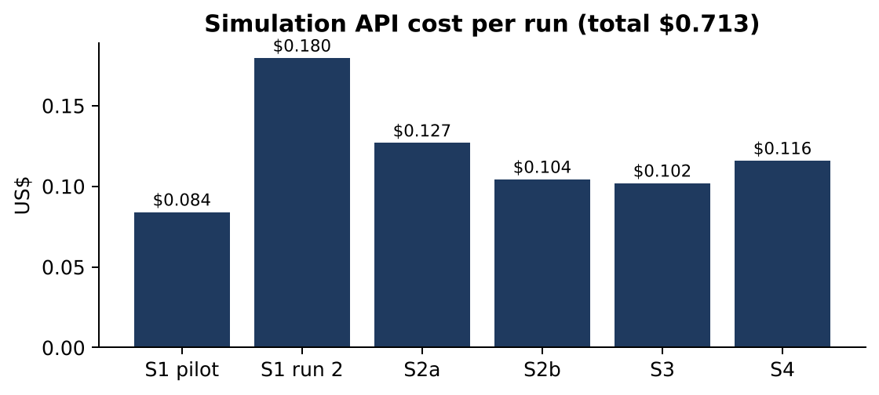
Appendix: files, sources and cost
File | Contents
strategic-intelligence-report.md | Full report v2.0
recommendations-register.md / .csv | 24 recommendations
implementation-roadmap.md | 30/60/90 plan
customer-journey-map.md | Journey and KPIs
competitor-benchmark.md / CSV | Verification status per fact
validation-plan.md | Hypotheses, methods, gates
report-audit.md | Audit of v1
evidence/, results/ | Crawl data; simulation raw data
Simulation API cost: $0.713 for 6 runs (490 requests, 0 errors).
This review: no new simulations, no paid API calls.
Source: research/the-hvn/ | The HVN strategy review · 15 Oct 2026 · 24
Notes:
All files are in the repository under research/the-hvn/. Charts regenerate with charts/build_assets.py.

