Slide 1
JS & ReactJS
Alireza Edalatpour

Slide 2
My Profile
Alireza Edalatpour
Senior full-stack developer at Chargoon
Head of Front-End Team (HR Systems)
Teaching at Sematec and MapsaHR
C# / .NET Framework / .NET Core / PHP
T-SQL / MSSQLServer / EF Core / Dapper
HTML / CSS / JavaScript / React / Redux / NextJS
Notes:
ری‌اکت ساختن رابط‌کاربری پویا را ساده می‌کند. برای هر وضعیت برنامه خود یک view ساده طراحی کنید و هربار که داده‌های شما تغییر می‌کند، ری‌اکت به صورت بهینه‌‌ای، فقط کامپوننت‌های مربوطه را به‌روز رسانی و رندر می‌کند.
کامپوننت‌هایی بسازید که state داخلی خود را، خودشان مدیریت می‌کنند و کپسوله شده‌اند.سپس با ترکیب آن‌ها رابط‌کاربری‌های پیچیده را بسازید.
از آن‌جا که منطق یک کامپوننت به‌جای استفاده از قالب با جاوااسکریپت نوشته می‌شود، شما به‌راحتی می‌توانید داده‌هایی با ساختار متفاوت‌ را میان کامپوننت‌ها منتقل کنید و state کامپوننت‌ها را مستقل از DOM نگه‌دارید.
ما پیش‌فرضی درباره دیگر تکنولوژی‌های به‌کاررفته در پروژه شما نداریم، بنابراین می توانید قابلیت‌های جدید را با ری‌اکت بسازید.
ری‌اکت روی سرور و همچنین به‌وسیله ری‌اکت نیتیو. روی اپ موبایل هم رندر می‌شود.

Slide 3
Course Roadmap
JavaScript Basics
Modern JavaScript
React (basic, hook, router, access server, etc.)
State Management by Context
State Management by Redux

Slide 4
JavaScript
A high-level, dynamic, untyped, and interpreted programming language.

Slide 5
JavaScript Engines
SpiderMonkey
Mozilla – Firefox
ES5.1
Chakra
Microsoft – Edge
ES6
V8
Google
Chrome, Couchbase, MongoDB, Node.js
ES6

Slide 6
ECMAScript (ES)
A scripting-language specification standardized by ECMA International in ECMA-262
First Edition in 1997
ES5 in 2009 (Most Supported Version)
ES11 is last one released in 2020

Slide 7
Implementations of ECMAScript
JScript • Microsoft • 1996 – 2011
ActionScript • Adobe • 1998 – 2006
JavaScript • 1995 - Current

Slide 8
Javascript basic
Browser (Script tag) / NodeJS
case-sensitive
Comments (singleline, multiline)
Optional semicolon, white space
Variable (var, let)
Constant (const)
Primitive Types (Number, String, Boolean)

Slide 9
Javascript basic
Operators
Condition (if, switch)
Loops (for,while,do while, break, continue)
Math (floor, random, round, min, max)

Slide 10
Javascript basic
Scope (var, let)
Hoisting
DataTypes (Number, String, Boolean, SpecialTypes)
SpecialTypes
null
undefined
Symbol
Every thing else is object (object, array, Date, RegExp, Map,WeakMap,Set, WeakSet)

Slide 11
Number
10.4, 10e4, 50
Converting
Number()
+
NaN
Infinity, -infinity

Slide 12
String
String()
Characters
“” ,’’ ,``
length
string methods
Special characters (\n \r \t \’ \” \` \$ \\,)

Slide 13
Boolean
Boolean()
Falsy values (false, null, undefined, “’’, 0, NaN)
!!
Truthy values (-1, infinity, “ ”, “0”, ”false”, [], {}, function(){}

Slide 14
Special Types
null
undefined

Slide 15
Primitive values
Number
String
Boolean
Null
Undefined
Symbol

Slide 16
Object
An unordered collection of related data, of primitive or reference types, in the form of key:value pairs.
Variable or function => property, method
Value in memory referenced by an identifier

Slide 17
Object
new Object();
object initializer
Constructor
Factory
Accessing properties to set or get
Unassigned variables will be undefined.
Properties can be an object.

Slide 18
Object
Methods in object
this
Equality

Slide 19
Array
Orderd collection
Lists
Index | 0 | 1 | 2 | 3 | 4 | 5 | 6
array | ‘ali’ | ‘reza’ | 123 | True | { a:’a’ } | [3,54,2] | false

Slide 20
Array
string.split vs array.join
push,pop
shift,unshift
indexOf
splice

Slide 21
Array
Shallow copy : slice(); (keeps reference types)
reverse()
sort()
concat()
filter()
includes()
every() some()
find()
findIndex()

Slide 22
Array
foreach()
map()
reduce() reduceRight()

Slide 23
Expression
produces a value.
Assignment (= ,+= ,=+, *=, /=, %=)
Operator (+ ,- ,* ,/ ,%, ++(pre,post), --(pre,post))
Operand (2 + 4 => 2 and 4 are operands)
Logical (&& || !)
Default operator ||
Guard operator &&

Slide 24
Other operators
Ternary (condition ? “is true” : “is false”)
typeof

Slide 25
Identifiers
Identifiers must start with a letter, dollar sign ($) or underscore(_)
They can consist of numbers.
Unicode allowed
Cant be a reserved word.(let, var, if, while, for, break, class, etc)

Slide 26
Naming Identifier
camelCase
firstName,lastName,birthdayDate
snake_case
first_name,last_name,birthday_date
PascalCase
FirstName,LastName,BirthDate

Slide 27
Naming Notes
Identifiers shouldn’t start with a capital letter except for classes.
Identifiers that start with one or two underscores are used to represent special or internal variables.
Identifiers for constants are in capital letters.

Slide 28
function
A function is a self-contained collection of statements that run as a single unit.
Define functions
function hello(name){
console.log(‘Hello ’ + name);
}
call functions
hello(‘Tom’)
call run execute invoke dispatch
Functions can return values

Slide 29
Referencing
Calling and referencing
We have parentheses or not.

Slide 30
Arguments , Parameters
function sayHi(arg1){} ‘arg1’ is an argument
sayHi(‘ali’) ‘ali’ is a parameter
Default parameters
Functions as values

Slide 31
Anonymous function
function (x){
return x * x;
}
IIFE (Immediately Invoked Function Expression)
Assign to variable

Slide 32
Modern JavaScript (ES6-2015)
Arrow function
Destructuring
Array
Object
Spread operator

Slide 33
this
Execution context
window object (var)
Instance of an object
call
apply (input arguments should be an array)
bind (didn’t call the function)

Slide 34
this
Function is called with new keyword?
Function is called with call or apply?
Function is called via context object?
Global object (window)
Arrow function vs normal function

Slide 35
Useful functions (browser and nodejs)
window.setTimeout()
window.clearTimeout()
window.setInterval()
window.clearInterval()

Slide 36
Execution context
Execution context
Global
Function
Function call process
Creates a local execution context
Sent to execution stack
At the end, the execution context removes from execution stack
Return value sends to calling context.
Destroy local execution context;

Slide 37
Lexical scope
Function has access to variables in calling context.

Slide 38
Return function

Slide 39
Closure
The closure is a collection of all the variables in scope at the time of creation of the function.
Scope chain
Local scope (own scope)
Outer functions scope
Global scope

Slide 40
Class
Constructor
Methods
Instance vs Class
Inheritance

Slide 41
Promise
rejected or resolved
sync / async
then / catch / finally
all
rece

Slide 42
Ajax
Asyncronous Javascript And XML.
XMLHttpRequest
HttpRequest Verbs

Slide 43
JSON
JavaScript Object Notation
Name/value pair
comma separated
Curly braces holds objects
Square brackets holds arrays.
JSON.parse();
JSON.stringify();

Slide 44
fetch

Slide 45
HTML CSS
DOM (Document Object Model)
HTML DOM
A tree of objects

Slide 46
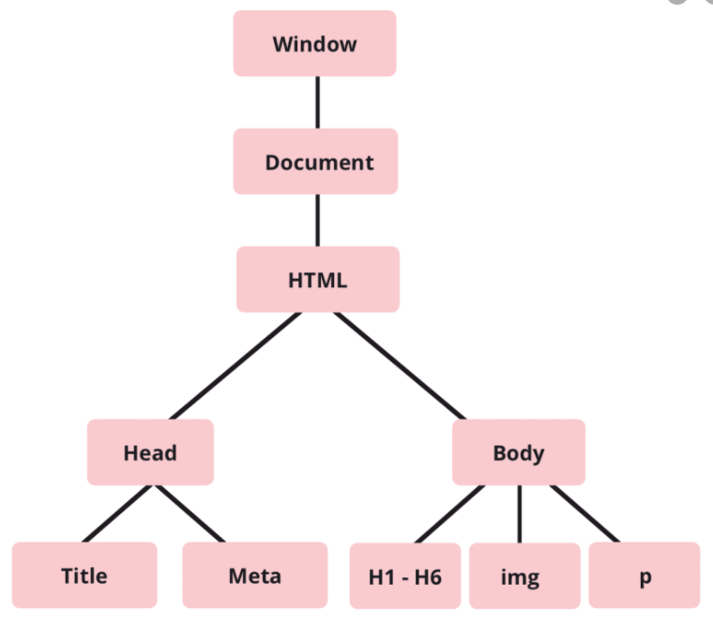
DOM

Slide 47
HTML CSS
Finding HTML elements
Changing HTML elements
Adding or Deleting elements
Event

Slide 48
Events
When a user click
When a web page has loaded
Where an image han been uploaded
When an input field is changed
When an HTML form is submitted
When a user strokes a key

Slide 49
Events
event attributes ---- onclick=“handleClick()”
element.onclick = handleClick;
addEventListener() ---- without ‘on’
removeEventListener()
handleClick is an event listener.

Slide 50
Events
onchange
onmouseover, onmouseout
onmousedown, onmouseup
onfocus
onclick

Slide 51
Event bubbling vs Event capturing
bubbling : child to parent
Capturing : parent to child
propagation
preventDefault

Slide 52
Git 1
git init
git status
git add [filename|.]
git commit -m "initial mapsa trainig js"
git remote add origin [address]
git push origin master

Slide 53
React
A JavaScript library created by Facebook 2013
It was first deployed on Facebook's News Feed in 2011 and later on Instagram in 2012
17.0.1 is the latest version released in October 20, 2020.

Slide 54
Single Page Application
Single page applications
More like a desktop application
HTML, JavaScript, and CSS – is retrieved with a single page load
Does not reload
Vue.js , AngularJS , Ember.js are alternatives

Slide 55
React
React.js
React-DOM.js
React.createElement()
ReactDOM.render()

Slide 56
JSX
<h1>Hello world</h1>
Stands for JavaScript XML
Allows us to write HTML in React
Makes it easier to write and add HTML in React

Slide 57
Let’s write JSX code
Expressions in JSX
One Top Level Element (contain children)
Elements Must be Closed
You can put any valid JavaScript expression in JSX
JSX is an Expression Too
Specifying Attributes with JSX
JSX Prevents Injection Attacks
JSX Represents Objects

Slide 58
Node runs JS files at server
Server usage
Client usage

Slide 59
NodeJs
Module
npm
webpack
babel
Web server

Slide 60
Module
Maintainability
Namespacing
Reusability

Slide 61
Modules
Anonymous Closure
CommonJS
module.exports can return array,object,function, etc.
js/json extention
Relative path
Import / export in ES6
Built-in modules

Slide 62
npm
npm init
Dependency / devdependency
scripts
node_modules

Slide 63
Step-1
npm install
react
react-dom

Slide 64
webpack
bundle file
config
entry
output
…

Slide 65
Step-2
npm install -g
webpack
webpack-cli

Slide 66
babel
Webpack loader

Slide 67
Step-3
npm install
babel-loader
@babel/cli
@babel/core
@babel/preset-env
@babel/preset-react

Slide 68
Web server
port
Watch files and refresh page

Slide 69
Step-4
npm install
webpack-dev-server

Slide 70
Component
Class component / function component
Props
Children
List & keys

Slide 71
Component
Lifecycle methods
Hook

Slide 72
State in class components
Lifecycle methods
Mounting
Updating
Unmounting
setState()
Asynchronous
Merge
The data flows down

Slide 73
Styling components
Css
Inline style
Css module
Other libraries

Slide 74
Starting New Project
create-react-app
BurgerBuilder Project
Structure

Slide 75
Events
Pass references instead of string in attrebuite
e.preventDefault();
bind to this / arrow functions
Passing arguments to event handler
arrow function
bind

Slide 76
Conditional Rendering

Slide 77
Pure Component

Slide 78
axios

