Slide 1













Evaluation of NoSQL in the Energy Marketplace with GraphQL Optimization
Michael Howard, Dept. of Computer Science, Portland State University

Slide 2
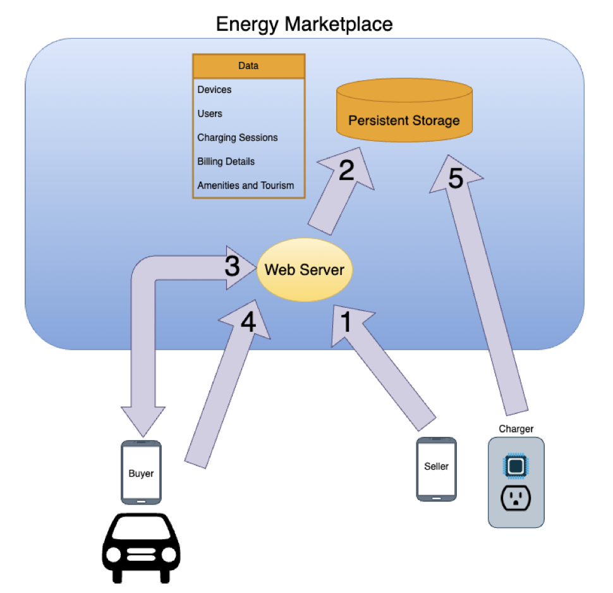
Motivation & Workflow
Why energy peer‑to‑peer?
EV adoption → range anxiety
Commercial DC fast charger gap vs. gas stations
Marketplace workflow:
Device registration
Data storage
Search & reserve
Session management
Session details
Key requirements: low latency, horizontal scale, schema flexibility

Slide 3
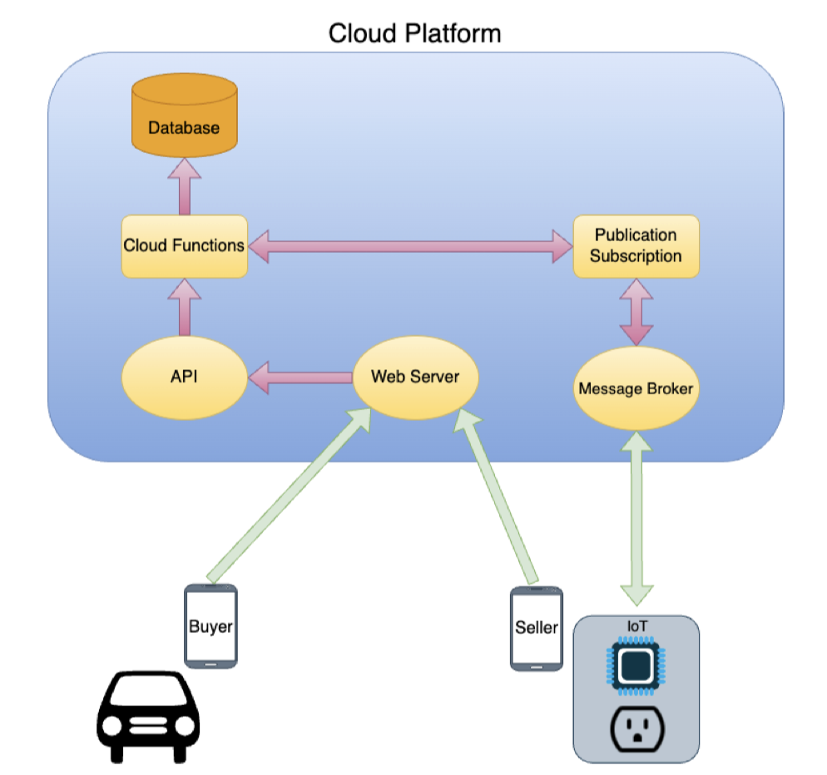
System Architecture Overview
Edge & Cloud components:
IoT microcontroller at charger (Edge)
Message broker + Pub/Sub + Cloud Functions
Web‑based UI for buyer & seller
Database sits behind Cloud Functions
Research question: Can Firestore meet cost, latency, flexibility vs. MySQL?

Slide 4
Data & Query Requirements
Data objects: charger metadata, users, sessions, billing, ratings, amenities Workflows require:
Geospatial search (lat/long ranges)
Multi‑field filtering (type, rating, amenities)
Storage must allow:
Flexible schema for evolving features
Horizontal sharding across regions

Slide 5
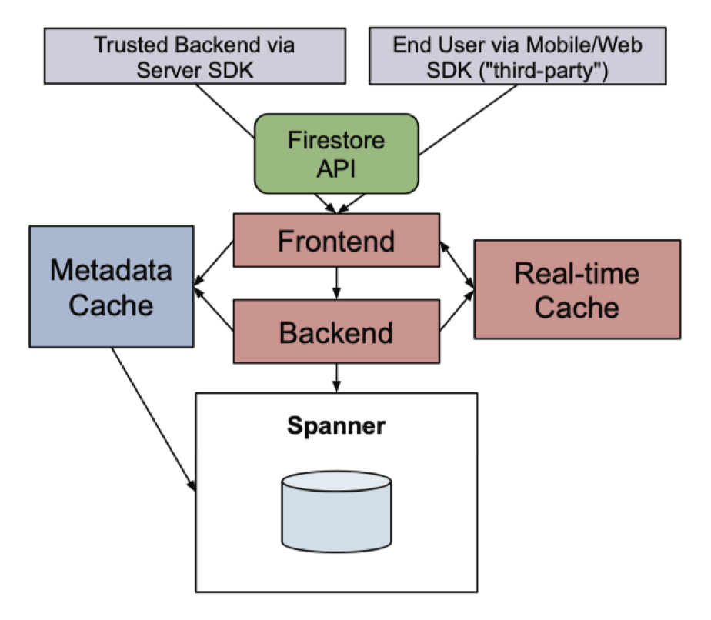
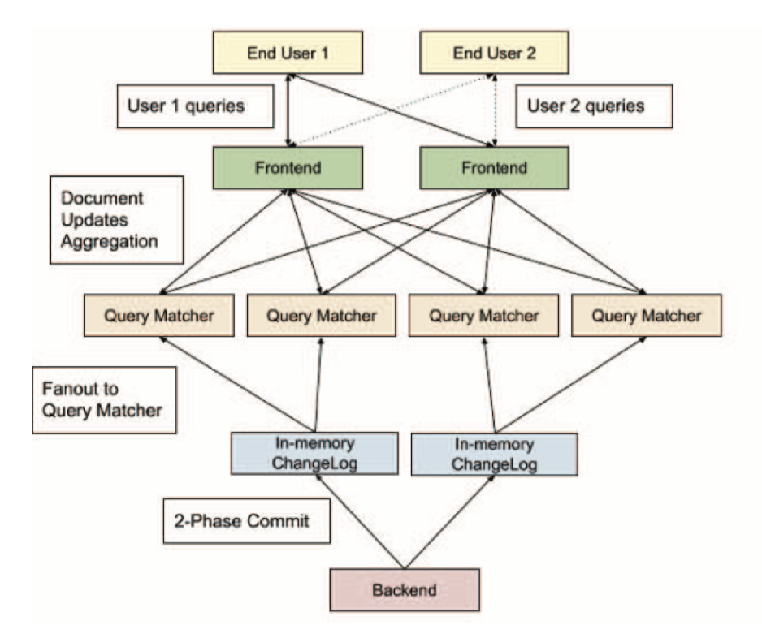
Firestore Architecture
Document‑model, schemaless → flexible fields
Serverless: billed per CRUD + storage
SDKs: Server (trusted) vs. Mobile/Web (untrusted)
Realtime cache & secondary indices

Slide 6
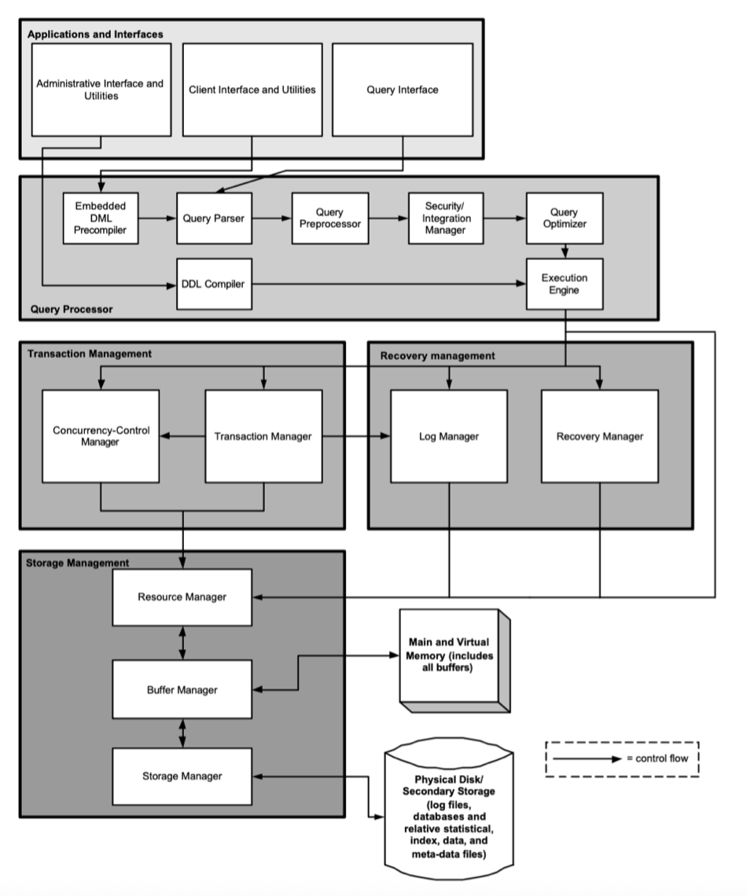
Cloud SQL MySQL Architecture
Relational tables with strict schema
ACID transactions via Transaction Management layer
Server‑based: billed per vCPU/RAM/storage
Joins & multi‑field range queries natively supported

Slide 7
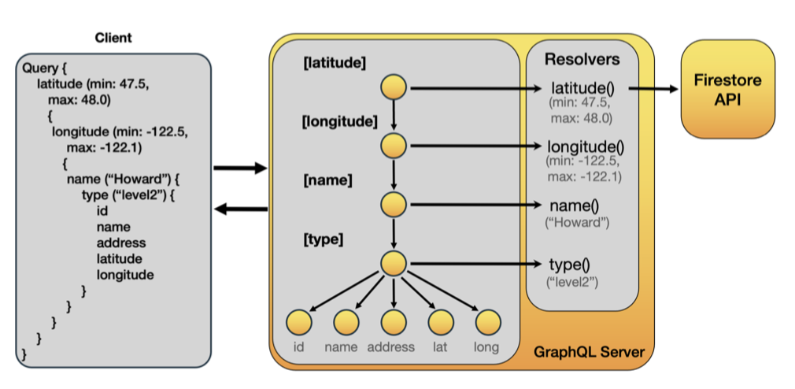
GraphQL Middleware Layer
Apollo Server as middleware
Strongly‑typed schema + resolvers
Single query → nested data tree
Mitigates Firestore’s single‑range limitation

Slide 8
Experimental Setup
01
02
03
04
Mock data: 10¹ to 10⁶ documents/rows
Workflows: single read (PK), iterative read, read‑all, update, create
Conditional read: name, type, lat-range, long-range
Metrics: latency (ms), ops/s, kB/s

Slide 9
Firestore: ~190 ms per PK read; ~19 ops/s; ~360 kB/s
01.
Read Performance Comparison
02.
MySQL: ~92 ms per PK read; ~54 ops/s; ~115 000 kB/s
Observations: MySQL outperforms in raw read throughput
03.

Slide 10
Write & Update Performance
Firestore: ~160 ms/update; ~25 creates/s
MySQL: ~92 ms/update; ~46 creates/s
Constant‑time behavior for both

Slide 11
Conditional Query Performance
Firestore + client‑filter:
Full scan: O(n) → e.g. 459 s for 10⁶ docs
Single‑range + filter: 66 s
MySQL: multi‑range query = 905 ms for 10⁶ rows
GraphQL + Firestore: ~41 s for 10⁶ docs

Slide 12
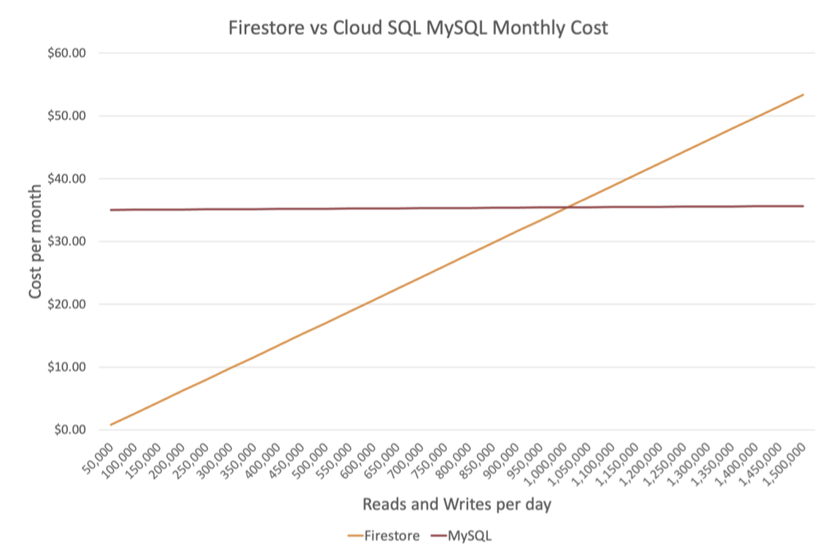
Cost Comparison
Firestore (1 M reads + writes/day → 76 MB data): $1.30/month
MySQL (1 vCPU, 0.6 GB RAM, 10 GB SSD): $35/month
Break‑even at ~1 M transactions/day

Slide 13

When to use MySQL:
When to use Firestore:
High‑volume, complex multi‑range queries
Low‑to‑moderate transaction volume
Discussion & Recommendations
Strong ACID & join needs
Rapid development & schema evolution
Predictable pricing
Serverless convenience

Slide 14
Future Work & Conclusion
Latency optimization: geohashing for spatial queries
Alternative middleware: caching layers or Spanner directly
Conclusion: choose storage based on feature, performance, cost trade‑offs

Slide 15
Thank you very much!

