Slide 1
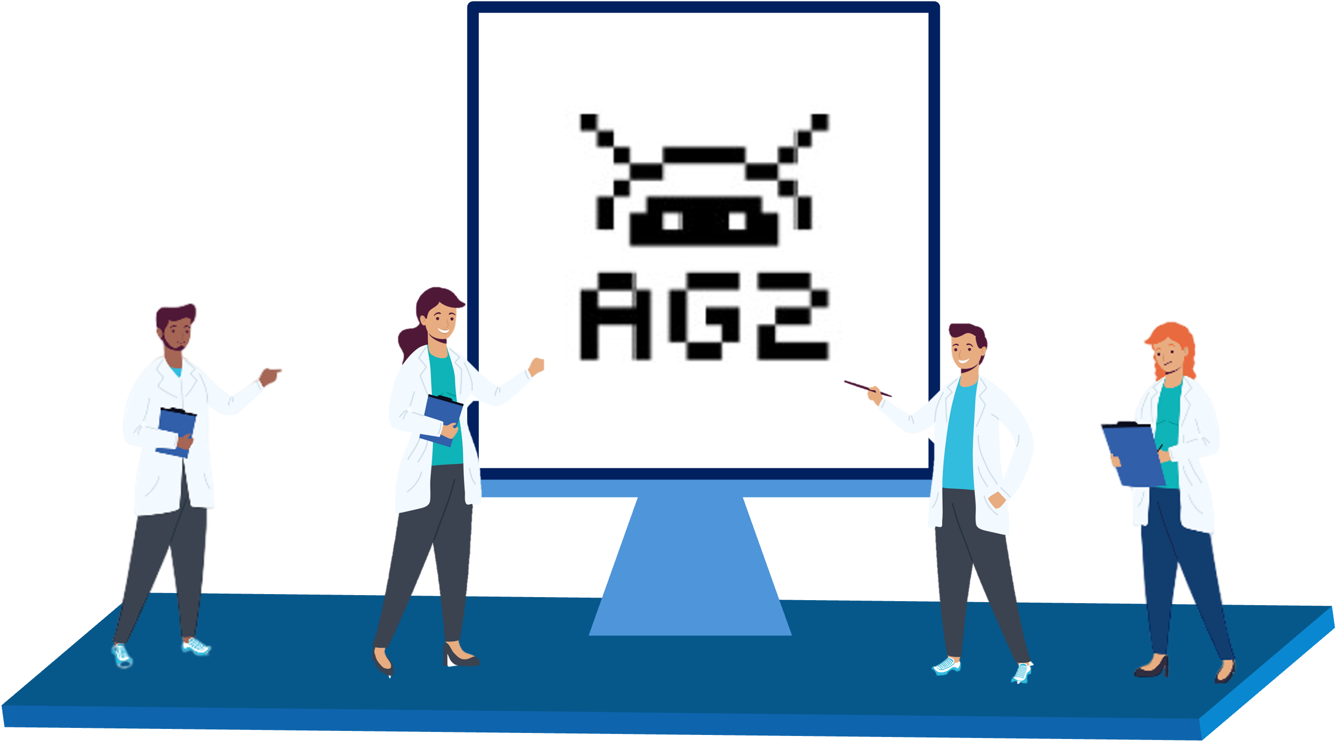

Sharif LLM Agent Hackathon
Khordad 6, 1404
Building LLM-powered
multiagent systems with AG2
Alireza Ghafarollahi
Massachusetts Institute of Technology
Notes:
Thank you very much. I am very excited to be here today.
Before I start, I would like to take this moment to thank Professors Bill Curtin and Markus Buehler, my PhD and postdoctoral advisors, for their invaluable support and guidance.

Slide 2
Overview
A pre-programmed multi-agent system with Python
Fully automated multi-agent system (AG2)
Basic Concepts
LLM Configuration
ConversableAgent
Human in the Loop
Agent Orchestration
Tools
Structured Outputs
Agent Orchestration Deep Dive
Two Agent Chat
Sequential Chat
Group Chats
Tools and functions
Context Variables
Handoffs
Orchestration Patterns (if time allowed)

Slide 3
A pre-programmed multi-agent system with Python

Slide 4
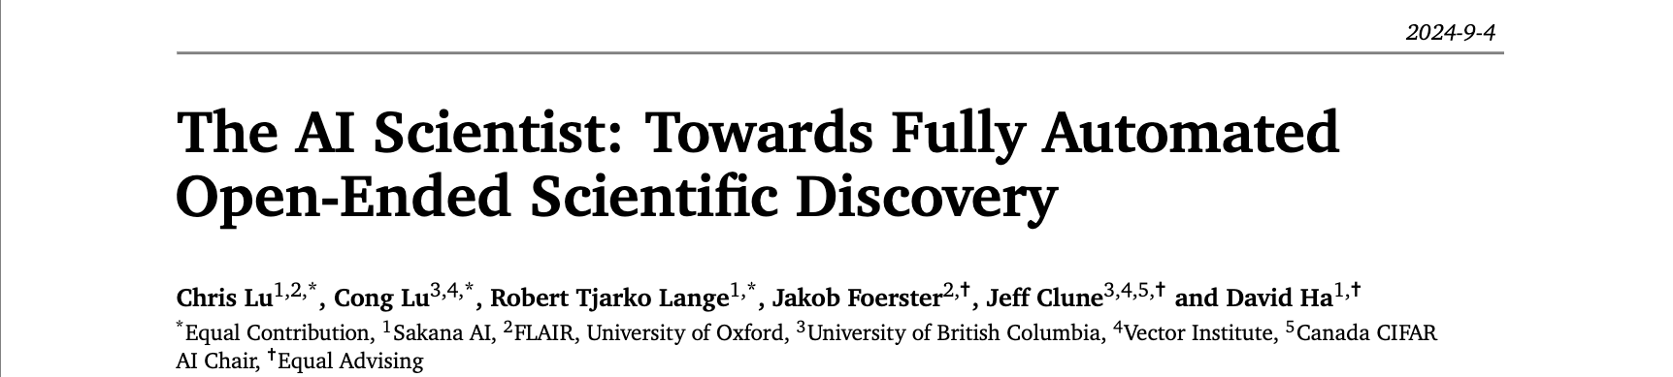
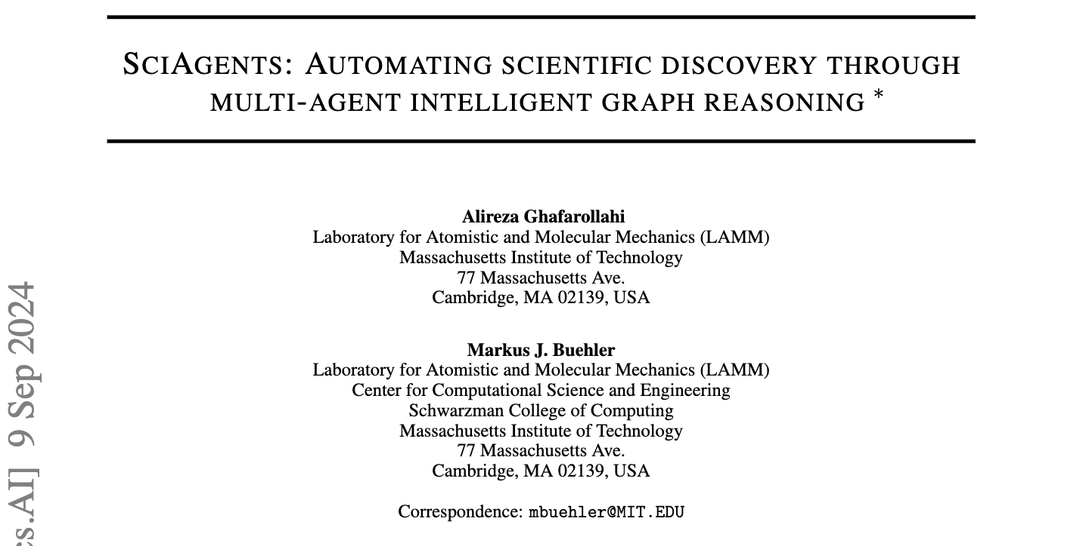
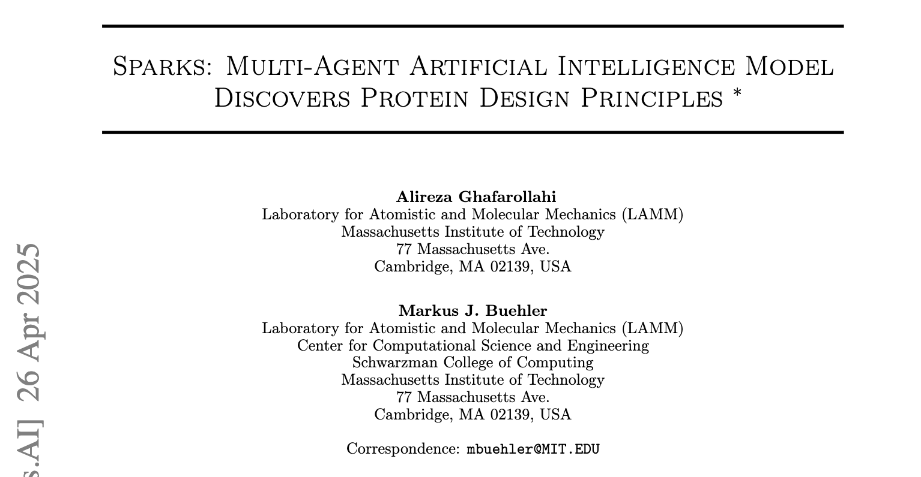
A pre-programmed multi-agent system with Python
Pre-programmed sequence of interactions between agents
More consistency and reliability
Less flexibility
No human in the loop

Slide 5
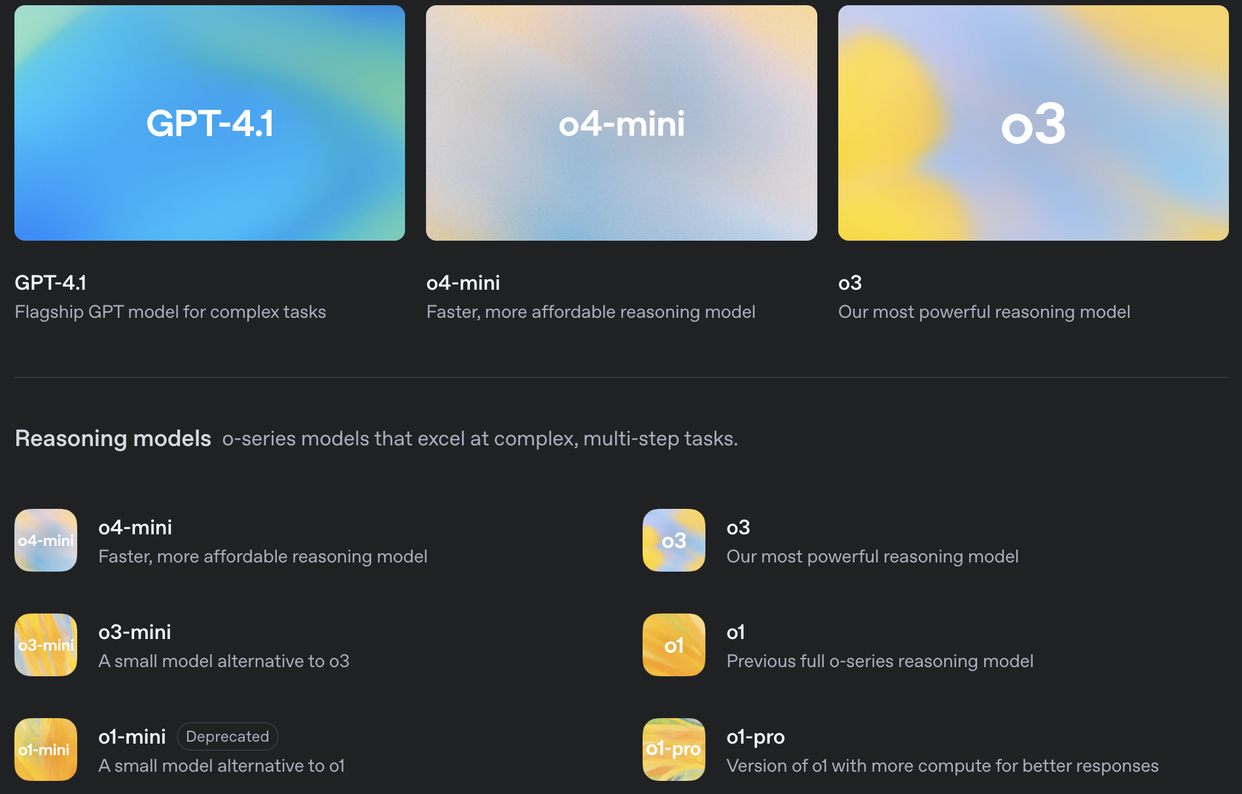
Create your first agent
Agents use LLMs as key components to understand and react
OpenAI models
client = OpenAI()
response = client.chat.completions.create(
model,
messages,
temperature,
max_completion_tokens,
)
content = response.choices[0].message.content

Slide 6
Create your first agent
messages=[
{“role”: “user”, “content”: “prompt_1”}
]
prompt
agent’s profile
+
user’s query
messages
msg_history
response

Slide 7
Now let’s add another agent that interacts with the first agent
messages=[
{“role”: “user”, “content”: “prompt_1”},
{“role”: “assistant”, “content”: “response_1”},
{“role”: “user”, “content”: “prompt_2”},]
msg_history
msg_history (old prompt+old response)
messages
msg_history
new prompt
new response

Slide 8
AG2: Building fully automated multi-agent systems

Slide 9
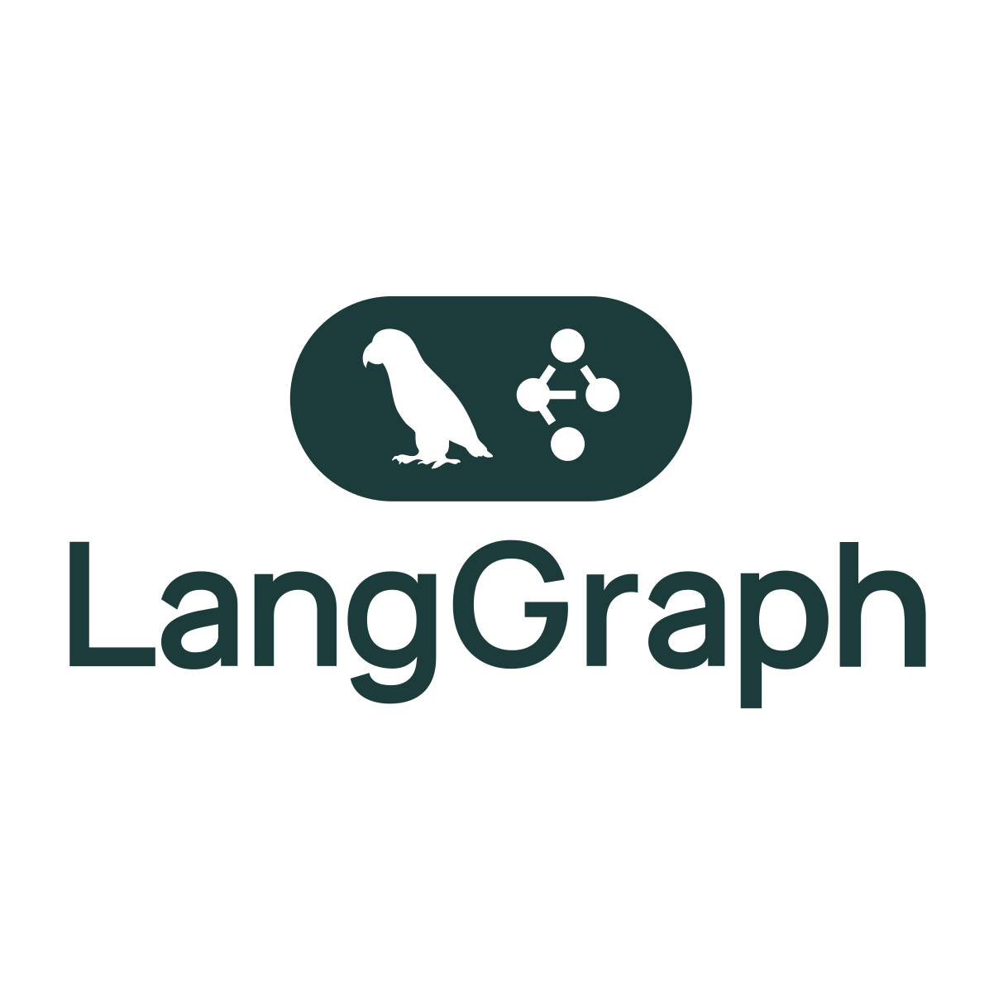
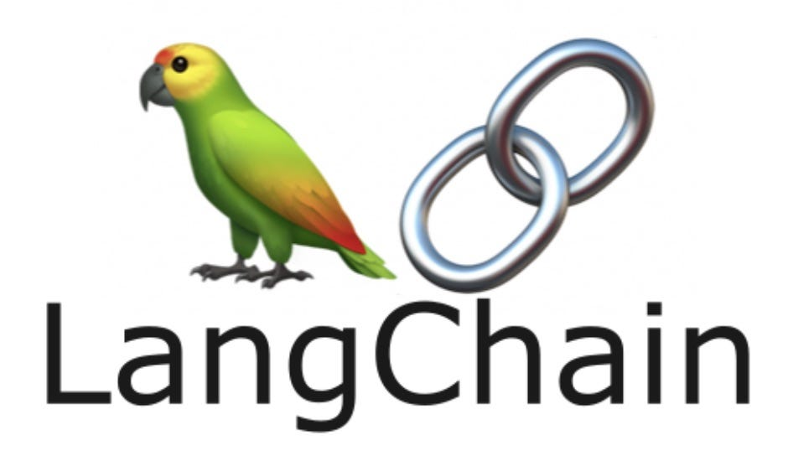





Multi-agent frameworks

Slide 10
Multi-agent frameworks
Add something here!

Slide 11
Multi-agent frameworks
Basic Concepts
LLM Configuration
ConversableAgent
Human in the Loop
Agent Orchestration
Tools
Structured Outputs

Slide 12
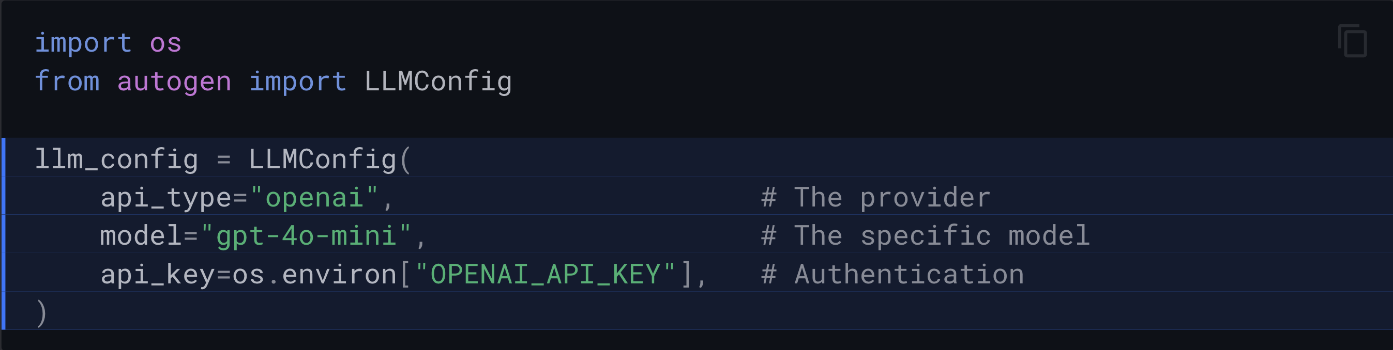
LLM configuration
LLM Configuration controls how an agent:
Connects to and authenticates with language model providers
Selects models and sets parameters
Thinks, reasons, and generates responses

Slide 13
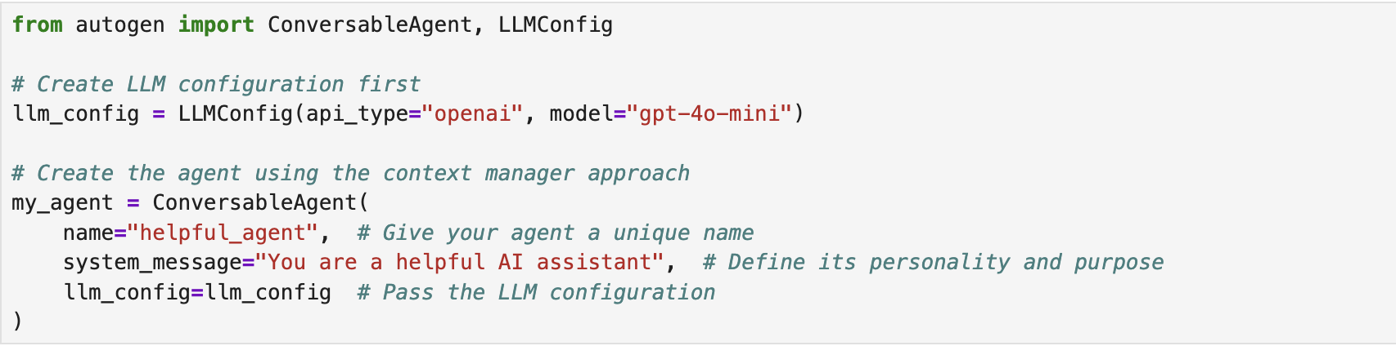
ConversableAgents: Building Intelligent Agents
The ConversableAgent is the fundamental building block of AG2.
With an LLM configuration providing its thinking power, a ConversableAgent can:
Communicate with other agents and humans
Process information and generate responses
Follow instructions defined in its system message
Execute tools and functions when needed

Slide 14
Agent Orchestration: Coordinating Multiple Agents
Multi-agent systems allow specialized agents to collaborate dynamically to achieve complex workflows.
AG2 provides different patterns to define the agent-agent interactions
Implementing a group chat in AG2 is a simple two-step process
First, create a pattern that defines how agents will interact
Then, initialize the group chat using the pattern

Slide 15
Agent Orchestration: Coordinating Multiple Agents
The pattern defines the orchestration logic - which agents are involved, who speaks first, and how to transition between agents. AG2 provides several pre-defined patterns to choose from:
DefaultPattern: A minimal pattern for simple agent interactions where the handoffs and transitions needs to be explicitly defined
AutoPattern: Automatically selects the next speaker based on conversation context
RoundRobinPattern: Agents speak in a defined sequence
RandomPattern: Randomly selects the next speaker
ManualPattern: Allows human selection of the next speaker
The easiest pattern to get started with is the AutoPattern, where a group manager agent automatically selects agents to speak by evaluating the messages in the chat and the descriptions of the agents.

Slide 16
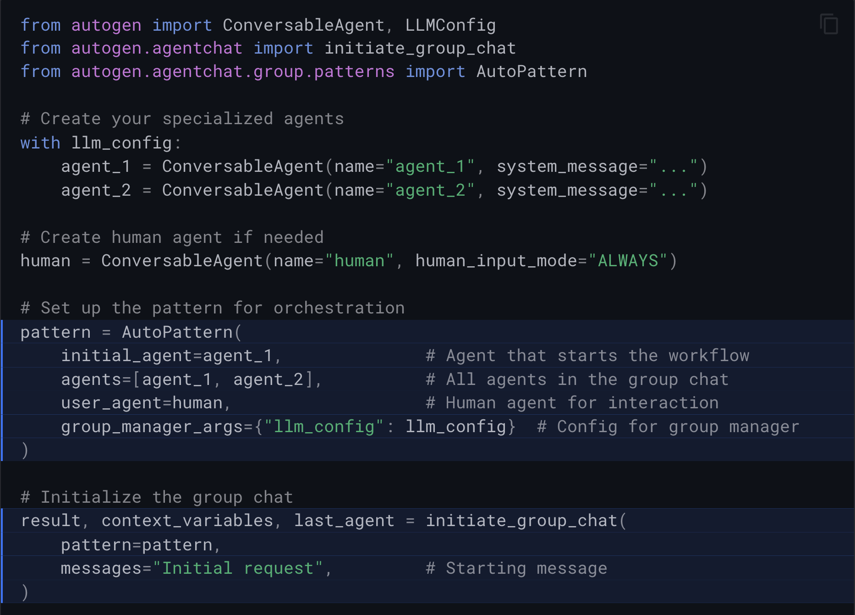
Agent Orchestration: Coordinating Multiple Agents

