Slide 1
University of San Francisco Master of Science in Health Informatics Program HS-619 course NLP Project Professor: Dr. Andrew Nguyen Student: Alireza Ghezavati

Slide 2
Prevalence of Endotracheal Intubation in Cancer patients In ICU

Slide 3
Database: MIMIC III
Cancer ICD9 codes: 140- 239
Number of patients with cancer: 388

Slide 4
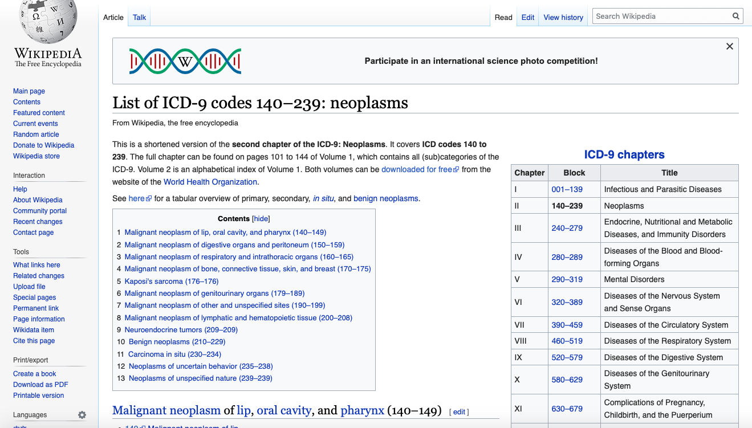

Slide 5
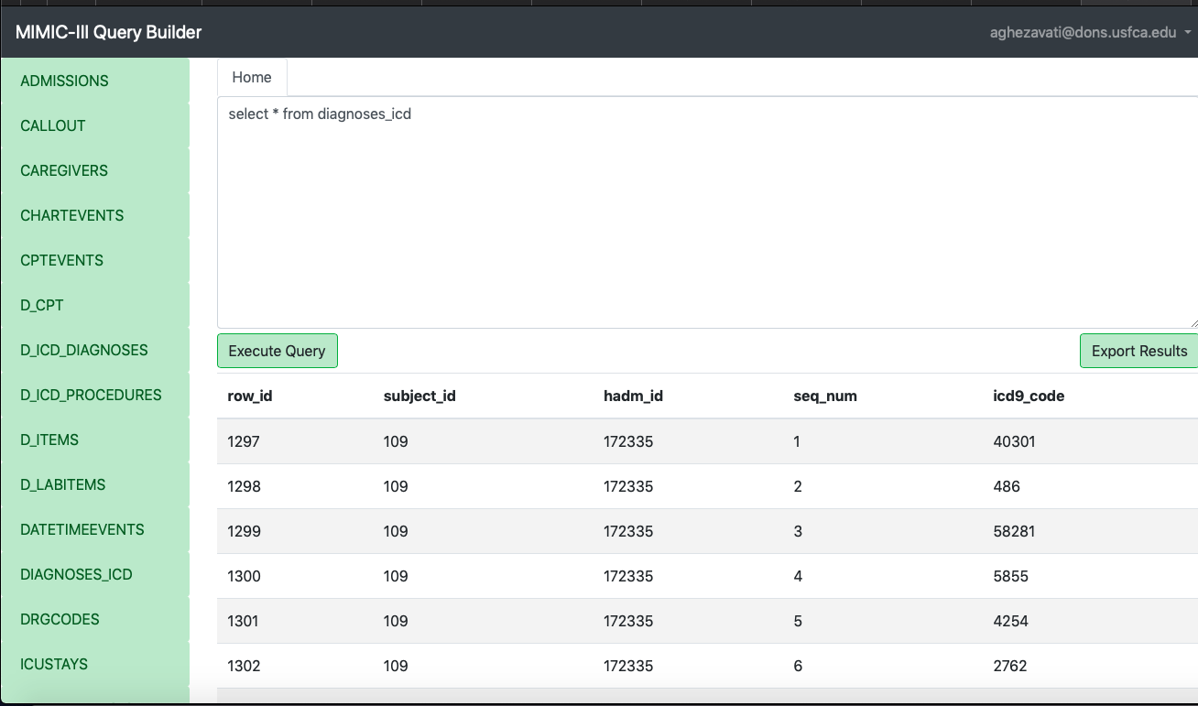

Slide 6
In the next slide we can see the query that shows how many patients has an icd9 code that relates to some kind of cancer, and in the next following slide we can see only patients with cancer:

Slide 7
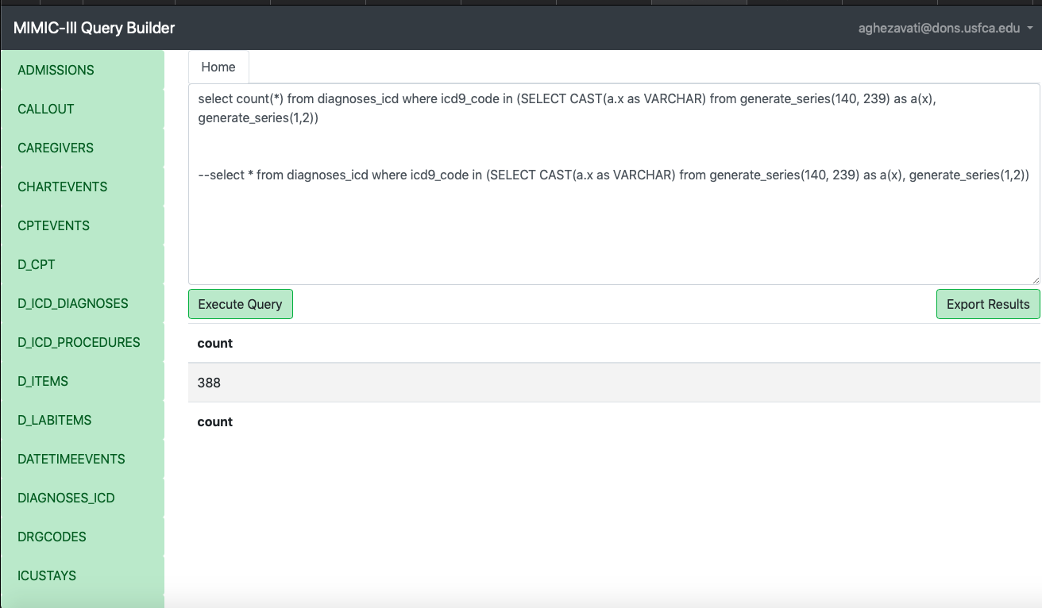

Slide 8
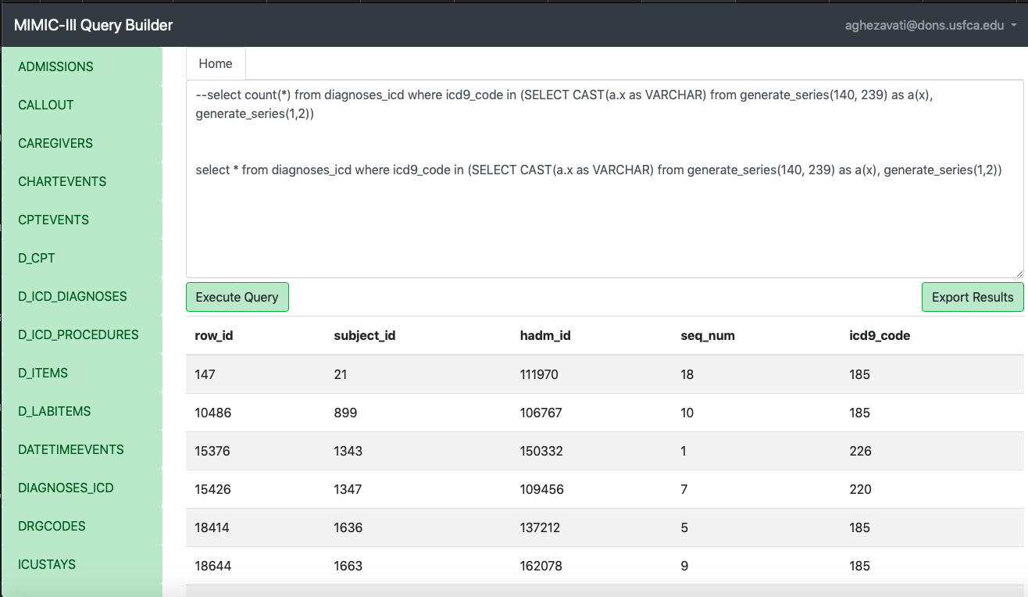

Slide 9
In the next slide we can see in the noteevnts table we have text column which provide us with clinical history. Also, there is a category column which tells us the source of that history, like nursing or radiology. However, we want to see if patients has intubated or not, and we know that all intubated patients will have an x-ray to confirm the correct placement of endotracheal tube. So, we can use only radiology notes to find out if a patient has intubated or not.

Slide 10
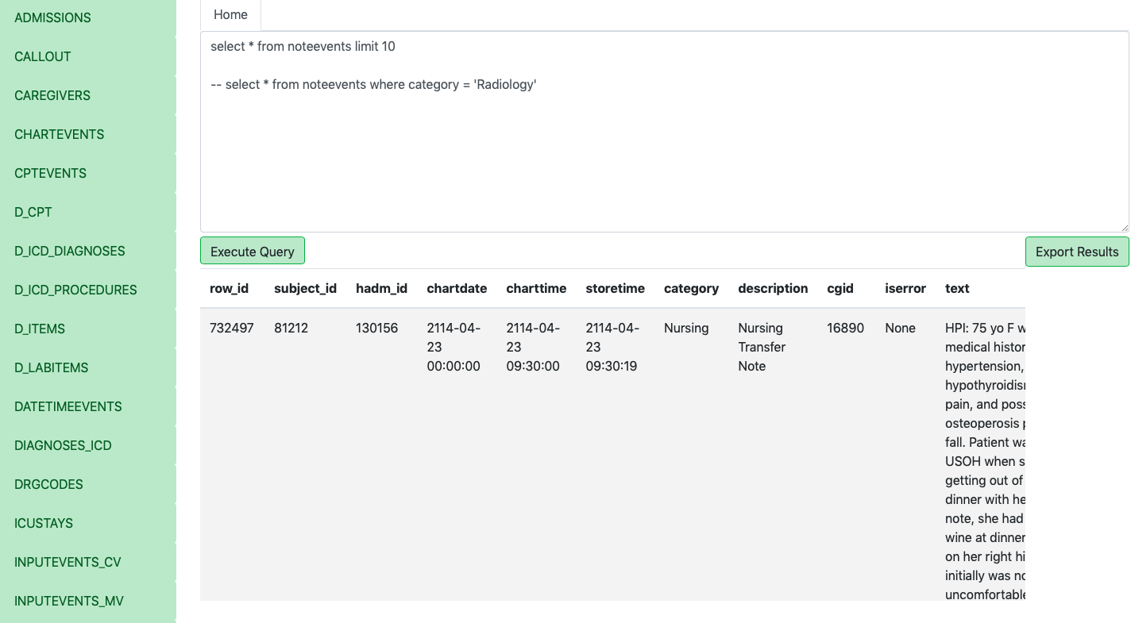

Slide 11
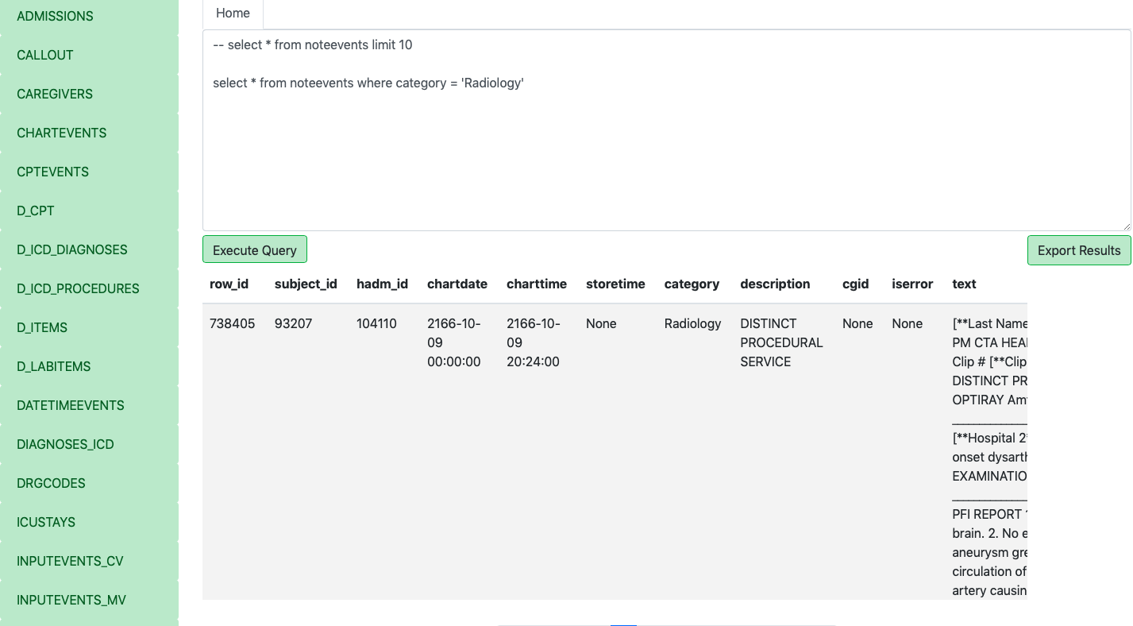

Slide 12
In the next 2 slides we have joined both above tables to get radiology notes for cancer patients. So we can later work on those notes to find if they have intubated or not.
In the next first slide we find the number of patients with cancer that also have radiology notes.
In the next second slide, we have selected hamd_id and radiology notes for those cancer patients and will save the results in a csv file.

Slide 13
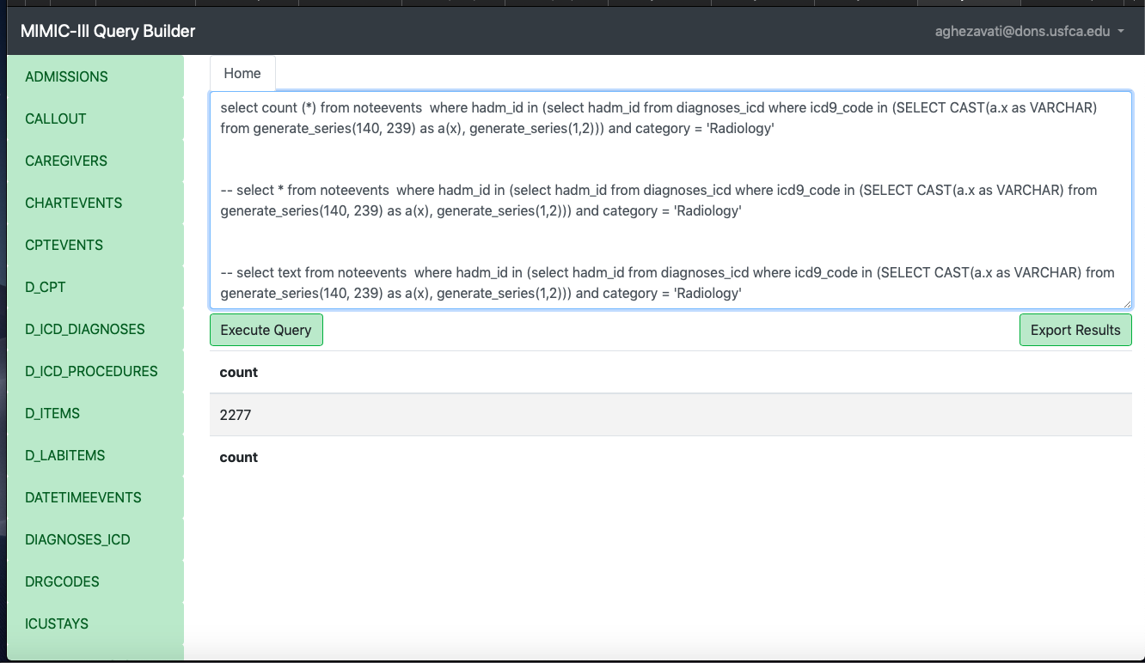

Slide 14
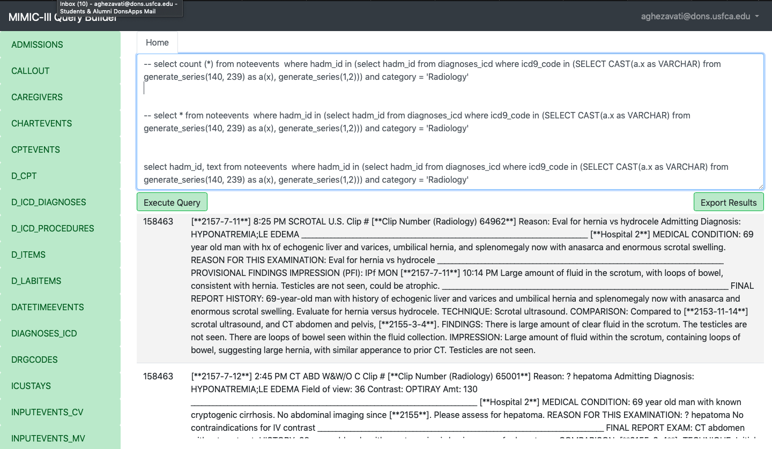

Slide 15
Conclusion
In the Jupyter notebook, and using python code, we first combine all rows with same hamd_id to have all radiology notes for each cancer patient.
Then we do regex to find out which patients have endotracheal intubation in their radiology notes
We can see 50% of cancer patients (12 out of 24) were intubated while they were admitted in the ICU.

Slide 16
Thank You

