Slide 1






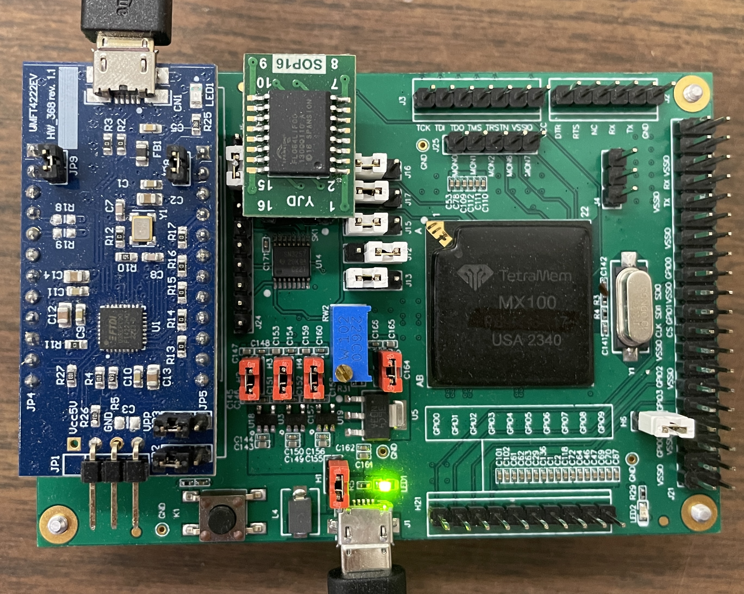
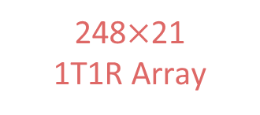
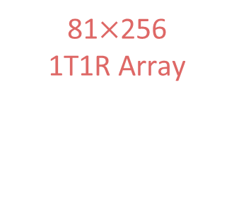
Hardware-Algorithm Co-Design for Hyperdimensional Computing Based on Memristive System-on-Chip
Yi Huang, Alireza Jaberi Rad, Qiangfei Xia (qxia@umass.edu)
Department of Electrical and Computer Engineering, University of Massachusetts Amherst
Challenges and Motivations
AI Models
Algorithm:
Artificial intelligence (AI) models are too large for edge devices
Most AI models require multiple layers of computation (like DNNs)
Hardware:
Limited computing resources on edge devices
Limited power source on most edge devices
Algorithm solution:
→ Brain-inspired hyper-dimensional computing (HDC)
Hardware solution:
→ In-memory computing (IMC) hardware based on memristor devices
Hardware-Algorithm co-design solution:
→ VMM-based encoding + Single-layer perceptron classifier
Data
Results
Edge Devices
HW-Algorithm Co-Design: HDC with VMM
Hardware Platform: Memristive SoC¹
conventional method
Input
Memristive SoC
10 memristive analog computing cores
RSIC-V CPU
On-chip interconnections between CPU, memory and computing Cores
SPI for off-chip communications
Memristive computing core
248 × 256 1T1R crossbar array for analog VMM
On-chip TIA, ADC, DAC for A/D conversion
Max Pooling on-chip activation function
HDC with VMM
Text, Image, Audio, etc.
Convert to binary feature vectors
Mapping
Combinational logic operations
Binary Vectors
Single-step VMM
Encoding
Memristive SoC
Encoded HVs
Encoded HVs
CPU
Memory
Encoded HV
Similarity Check
Single-layer Perceptron
Interconnect
Class HV
Projected HV
…
…
…
Class 1
Class 2
DAC
Core 9
Core 10
Class N
Class 3
Class 1
Class 2
Class 3
Class
N
…
…
Control
ADC
Classification Result
Classification Result
Classifier
SoC: system on chip
CPU: central processing unit
1T1R: 1-transistor-1-memristor
ADC: analog-to-digital converter
HVs: hyperdimensional vectors
HW: hardware
VMM: vector-matrix multiplication
SPI: Serial peripheral interface
TIA: transimpedance amplifier
DAC: digital-to-analog converter
Hardware Implementation of HDC with Memristive SoC
1
Conventional approach
0
0
Encoded HVs
Hardware-aware Encoding
Input vectors: Voltage vectors as feature vectors
Random matrix: Conductance matrix using the intrinsic randomness of memristors
Output HVs: Single-step VMM outputs
1
1
1
Transformation
Processing
Classifier
0
Text Input
1
0
Classification results
0
0
1
…
…
computing
…
Encoding
0
calculul
Mapping
1
1
obliczenia
Encoding
HVs
Classifier
…
informatica
0.072
Encoded
HVs
0.01
Memristive Single-layer Perceptron as Classifier
Input data: Encoded HVs after hardware-aware processing in on-chip CPU
Weight matrix: Offline trained conductance matrix
Classification results: Maximum output of analog VMM
…
81$×$256
1T1R Array
Hardware aware processing
…
248$×$21
1T1R Array
0.016
0.13
0.072
0
Proposed approach
0.072
0.03
0.016
0.16
Core
Core
Core
Memristive SoC
Core
Core
Core
Simulation and Experimental Results for Language Classification
SW/SW: Simulation accuracy comparable to existing work²
SW/HW vs SW/SW: Low accuracy degradation shows the memristive single-layer perceptron classifier is robust against hardware non-idealities
HW/SW vs SW/SW: Encoding process is more sensitive than the classifier to hardware non-idealities
HW/HW vs SW/SW: 6% accuracy degradation because of hardware non-idealities
HDC requires only 2 layers of computation (while most AI models require multiple layers)
Much lower HV dimensions (512) than conventional HDC (10000)
94.8% savings in hardware utilization resulting in lower energy consumption and less area
88.8
84.6
93.3
94.4
95.4
94.1
89.0
92.6
91.8
93.1
94.9
87.0
89.7
93.5
88.5
92.0
88.8
81.1
86.6
93.4
92.3
SW/SW: software VMM encoding + software single-layer perceptron classifier
SW: software
HW: hardware
1. TetraMem. Tetramem mx100 soc. https://www.tetramem.com/products, 2024. Accessed: September 11, 2024.
2. Abbas Rahimi, Pentti Kanerva, and Jan M. Rabaey. ”A robust and energy-efficient classifier using brain-inspired hyperdimensional computing.” In Proceedings of the International Symposium on Low Power Electronics and Design, pages 64–69. IEEE., 8 2016..

