Slide 1


Linux partions

Slide 3






Distribution

Slide 4
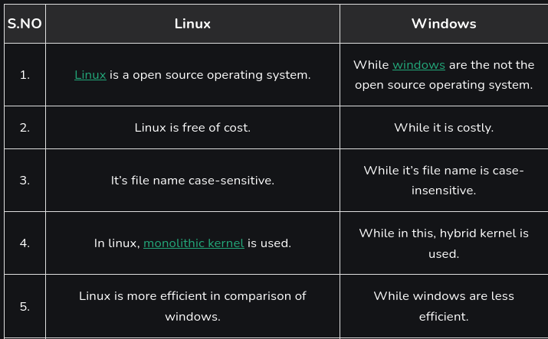

Slide 5
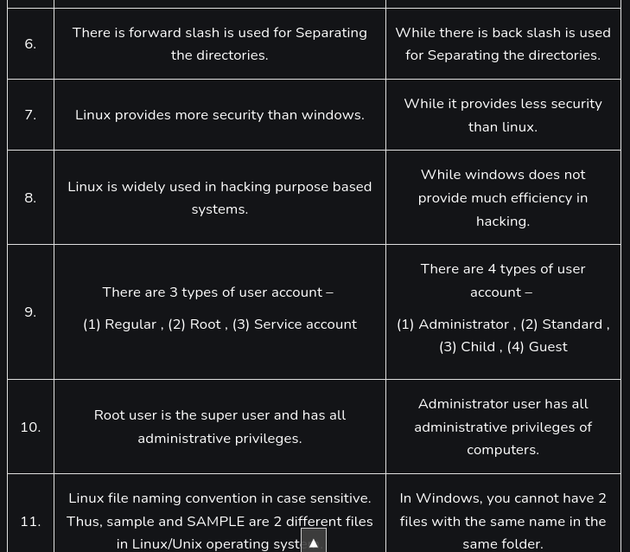

Slide 6
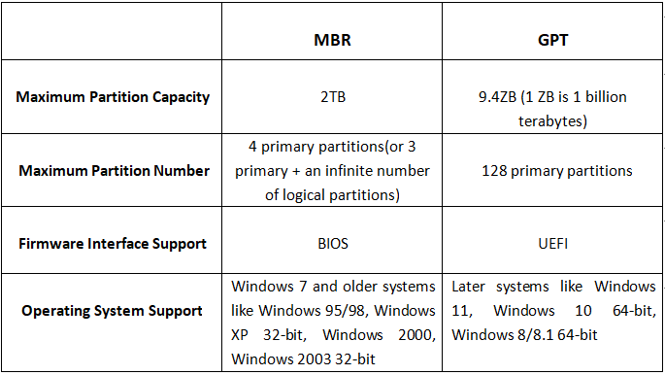
MBR & GPT

Slide 7
tools
parted A text-based tool that supports both MBR and GPT.
gparted A graphical version of parted.
ofdisk The traditional text-based Linux disk partitioning tool. fdisk does not support GPT.
gdisk A version of fdisk that supports GPT but not MBR.

Slide 8
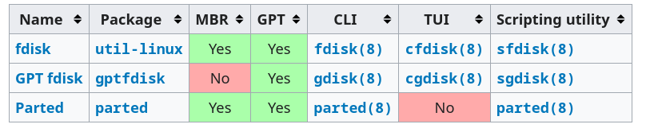
tools

Slide 9
fdisk
fdisk -l
fdisk /dev/sdb
m -> help
p -> print partition table
n -> create new partition
d -> delete partition
q -> quit without writing
w -> write to disk

Slide 10
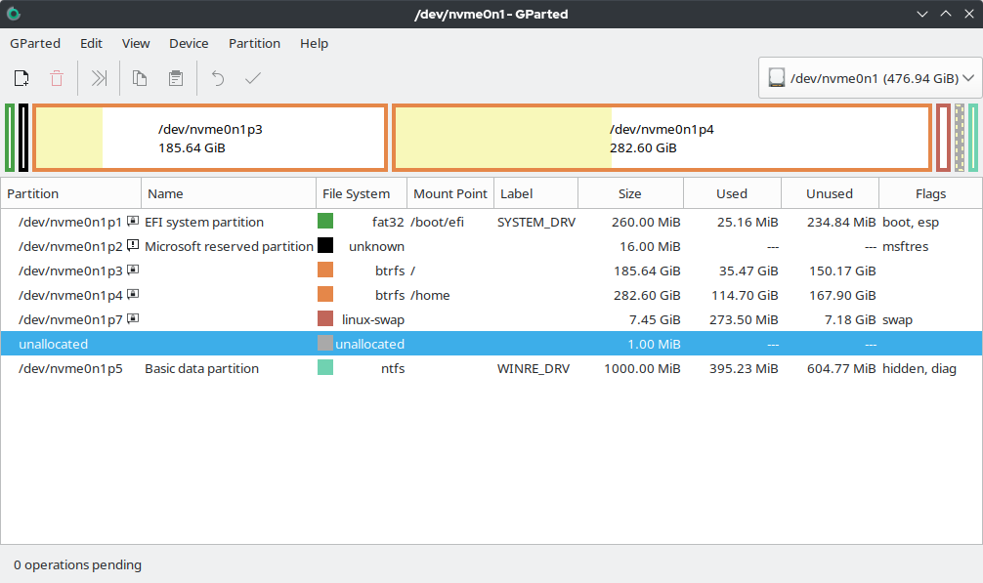

Slide 11


vm

Slide 12
More resource
https://wiki.archlinux.org/title/partitioning
https://docs.redhat.com/en/documentation/red_hat_enterprise_linux/8/html/managing_storage_devices/disk-partitions_managing-storage-devices

