Slide 1


Linux lpic 1

Slide 2
References:
https://linux1st.com/
https://www.youtube.com/playlist?list=PL-tKrPVkKKE0kM18Sg5fqaZW1V2nidAeU
…

Slide 3
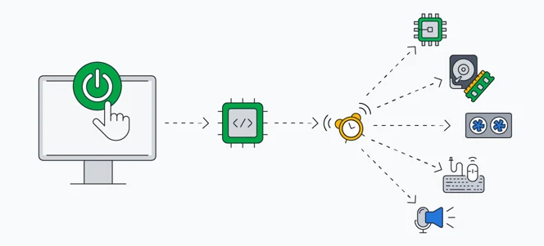
Determine and configure hardware settings
Firmware
BIOS & UEFI
Other hardware
Sysfs
/sys/
/dev/
Dbus
/proc/

Slide 4
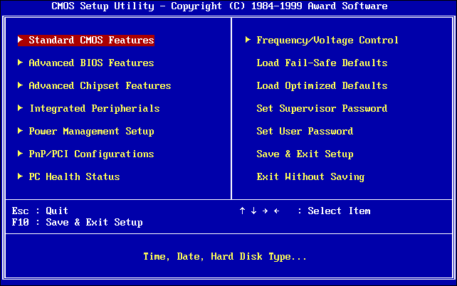
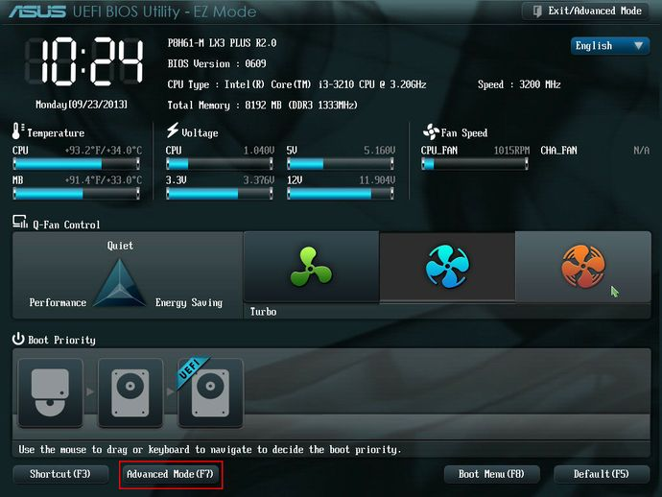
firmware
Firmware is the software on your hardware that runs it; Think of it as a built-in os or driver for your hardware. Motherboards need some firmware to be able to work too.
Firmware is a type of software that lives in hardware. Software is any program or group of programs run by a computer.

Slide 5
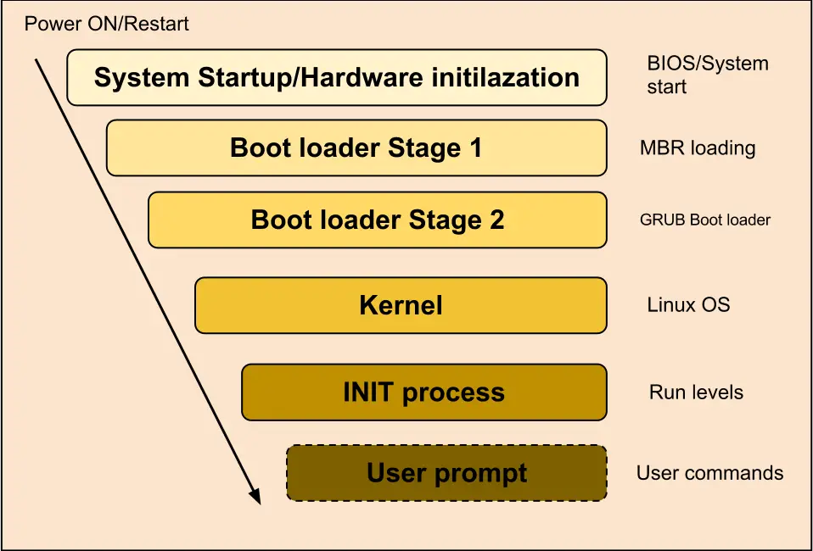
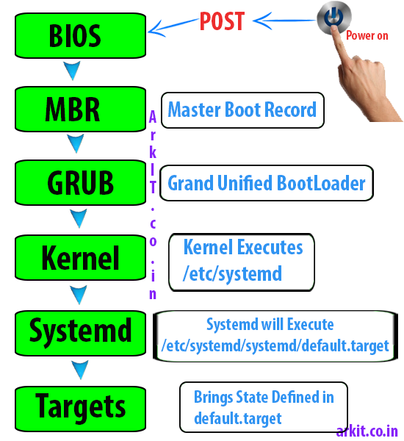
BIOS & UEFI

Slide 6
Linux Booting process

Slide 7
sysfs
udev
udev (userspace /dev) is a device manager for the Linux kernel. As the successor of devfsd and hotplug, udev primarily manages device nodes in the /dev directory. At the same time, udev also handles all user space events raised when hardware devices are added into the system or removed from it, including firmware loading as required by certain devices.
sysfs is a pseudo file system provided by the Linux kernel that exports information about various kernel subsystems, hardware devices, and associated device drivers from the kernel's device model to user space through virtual files.[1] In addition to providing information about various devices and kernel subsystems, exported virtual files are also used for their configuration.

Slide 8
udev
dbus
udev (userspace /dev) is a device manager for the Linux kernel. As the successor of devfsd and hotplug, udev primarily manages device nodes in the /dev directory. At the same time, udev also handles all user space events raised when hardware devices are added into the system or removed from it, including firmware loading as required by certain devices.
D-Bus is a message bus system, a simple way for applications to talk to one another. In addition to inter-process communication, D-Bus helps coordinate process lifecycle; It makes it simple and reliable to code a "single instance" application or daemon and to launch applications and daemons on demand when their services are needed.

Slide 9
dbus
D-Bus is a message bus system, a simple way for applications to talk to one another. In addition to inter-process communication, D-Bus helps coordinate process lifecycle; It makes it simple and reliable to code a "single instance" application or daemon and to launch applications and daemons on demand when their services are needed.

Slide 10
proc
This is where the Kernel keeps its settings and properties. This directory is created on ram and files might have write access (say for some hardware configurations). You can find things like:
IRQs (interrupt requests)
I/O ports (locations in memory where CPU can talk with devices)
DMA (direct memory access, faster than I/O ports)
Processes
Network Settings
...

Slide 11
Determine and configure hardware settings
lsusb, lspci, lsblk, lshw,lsmod
System init (system)
Journalctl

