Slide 1
Brain Tumor Detection Using Image Processing Techniques
Ameer Hamza 15-SE-37
Basit Aziz 15-SE-61
Ali Riaz 15-SE-87

Slide 2
Problem Statement
Detection of tumor in brain with precise accuracy and the location of the tumor with in the brain is time taking and lengthy process by use of humanoid techniques

Slide 3
Aims & Objectives
Hard to identify brain tumors using traditional methodology
Mainly focusing on medical imaging field.
Reduce failure ratio and minimal time for the identification
Accuracy comparison between Algorithms

Slide 4
Deliverables
GUI Design
Problem Implementation on MATLAB
Documentation
Research Paper

Slide 5
Literature Review
Brain tumor could appear anywhere in brain in different size, shape and contrast. Convolutional Neural Network is highly efficient which exploits both logical and contextual feature
The challenging thing in the identification of brain tumor is segmentation, registration and modelling as tumor causes morphological changes in the brain.
Different segmentation algorithms work best for different sub-parts but not a single algorithm devise for the purpose that could be implemented and work best for each sub-region.

Slide 6
Literature Review
Brain tumor detection become apparent in biomedical imaging. Detection is critical as tumor morphological changes remain subtle. Watershed segmentation is utilized to distinguish unusual tissues from normal surrounding tissues with connected component labeling for the better identification of brain tumor.
One image processing technique for the identification of brain tumor is hybrid self-organizing map(SOM) with Fuzzy K-means(FKM) which is efficient in term of specificity, sensitivity, mean square error, time of computation and memory demand

Slide 7
Literature Review
Image segmentation always remain a challenging problem due to the cluttered object, image noise, image contents and other factors. K-means clustering integrated with Fuzzy C- means algorithm helps us in minimal computation time and in accuracy of detection
The target is to detect tumor in the brain using image processing techniques as detection from MRI is quite time taking and difficult. Major steps in image processing includes image pre-processing, segmentation of pathological tissues, normal tissues and gray matter and cerebrospinal fluid, feature extraction from every segmentation and classification is done with Neural Networks

Slide 8
Literature Review
If we are able to understand the texture of brain and able to analyze it we will be able to get much more efficient and better result it have different application including segmentation and differentiate between healthy and faulty tissues.

Slide 9
Proposed Solution

Slide 10
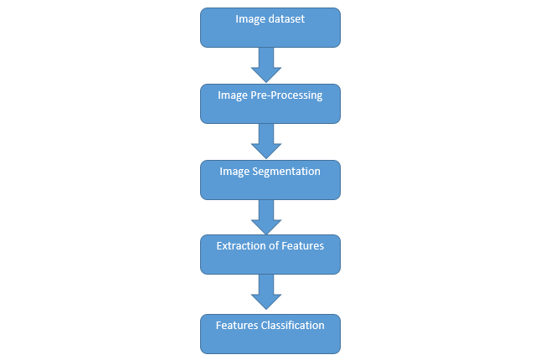
Work Flow

Slide 11
Methodology
Feature Extraction and Matching Algorithm
SIFT
SURF

Slide 12
Experimental Setup
MATLAB
Preprocessing
Segmentation
SIFT
SURF

Slide 13
Evaluation Parameters
Parameters | Description
Accuracy | The quality or state of being correct or accurate. More accurate the system is more preferable it is.
Efficiency | It is concerned with time. A system is preferable which takes less storage and less time to run.

Slide 14
Utilization
Reducing Human Effort
Accuracy
Minimum Failure Ratio
End Users

Slide 15
Conclusion
Emerging Field
Tough and time taking job
Reducing the human effort
Comparison between different Algorithms

Slide 16
References
S. a. W. R. a. N. L.-P. a. R. M. Bauer, "A survey of MRI-based medical image analysis for brain tumor studies," Physics in Medicine \& Biology, vol. 58, no. IOP publishing, p. R97, 2013
B. H. a. J. A. a. B. S. a. K. a. C. J. a. F. K. a. K. J. a. B. Y. a. P. N. a. S. J. a. W. R. a. O. Menze, "The multimodal brain tumor image segmentation benchmark (BRATS)," IEEE transaction on medical imaging, vol. 34, no. NIH Public Access, p. 1993, 2015
E. a. E. M. a. A.-A. R. Abdel-Maksoud, "Brain tumor segmentation based on a hybrid clustering technique," Egyptian Informatics Journal, vol. 16, no. Elsevier, pp. 71--81, 2015
M. a. D. a. W.-F. D. a. B. A. a. C. A. a. B. Y. a. P. ,. C. a. J. P.-M. a. L. H. Havaei, "Brain tumor segmentation with depp neural nerworks," Medical image analysis, vol. 35, no. Elsevier, pp. 18--31, 2017

Slide 17
References
A. a. K. E. a. B. M. S. Aslam, "Improved edge detection algorithm for brain tumor segmentation," Procedia Computer Science, vol. 58, no. Elsevier, pp. 430--437, 2015
S. a. R. D. Damodharan, "Combining Tissue Segmentation and Neural Network for Brain Tumor Detection," Intrernational Arab Journal of Information Technology (IAJIT), vol. 12, no. 1, 2015.
G. a. B. L. a. L. L. a. C. F. Castellano, "Texture analysis of medical images," Clinical radiology, vol. 59, no. 12, pp. 1061--1069, 2004

