Slide 1



SHARIF UNIVERSITY OF TECHNOLOGY
Fault-Tolerant Deep Neural Network
Hardware Accelerator Design
for Image and Video Processing Applications
Presented by Ali Roshani
Supervisors Dr. Ansari & Dr. Manzouri
Cyber-Physical Systems Laboratory
1 / 25
Notes:
Title slide. Seminar presentation — Fault-tolerant DNN hardware accelerator design, H-ASIZH.

Slide 2
INTRODUCTION
§ 1-1 · THE CHALLENGE
Three Critical Walls → One Revolutionary Solution
!
Moore's Wall
!
Von Neumann Wall
!
Energy Wall
PHYSICAL LIMIT
BUS & MEMORY BOTTLENECK
POWER LIMIT
Transistor scaling hit atomic barriers. Gate oxide only a few atoms thick — leakage becomes prohibitive below 7 nm.
Memory and processor are physically separated. Data shuttling consumes up to 200× more energy than the computation itself.
180+ ZB of data by 2025. Edge AI needs real-time inference at µW budgets — impossible with traditional architectures.
PARADIGM SHIFT
⏳
THE SOLUTION
🧠
Neuromorphic Computing Paradigm
Spiking Neural Networks — the third generation of artificial intelligence
⚡Event-Driven · 🧠 Brain-Inspired · 🔋 µW Power
H-ASIZH · Ali Roshani · Sharif University of Technology
2 / 25
Notes:
Three walls — Moore, Von Neumann, Energy — converge on a paradigm shift toward neuromorphic computing.

Slide 3
INTRODUCTION
§ 1-2 · RELIABILITY CRISIS
Sub-10 nm Silicon Meets Mission-Critical Edge AI
Permanent fault sources in nanoscale VLSI
Where failure equals catastrophe
A single stuck-at fault can collapse an entire system
❌
Manufacturing Defects
❌
🏭
Lithography errors and process variation at sub-7 nm
🛰️
Aerospace
Cosmic radiation — no repair is possible in orbit
⏳
Aging — NBTI / HCI
Threshold shift and increased leakage over years of use
Medical Implants
🫀
Neuroprosthetics — replacement means invasive surgery
🌡️
Voltage & Temperature
IR drops, hotspots and timing violations
🚗
Autonomous Vehicles
Real-time safety — a failure can cost lives
☀️
Radiation — SEU / SET
Alpha particles and neutron strikes cause bit-flips
🏭
Industrial IoT / Edge
Unattended operation in extreme environments
H-ASIZH · Ali Roshani · Sharif University of Technology
3 / 25
Notes:
Permanent fault sources at nanoscale, and the application domains where a fault is unacceptable.

Slide 4
INTRODUCTION
§ 1-3 · NEUROMORPHIC PARADIGM
Spiking Neural Networks — The Third Generation
Feature | Traditional ANN | Spiking NN (SNN)
Information coding | Continuous real values | Discrete spikes (temporal)
Computation | MAC — multiply-accumulate | Accumulate — event-driven
Power consumption | Watts — always active | µW — sparse, event-driven
Biological plausibility | Low — rate abstraction | High — spike-timing dynamics
Hardware cost | DSP slices required | Shift-add only
⚡
Event-Driven
Neurons compute only when a spike arrives — idle power is near zero
🧠
Biological Dynamics
20+ firing patterns (RS, IB, CH, FS) far beyond simple rate coding
🔋
Ultra-Low Power
µW to mW range — up to 1000× more efficient than equivalent ANNs
🏭
Temporal Coding
Information lives in precise spike timing: phase, latency, synchrony
H-ASIZH · Ali Roshani · Sharif University of Technology
4 / 25
Notes:
ANN vs SNN comparison and the four properties that make SNNs attractive for edge hardware.

Slide 5
INTRODUCTION
§ 1-4 · RESEARCH GAPS
Five Critical Research Gaps
Biological Fidelity vs. Hardware Reliability
CURRENT LIMITATION
SNN fault-tolerance research focuses almost exclusively on simplistic LIF neurons.
→
THE GAP
No study addresses the fault vulnerability of nonlinear, biologically plausible dynamics needed for neuroprosthetics and BCIs.
1
Lack of Physically Accurate Reliability Assessment
CURRENT LIMITATION
Tools rely on high-level software simulation or simple binary (0,1) logic.
→
THE GAP
No framework models bridging and stuck-open faults with full 4-valued logic (0,1,X,Z) at gate level.
2
Classical FT Clashes with Edge / Implant Constraints
CURRENT LIMITATION
TMR imposes more than 200% area and power overhead.
→
THE GAP
Prohibitive for µW-scale edge devices, neuroprosthetics and autonomous systems.
3
Absence of Predictable, Intrinsic Self-Healing
CURRENT LIMITATION
Mitigation relies on heuristic retraining, offline mapping or external redundancy.
→
THE GAP
No intrinsic, mathematically guaranteed mechanism reacts the instant a hardware fault occurs.
4
Disconnect: Neuron Resilience → System Execution
CURRENT LIMITATION
Fault tolerance is isolated at the software algorithm level or the hardware module level — never both.
→
THE GAP
No unified architecture bridges neuron-level biological resilience with system-level physical implementation.
5
H-ASIZH · Ali Roshani · Sharif University of Technology
5 / 25
Notes:
The five gaps in the literature that this work sets out to close.

Slide 6
INTRODUCTION
§ 1-5 · RESEARCH OBJECTIVES
Five Research Objectives
Hardware-Aware Design of Biologically Rich Neurons
GAP 1
🌟
A hardware-optimised, multiplier-less architecture for highly nonlinear, biologically plausible spiking models (Izhikevich) that keeps biological fidelity without sacrificing silicon efficiency.
Mathematically Guaranteed Intrinsic Self-Healing
GAP 4
🌟
An autonomous homeostatic regulator with formal Lyapunov stability proofs, ensuring neuron firing stays bounded and stable even under severe permanent hardware faults.
Rigorous, Physically Accurate Fault Evaluation
GAP 2
🌟
A multi-valued (0,1,X,Z) gate-level fault-injection framework (GLFI) able to simulate realistic physical defects — bridging and stuck-open — at netlist level.
Ultra-Lightweight Fault Tolerance for Edge Constraints
GAP 3
🌟
Mission-critical reliability at a fraction of the area and power overhead of classical redundancy (TMR), making it viable for µW-scale edge AI and neuroprosthetics.
Cross-Layer System Integration for Real-Time Inference
GAP 5
🌟
Self-healing homeostatic neuron cores integrated into a unified, time-multiplexed SNN accelerator — bridging device-level resilience to system-level execution.
H-ASIZH · Ali Roshani · Sharif University of Technology
6 / 25
Notes:
Five objectives mapped one-to-one onto the five gaps.

Slide 7
§ 2 · LITERATURE REVIEW
Methodology Roadmap
Three prior works and the proposed framework
1
2
3
4
SPANNER
SoftSNN
Spyrou
Our Method
Astrocyte self-repair
on FPGA hardware
Transient soft-error mitigation
in SNN accelerators
Neuron fault tolerance
via dropout and TMR
H-ASIZH + GLFI Engine
with FAASS integration
H-ASIZH · Ali Roshani · Sharif University of Technology
7 / 25
Notes:
Section divider — literature review roadmap.

Slide 8
LITERATURE REVIEW
§ 2-1 · FT TECHNIQUES
Table 1 — Fault Tolerance: Critical Comparative Analysis
Reference | FT Method | Reliability & Key Results | PPA Report | Platform | Critical Weakness
SPANNER [3] (Liu 2018) | Astrocyte self-repair (e-SP + DSE, Li-Rinzel ODE) | 40% fault tolerance 80% fault → 20% perf. drop Graceful degradation | 3552 slices 45 DSPs (125% overhead) Claims 15.4% — misleading | FPGA LIF neuron | Baseline not optimised → relative % deceptive 15 ODEs = heavy compute
Spyrou [5] (2021) | Fault hopping + dropout + TMR (output layer only) | 40% dead neurons tolerated N-MNIST: no accuracy loss | No PPA report Analog schematic only 1 transistor / neuron claim | Hybrid (Analog + PyTorch) | Not real-time — offline test Saturated → dead = data loss No digital PPA validation
SoftSNN [4] (Putra 2022) | Bound-and-Protect (BnP) Weight clipping + reset disable | < 3% accuracy drop at 10% soft-error rate | 14–18% area 1.6× energy Relative only — no absolutes | ASIC 65 nm LIF neuron | Only transient soft errors No fault-injection details No digital PPA validation
RescueSNN [15] (Putra 2023) | FAM + bit-shuffling Fault-aware mapping | 80% accuracy recovery < 25% throughput loss at 50% permanent fault rate | 36.5% area (36.2% = ECU regs) 30% energy overhead HEB blocks: 0.3% area | ASIC 65 nm LIF neuron | Requires offline fault map No on-chip learning ECU dominates area cost
Naghieh (2023) | BoF astrocyte-based working memory + self-repair | 20% working-memory gain 60% synaptic fault tolerance | Not reported Theoretical only | Simulation (software) | No hardware implementation No PPA data Purely theoretical
Spyrou [20] (2022) | Bit-flip injection + BER analysis | Critical regions identified: splitter, router, kernel | Selective protection enabled by the analysis | FPGA HW accelerator | Analysis only — no FT solution Memory-only fault model No combinational coverage
This Work (H-ASIZH) | Homeostasis + Restoring Organ | 95.8% survival (GLFI) 84.3% on-chip learning Lyapunov stability proof | 4093 cells (absolute) 91.4 mW at 62 MHz SkyWater 130 nm | ASIC 130 nm Izhikevich neuron | Real-time dynamic FT Mathematical proof Exhaustive GLFI · absolute PPA
🚫
🚫
🚫
🚫
🚫
🚫
🚫
🚫
🚫
🚫
🚫
🚫 🚫 🚫
🚫 🚫 🚫
✅
✅
✅
H-ASIZH · Ali Roshani · Sharif University of Technology
8 / 25
Notes:
Comparative analysis of prior fault-tolerance techniques and where this work stands.

Slide 9
LITERATURE REVIEW
§ 2-2 · FI TOOLCHAINS
Table 2 — Fault Injection & Analysis Frameworks
Tool / Reference | Injection Level | Open Source | 4-Valued Logic | VHDL & Verilog | Key Limitation / Primary Innovation
SpikeFI (Spyrou 2024) [20] | Software (PyTorch) | ● | ○ | ○ | Lacks physical hardware fidelity — software-level injection only
RADSAFiE (Monopoli 2025) [10] | Netlist (FPGA) | ○ | ○ | ○ | Vendor-locked to Vivado; cannot model bridging faults
SHADOWFI (Guerrero 2025) [11] | Netlist (ASIC) | ● | ○ | ○ | Verilog only; fails to capture X / Z physical states
El-Sayed [21,23] (2019–2023) | Netlist / transistor | ● | ○ | ○ | Lacks an automated GLFI campaign architecture
Spyrou [20] (2022) | Memory (FPGA) | ○ | ○ | ○ | Restricted to memory SEUs; no combinational fault injection
This Work GLFI Engine | Gate-level simulation | ● | ● | ● | Multi-agent LLM testbench generation · Shadow-Hook FI engine (saboteur weaving) 4-valued logic (0,1,X,Z) for bridging and stuck-open · VHDL + Verilog + Cocotb Online FAASS service: faass.viracoai.net
● supported ○ not supported
H-ASIZH · Ali Roshani · Sharif University of Technology
9 / 25
Notes:
Fault-injection toolchains: none combine gate level, 4-valued logic and multi-language support.

Slide 10
§ 3 · METHODOLOGY
A Two-Part Methodology
Reference works are dissected first, then the proposed architecture is built on what they leave open.
A
Reference Papers
B
Proposed Methodology
SPANNER · SoftSNN · Spyrou
H-ASIZH · GLFI Engine
One slide per paper: key figures, five takeaways, and the weakness that motivates the next step.
Affine hardware mapping, homeostatic control with a Lyapunov proof, and an exhaustive GLFI campaign.
H-ASIZH · Ali Roshani · Sharif University of Technology
10 / 25
Notes:
Methodology divider — Part A reviews the references, Part B presents the proposed method.

Slide 11
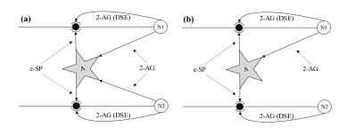
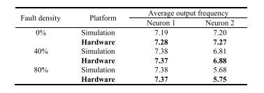
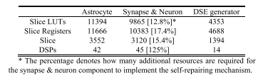
METHODOLOGY
§ 3-1 · PART A: REFERENCE PAPERS
SPANNER [3]: Astrocyte-Mediated Self-Repair (Liu 2018)
The astrocyte–neuron tripartite synapse mimics the brain's adaptive homeostasis for fine-grained fault tolerance.
1
When synapses fail, the astrocyte sends indirect feedback (e-SP) that raises the release probability of the healthy synapses.
BUT: 125% DSP overhead, no mathematical stability proof, and all PPA figures are reported relative to an unoptimised baseline.
2
Fully modular digital hardware — neuron, synapse, astrocyte — with pipelining that boosts throughput by 49%.
3
Graceful degradation: even at 80% synaptic fault density the performance loss is only 20%.
4
TABLE I — output frequency
TABLE II — hardware utilisation
Fig1:Tripartite synapse — self-repair
H-ASIZH · Ali Roshani · Sharif University of Technology
11 / 25
Notes:
SPANNER: astrocyte-mediated self-repair on FPGA. Strong graceful degradation, weak PPA reporting.

Slide 12
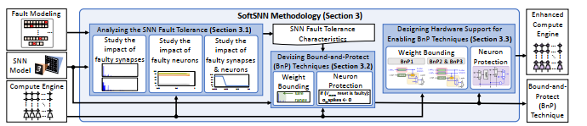
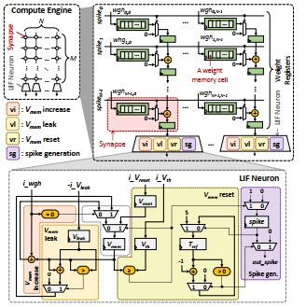
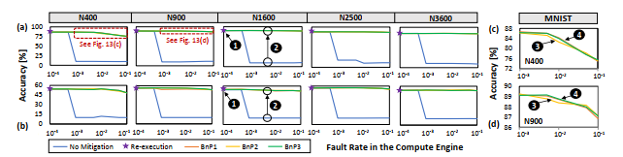
METHODOLOGY
§ 3-2 · PART A: REFERENCE PAPERS
SoftSNN [4]: Bound-and-Protect for Soft Errors (Putra 2022)
1
A run-time methodology that neutralises soft errors (bit-flips) in the weight registers without re-execution overhead.
BUT: only transient soft errors are covered, every PPA figure is a relative percentage, and no exhaustive fault scenario is given.
2
Bound-and-Protect clips abnormal weights and disables the neuron output when the critical Vmem reset operator fails
3
Radiation-hardened registers and lightweight MUX gates are integrated into the baseline compute engine.
4
Accuracy loss stays below 3% at the highest fault rates, with 3× lower latency and 2.3× energy savings.
Fig1:Bound-and-Protect flow
Fig2:Accuracy / latency / energy
Fig3:SNN accelerator architecture
H-ASIZH · Ali Roshani · Sharif University of Technology
12 / 25
Notes:
SoftSNN: bound-and-protect against soft errors in an ASIC SNN accelerator.

Slide 13
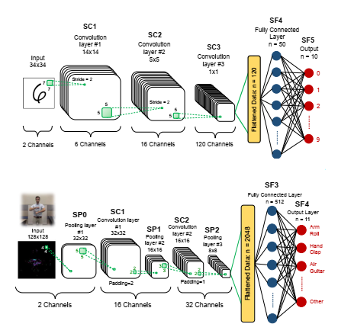
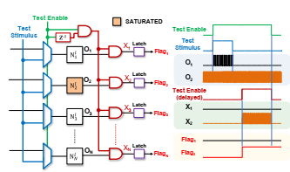
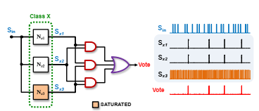
METHODOLOGY
§ 3-3 · PART A: REFERENCE PAPERS
Spyrou [5]: Neuron Fault Tolerance in SNNs (Spyrou 2021)
Fault models and dropout effect
I&F neuron + self-test + TMR
Multiple fault scenario results
1
Dual strategy for dead, saturated and timing-variation faults at behavioural level — no hardware redundancy in hidden layers.
2
Fault hopping: dropout training neutralises dead neurons, while online self-test converts saturated neurons into dead ones.
3
A 3-bit counter per neuron performs online saturation detection; TMR is applied only to the output layer (< 1% of neurons).
4
Full accuracy is preserved with 40% of hidden neurons dead — at the cost of just one control transistor per neuron.
BUT: no PPA report, no gate-level fault injection, and behavioural-level validation only — never real silicon.
H-ASIZH · Ali Roshani · Sharif University of Technology
13 / 25
Notes:
Spyrou 2021: neuron fault tolerance through dropout, self-test and output-layer TMR.

Slide 14
§ 3-4 · PART B: PROPOSED METHOD
H-ASIZH + GLFI Engine
Homeostatic-Adaptive Spiking Izhikevich Hardware, verified by a gate-level fault-injection engine.
1
Izhikevich Neuron
2
Homeostasis
3
GLFI Engine
Nonlinear ODE dynamics
Q7.19 fixed point, no multipliers
Plant–controller structure
Lyapunov UUB proof
Multi-agent LLM testbenches
Shadow-Hook fault injection
H-ASIZH · Ali Roshani · Sharif University of Technology
14 / 25
Notes:
Part B divider — the three pillars of the proposed method.

Slide 15
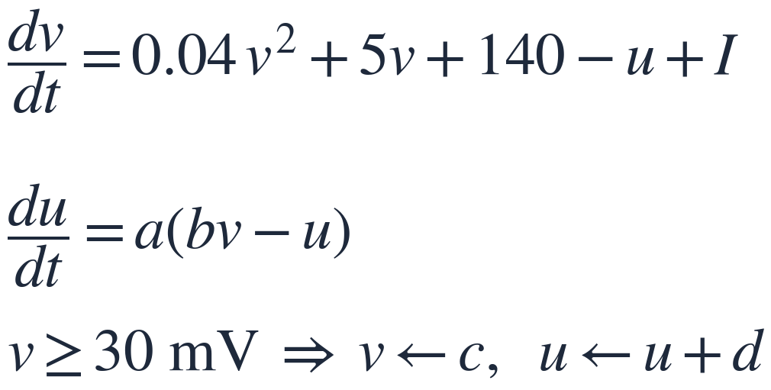
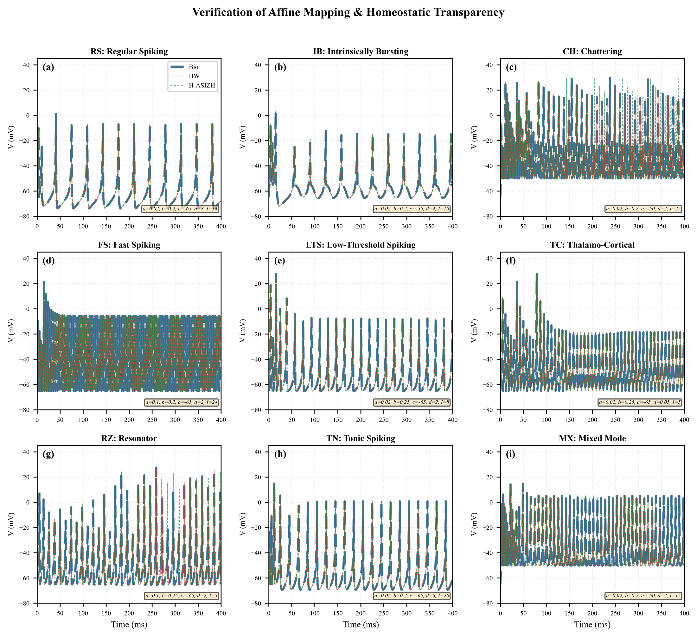
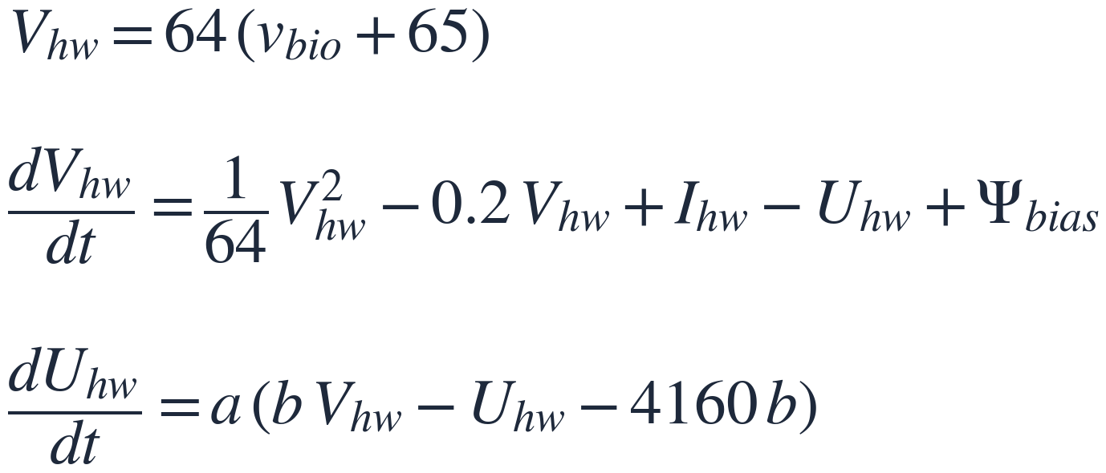
METHODOLOGY
§ 3-5 · PART B: PROPOSED METHOD
Mathematical Framework — From Biology to Hardware
STEP 1 · Continuous Izhikevich model (biological)
Nine Izhikevich spiking patterns — exact match
Signed range [−70, +30] mV · requires true multipliers
↓ AFFINE SHIFT + SCALE
STEP 2 · Hardware-mapped domain
[−65, +30] mV → [0, 1.48] · all positive, no sign bit
No signed arithmetic · shift-add only · phase portrait preserved
All nine patterns reproduced — RMSE < 10⁻¹³
H-ASIZH · Ali Roshani · Sharif University of Technology
15 / 25
Notes:
Affine mapping takes the biological Izhikevich model into an unsigned, multiplier-free hardware domain.

Slide 16

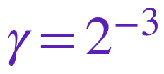
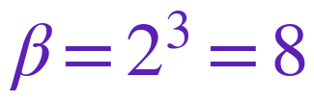
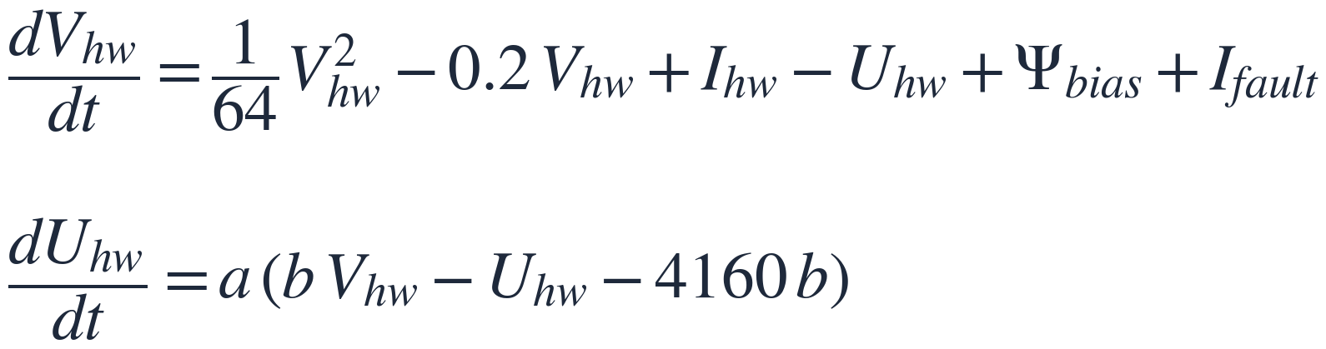
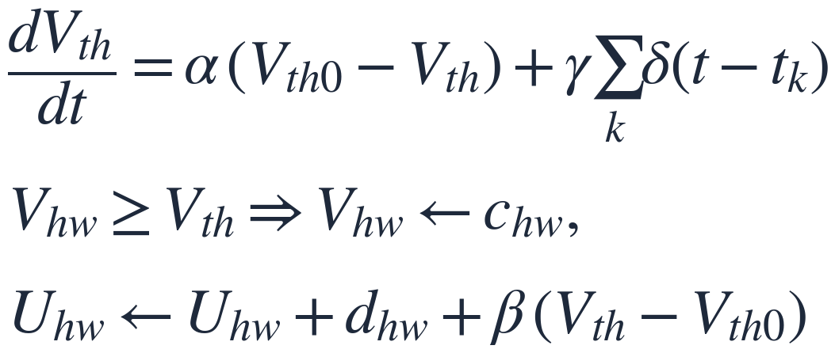
METHODOLOGY
§ 3-6 · PART B: PROPOSED METHOD
The H-ASIZH Homeostatic Controller
Leak Rate
Penalty Jump
Beta-Brake
Analogue of Ca²⁺ diffusion. Vth decays back to its baseline during normal firing.
Every spike penalises Vth by γ, so consecutive spikes choke a runaway seizure.
Regulates Uhw reset to prevent deep hyperpolarization and avoid dead neurons during faults.
The complete H-ASIZH ODE set
Plant (fast dynamics)
Controller (slow dynamics)
H-ASIZH · Ali Roshani · Sharif University of Technology
16 / 25
Notes:
Three power-of-two parameters (α, γ, β) and the full plant-controller ODE set.

Slide 17
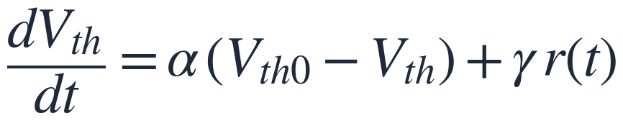
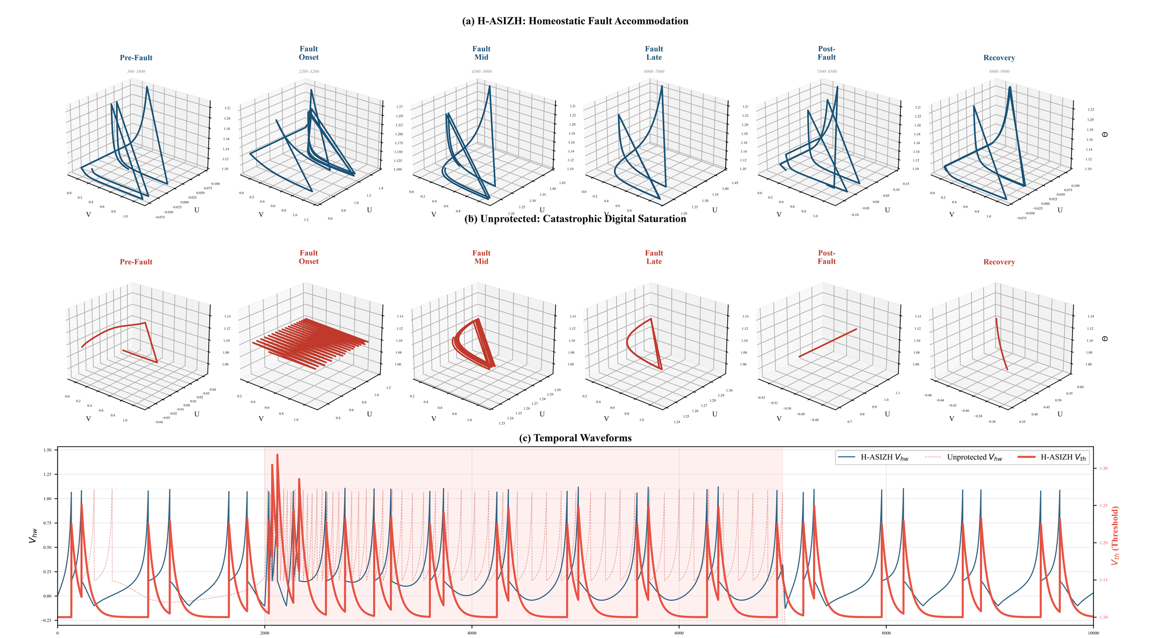
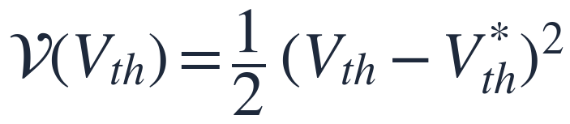
METHODOLOGY
§ 3-7 · PART B: PROPOSED METHOD
Lyapunov Stability Proof
STEP 1 · Averaging theorem
2-D limit cycle → 3-D homeostatic attractor
Dirac pulses are mapped onto a continuous mean firing rate r(t).
∂r/∂Vth < 0 — raising the threshold always reduces firing.
STEP 2 · Lyapunov function
Equilibrium: α(Vth0 − Vth*) + γ r* = 0
Positive definite for Vth ≠ Vth*, and zero at equilibrium.
STEP 3 · Lie derivative
The derivative is negative in both hyperactive and hypoactive states.
Q.E.D. — UUB guaranteed, digital saturation is impossible.
Normal: 2-D cycle · Fault: collapse · H-ASIZH: bounded 3-D attractor
H-ASIZH · Ali Roshani · Sharif University of Technology
17 / 25
Notes:
Three-step proof: averaging, Lyapunov candidate, Lie derivative — UUB is guaranteed.

Slide 18
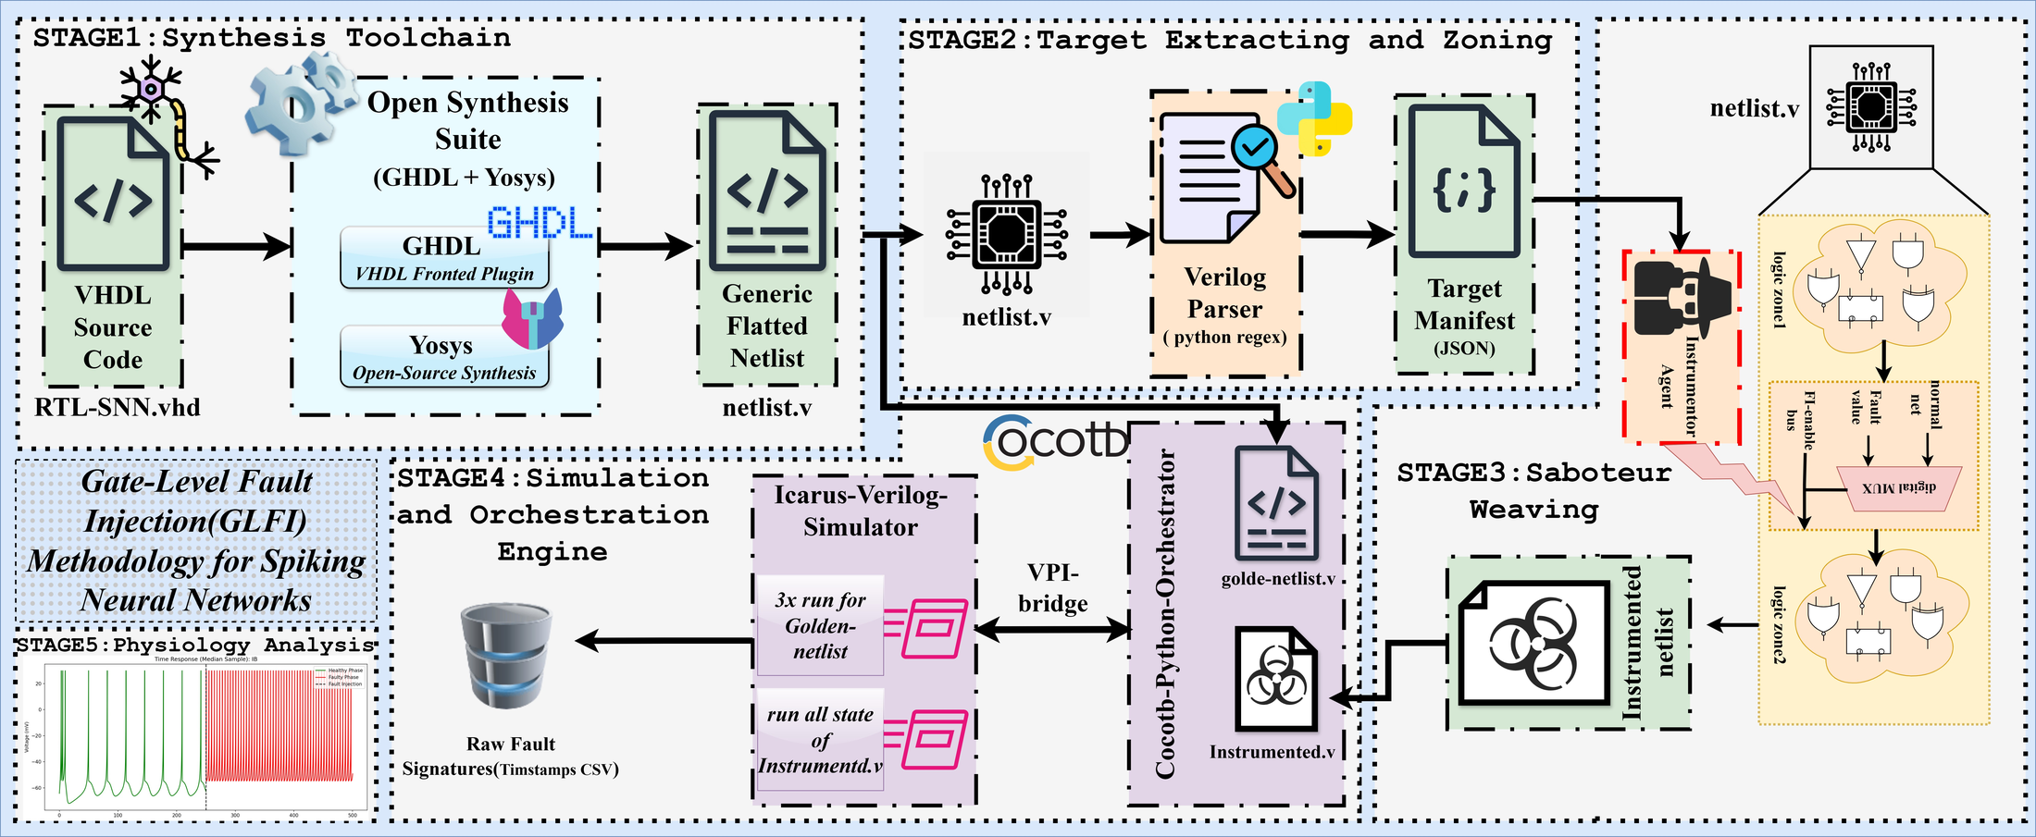
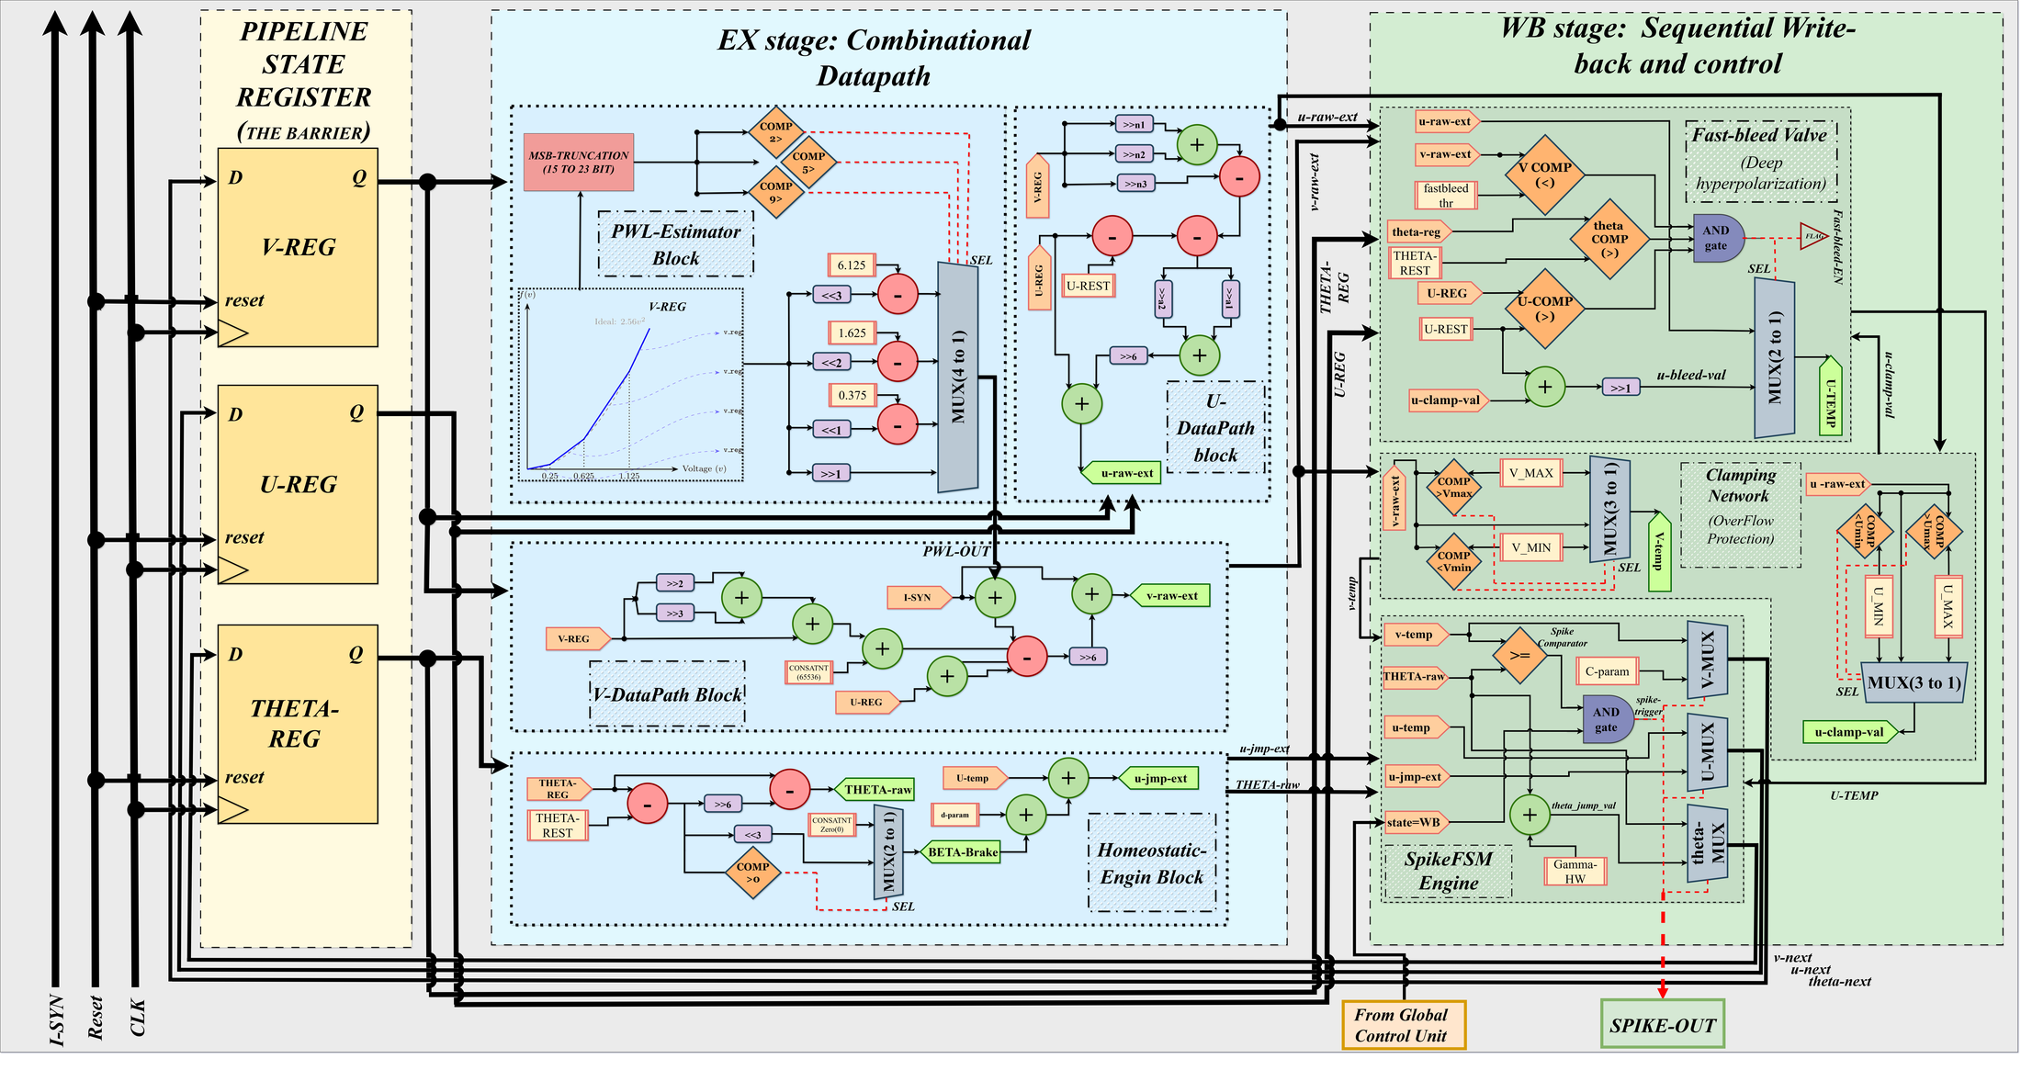
METHODOLOGY
§ 3-8 · PART B: PROPOSED METHOD
Micro-Architecture + GLFI Framework
1
Izhikevich neuron with the affine mapping Vhw = 64 (vbio + 65) — no multipliers, shift-add only.
2
Plant–controller homeostasis with Lyapunov-proven UUB stability — saturation is ruled out mathematically.
3
GLFI Engine Mark I: a multi-agent LLM generates the Cocotb testbenches; Shadow Hook injects SA0 / SA1 faults.
4
Four-valued logic (0,1,X,Z) models bridging and stuck-open defects that binary simulators cannot express.
5
An exhaustive campaign sweeps five PPA models, from the bare baseline through to full TMR.
Fig2:H-ASIZH neuron core architecture
Fig1:GLFI engine — fault-injection architecture
H-ASIZH · Ali Roshani · Sharif University of Technology
18 / 25
Notes:
Neuron core micro-architecture alongside the GLFI fault-injection framework.

Slide 19
§ 4 · RESULTS
Results & Analysis
Power, performance and area · the GLFI campaign · reliability metrics · on-chip learning
95.8%
4093
91.4 mW
84.3%
Functional survival
under exhaustive GLFI
Standard cells
SkyWater 130 nm
Total power
at 62 MHz
On-chip SDSP
learning accuracy
H-ASIZH · Ali Roshani · Sharif University of Technology
19 / 25
Notes:
Results divider with the four headline numbers.

Slide 20
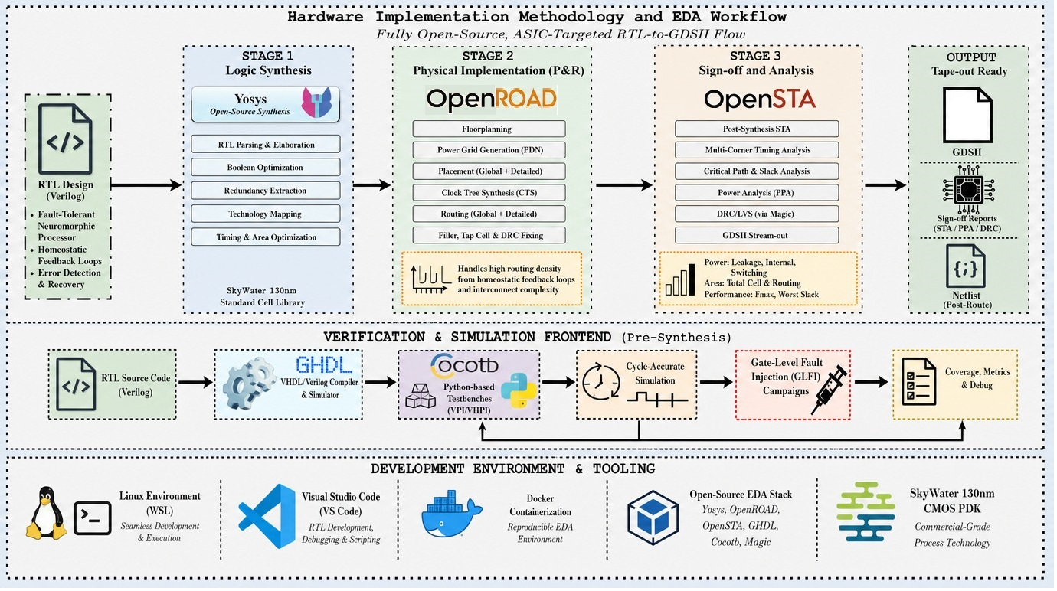
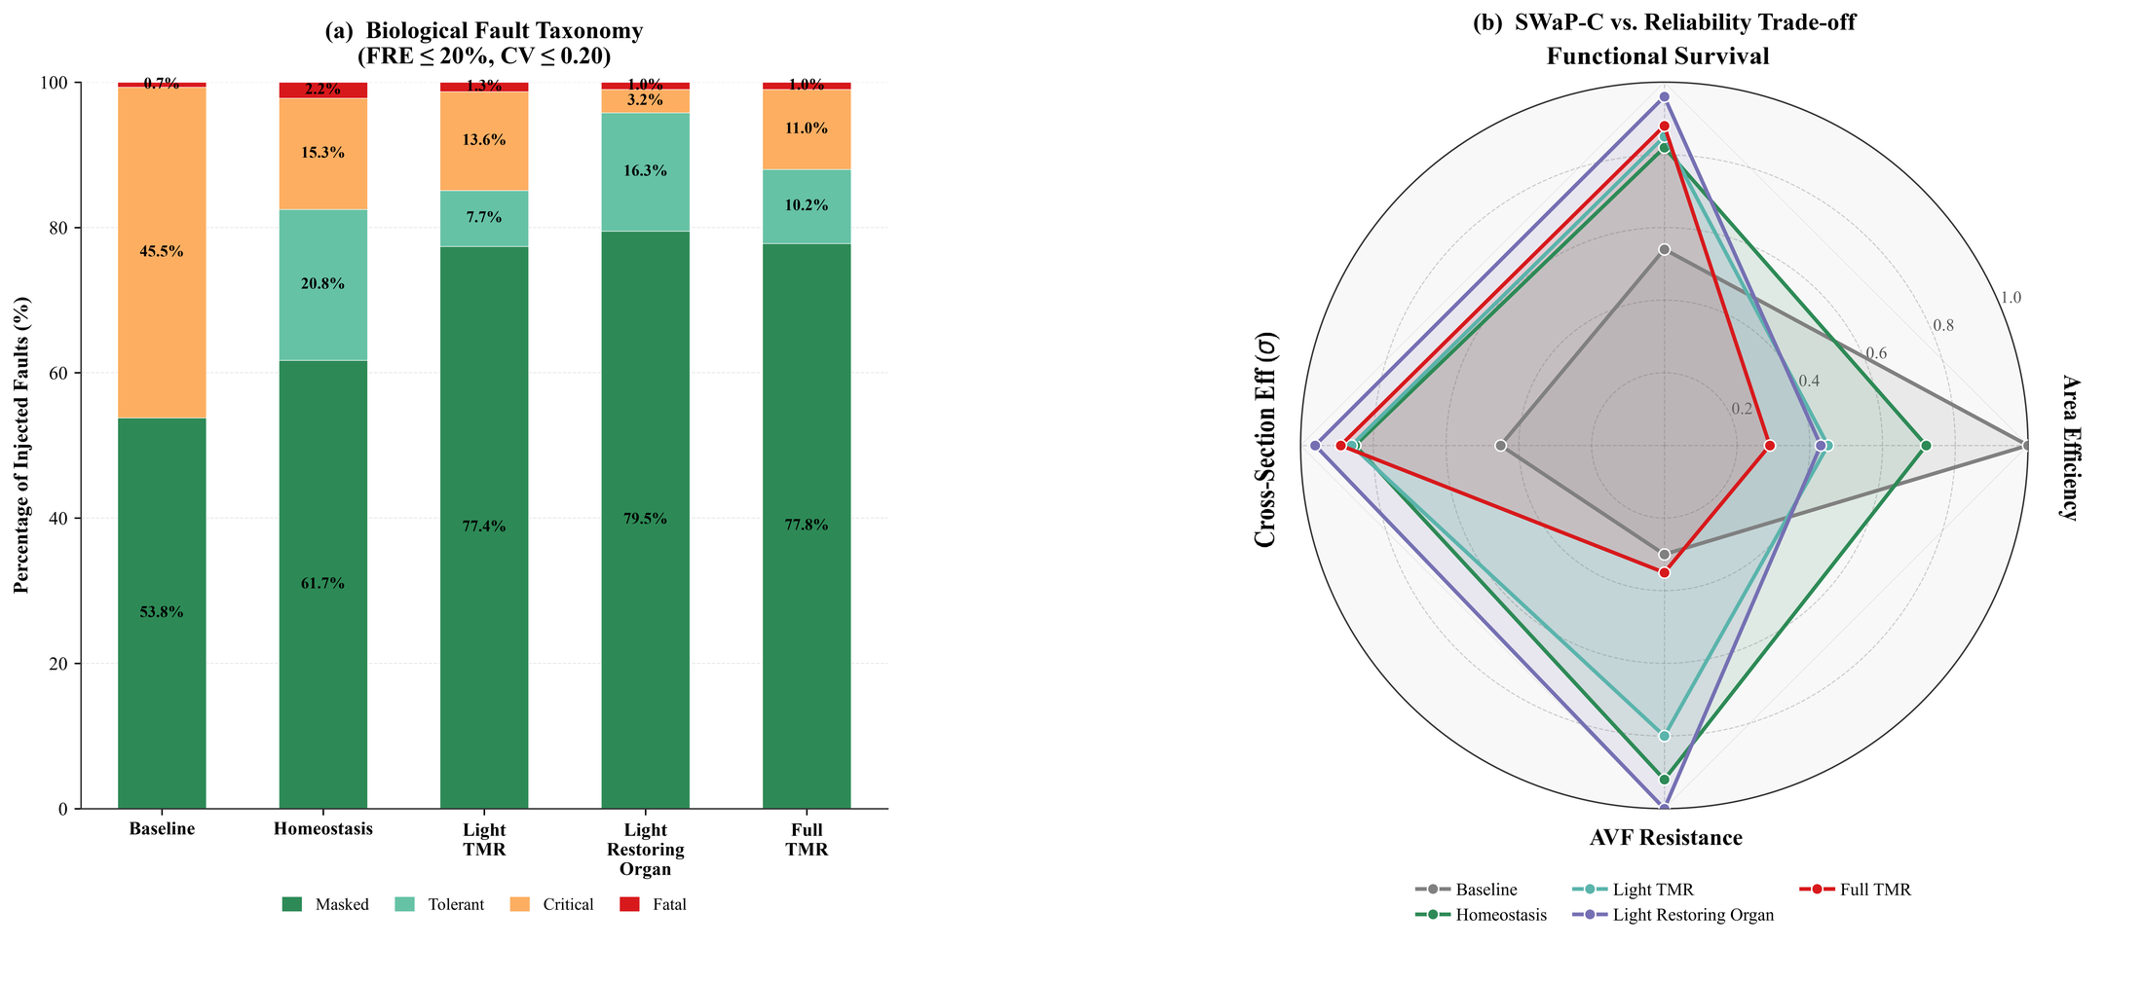
RESULTS
§ 4-1 · PPA & GLFI RESULTS
Synthesis Results & Exhaustive Fault Injection
1. Baseline
2. Homeostasis
3. Light TMR
4. Restoring Organ
1,772 cells
2,469 cells
3,969 cells
4,093 cells
83.6 MHz · 30.7 mW
64.9 MHz · 52.8 mW
64.2 MHz · 88.5 mW
62.1 MHz · 91.4 mW
Fig2:GLFI campaign — 100% fault coverage
Fig1:EDA workflow — fully open-source RTL-to-GDSII flow
H-ASIZH · Ali Roshani · Sharif University of Technology
20 / 25
Notes:
PPA across five variants and the exhaustive gate-level fault-injection campaign.

Slide 21
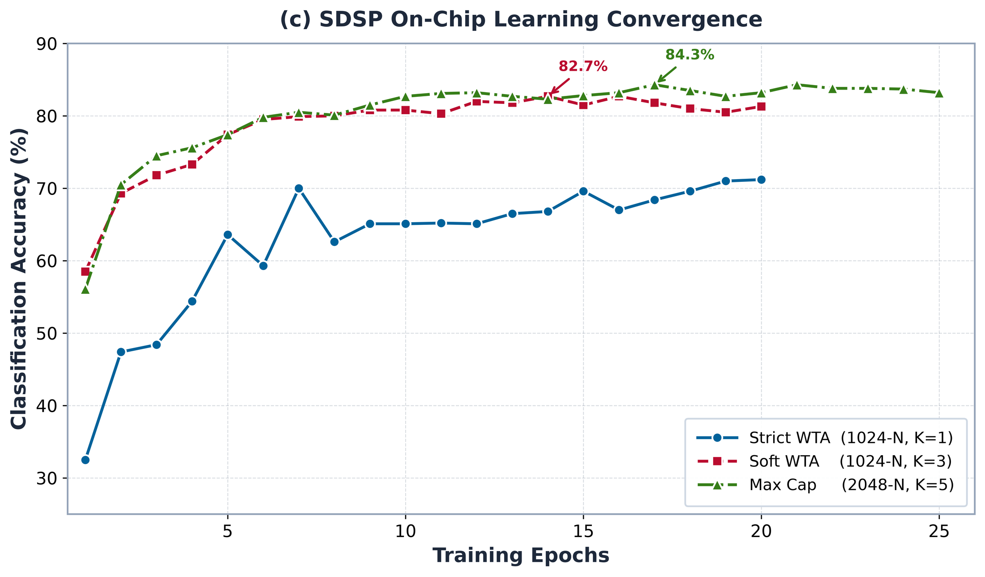
RESULTS
§ 4-2 · RELIABILITY & LEARNING
Four-Dimensional Reliability Analysis + On-Chip Learning
Area Efficiency
SDSP on-chip learning — convergence
1
H-ASIZH adds 39% more cells, where full TMR adds 240%.
Functional Survival
2
The highest survival rate of all variants, through graceful degradation.
AVF Resistance
3
Triple defence: anti-windup clamping, fast-bleed and beta-brake.
Cross-Section Efficiency (σ)
84.3%
on-chip learning accuracy
4
Soft WTA (K = 3): 82.7% — converges within 15–20 epochs
Survival parity with full TMR at a fraction of the overhead.
H-ASIZH · Ali Roshani · Sharif University of Technology
21 / 25
Notes:
Reliability across four dimensions plus SDSP on-chip learning convergence.

Slide 22
FUTURE WORK
§ 5 · FUTURE WORK
From Fault Tolerance to Next-Generation Systems
1
Spiking YOLO & UAV Accelerators
2
Biocompatible Neuroprosthetics
R-STDP for real-time object detection, and an ASIC UAV processor fortified with adaptive homeostasis against atmospheric radiation.
EEG/EMG-driven on-chip learning at µW power, with thermal safety and zero-failure tolerance for bionic limbs and BCIs.
3
Spiky Transformers & LLMs
4
Self-Healing Silicon
Spiking self-attention carried by spike timing — MACs replaced by accumulators, giving mW-level NLP on edge devices.
R-STDP combined with homeostasis for online repair: healthy neighbours recalibrate and absorb the load after damage.
“Adaptive homeostasis — the DNA of tomorrow's processors.”
H-ASIZH · Ali Roshani · Sharif University of Technology
22 / 25
Notes:
Four directions for future work.

Slide 23
CLOSING STATEMENT
This work is not merely a noise-mitigation strategy — it is the DNA of tomorrow's processors.
Whether we are grafting a neuroprosthetic hand, building a radiation-hardened drone, or running an LLM on a smartwatch, we need silicon that learns, consumes µW of power, heals itself, and stays thermally optimal.
This is the road ahead for neuromorphic architectures.
Learns
µW Power
Self-Healing
Thermally Safe
H-ASIZH — Homeostatic-Adaptive Spiking Izhikevich Hardware
H-ASIZH · Ali Roshani · Sharif University of Technology
23 / 25
Notes:
Closing statement.

Slide 24
FUTURE WORK
REFERENCES · 1 OF 2
References
[1]
R. Karamimanesh et al., “Spiking neural networks on FPGAs: a comprehensive review of implementations and methodologies,” IEEE Access, vol. 13, 2025.
[2]
M. Capra, B. Bussolino, A. Marchisio, G. Masera, M. Martina and M. Shafique, “Hardware and software asymmetries in deep neural networks: an overview,” IEEE Access, vol. 8, pp. 192844–192867, 2020.
[3]
J. Liu, J. Harkin, L. P. Maguire, L. J. McDaid and J. J. Wade, “SPANNER: a self-repairing spiking neural network hardware architecture,” IEEE Trans. Neural Netw. Learn. Syst., vol. 29, no. 4, pp. 1287–1300, 2018.
[4]
R. V. W. Putra, M. A. Hanif and M. Shafique, “SoftSNN: low-cost fault tolerance for spiking neural network accelerators under soft errors,” Proc. 59th ACM/IEEE DAC, pp. 151–156, 2022.
[5]
T. Spyrou et al., “Neuron fault tolerance in spiking neural networks,” Proc. DATE, pp. 743–748, 2021.
[6]
D. Xu et al., “Reliability evaluation and analysis of FPGA-based neural network acceleration system,” IEEE Trans. VLSI Syst., vol. 29, no. 3, pp. 472–484, 2021.
[7]
C. Liu et al., “Special session — fault-tolerant deep learning: a hierarchical perspective,” Proc. IEEE VTS, 2022.
[8]
C. Calaim et al., “Geometry of resilience in spiking neural networks,” Nature Communications, 2022.
[9]
A. Siddique et al., “FalVolt: fault-tolerant voltage scaling for neuromorphic architectures,” IEEE Trans. VLSI Syst., 2023.
[10]
M. Monopoli et al., “RADSAFiE: a netlist-level fault injection user interface application for FPGA-based digital systems,” IEEE Access, vol. 13, pp. 28809–28823, 2025.
[11]
J.-D. Guerrero-Balaguera et al., “SHADOWFI: an open-source framework for fault evaluation of complex IC designs using hyperscale computing,” IEEE Access, vol. 13, pp. 211382–211406, 2025.
[12]
M. Davies et al., “Loihi: a neuromorphic manycore processor with on-chip learning,” IEEE Micro, vol. 38, no. 1, pp. 82–99, 2018.
[13]
F. Groenen, A. Shahsavari et al., “GazeSCRNN: gaze tracking using DVS cameras and spiking neural networks,” arXiv:2503.16012, 2025.
H-ASIZH · Ali Roshani · Sharif University of Technology
24 / 25
Notes:
References.

Slide 25
FUTURE WORK
REFERENCES · 2 OF 2
References
[14]
C. Hens, A. Shahsavari et al., “LAST-PAIN: learning adaptive spike thresholds for low-back-pain biosignal classification,” arXiv preprint, 2025.
[15]
R. V. W. Putra, M. A. Hanif and M. Shafique, “RescueSNN: energy-efficient fault tolerance for spiking neural networks considering unreliable memories,” Proc. IEEE/ACM ICCAD, 2021.
[16]
E. M. Izhikevich, “Simple model of spiking neurons,” IEEE Trans. Neural Netw., vol. 14, no. 6, pp. 1569–1572, 2003.
[17]
P. A. Merolla et al., “A million spiking-neuron integrated circuit with a scalable communication network and interface,” Science, vol. 345, no. 6197, pp. 668–673, 2014.
[18]
S. B. Furber et al., “The SpiNNaker project,” Proc. IEEE, vol. 102, no. 5, pp. 652–665, 2014.
[19]
S. Y. Yerima et al., “Fault tolerance in hardware architectures for neural networks: a review,” IEEE Access, 2023.
[20]
T. Spyrou et al., “Reliability analysis of a spiking neural network hardware accelerator,” Proc. DATE, 2022.
[21]
S. A. El-Sayed et al., “Spiking neuron hardware-level fault modeling,” Proc. IEEE IOLTS, 2020.
[22]
P. R. Santos et al., “Defect-oriented mixed-level fault simulation of digital systems,” Proc. IEEE ITC, 1999.
[23]
S. A. El-Sayed et al., “Compact functional testing for neuromorphic computing circuits,” IEEE Trans. CAD, vol. 42, no. 7, pp. 2391–2403, 2023.
[24]
J. Geier et al., “Techniques and tools for fast fault injection simulations of RISC-V processors at RTL,” Proc. RISC-V Summit Europe, 2024.
[25]
S. A. El-Sayed et al., “Self-testing analog spiking neuron circuit,” Proc. SMACD, pp. 81–84, 2019.
H-ASIZH · Ali Roshani · Sharif University of Technology
25 / 25
Notes:
References.

