Slide 1



SHARIF UNIVERSITY OF TECHNOLOGY
Fault-Tolerant Deep Neural Network
Hardware Accelerator Design
for Image and Video Processing Applications
M.Sc. THESIS · RESEARCH PROGRESS REPORT
Presented by Ali Roshani
Supervisors Dr. Mohsen Ansari & Dr. Mohammad T. Manzuri Shalmani
Date Aban 1405 · November 2026
Cyber-Physical Systems Laboratory
1 / 30
Notes:
Title slide. Seminar presentation — Fault-tolerant DNN hardware accelerator design, H-ASIZH.

Slide 2

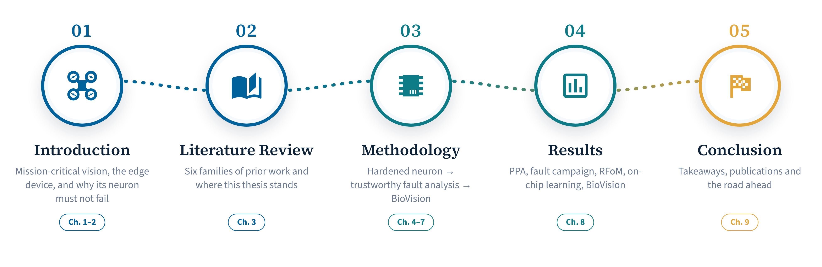
ROADMAP
Outline
01
Introduction
02
Literature
03
Methodology
04
Results
05
Conclusion
THESIS STATEMENT
The system can share the load, but not the responsibility: fault tolerance must move down the stack — from the system to the accelerator, and into the neuron.
M.Sc. Thesis
‹
2 / 13
›

Slide 3
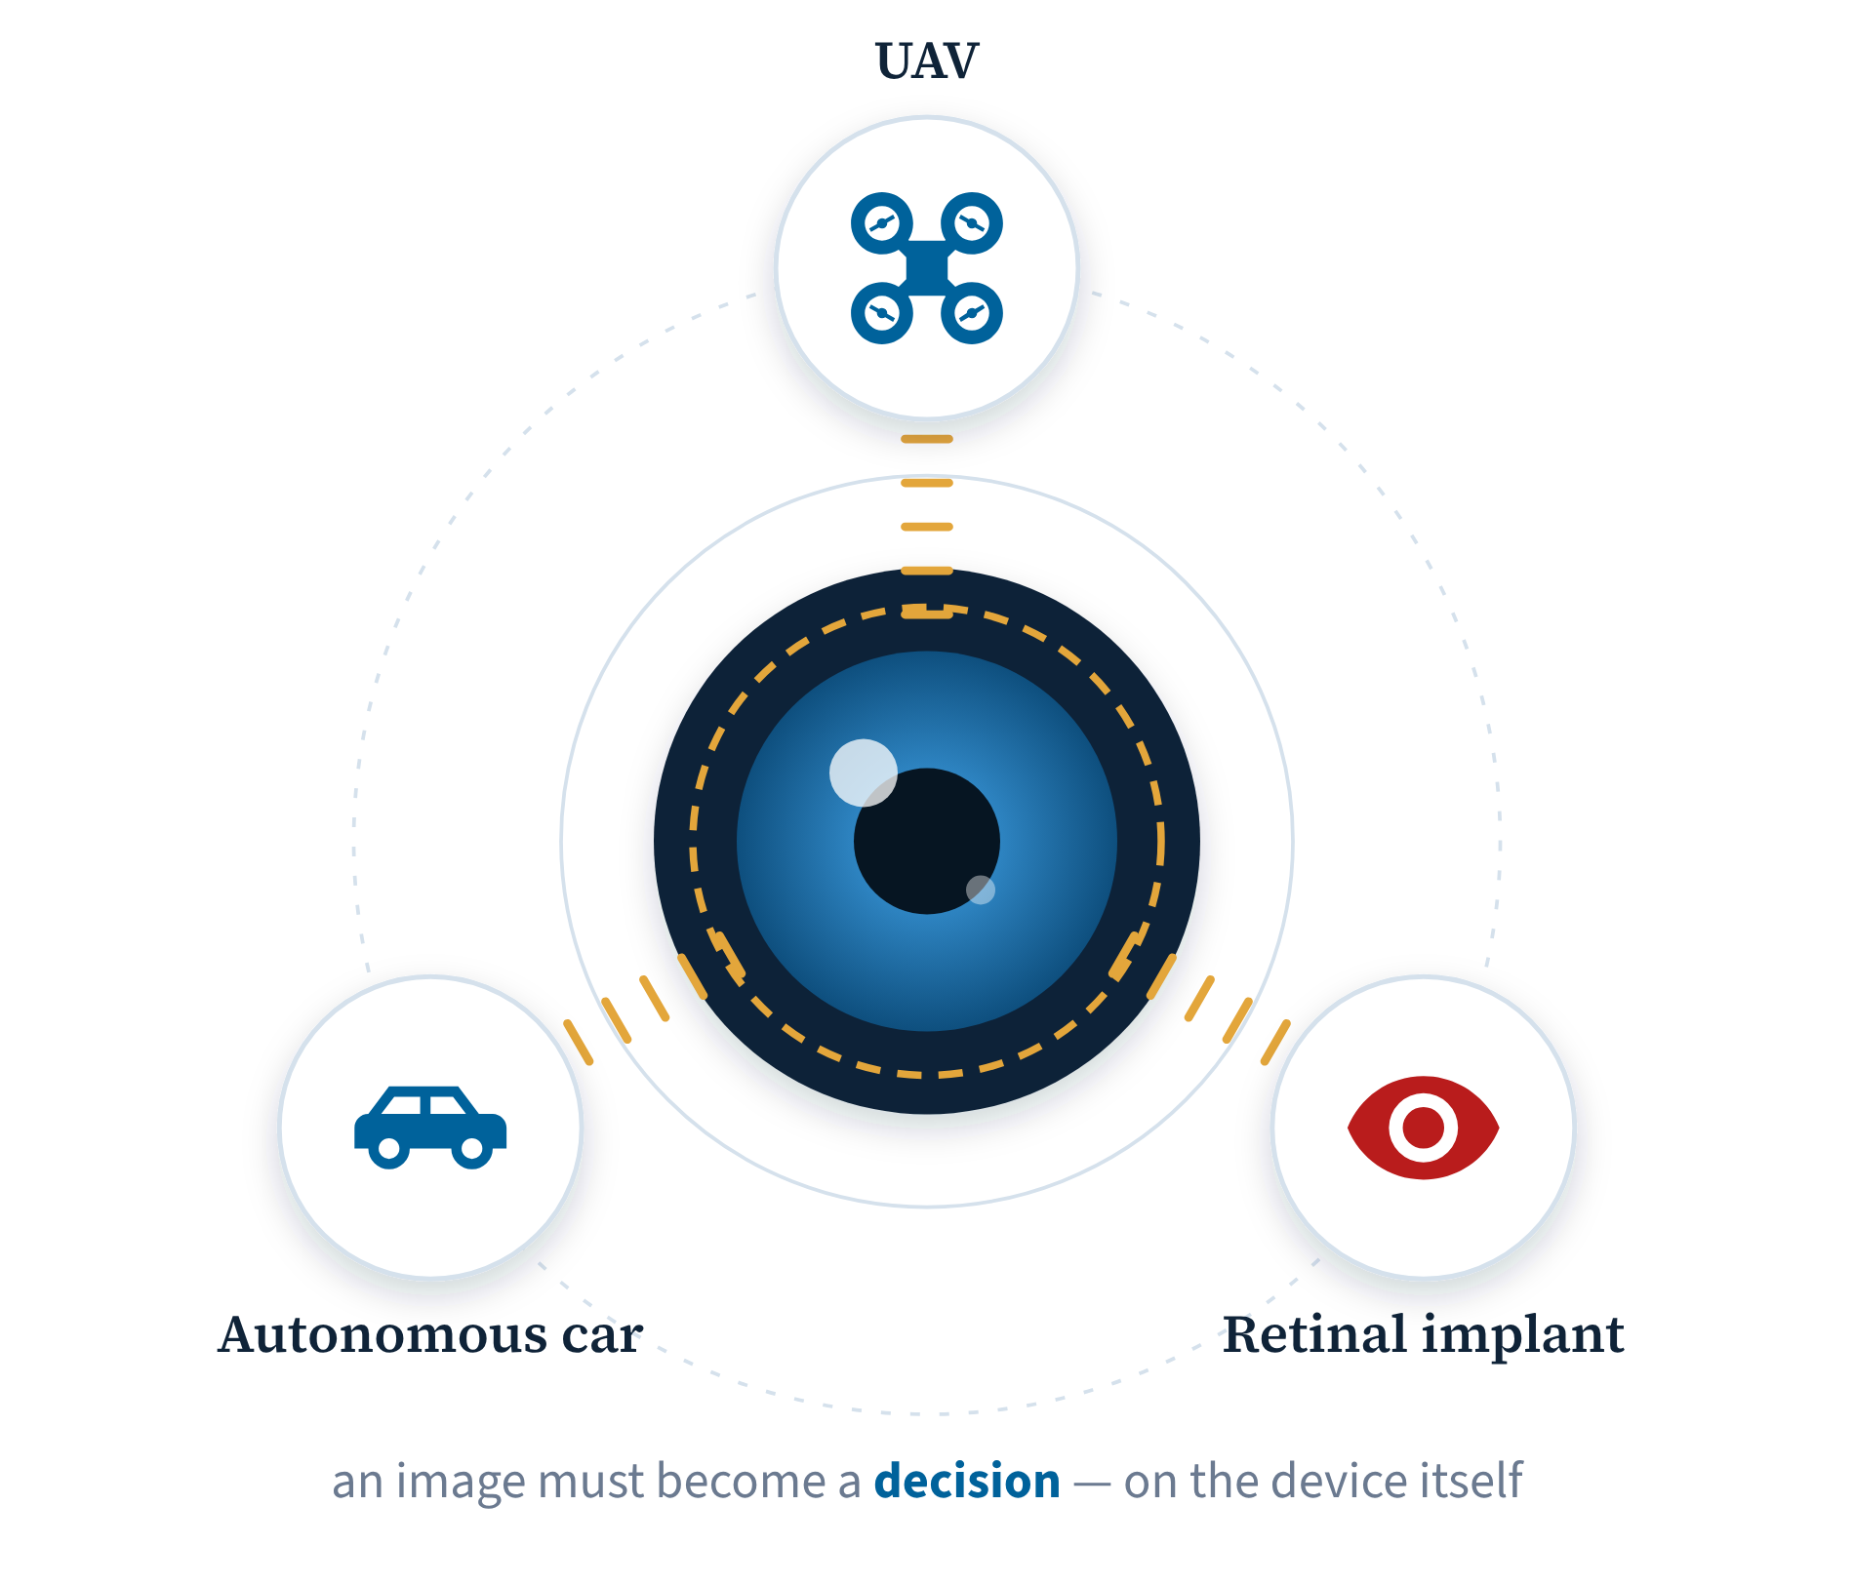
01
Introduction
01 Introduction
02 Literature Review
03 Methodology
04 Results
05 Conclusion
‹
3 / 13
›

Slide 4
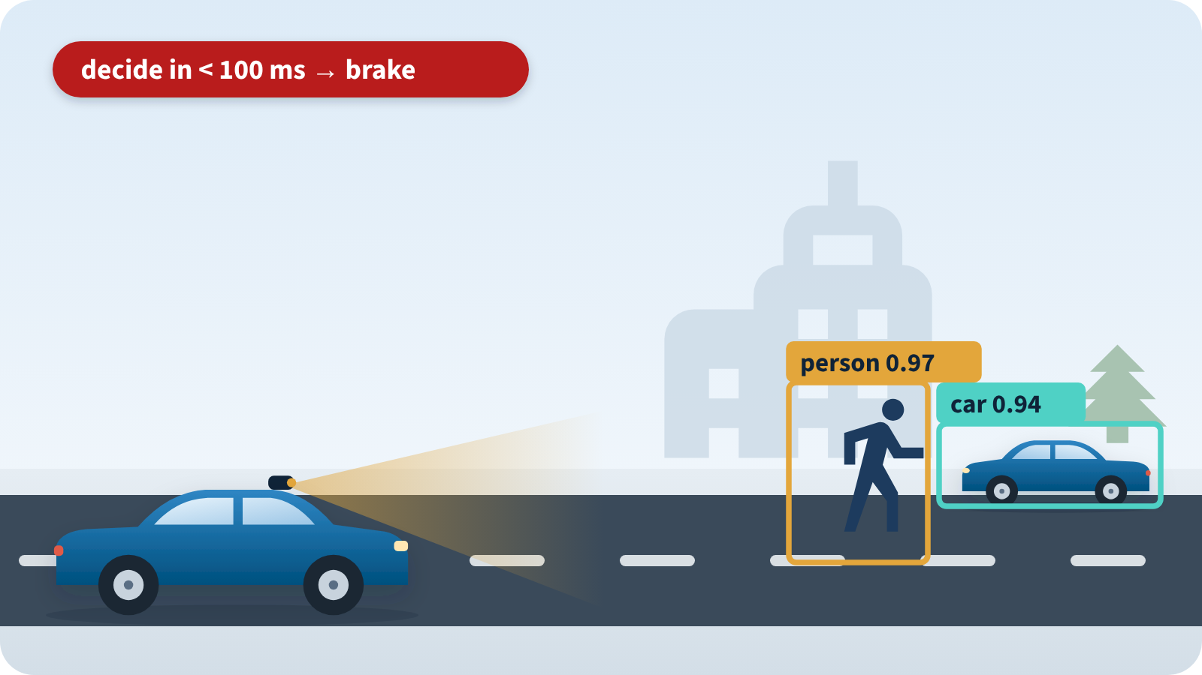
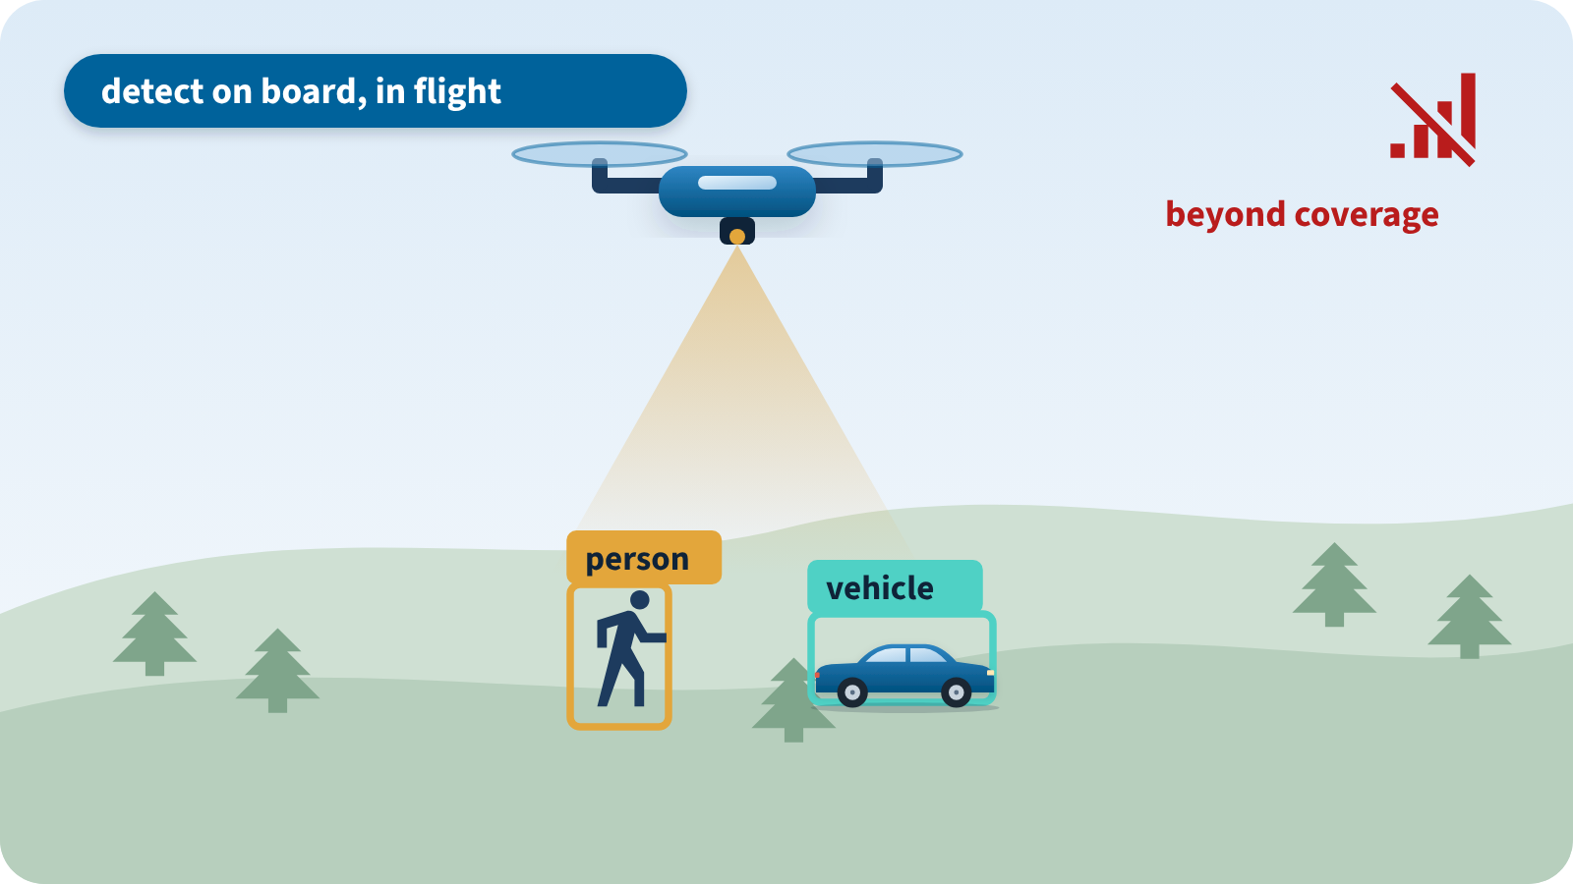
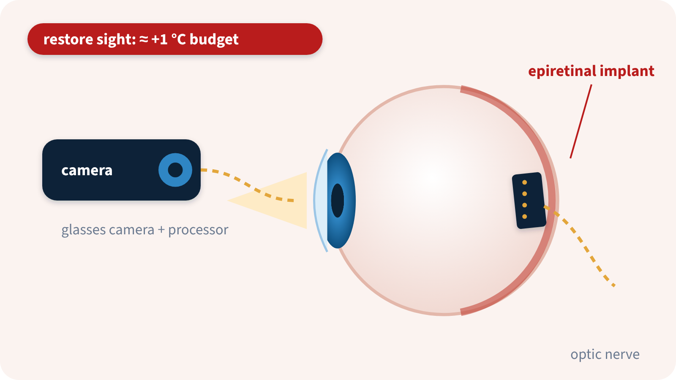
01 · INTRODUCTION
Our Thesis and Where It Matters
01
Introduction
THIS THESIS
A fault-tolerant hardware accelerator for image and video processing — dependable vision on the device itself.
02
Literature
03
Methodology
04
Results
Autonomous vehicles
UAVs and robots
Retinal implants
On-board perception must decide within milliseconds.
Detection must keep working in flight, beyond coverage.
Artificial sight for the blind runs inside the body.
05
Conclusion
A missed obstacle is a safety failure.
No repair until the mission ends.
≈ +1 °C budget; repair means surgery.
Common need: real-time · low-power · dependable image processing at the extreme edge
M.Sc. Thesis
Safety: ISO 26262 (road vehicles) · Implant thermal limit ≈ +1 °C: Kim et al., IEEE TNSRE 2007 · Retinal prostheses: refs. [62, 63] of Ch. 1
‹
4 / 13
›

Slide 5
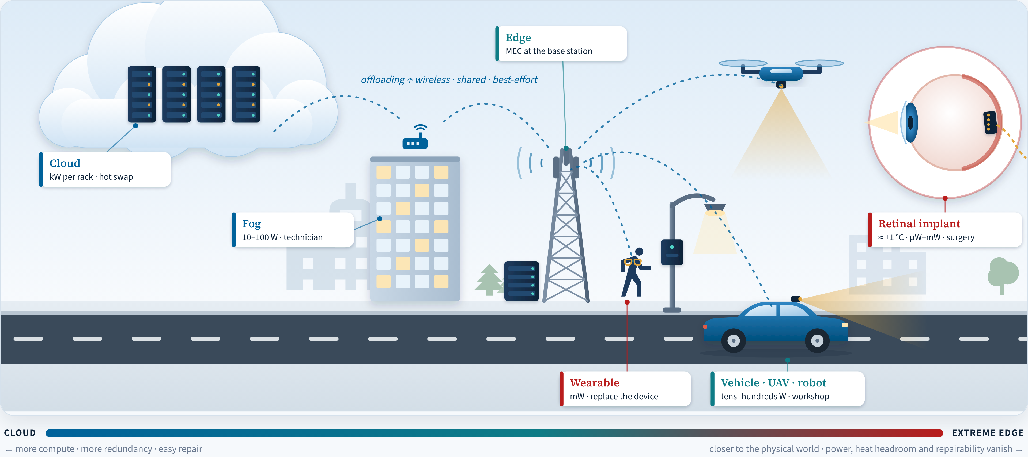
01 · INTRODUCTION
Where Should the Computation Live?
01
Introduction
02
Literature
03
Methodology
04
Results
05
Conclusion
The systems answer was offloading — it quietly assumes the end device is a correct black box
M.Sc. Thesis
Cloudlets: Satyanarayanan 2009 · Fog: Bonomi 2012 · Edge: Shi 2016 · Platform power: Capra et al. 2020 · Implant limit: Kim et al. 2007 (thesis Table 1.1)
‹
5 / 13
›

Slide 6








01 · INTRODUCTION
Why Offloading Fails Safety-Critical Vision
01
Introduction
01 Time & determinism
02 Connectivity
Latency becomes a distribution: 1 % slow servers make 63 % of requests slow.
Coverage gaps, jamming and tissue attenuation cut the link when it is needed most.
02
Literature
03 Energy & heat
04 Security & privacy
Sending 1 kbit over 100 m costs as much energy as 3 M instructions.
Every hop is an attack surface; split learning leaks private data.
03
Methodology
05 Dependability & certification
06 Silent data corruption
An open, shared chain cannot be certified to IEC 61508 / ISO 26262.
Even cloud cores corrupt data silently — a few per several thousand machines.
04
Results
07 Scale & economics
08 Environment & modelling
05
Conclusion
Spectrum and fog / MEC infrastructure are finite and costly to run.
Radiation, heat and vibration hit the device anyway; offloading models assume it is correct.
8 weakness groups → the critical perception–decision loop must close on the device itself
M.Sc. Thesis
Dean & Barroso 2013 · Pottie & Kaiser 2000 · Pasquini et al. 2021 · Koopman & Wagner 2016 · Hochschild et al. 2021 · Dixit et al. 2021 · Baumann 2005
‹
6 / 13
›

Slide 7
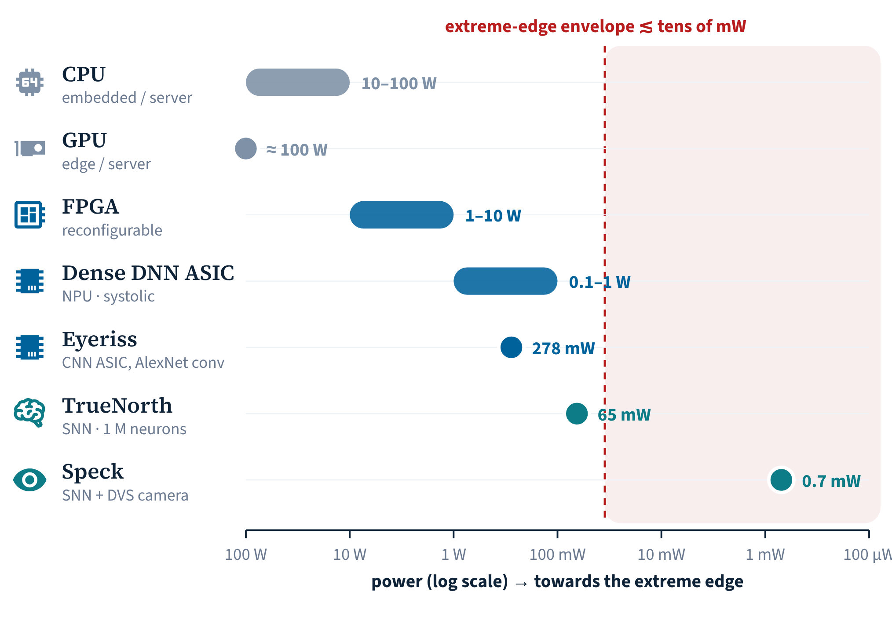



01 · INTRODUCTION
Which Accelerator for the Extreme Edge?
01
Introduction
Dense NPU / systolic ASIC
Efficient for CNNs — but computes every pixel, every frame.
02
Literature
QNN · TinyML
03
Methodology
Quantisation and pruning shrink the model, not the dense computation.
04
Results
✓ OUR CHOICE
SNN · neuromorphic
Computes only on spikes — event-driven, sparse, mW-scale.
05
Conclusion
So we build our own extreme-edge device on SNN — local · real-time · within power and heat · accurate
M.Sc. Thesis
Capra et al. 2020 (platform power) · Chen et al. 2017 (Eyeriss) · Akopyan et al. 2015 (TrueNorth) · Yao et al. 2024 (Speck) · implant envelope: Kim et al. 2007
‹
7 / 13
›

Slide 8
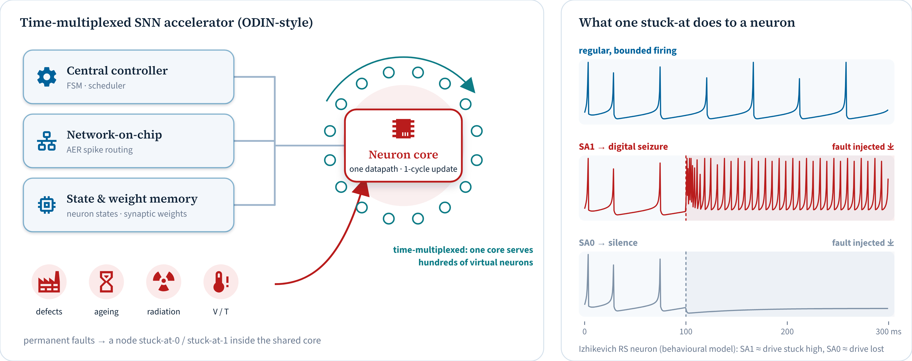
01 · INTRODUCTION
Why Dependability Must Be Built In
01
Introduction
02
Literature
03
Methodology
04
Results
05
Conclusion
Alone at the edge, nothing can outvote a faulty core → harden the shared neuron core first
M.Sc. Thesis
Frenkel et al. 2019 (ODIN) · Izhikevich 2003 · Baumann 2005 · Vatajelu et al. 2019 · Spyrou et al. 2021 · Hochschild et al. 2021
‹
8 / 13
›

Slide 9





01 · INTRODUCTION
Research Gaps and Contributions
01
Introduction
THE GAP
OUR ANSWER
G1 No deterministic guarantees
C1 · H-ASIZH neuron core
Phase 1
deadline · power · energy · accuracy met only statistically
Deterministic by design: one-cycle update, Lyapunov-bounded, 182.8 µW for two cores.
02
Literature
G2 Standards rarely met
C2 · GateScan
Phase 2
e.g. ISO 14708: ≤ 2 °C implant heating
Certified fault brackets instead of percentages — evidence a standard can accept.
03
Methodology
G3 The device is assumed correct
C1 · H-ASIZH neuron core
Phase 1
reliability, availability, security barely studied
A self-protecting core: more than 4× better than full TMR, with one-third less silicon.
04
Results
G4 Neuromorphic is not mature
C3 · BioVision
Phase 3
still below YOLO-class accuracy on COCO
Brain-like spiking vision with local learning: classification done, COCO detection next.
05
Conclusion
G5 No learning in the field
C4 · On-chip learning
Phase 1
devices drift and wear; learning stops
STDP learning on the hardened core: 1020 / 1024 neurons stay active, 81.8 % on MNIST.
Out of scope: security attacks and rare long-tail events.
M.Sc. Thesis
Buttazzo, Hard Real-Time Computing Systems · ISO 14708-1:2014 · ISO 26262:2018 · Roshani et al., TCAS-I (submitted) · Roshani et al., GateScan, TCAD (draft)
‹
9 / 13
›

Slide 10
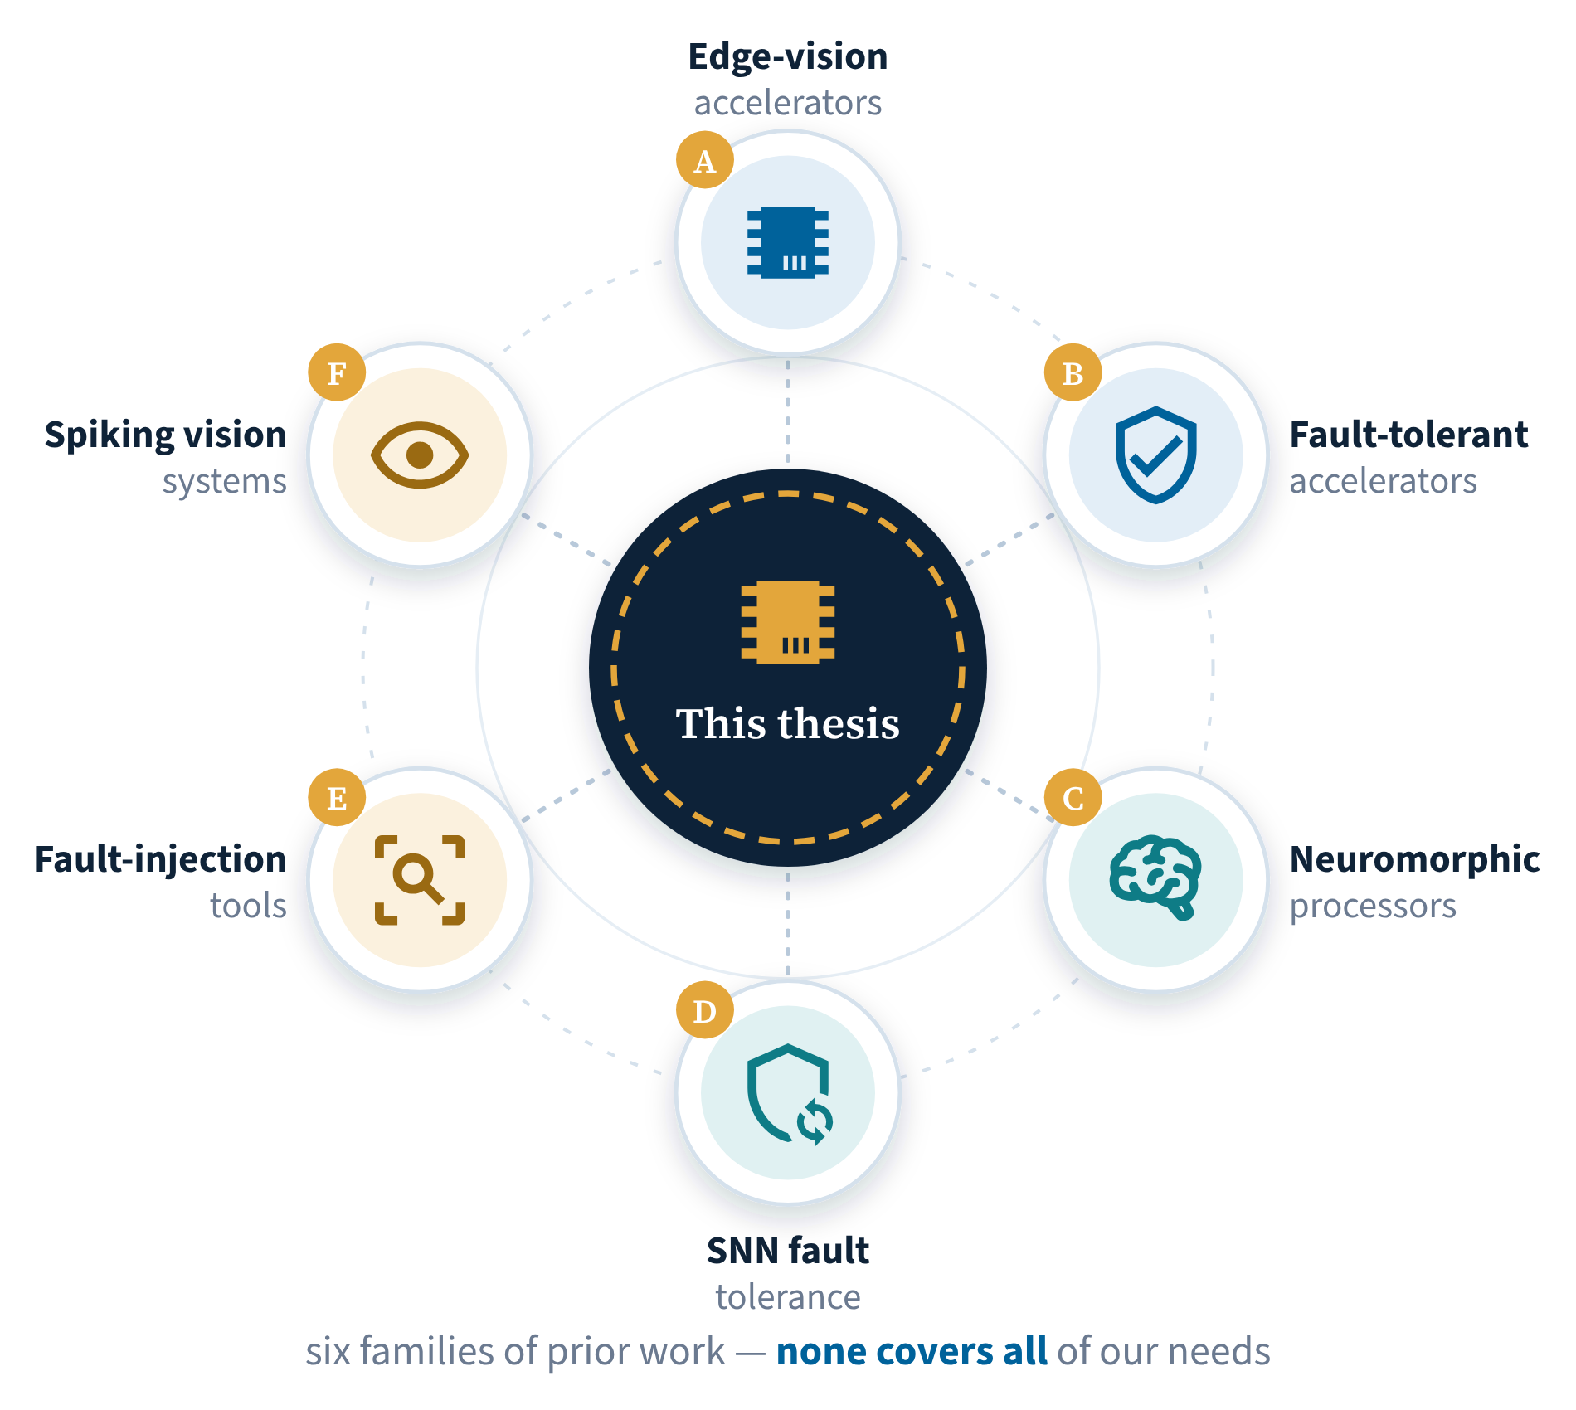
02
Literature Review
01 Introduction
02 Literature Review
03 Methodology
04 Results
05 Conclusion
‹
10 / 13
›

Slide 11
02 · LITERATURE REVIEW
Where This Thesis Stands
01
Introduction
Family | Work | Edge vision | Hardware |  | Accelerator type | Fault tolerance |  | Fault-assessment campaign | On-chip learning
 |  |  | ASIC | FPGA |  | Permanent | Transient
A Edge-vision accelerators | Eyeriss · JSSC 2017 | ✓ | ✓ 65 nm | ✗ | CNN PE array | ✗ | ✗ | ✗ | ✗
 | Suh et al. (UAV) · TRETS 2023 | ✓ | ✗ | ✓ | CNN engine | ✗ | ✗ | ✗ | ✗
B Fault-tolerant accelerators | Zhang et al. · VTS 2018 | ✗ | ◐ model | ✗ | Systolic array | ✓ stuck-at | ✗ | behavioural simulation | ✗
 | YOLO on Versal (BYU) · 2026 | ◐ space | ✗ | ✓ | CNN engine | ✗ | ✓ SEU | config-memory injection + proton beam | ✗
C Neuromorphic processors | ODIN · TBioCAS 2019 | ◐ MNIST | ✓ 28 nm | ✗ | Neuromorphic NPU | ✗ | ✗ | ✗ | ✓
 | Speck · Nat. Commun. 2024 | ✓ DVS | ✓ | ✗ | Neuromorphic NPU | ✗ | ✗ | ✗ | ✗
 | Loihi 2 · 2021 | ✗ | ✓ Intel 4 | ✗ | Neuromorphic NPU | ✗ | ✗ | ✗ | ✓
D SNN fault tolerance | Spyrou et al. · DATE 2021 | ◐ N-MNIST | ✗ | ✗ | SW model | ✓ dead / sat. | ✗ | behavioural | ✗
 | SoftSNN · DAC 2022 | ◐ MNIST | ✓ 65 nm | ✗ | Neuromorphic NPU | ✗ | ✓ soft err. | behavioural | ✗
 | RescueSNN · Front. Neuro. 2023 | ◐ MNIST | ✓ 65 nm | ✗ | Neuromorphic NPU | ✓ stuck-at | ✗ | behavioural | ✗
E Fault-injection tools | ShadowFI · IEEE Access 2025 | ✗ | ✓ netlists | ✓ emul. | GPU units | — | — | gate-level · 2-valued · SDC / DUE / masked | ✗
 | SpikeFI · 2024 | ✗ | ✗ | ✗ | GPU (SW) | — | — | software (PyTorch) | ✗
F Spiking vision systems | Kheradpisheh et al. · 2018 | ✗ | ✗ | ✗ | CPU / GPU (SW) | ✗ | ✗ | ✗ | ◐ STDP, SW
 | SpikeYOLO · ECCV 2024 | ✗ | ✗ | ✗ | GPU (SW) | ✗ | ✗ | ✗ | ✗
★ | This thesis | ✓ µW cores | ✓ Sky130 | ✗ | Neuromorphic NPU | ✓ all nodes | ◐ assessed | gate-level · 4-valued · certified bracket | ✓ STDP
02
Literature
03
Methodology
04
Results
05
Conclusion
✓ yes ◐ partial / model / assessed only ✗ no Edge vision = on a low-power edge device, not a GPU / PC · NPU = neural processing unit (neuromorphic) · systolic / PE array = dense DNN accelerator
Only this thesis combines edge vision · permanent-fault tolerance · a faithful campaign · on-chip learning
M.Sc. Thesis
Chen 2017 · Suh 2023 · Zhang 2018 · BYU 2026 · Frenkel 2019 · Yao 2024 · Davies 2021 · Spyrou 2021 · Putra 2022, 2023 · Guerrero-Balaguera 2025 · Spyrou 2024 · Kheradpisheh 2018 · Luo 2024
‹
11 / 13
›

Slide 12
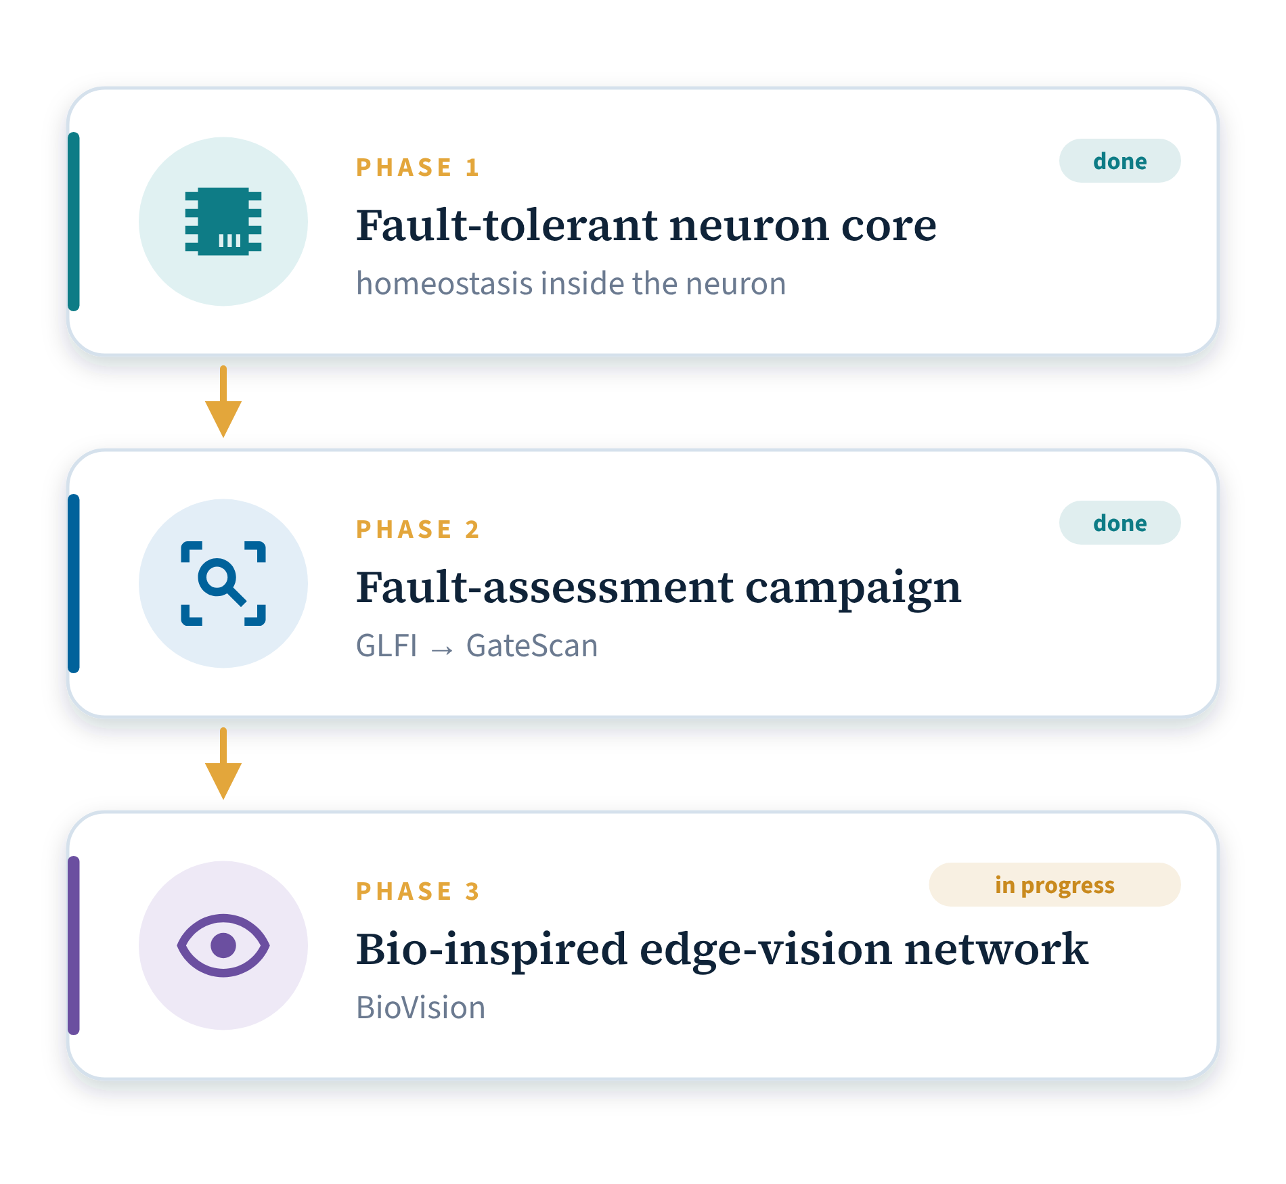
03
Methodology
01 Introduction
02 Literature Review
03 Methodology
04 Results
05 Conclusion
‹
12 / 13
›

Slide 13
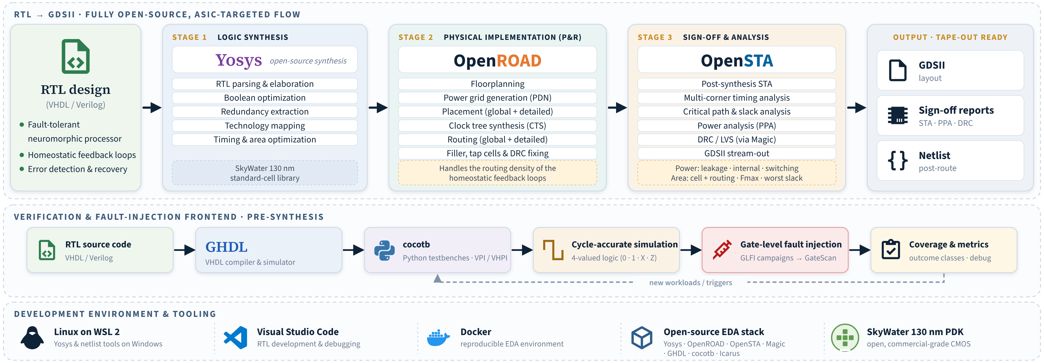
03 · METHODOLOGY
Our Path and Our Toolbox
01
Introduction
PHASE 1
PHASE 2
PHASE 3
Fault-tolerant neuron core
Fault-assessment campaign
Bio-inspired edge-vision network
Of the four vulnerable parts of an ODIN-style accelerator, we harden the Izhikevich / LIF neuron first — with Lyapunov-guided homeostasis, not redundancy.
Bonus: the adaptive threshold is also a learning rule — overhead ≈ only α, β, γ.
We build GLFI, grow it into GateScan, and test every node of the core with it.
We scale the hardened core into a network and build BioVision on it.
02
Literature
03
Methodology
04
Results
05
Conclusion
M.Sc. Thesis
Toolbox: Yosys · OpenROAD · OpenSTA · Magic · GHDL · cocotb · Icarus Verilog · SkyWater 130 nm PDK · WSL 2 · Docker · VS Code
‹
13 / 13
›

