Slide 1
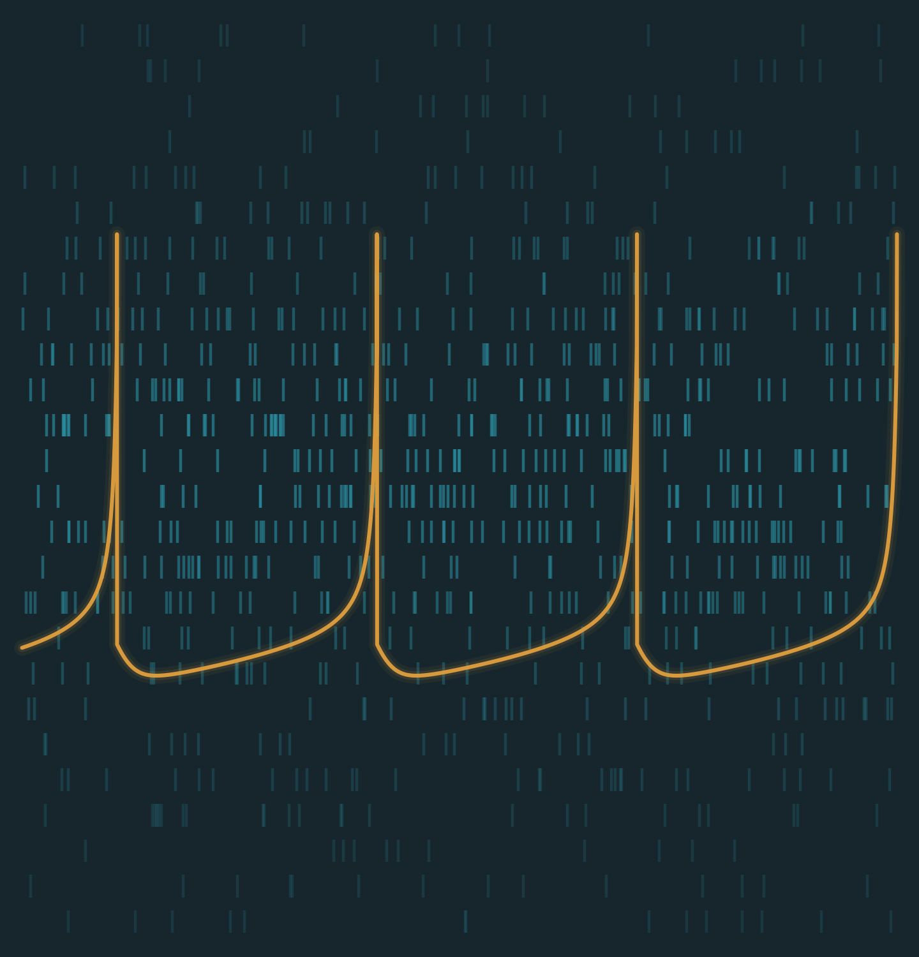


SHARIF UNIVERSITY OF TECHNOLOGY
Department of Computer Engineering
M.Sc. Thesis
Design of a Fault-Tolerant Deep Neural Network Hardware Accelerator for Image and Video Processing Applications
Presented by Ali Roshani
Supervisors Dr. M. Ansari & Dr. M. T. Manzuri Shalmani
Date Aban 1405
Cyber-Physical Systems Laboratory

Slide 2
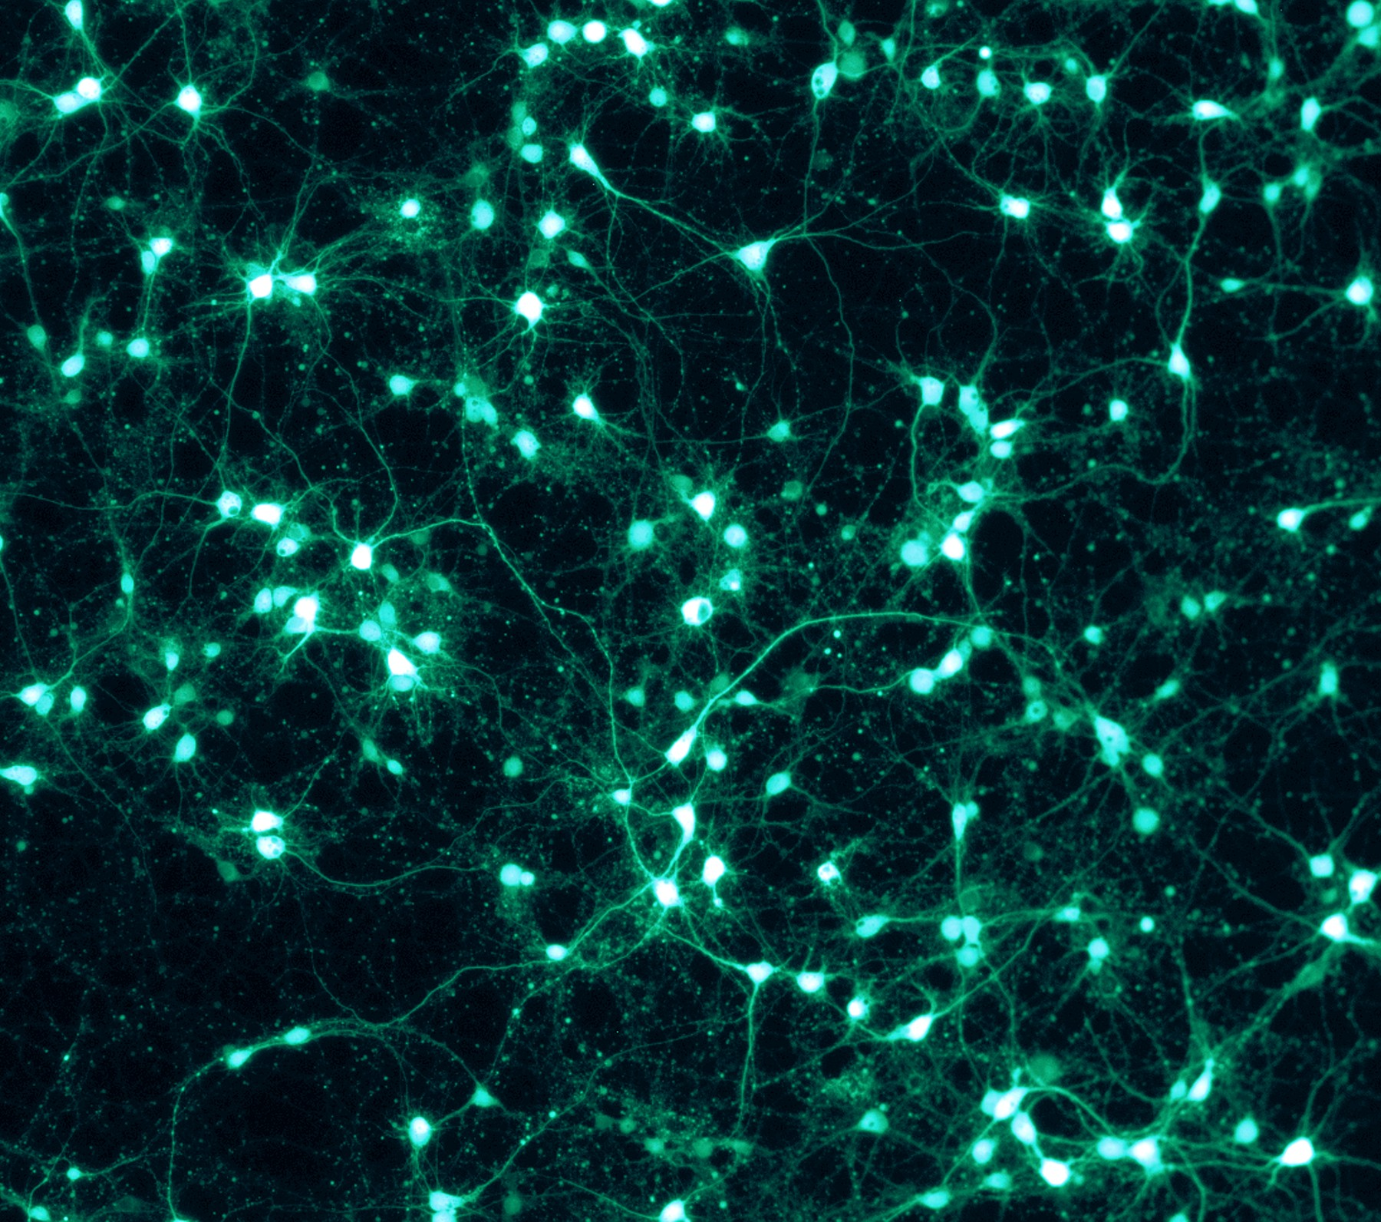
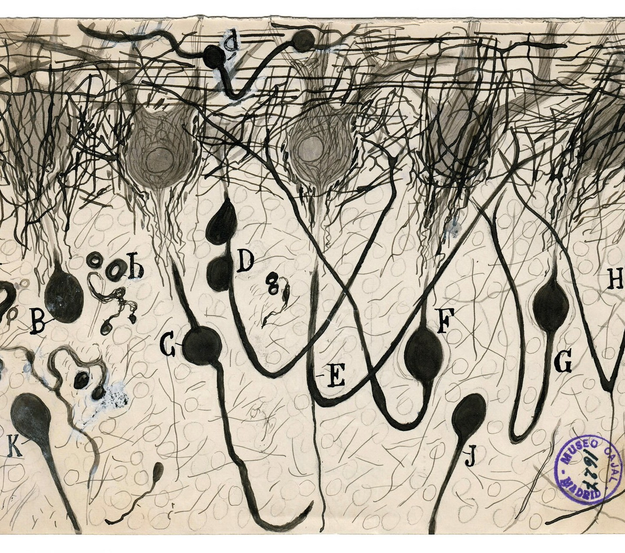
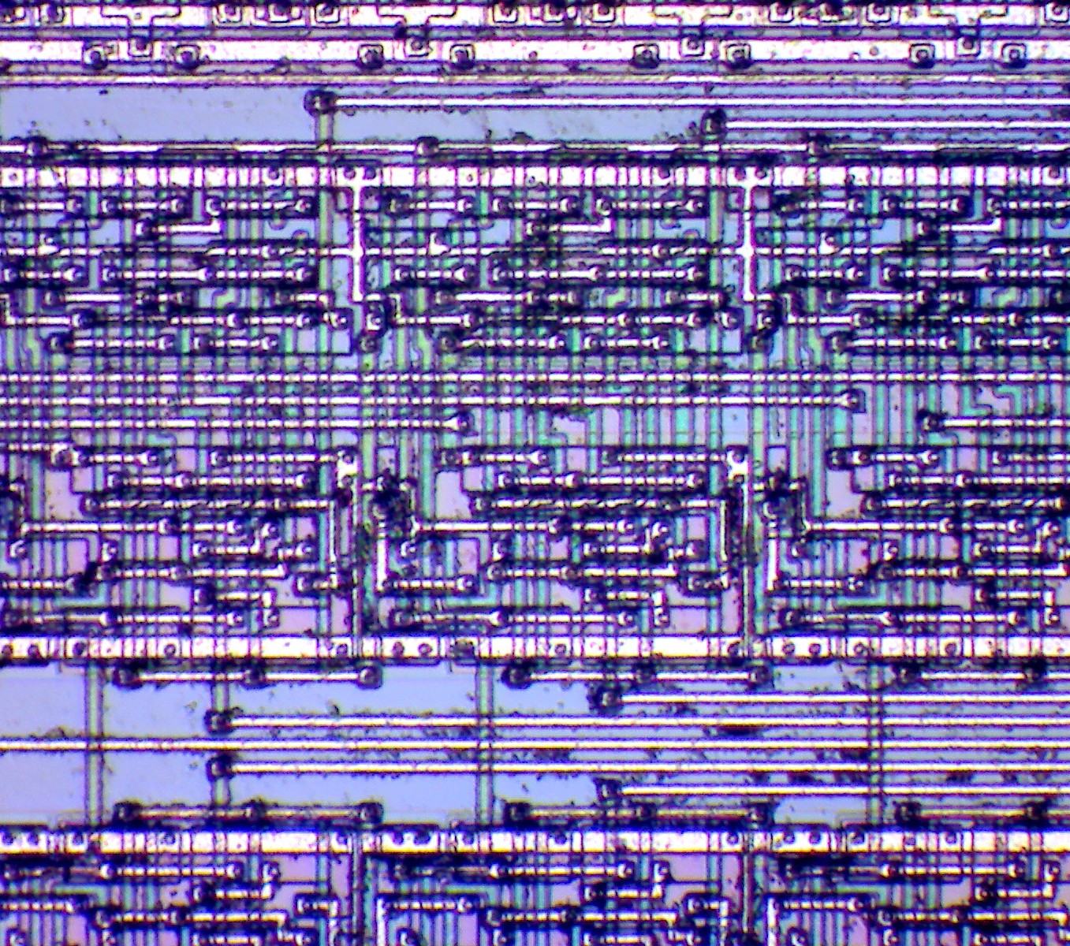
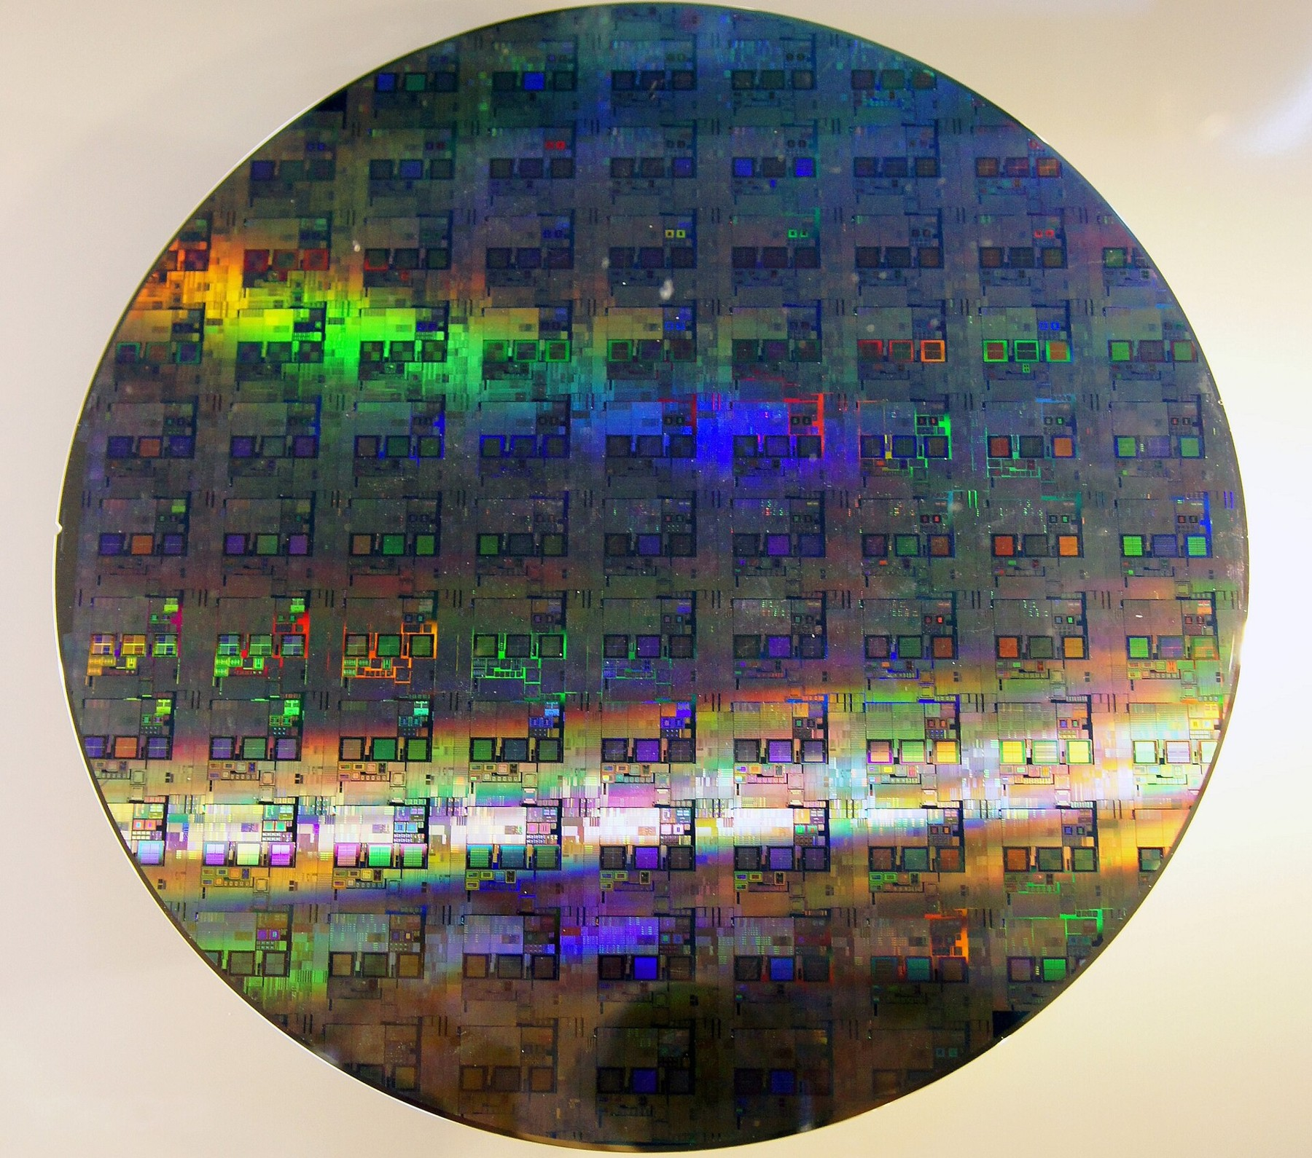
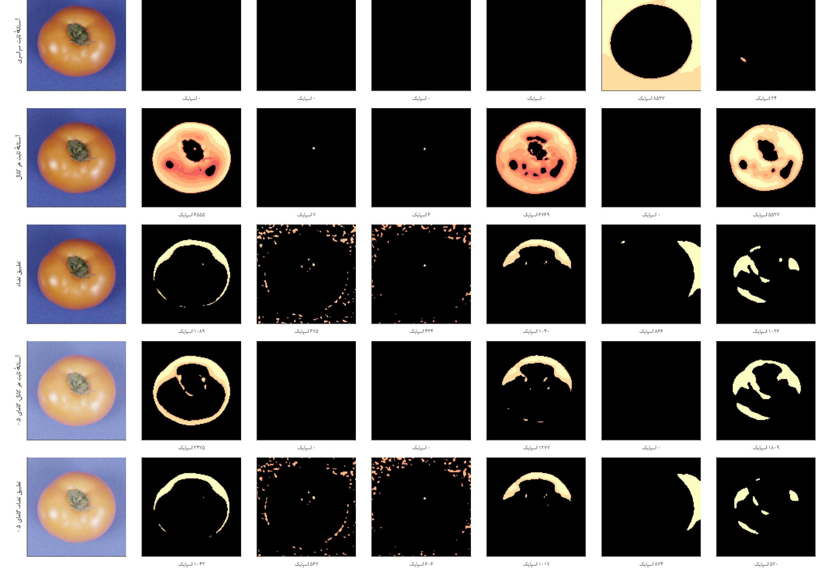
ROADMAP
Outline
01
Introduction
02
Literature
03
Methodology
01
02
03
04
05
Introduction
Literature Review
Methodology
Results
Conclusion
04
Results
Mission-critical vision, the edge device, and why its neuron must not fail
Six families of prior work and where this thesis stands
Hardened core → trustworthy fault analysis → BioVision
PPA, fault campaign, RFoM, learning, BioVision
Takeaways, publications and the road ahead
05
Conclusion
M.Sc. Thesis
‹
2 / 38
›

Slide 3
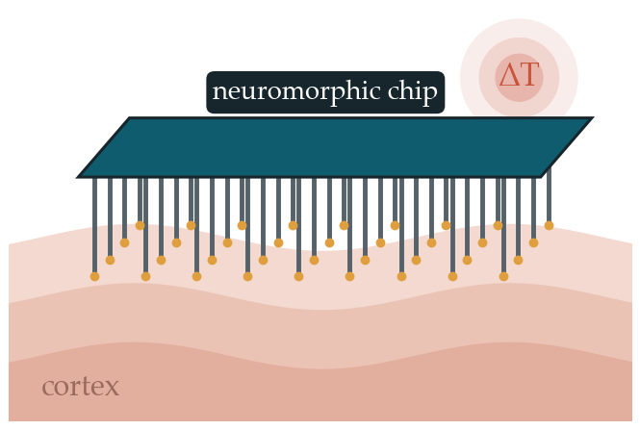
01
Introduction
01 Introduction
02 Literature Review
03 Methodology
04 Results
05 Conclusion
‹
3 / 38
›

Slide 4
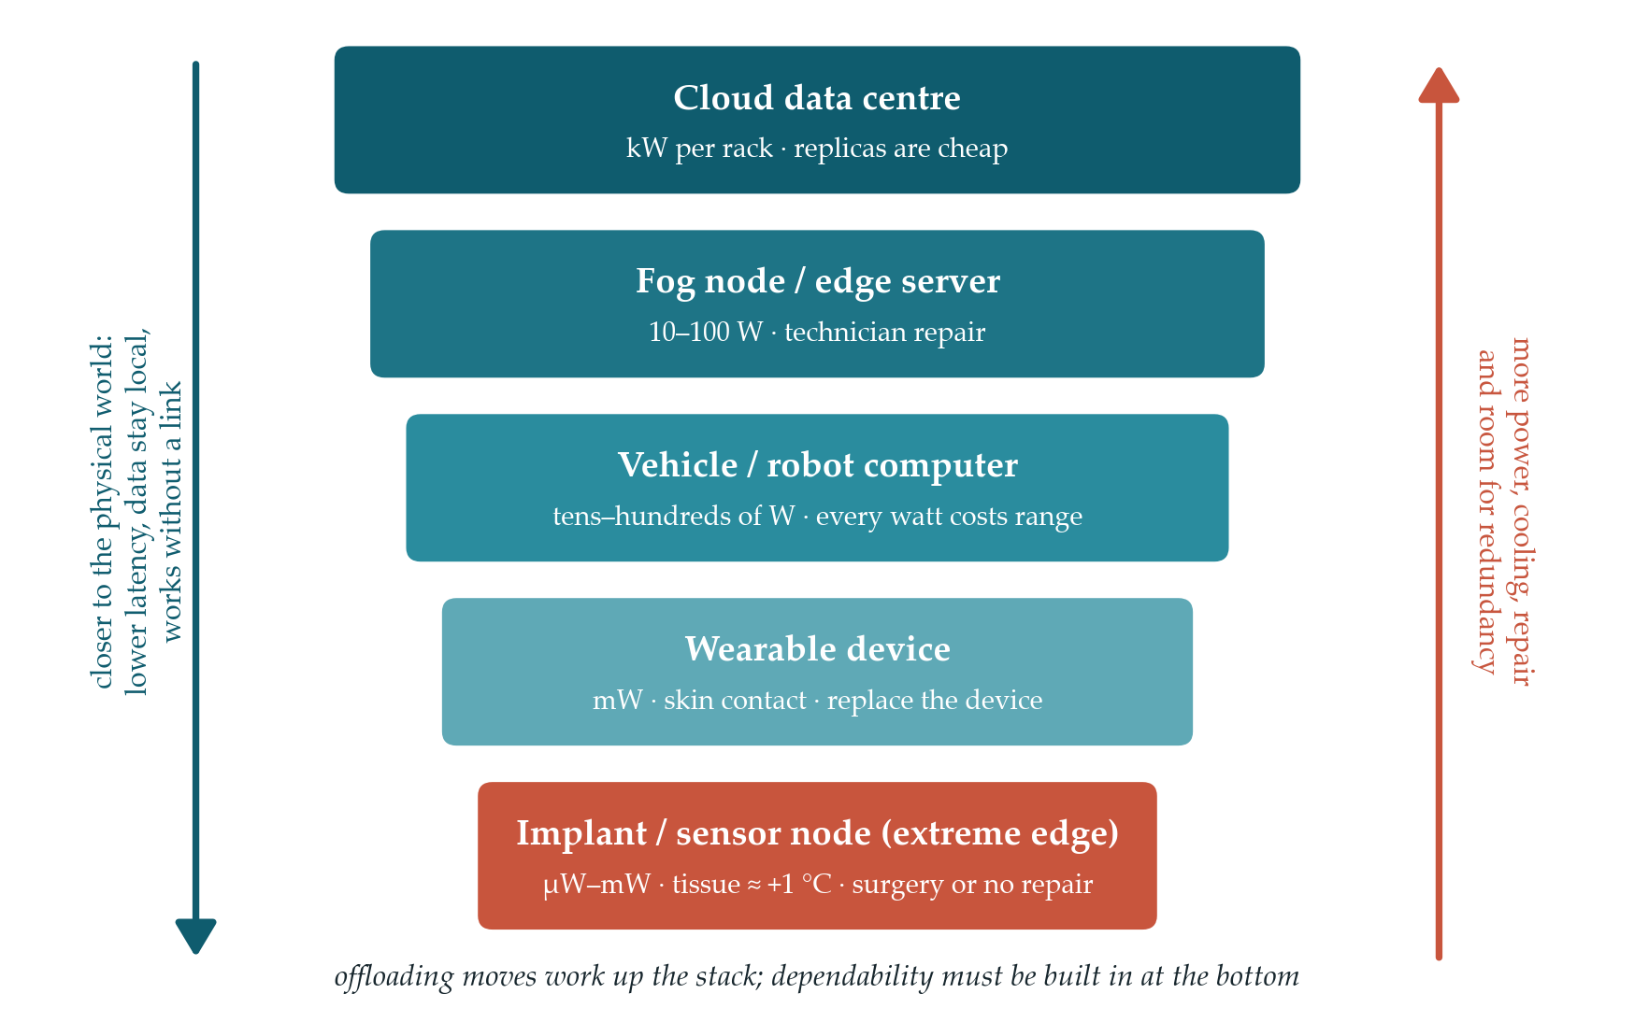
01 · INTRODUCTION
Where Should Intelligence Live?
01
Introduction
1
Mission-critical vision
UAVs, autonomous cars, robots and retinal implants: the camera is the first stage of a decision that must be made in real time.
02
Literature
2
The systems answer: offloading
03
Methodology
Cloudlets, fog and MEC move servers closer [54, 55, 56]; DNNs are split by layer [57]; split & federated learning [58, 59].
04
Results
3
Its hidden assumption
The end device is a black box that always computes correctly; only its speed matters.
05
Conclusion
Down the ladder, power, heat headroom and repairability vanish — an implant must stay within ≈ +1 °C
M.Sc. Thesis
[54] Satyanarayanan 2009 [55] Bonomi 2012 [56] Shi 2016 [57] Kang 2017 [58] Zhou 2019 [59] Kairouz 2021 [15] Kim 2007
‹
4 / 38
›

Slide 5
01 · INTRODUCTION
Why Offloading Fails Safety-Critical Vision
01
Introduction
1
Time & determinism
2
Connectivity
3
Energy & heat
4
Security & privacy
Tail latency: 1 % slow × 100 servers → 63 % slow [61]; no worst-case bound; handover outages; model/state skew
Coverage gaps, jamming, radio loss in tissue and under water, cascading infrastructure failure
1 kbit over 100 m ≈ 3 M instructions [62]; video saturates the uplink; radio heat and retransmissions
Every hop is an attack surface; split learning leaks raw data [60]; trust in the operator
02
Literature
03
Methodology
5
Certification
6
Silent corruption
7
Scale & cost
8
Environment & modelling
IEC 61508 / ISO 26262 need a bounded system [63]; unknown fault-containment boundary; liability
Even cloud cores corrupt data silently [64]; the remote node is not a safe harbour
Spectrum capacity, deployment and upkeep of the infrastructure
Radiation, heat and vibration hit the device anyway; offloading optimisers assume a fixed network model
04
Results
05
Conclusion
24 weaknesses in 8 groups → the critical perception–decision loop must close on the device itself
M.Sc. Thesis
[61] Dean & Barroso 2013 [62] Pottie & Kaiser 2000 [60] Pasquini 2021 [63] Koopman & Wagner 2016 [64] Hochschild 2021
‹
5 / 38
›

Slide 6
01 · INTRODUCTION
Our Anchor: Build the Extreme-Edge Device
01
Introduction
Power envelope down the ladder
A1
A1 · Extreme edge
3
Why spikes
The safety-critical loop closes on the device; offloading stays for training, maps and analytics.
Platform | Typical power
CPU | 10–100 W
GPU | ≈ 100 W
FPGA | 1–10 W
ASIC accelerator | 0.1–1 W
Brain implant | tens of mW (≈ +1 °C)
▸ Brain: 10¹¹ neurons at ≈ 20 W [7]
▸ Event-driven, sparse, memory beside compute
▸ Dense NPU (TPU, phone NPU) ≠ neuromorphic processor: lower throughput, far lower power and heat
▸ Chips exist: TrueNorth, Loihi [10, 11]
02
Literature
03
Methodology
A2 · Purpose-built device
A2
A device designed for this task — image and video — under size, weight, power, heat and cost limits.
04
Results
05
Conclusion
Device + spikes: a spiking accelerator for vision that must also be dependable
M.Sc. Thesis
[68] Capra 2020 [15] Kim 2007 [7] Roy 2019 [10] Akopyan 2015 [11] Davies 2018 [67] Jouppi 2017
‹
6 / 38
›

Slide 7
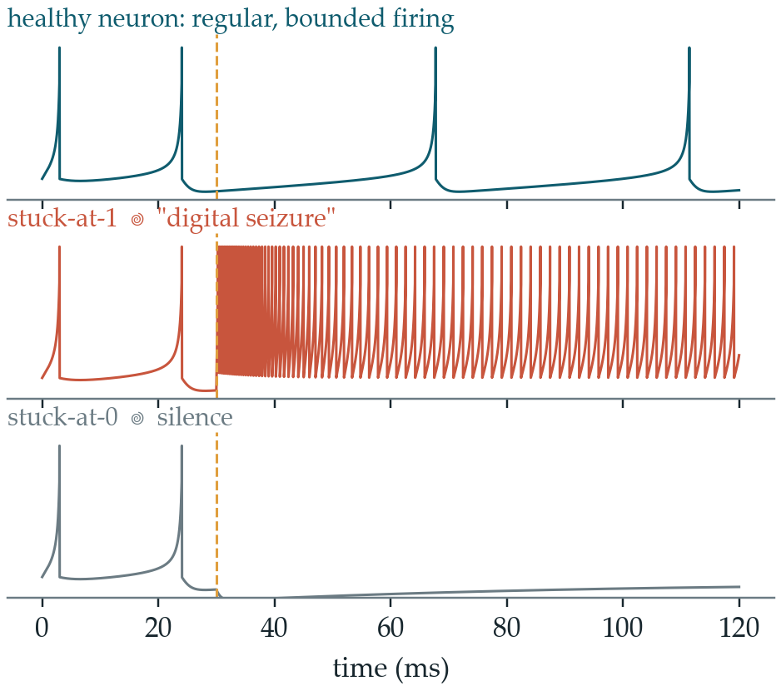
01 · INTRODUCTION
Inside a Time-Multiplexed SNN Accelerator: Who Can Fail?
01
Introduction
ODIN-style accelerator
[52]
Central controller / FSM
Network-on-chip / AER router
02
Literature
Neuron-state & weight memory
Neuron core ×1…5 (time-multiplexed)
03
Methodology
One core serves hundreds of virtual neurons: a single permanent defect in it reaches every neuron mapped onto it.
Four vulnerable parts — this thesis hardens the neuron core first.
04
Results
SA1 → parasitic current → digital seizure; SA0 → silence [17, 24]
05
Conclusion
TMR masks it at 3.40× the cells — the extreme edge cannot pay for triplication
M.Sc. Thesis
[52] Frenkel 2019 (ODIN) [17] Vatajelu 2019 [24] Spyrou 2021 [16] Hill 2022
‹
7 / 38
›

Slide 8
01 · INTRODUCTION
Research Gaps
01
Introduction
The device is an ideal black box
Edge-intelligence research optimises placement and assumes a correct device [57, 58].
G1
02
Literature
G2
No dependable path for vision at the extreme edge
Neuromorphic + event vision is efficient, but its behaviour under permanent faults is little studied [17, 18].
G3
Fault tolerance does not scale down
TMR ≈ 3× [19]; SNN schemes need spares, fault maps, re-mapping [22, 34]; supervisors are unprotected [21, 46].
03
Methodology
G4
The neuron is a primitive, not a design object
Protection acts on, around or above the neuron; no proven bound on its behaviour [24, 47].
04
Results
G5
Evaluation is not physically faithful
Software or two-valued campaigns; faithful gate-level tools are closed and costly [25, 26].
05
Conclusion
G6
Dependability and learning are studied apart
Fault tolerance is tested on frozen networks; compatibility with on-chip learning is rarely shown.
M.Sc. Thesis
[57] Kang 2017 [58] Zhou 2019 [17] Vatajelu 2019 [18] Schuman 2020 [19] Lyons 1962 [22] ReSpawn [34] RescueSNN [21] SPANNER [46] Johnson 2018 [47] Das 2025 [25] Leveugle 2009 [26] SHADOWFI
‹
8 / 38
›

Slide 9
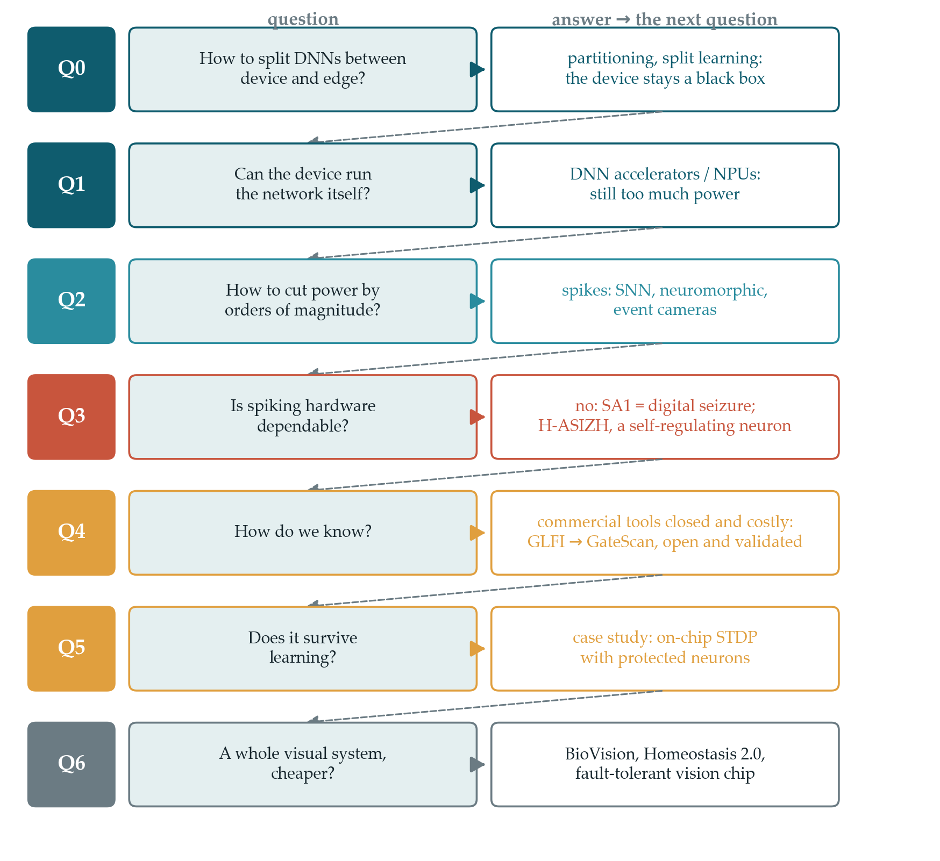
01 · INTRODUCTION
Research Questions and Contributions
01
Introduction
System argument
Ch. 1–3
C1
Safety-critical vision must close its loop on the device; fault tolerance moves down the stack.
02
Literature
H-ASIZH neuron
C2
Ch. 4
Exact affine map + homeostatic threshold; Lyapunov proof of a uniformly ultimately bounded rate.
03
Methodology
Hardware-ready core
C3
Ch. 5
Powers-of-two DSE, 1-cycle Q7.19 datapath, restoring-organ control plane, P&R on Sky130.
04
Results
Trustworthy fault analysis
Ch. 6
C4
GLFI: four-valued, in-circuit saboteurs → GateScan: certified vulnerability bracket.
05
Conclusion
Neuron → vision system
Ch. 7–8
C5
On-chip STDP learning; BioVision-SNN: retina, ventral & dorsal streams, local learning.
M.Sc. Thesis
‹
9 / 38
›

Slide 10
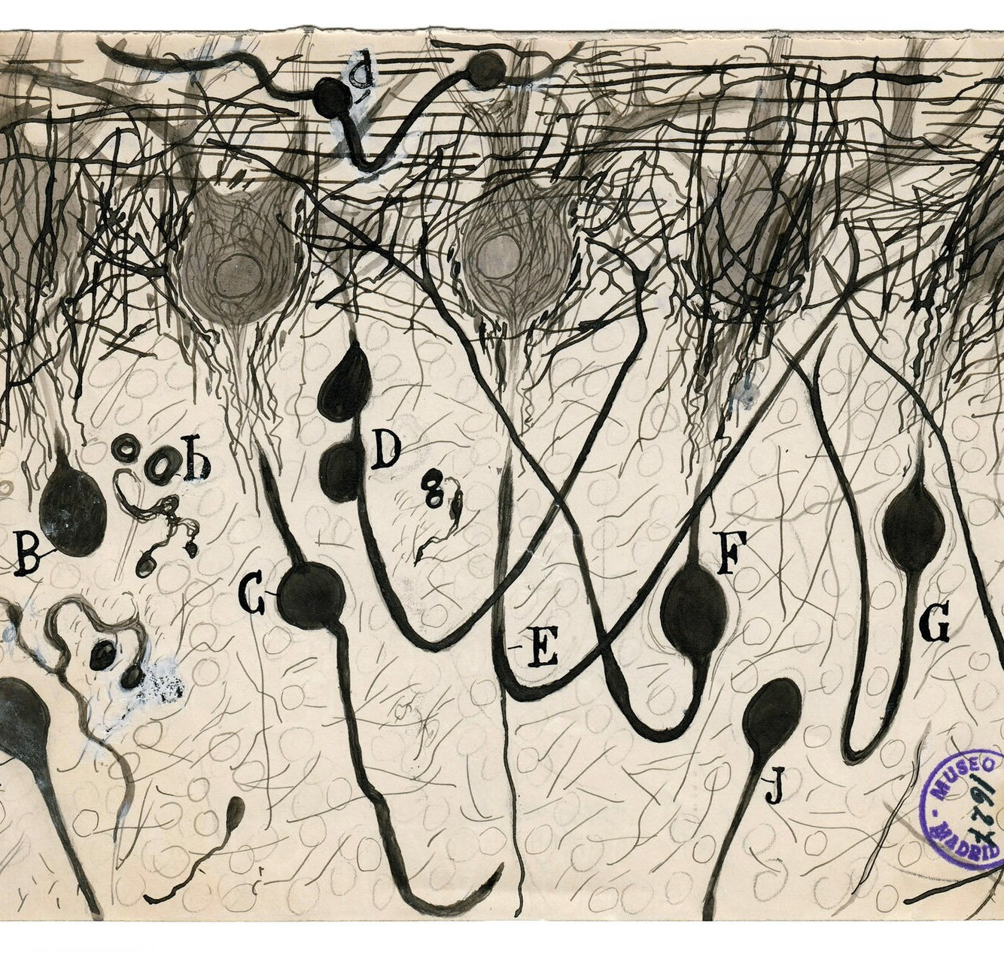
02
Literature Review
01 Introduction
02 Literature Review
03 Methodology
04 Results
05 Conclusion
‹
10 / 38
›

Slide 11
02 · LITERATURE REVIEW
Accelerators for Vision: Fast, but Assumed Correct
01
Introduction
Work | Class | Mechanism | Fault model | Limitation at the extreme edge
Eyeriss [66] | A · ASIC | Row-stationary dataflow; AlexNet conv 34.7 fps @ 278 mW | — | Assumes correct hardware
TPU [67] | A · ASIC | Systolic array; 15–30× faster than CPU/GPU | — | Data-centre power
UAV detector on FPGA [69] | A · FPGA | Low-precision SSD co-design | — | 2.54 W; no protection
Zhang et al. [70] | B · systolic | Fault-aware pruning + retraining | Permanent | Needs fault map and retraining
Li / Ares [71, 72] | B · analysis | Error propagation, resilience quantification | Transient | Analysis only
SalvageDNN [42] | B · mapping | Saliency-driven fault-aware mapping | Permanent | Diagnosis + re-mapping
FORTALESA / reuse [74, 75] | B · systolic | Reconfigurable PE protection; algorithmic reuse | Trans. + perm. | Redundancy inside the PE
Space CNN / YOLO [76, 77] | B · FPGA | TMR / NMR, scrubbing, SET-aware placement | SEU | ≈ 3× area and power
None of the above | — | Spiking computation | — | Not event-driven, not µW-scale
02
Literature
03
Methodology
04
Results
05
Conclusion
Protection sits on, around or above the processing element — and none of it is spiking
M.Sc. Thesis
[66] Eyeriss [67] TPU [69] Suh 2023 [70] Zhang 2018 [71] Li 2017 [72] Ares [42] SalvageDNN [29] Libano 2019 [74] FORTALESA [75] Ait Alam 2024 [76] Sterpone 2023 [77] Antunes 2025
‹
11 / 38
›

Slide 12
02 · LITERATURE REVIEW
Neuromorphic Processors and Neuron Cores
01
Introduction
Chip / core | Year · node | Neurons | Highlight | Fault tolerance
TrueNorth [10, 78] | 2014 · 28 nm | 1 M, 256 M synapses | ≈ 65 mW real time | Not a target
SpiNNaker [79] | 2014 | ARM many-core | Large-scale real-time simulation | Not a target
Loihi / Loihi 2 [11, 80] | 2018 / 2021 | Programmable | On-chip learning | Not a target
ODIN [52] | 2019 · 28 nm | 256 · LIF or 20 Izhikevich behaviours | 0.086 mm², 12.7 pJ/SOP, time-multiplexed | Not a target
MorphIC [81] | 2019 · 65 nm | 4 × 512 LIF | Binary weights, hierarchical routing | Not a target
Speck [82] | 2024 | 327k-neuron CNN + DVS | Clockless; 0.70 mW system | Not a target
QUANTISENC [83] | 2024 | Configurable LIF | Software-defined fixed-point cores | Not a target
Multiplier-free Izhikevich [13, 84] | 2018–2025 | Izhikevich | Shift-add, PWL / comb-exp | Not a target
02
Literature
03
Methodology
04
Results
05
Conclusion
A time-multiplexed core is a single point of failure for hundreds of neurons — yet no core protects itself
M.Sc. Thesis
[10] Akopyan 2015 [78] Merolla 2014 [79] Furber 2014 [11] Davies 2018 [80] Orchard 2021 [52] Frenkel 2019 [81] MorphIC [82] Speck [83] QUANTISENC [13] Haghiri 2018 [84] Sruthi 2025
‹
12 / 38
›

Slide 13
02 · LITERATURE REVIEW
Fault Tolerance in SNN Hardware, Layer by Layer
01
Introduction
Layer | Representative work | Mechanism | Fault model | Cost / weakness
System & memory | SoftSNN, SparkXD, EnforceSNN [37, 35, 36] | Bound-and-protect; approximate DRAM | Soft / memory | Transient only; relative PPA
Mapping & NoC | ReSpawn, RescueSNN, MigSpike, 3D-NoC [22, 34, 23, 38] | Fault-aware mapping, migration | Permanent | Spares + fault map; timing tied to one die
Bio-inspired supervisor | SPANNER, astrocyte nets, NeuFT [21, 44, 86] | Astrocyte-like monitor beside the neurons | Synapse / SEU | Supervisor on the same die is unprotected
External homeostasis | Johnson et al. [46] | Astrocyte-driven regulation | Permanent | Regulator ≠ neuron
Neuron & structure | Spyrou, dendritic, population coding [24, 47, 88] | Self-test + output TMR; structural; redundant populations | Dead / saturated | Behavioural only; ≈ 60 % overhead; extra neurons
Neuron-intrinsic (this thesis) | H-ASIZH | Adaptive threshold as a state variable + restoring organ | Stuck-at, every node | 1.39× cells (2.31× hardened); proven bound
02
Literature
03
Methodology
04
Results
05
Conclusion
Every branch acts on, around or above the neuron — none acts inside it
M.Sc. Thesis
[37] SoftSNN [35] SparkXD [36] EnforceSNN [22] ReSpawn [34] RescueSNN [23] MigSpike [38,40] 3D-NoC [21] SPANNER [43–45] astrocytes [86] NeuFT [46] Johnson [24,87] Spyrou [47] Das [88] Gleyo [90] Stratigopoulos
‹
13 / 38
›

Slide 14
02 · LITERATURE REVIEW
Fault-Injection and Reliability Tools
01
Introduction
Tool | Injection level | Open | 4-valued | Note
Synopsys FuSa / fault simulator | Gate | ✗ | ✓ | Licensed, ISO 26262; hard to reproduce outside
SHADOWFI [26] | Netlist (ASIC) | ✓ | ✗ | Hyperscale; injection outside the design; Verilog only
RADSAFiE [91] | Netlist (FPGA) | ✗ | ✗ | Vendor-locked to Vivado
FIdelity [73] | SW model of accelerator RTL | — | — | 46 M injections on NVDLA; transient logic faults
enpheeph / SpikingJET / SpikeFI [92, 93, 94] | Software (SNN) | ✓ | ✗ | No hardware fidelity
El-Sayed et al. [89] | Netlist / transistor | ✓ | ✗ | Neuron fault models; no automated campaign
GLFI → GateScan (this thesis) | Gate, in-circuit saboteurs | ✓ | ✓ | Dual-engine, formal oracle, certified bracket
02
Literature
03
Methodology
04
Results
05
Conclusion
Without X/Z and cross-checks, robustness describes the model, not the circuit [25]
M.Sc. Thesis
[26] SHADOWFI [91] RADSAFiE [73] FIdelity [92] enpheeph [93] SpikingJET [94] SpikeFI [89] El-Sayed [25] Leveugle 2009
‹
14 / 38
›

Slide 15
02 · LITERATURE REVIEW
Bio-Inspired Spiking Vision Systems
01
Introduction
Work | Spiking | Local learning | Streams | Attention | Output
Kheradpisheh 2018 [95] | ✓ TTFS | STDP | Ventral | — | Class
Mozafari 2018 [96] | ✓ TTFS | R-STDP | Ventral | — | Class
Paredes-Vallés 2019 [98] | ✓ events | STDP | Motion | — | Optical flow
StereoSpike 2022 [99] | ✓ | ✗ surrogate | — | — | Dense depth
WWN-2 2010 [100] | ✗ | Hebbian | What + where | Top-down | Location + identity
SpikeYOLO 2024 [97] | ✓ I-LIF | ✗ backprop | — | — | Boxes: COCO 66.2 mAP@50
Speck 2024 [82] | ✓ + DVS | ✗ | — | Dynamic | Class at 0.70 mW
BioVision-SNN (this thesis) | ✓ TTFS waves | STDP / R-STDP | Ventral + dorsal | Feedback to LGN | What-where, depth, motion, identity
02
Literature
03
Methodology
04
Results
05
Conclusion
No spiking model learns border ownership locally; feedback attention is shown in biology [102]
M.Sc. Thesis
[95] Kheradpisheh 2018 [96] Mozafari 2018 [98] Paredes-Vallés 2019 [99] StereoSpike [100] WWN-2 [97] SpikeYOLO [82] Speck [101] Zhou 2000 [102] Debes & Dragoi 2023
‹
15 / 38
›

Slide 16
02 · LITERATURE REVIEW
Where This Thesis Stands
01
Introduction
Work | Vision | HW (RTL/ASIC) | Spiking | Fault-tolerant | Permanent faults | Formal bound | Gate-level 4-valued | Local learning
Eyeriss, TPU | ✓ | ✓ | ✗ | ✗ | ✗ | ✗ | ✗ | ✗
Zhang 2018, SalvageDNN | ✓ | ✓ | ✗ | ✓ | ✓ | ✗ | ✗ | ✗
Space CNN / YOLO + TMR | ✓ | ◐ | ✗ | ✓ | ◐ | ✗ | ✗ | ✗
ODIN, MorphIC, Speck | ◐ | ✓ | ✓ | ✗ | ✗ | ✗ | ✗ | ◐
SoftSNN, RescueSNN | ◐ | ✓ | ✓ | ✓ | ◐ | ✗ | ✗ | ✗
SPANNER, NeuFT, Johnson | ✗ | ◐ | ✓ | ✓ | ◐ | ✗ | ✗ | ✗
Spyrou 2021, population coding | ◐ | ✗ | ✓ | ✓ | ✓ | ✗ | ✗ | ✗
SpikeYOLO | ✓ | ✗ | ✓ | ✗ | ✗ | ✗ | ✗ | ✗
Kheradpisheh / Mozafari | ✓ | ✗ | ✓ | ✗ | ✗ | ✗ | ✗ | ✓
This thesis | ✓ | ✓ | ✓ | ✓ | ✓ | ✓ | ✓ | ✓
02
Literature
03
Methodology
04
Results
05
Conclusion
✓ yes ◐ partly ✗ no — references on the previous five slides
M.Sc. Thesis
‹
16 / 38
›

Slide 17
03
1
Hardened neuron
H-ASIZH + Lyapunov bound
2
Silicon core
1-cycle Q7.19 on SkyWater 130 nm
3
Control-plane hardening
light TMR + restoring organ
Methodology
4
Fault analysis
GLFI → GateScan
5
Vision system
BioVision-SNN
01 Introduction
02 Literature Review
03 Methodology
04 Results
05 Conclusion
‹
17 / 38
›

Slide 18
03 · METHODOLOGY
Methodology: Three Phases, One Device
01
Introduction
done
done
in progress
Phase 1 · Harden the neuron core
Phase 2 · Trust the measurement
Phase 3 · Build the vision system
▸ Exact affine map of Izhikevich
▸ Homeostatic threshold controller
▸ Lyapunov UUB proof; powers-of-two DSE
▸ 1-cycle Q7.19 RTL; restoring organ
▸ P&R on SkyWater 130 nm
▸ Extended to LIF / IF cores
▸ GLFI: in-circuit saboteurs, 4-valued
▸ Neuro-metric fault classes
▸ GateScan: dual-engine (Verilator + Icarus)
▸ Formal oracle, exact statistics
▸ Certified vulnerability bracket
▸ LLM agents propose; the core decides
▸ BioVision-SNN: retina outside the network
▸ Ventral + dorsal streams, attention
▸ TTFS waves, STDP / R-STDP only
▸ Multiplier-free (shift-add) learning
▸ Phase 0–1 done; 2–5 to go
▸ Then: cross-layer fault campaign
02
Literature
→
→
03
Methodology
04
Results
05
Conclusion
Time-multiplexing makes the core the single point of failure → harden it, prove it, measure it, deploy it
M.Sc. Thesis
‹
18 / 38
›

Slide 19
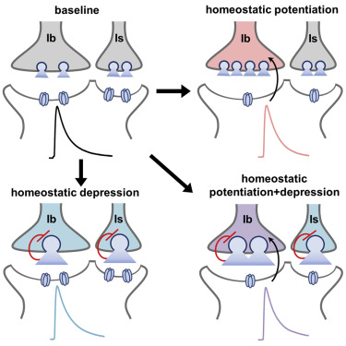
03 · METHODOLOGY
Phase 1 · The Intrinsic Homeostatic Controller
01
Introduction
dθ/dt = α (θ₀ − θ) + γ Σ δ(t − tₖ)
if V ≥ θ: V ← c, U ← U + d + β (θ − θ₀)
02
Literature
α
leak
returns θ to θ₀ when the neuron is healthy
03
Methodology
γ
penalty
raises θ at every spike
04
Results
β
brake
deepens the reset of U after a burst
05
Conclusion
Biological analogue: receptor homeostasis driven by intracellular Ca²⁺ [46]
M.Sc. Thesis
[46] A. P. Johnson et al., “Homeostatic fault tolerance in spiking neural networks: A dynamic hardware perspective,” IEEE Trans. Circuits Syst. I, 2018.
‹
19 / 38
›

Slide 20
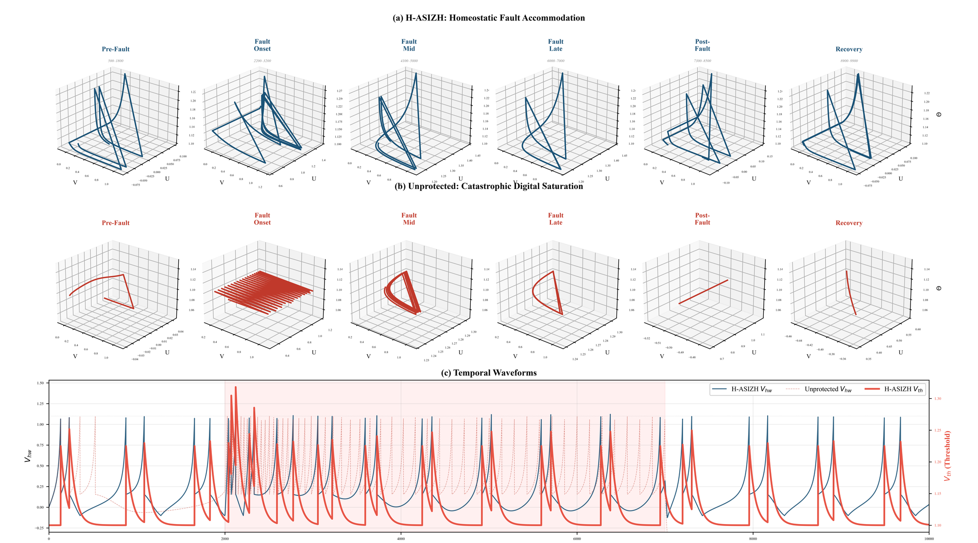
03 · METHODOLOGY
Phase 1 · It Cannot Run Away: Lyapunov Bound
01
Introduction
𝒱(θ) = ½ (θ − θ*)², ∂r/∂θ < 0
d𝒱/dt = (θ − θ*) [ −α(θ − θ*) + γ (r − r*) ] < 0
02
Literature
03
Methodology
Hyperactive phase
θ < θ* → r > r* → d𝒱/dt < 0
Hypoactive phase
θ > θ* → r < r* → d𝒱/dt < 0
04
Results
Uniformly ultimately bounded
band |θ − θ*| ≲ γ, set by the penalty, not by the fault [50, 51]
05
Conclusion
2-D limit cycle → bounded 3-D homeostatic attractor; θ rises and absorbs the defect
M.Sc. Thesis
‹
20 / 38
›
[50] H. K. Khalil, Nonlinear Systems, 3rd ed. Prentice Hall, 2002.
[51] J.-J. E. Slotine and W. Li, Applied Nonlinear Control. Prentice Hall, 1991.

Slide 21
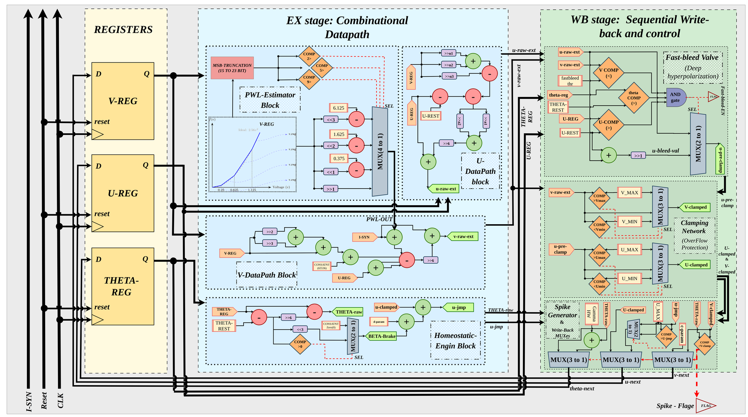
03 · METHODOLOGY
Phase 1 · A One-Cycle Micro-Architecture
01
Introduction
EX stage
PWL estimator, V/U datapaths, homeostatic engine
02
Literature
WB stage
clamps, fast-bleed valve, spike generator
03
Methodology
No multiplier
shifts and additions only
04
Results
1 update / cycle
no latency jitter in a timing code
05
Conclusion
M.Sc. Thesis
‹
21 / 38
›

Slide 22
03 · METHODOLOGY
Phase 1 · Hardening the Control Plane
01
Introduction
Light TMR
Restoring organ
θA
θA
vote
02
Literature
θB
vote
θB
vote
03
Methodology
single point of failure
θC
θC
vote
04
Results
θ-register + 7 decision flags → +1,500 cells
voters triplicated too → +124 cells (≈ 3%)
no single net
05
Conclusion
V-REG, U-REG, the PWL estimator and both adder trees stay simplex: the controller already protects them.
M.Sc. Thesis
‹
22 / 38
›

Slide 23
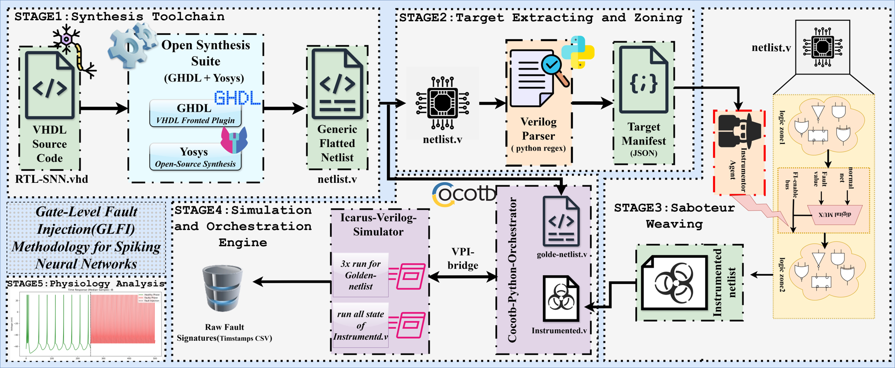
03 · METHODOLOGY
Phase 2 · From GLFI to GateScan
01
Introduction
2
GateScan Mark III
▸ A certified bracket instead of one SDC %: lower = proven detections, upper = all but proven-harmless
▸ Exact intervals: Clopper–Pearson, hypergeometric, census
▸ Escape certificate and an 11-class taxonomy beside SDC/DUE/Masked
▸ Two engines (Verilator + Icarus/cocotb) and a formal oracle
▸ LLM agents only propose workloads; a wrong agent can widen the bracket, never falsify it
▸ 1,834 two-engine runs, 0 disagreements; 13–55 % of “masked” faults proven vulnerable
02
Literature
03
Methodology
04
Results
Shadow hook, compiled into the netlist: assign net = (fi_enable && fi_target_id==ID) ? fi_value : hook_net;
One instrumented netlist for the whole campaign; fi_value can force 0, 1, X or Z.
05
Conclusion
GLFI asked “is the neuron robust?” — GateScan asks “can we trust the answer?”
M.Sc. Thesis
[25] Leveugle 2009 [26] SHADOWFI GateScan Mark III.1 (github.com/gatescan-dev/gatescanMarkIII)
‹
23 / 38
›

Slide 24
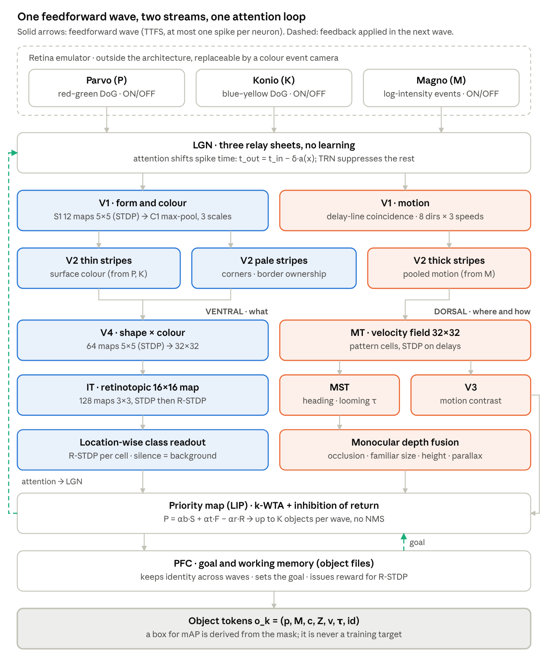
03 · METHODOLOGY
Phase 3 · BioVision-SNN Architecture
01
Introduction
Retina (fixed)
P / K / M channels, DoG, divisive normalisation, intensity→latency; microsaccade events (no DVS camera)
LGN
Relay + attention gate: attended spikes fire earlier (δ = 3 steps); virtual fovea
02
Literature
V1 · V2
S1 12 maps (1,800 weights), C1 = earliest spike; thin / pale / thick stripes; direction-selective cells
Ventral
V4 (64) → IT (128); location-wise R-STDP readout: silence = background
03
Methodology
Dorsal
MT (aperture problem), V3 motion contrast, MST heading and time-to-contact
04
Results
Depth · select
5 monocular cues; priority map with k-WTA replaces NMS; PFC object files keep identity
Output
Token o = (position, mask, class, depth, velocity, TTC, id); border ownership B±
05
Conclusion
TTFS waves: one spike per neuron per wave; worst-case ≈ 46 ms (wave 1), ≈ 91 ms (wave 2); ≈ 156k weights
M.Sc. Thesis
[95] Kheradpisheh 2018 [96] Mozafari 2018 [101] Zhou 2000 [102] Debes & Dragoi 2023 [103] Lichtsteiner 2008 [107] SpykeTorch
‹
24 / 38
›

Slide 25
03 · METHODOLOGY
Phase 3 · Hardware-Aware Retina and Learning
01
Introduction
1
Log-domain retina
2
Multiplier-free learning
3
H-ASIZH inside TTFS
4
Reward learning
▸ Binomial filters instead of Gaussians
▸ Mitchell log: error ≤ 0.0861 octave
▸ Divisive normalisation = one subtraction
▸ Brightness invariance ≤ 0.172 octave
▸ s(w) = ½·min(w, 1−w) replaces w(1−w)
▸ Rates = sums of two powers of two
▸ 16-bit weights; 24–29-bit accumulators
▸ Accuracy cost ≈ 0 vs. floating point
▸ θ ← θ + α(θ₀ − θ) + γ·z per image
▸ Calcium C = (α/γ)(θ − θ₀) ∈ [0, 1]
▸ β-brake moved into plasticity
▸ Floor θ ≥ θ₀ silenced S1 → two-sided rate homeostasis (Homeostasis 2.0)
▸ First-spike R-STDP decision layer
▸ Per-neuron calcium adaptive rate
▸ AGREL attention rule for hidden layers [106]: +15 % on ETH-80
▸ SDSP / R-SDSP tested [105]
02
Literature
03
Methodology
04
Results
0 · Reproduce
1 · Colour ventral
2 · Where (readout)
3 · Dorsal & waves
4 · Attention, depth
5 · Borders, faults
05
Conclusion
Two design rules for every block: a biological counterpart and shift-add-compare hardware
M.Sc. Thesis
[104] Kheradpisheh 2016 [105] Brader 2007 [106] Roelfsema & van Ooyen 2005 [96] Mozafari 2018
‹
25 / 38
›

Slide 26
04
4.2%
4.76×
dangerous faults
(12.0% for full TMR)
reliability figure of merit
(1.13× for full TMR)
Results
1.47 pJ
1020 / 1024
per update — the same
energy as full TMR
hidden neurons stay
active while learning
01 Introduction
02 Literature Review
03 Methodology
04 Results
05 Conclusion
‹
26 / 38
›

Slide 27
04 · RESULTS
Physical Implementation and Energy
01
Introduction
Design | Cells | Fmax (MHz) | Power (µW) | pJ / update
Baseline | 1,772 | 83.61 | 30.7 | 0.367
Homeostasis | 2,469 | 64.92 | 52.8 | 0.813
+ Light TMR | 3,969 | 64.18 | 88.5 | 1.379
+ Restoring organ | 4,093 | 62.11 | 91.4 | 1.472
Full TMR | 6,025 | 80.00 | 116.8 | 1.460
02
Literature
03
Methodology
04
Results
05
Conclusion
▸ The controller alone costs 697 cells (1.39×)
▸ Full TMR is faster but not more efficient
1.472 vs 1.460 pJ
≈ 3× safer at the same energy
M.Sc. Thesis
SkyWater 130 nm, OpenLane place & route, OpenSTA sign-off at 1.8 V, 25 °C with post-route parasitics; leakage < 0.05% of the total.
‹
27 / 38
›

Slide 28
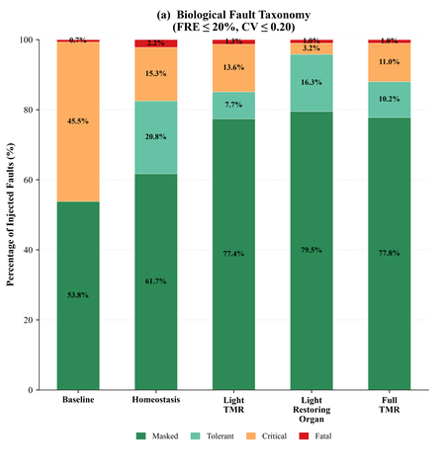
04 · RESULTS
Fault Outcome Distribution
01
Introduction
Baseline
45.5% critical and no tolerant class: a fault is invisible or destructive
02
Literature
Homeostasis
critical falls threefold to 15.3%; a 20.8% tolerant class appears; fatal rises to 2.2% (brake)
03
Methodology
Restoring organ
79.5% masked, 3.2% critical, 1.0% fatal — the floor set by the spike output
04
Results
05
Conclusion
Every node injected, both polarities, four-valued logic
M.Sc. Thesis
‹
28 / 38
›

Slide 29
04 · RESULTS
Reliability Figure of Merit (RFoM)
01
Introduction
RFoM = (AVF_base / AVF_i) ÷ (N_i / N_base)
vulnerability reduction ÷ area growth
02
Literature
▸ AVF = (critical + fatal) / all faults
▸ Worth its silicon only if RFoM > 1
▸ Full TMR: 3.85× safer but 3.40× larger
▸ Restoring organ: 11.0× safer, 2.31× larger
03
Methodology
04
Results
05
Conclusion
Plain homeostasis already beats full TMR by 1.67×
M.Sc. Thesis
‹
29 / 38
›

Slide 30
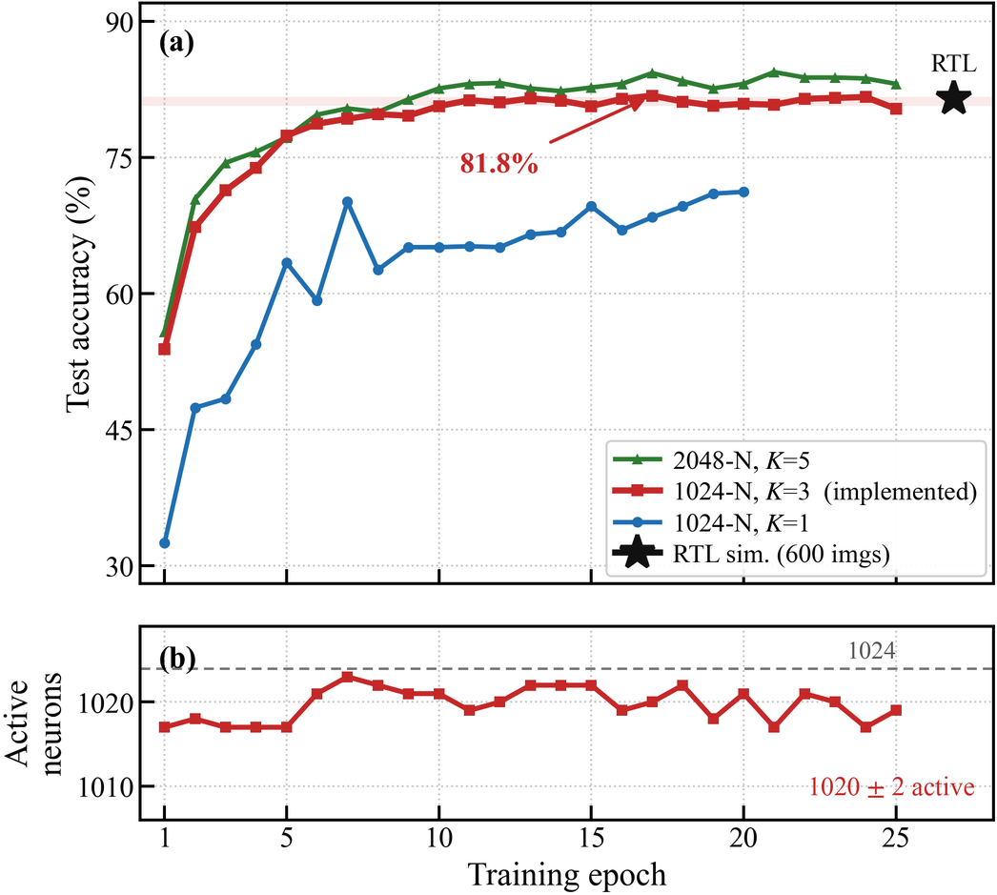
04 · RESULTS
Phase 1 · On-Chip Learning Case Study
01
Introduction
81.8%
peak; 81.2 ± 0.5% steady state
02
Literature
81.5%
synthesisable RTL, 600 test images
03
Methodology
1020 ± 2 / 1024
hidden neurons stay active
04
Results
The same θ that stops a runaway also stops neuron death and domination.
05
Conclusion
M.Sc. Thesis
‹
30 / 38
›

Slide 31
04 · RESULTS
BioVision-SNN: Results So Far (Phases 0–1)
01
Introduction
Phase 0 (test %) | Paper | Ours
RL · Caltech (Mozafari) | 98.9 ± 0.4 | 98.65 ± 0.49
RL · ETH-80 leave-one-out | 89.5 ± 1.9 | 81.83 ± 5.58
Probe · Caltech (SDNN) | 99.1 ± 0.2 | 98.96 ± 0.25
Probe · MNIST (SDNN) | 98.4 | 98.52 ± 0.06
Probe · ETH-80 5/5 (SDNN) | 82.8 | 84.25 ± 3.49
Multiplier-free mode | — | −0.9 / +1.7 pp
Phase 1 (draft, 128 px)
1
▸ Colour helps: P+K +6.7 pp over grey (RL, ETH-80 val.)
▸ RL ETH-80 test: 72.87 ± 2.22 (decision still rising at epoch 80)
▸ Caltech-4, grey retina: 89.42 ± 1.18
▸ Darker images: invariant (log-domain theorem)
▸ Gamma 0.5 collapsed accuracy → contrast adaptation (running)
▸ Found and fixed: K-channel background artefact, power-of-two rate collapse, 3 errors in the design maths (107 unit tests)
02
Literature
03
Methodology
04
Results
H-ASIZH threshold gave the best ETH-80 features (84.25 %); per-neuron calcium rate matched Mozafari on Caltech; decisions with < 1,000 input spikes.
05
Conclusion
Local learning reproduces — and on MNIST and ETH-80 exceeds — the SDNN baseline, multiplier-free
M.Sc. Thesis
[95] Kheradpisheh 2018 (SDNN) [96] Mozafari 2018 — all numbers: test accuracy, mean ± std over seeds / folds; Phase 0 gate closed 2026-10-20
‹
31 / 38
›

Slide 32
05
Conclusion
01 Introduction
02 Literature Review
03 Methodology
04 Results
05 Conclusion
‹
32 / 38
›

Slide 33
05 · CONCLUSION
Conclusion
01
Introduction
A
Dependability is a device requirement
B
Fault tolerance can live inside the neuron
For safety-critical vision the loop must close on the device; fault tolerance has to move down the stack with the computation.
H-ASIZH: proven bounded rate; 4.2 % vs 12.0 % dangerous faults, RFoM 4.76× vs 1.13×, at the same 1.47 pJ per update.
02
Literature
03
Methodology
The measurement itself must be trusted
From a neuron to a vision system
C
D
GLFI → GateScan: four-valued, in-circuit, cross-checked; a certified bracket instead of an optimistic point estimate.
On-chip learning keeps 1020/1024 neurons alive; BioVision reproduces the SDNN baselines with local, multiplier-free learning.
04
Results
05
Conclusion
Triplication buys nothing that accommodation does not buy more cheaply
M.Sc. Thesis
‹
33 / 38
›

Slide 34
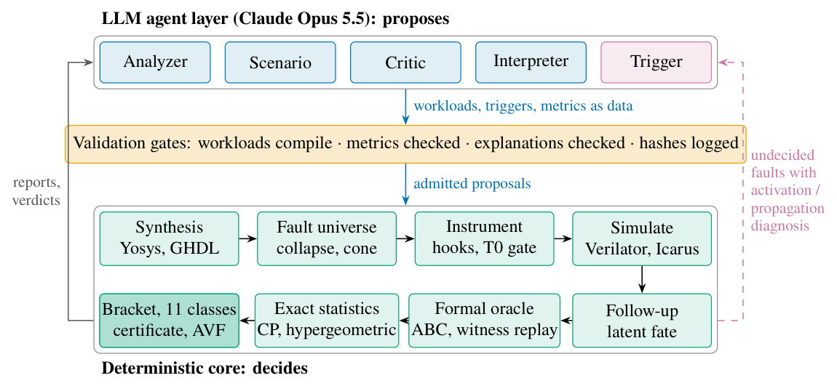
05 · CONCLUSION
Future Work: Where This Goes Next
01
Introduction
in progress
in progress
in progress
Homeostasis 2.0 on cheaper cores
GLFI → GateScan
BioVision-SNN on fault-tolerant cores
02
Literature
θ
rate
control
brake
activity
03
Methodology
gain
sensors → controller → actuators
▸ From Izhikevich to LIF / IF cores
▸ Replace TMR and the restoring organ with a richer loop: 2 sensors, 3 actuators
▸ Different mechanisms, one goal — degeneracy, as in biology [53]
▸ An open fault-analysis application: RTL in, per-node vulnerability out
▸ LLM agents propose workloads; simulation and formal proof decide
▸ 0 disagreements in 1,834 cross-checks; agent workloads lift ITC’99 b13 detection 35.7% → 86.0%
▸ Phases 0–1 done: retina emulator and colour ventral stream; next: location-wise readout, dorsal stream, attention, depth, border ownership
▸ Cross-layer campaign: gate-level fault outcomes injected per layer of the vision system
04
Results
05
Conclusion
M.Sc. Thesis
[53] E. Marder and J.-M. Goaillard, “Variability, compensation and homeostasis in neuron and network function,” Nat. Rev. Neurosci., vol. 7, pp. 563–574, 2006.
‹
34 / 38
›

Slide 35
05 · CONCLUSION
Research Articles and Artefacts
01
Introduction
H-ASIZH: A Highly Reliable Digital Izhikevich Neuron Core Using Adaptive Threshold Control for Fault Accommodation
1
IEEE TCAS-I · submitted
A. Roshani, M. Ansari, M. T. Manzuri Shalmani
02
Literature
GateScan: certified gate-level vulnerability analysis (working title “Masked Is Not Harmless…”)
2
IEEE TCAD · in preparation
GateScan Mark III.1
03
Methodology
BioVision-SNN: a hardware-aware bio-inspired spiking vision system with local learning
3
in preparation
Phase reports 0–1
04
Results
Open source: github.com/aliroshanidino/GLFI_fault_campaign · github.com/gatescan-dev/gatescanMarkIII (MIT)
05
Conclusion
M.Sc. Thesis
‹
35 / 38
›

Slide 36
05 · CONCLUSION
References (I)
01
Introduction
[1] M. M. Waldrop, “The chips are down for Moore’s law,” Nature, vol. 530, pp. 144–147, 2016.
[2] M. Horowitz, “Computing’s energy problem (and what we can do about it),” in Proc. IEEE ISSCC, 2014, pp. 10–14.
[3] J. Backus, “Can programming be liberated from the von Neumann style?” Commun. ACM, vol. 21, no. 8, pp. 613–641, 1978.
[4] H. Esmaeilzadeh et al., “Dark silicon and the end of multicore scaling,” in Proc. ISCA, 2011, pp. 365–376.
[5] J. Preskill, “Quantum computing in the NISQ era and beyond,” Quantum, vol. 2, p. 79, 2018.
[6] B. J. Shastri et al., “Photonics for artificial intelligence and neuromorphic computing,” Nature Photonics, vol. 15, pp. 102–114, 2021.
[7] K. Roy et al., “Towards spike-based machine intelligence with neuromorphic computing,” Nature, 2019.
[8] C. D. Schuman et al., “Opportunities for neuromorphic computing algorithms and applications,” Nature Comput. Sci., vol. 2, pp. 10–19, 2022.
[9] W. Maass, “Networks of spiking neurons: The third generation of neural network models,” Neural Networks, 1997.
[10] F. Akopyan et al., “TrueNorth: Design and tool flow of a 65 mW 1 million neuron programmable neurosynaptic chip,” IEEE Trans. CAD, 2015.
[11] M. Davies et al., “Loihi: A neuromorphic manycore processor with on-chip learning,” IEEE Micro, 2018.
[12] E. M. Izhikevich, “Simple model of spiking neurons,” IEEE Trans. Neural Netw., 2003.
[13] S. Haghiri et al., “Multiplierless implementation of noisy Izhikevich neuron with low-cost digital design,” IEEE Trans. Biomed. Circuits Syst., 2018.
[14] R. H. Masland, “The neuronal organization of the retina,” Neuron, vol. 76, no. 2, pp. 266–280, 2012.
[15] S. Kim, P. Tathireddy, R. A. Normann and F. Solzbacher, “Thermal impact of an active 3-D microelectrode array implanted in the brain,” IEEE Trans. Neural Syst. Rehabil. Eng., vol. 15, no. 4, pp. 493–501, 2007.
[16] I. Hill et al., “CMOS reliability from past to future: A survey of requirements, trends, and prediction methods,” IEEE Trans. Device Mater. Rel., 2022.
[17] E.-I. Vatajelu et al., “Special session: Reliability of hardware-implemented spiking neural networks (SNN),” in Proc. IEEE 37th VLSI Test Symp., 2019.
[18] C. D. Schuman et al., “Resilience and robustness of spiking neural networks for neuromorphic systems,” in Proc. Int. Joint Conf. Neural Netw. (IJCNN), 2020.
[19] R. E. Lyons et al., “The use of triple-modular redundancy to improve computer reliability,” IBM J. Res. Dev., 1962.
[20] K. S. Morgan et al., “A comparison of TMR with alternative fault-tolerant design techniques for FPGAs,” IEEE Trans. Nucl. Sci., 2007.
[21] J. Liu et al., “SPANNER: A self-repairing spiking neural network hardware architecture,” IEEE Trans. Neural Netw. Learn. Syst., 2018.
[22] R. V. W. Putra et al., “ReSpawn: Energy-efficient fault-tolerance for spiking neural networks considering unreliable memories,” in Proc. IEEE/ACM Int. Conf. Comput.-Aided Design (ICCAD), 2021.
[23] K. N. Dang et al., “MigSpike: A migration based algorithms and architecture for scalable robust neuromorphic systems,” IEEE Trans. Emerg. Topics Comput., 2022.
[24] T. Spyrou et al., “Neuron fault tolerance in spiking neural networks,” in Proc. DATE, 2021.
[25] R. Leveugle et al., “Statistical fault injection: Quantified error and confidence,” in Proc. DATE, 2009.
[26] J.-D. Guerrero-Balaguera et al., “SHADOWFI: An open-source framework for fault evaluation of complex IC designs using hyperscale computing,” IEEE JETCAS, 2025.
[27] R. Vadlamani et al., “Multicore soft error rate stabilization using adaptive dual modular redundancy,” in Proc. DATE, 2010.
[28] B. Pratt et al., “Fine-grain SEU mitigation for FPGAs using partial TMR,” IEEE Trans. Nucl. Sci., 2008.
[29] F. Libano et al., “Selective hardening for neural networks in FPGAs,” IEEE Trans. Nucl. Sci., 2019.
[30] K. Zhang et al., “Triple modular redundancy with standby (TMRSB) supporting dynamic resource reconfiguration,” in Proc. IEEE Autotestcon, 2006.
[31] S. T. Ahmed et al., “NeuroScrub+: Mitigating retention faults using flexible approximate scrubbing in neuromorphic fabric based on resistive memories,” IEEE Trans. Comput.-Aided Des. Integr. Circuits Syst., 2023.
[32] F. Cheng et al., “MulPi: A multi-class and patient-independent epileptic seizure classifier with co-designed input-stationary computing-in-SRAM,” IEEE Trans. Biomed. Circuits Syst., 2025.
[33] A. Yan et al., “TUTPFL: Triple node upset-tolerant and single-event transient filtered low-power latch,” IEEE Trans. Very Large Scale Integr. (VLSI) Syst., 2025.
[34] R. V. W. Putra et al., “RescueSNN: enabling reliable executions on spiking neural network accelerators under permanent faults,” Frontiers in Neuroscience, 2022.
[35] R. V. W. Putra et al., “SparkXD: A framework for resilient and energy-efficient spiking neural network inference using approximate DRAM,” in Proc. 58th ACM/IEEE Design Automation Conf. (DAC), 2021.
[36] R. V. W. Putra et al., “EnforceSNN: Enabling resilient and energy-efficient SNN inference considering approximate DRAMs,” Frontiers in Neuroscience, 2022.
[37] R. V. W. Putra et al., “SoftSNN: Low-cost fault tolerance for spiking neural network accelerators under soft errors,” in Proc. DAC, 2022.
[38] O. M. Ikechukwu et al., “On the design of a fault-tolerant scalable three dimensional NoC-based digital neuromorphic system with on-chip learning,” IEEE Access, 2021.
[39] M. L. Varshika et al., “Design of many-core big little µBrains for energy-efficient embedded neuromorphic computing,” in Proc. DATE, 2022.
[40] W. Y. Yerima et al., “Fault-tolerant spiking neural network mapping algorithm and architecture to 3D-NoC-based neuromorphic systems,” IEEE Access, 2023.
[41] T. Titirsha et al., “Endurance-aware mapping of spiking neural networks to neuromorphic hardware,” IEEE Trans. Parallel Distrib. Syst., 2022.
[42] M. A. Hanif et al., “SalvageDNN: Salvaging deep neural network accelerators with permanent faults through saliency-driven fault-aware mapping,” Philos. Trans. Roy. Soc. A, 2019.
[43] M. Naeem et al., “On the role of astroglial syncytia in self-repairing spiking neural networks,” IEEE Trans. Neural Netw. Learn. Syst., 2015.
[44] M. Isik et al., “A design methodology for fault-tolerant computing using astrocyte neural networks,” in Proc. 19th ACM Int. Conf. Computing Frontiers (CF), 2022.
[45] M. L. Varshika et al., “Design of a tunable astrocyte neuromorphic circuitry with adaptable fault tolerance,” in Proc. IEEE 66th Int. Midwest Symp. Circuits Syst. (MWSCAS), 2023.
[46] A. P. Johnson et al., “Homeostatic fault tolerance in spiking neural networks: A dynamic hardware perspective,” IEEE Trans. Circuits Syst. I, 2018.
[47] A. Das et al., “Exploring dendritic computation in bio-inspired architectures for dynamic programming,” in Proc. DATE, 2025.
[48] Q. Cheng et al., “A radiation-hardened neuromorphic imager with self-healing spiking pixels and unified spiking neural network for space robotics,” in Proc. IEEE Symp. VLSI Technol. Circuits, 2025.
[49] I. Koren et al., “Defect tolerance in VLSI circuits: techniques and yield analysis,” Proc. IEEE, 1998.
[50] H. K. Khalil, Nonlinear Systems, 3rd ed. Prentice Hall, 2002.
[51] J.-J. E. Slotine and W. Li, Applied Nonlinear Control. Prentice Hall, 1991.
[52] C. Frenkel et al., “A 0.086-mm² 12.7-pJ/SOP 64k-synapse 256-neuron online-learning digital spiking neuromorphic processor in 28-nm CMOS,” IEEE Trans. Biomed. Circuits Syst., 2019.
[53] E. Marder and J.-M. Goaillard, “Variability, compensation and homeostasis in neuron and network function,” Nat. Rev. Neurosci., vol. 7, pp. 563–574, 2006.
02
Literature
03
Methodology
04
Results
05
Conclusion
M.Sc. Thesis
‹
36 / 38
›

Slide 37
05 · CONCLUSION
References (II)
01
Introduction
[54] M. Satyanarayanan et al., “The case for VM-based cloudlets in mobile computing,” IEEE Pervasive Comput., 2009.
[55] F. Bonomi et al., “Fog computing and its role in the Internet of Things,” in Proc. MCC Workshop, 2012.
[56] W. Shi et al., “Edge computing: Vision and challenges,” IEEE Internet Things J., 2016.
[57] Y. Kang et al., “Neurosurgeon: Collaborative intelligence between the cloud and mobile edge,” in Proc. ASPLOS, 2017.
[58] Z. Zhou et al., “Edge intelligence: Paving the last mile of AI with edge computing,” Proc. IEEE, 2019.
[59] P. Kairouz et al., “Advances and open problems in federated learning,” Found. Trends Mach. Learn., 2021.
[60] D. Pasquini et al., “Unleashing the tiger: Inference attacks on split learning,” in Proc. ACM CCS, 2021.
[61] J. Dean and L. A. Barroso, “The tail at scale,” Commun. ACM, 2013.
[62] G. J. Pottie and W. J. Kaiser, “Wireless integrated network sensors,” Commun. ACM, 2000.
[63] P. Koopman and M. Wagner, “Challenges in autonomous vehicle testing and validation,” SAE Int. J. Transp. Safety, 2016.
[64] P. H. Hochschild et al., “Cores that don’t count,” in Proc. HotOS, 2021.
[65] A. Avizienis et al., “Basic concepts and taxonomy of dependable and secure computing,” IEEE Trans. Dependable Secure Comput., 2004.
[66] Y.-H. Chen et al., “Eyeriss: An energy-efficient reconfigurable accelerator for deep CNNs,” IEEE J. Solid-State Circuits, 2017.
[67] N. P. Jouppi et al., “In-datacenter performance analysis of a tensor processing unit,” in Proc. ISCA, 2017.
[68] M. Capra et al., “Hardware and software optimizations for accelerating deep neural networks: Survey,” IEEE Access, 2020.
[69] D. Suh et al., low-precision SSD co-design for drone detection on a resource-constrained FPGA, ACM Trans. Reconfig. Technol. Syst., 2023, doi:10.1145/3583074.
[70] J. J. Zhang et al., “Analyzing and mitigating the impact of permanent faults on a systolic array based neural network accelerator,” in Proc. IEEE VTS, 2018.
[71] G. Li et al., “Understanding error propagation in deep learning neural network accelerators and applications,” in Proc. SC, 2017.
[72] B. Reagen et al., “Ares: A framework for quantifying the resilience of deep neural networks,” in Proc. DAC, 2018.
[73] Y. He, P. Balaprakash and Y. Li, “FIdelity: Efficient resilience analysis framework for deep learning accelerators,” in Proc. MICRO, 2020.
[74] “FORTALESA: Fault-tolerant reconfigurable systolic array for DNN inference,” arXiv:2503.04426, 2025.
[75] Ait Alam et al., “Algorithmic strategies for sustainable reuse of neural network accelerators with permanent faults,” arXiv:2412.16208, 2024.
[76] L. Sterpone et al., SET-aware placement of CNN neuron cores on radiation-hardened FPGAs (RTG4), IEEE Trans. Comput.-Aided Design, 2023.
[77] Antunes and Podobas, “FPGA-based neural network accelerators for space applications: A survey,” arXiv:2504.16173, 2025.
[78] P. A. Merolla et al., “A million spiking-neuron integrated circuit with a scalable communication network and interface,” Science, 2014.
[79] S. B. Furber et al., “The SpiNNaker project,” Proc. IEEE, 2014.
[80] G. Orchard et al., “Efficient neuromorphic signal processing with Loihi 2,” in Proc. IEEE SiPS, 2021.
[81] C. Frenkel et al., “MorphIC: A 65-nm 738k-synapse/mm² quad-core binary-weight digital neuromorphic processor with stochastic spike-driven online learning,” IEEE Trans. Biomed. Circuits Syst., 2019.
[82] M. Yao et al., “Spike-based dynamic computing with asynchronous sensing-computing neuromorphic chip,” Nat. Commun., 2024.
[83] S. Matinizadeh et al., “QUANTISENC: A fully-configurable software-defined digital quantized spiking neural core architecture,” arXiv:2404.02248, 2024.
[84] P. V. Sruthi and T. S. Bindiya, “Modeling of Izhikevich spiking neurons with high matching accuracy using comb-exp functions and its multiplier-free realization,” IEEE Trans. Circuits Syst. I, 2025.
[85] A. Siddique et al., “FalVolt: Fault-tolerant voltage scaling for neuromorphic architectures,” IEEE Trans. VLSI Syst., 2023.
[86] NeuFT: astrocyte-inspired fault tolerance of FPGA-based neuromorphic hardware against SEUs, in Proc. IEEE DFT, 2024 (Drexel University).
[87] T. Spyrou et al., “Reliability analysis of a spiking neural network hardware accelerator,” in Proc. DATE, 2022.
[88] A. Gleyo and B. Girau, “Population coding to improve fault tolerance of neuromorphic networks in regression tasks,” in Proc. DATE, 2026.
[89] S. A. El-Sayed et al., “Spiking neuron hardware-level fault modeling,” in Proc. IEEE IOLTS, 2020.
[90] H.-G. Stratigopoulos et al., “Testing and reliability of spiking neural networks: A review of the state-of-the-art,” in Proc. IEEE DFT, 2023.
[91] M. Monopoli et al., “RADSAFiE: A netlist-level fault injection user interface application for FPGA-based digital systems,” IEEE Access, 2025.
[92] A. Colucci, A. Steininger and M. Shafique, “enpheeph: A fault injection framework for spiking and compressed deep neural networks,” in Proc. IEEE/RSJ IROS, 2022.
[93] A. B. Gogebakan et al., “SpikingJET: Enhancing fault injection for fully and convolutional spiking neural networks,” in Proc. IEEE IOLTS, 2024.
[94] T. Spyrou et al., “SpikeFI: A fault injection framework for spiking neural networks,” arXiv:2412.06795, 2024.
[95] S. R. Kheradpisheh et al., “STDP-based spiking deep convolutional neural networks for object recognition,” Neural Netw., 2018.
[96] M. Mozafari et al., “First-spike-based visual categorization using reward-modulated STDP,” IEEE Trans. Neural Netw. Learn. Syst., 2018.
[97] X. Luo et al., “Integer-valued training and spike-driven inference spiking neural network for high-performance and energy-efficient object detection,” in Proc. ECCV, 2024.
[98] F. Paredes-Vallés et al., “Unsupervised learning of a hierarchical spiking neural network for optical flow estimation,” IEEE Trans. Pattern Anal. Mach. Intell., 2019.
[99] U. Rançon et al., “StereoSpike: Depth learning with a spiking neural network,” IEEE Access, 2022.
[100] Z. Ji and J. Weng, “WWN-2: A biologically inspired neural network for concurrent visual attention and recognition,” in Proc. IJCNN, 2010.
[101] H. Zhou, H. S. Friedman and R. von der Heydt, “Coding of border ownership in monkey visual cortex,” J. Neurosci., 2000.
[102] S. R. Debes and V. Dragoi, “Suppressing feedback signals to visual cortex abolishes attentional modulation,” Science, 2023.
[103] P. Lichtsteiner, C. Posch and T. Delbruck, “A 128×128 120 dB 15 µs latency asynchronous temporal contrast vision sensor,” IEEE J. Solid-State Circuits, 2008.
[104] S. R. Kheradpisheh, M. Ganjtabesh and T. Masquelier, “Bio-inspired unsupervised learning of visual features leads to robust invariant object recognition,” Neurocomputing, 2016.
[105] J. M. Brader, W. Senn and S. Fusi, “Learning real-world stimuli in a neural network with spike-driven synaptic dynamics,” Neural Comput., 2007.
[106] P. R. Roelfsema and A. van Ooyen, “Attention-gated reinforcement learning of internal representations for classification,” Neural Comput., 2005.
[107] M. Mozafari et al., “SpykeTorch: Efficient simulation of convolutional spiking neural networks with at most one spike per neuron,” Front. Neurosci., 2019.
02
Literature
03
Methodology
04
Results
05
Conclusion
M.Sc. Thesis
‹
37 / 38
›

Slide 38
Thank you
Questions and discussion
Ali Roshani
Sharif University of Technology · CPSLab
github.com/aliroshanidino/GLFI_fault_campaign
‹
38 / 38
›

