Slide 1
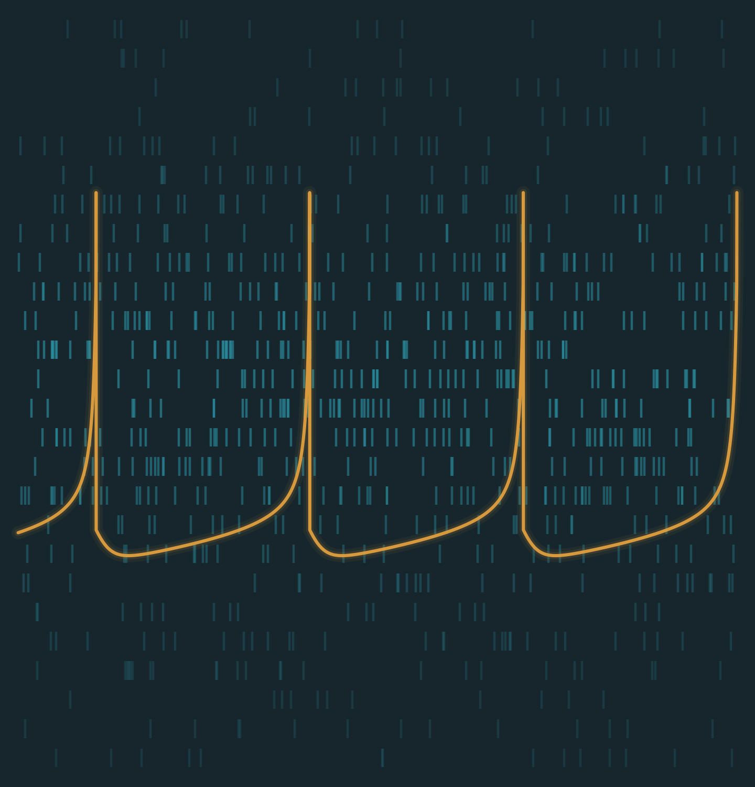


SHARIF UNIVERSITY OF TECHNOLOGY
Department of Computer Engineering
H-ASIZH
A Highly Reliable Digital Izhikevich Neuron Core Using Adaptive Threshold Control for Fault Accommodation
Presented by Ali Roshani
Supervisors Dr. Mohsen Ansari
Date Aban 1405
Cyber-Physical Systems Laboratory

Slide 2
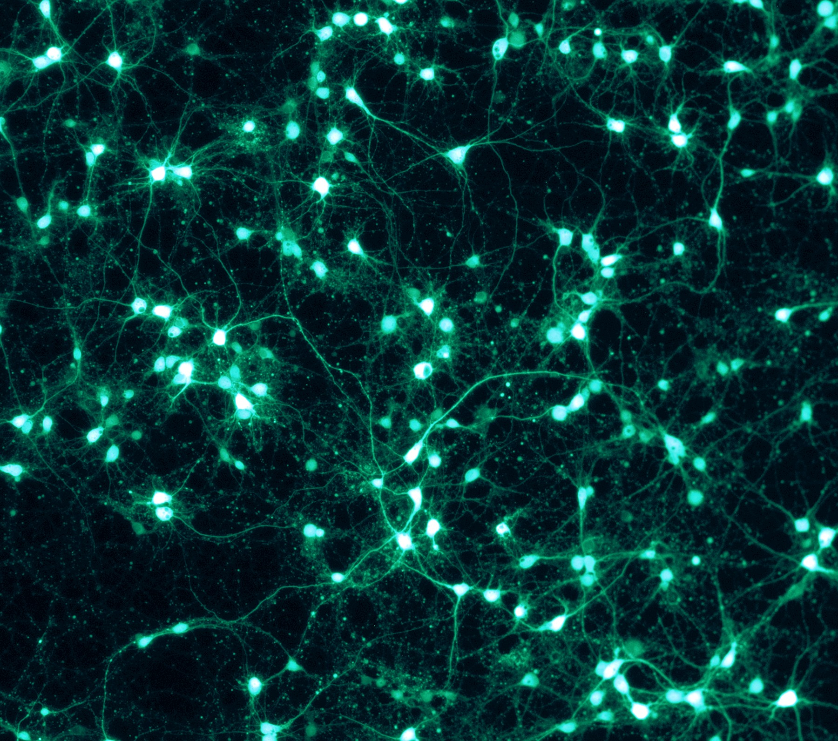
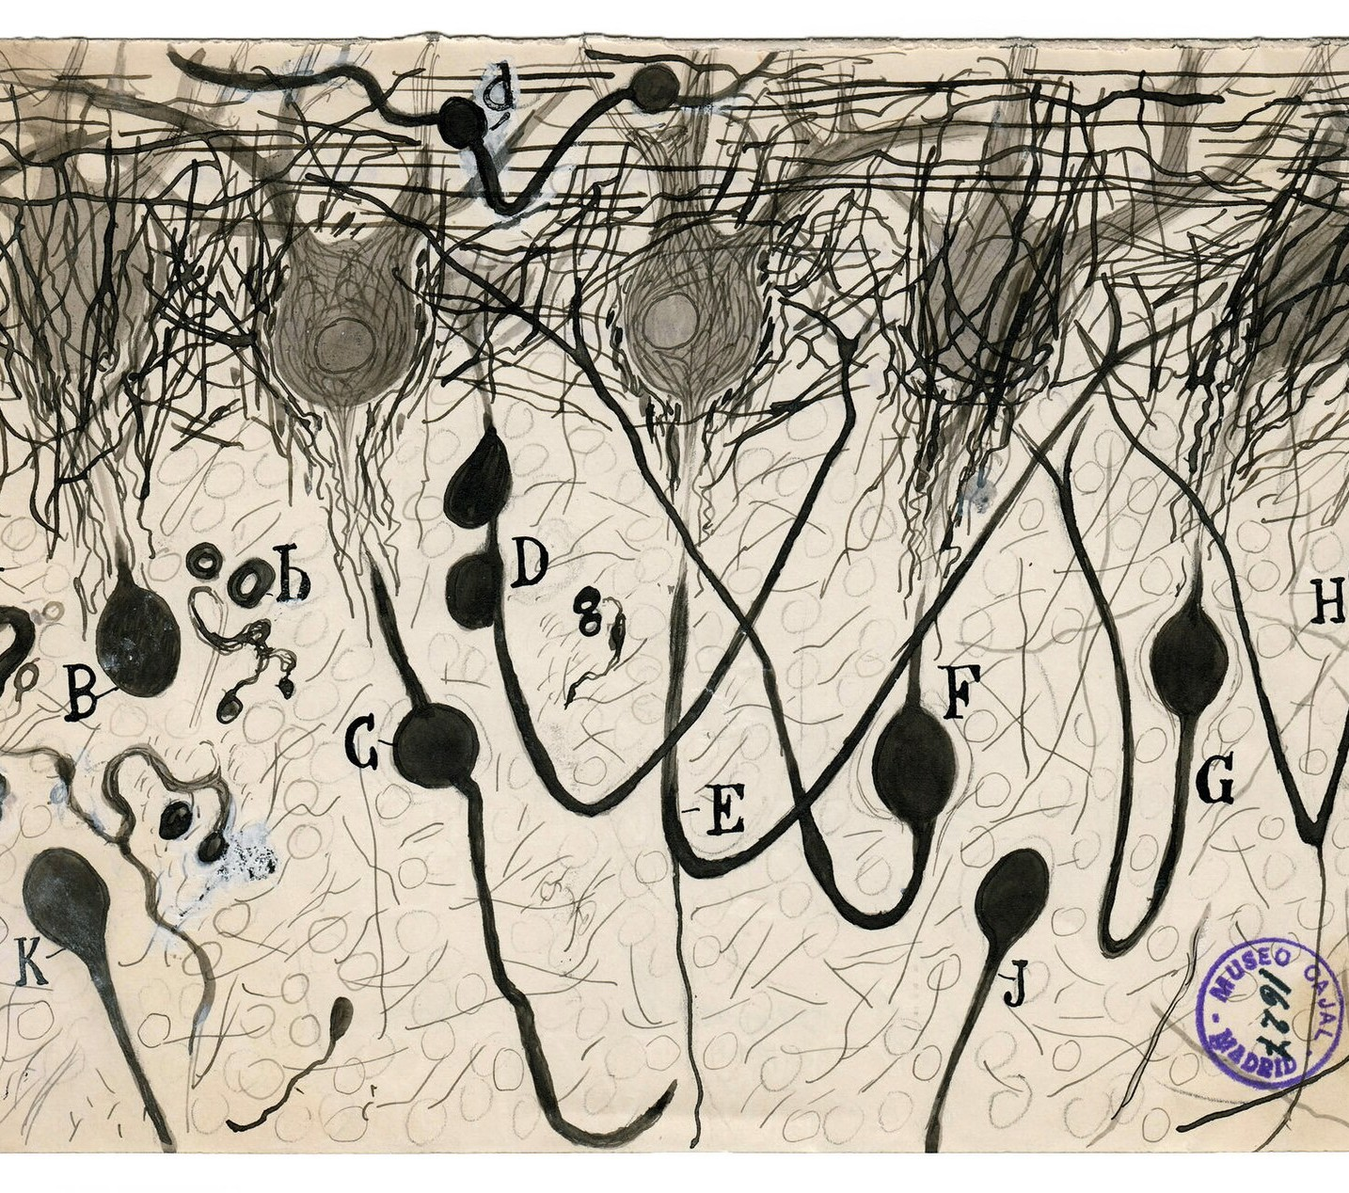
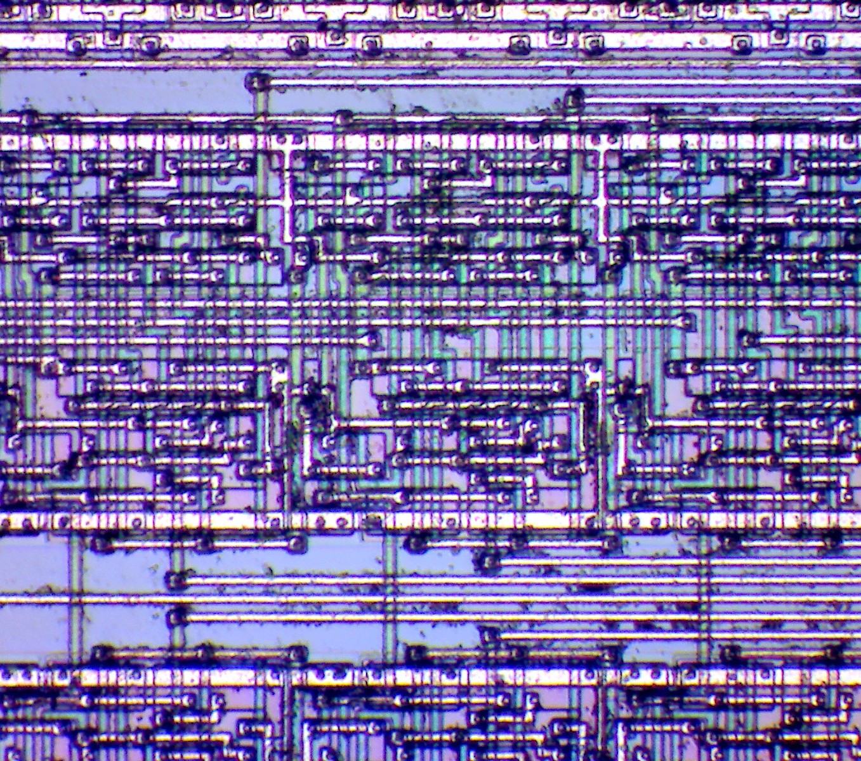
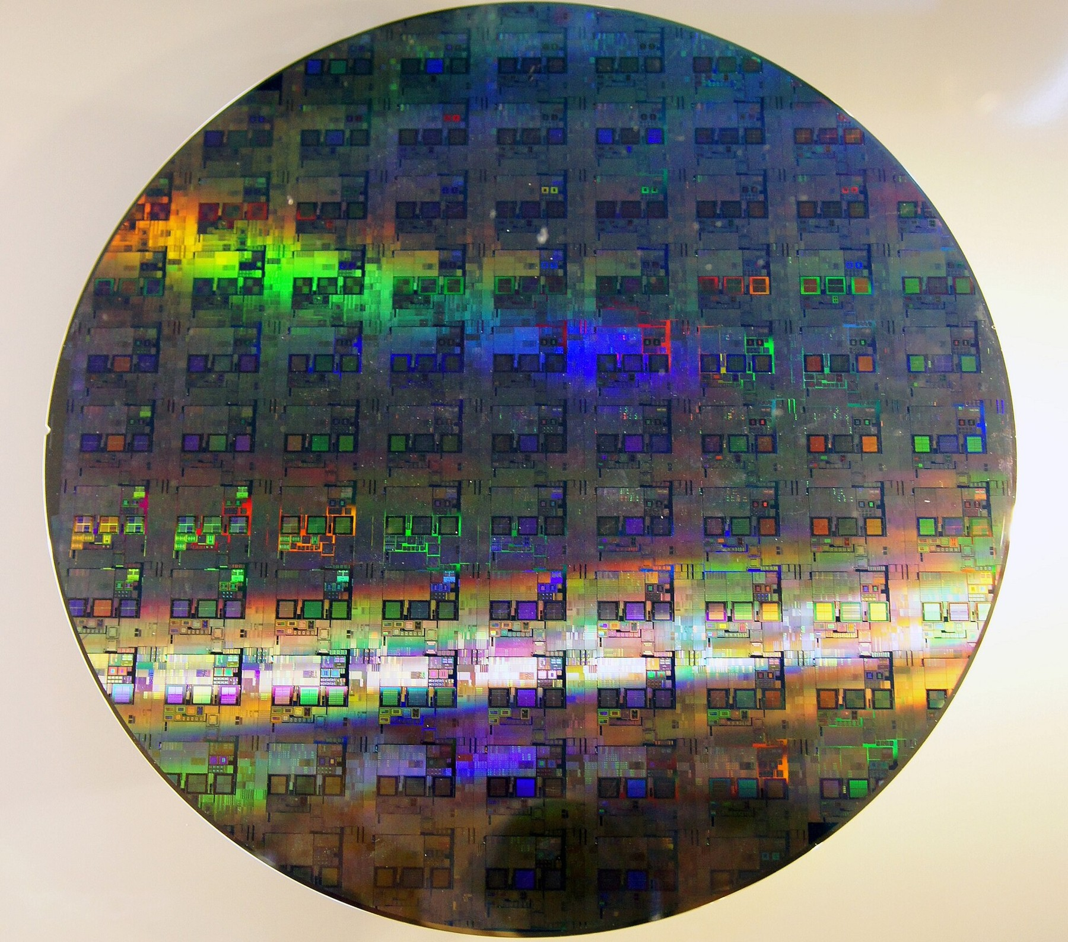
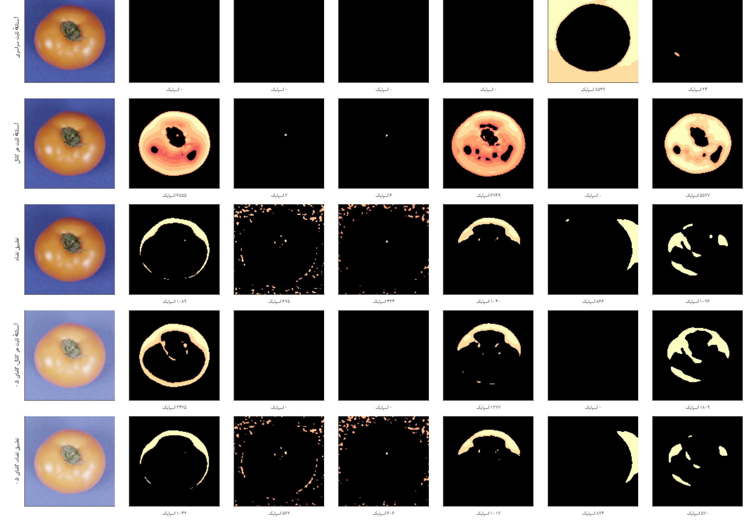
ROADMAP
Outline
01
Introduction
02
Literature
03
Methodology
01
02
03
04
05
Introduction
Literature Review
Methodology
Results
Conclusion
04
Results
Three walls, a paradigm shift, and why the neuron must not fail
Taxonomy, timeline and the landmark works
Affine map → controller → proof → RTL → GLFI
PPA, fault campaign, RFoM and on-chip learning
Takeaways and the road ahead
05
Conclusion
H-ASIZH
‹
2 / 35
›

Slide 3
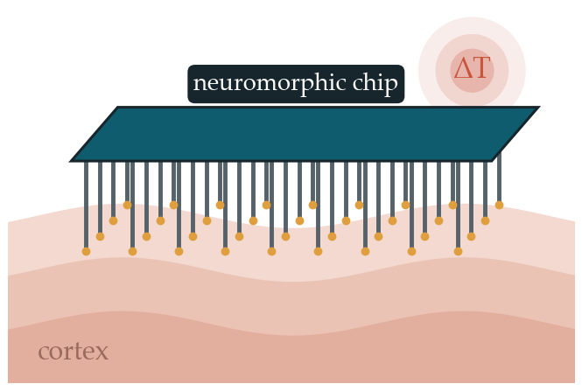
01
Introduction
01 Introduction
02 Literature Review
03 Methodology
04 Results
05 Conclusion
‹
3 / 35
›

Slide 4
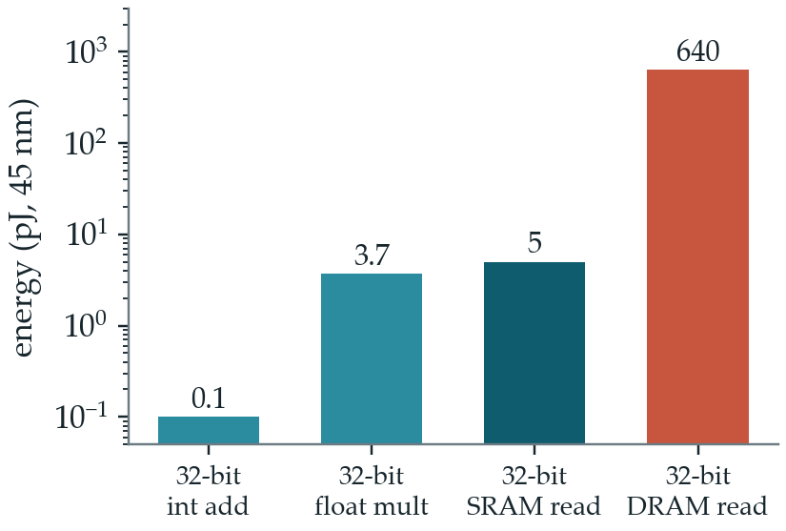
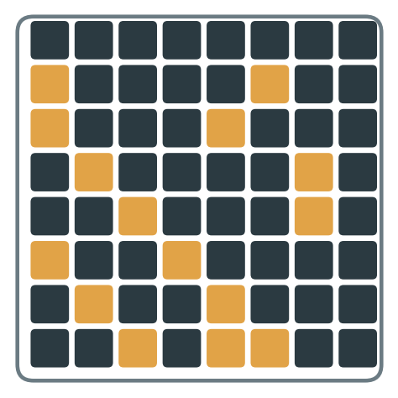
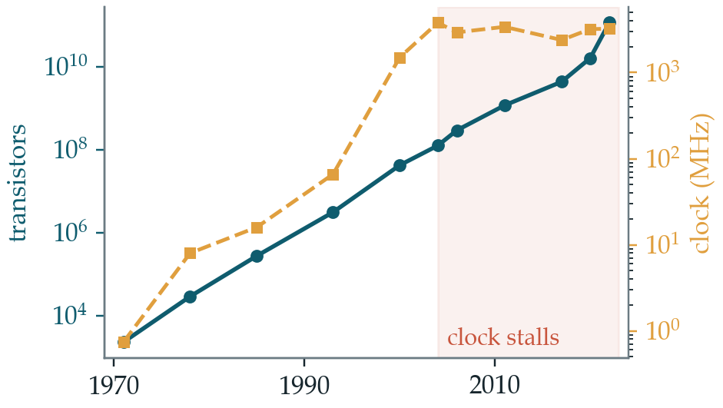
01 · INTRODUCTION
Three Walls of Classical Computing
01
Introduction
1
Moore’s wall
2
Memory wall
3
Power wall
02
Literature
03
Methodology
04
Results
Transistor counts still grow, but clock speed stopped rising around 2005 [1].
Fetching one word from DRAM costs ~170× a floating-point multiply [2, 3].
Under a fixed power budget, much of the chip must stay dark [4].
05
Conclusion
More transistors no longer mean more useful work per joule → the architecture itself must change.
H-ASIZH
[1] M. M. Waldrop, “The chips are down for Moore’s law,” Nature, vol. 530, pp. 144–147, 2016.
[2] M. Horowitz, “Computing’s energy problem (and what we can do about it),” in Proc. IEEE ISSCC, 2014, pp. 10–14.
[3] J. Backus, “Can programming be liberated from the von Neumann style?” Commun. ACM, vol. 21, no. 8, pp. 613–641, 1978.
[4] H. Esmaeilzadeh et al., “Dark silicon and the end of multicore scaling,” in Proc. ISCA, 2011, pp. 365–376.
‹
4 / 35
›

Slide 5
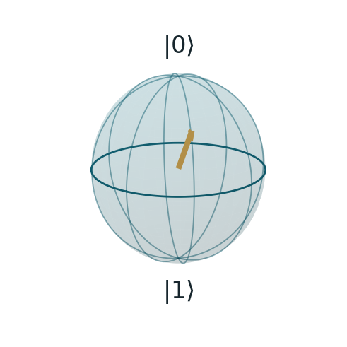
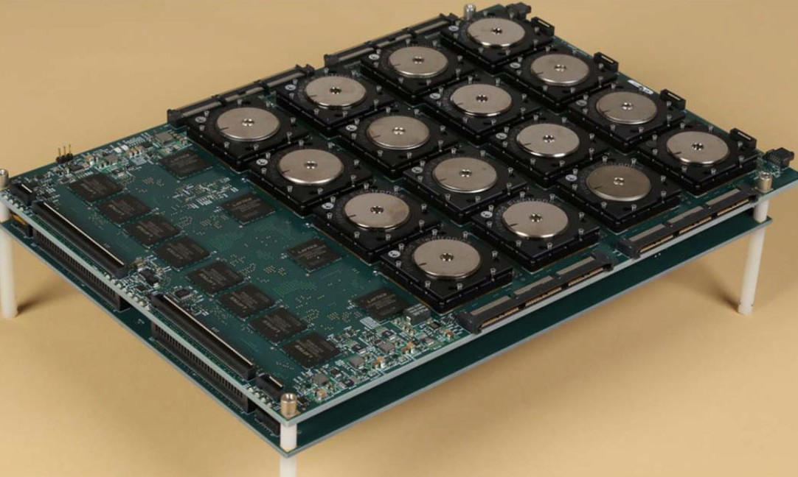
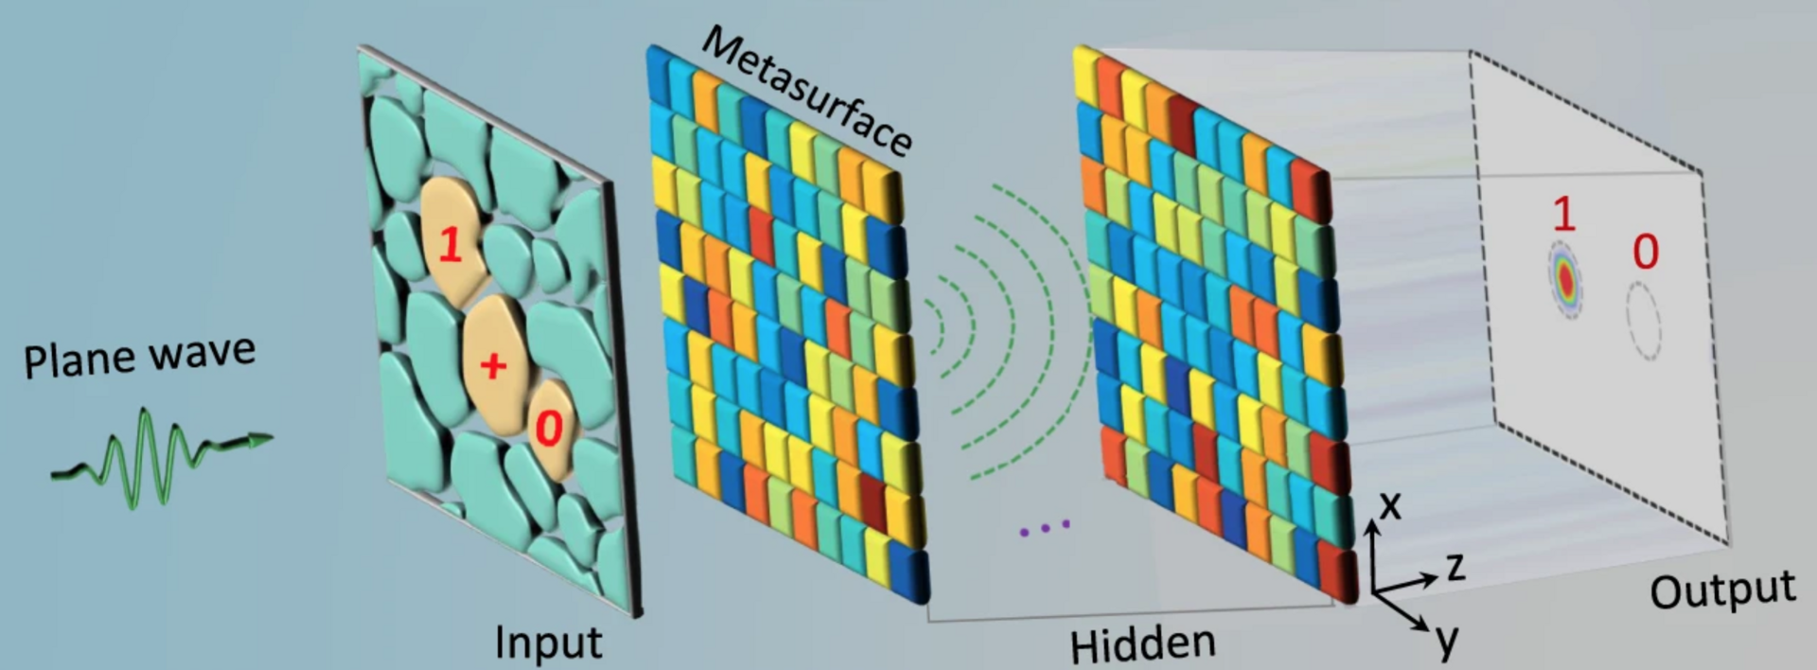
01 · INTRODUCTION
A Paradigm Shift Beyond von Neumann
01
Introduction
our choice
Quantum computing
Optical computing
Neuromorphic computing
02
Literature
03
Methodology
Diffractive optical network — Qian et al., CC BY 4.0
IBM TrueNorth 16-chip board — DARPA SyNAPSE, public domain
04
Results
A huge state space, but cryogenic and error-prone today [5].
Linear algebra at the speed of light; nonlinearity and memory remain hard [6].
Event-driven, memory beside compute, µW-scale on standard CMOS [7, 8].
05
Conclusion
Neuromorphic hardware is the paradigm that already fits inside a sensor or an implant.
H-ASIZH
[5] J. Preskill, “Quantum computing in the NISQ era and beyond,” Quantum, vol. 2, p. 79, 2018.
[6] B. J. Shastri et al., “Photonics for artificial intelligence and neuromorphic computing,” Nature Photonics, vol. 15, pp. 102–114, 2021.
[7] K. Roy et al., “Towards spike-based machine intelligence with neuromorphic computing,” Nature, 2019.
[8] C. D. Schuman et al., “Opportunities for neuromorphic computing algorithms and applications,” Nature Comput. Sci., vol. 2, pp. 10–19, 2022.
‹
5 / 35
›

Slide 6
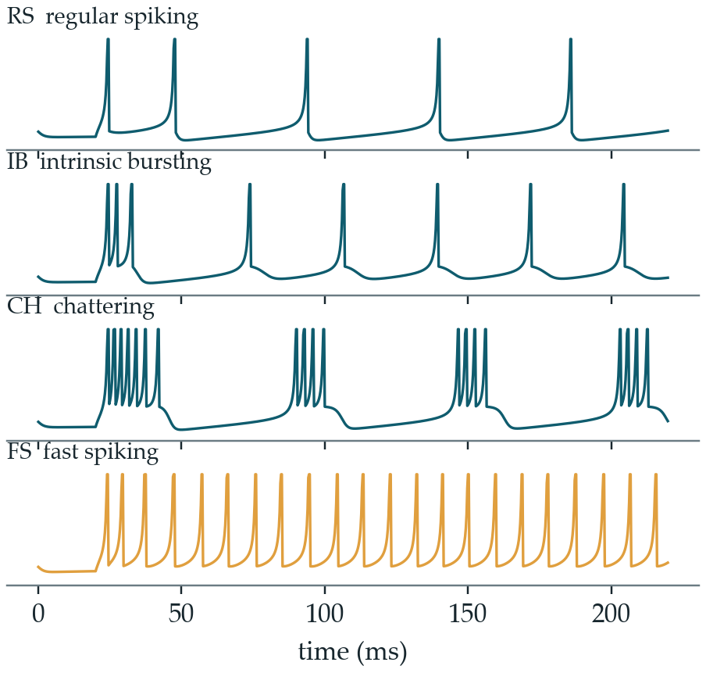
01 · INTRODUCTION
Neuromorphic Computing and the Izhikevich Neuron
01
Introduction
Spikes: information lives in event timing — the third generation of neural networks [9].
02
Literature
Chips: TrueNorth packs 1 M neurons [10]; Loihi learns on chip [11].
03
Methodology
Izhikevich: two equations, 20+ biological firing patterns, multiplier-free designs exist [12, 13].
04
Results
But these chips are still silicon.
What happens when one of their transistors fails?
05
Conclusion
Four firing patterns of one model, simulated [12]
H-ASIZH
‹
6 / 35
›
[9] W. Maass, 1997 [10] F. Akopyan et al., 2015 [11] M. Davies et al., 2018 [12] E. M. Izhikevich, 2003 [13] S. Haghiri et al., 2018

Slide 7
01 · INTRODUCTION
Where It Must Work: Bio-Vision and Brain Implants
01
Introduction
Bio-inspired vision
Brain implants and BCIs
02
Literature
03
Methodology
04
Results
Spiking retina front-end of our vision system: ON/OFF and contrast channels [14]
The chip computes on cortical signals, inside living tissue
05
Conclusion
Thermal
tissue heating below ~1 °C [15]
Power
µW per neuron, battery for years
Lifetime
no repair; replacement means surgery
Reliability
a failure is a clinical event
H-ASIZH
‹
7 / 35
›
[14] R. H. Masland, “The neuronal organization of the retina,” Neuron, vol. 76, no. 2, pp. 266–280, 2012.
[15] S. Kim, P. Tathireddy, R. A. Normann and F. Solzbacher, “Thermal impact of an active 3-D microelectrode array implanted in the brain,” IEEE Trans. Neural Syst. Rehabil. Eng., vol. 15, no. 4, pp. 493–501, 2007.

Slide 8
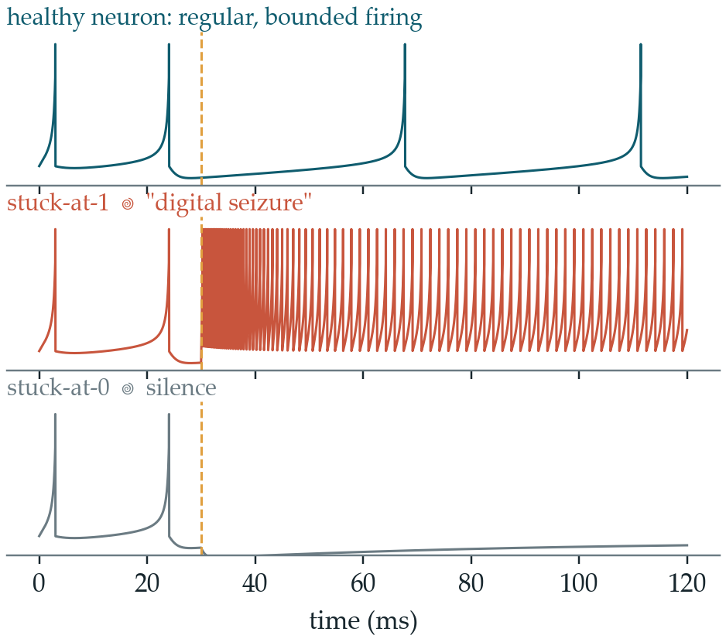
01 · INTRODUCTION
When Silicon Fails: Seizure or Silence
01
Introduction
Manufacturing defects
process variation, lithography errors
02
Literature
Aging
NBTI, hot carriers, electromigration
03
Methodology
Radiation
particle strikes, single-event effects
04
Results
Voltage & temperature
IR drop, hot spots, timing stress
05
Conclusion
→ a node ends up stuck-at-0 or stuck-at-1 [16]
Simulated neuron: SA1 acts as a parasitic current, SA0 removes the drive [17]
H-ASIZH
‹
8 / 35
›
[16] I. Hill et al., “CMOS reliability from past to future: A survey of requirements, trends, and prediction methods,” IEEE Trans. Device Mater. Rel., 2022.
[17] E.-I. Vatajelu et al., “Special session: Reliability of hardware-implemented spiking neural networks (SNN),” in Proc. IEEE 37th VLSI Test Symp., 2019.

Slide 9
01 · INTRODUCTION
Research Gaps
01
Introduction
Reliability is not a design target
Neuromorphic chips are tuned for energy and accuracy; permanent faults are studied after the fact [17, 18].
G1
02
Literature
Redundancy breaks the budget
Replication (TMR) triples area, power and heat — not viable at µW or inside tissue [19, 20].
G2
03
Methodology
Protection lives outside the neuron
Supervisors, remapping and retraining sit beside or above the neuron, and can fail themselves [21, 22, 23].
G3
04
Results
Rich neurons are left out
Fault-tolerance studies use simple integrate-and-fire neurons, not bio-plausible dynamics [24].
G4
05
Conclusion
G5
Assessment is too optimistic
Reliability is mostly estimated in software or at RTL, not on the gate-level netlist [25, 26].
H-ASIZH
[17] E.-I. Vatajelu et al., 2019 [18] C. D. Schuman et al., 2020 [19] R. E. Lyons et al., 1962 [20] K. S. Morgan et al., 2007 [21] J. Liu et al., 2018 [22] R. V. W. Putra et al., 2021 [23] K. N. Dang et al., 2022 [24] T. Spyrou et al., 2021 [25] R. Leveugle et al., 2009 [26] J.-D. Guerrero-Balaguera et al., 2025
‹
9 / 35
›

Slide 10
01 · INTRODUCTION
Research Objectives
01
Introduction
Reliable neuromorphic blocks for the body and the sensor
neuron cores that vision systems and implants can trust for years
O1
closes G1
02
Literature
Fault tolerance without replicas
protection that fits a µW, heat-limited budget
O2
closes G2
03
Methodology
A neuron that regulates itself
tolerance built into the neuron’s own dynamics, as in biological homeostasis
O3
closes G3
04
Results
Keep the biology, drop the multiplier
a full Izhikevich core in shifts and additions only
O4
closes G4
05
Conclusion
O5
Measure it honestly, then let it learn
open gate-level fault injection and an on-chip learning test
closes G5
H-ASIZH
‹
10 / 35
›

Slide 11
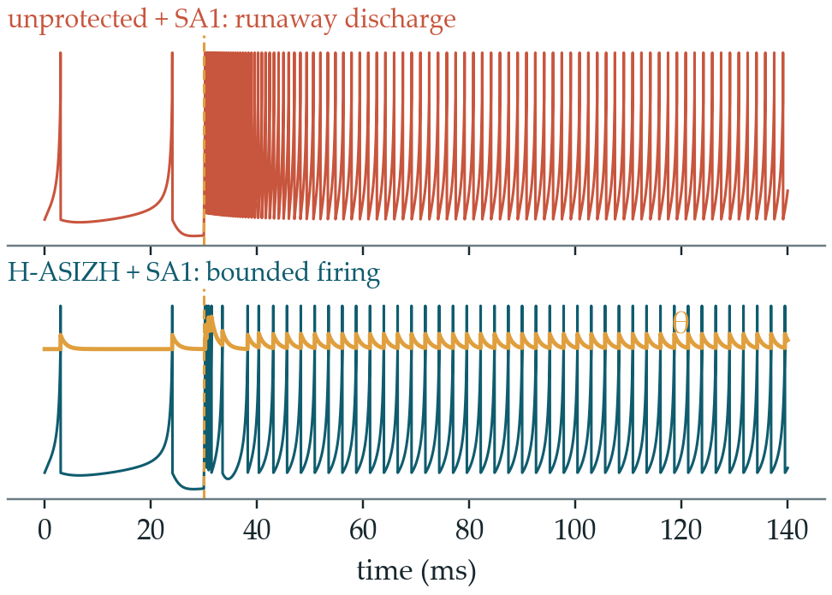
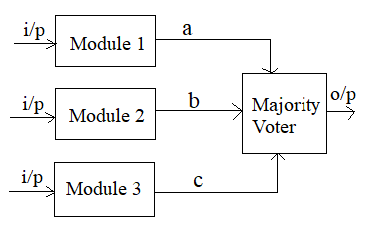
01 · INTRODUCTION
Our Idea: Accommodate, Don’t Mask
01
Introduction
Masking (TMR)
3.40×
cells
3.80×
power, in our 130 nm study
02
Literature
03
Methodology
Accommodation (H-ASIZH)
04
Results
▸ The threshold θ becomes a slow state variable
▸ Negative feedback absorbs the defect
▸ Regulator and neuron are the same circuit
Same stuck-at-1 defect, simulated with and without the controller
05
Conclusion
Fault ↑ firing → θ rises → firing ↓
a new bounded equilibrium, with the defect still present
H-ASIZH
‹
11 / 35
›
[19] R. E. Lyons et al., “The use of triple-modular redundancy to improve computer reliability,” IBM J. Res. Dev., 1962.

Slide 12
01 · INTRODUCTION
Contributions
01
Introduction
Exact affine map + Lyapunov bound
the firing rate is uniformly ultimately bounded
Hardware-aware design-space search
α, γ and β become exact powers of two
1
2
02
Literature
03
Methodology
One-cycle Q7.19 RTL core
shifts and additions only, SkyWater 130 nm
Open gate-level fault injection (GLFI)
four-valued logic, five cores, every node
3
4
04
Results
4.2% dangerous faults vs 12.0% for full TMR — with 32% fewer cells
05
Conclusion
H-ASIZH
Code and data: github.com/aliroshanidino/GLFI_fault_campaign
‹
12 / 35
›

Slide 13
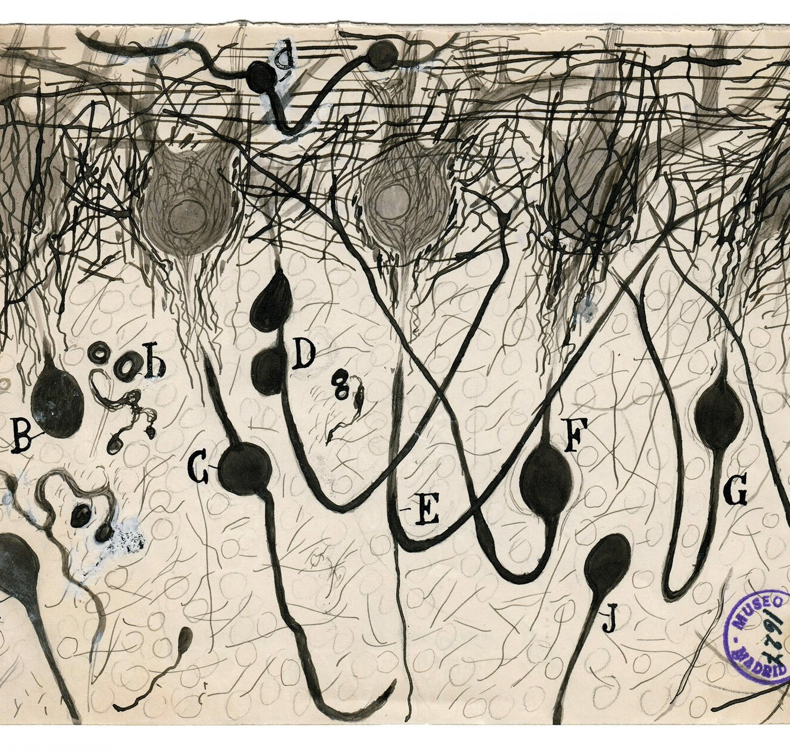
02
Literature Review
01 Introduction
02 Literature Review
03 Methodology
04 Results
05 Conclusion
‹
13 / 35
›

Slide 14
02 · LITERATURE REVIEW
Taxonomy of SNN Fault-Tolerance Work
01
Introduction
Reliability assurance and fault tolerance in SNN hardware
02
Literature
Classical redundancy
System, mapping & compiler
Bio-inspired, beside the neuron
Intrinsic, inside the neuron
Spatial / modular
TMR [19], adaptive DMR [27], partial TMR [28], TMR trade-off [20], selective hardening [29], TMR with standby [30]
Information
NeuroScrub+ [31], MulPi [32]
Radiation hardening
TUTPFL latch [33]
Fault-aware mapping
ReSpawn [22], RescueSNN [34]
Approximate memory
SparkXD [35], EnforceSNN [36], SoftSNN [37]
3D-NoC & migration
R-NASH [38], µBrains [39], MigSpike [23], [40]
Lifetime & saliency
eSpine [41], SalvageDNN [42], [18]
Extrinsic supervisor
SPANNER [21], astroglial syncytia [43], astrocyte methodology [44], tunable astrocyte [45], homeostatic network [46]
Structural isolation
dendritic computation [47], self-healing pixels [48]
03
Methodology
H-ASIZH
this work
intrinsic adaptive homeostasis
04
Results
Every other branch acts on, around or above the neuron. None acts within it.
05
Conclusion
H-ASIZH
‹
14 / 35
›

Slide 15
02 · LITERATURE REVIEW
A Timeline of Reliable Neuromorphic Hardware
01
Introduction
TMR
Lyons & Vanderkulk [19]
Defect tolerance in VLSI
Koren & Koren [49]
Adaptive DMR
Vadlamani et al. [27]
SPANNER; homeostatic FT
Liu; Johnson et al. [21, 46]
RescueSNN, SoftSNN, MigSpike
Putra; Dang et al. [34, 37, 23]
Dendritic FT, SHADOWFI
Das; Guerrero et al. [47, 26]
02
Literature
03
Methodology
1962
1998
2010
2018
2022
2025
1997
2003
2015
2021
2023
2026
04
Results
SNNs: 3rd generation
Maass [9]
Izhikevich model
Izhikevich [12]
TrueNorth: 1 M neurons
Akopyan et al. [10]
ReSpawn; neuron FT study
Putra; Spyrou et al. [22, 24]
Tunable astrocyte, NeuroScrub+
Varshika; Ahmed et al. [45, 31]
H-ASIZH
this work
05
Conclusion
H-ASIZH
‹
15 / 35
›

Slide 16
02 · LITERATURE REVIEW
Landmark Works Compared
01
Introduction
Work | Where it acts | Mechanism | Main limitation
TMR [19] | Module | Majority vote masks the fault | 3.4× cells, voter jitter
SPANNER [21] | Beside the cores | Astrocyte monitor repairs synapses | The supervisor can fail too
Johnson et al. [46] | Network | Homeostasis via an astrocyte network | Regulator ≠ neuron
RescueSNN, ReSpawn [34, 22] | Mapping | Move work to healthy parts | Timing no longer fixed
H-ASIZH (ours) | Inside the neuron | Adaptive threshold feedback | 39% overhead, no replicas
02
Literature
03
Methodology
04
Results
05
Conclusion
H-ASIZH
[19] R. E. Lyons et al., 1962 [21] J. Liu et al., 2018 [46] A. P. Johnson et al., 2018 [34] R. V. W. Putra et al., 2022 [22] R. V. W. Putra et al., 2021 [47] A. Das et al., 2025
‹
16 / 35
›

Slide 17
03
1
Affine map
exact, shift-only
2
Control loop
θ as a state variable
3
Proof & DSE
UUB + powers of two
Methodology
4
RTL core
1-cycle Q7.19
5
Fault injection
every node, SA0/SA1
01 Introduction
02 Literature Review
03 Methodology
04 Results
05 Conclusion
‹
17 / 35
›

Slide 18
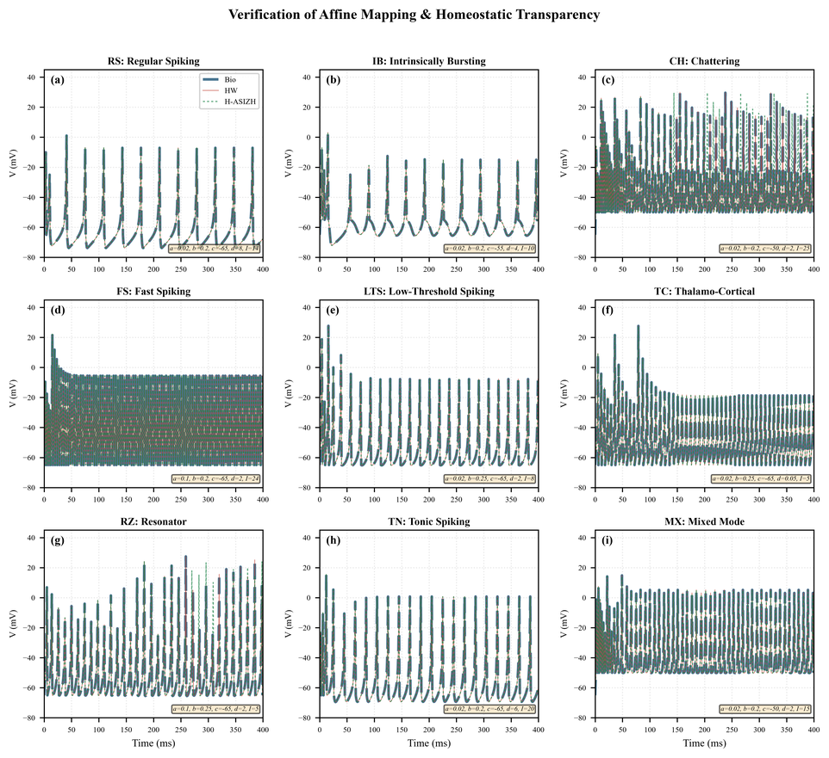
03 · METHODOLOGY
Step 1 — An Exact Affine Mapping
01
Introduction
V = (v + 65) / 64, U = u / 64
dV/dt = 2.56 V² − 0.2 V + I − U − 0.25
dU/dt = a (b V − U − (65/64) b)
02
Literature
03
Methodology
▸ Rest moves to the origin; ÷64 is a free right-shift
▸ Exact: nullclines and phase portrait are kept
▸ All nine patterns match at RMSE < 10⁻¹³
▸ Spike apex 30 mV maps to 95/64 = 1.484
04
Results
05
Conclusion
Biological vs mapped model, nine firing patterns
H-ASIZH
[12] E. M. Izhikevich, “Simple model of spiking neurons,” IEEE Trans. Neural Netw., 2003.
‹
18 / 35
›

Slide 19
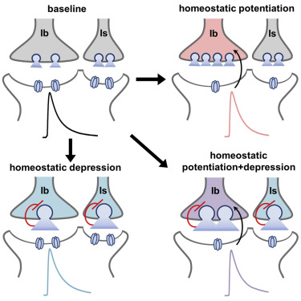
03 · METHODOLOGY
Step 2 — The Intrinsic Homeostatic Controller
01
Introduction
dθ/dt = α (θ₀ − θ) + γ Σ δ(t − tₖ)
if V ≥ θ: V ← c, U ← U + d + β (θ − θ₀)
02
Literature
α
leak
returns θ to θ₀ when the neuron is healthy
03
Methodology
γ
penalty
raises θ at every spike
04
Results
β
brake
deepens the reset of U after a burst
05
Conclusion
Biological analogue: receptor homeostasis driven by intracellular Ca²⁺ [46]
H-ASIZH
[46] A. P. Johnson et al., “Homeostatic fault tolerance in spiking neural networks: A dynamic hardware perspective,” IEEE Trans. Circuits Syst. I, 2018.
‹
19 / 35
›

Slide 20
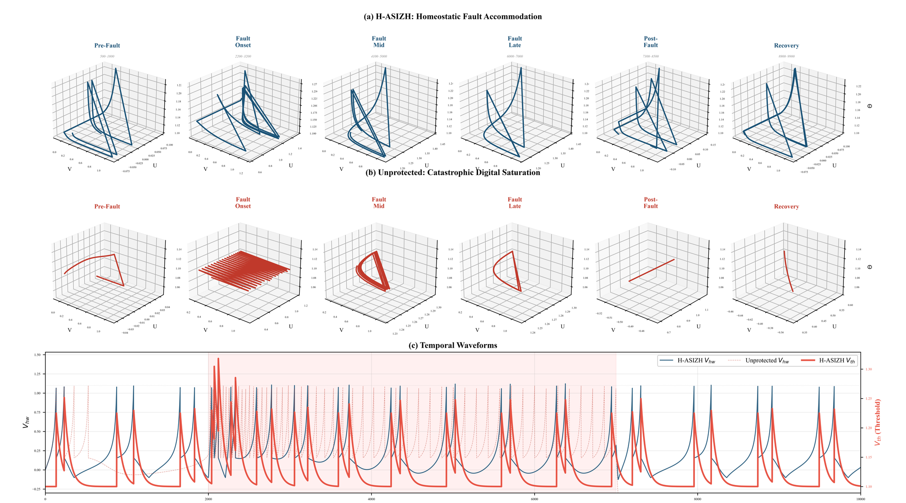
03 · METHODOLOGY
Step 3 — It Cannot Run Away: Lyapunov Bound
01
Introduction
𝒱(θ) = ½ (θ − θ*)², ∂r/∂θ < 0
d𝒱/dt = (θ − θ*) [ −α(θ − θ*) + γ (r − r*) ] < 0
02
Literature
03
Methodology
Hyperactive phase
θ < θ* → r > r* → d𝒱/dt < 0
Hypoactive phase
θ > θ* → r < r* → d𝒱/dt < 0
04
Results
Uniformly ultimately bounded
band |θ − θ*| ≲ γ, set by the penalty, not by the fault [50, 51]
05
Conclusion
2-D limit cycle → bounded 3-D homeostatic attractor; θ rises and absorbs the defect
H-ASIZH
‹
20 / 35
›
[50] H. K. Khalil, Nonlinear Systems, 3rd ed. Prentice Hall, 2002.
[51] J.-J. E. Slotine and W. Li, Applied Nonlinear Control. Prentice Hall, 1991.

Slide 21
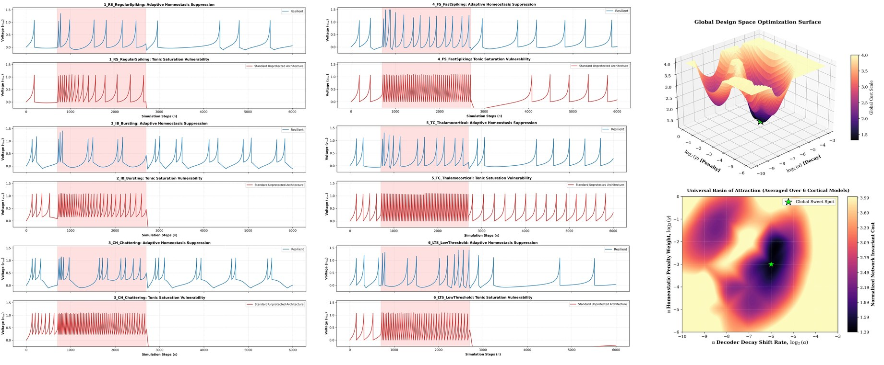
03 · METHODOLOGY
Step 3b — Hardware-Aware Design-Space Exploration
01
Introduction
02
Literature
03
Methodology
04
Results
Cost landscape over (α, γ): two ridges — self-silencing and uncontained seizure — around one valley
α* = 2⁻⁶
shift ≫ 6
γ* = 2⁻³
shift ≫ 3
β* = 2³
shift ≪ 3
cost = 0.25 c_bio + 0.40 c_sup
+ 0.35 c_rec over 392 grid points
05
Conclusion
H-ASIZH
‹
21 / 35
›

Slide 22
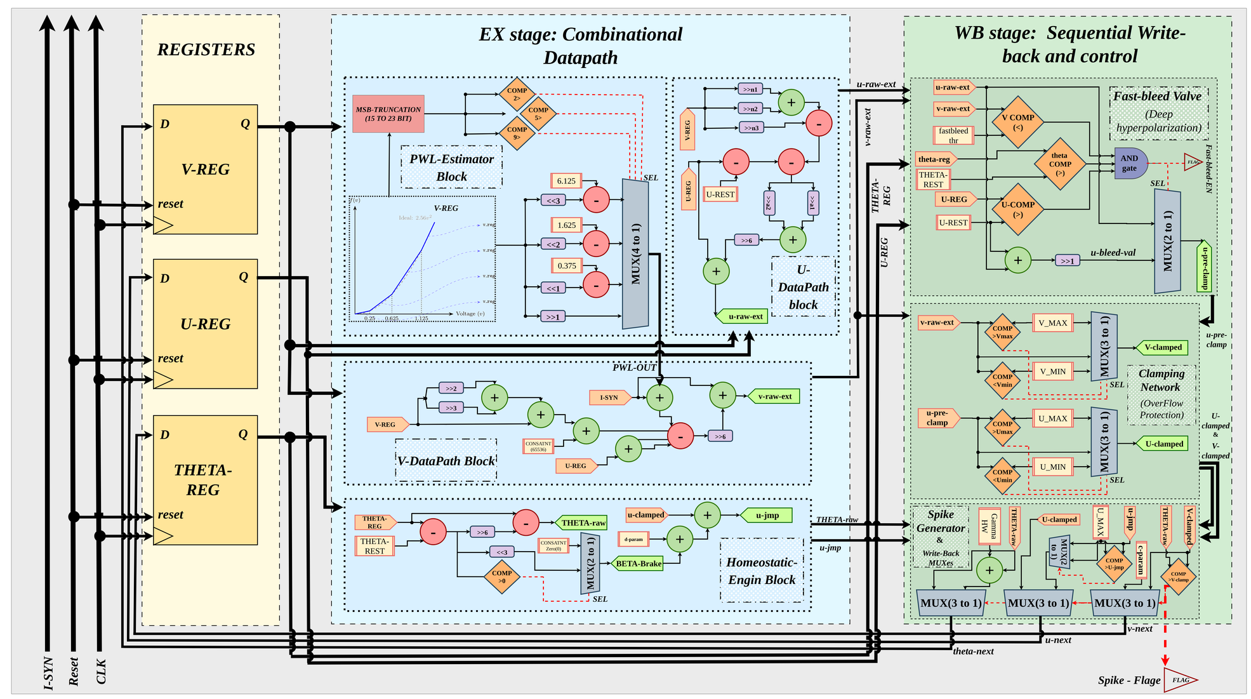
03 · METHODOLOGY
Step 4 — A One-Cycle Micro-Architecture
01
Introduction
EX stage
PWL estimator, V/U datapaths, homeostatic engine
02
Literature
WB stage
clamps, fast-bleed valve, spike generator
03
Methodology
No multiplier
shifts and additions only
04
Results
1 update / cycle
no latency jitter in a timing code
05
Conclusion
H-ASIZH
‹
22 / 35
›

Slide 23
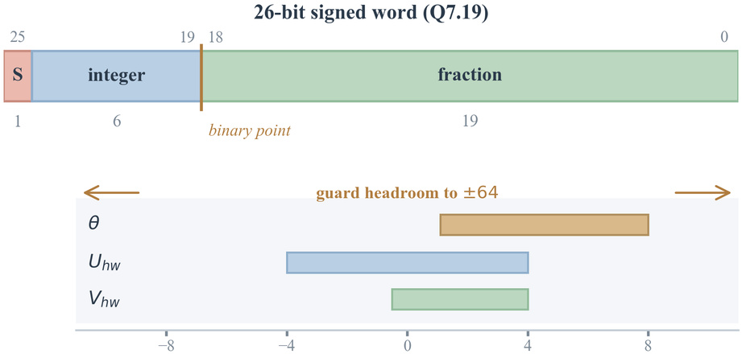
03 · METHODOLOGY
Fixed-Point Word, Multiplier-Free PWL, Write-Back Safety
01
Introduction
PWL(V) ≈ 2.56 V²
0
V < 0
02
Literature
V ≫ 1
0 ≤ V < 0.25
(V ≪ 1) − 0.375
0.25 ≤ V < 0.625
03
Methodology
26-bit Q7.19 word: state stays within 1/8 of ±64
(V ≪ 2) − 1.625
0.625 ≤ V < 1.125
(V ≪ 3) − 6.125
V ≥ 1.125
04
Results
▸ Resolution 2⁻¹⁹ ≈ 1.9 × 10⁻⁶ — the leak step is never lost
▸ No wrap-around, so the proof still holds in hardware
▸ Clamps bound V and U; the fast-bleed valve pulls U halfway to rest in one cycle
Without the valve, 5 of 6 patterns never fire again after the defect clears
05
Conclusion
H-ASIZH
‹
23 / 35
›

Slide 24
03 · METHODOLOGY
Hardening the Control Plane
01
Introduction
Light TMR
Restoring organ
θA
θA
vote
02
Literature
θB
vote
θB
vote
03
Methodology
single point of failure
θC
θC
vote
04
Results
θ-register + 7 decision flags → +1,500 cells
voters triplicated too → +124 cells (≈ 3%)
no single net
05
Conclusion
V-REG, U-REG, the PWL estimator and both adder trees stay simplex: the controller already protects them.
H-ASIZH
‹
24 / 35
›

Slide 25
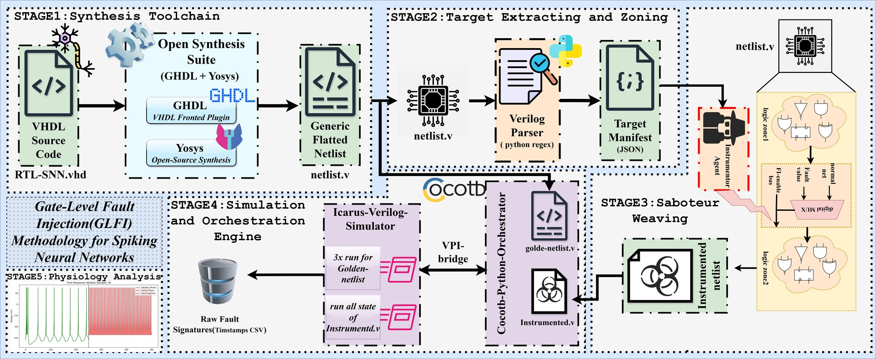
03 · METHODOLOGY
Step 5 — Gate-Level Fault Injection (GLFI)
01
Introduction
Four outcome classes
Masked
identical spike timestamps
02
Literature
Tolerant
FRE ≤ 20%, CV ≤ 0.20
03
Methodology
Critical
outside the band, still firing
04
Results
Fatal
silenced or saturated
assign net = (fi_enable && fi_target_id == ID)
? fi_value : hook_net;
▸ Fault compiled into the netlist, unlike simulator force/release [26]
▸ 2,000 clean cycles, then the fault stays on to cycle 10,000
05
Conclusion
H-ASIZH
‹
25 / 35
›
[26] J.-D. Guerrero-Balaguera et al., “SHADOWFI: An open-source framework for fault evaluation of complex IC designs using hyperscale computing,” IEEE JETCAS, 2025.

Slide 26
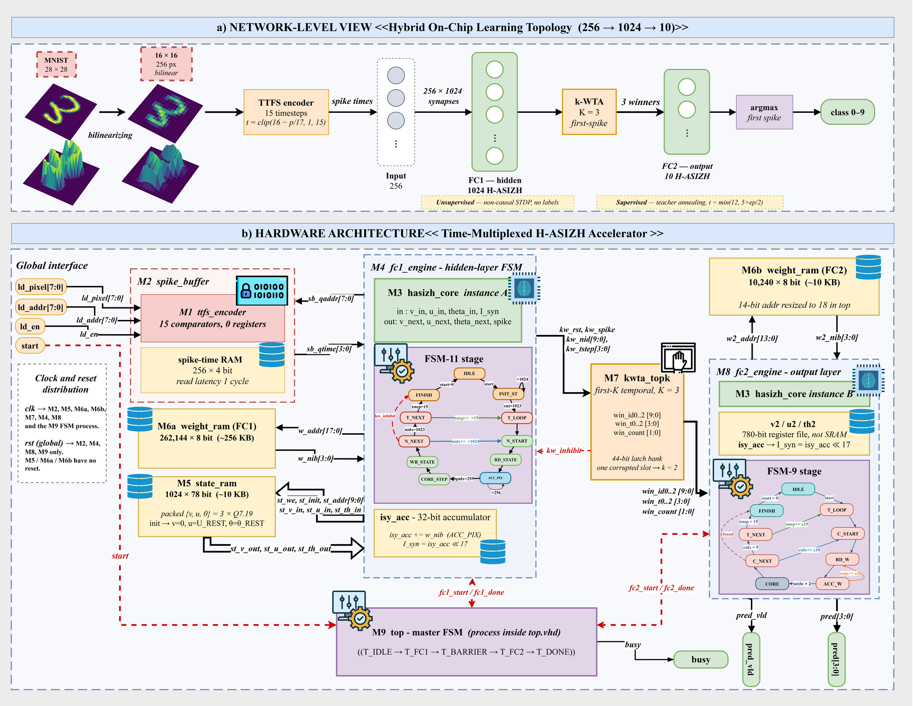
03 · METHODOLOGY
Step 6 — Case Study: On-Chip Learning System
01
Introduction
256 → 1024 → 10
TTFS-coded SNN, 4-bit weights
02
Literature
2 cores
1,034 logical neurons, time-multiplexed
03
Methodology
182.8 µW
both hardened cores together
04
Results
Rate codes forgive timing errors; TTFS does not [52].
05
Conclusion
(a) TTFS network with unsupervised STDP and first-K k-WTA (b) time-multiplexed accelerator
H-ASIZH
‹
26 / 35
›
[52] C. Frenkel et al., “A 0.086-mm² 12.7-pJ/SOP 64k-synapse 256-neuron online-learning digital spiking neuromorphic processor in 28-nm CMOS,” IEEE Trans. Biomed. Circuits Syst., 2019.

Slide 27
04
4.2%
4.76×
dangerous faults
(12.0% for full TMR)
reliability figure of merit
(1.13× for full TMR)
Results
1.47 pJ
1020 / 1024
per update — the same
energy as full TMR
hidden neurons stay
active while learning
01 Introduction
02 Literature Review
03 Methodology
04 Results
05 Conclusion
‹
27 / 35
›

Slide 28
04 · RESULTS
Physical Implementation and Energy
01
Introduction
Design | Cells | Fmax (MHz) | Power (µW) | pJ / update
Baseline | 1,772 | 83.61 | 30.7 | 0.367
Homeostasis | 2,469 | 64.92 | 52.8 | 0.813
+ Light TMR | 3,969 | 64.18 | 88.5 | 1.379
+ Restoring organ | 4,093 | 62.11 | 91.4 | 1.472
Full TMR | 6,025 | 80.00 | 116.8 | 1.460
02
Literature
03
Methodology
04
Results
05
Conclusion
▸ The controller alone costs 697 cells (1.39×)
▸ Full TMR is faster but not more efficient
1.472 vs 1.460 pJ
≈ 3× safer at the same energy
H-ASIZH
SkyWater 130 nm, OpenLane place & route, OpenSTA sign-off at 1.8 V, 25 °C with post-route parasitics; leakage < 0.05% of the total.
‹
28 / 35
›

Slide 29
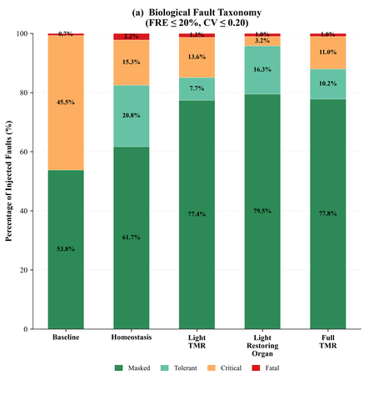
04 · RESULTS
Fault Outcome Distribution
01
Introduction
Baseline
45.5% critical and no tolerant class: a fault is invisible or destructive
02
Literature
Homeostasis
critical falls threefold to 15.3%; a 20.8% tolerant class appears; fatal rises to 2.2% (brake)
03
Methodology
Restoring organ
79.5% masked, 3.2% critical, 1.0% fatal — the floor set by the spike output
04
Results
05
Conclusion
Every node injected, both polarities, four-valued logic
H-ASIZH
‹
29 / 35
›

Slide 30
04 · RESULTS
Reliability Figure of Merit (RFoM)
01
Introduction
RFoM = (AVF_base / AVF_i) ÷ (N_i / N_base)
vulnerability reduction ÷ area growth
02
Literature
▸ AVF = (critical + fatal) / all faults
▸ Worth its silicon only if RFoM > 1
▸ Full TMR: 3.85× safer but 3.40× larger
▸ Restoring organ: 11.0× safer, 2.31× larger
03
Methodology
04
Results
05
Conclusion
Plain homeostasis already beats full TMR by 1.67×
H-ASIZH
‹
30 / 35
›

Slide 31
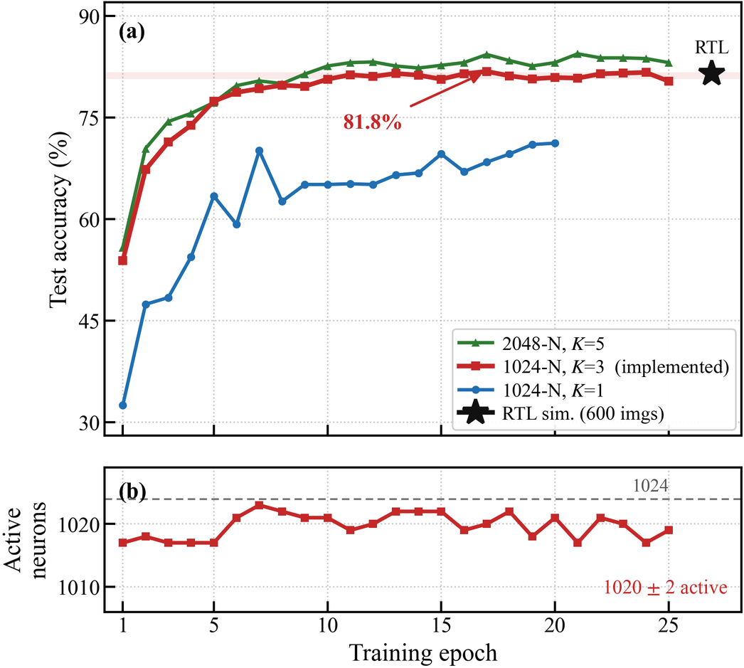
04 · RESULTS
On-Chip Learning: Accuracy and a Healthy Population
01
Introduction
81.8%
peak; 81.2 ± 0.5% steady state
02
Literature
81.5%
synthesisable RTL, 600 test images
03
Methodology
1020 ± 2 / 1024
hidden neurons stay active
04
Results
The same θ that stops a runaway also stops neuron death and domination.
05
Conclusion
H-ASIZH
‹
31 / 35
›

Slide 32
05 · CONCLUSION
Conclusion
01
Introduction
Fault tolerance moved inside the neuron
the threshold is a slow, self-regulating state
Proven and cheap
bounded firing rate; shifts and adds on a 1-cycle Q7.19 core
θ
✓
02
Literature
03
Methodology
4.2% vs 12.0% dangerous faults
32% fewer cells than full TMR
4.76× RFoM vs 1.13×
at the same 1.47 pJ per neuron update
%
×
04
Results
05
Conclusion
Triplication buys nothing that accommodation does not buy more cheaply.
H-ASIZH
‹
32 / 35
›

Slide 33
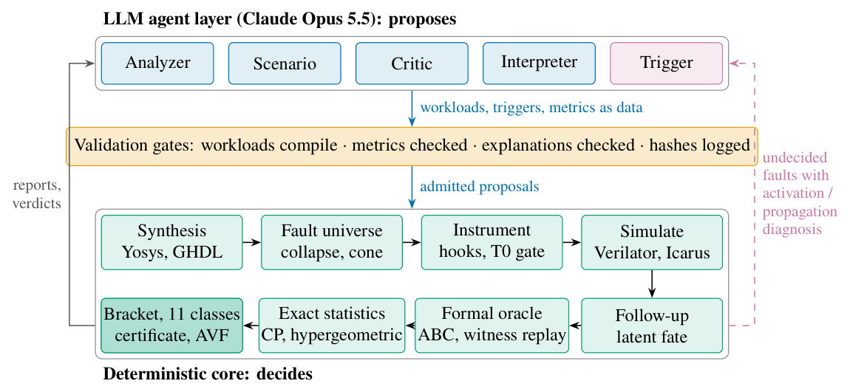
05 · CONCLUSION
Future Work: Where This Goes Next
01
Introduction
in progress
in progress
in progress
Homeostasis 2.0 on cheaper cores
GLFI → GateScan
A fault-tolerant bio-vision chip
02
Literature
θ
rate
control
brake
activity
03
Methodology
gain
sensors → controller → actuators
▸ From Izhikevich to LIF / IF cores
▸ Replace TMR and the restoring organ with a richer loop: 2 sensors, 3 actuators
▸ Different mechanisms, one goal — degeneracy, as in biology [53]
▸ An open fault-analysis application: RTL in, per-node vulnerability out
▸ LLM agents propose workloads; simulation and formal proof decide
▸ 0 disagreements in 1,834 cross-checks; agent workloads lift ITC’99 b13 detection 35.7% → 86.0%
▸ A human-visual-system SNN: spiking retina, TTFS, reward-modulated STDP
▸ Built from our fault-tolerant LIF / IF cores, shift-and-add only, for FPGA
04
Results
05
Conclusion
H-ASIZH
[53] E. Marder and J.-M. Goaillard, “Variability, compensation and homeostasis in neuron and network function,” Nat. Rev. Neurosci., vol. 7, pp. 563–574, 2006.
‹
33 / 35
›

Slide 34
05 · CONCLUSION
References
01
Introduction
[1] M. M. Waldrop, “The chips are down for Moore’s law,” Nature, vol. 530, pp. 144–147, 2016.
[2] M. Horowitz, “Computing’s energy problem (and what we can do about it),” in Proc. IEEE ISSCC, 2014, pp. 10–14.
[3] J. Backus, “Can programming be liberated from the von Neumann style?” Commun. ACM, vol. 21, no. 8, pp. 613–641, 1978.
[4] H. Esmaeilzadeh et al., “Dark silicon and the end of multicore scaling,” in Proc. ISCA, 2011, pp. 365–376.
[5] J. Preskill, “Quantum computing in the NISQ era and beyond,” Quantum, vol. 2, p. 79, 2018.
[6] B. J. Shastri et al., “Photonics for artificial intelligence and neuromorphic computing,” Nature Photonics, vol. 15, pp. 102–114, 2021.
[7] K. Roy et al., “Towards spike-based machine intelligence with neuromorphic computing,” Nature, 2019.
[8] C. D. Schuman et al., “Opportunities for neuromorphic computing algorithms and applications,” Nature Comput. Sci., vol. 2, pp. 10–19, 2022.
[9] W. Maass, “Networks of spiking neurons: The third generation of neural network models,” Neural Networks, 1997.
[10] F. Akopyan et al., “TrueNorth: Design and tool flow of a 65 mW 1 million neuron programmable neurosynaptic chip,” IEEE Trans. CAD, 2015.
[11] M. Davies et al., “Loihi: A neuromorphic manycore processor with on-chip learning,” IEEE Micro, 2018.
[12] E. M. Izhikevich, “Simple model of spiking neurons,” IEEE Trans. Neural Netw., 2003.
[13] S. Haghiri et al., “Multiplierless implementation of noisy Izhikevich neuron with low-cost digital design,” IEEE Trans. Biomed. Circuits Syst., 2018.
[14] R. H. Masland, “The neuronal organization of the retina,” Neuron, vol. 76, no. 2, pp. 266–280, 2012.
[15] S. Kim, P. Tathireddy, R. A. Normann and F. Solzbacher, “Thermal impact of an active 3-D microelectrode array implanted in the brain,” IEEE Trans. Neural Syst. Rehabil. Eng., vol. 15, no. 4, pp. 493–501, 2007.
[16] I. Hill et al., “CMOS reliability from past to future: A survey of requirements, trends, and prediction methods,” IEEE Trans. Device Mater. Rel., 2022.
[17] E.-I. Vatajelu et al., “Special session: Reliability of hardware-implemented spiking neural networks (SNN),” in Proc. IEEE 37th VLSI Test Symp., 2019.
[18] C. D. Schuman et al., “Resilience and robustness of spiking neural networks for neuromorphic systems,” in Proc. Int. Joint Conf. Neural Netw. (IJCNN), 2020.
[19] R. E. Lyons et al., “The use of triple-modular redundancy to improve computer reliability,” IBM J. Res. Dev., 1962.
[20] K. S. Morgan et al., “A comparison of TMR with alternative fault-tolerant design techniques for FPGAs,” IEEE Trans. Nucl. Sci., 2007.
[21] J. Liu et al., “SPANNER: A self-repairing spiking neural network hardware architecture,” IEEE Trans. Neural Netw. Learn. Syst., 2018.
[22] R. V. W. Putra et al., “ReSpawn: Energy-efficient fault-tolerance for spiking neural networks considering unreliable memories,” in Proc. IEEE/ACM Int. Conf. Comput.-Aided Design (ICCAD), 2021.
[23] K. N. Dang et al., “MigSpike: A migration based algorithms and architecture for scalable robust neuromorphic systems,” IEEE Trans. Emerg. Topics Comput., 2022.
[24] T. Spyrou et al., “Neuron fault tolerance in spiking neural networks,” in Proc. DATE, 2021.
[25] R. Leveugle et al., “Statistical fault injection: Quantified error and confidence,” in Proc. DATE, 2009.
[26] J.-D. Guerrero-Balaguera et al., “SHADOWFI: An open-source framework for fault evaluation of complex IC designs using hyperscale computing,” IEEE JETCAS, 2025.
[27] R. Vadlamani et al., “Multicore soft error rate stabilization using adaptive dual modular redundancy,” in Proc. DATE, 2010.
[28] B. Pratt et al., “Fine-grain SEU mitigation for FPGAs using partial TMR,” IEEE Trans. Nucl. Sci., 2008.
[29] F. Libano et al., “Selective hardening for neural networks in FPGAs,” IEEE Trans. Nucl. Sci., 2019.
[30] K. Zhang et al., “Triple modular redundancy with standby (TMRSB) supporting dynamic resource reconfiguration,” in Proc. IEEE Autotestcon, 2006.
[31] S. T. Ahmed et al., “NeuroScrub+: Mitigating retention faults using flexible approximate scrubbing in neuromorphic fabric based on resistive memories,” IEEE Trans. Comput.-Aided Des. Integr. Circuits Syst., 2023.
[32] F. Cheng et al., “MulPi: A multi-class and patient-independent epileptic seizure classifier with co-designed input-stationary computing-in-SRAM,” IEEE Trans. Biomed. Circuits Syst., 2025.
[33] A. Yan et al., “TUTPFL: Triple node upset-tolerant and single-event transient filtered low-power latch,” IEEE Trans. Very Large Scale Integr. (VLSI) Syst., 2025.
[34] R. V. W. Putra et al., “RescueSNN: enabling reliable executions on spiking neural network accelerators under permanent faults,” Frontiers in Neuroscience, 2022.
[35] R. V. W. Putra et al., “SparkXD: A framework for resilient and energy-efficient spiking neural network inference using approximate DRAM,” in Proc. 58th ACM/IEEE Design Automation Conf. (DAC), 2021.
[36] R. V. W. Putra et al., “EnforceSNN: Enabling resilient and energy-efficient SNN inference considering approximate DRAMs,” Frontiers in Neuroscience, 2022.
[37] R. V. W. Putra et al., “SoftSNN: Low-cost fault tolerance for spiking neural network accelerators under soft errors,” in Proc. DAC, 2022.
[38] O. M. Ikechukwu et al., “On the design of a fault-tolerant scalable three dimensional NoC-based digital neuromorphic system with on-chip learning,” IEEE Access, 2021.
[39] M. L. Varshika et al., “Design of many-core big little µBrains for energy-efficient embedded neuromorphic computing,” in Proc. DATE, 2022.
[40] W. Y. Yerima et al., “Fault-tolerant spiking neural network mapping algorithm and architecture to 3D-NoC-based neuromorphic systems,” IEEE Access, 2023.
[41] T. Titirsha et al., “Endurance-aware mapping of spiking neural networks to neuromorphic hardware,” IEEE Trans. Parallel Distrib. Syst., 2022.
[42] M. A. Hanif et al., “SalvageDNN: Salvaging deep neural network accelerators with permanent faults through saliency-driven fault-aware mapping,” Philos. Trans. Roy. Soc. A, 2019.
[43] M. Naeem et al., “On the role of astroglial syncytia in self-repairing spiking neural networks,” IEEE Trans. Neural Netw. Learn. Syst., 2015.
[44] M. Isik et al., “A design methodology for fault-tolerant computing using astrocyte neural networks,” in Proc. 19th ACM Int. Conf. Computing Frontiers (CF), 2022.
[45] M. L. Varshika et al., “Design of a tunable astrocyte neuromorphic circuitry with adaptable fault tolerance,” in Proc. IEEE 66th Int. Midwest Symp. Circuits Syst. (MWSCAS), 2023.
[46] A. P. Johnson et al., “Homeostatic fault tolerance in spiking neural networks: A dynamic hardware perspective,” IEEE Trans. Circuits Syst. I, 2018.
[47] A. Das et al., “Exploring dendritic computation in bio-inspired architectures for dynamic programming,” in Proc. DATE, 2025.
[48] Q. Cheng et al., “A radiation-hardened neuromorphic imager with self-healing spiking pixels and unified spiking neural network for space robotics,” in Proc. IEEE Symp. VLSI Technol. Circuits, 2025.
[49] I. Koren et al., “Defect tolerance in VLSI circuits: techniques and yield analysis,” Proc. IEEE, 1998.
[50] H. K. Khalil, Nonlinear Systems, 3rd ed. Prentice Hall, 2002.
[51] J.-J. E. Slotine and W. Li, Applied Nonlinear Control. Prentice Hall, 1991.
[52] C. Frenkel et al., “A 0.086-mm² 12.7-pJ/SOP 64k-synapse 256-neuron online-learning digital spiking neuromorphic processor in 28-nm CMOS,” IEEE Trans. Biomed. Circuits Syst., 2019.
[53] E. Marder and J.-M. Goaillard, “Variability, compensation and homeostasis in neuron and network function,” Nat. Rev. Neurosci., vol. 7, pp. 563–574, 2006.
02
Literature
03
Methodology
04
Results
05
Conclusion
H-ASIZH
‹
34 / 35
›

Slide 35
Thank you
Questions and discussion
Ali Roshani
Sharif University of Technology · CPSLab
github.com/aliroshanidino/GLFI_fault_campaign
‹
35 / 35
›

