Slide 1
Lab3
PART A: Python Code
Ways to tokenize
Stemming
Lemmatization
Parse Trees
PART B: eHOST

Slide 2
1. Tokenization
s.split()
word_tokenize(s) **
regexp_tokenize(s, pattern='\w+’) **
regexp_tokenize(s, pattern='\d+’) **
wordpunct_tokenize(s) **
blankline_tokenize(s) **
**Be sure to import your tokenize functions from nltk:
from nltk.tokenize import word_tokenize, regexp_tokenize, wordpunct_tokenize, blankline_tokenize

Slide 3
2. Stemming
PorterStemmer
LancasterStemmer
SnowballStemmer
http://textminingonline.com/dive-into-nltk-part-iv-stemming-and-lemmatization
http://www.nltk.org/api/nltk.stem.html

Slide 4
3. Lemmatization
POS = part of speech
V- verb
A- adjective
N - noun

Slide 5
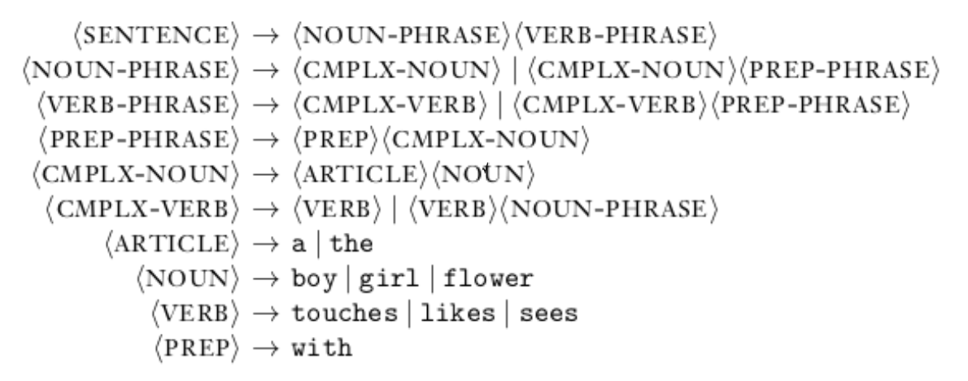
4. Parse Trees - Generating a Grammar
“the girl touches the boy with the flower”

Slide 6
4. Parse Trees - Generating a Grammar
“the girl touches the boy with the flower”
sentence is (syntactically) ambiguous – 2 ways to generate it using the grammar rules ⇒ 2 possible parse trees

Slide 7
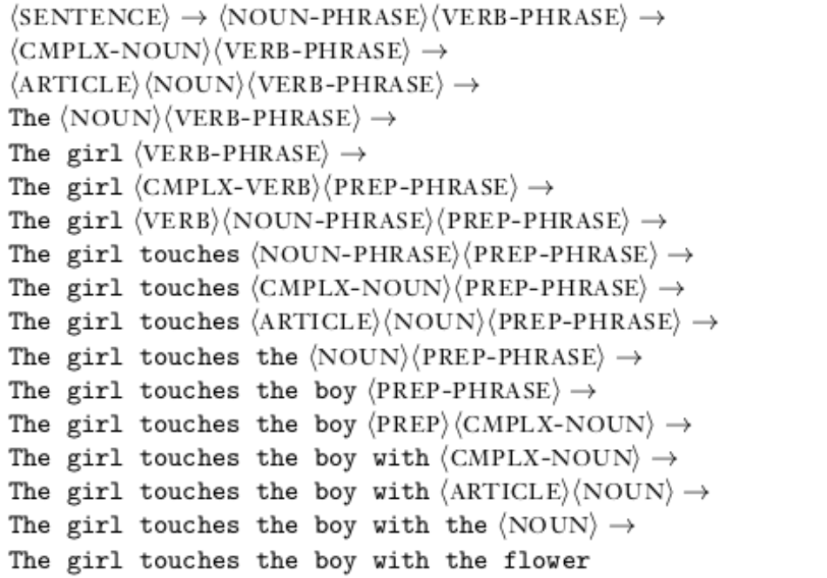
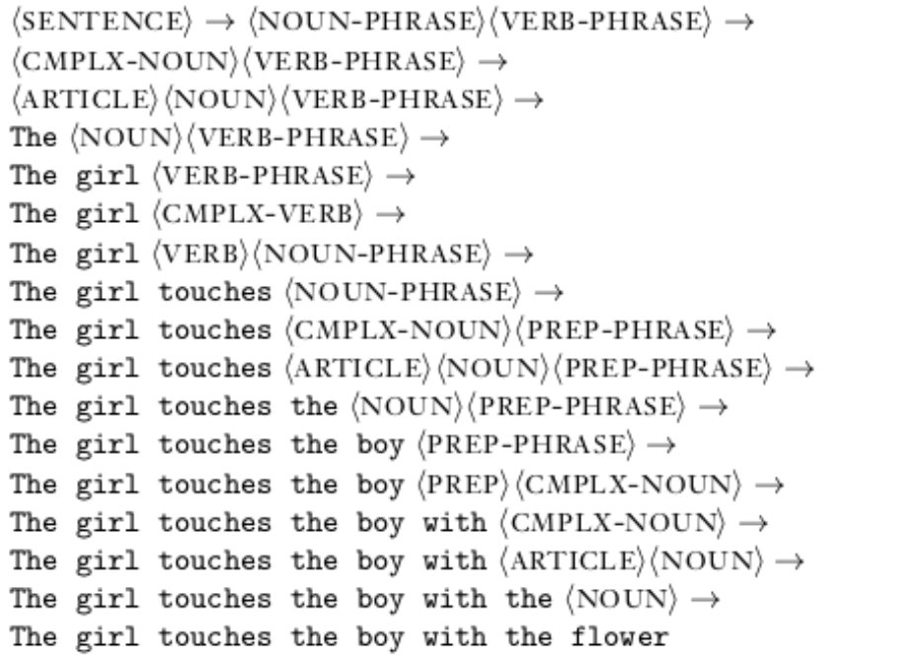
4. Parse Trees - Generating a Grammar

Slide 8
eHOST
Annotation software
“prototype annotation system that provides an open-source stand-alone client for manual annotation of clinical texts”
http://blulab.chpc.utah.edu/content/ehost-extensible-human-oracle-suite-tools

