Slide 1


Slide 2
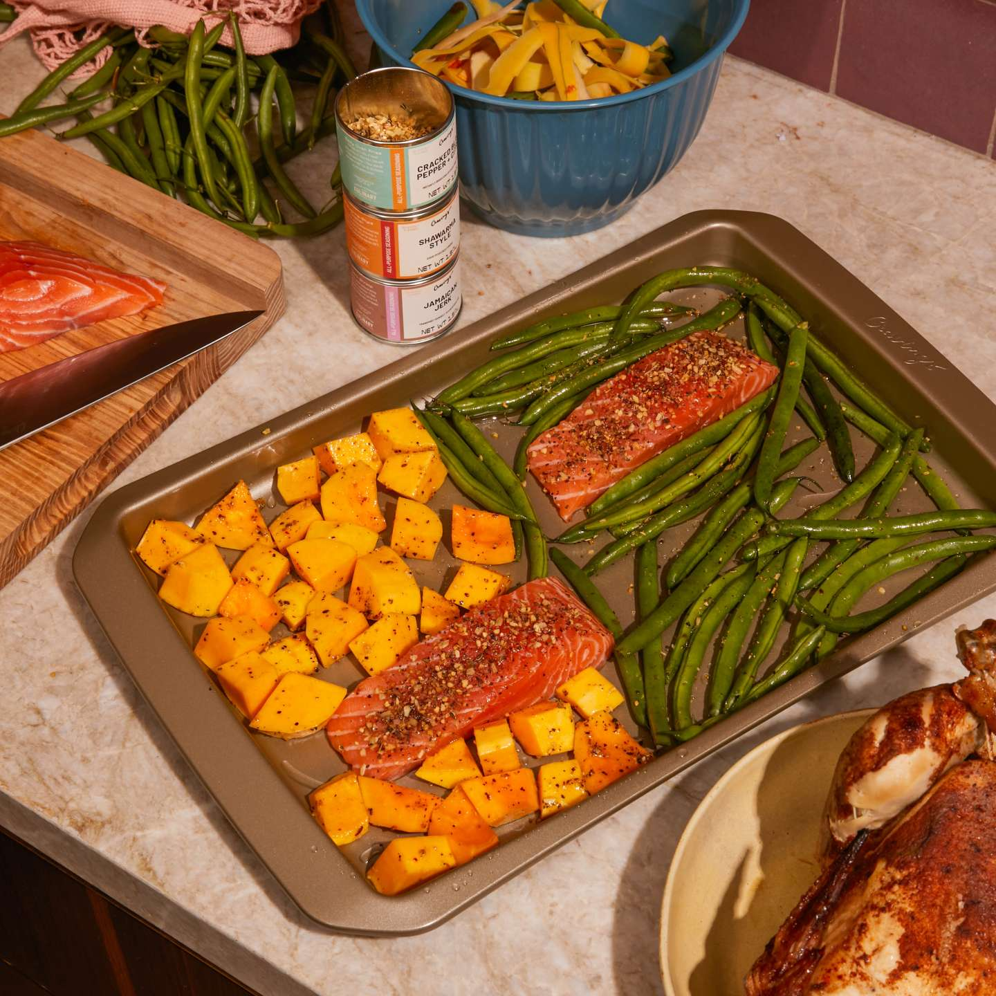
What's for dinner? Not quite sure? Trying to prepare meals for the week ahead?

Slide 3
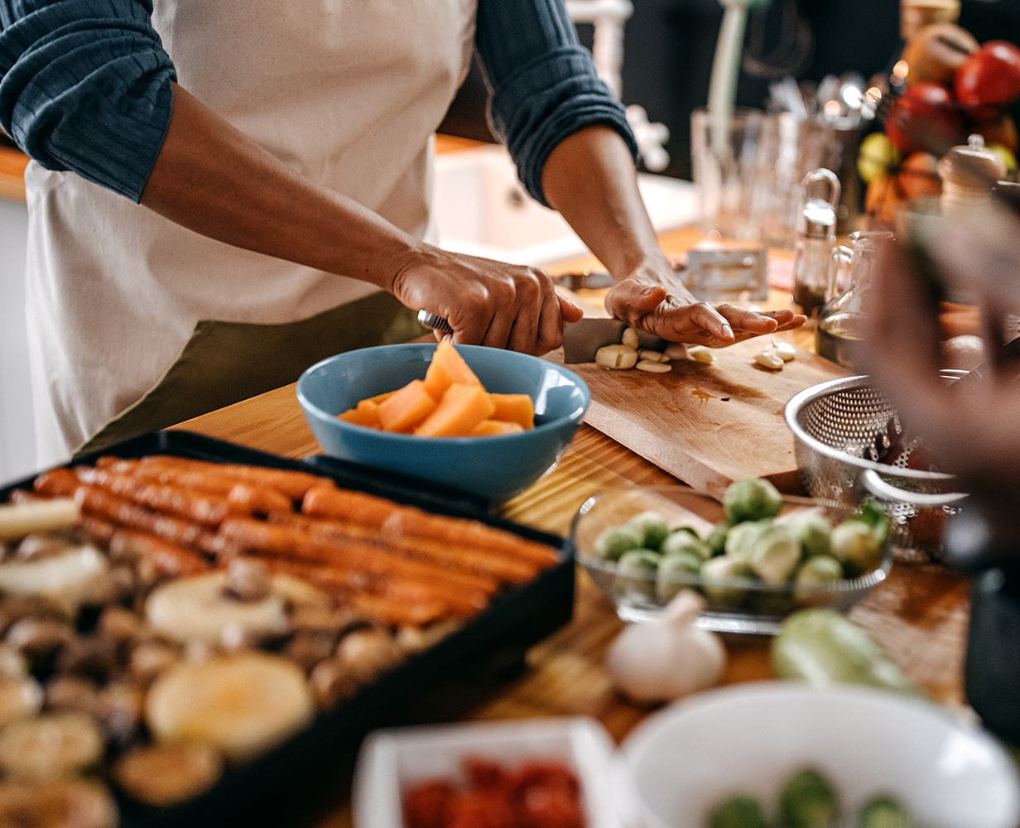
Let us help with that.
Search any meal you'd like to make and we'll lend a helping hand.
Multiple recipe suggestions with corresponding cooking instructions.
Nutrition breakdown of each meal along with serving sizes.

Slide 4
Description
We created an app that’s aimed at making meal prepping as easy as 1,2,3.
Built with JavaScript, HTML, CSS and a Bootstrap framework.
API used: Recipe
"https://api.api-ninjas.com/v1/recipe?query="
Nutrition Value
"https://api.api-ninjas.com/v1/nutrition?query="

Slide 5
Task Breakdown
Alisa
Daisha
Victor
Shamary

Slide 6
The Pros and Cons

Slide 7
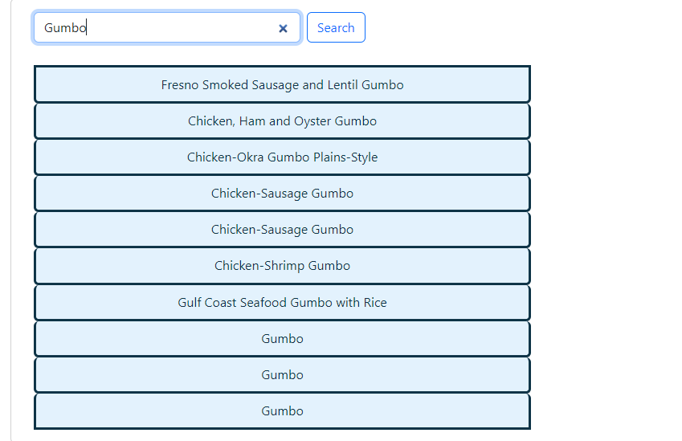
Project Demo -> Search the meal you'd like to make and get a great list of recipes.

Slide 8
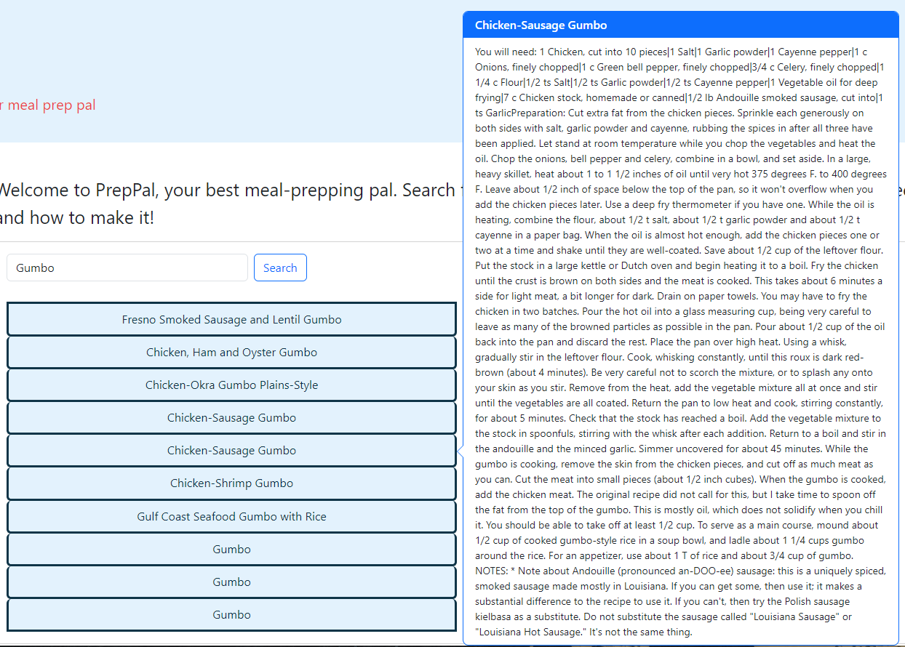
Click on chosen meal and the recipe and cooking instructions will pop up->

Slide 9
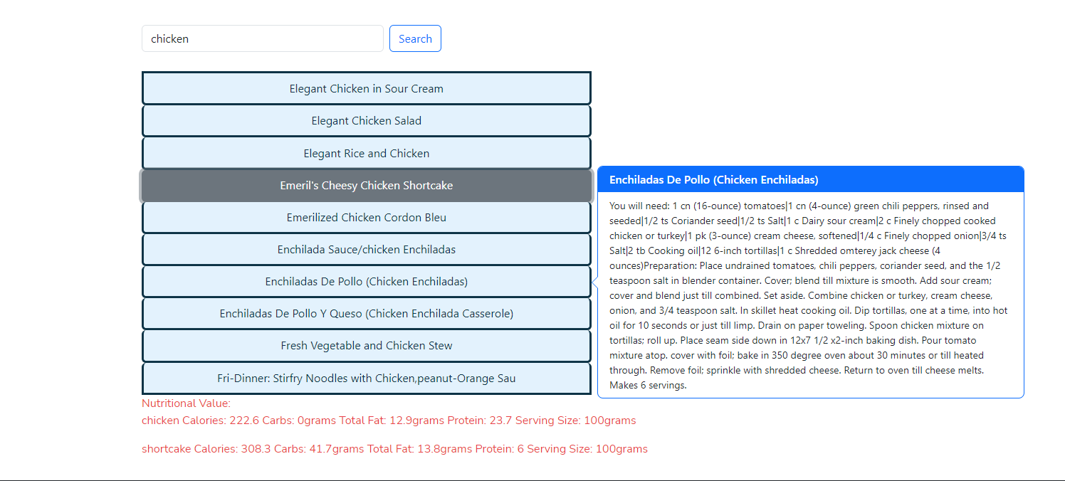

Slide 10
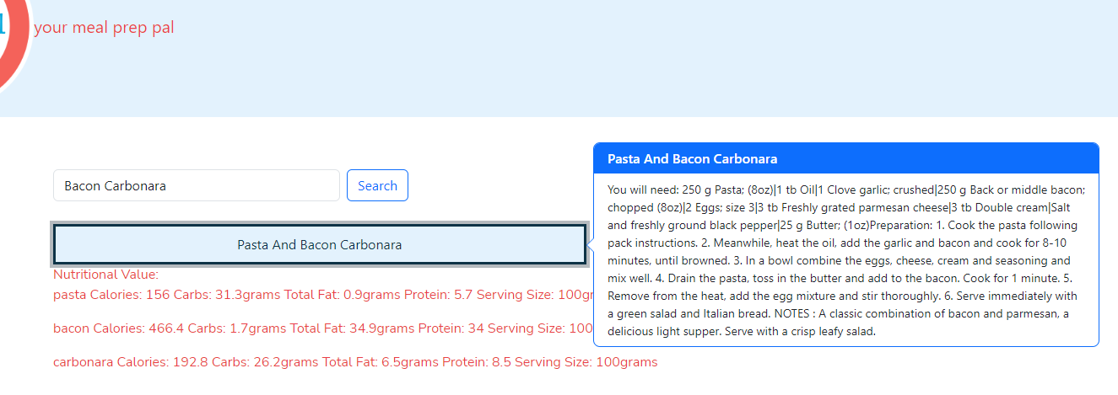

Slide 11
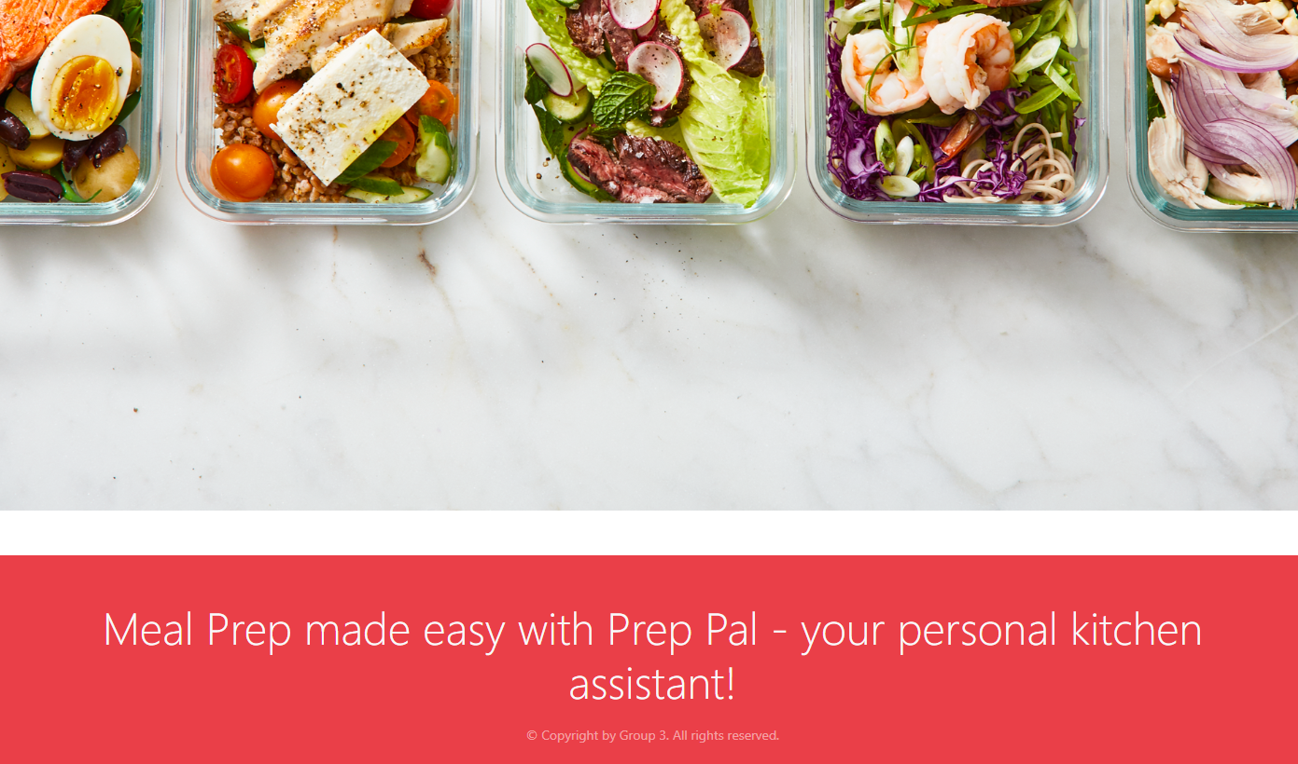

Slide 12
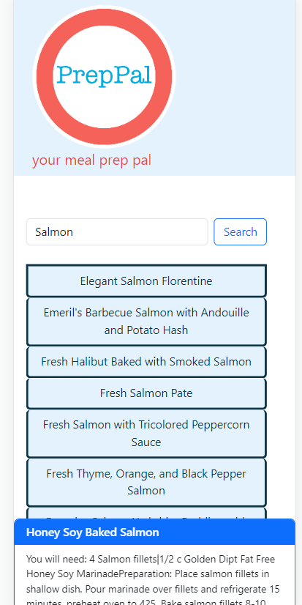
Mobile View->
Deployed Website: https://alisabevers.github.io/team-project-1/
Git Hub Repo: https://github.com/alisabevers/team-project-1

Slide 13
Future Features

