Slide 1
Title: FPGA-Based Image Blur Filter using Parallel Matrix Computation
(FPGA-Based Design Project)
Team members:
Alisa carisma Fernandes (4SO24EC007)
Avikshith dion (4S024EC019)
Adhithya K (4S024EC005)
Ashwin madtha (4SO24EC017)

Slide 2
Problem statement:
Modern applications such as biomedical signal analysis, climate modelling, and artificial intelligence rely heavily on matrix computations. Software-based matrix multiplication consumes high computational time and energy, especially in resource-constrained embedded systems. Develop a hardware solution on FPGA that significantly improves the performance and energy efficiency of matrix-based computations compared to a sequential implementation.
Objectives:
Creating a blur filter on FPGA.
Using parallel computation to speed things up.
Making the system efficient enough for real-time use.
Ensuring the design is reliable through proper testing.

Slide 3
Background:
Over the past few years, matrix computations have become the backbone of many modern applications — from biomedical signal analysis and climate modeling to artificial intelligence. These operations drive essential tasks like image processing, pattern recognition, and large-scale data analysis.
In image processing, one of the most common techniques is blurring, which helps reduce noise and smooth out details. This is typically achieved through convolution, where an image is combined with a kernel using matrix multiplication.
The challenge, however, is that performing these matrix operations purely in software can be slow and power-hungry, especially in real-time or embedded systems. That’s where FPGAs (Field Programmable Gate Arrays) come in. By leveraging hardware-based parallel processing, FPGAs can handle multiple computations simultaneously, delivering faster performance and greater efficiency compared to traditional software approaches.

Slide 4
Review of Existing Work:
A research has already been carried out on FPGA-based image processing systems. Most of these studies rely on convolution techniques, which are widely used for tasks such as blurring, sharpening, and edge detection.
Early implementations followed a sequential approach, where each pixel was processed one after another. While this method is straightforward, it quickly becomes inefficient when dealing with large images or applications that demand real-time performance.
To overcome these limitations, more recent work has shifted toward parallel architectures on FPGA. By allowing multiple computations to run at the same time, these designs achieve much higher speeds. Thus clear improvements in throughput and overall efficiency are compared to traditional sequential methods.

Slide 5
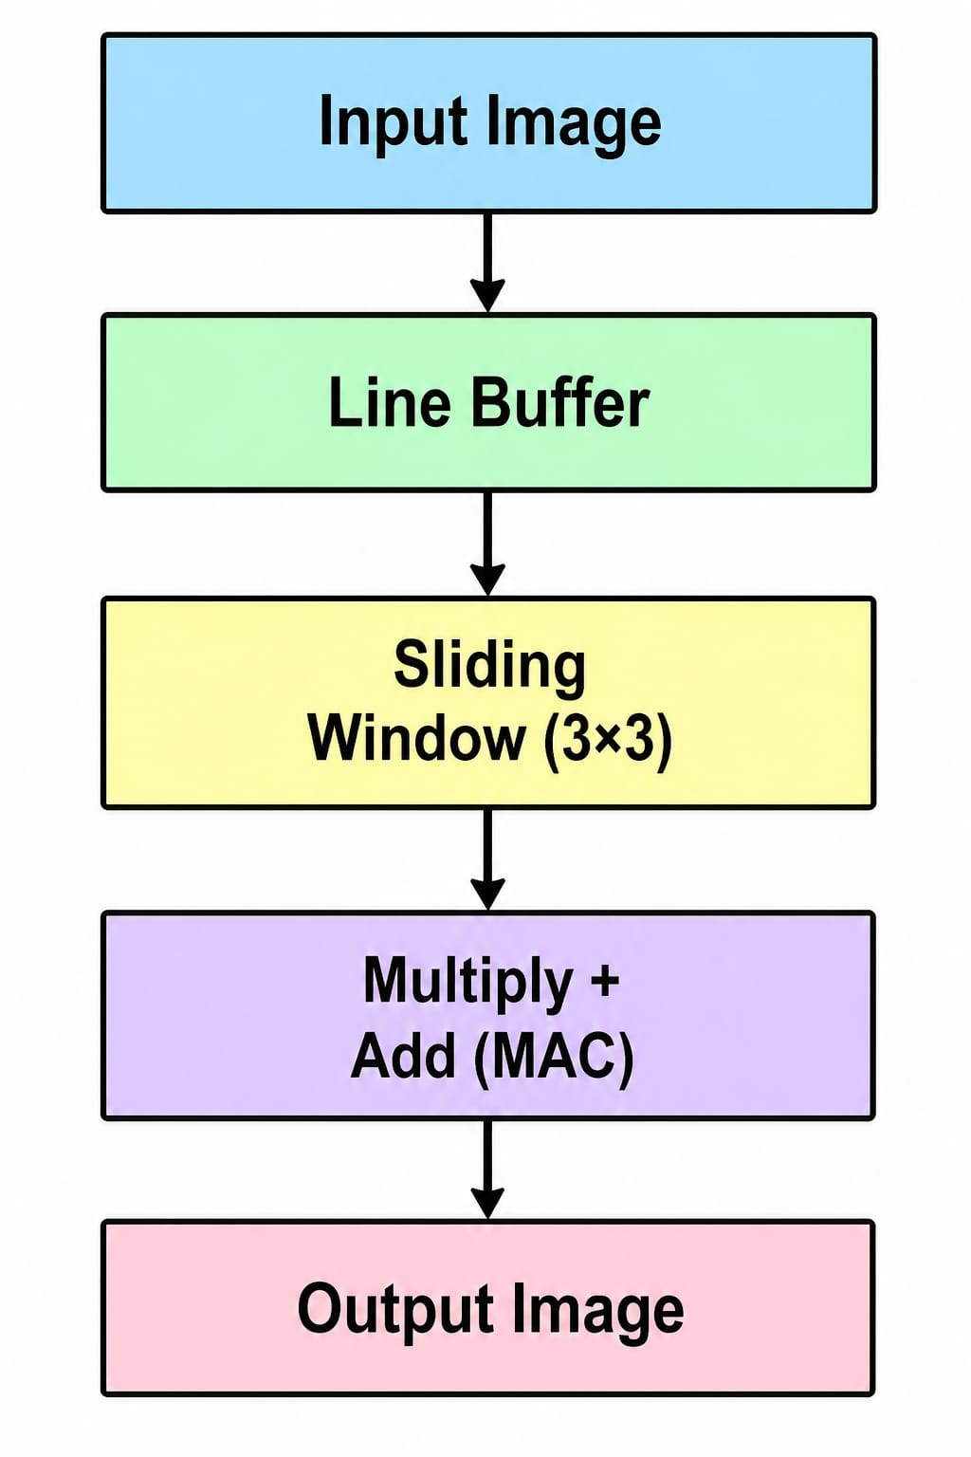
Block diagram:

Slide 6
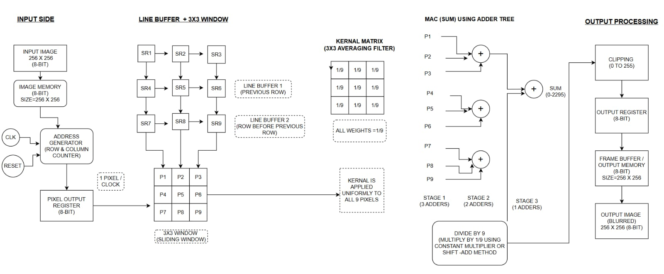
Architecture diagram:

Slide 7
Software requirements:
Tools used: The design and verification process was carried out using Vivado Design Suite 2018.2, which served as the primary platform for HDL development, simulation, and analysis.
Testbench Simulation:Custom testbenches were created for each module and executed in Vivado’s built-in simulator. These simulations ensured that the modules behaved correctly under different input scenarios.
Waveform Analysis:Simulation outputs were observed through waveform plots. The timing and logical behavior were carefully checked to confirm that the modules produced the expected results.
RTL/Circuit Diagram:Vivado’s RTL Analysis feature was used to automatically generate schematic diagrams of the modules, providing a clear visualization of the internal structure and signal flow.
draw.io (diagrams.net):The overall Block Diagram and Architecture Diagram of the system were designed using draw.io, offering a high-level representation of how the modules interact within the complete design.

Slide 8
Theoritical background:
1.D Flip-Flop (1-bit):Inside shift registers,Inside output registers
Everywhere data needs to be stored per clock
FORMULA:Q(t+1)=D
2. Shift Register (8-bit):
To move pixel data step-by-step
Forms part of sliding window
FORMULA:Q(t+1)=Qi-1(t)
3. Full Adder (8-bit):It is inside the adder tree.
Add 9 pixel values.
Each pixel size is 8-bit
FORMULA:
Sum=A ^ B ^ Cin
Carry=A*B + B*Cin + A*Cin
4. Output Register:To store the final blurred pixel
Ensures stable & synchronized output
It Removes glitches
FORMULA:Q(t+1) = D

Slide 9
GITHUB LINK:
ALISA CARISMA FERNANDES : https://github.com/alisacarisma9/imageblur
AVIKSHITH DION: https://github.com/Avikshith9
ADHITHYA K: https://github.com/Adithya161105
ASHWIN MADTHA: https://github.com/ashwinmadtha

