Slide 1
Utilizing Convolutional Neural Networks for Sign Language Classification
Team 2:
Ali Saeidi Ashtiyani, Raymond Hong, Ryan Shu

Slide 2
Outline
Dataset
Goals
Methods
Algorithms
Conclusions
Future Development
References

Slide 3



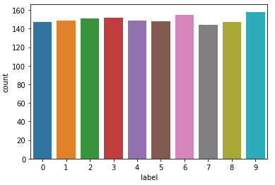
Signed MNIST
Novel Dataset: No previous work utilizing this dataset
Size of dataset: 1500 labeled images and 562 unlabeled images (2nd dataset: 2100 images)
Important: Breakthroughs in this field could facilitate new methods of communication
Accessible: Publically available and utilizes well formatted, uniform, labeled data
Notes:
Ryan 1500 64x64 Train 562 Test - target classes are equally distributed
64x64 is very small for a handsign in a real world enviornment unlike digits or objects

Slide 4
Goals
Despite being a research topic for over 20 years, there are few mature technologies in this domain
There are few publically available datasets
Available datasets are usually highly specialized
Develop various models for recognition of image data
Produce small and efficient versions of the model for use on mobile platforms
Notes:
Ryan - Many research teams in this domain utilize their own custom datasets
The field of research has been around since the ‘90s recently a resurgence thanks to CNNs

Slide 5
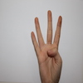




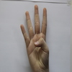
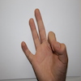









Methods
Training 64x64 single channel imgs
Training 64x64 three channels imgs
Training resized 224x224 three channels imgs
Using Data Augmentation
Training similar datasets for cross-evaluation
New Dataset
Original Dataset
Notes:
Ali - software size requirement +190x190 , data augmentation good for live feed or left handed

Slide 6
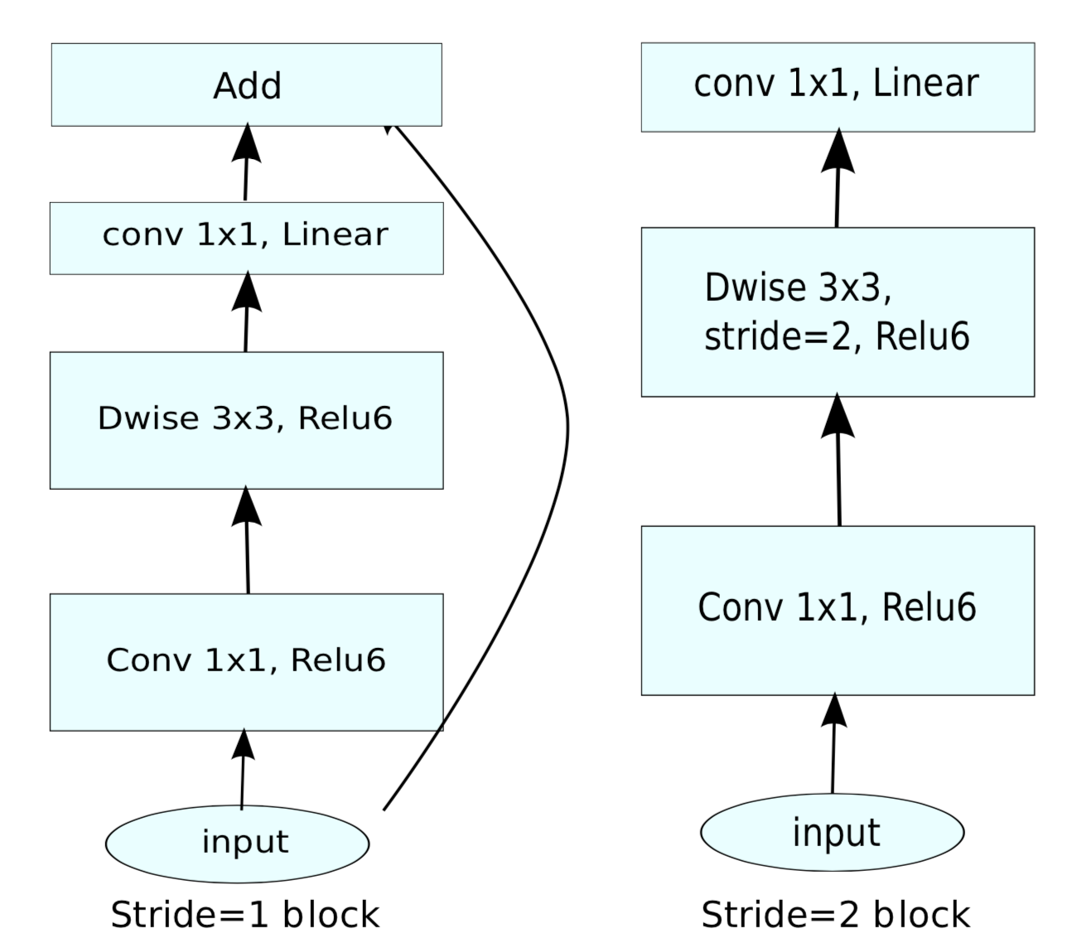
Mobilenet v2 Discussion
Model developed emphasizing efficiency for mobile platforms
Utilizes a series of bottleneck convolution layers with residuals
Effective for both Classification and Segmentation tasks
Can utilize transfer learning from pretrained weights
Filesize of model: hdf5 = 5MB | tflite = 483KB
Notes:
Ryan - Default architecture from the Keras library, meaning it was fairly deeply convoluted

Slide 7
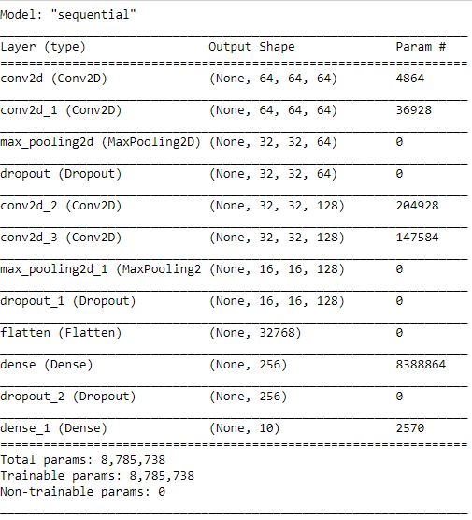
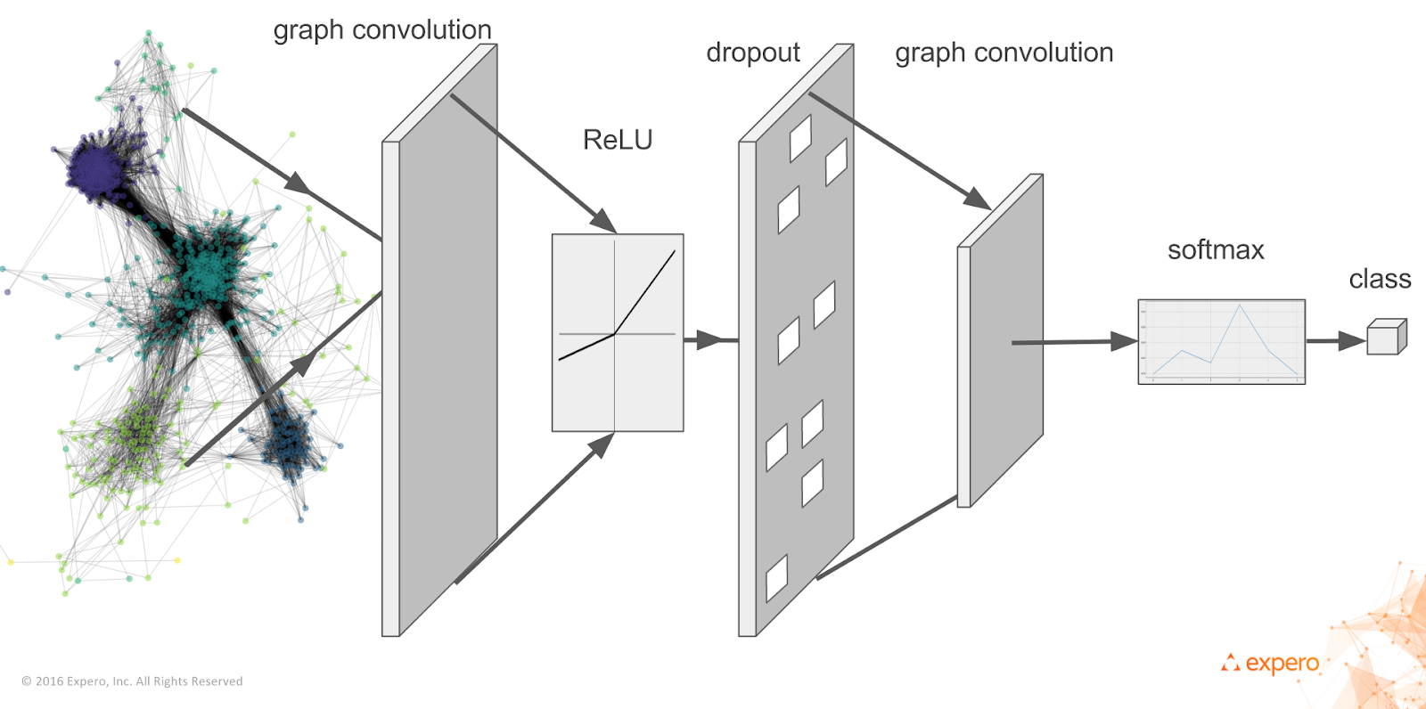
Custom Model Discussion
4 layer Conv2d layers
Maxpooling + Dropout + Flatten Layers
2 layer Neural Network (Dense Layers)
Relu Activation
Learning Rate of 0.0001
Filter sizes of 16, 32, 64, 128 in order
Kernel sizes of 15x15, 9x9, 7x7 and 5x5 in order
Notes:
Ali - tried elu activation - tried 6 layers and 2 layers (not good), color images required more filters

Slide 8
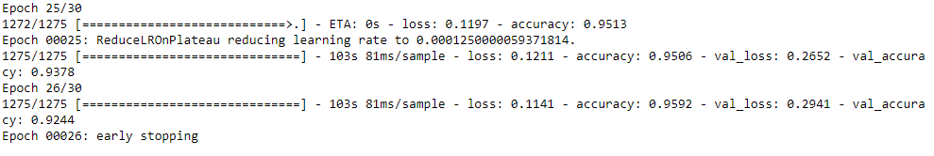
Model Tuning
Adjusting kernel sizes based on img size
Adjusting #filters based on model complexity
Changing number of layers
Changing learning rate
Early stopping method (from keras)
Reducing learning rate method (from keras)
Notes:
Ali - callbacls , Early stopping patience 3 - Reduce LR patience 2

Slide 9
Model Comparison
Mobilenet V2 Transfer Learning Baseline
Performance: ~0.91 Validation Accuracy
Best Performing Custom Model
Performance: ~0.95 Validation Accuracy
Notes:
Ali

Slide 10
Results and Discussion
Integrate and Test models on mobile hardware
Steps:
Export trained models as TFLite
Program interfaces between model and hardware
Test the effectiveness in real world environments
Discussion:
Able to produce a mobile application capable of utilizing our trained models. However, the dataset is only concerned with classification, not segmentation. Depending on end user requirements, deployment in real world may require entirely new methodology with models trained on a new dataset.
Notes:
Ryan

Slide 11
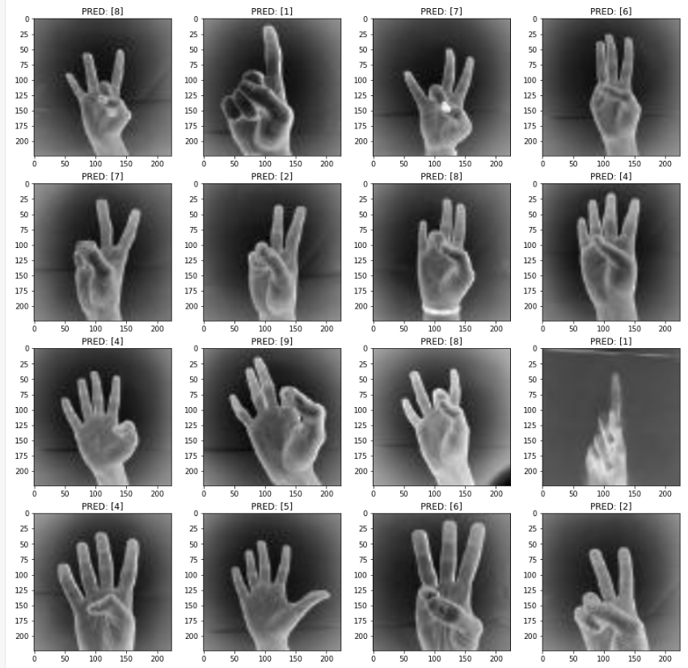
Results and
Discussion
Notes:
These are unlabeled data

Slide 12
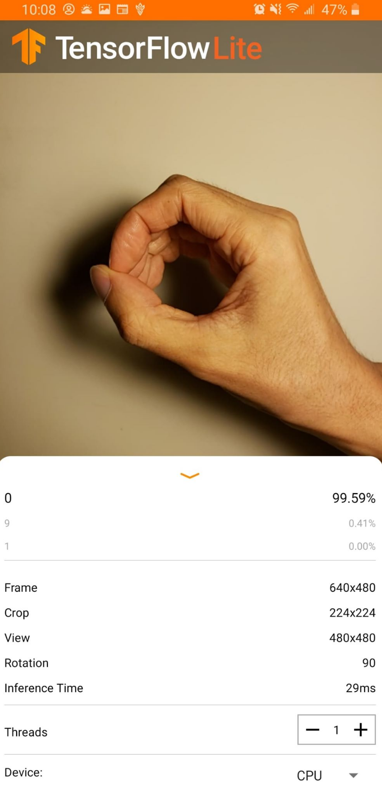
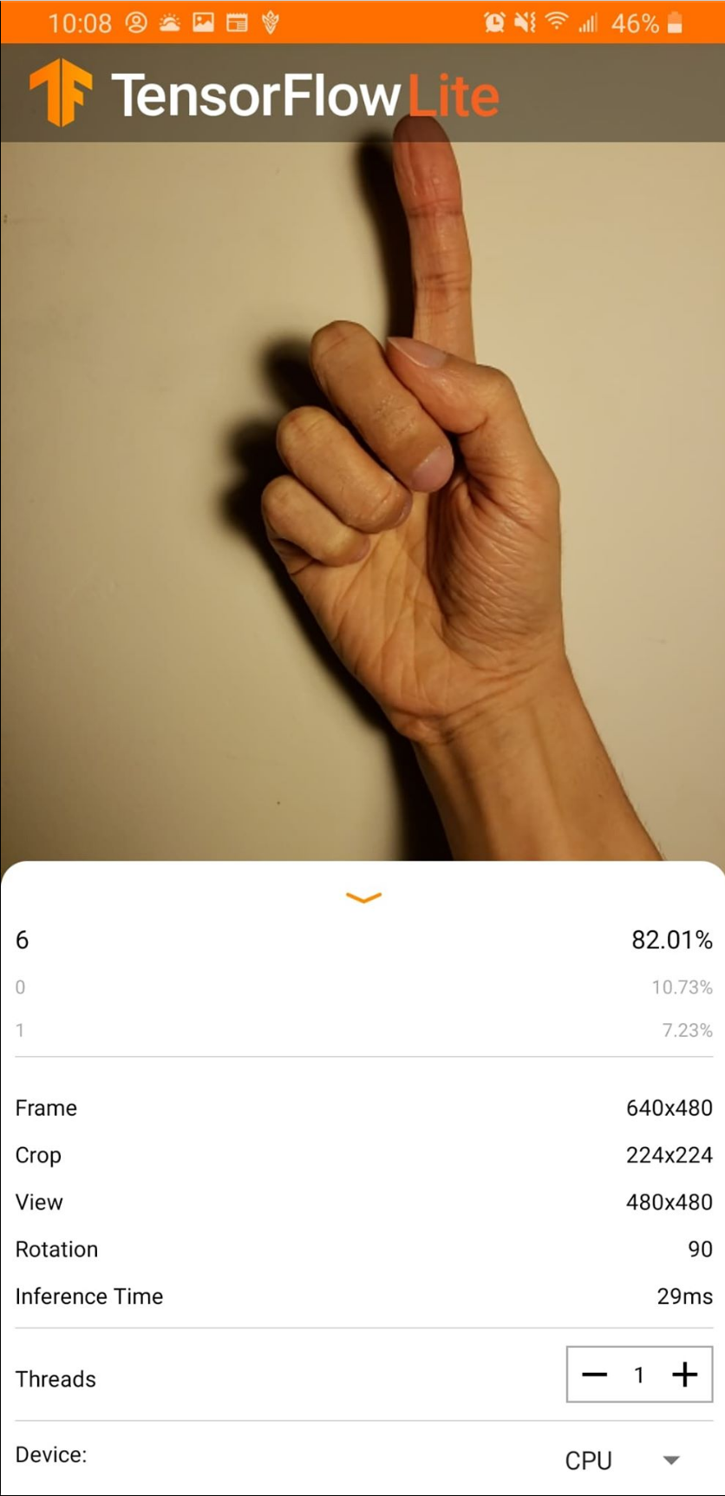
Results and Discussion
Application
Create TFlite interpreter in Java App
Despite high verification accuracy, classification was still poor.
Notes:
Got working model -> convert -> tflite
Created a tflite interpreter

Slide 13
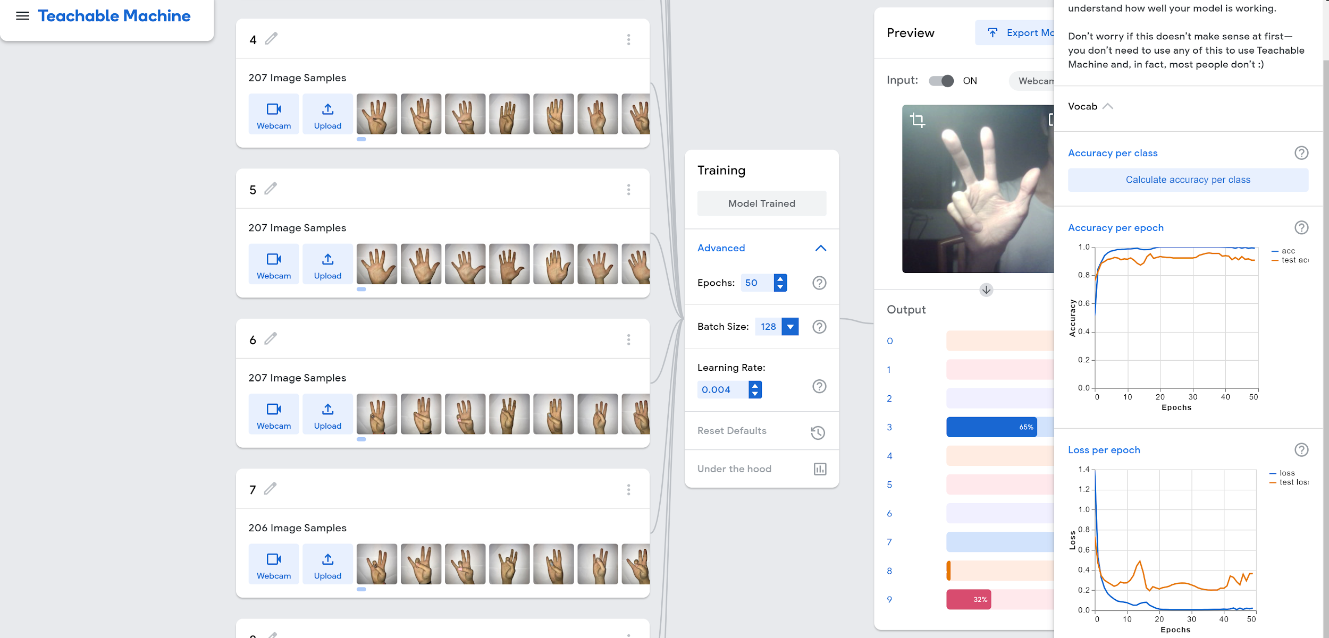
Google’s Teachable Machine

Slide 14
Future Development
Further exploration that seems possible based on our results
Signed Dictionary: Recognition of sign language words from video or image sequences
Sign Conversation: Identify and classify signed words, formed into sentences from video data
http://www.bu.edu/asllrp/av/dai-asllvd.html
Hybrid: Hand Pose Estimation with Sign Recognition
Notes:
Ryan - Challenge in sign language words: Motion

Slide 15
Q & A

Slide 16
References
L. Zheng, B. Liang and A. Jiang, "Recent Advances of Deep Learning for Sign Language Recognition," 2017 International Conference on Digital Image Computing: Techniques and Applications (DICTA), Sydney, NSW, 2017, pp. 1-7.
https://ieeexplore.ieee.org/abstract/document/8227483
Y. Ji, S. Kim and K. Lee, "Sign Language Learning System with Image Sampling and Convolutional Neural Network," 2017 First IEEE International Conference on Robotic Computing (IRC), Taichung, 2017, pp. 371-375.
https://ieeexplore.ieee.org/document/7926567/
G. A. Rao, K. Syamala, P. V. V. Kishore and A. S. C. S. Sastry, "Deep convolutional neural networks for sign language recognition," 2018 Conference on Signal Processing And Communication Engineering Systems (SPACES), Vijayawada, 2018, pp. 194-197.
https://ieeexplore.ieee.org/abstract/document/8316344

