Slide 1

Title:
Sensor Network Fault Detection System (Project Presentation)
Submitted By: | Roll Number:
Ali Hassan | B2331012
Abdul Wahab | B2331006
Anas Hussain | B20331018
Supervisor: Prof. Anwer Ali

Slide 2

Project Objective & Overview:
Objective:
To develop a real-time system that identifies faulty vehicle sensor readings using anomaly detection algorithms while preserving extreme outliers.
Key Sensors:
Accelerometer: Accel_X, Accel_Y, Accel_Z
GPS Speed: GPS_Speed
Engine: Engine_RPM
System Goals:
Detect anomalies in sensor data
Flag faulty sensor(s) precisely
Retain outliers for diagnostic integrity

Slide 3

Data Generation :
Dataset Overview:
Rows: 2000
Sensors: RPM, GPS_Speed, Accel_X, Accel_Y, Accel_Z
Timestamps: Randomized between Jan 1–Dec 31, 2024, sorted chronologicallyFault
Injection Process:
15% of all cells randomly injected with spikes/drops
Fault magnitude: ±15–30× standard deviation
Example Row:
File Saved As:
sensor_fault_dataset_v2.csv
Timestamp | RPM | GPS_Speed | Accel_X | Accel_Y | Accel_Z
19-08-24 6:26 | 1835 | 50 | 0.0035 | -0.0455 | 9.813

Slide 4

Data Preprocessing & Feature Engineering
Preprocessing Goals:
Retain all faulty readings (no filtering).
Standardize sensor data for uniform scaling.
Create features to capture dynamic relationships.
Steps Taken:
Loaded raw data.
Standardized with StandardScaler.
Engineered features:
  Delta_GPS_Speed = GPS_Speed.diff()
  Speed_RPM_Ratio = GPS_Speed / Engine_RPM
Saved preprocessed file as vehicle_sensor_data_preprocessed.csv.
Key Point:
Extreme (faulty) values were preserved to enhance anomaly detection capability.

Slide 5
Model Comparison & Evaluation
Models Tested:
PCA (Principal Component Analysis) – Linear reconstruction
Isolation Forest – Tree-based anomaly detection
Gaussian Mixture Model (GMM) – Probabilistic density estimation
Ground Truth:
63 injected anomalies marked as true faults
Evaluation Results:
Conclusion:
Isolation Forest provided the best anomaly detection due to its ability to model nonlinear correlations and retain extreme values.
Model | AUC-ROC
Isolation Forest | 0.9964
GMM | 0.9201
PCA | 0.4721

Slide 6
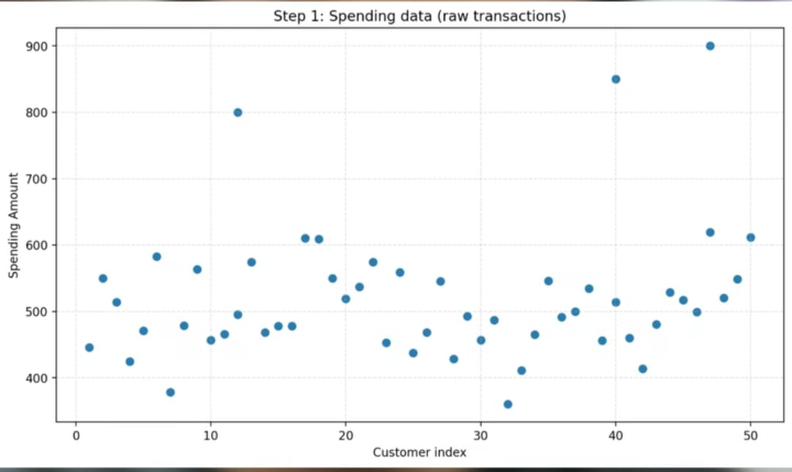

Slide 7
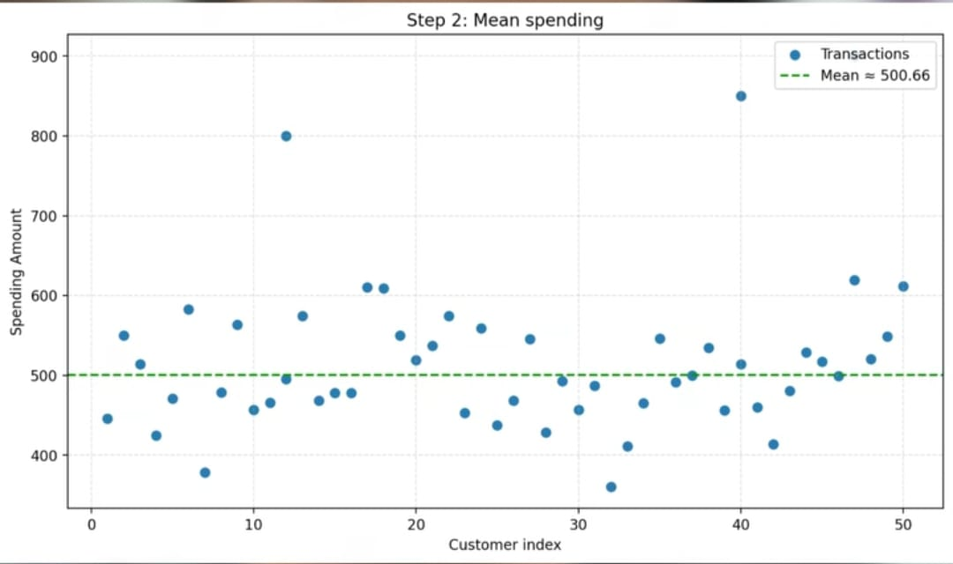

Slide 8
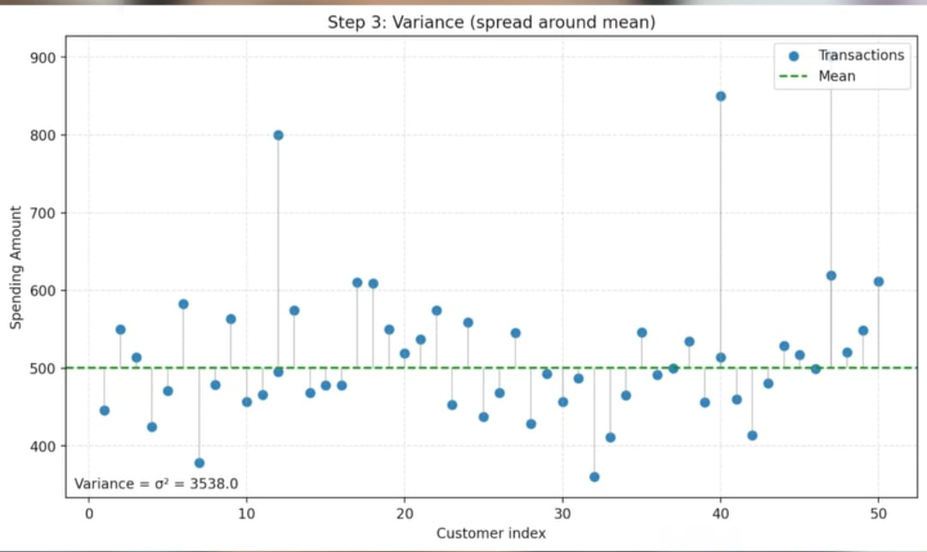

Slide 9
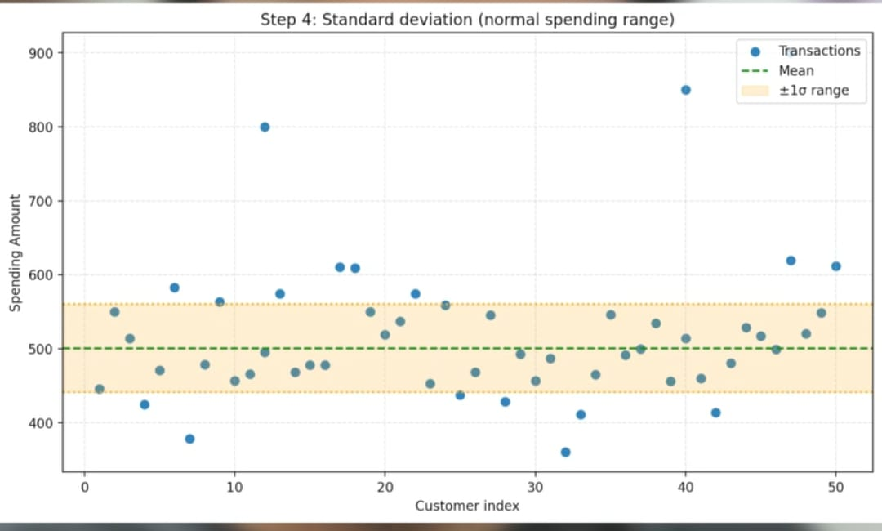

Slide 10
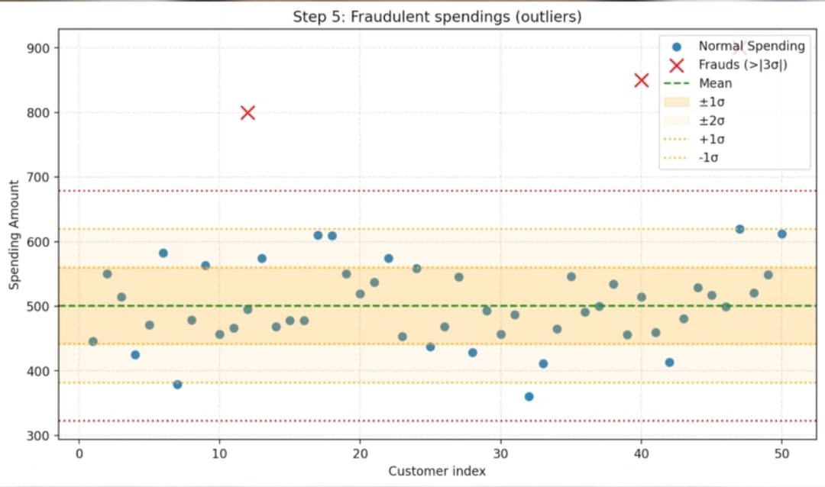

Slide 11
Code Explanation

Slide 12


