Slide 1
Housing Market Prediction current Real-Estate Market in United States. The Economic growth, House Pricing by states and Buyers and Sellers information
Analysis Conducted by:
Fenny Patel, Luis Hernandez, Justin Ho, Dennis Chen &
Ali Saghafi

Slide 2
Abstract
As the pandemic just happened, the real estate market is booming, and it is facing different challenges. We will choose the finance side of the real-estate market. We will work on the Data set and API from Zillow.com.

Slide 3
Project questions
Are there significant differences between Top 5 states in prices from year 2000 to march 2022 and Top 2 State?
Are there significant differences between cities of California in prices from year 2000 to march 2022?

Slide 4
Data CSV Files Used For The Analysis
Following is the link of the CSV files
https://www.zillow.com/research/data/
Use city , state , rent and zip code csv file.
https://github.com/alisaghaffi/project-1/tree/main/Resources

Slide 5
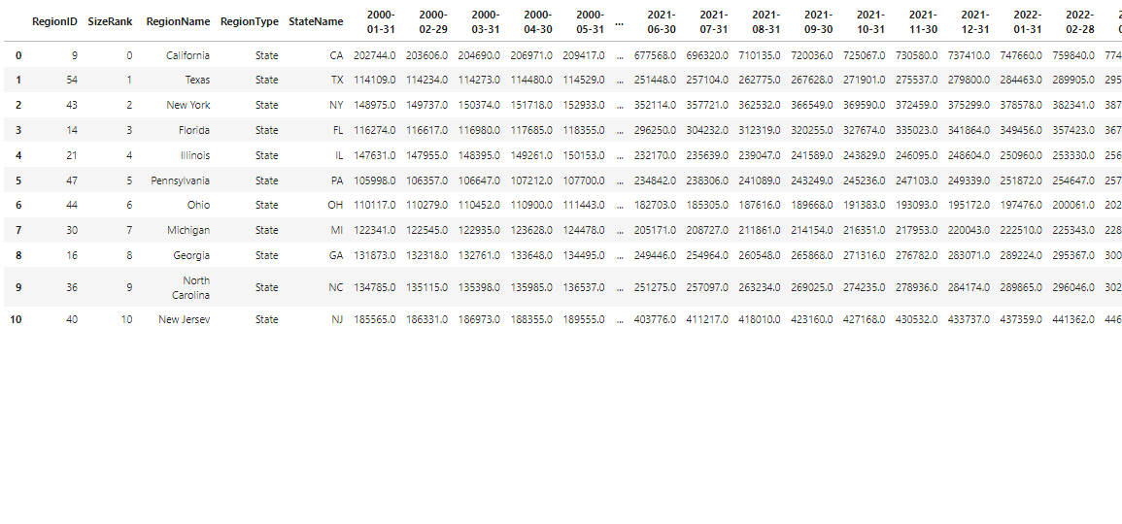
Data RAW CSV Files Used For The Analysis

Slide 6
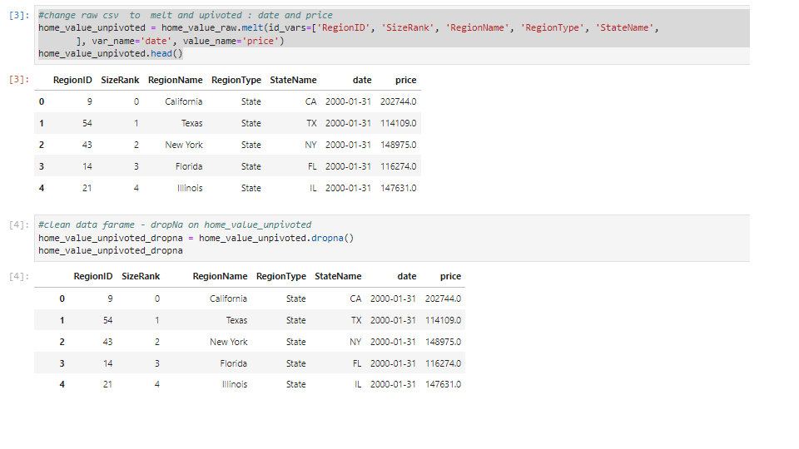
Melt Raw CSV Files : Date and Price

Slide 7
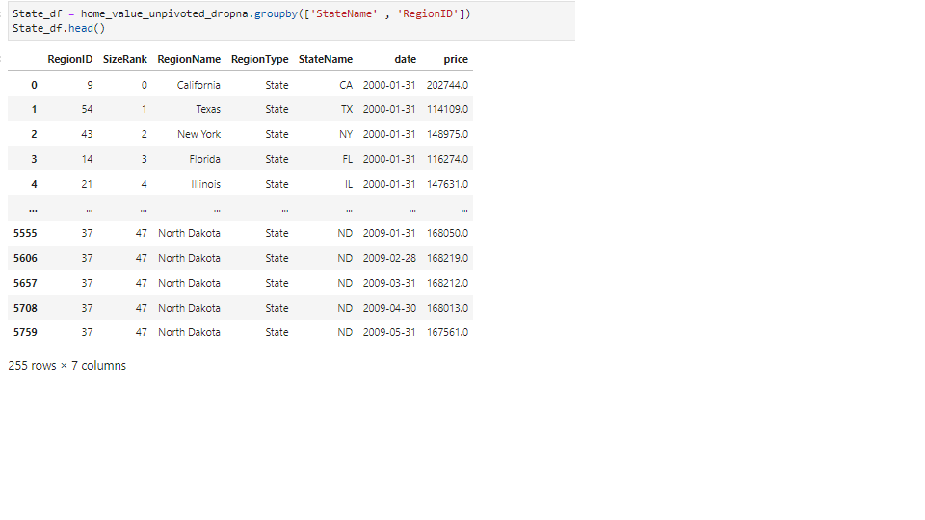
Group by state and regionalID

Slide 8
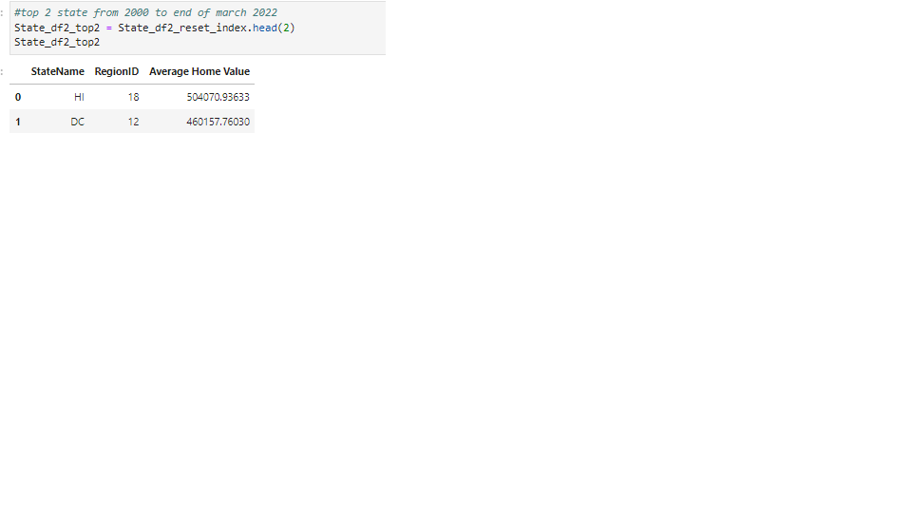
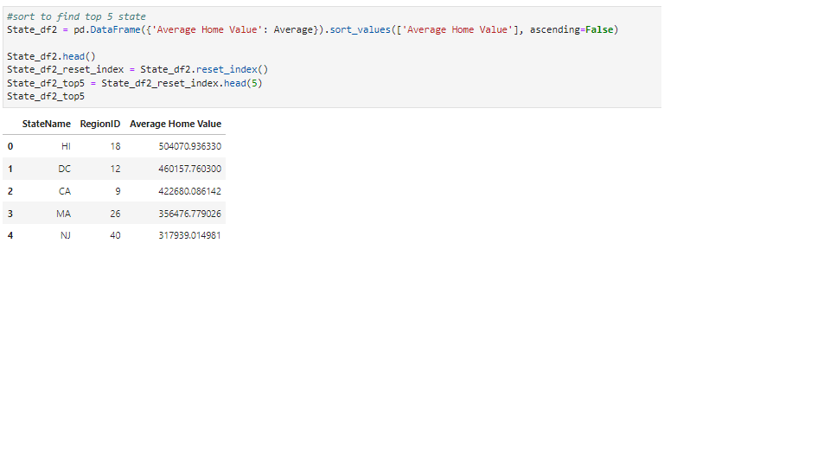
Top 5 state and Top 2 from year :JAN 2000 to MARCH 2022

Slide 9
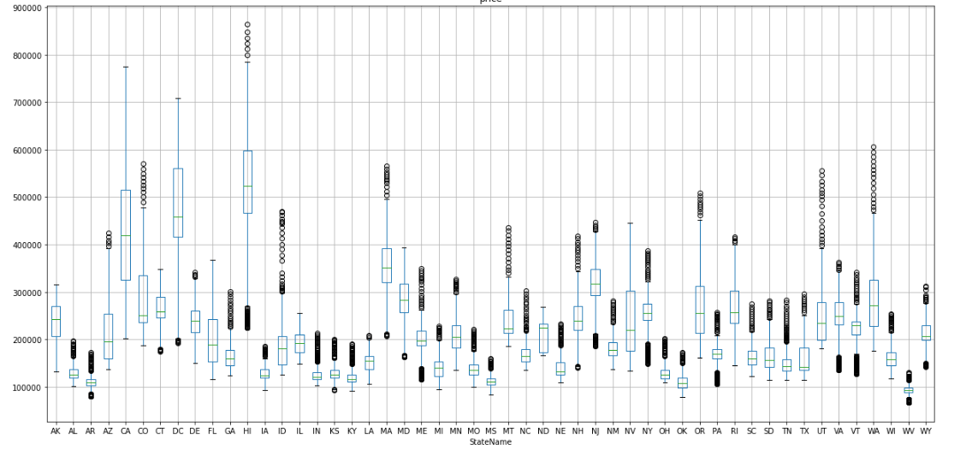
BOX PLOT FOR : SATE NAME AND PRICE

Slide 10
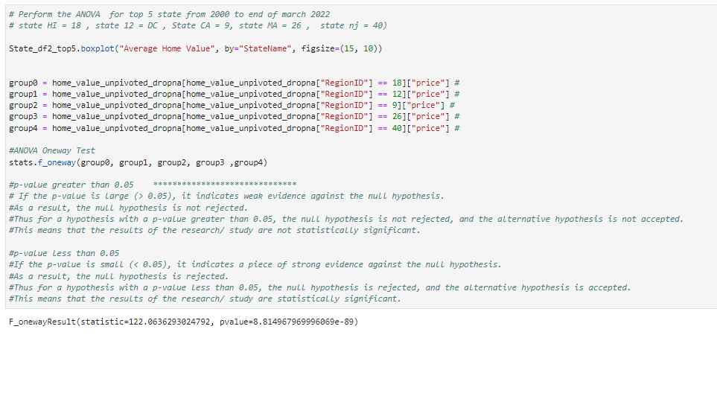
ANOVA TEST RESULT : TOP 5 STATE

Slide 11
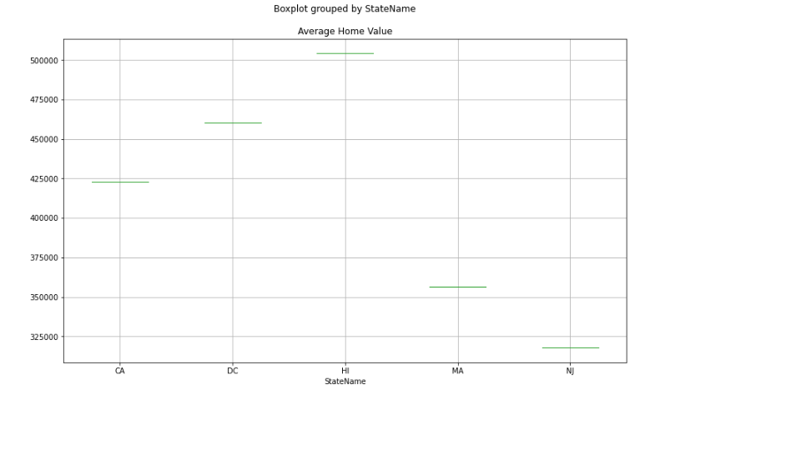
ANOVA TEST RESULT : BOX PLOT TOP 5

Slide 12
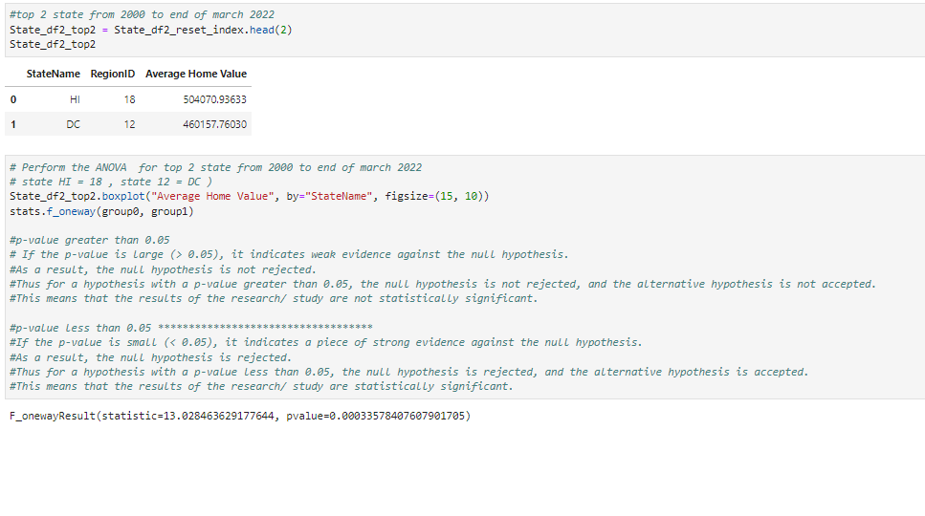
ANOVA TEST RESULT : TOP 2 STATE

Slide 13
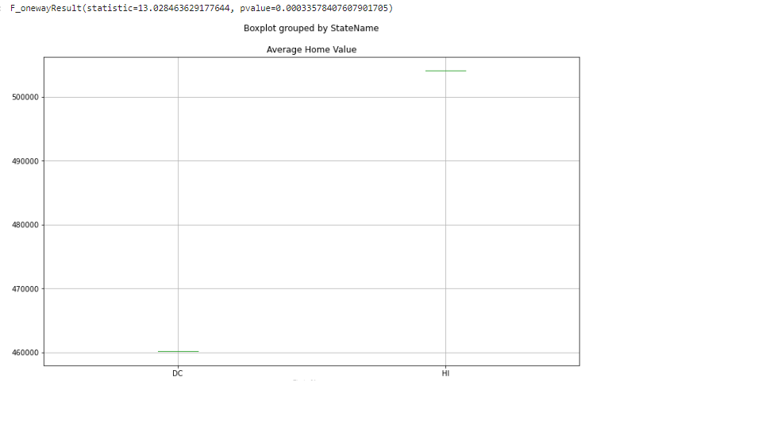
ANOVA TEST RESULT : BOX PLOT TOP 2 STATE

Slide 14
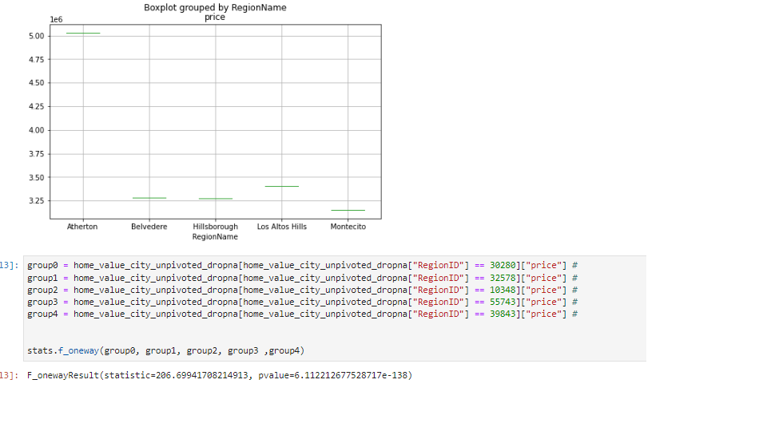
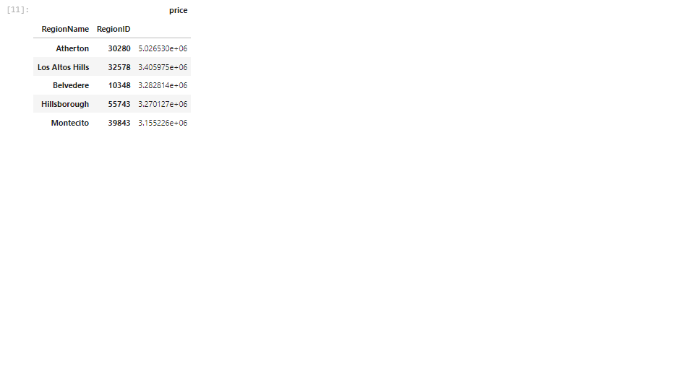
ANOVA TEST RESULT FOR TOP 5 CITY IN CALIFORNIA

Slide 15
ANOVA TEST RESULT FOR TOP 5 CITY IN CALIFORNIA
#p-value greater than 0.05
# If the p-value is large (> 0.05), it indicates weak evidence against the null hypothesis.
#As a result, the null hypothesis is not rejected.
#Thus for a hypothesis with a p-value greater than 0.05, the null hypothesis is not rejected, and the alternative hypothesis is not accepted.
#This means that the results of the research/ study are not statistically significant.
#p-value less than 0.05
#If the p-value is small (< 0.05), it indicates a piece of strong evidence against the null hypothesis.
#As a result, the null hypothesis is rejected.
#Thus for a hypothesis with a p-value less than 0.05, the null hypothesis is rejected, and the alternative hypothesis is accepted.
#This means that the results of the research/ study are statistically significant.

Slide 16
ANOVA TEST RESULT FOR TOP 5 CITY IN CALIFORNIA
Based on the TOP 5 STATE VALUE FROM JAN 2000 TO MARCH 2022, does not have any significant IN PRICE.
Based on the TOP 2 STATE VALUE FROM JAN 2000 TO MARCH 2022, have significant IN PRICE.
Based on the TOP 5 CITY IN CALIFORNIA VALUE FROM JAN 2000 TO MARCH 2022, does not have any significant IN PRICE.
F_onewayResult(statistic=122.0636293024792, pvalue=8.814967969996069e-89)
F_onewayResult(statistic=13.028463629177644, pvalue=0.00033578407607901705)
F_onewayResult(statistic=206.69941708214913, pvalue=6.112212677528717e-138)

