Slide 1
Effectiveness of issue resolution in Chromium
Ali Sangari | 6816304
Hojabr Sattari | 6435807
Bhaskar Baddam | 6761038

Slide 2
Goal
We would like to ensure that Chrome is running smoothly by studying
How reported issues are tracked and resolved
Cohesiveness and coupling of modules.

Slide 3
Questions
Does collaboration (CCed developers on an issue ticket) reduce issue resolution time?
Does the cohesiveness and coupling of packages remain unchanged as new versions are released?

Slide 4
Measures
Outcome measure:
Length of issue resolution time.
Cohesiveness and coupling of C++ classes.
Predictive measures:
number CCed developers on issues and delta between report date and close date.
CBO and LCOM metrics.
Confounding measures:
Expertise of the developer.
Size and complexity of the class.

Slide 5
Raw Data
Describe the different datasets
Bug reports (including discussion threads).
Source code versioning control.

Slide 6
Process Data and Extract Attributes
For number of CCed developers we extracted all unique username/email accounts from each bug report using webpage source analysis.
We used Understand Python API to calculate/extract CBO metric for each C++ class.

Slide 7
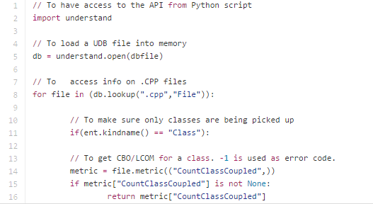
Process Data and Extract Attributes
Using Understand API to calculate CBO for a class

Slide 8
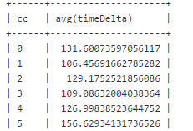
Store and Link
The unit in bug report with CCed developers is id(issue_id).
The unit in developer table is email
In summary table the unit is number of CCed developers (cc)

Slide 9
Issue resolution vs. CCed devs
Average issue resolution time based on number of CCed developers.

Slide 10
Issue resolution vs. CCed devs cont.
In general as the number of CCed developers increases, the average time for resolving an issue also increases.
Collaboration on its own is not a sufficient measure for issue resolution effectiveness. Other measures need to be considered as well.

Slide 11
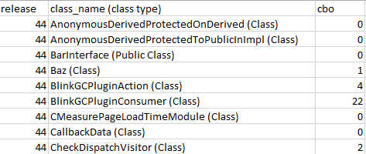
Store and Link
The unit in class cohesion and coupling is class_name. Each of our measures is in the summary table.

Slide 12
Average CBO for each release
Coupling drastically drops as the application moves from version 29 to 30.
This improvement in coupling between classes may have been the result of a major refactoring.
25
26
27
28
29
30
31
32
33
34
44

Slide 13
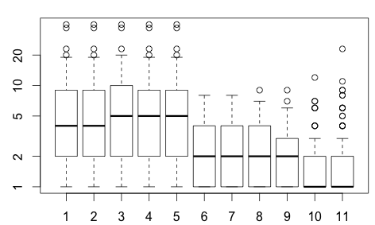
Average CBO for each release
Versions under 30 have CBO between 2 and 10.
Versions 30 – 33 have lower coupling compared to their older versions.
From version 34 – 44 CBO improves even further and remains consistent.
25
26
27
28
29
30
31
32
33
34
44

Slide 14
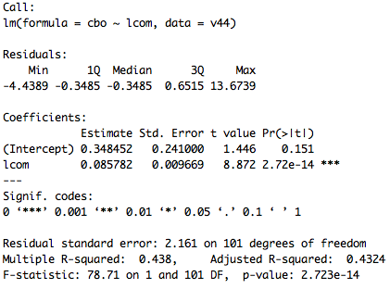
Statistical Model

Slide 15
Conclusion
The number of CCed developers on a issue has direct relationship with the average issue resolution time. This could mean this type of collaboration is counterproductive.
Studying CBO metric in different versions of Chromium suggests that coupling between classes is decreasing and maintainability is increasing.

Slide 16
Thank you

