Slide 1
Scheduler
Presented to: Dr.Zubair Malik

Slide 2
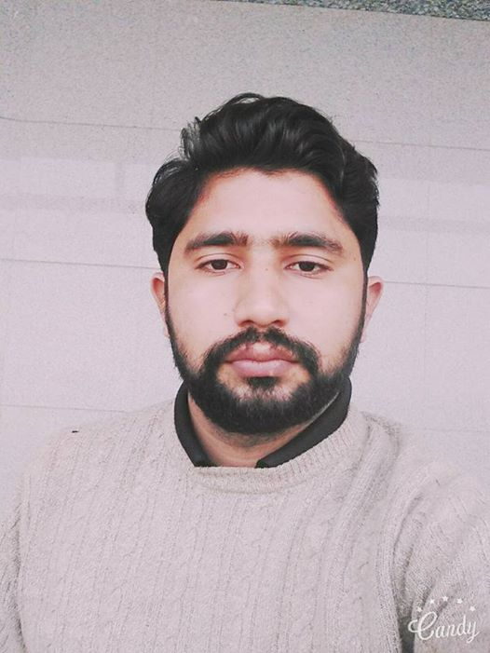

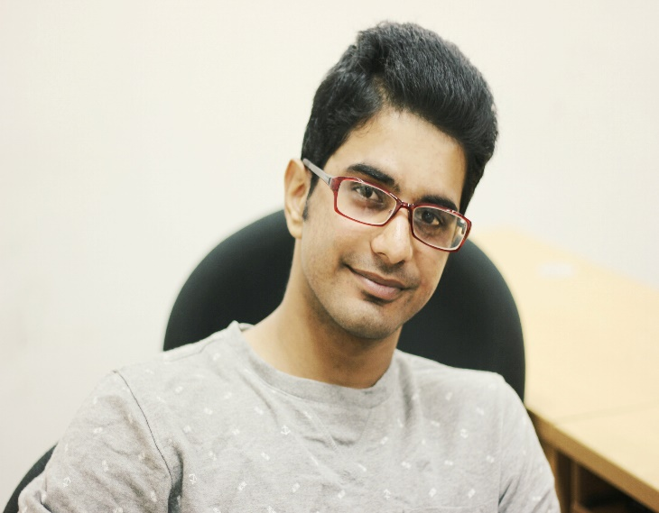

Team Members
Ali Satwat(BSCS13002)
Usman Zafar(BSCS13005)
Muhammad Ali(BSCS13022)
Badar Hashmi(BSCS13035)

Slide 3
Scheduler: Manage your Timetable Effectively
Problem
It is really difficult for students to check their semester’s schedule on notice board besides, it is also painful task for T.A’s and lab attendant to check the availability of rooms.
Solution
Scheduler App will help students and T.A’s to check the schedule at any time with just one touch. It will also help administration to organize events as they always remain up-to-date with the schedule of classes.

Slide 4
Tasks:
Simple: See regular timetable on the app.
Moderate: Check the availability of free slots for the scheduling of classes, T.A’s sessions and events
Complex: Could manage makeup classes with update function in the app

Slide 5
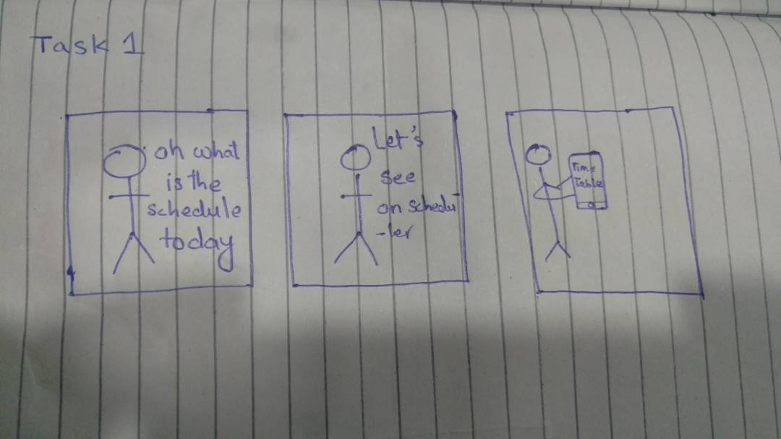
Tasks 1:

Slide 6
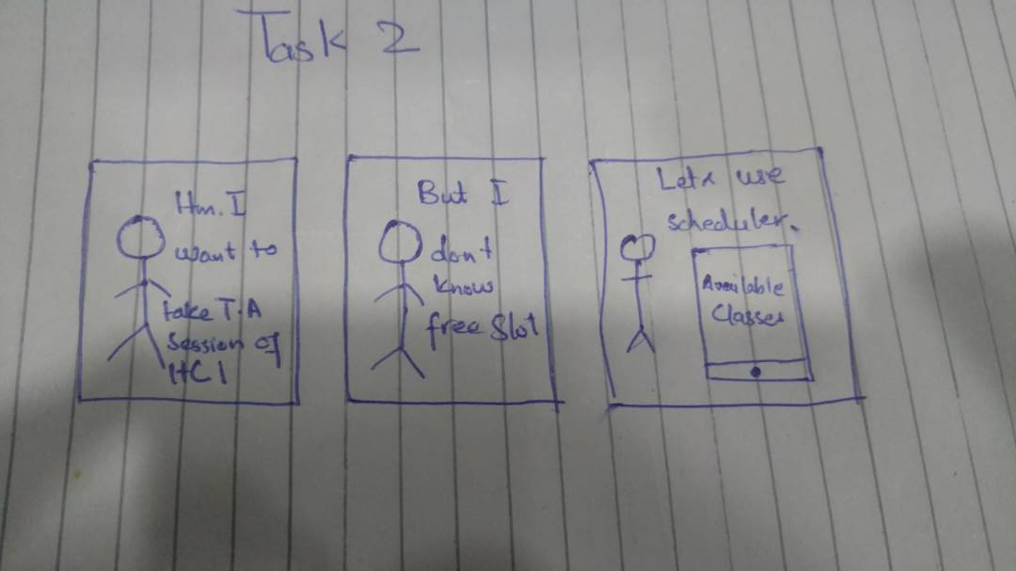
Tasks 2:

Slide 7
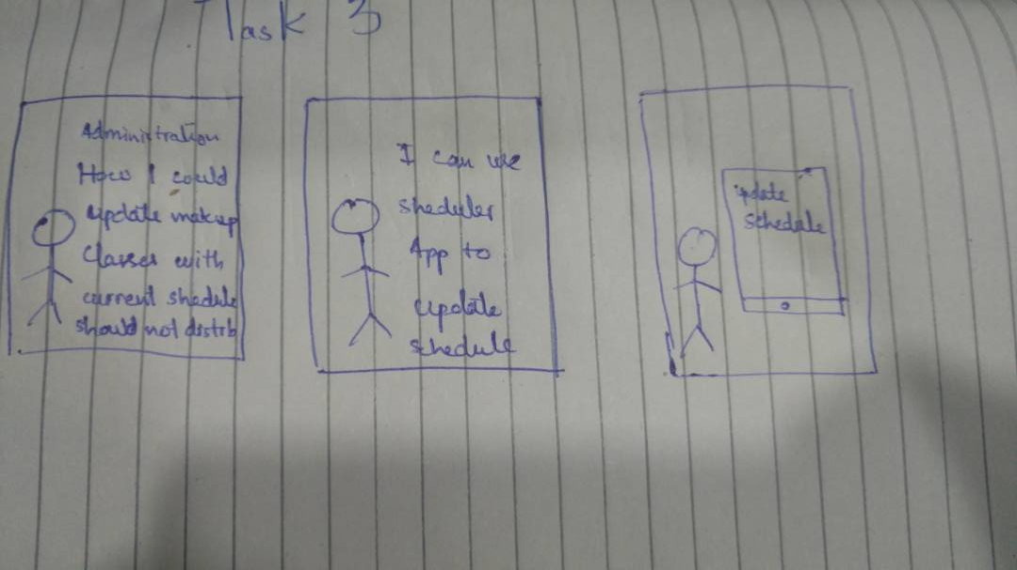
Tasks 3:

