Slide 1
Scheduler
Everything schedule on Time !
Presenting to:
Ms. Amna batool

Slide 2
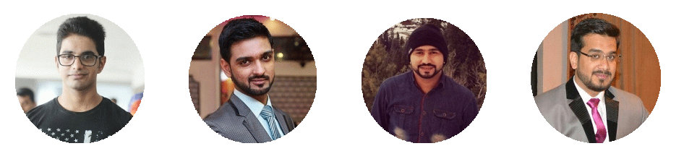
Team Members
Muhammad Ali Ali Satwat Khan Usman Zafar Badar Hashmi

Slide 3
INTRODUCTION
Problem Domain
Many applications exist which generate the schedule for the university classes but amendments in a fixed schedule is a challenging task. For example, finding time slots for guest-lectures or make-up sessions. It is much difficult to remember the overall schedule for a person and the facilitation staff face problem to facilitate students or staff about their schedule. Updating the schedule is also a problem for the facilitation staff.

Slide 4
idea

Slide 5
Idea Processing
IDEA
NEEDS
POV’s
HMW
VIDEO

Slide 6
Need Finding

Slide 7

Potential Users
User Attribute List
Administration of the University
Facilitation Staff
Students
Faculty Staff

Slide 8
Potential Users
People Interviewed
Mariam Aftab Schedule generator at ITU Management team Event organizer Maintains Calendar | Meesam Ali Student at FAST Follow schedule Attends Events
Anwar Ahmed Assistant Professor at FAST Batch Advisor Follow Schedule Researcher | Mr. Ammar Facilitator at ITU Management Team Deals with faculty and students

Slide 9
Potential Users
People Interviewed
Ms. Shagufha Rawthore Communication Officer Guest-Lectures Organizer Training Events Organizer Management Team Hafiz Suleman M.SC student in PU Follow schedule | Mr. Khurram Bhatti Assistant Professor at ITU Post-Doctorate Researcher Sami Ullah Student at FAST Follow schedule

Slide 10
Potential Users
Criteria
Why they were selected
Because they are the stakeholders of our project
How they were recruited
We met them personally in their office and ask them for time slot
Where they were interviewed
They were interviewed in there office
Some of them were interviewed on mobile.

Slide 11
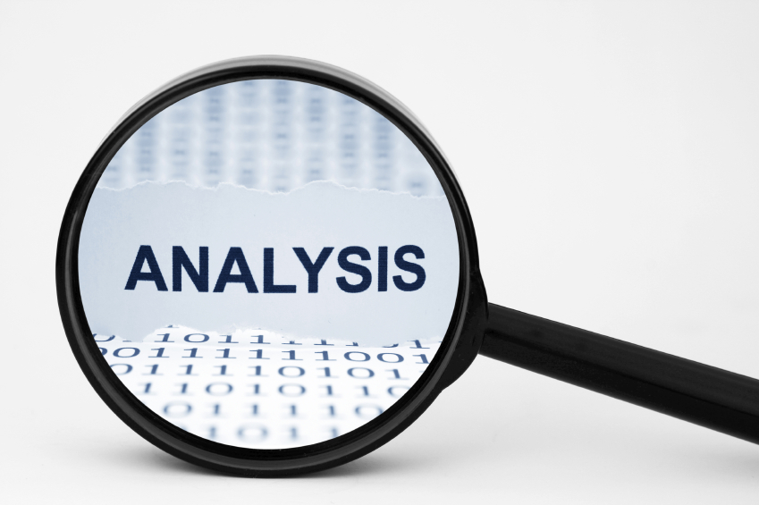
Analysis and importance
Initially we were unaware of the Importance of our Project
Primary Stakeholders really need such solution of their problem

Slide 12
Empathy Map
SAY Schedule maker was saying that software should be able to read the excel file Facilitator was saying that he really need such mobile application Communication Officer said it is difficult to know about make-up classes | DO Schedule maker was showing the problems of using current software Facilitator also showed his method Of traversing through schedule, exhausting Communication Officer was humbly telling about her tasks
THINK Schedule Maker was thinking that new software will be easy to use and will have more features Facilitator was thinking that he is going to have this application within few months Communication Officer was thinking of minimizing his workload | FEEL Schedule Maker was feeling relieved by thinking of using such software Facilitator was feeling happy Communication officer was excited

Slide 13
Needs and Insights
Administration wants to get rid off of manually scheduler making
Facilitation staff wants the quick way to find the room of a particular class. Also empty LTs for make up or TA sessions.
Faculty wants to know the suggestions of time slots for make-up sessions

Slide 14
POV’s
Maryam Aftab, a schedule generator and event organizer at ITU. We were amazed to realize she had bad experiences with generating schedules. It would be game changing if she has to do less manual work to generate a schedule.
Ms.Shagufha Rawthore, a communication officer at ITU and also a member of management team. We learned that when she wanted to organize an event in a specific time slot and that time slot is already taken, she had to ask from the admin for the availability of any other slot.
Khurram Bhatti, Assistant Professor at ITU. He said that he face problem while deciding when to take makeup classes. He has to ask from the admin about the available free slot in which the makeup session can be scheduled. He suggested that take any other scheduler and make changes in it in such a way that changed can be implemented in schedule at run time.

Slide 15
HMW’s
Make everybody in the university known about the schedule.
Provide the complete detail of all classes.
Help to analyze the makeup class’s recovery.
Provide the complete ongoing activities in the university.
Tell students about teacher’s office hours.
Help event management team to finding free slot.
Check the availability of classes without asking from any one.

Slide 16
Best selected Hmw’s
Make everybody in the university known about the schedule.
Incentivize teacher to share their free timings
Help event management team to finding free slot.
Provide the complete ongoing activities in the university.

Slide 17
Product
Schedule generator It will read the excel file in which courses, associated professors and associated classes will be given, it will then generate the time slots for lectures with allotted rooms without collisions.
Schedule manager The application can sort the schedule according to rooms, classes, professors and current time.

Slide 18
prototyping

Slide 19
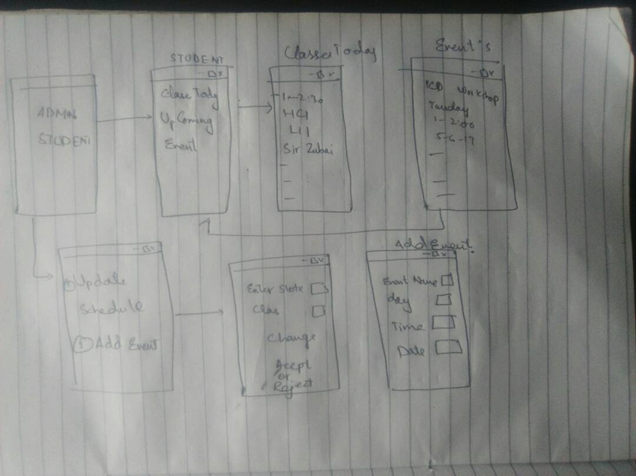
LOW-FI PROTOTYPE

Slide 20
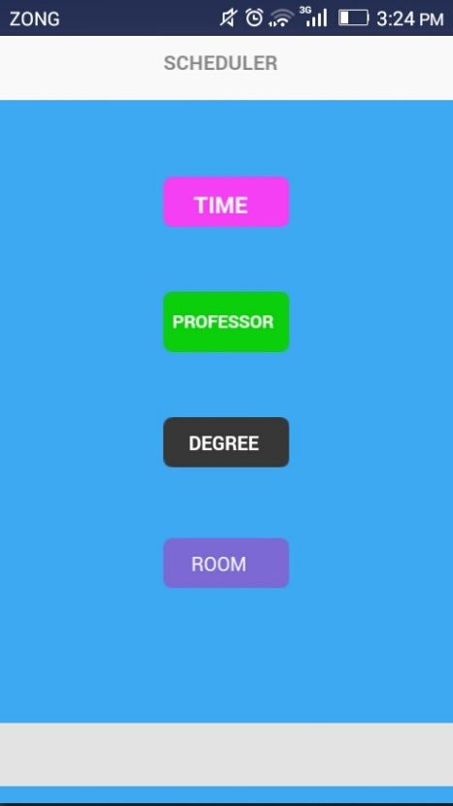
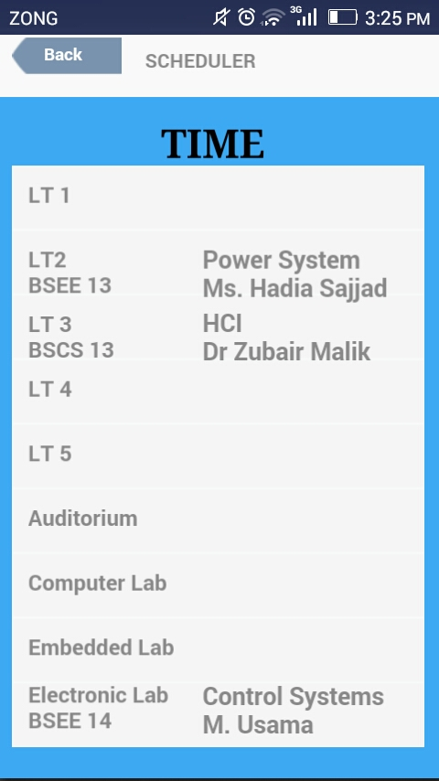
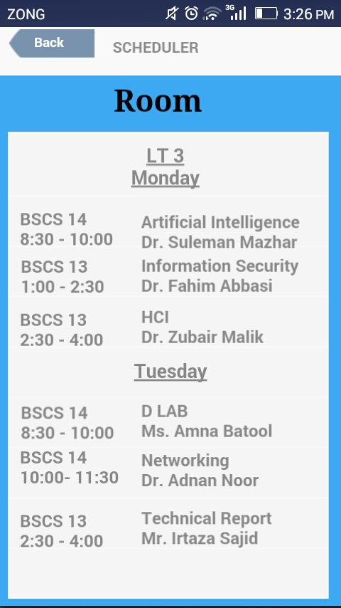
MEDIUM-FI prototype

Slide 21
Testing Analysis

Slide 22
HEURISTIC EVALUATION
Problems with Medium-Fi prototype:
No Login Panel for registration
No Consistency for current schedule
Need Menu for options
No Notification Alert field
more…
Heuristics by:
Usama Latif
Faisal Noor
Zeeshan Muzammil

Slide 23
Prototype Testing
Mehar Usama(BSCS 14) : This kind of application can help me in finding the availability of a professor. It will be more beneficial for me if it will show the notifications before the start of class. During this, he showed me his old app which notifies him for the class.
Ammar (help desk): Good app, and it is perfect for me now, no need of any extra features.
Huziafa (TA and RA): Beneficial for me to find the slots for extra sessions, like TA or Makeup. It has a boring interface, make it more attractive.

Slide 24
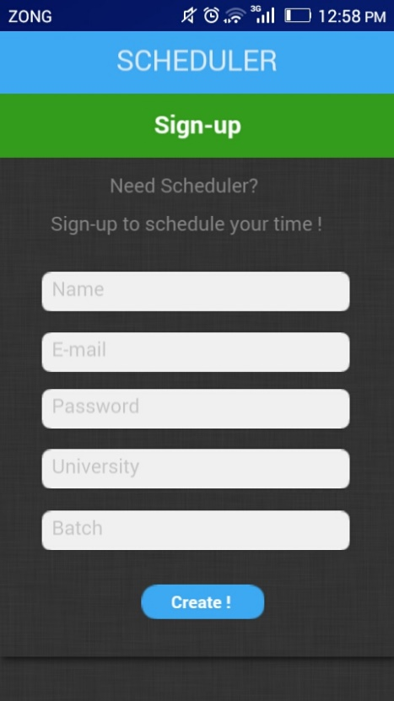
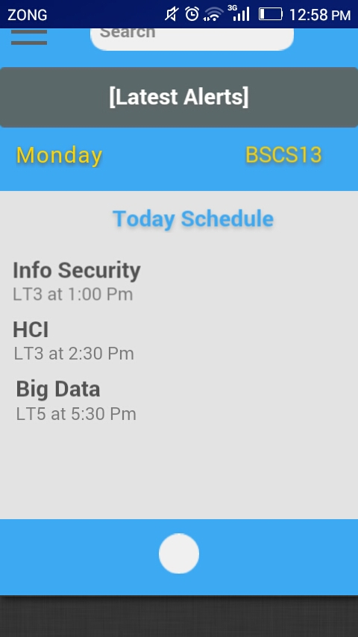
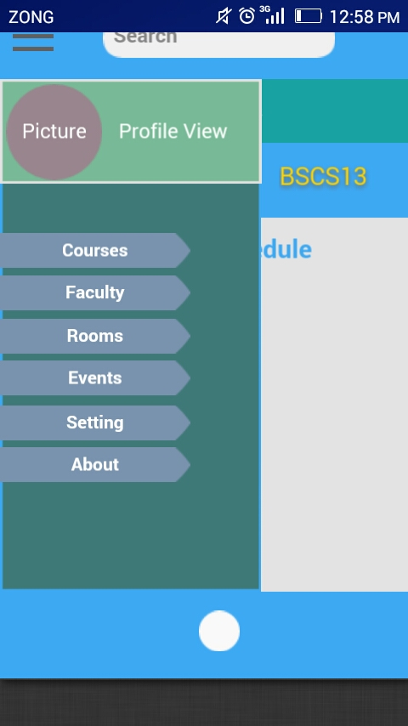
HI-FI Prototype

Slide 25
conclusion
The problem is quite genuine for many people and they need an easy solution
We are hoping to fulfill their needs in the best way we can

Slide 26
Website - Prototype - GitHub
Website:
schedulerpro.wordpress.com
Prototype:
www.fluidui.com
GitHub:
Github.com/alisatwat/Scheduler_HCI_Project

Slide 27
Thank You ☺

