Slide 1
Choosing an experiment platform
Alisdair Tullo
alisdair@tullo.me.uk
Online Experiments Workshop
Aarhus University
28th-29th May 2020

Slide 2
Lots of options!
As you saw in the last talk, there are lots of different options for online experiments
Don't be afraid to try out different platforms
Don't be afraid to switch if yours isn't working

Slide 3
What to consider?
What do people use in your subfield, or for your particular type of data collection?
What does your supervisor use?
Notes:
You might find that use (or lack of) a particular technology affects how your paper is seen in your field. Your supervisor and other academic mentors will know if this is a problem. Fortunately this seems to be more of an issue in e.g. life sciences -- I haven't encountered much of this in the humanities.
What others doing similar work use is still a useful guide for valid reasons though, as they will have put some thought into their selection!

Slide 4
What to consider?
Can it do everything you want?
Can it do everything you want for the next version of the experiment?
Do you need it to be repeatable in 5 years?
Is it mature, stable and tested with a strong community or business behind it?
Notes:
Will talk about “can it do what you want” in a bit more detail.
Longevity of software is a real problem -- after a while the only way to replicate may be to rewrite in a newer technology. It's important to document the protocol in as much detail as possible for this reason. There are efforts to enhance replicability in other spheres by storing VMs (virtual machines) of software used for data analysis. (This would be problematic for online experiments though, for security reasons).

Slide 5
Can it do what you want?
Do a proof-of-concept experiment
Can it do the type of structure, and the type of randomisation you need? You can try this without having your real stimuli and all the trials etc.
Can it handle the stimulus and response types you need?

Slide 6
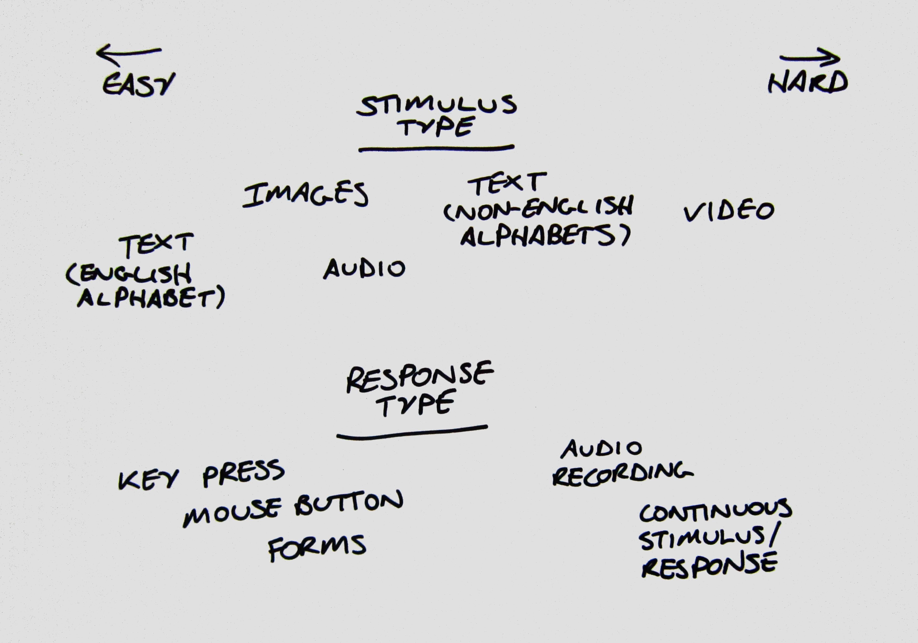
Can it do what you want?

