Slide 1
oTree
Alisdair Tullo
alisdair@tullo.me.uk
Online Experiments Workshop
Aarhus University
28th-29th May 2020

Slide 2
Links
oTree documentation:
https://otree.readthedocs.io/en/latest/
oTree Hub
https://www.otreehub.com/
Mozilla Developer Network (HTML, CSS, JS)
https://developer.mozilla.org

Slide 3
What can you do with oTree?
From the website:
“oTree is a framework based on Python that lets you build:
Multiplayer strategy games, like the prisoner’s dilemma, public goods game, and auctions
Controlled behavioral experiments in economics, psychology, and related fields
Surveys and quizzes”

Slide 4
Good for:
Turn based games
Text or choice based responses
Multi-participant interaction
Chat built in
(These last two are usually quite difficult, oTree makes them much easier!)

Slide 5
Not good for:
Reaction times - input is form-based
Precisely timed stimuli
Real-time interaction
All of these could be added with custom JavaScript (with some effort)
Notes:
If you find yourself needing one of these it might be time to try a different platform -- though oTree might be worth keeping for the multiplayer aspect.

Slide 6
A word about programming styles
Three styles relevant to this and jsPsych ....
Procedural
Functional
Object-oriented

Slide 7
Procedural programming
10 PRINT HELLO
20 GOTO 10
Run one line then the next, all in order
Call functions in a simple manner
The other two build on this ....

Slide 8
Functional programming
Using functions indirectly
Functions passed to functions
More later (jsPsych uses this)
function firstLetter(word) {
return word[0];
}
["one", "two", "three","four"].map(firstLetter)
Notes:
This is an aside - not very relevant to oTree but we'll see it later in jsPsych

Slide 9
Object-oriented programming
Classes and objects
A class is a definition of the properties and capabilities of a certain category of thing
An object is a specific thing in that category

Slide 10

Object-oriented programming
E.g. “Dogs” is a species of animal
This is an instance:

Slide 11
Object oriented programming in Python
Definition:
Use:
class Dog:
def __init__(self, name):
self.legs = 4
self.name = name
def bark(self):
print("woof")
poppy = Dog("Poppy")
poppy.bark()
print(poppy.legs)
print(poppy.name)

Slide 12
oTree objects - experiment sequence
A Page is one page to be presented to participants
Pages are defined in a sequence packaged in an App
A Subsession is one run of an App (an App can be repeated for multiple rounds)
A Session is a collection of SubSessions
For the participant's point of view, the Session is what they take part in (the experiment)

Slide 13
oTree objects - an example
Let's take an example
We want participants to play three rounds of Prisoner's Dilemma
In this experiment, they get to chat before the first round

Slide 14
oTree objects - an example
Create four apps:
intro and demographics,
chat,
Prisoner's Dilemma, and
debrief
Repeat Prisoner's Dilemma 3 times
Combine these together in a Session which specifies the order

Slide 15
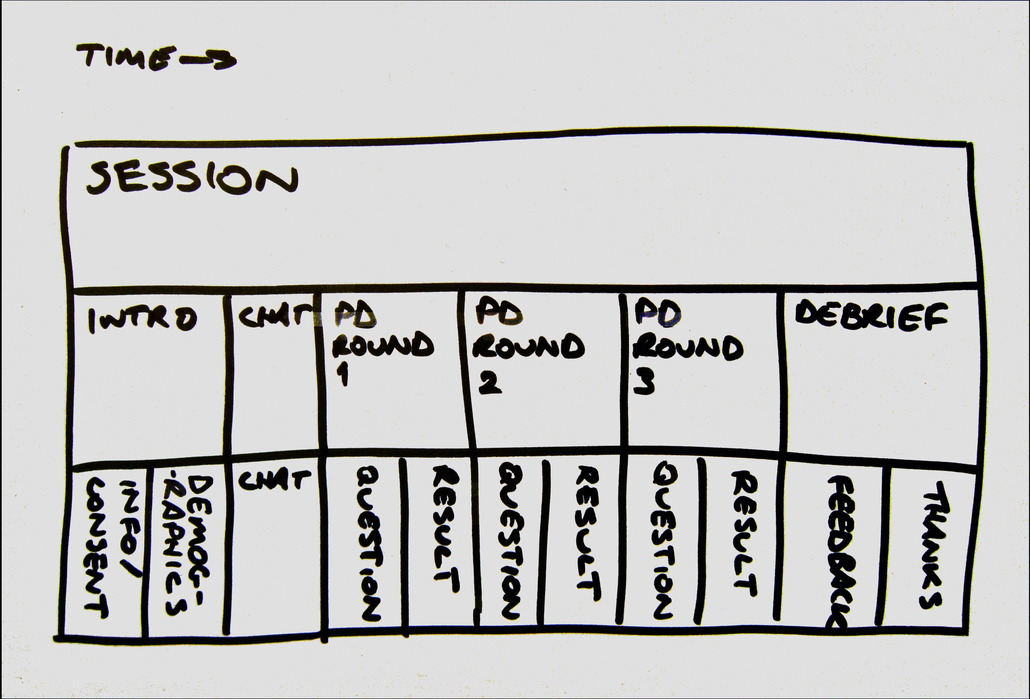
oTree objects - an example

Slide 16
oTree objects - participants
Participant - a particular person that is taking part in your study
Player - a particular role in an Subsession
(a Participant can take different roles in different Subsessions)
Group - a group of players, usually for the purposes of matching for multi-participant experiments (can be different per Subsession)

Slide 17
oTree objects - participants example
Let's say we have one app which is a 2 player game
Participants to play it once, then swap roles and play again
Then they play a 3 player game, with each trio taking one player each from the pairs
This is possible in oTree!
Setups this complex require custom coding - simple cases (e.g. same groups all the way through) don't

Slide 18
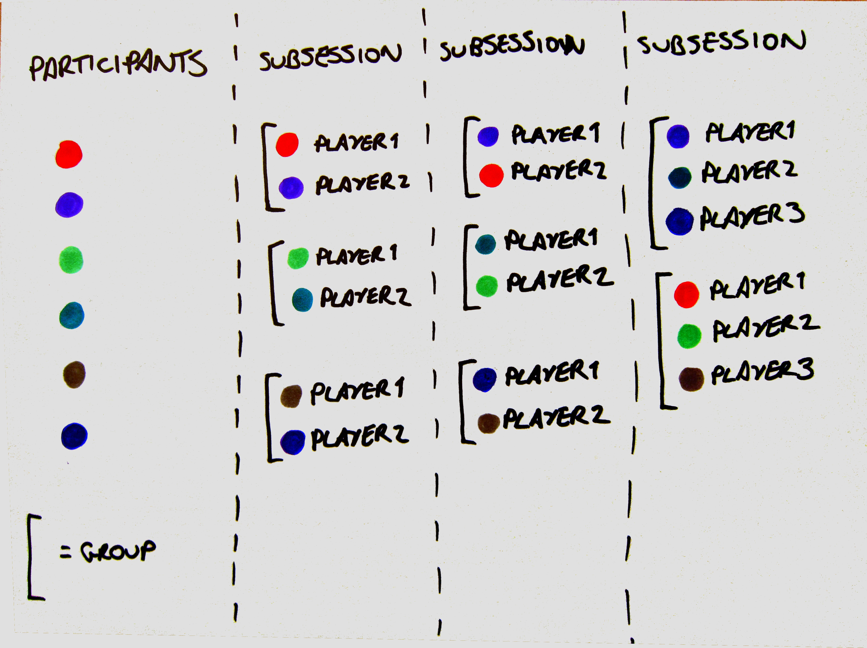
oTree objects - people

Slide 19
Constants
Allows you to define values which won't change throughout the App in one place
Built-in constants with special meanings:
players_per_group
num_rounds - how many repeats of this App (Subsessions)
name_in_url - name of the App for the URL
(where the real name shouldn't be shown to participants - e.g. if your App is called “deception”)

Slide 20
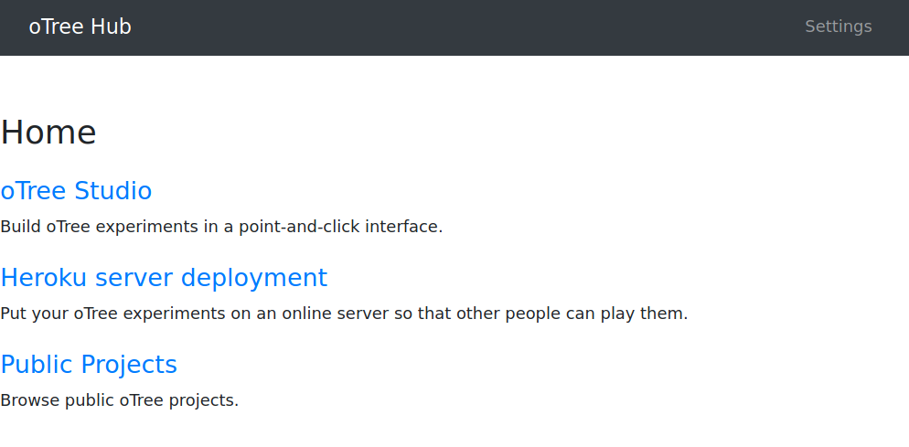
oTree Hub
Log in to https://www.otreehub.com/

Slide 21
oTree Hub
“oTree Studio” allows you to create experiments
Using “Heroku server deployment” run them (but we'll use AU servers)
“Public projects” allows you to browse all projects
Ours will be public too!
(The paid plan is required to have private projects)

Slide 22
Sequence of events
Participants are recruited and come to the oTree experiment (see Rooms for how this can be managed)
Participants are assigned to Groups
Each participant has a unique ID and a player ID within the group
This Group begins the first app - this is a Subsession

Slide 23
Sequence of events
Each Player in the Group starts on the first Page
As each Player finishes a Page, they go to the next one
This is individual to the Player - oTree doesn't wait for Players to catch up!

Slide 24
Displaying information on a Page
Add HTML and it will be shown to the participant
This content will need to vary though!
There are also special things
.... like form fields
.... and the button to go to the next page (submit button)
oTree uses Django templates for this

Slide 25
Templates
Template tags are:
{{ .... }} for simple information
{% .... %} for some special action
The default template in oTree Studio is:
This displays the form and the Next button
{% formfields %}
{% next_button %}

Slide 26
Templates
The information tags {{ .... }} can only contain certain variables
oTree gives us player, group, subsession, participant, session, and Constants
We can't write Python in the tags though!
Other variables can be defined in the Page's vars_for_template method
This allows you to pass other values to the template

Slide 27
Flow control
Unlike other software, oTree doesn't have explicit loops and branches in between Pages
It does have other facilities allowing us to do similar things, though!
Notes:
e.g. the loops we saw in OpenSesame

Slide 28
oTree looping
To repeat a sequence of pages in oTree, first package them as an App
Then, set the variable num_rounds in the app's Constants
This will repeat that App the given number of times
The subsession, group, player and page objects all have an attribute self.round_number
This starts at 1 (unlike a lot of Python things which start at 0)

Slide 29
oTree branching
There's no such thing, but ....
.... each Page can have a method called is_displayed
Every time the Page is to be shown, this method is called
It returns True to show the Page, False to hide it
This can be used for the same purposes as branching

Slide 30
is_displayed
If a page is only relevant to one role, use is_displayed to make sure other players won't see it
Essential for sequential games where one player decides then the other

Slide 31
Synchronising players
Remember that by default, each Players may go through the Pages at their own speed
This avoids the Players getting frustrated but may not suit your game
To wait for the other Players to catch up, you can use a WaitPage
This will display a “please wait” message until everyone in the Group has caught up

Slide 32
Let's look at some code!
Trust game example - let's have a look
Notes:
Time budget 5 mins. Show is_displayed and WaitPages.

Slide 33
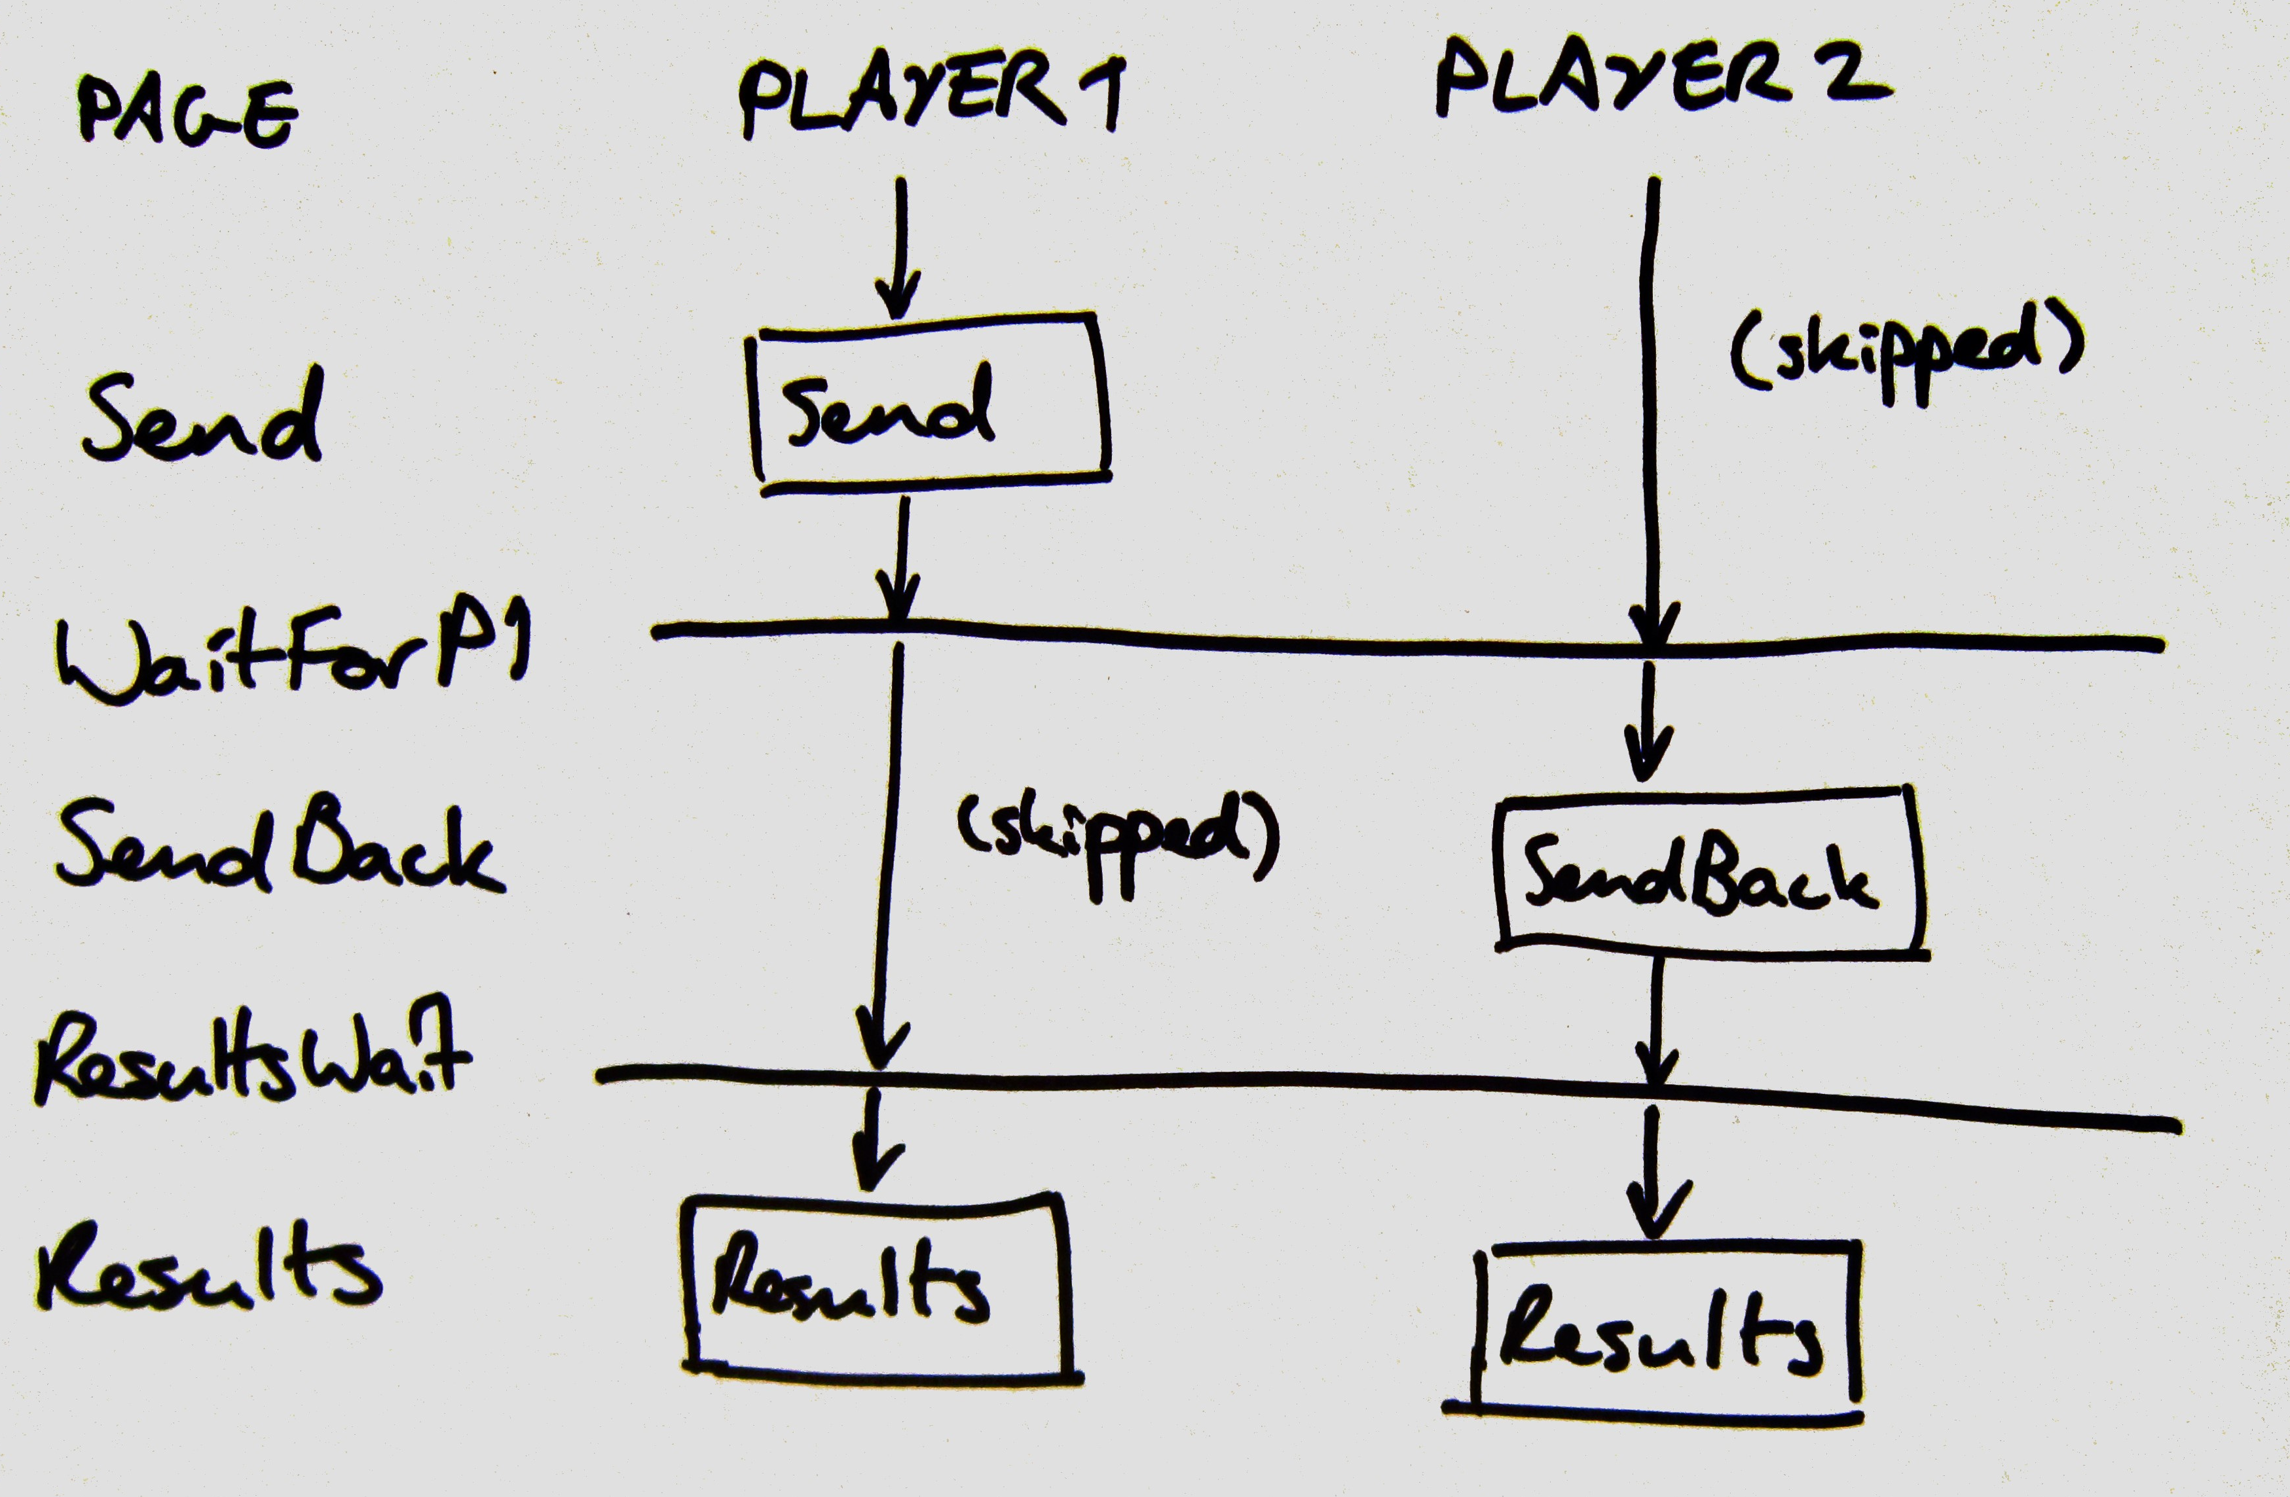
Trust game - is_displayed and WaitPage

Slide 34
Example apps
oTree has an amazing range of example apps!
You can use these in your own studies
When you create an App you can start with one of these instead of a blank app

Slide 35
How to write an oTree app
Think about the sequence of things that need to happen
Think about the flow of information - what needs to go where
Particularly, where do you need to skip pages for certain Players or use WaitPages to catch up?
Useful to map out what you want to happen before starting to code
Consider using an existing example as a base

Slide 36
Other oTree features
oTree has built in chat on Pages
It's really easy to include and logs are saved automatically
Group allocation / randomisation is extremely configurable
Vary Group size between Apps
e.g. a 2-player game, and then have each pair meet another pair for a 4-player game

Slide 37
Other oTree features
Despite the lack of built-in reaction timing ....
There are clear ways to force a minimum or maximum time spent on one particular page
You can even have a countdown timer!

Slide 38
Tips
Remember to use self in code to refer to the current object
Remember not to use self in templates - things like player, group, subsession and session are already defined
If you need anything else in a template, check out the Page method vars_for_template
Read the notes in the Studio interface, they're useful!

Slide 39
Tips
Constants doesn't support Python dictionaries (dict)
Instead, define a method on the Subsession

Slide 40
The other way to do oTree
We're using oTree Studio as it guides experiment creation
It's also possible to create an experiment in code
The best way to do this is to start from an example
Let's take a quick look at the code now

Slide 41
Looking at an example - prisoner
Prisoner's Dilemma
Two prisoners who can't communicate with each other
Can choose to cooperate, or betray, the other
Both cooperate: both 1 year of prison
One cooperates, other betrays: betrayer is freed, cooperator 3 years of prison
Both betray: both 2 years of prison
Notes:
Show reward matrix on wikipedia
(this is varied a lot in different games!)

Slide 42
Pages
Let's look at the Pages first, that's what the participant sees
Introduction, click through to template - this is instructions for the game
A timeout is set so the page is only shown for 100 seconds at most

Slide 43
Pages
Decision is where the player chooses to betray (defect) or cooperate

