Slide 1
Online Experiments Overview
Alisdair Tullo
alisdair@tullo.me.uk
Online Experiments Workshop
Aarhus University
28th-29th May 2020
Notes:
schedule 9.45 to 10.30
~1 min/slide then demos

Slide 2
The State of the Art
In this talk I'll compare existing platforms for online experiments
These vary a lot!
Balance technical difficulty, capability, cost
What's best for you?
Try a few!
Notes:
Trying different experiment software may seem time consuming but could be rewarding if starting from scratch. See what others doing similar tasks have used, don't be afraid to ask.

Slide 3
Tables of Experiment Software
I'll discuss most of these in more detail
The ones I won't are in (parentheses)
Difficulty ratings are relative to what you want to do!
Don't be put off trying something

Slide 4


Coding required
Platform | Coding | Difficulty | Requirements
JavaScript/CSS/HTML | yes |  | web hosting
jsPsych | yes |  | web hosting
p5.js | yes |  | web hosting
oTree | yes |  | paid service or web hosting
(Ibex/IbexFarm) | yes |  | web hosting or free service
(FindingFive.com) | yes? |  | paid service in future?
Notes:
Thinking face as didn't want to scare anyone! oTree rated as hard but it's possible to extend examples (PD etc.) without too much knowledge. Likewise a jsPsych plugin may do everything you want. FindingFive not really "coding" but most similar to jsPsych in syntax / approach (and the one of these I know the least about), but it looks like it may be commercialised in time. Not much experience of Ibex but it's well regarded in the field. The IbexFarm free service is located in the USA (I think) so may be problematic, but you can run your own.

Slide 5

Coding maybe required
Platform | Coding | Difficulty | Requirements
OpenSesame/OSWeb/ JATOS | maybe |  | desktop software JATOS server
lab.js | maybe |  | web hosting or JATOS server
Notes:
JATOS is a piece of server software which makes it easier to upload experiments and download results, and keep track of experiments / studies.

Slide 6


No coding required?
Platform | Coding | Difficulty | Requirements
(gorilla.sc) | no |  | paid service
(testable.org) | no |  | web hosting or free service
Notes:
Noting two paid services here for completeness. Gorilla is rated as more difficult but it's also more fully-featured; coding *is* possible but there's a large script library to paste in and you can make requests for new scripts. Testable allows you to create an experiment from a CSV of trials and they host the experiment and collect the results as CSV. Both are hosted in the EU (gorilla may leave!) and claim GDPR compliance. Both claim high levels of user support to justify the high cost (gorilla large amount per ppt in particular)

Slide 7
JavaScript / CSS / HTML
https://developer.mozilla.org
You'll end up duplicating some effort
Using existing libraries is also effort
It's a good skill to have
CSS will hurt your brain
Notes:
reinventing the wheel! There is no single official website for this, but MDN is the best reference I know.

Slide 8
jsPsych
https://www.jspsych.org/
A JavaScript library!
Shortcuts to commonly-used types of trial
Tied to stimulus-then-response model
Very stable and reliable
Notes:
Good website! We'll see it later.

Slide 9
p5.js
https://p5js.org/
Another JavaScript library!
Suitable for continuous stimulus / response
Tasks similar to computer games
Notes:
Descended from Processing, originally used by artists. Very good for beginners and easy to get started coding, requires a lot of work to create an experiment though. Incidentally, can also deploy Processing (similar but in Java) to Android and RPi ....

Slide 10
oTree
https://www.otree.org/
https://www.otreehub.com/ (paid service)
Suitable for microeconomic interaction
e.g. Prisoner's Dilemma
Very good support for multiple participants
Chat
Notes:
We'll see oTree later!

Slide 11
OpenSesame
https://osdoc.cogsci.nl/
Mature in-person experiment software
Online feature “OSWeb”
Generates experiment for upload to JATOS
Still in development, lacking some features
Gives a warning about experiments > 10MB
Notes:
I'm a big fan of OpenSesame for desktop software - very stable and reliable, good community, good user interface, nice coding interface when you need it.
Seems like JavaScript interface is in the early stages but if it does what you need it may suit you. 10MB “limit” is a problem for e.g. image-heavy code (and any videos!).

Slide 12
lab.js
https://lab.js.org/
Browser-based graphical interface
Constructs an experiment and gives you the code
You can then put it on your own web hosting
Referencing loop variables feels a bit like coding ....
Notes:
Will demo!

Slide 13
Demos!
Will now demo ....
p5.js
OpenSesame
lab.js
PsychoPy / pavlovia

Slide 14
p5.js demo
https://editor.p5js.org/
Notes:
setup() runs once at the beginning
draw() runs once every refresh (usually 60Hz on desktops, not sure how this works for web -- get the oscilloscope out if fine-grained timings matter to you!)
1. add a circle to draw()
circle(mouseX, mouseY, 50, 50);
circle, mouseX and mouseY are all built in to p5.
every frame, background is cleared and circle is drawn at the position of the mouse, so it looks like it moves with the mouse
2. Take out background()
now that background is gone, old circles are not removed (put it back in)
3. Add let c; to top of code, c = color(“red”) in setup, and mousePressed method with c = colour(random(255),random(255), random(255));
This is a fun way to learn code (and also good for experiments with continuous interaction with the participant).

Slide 15
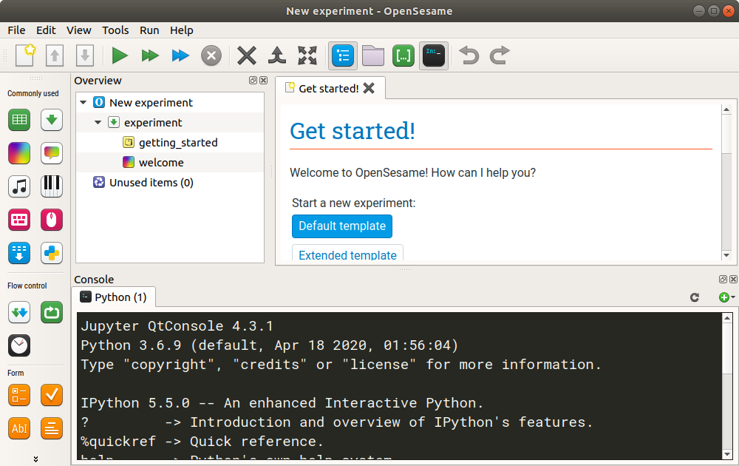
OpenSesame demo
https://osdoc.cogsci.nl/
https://cortex.jatos.org
test@jatos.org / abc1234
Notes:
Start PsychoPy (conda activate psychopy-py3 first)

Slide 16
lab.js demo
https://labjs.felixhenninger.com/
Notes:
Create a blank study
Create a loop, rename “Stroop loop”
Enter some words and colours
Create a trial, rename “Stroop trial”
Create a text item { this.parameters.word }
Change the colour to ${ this.parameters.colour }
In the behaviour tab, allow keypresses for r g b y
Can also add ${ this.parameters.colour } for correct response
Can download this to upload to JATOS, host yourself, etc. ....

Slide 17
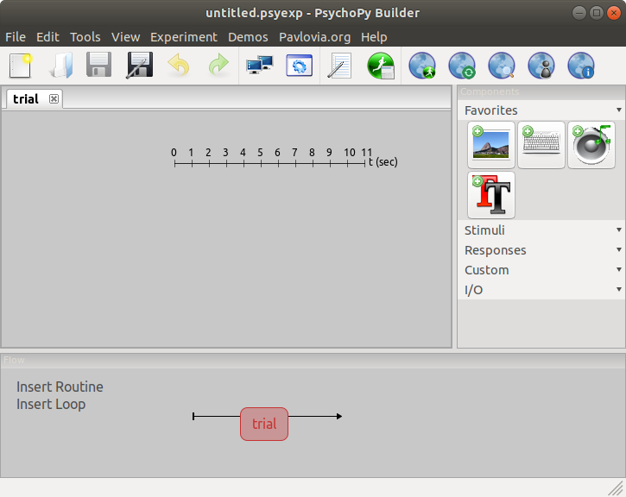
PsychoPy / pavlovia demo
https://www.psychopy.org/
https://pavlovia.org/
Notes:
win 10 virt and psychopy
make a loop and a stroop! remember:
- make a folder for experiment e.g. /Users/Alisdair/test2
- save experiment in /Users/Alisdair/test2
- PsychoPy needs a CSV file for a loop, save file in /Users/Alisdair/test2
- Add a text item
- set duration to “condition” and leave it blank
- Variables are $name
- You have to select “Set every repeat” for the relevant things (text and colour) so variables are interpreted correctly
- set flip to “vert” because rendering bug
- Add a keyboard item that takes rgby

Slide 18
Questions
?

