Slide 1
Online experiment technologies:
What are the options, and how do I choose?
Alisdair Tullo
alisdair.tullo@ed.ac.uk
LEL Postgraduate Conference
6th June 2022

Slide 2
Introduction
In this talk I'll compare existing platforms for online experiments
I’ll then talk a bit about what to take into account when choosing a platform
Notes:
Trying different experiment software may seem time consuming but could be rewarding if starting from scratch. See what others doing similar tasks have used, don't be afraid to ask.

Slide 3
The State of the Art
These vary a lot!
Balance technical difficulty, capability, cost
What's best for you?
Try a few!

Slide 4
Tables of Experiment Software
I'll discuss most of these in more detail
The ones I won't are in (parentheses)
Difficulty ratings are relative to what you want to do!
Don't be put off trying something

Slide 5


Coding required
Platform | Coding | Difficulty | Requirements
JavaScript/CSS/HTML | yes |  | web hosting
jsPsych | yes |  | web hosting
p5.js | yes |  | web hosting
oTree | yes |  | paid service or web hosting
(Ibex/IbexFarm) | yes |  | web hosting or free service
(FindingFive.com) | yes? |  | paid service in future?
Notes:
Thinking face as didn't want to scare anyone! oTree rated as hard but it's possible to extend examples (PD etc.) without too much knowledge. Likewise a jsPsych plugin may do everything you want. FindingFive not really "coding" but most similar to jsPsych in syntax / approach (and the one of these I know the least about), but it looks like it may be commercialised in time. Not much experience of Ibex but it's well regarded in the field. The IbexFarm free service is located in the USA (I think) so may be problematic, but you can run your own.

Slide 6

Coding maybe required
Platform | Coding | Difficulty | Requirements
OpenSesame/OSWeb/ JATOS | maybe |  | desktop software JATOS server
lab.js | maybe |  | web hosting or JATOS server
PsychoPy/pavlovia.org | maybe |  | Hosted on pavlovia.org (pay per participant)
Notes:
JATOS is a piece of server software which makes it easier to upload experiments and download results, and keep track of experiments / studies.

Slide 7


No coding required?
Platform | Coding | Difficulty | Requirements
(gorilla.sc) | no |  | paid service (per participant)
(testable.org) | no |  | paid or free service
Notes:
Noting two paid services here for completeness. Gorilla is rated as more difficult but it's also more fully-featured; coding *is* possible but there's a large script library to paste in and you can make requests for new scripts. Testable allows you to create an experiment from a CSV of trials and they host the experiment and collect the results as CSV. Both are hosted in the EU (gorilla may leave!) and claim GDPR compliance. Both claim high levels of user support to justify the high cost (gorilla large amount per ppt in particular)

Slide 8
JavaScript / CSS / HTML
https://developer.mozilla.org
You'll end up duplicating some effort
Using existing libraries is also effort
It's a good skill to have
CSS will hurt your brain
Notes:
reinventing the wheel! There is no single official website for this, but MDN is the best reference I know.

Slide 9
jsPsych
https://www.jspsych.org/
A JavaScript library!
Shortcuts to commonly-used types of trial
Tied to stimulus-then-response model
Very stable and reliable
Notes:
Good website! We'll see it later.

Slide 10
p5.js
https://p5js.org/
Another JavaScript library!
Suitable for continuous stimulus / response
Tasks similar to computer games
Notes:
Descended from Processing, originally used by artists. Very good for beginners and easy to get started coding, requires a lot of work to create an experiment though. Incidentally, can also deploy Processing (similar but in Java) to Android and RPi ....

Slide 11
oTree
https://www.otree.org/
https://www.otreehub.com/ (paid service)
Suitable for microeconomic interaction
e.g. Prisoner's Dilemma
Very good support for multiple participants
Chat
Notes:
We'll see oTree later!

Slide 12
OpenSesame
https://osdoc.cogsci.nl/
Mature in-person experiment software
Online feature “OSWeb”
Generates experiment for upload to JATOS
Still in development, lacking some features
Gives a warning about experiments > 10MB
Notes:
I'm a big fan of OpenSesame for desktop software - very stable and reliable, good community, good user interface, nice coding interface when you need it.
Seems like JavaScript interface is in the early stages but if it does what you need it may suit you. 10MB “limit” is a problem for e.g. image-heavy code (and any videos!).

Slide 13
lab.js
https://lab.js.org/
Browser-based graphical interface
Constructs an experiment and gives you the code
You can then put it on your own web hosting
Referencing loop variables feels a bit like coding ....
Notes:
Will demo!

Slide 14
Demos!
Will now demo ....
p5.js
OpenSesame
lab.js
PsychoPy / pavlovia

Slide 15
p5.js demo
https://editor.p5js.org/
Notes:
setup() runs once at the beginning
draw() runs once every refresh (usually 60Hz on desktops, not sure how this works for web -- get the oscilloscope out if fine-grained timings matter to you!)
1. add a circle to draw()
circle(mouseX, mouseY, 50, 50);
circle, mouseX and mouseY are all built in to p5.
every frame, background is cleared and circle is drawn at the position of the mouse, so it looks like it moves with the mouse
2. Take out background()
now that background is gone, old circles are not removed (put it back in)
3. Add let c; to top of code, c = color(“red”) in setup, and mousePressed method with c = colour(random(255),random(255), random(255));
This is a fun way to learn code (and also good for experiments with continuous interaction with the participant).

Slide 16
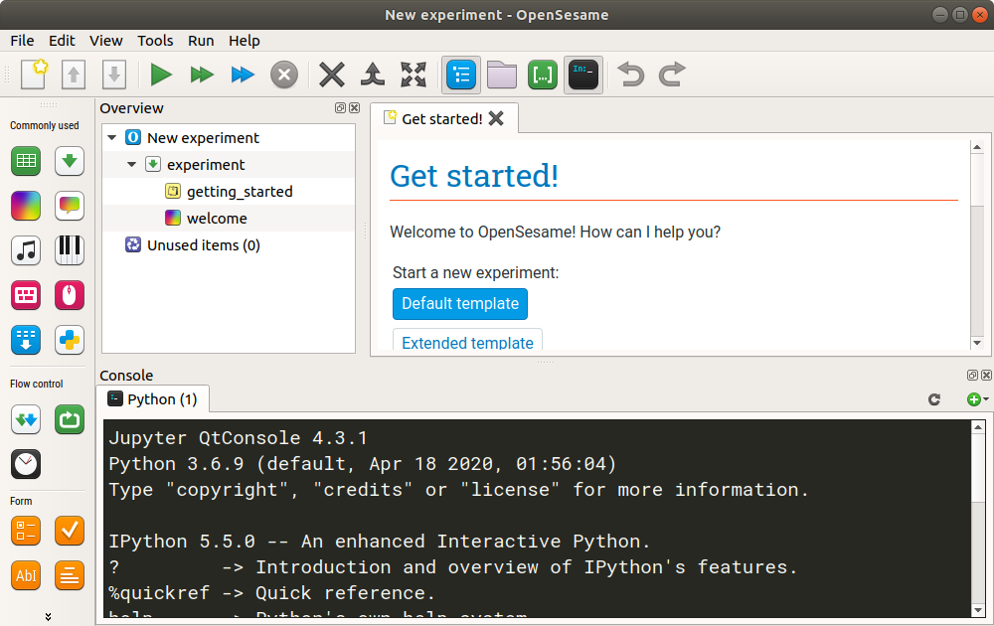
OpenSesame demo
https://osdoc.cogsci.nl/
https://cortex.jatos.org
test@jatos.org / abc1234
Notes:
Start PsychoPy (conda activate psychopy-py3 first)

Slide 17
lab.js demo
https://labjs.felixhenninger.com/
Notes:
Create a blank study
Create a loop, rename “Stroop loop”
Enter some words and colours
Create a trial, rename “Stroop trial”
Create a text item { this.parameters.word }
Change the colour to ${ this.parameters.colour }
In the behaviour tab, allow keypresses for r g b y
Can also add ${ this.parameters.colour } for correct response
Can download this to upload to JATOS, host yourself, etc. ....

Slide 18
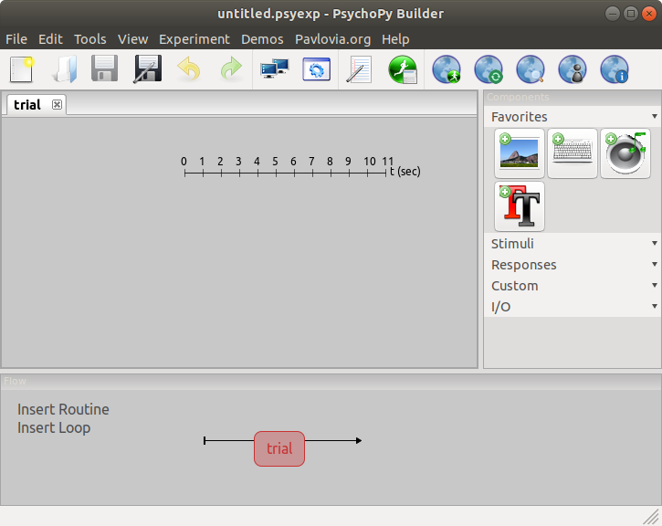
PsychoPy / pavlovia demo
https://www.psychopy.org/
https://pavlovia.org/
Notes:
win 10 virt and psychopy
make a loop and a stroop! remember:
- make a folder for experiment e.g. /Users/Alisdair/test2
- save experiment in /Users/Alisdair/test2
- PsychoPy needs a CSV file for a loop, save file in /Users/Alisdair/test2
- Add a text item
- set duration to “condition” and leave it blank
- Variables are $name
- You have to select “Set every repeat” for the relevant things (text and colour) so variables are interpreted correctly
- set flip to “vert” because rendering bug
- Add a keyboard item that takes rgby

Slide 19
Lots of options!
As you saw in the last talk, there are lots of different options for online experiments
Don't be afraid to try out different platforms
Don't be afraid to switch if yours isn't working

Slide 20
What to consider?
What do people use in your subfield, or for your particular type of data collection?
What does your supervisor use?
Notes:
You might find that use (or lack of) a particular technology affects how your paper is seen in your field. Your supervisor and other academic mentors will know if this is a problem. Fortunately this seems to be more of an issue in e.g. life sciences -- I haven't encountered much of this in the humanities.
What others doing similar work use is still a useful guide for valid reasons though, as they will have put some thought into their selection!

Slide 21
What to consider?
Can it do everything you want?
Can it do everything you want for the next version of the experiment?
Do you need it to be repeatable in 5 years?
Is it mature, stable and tested with a strong community or business behind it?
Notes:
Will talk about “can it do what you want” in a bit more detail.
Longevity of software is a real problem -- after a while the only way to replicate may be to rewrite in a newer technology. It's important to document the protocol in as much detail as possible for this reason. There are efforts to enhance replicability in other spheres by storing VMs (virtual machines) of software used for data analysis. (This would be problematic for online experiments though, for security reasons).

Slide 22
Can it do what you want?
Do a proof-of-concept experiment
Can it do the type of structure, and the type of randomisation you need? You can try this without having your real stimuli and all the trials etc.
Can it handle the stimulus and response types you need?

Slide 23
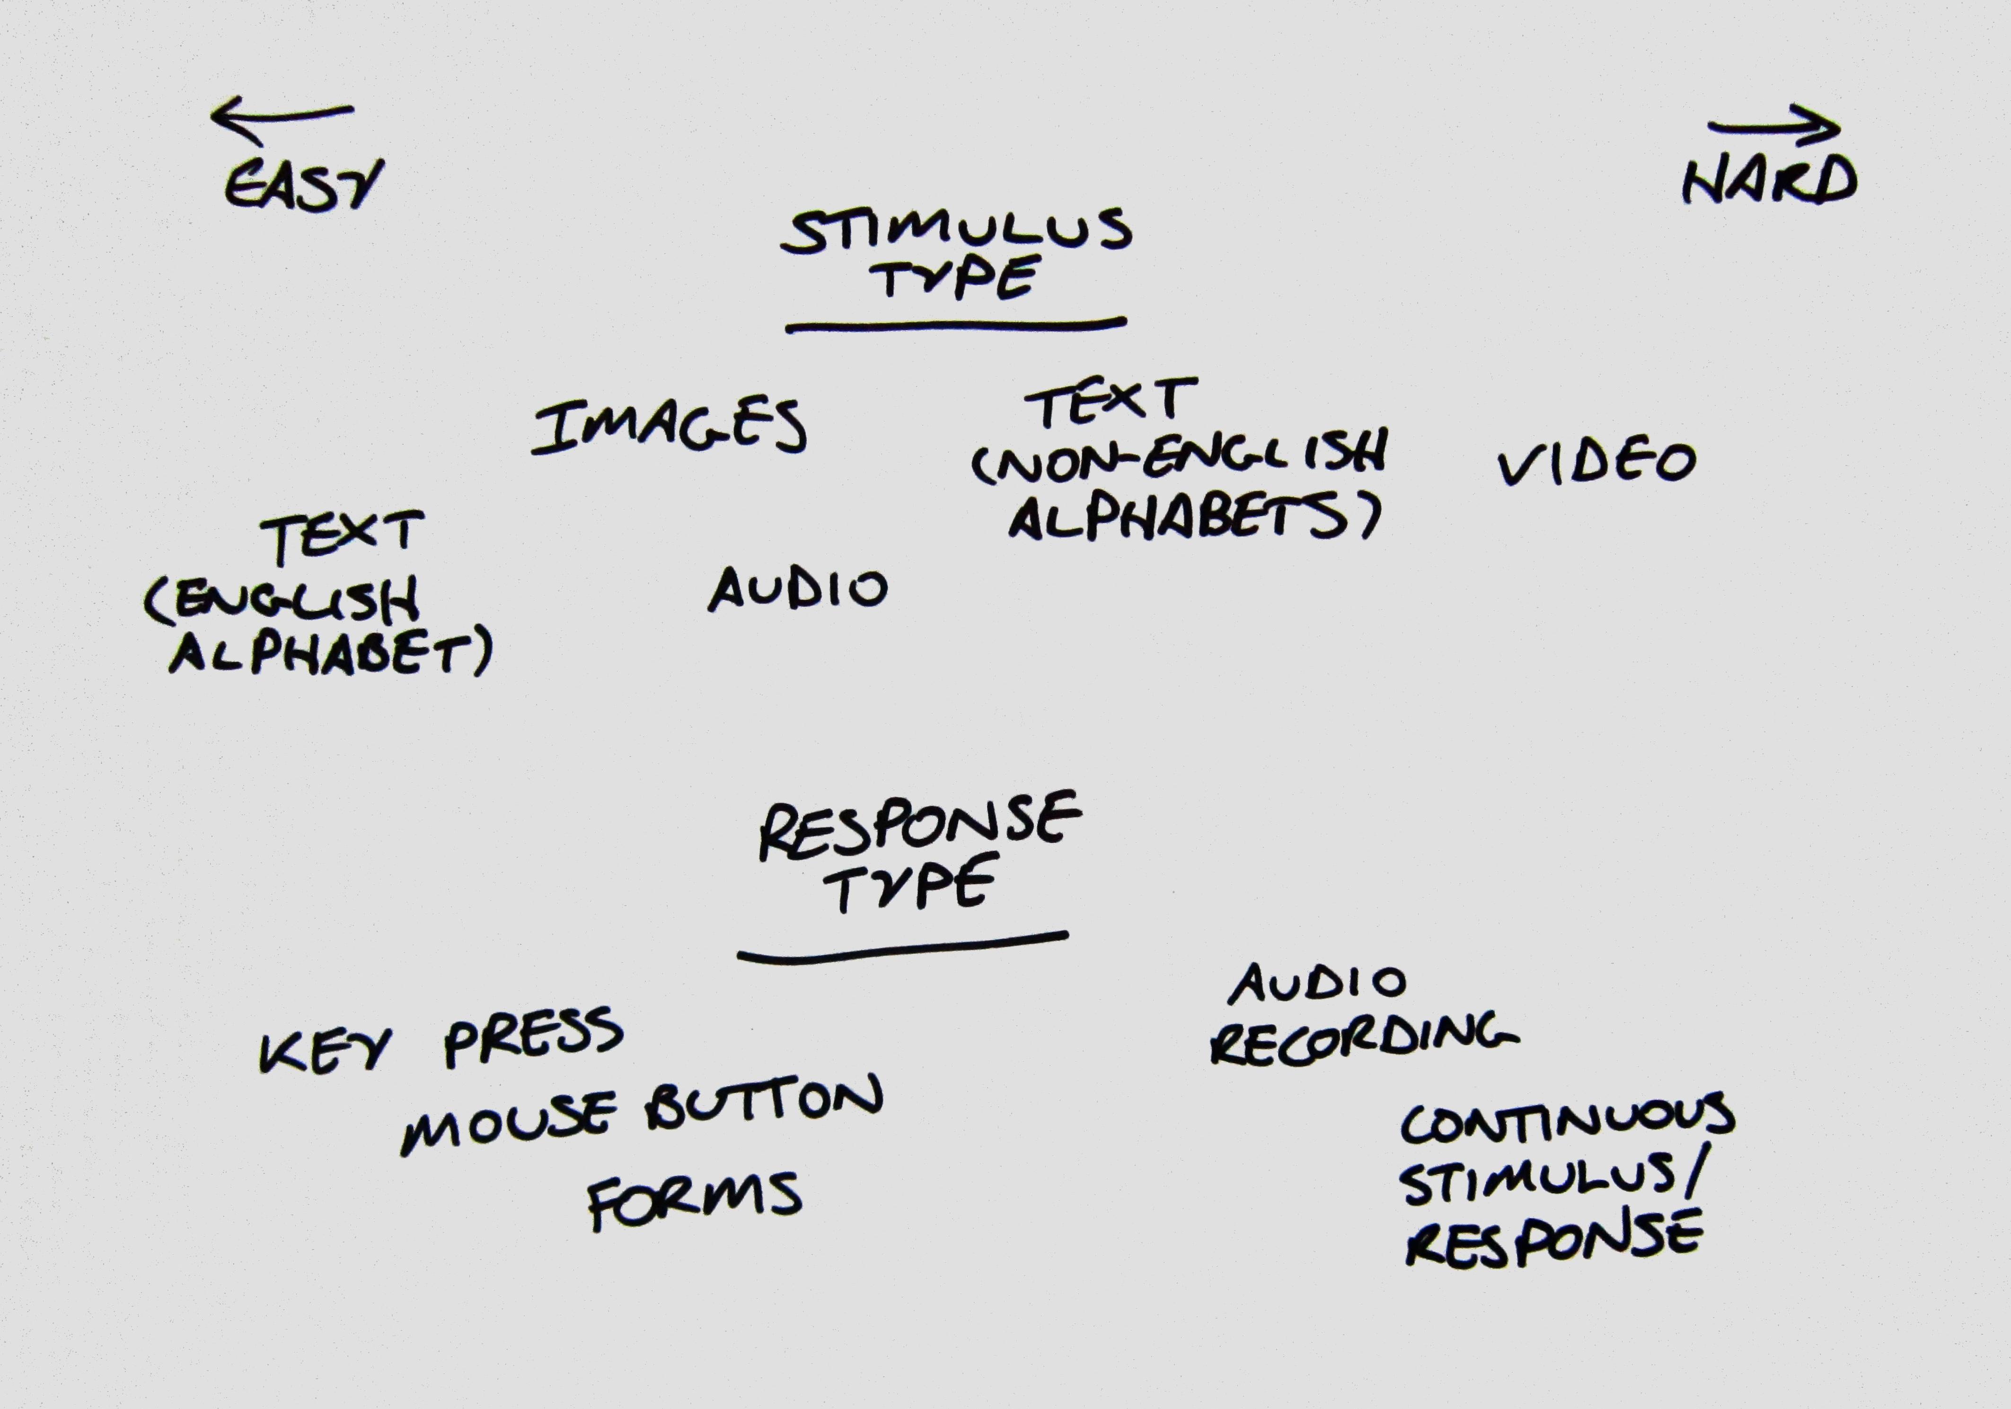
Can it do what you want?

