Slide 1
Image Recognition using Node.js

Slide 2
What our project do ?
Basically we upload a picture of animal and our application classify it’s type/class i.e. whether it is lion or rabbit or cat etc.
It also give the probability of accuracy of the result.

Slide 3
We have used TensorFlow
TensorFlow is a free and open-source software library for dataflow.
It is also used for machine learning applications such as neural networks.

Slide 4
Modules we have used
1. mobilenet
Pre-trained model for TensorFlow.js
MobileNets are small, low-latency, low-power models parameterized to meet the resource constraints of a variety of use cases. MobileNets trade off between latency, size and accuracy while comparing favorably with popular models from the literature.
2. tfjs-node
The module provides native TensorFlow execution backend JavaScript applications under the Node.js runtime.
3. tfjs
tfjs meansTensorFlow.js which is a library for machine learning in JavaScript. Develop ML models in JavaScript, and use ML directly in the browser or in Node.js.

Slide 5
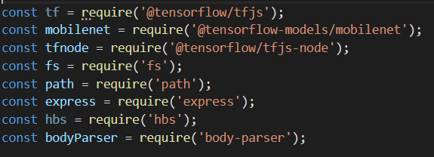
Modules snippet

Slide 6
Templating and Routing….
Front-end templating is done in Handlebars.
And
Express is used for handling routes.

Slide 7
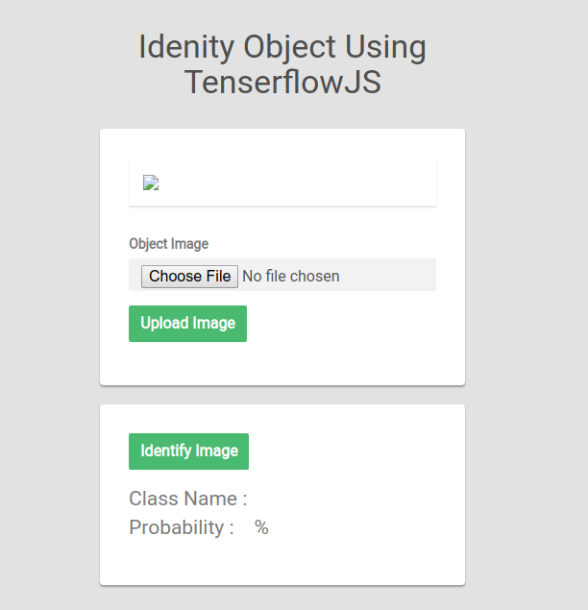
Here's how it looks like

Slide 8
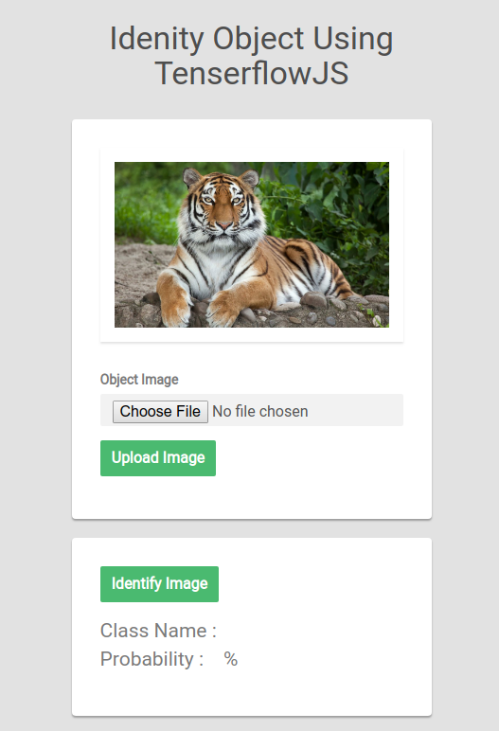
Here's how it looks like

Slide 9
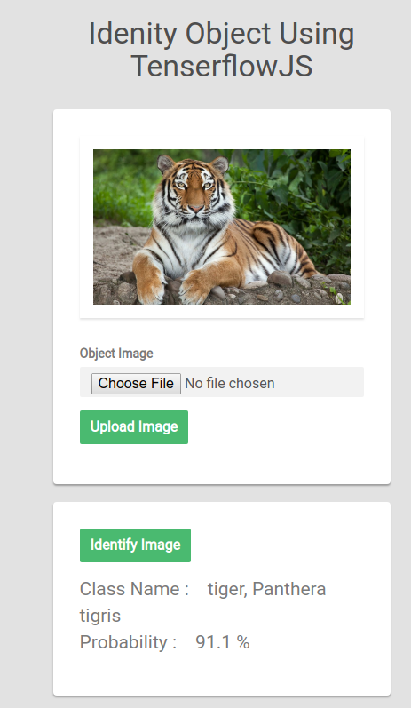
Here's how it looks like

Slide 10
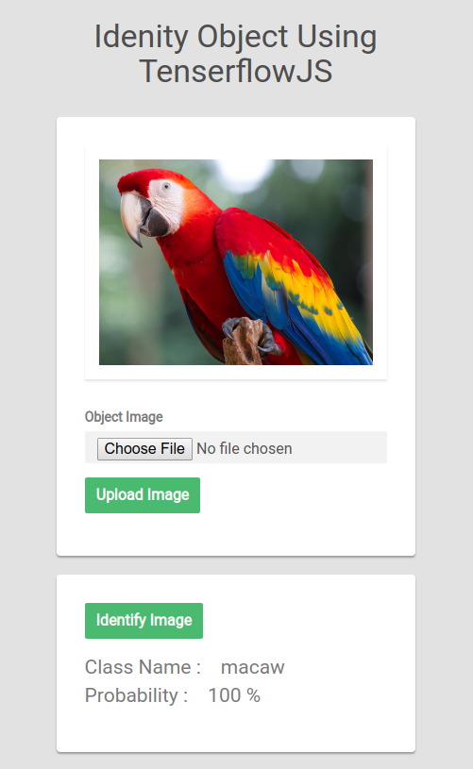
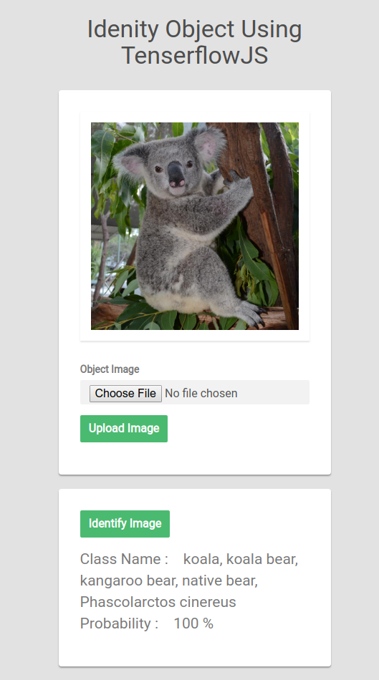
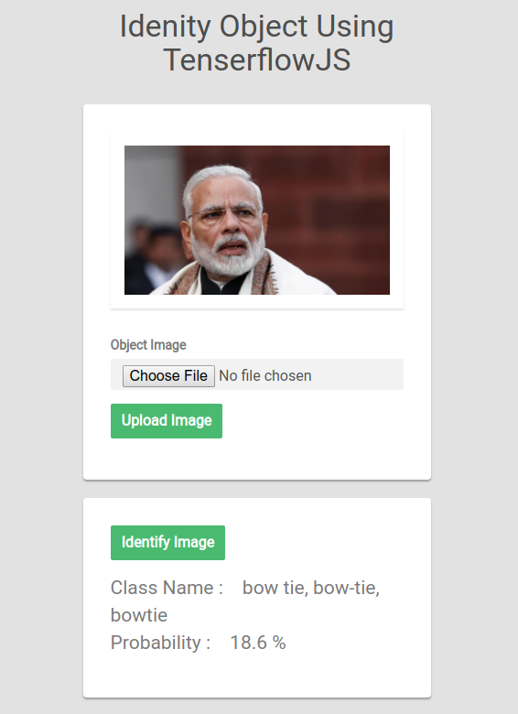
More fun we have done

Slide 11
Core concepts
We have a main function that do all the business i.e. ‘imageClassification’
It actually contain 2 important functions i.e. mobilenet.load() and mobilenetModel.classify()
const imageClassification = async function(path){
const image = readImage(path);
// Load the model.
const mobilenetModel = await mobilenet.load();
// Classify the image.
const predictions = await mobilenetModel.classify(image);
console.log('Classification Results:', predictions);
return predictions
}

Slide 12
‘mobilenet.load()’
This function actually loads ‘mobilenet’ model
It returns the loaded model by using which we can perform classification

Slide 13
‘mobilenetModel.classify()’
Takes an input image element and returns an array with top classes and their probabilities.
Returns a Promise that resolves to an array of classes and probabilities that may looks like:
[{
className: 'tiger, Panthera tigris',
probability: 0.9109411239624023
},
{ className: 'tiger cat',
probability: 0.08328785002231598
},
{ className: 'lynx, catamount',
probability: 0.003347322577610612
}
]
It is set default to return 3 objects in array with different probabilities(we can change it).

Slide 14


