Slide 1
Digital Forensic Examination Findings
Political Defamation & Harassment – Case 1
Presenter: Alish Mahat
Student ID: 23000965
Module: Forensic Computing Practice
Role: Digital Forensic Examiner

Slide 2
Case Background
Allegation of politically defamatory meme creation
Target: Manoj Oli
Suspect: Rahul
Device: Windows XP system

Slide 3
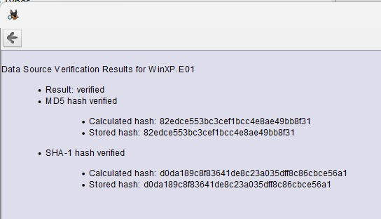
Scope of Examination
Verified E01 forensic image
File system & user activity analysis
Deleted data and concealment techniques
No live system interaction

Slide 4
Tools & Methodology
Autopsy – Primary forensic analysis
FTK Imager – Integrity verification
VeraCrypt – Encrypted container analysis
Repeatable forensic methodology

Slide 5
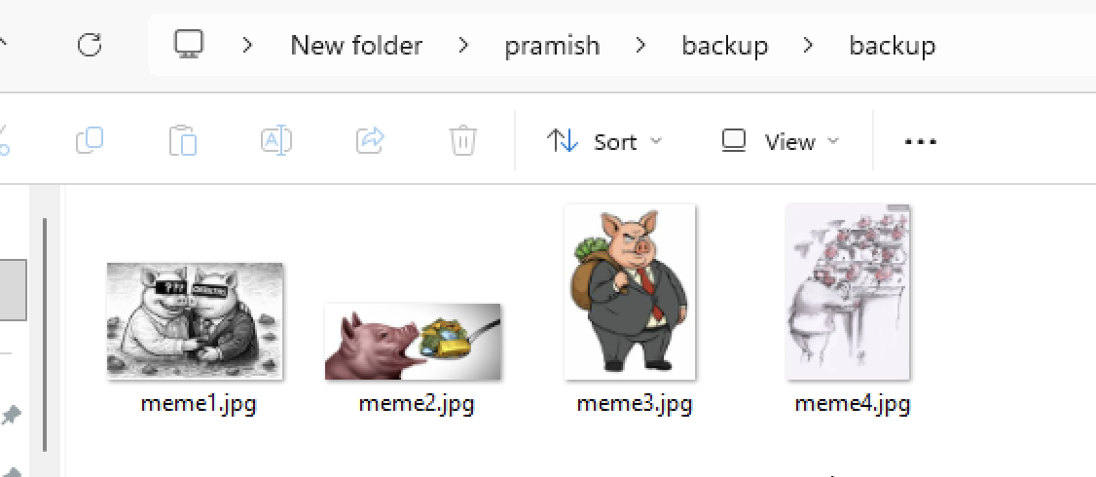
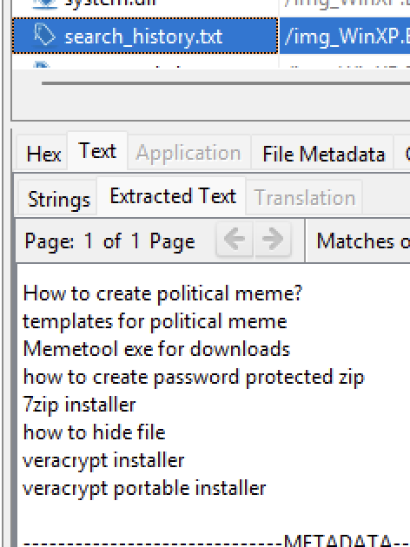
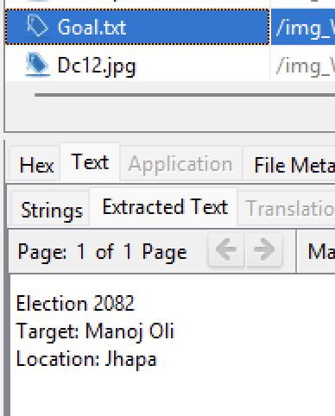
Evidence Theme 1 – Planning & Intent
Goal.txt outlining intent
Search artefacts
backup.zip preparatory materials

Slide 6
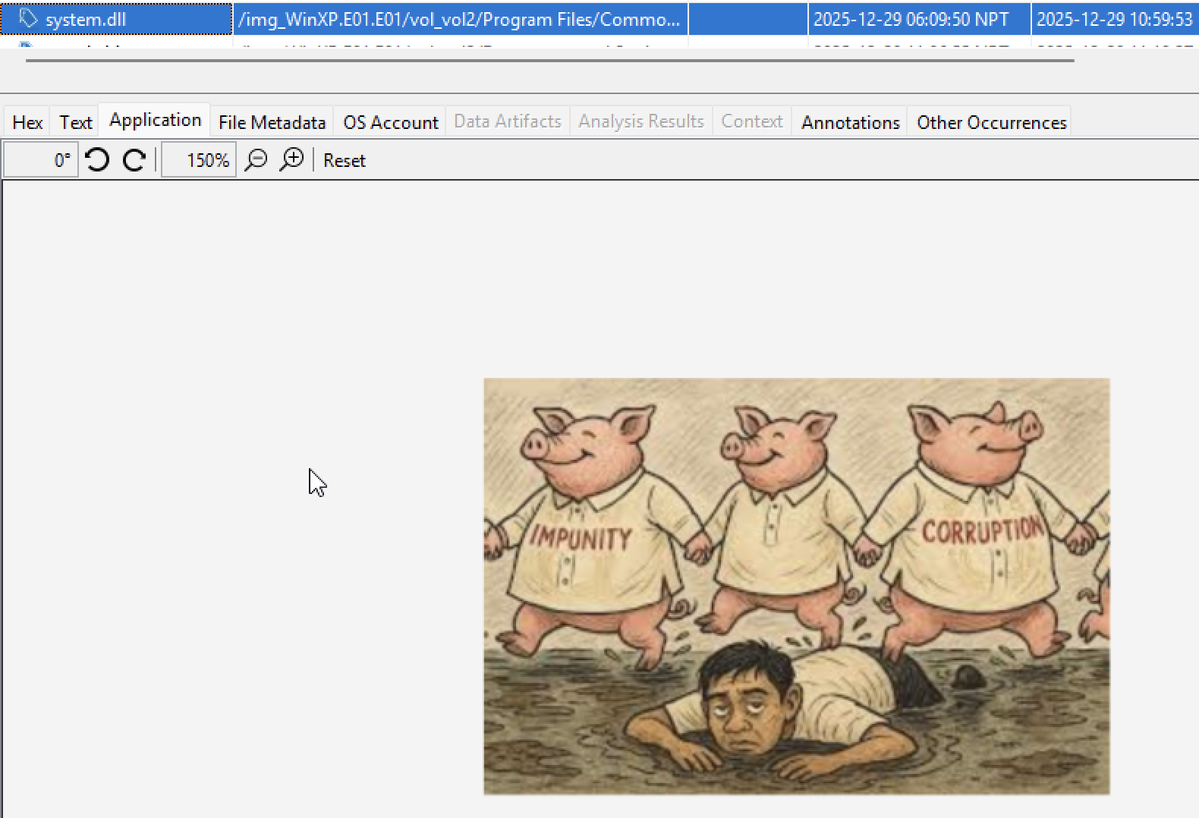
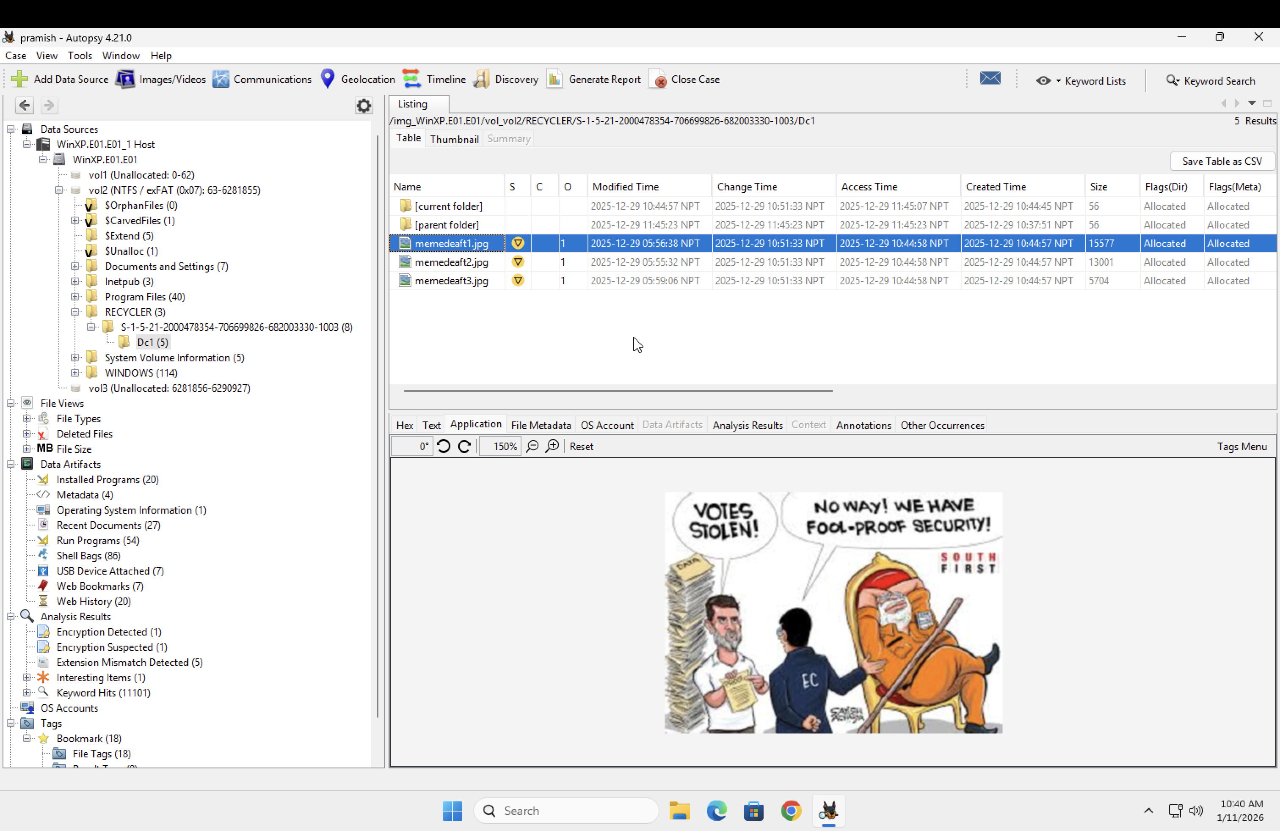
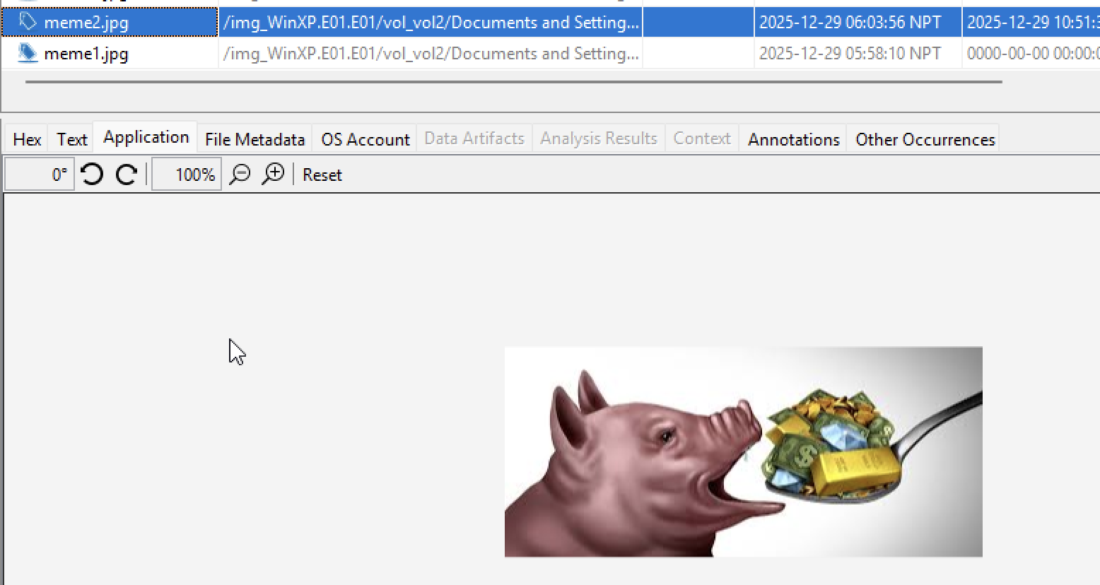
Evidence Theme 2 – Meme Creation
meme2.jpg (active location)
Deleted meme images
system.dll identified as renamed image

Slide 7
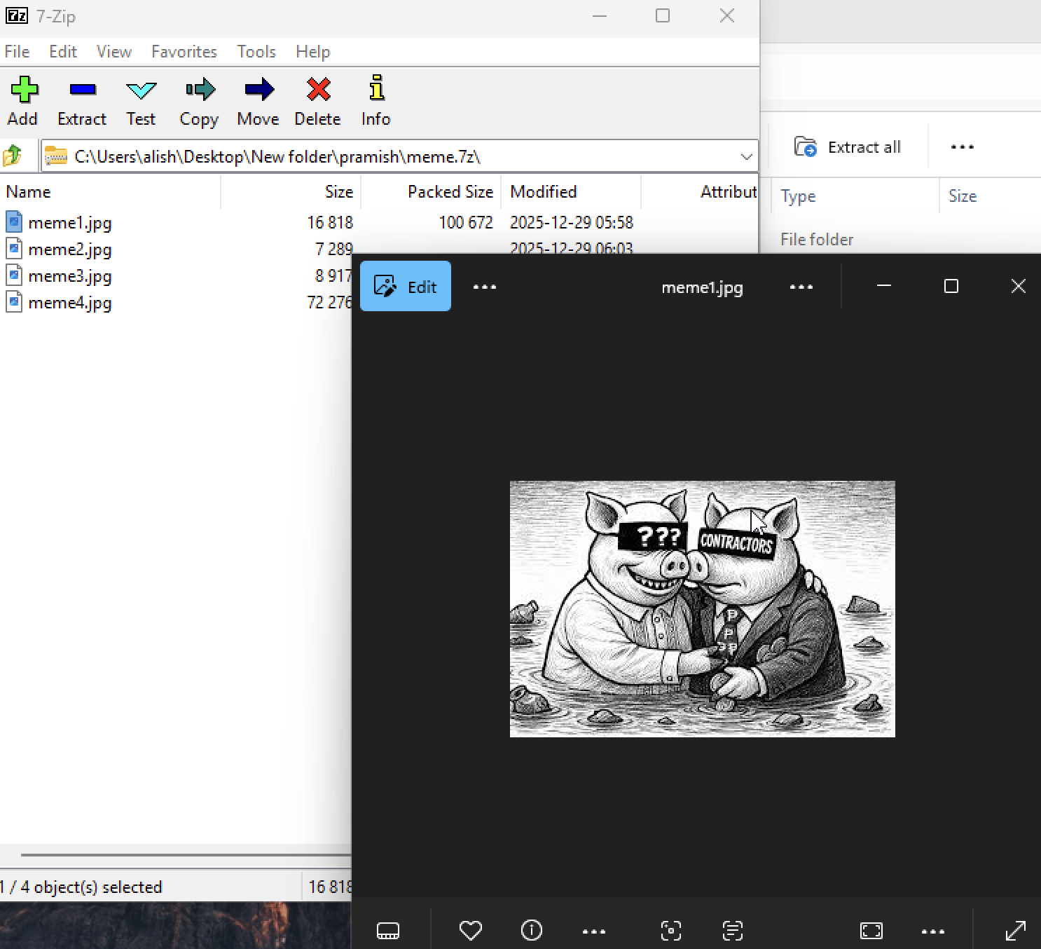
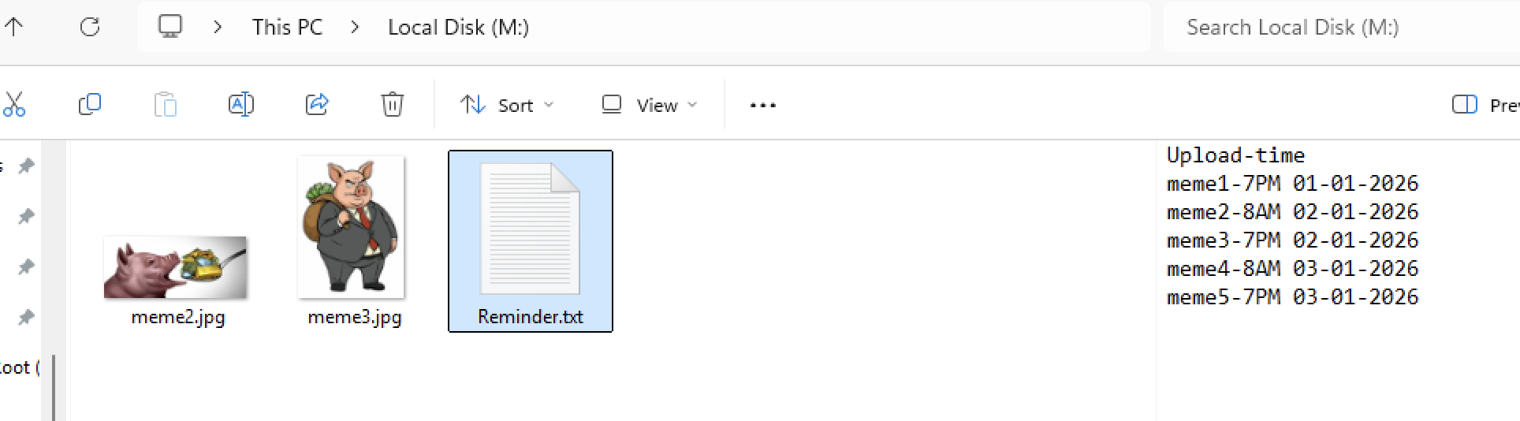
Evidence Theme 3 – Concealment
Encrypted container (fonts.dat)
Password-protected archive (meme.zip)
Scripts and ADS usage

Slide 8
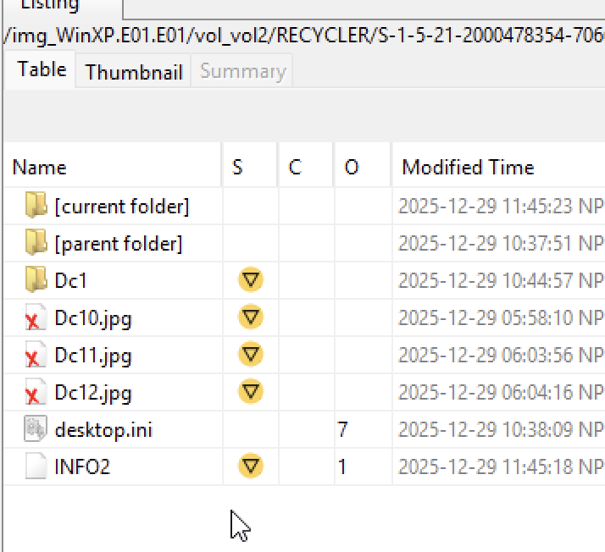
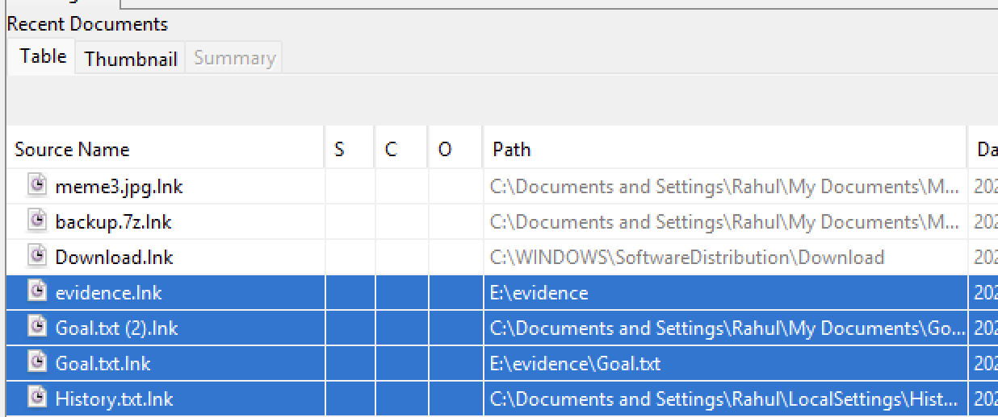
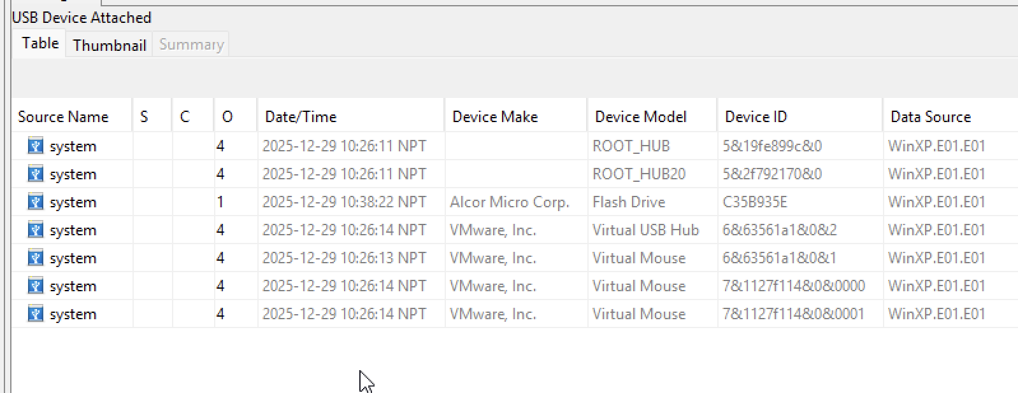
Evidence Theme 4 – Supporting Artefacts
USB activity artefacts
Deleted files
Recycle Bin & unallocated space

Slide 9

Scenario Reconstruction
Planned political defamation
Meme creation
Concealment via encryption
Deletion attempts

Slide 10

Professional Conclusion
Evidence shows deliberate behaviour
Findings are evidence-based
No determination of legal guilt

