Slide 1

Smart Lost & Found
Live cloud workflow
AI-powered campus lost & found platform on AWS
📝
Report item
AWS Cloud Management
🖼️
Upload image
🧠
AI labels
🙋
Claim item
✅
Admin return
Group members: __________________
Notes:
1

Slide 2
The business problem
Manual lost-and-found processes are slow, fragmented, and hard to verify.
⏳
Slow recovery
🔍
Poor identification
🛡️
Weak control
Students do not know where to search
Descriptions are incomplete
No role-based admin workflow
Reports are often paper-based or informal
Images are not searchable
No notifications for new items
No consistent item lifecycle tracking
Hard to verify ownership claims
Limited auditing and monitoring
Target audience: university students, staff, reception/security office, and lost & found administrators.
Notes:
2

Slide 3
The proposed solution
A serverless SaaS-style platform for reporting, claiming, and returning lost items.
User flow
Admin workflow
1
Register / Login
Admin Queue
Cognito authenticates users
Claimed items are collected into a review queue. Admins verify claim details and mark the item as returned.
2
Report item
Submit title, details, priority, location, image
3
AI labeling
Rekognition extracts searchable labels
My Reports
My Claims
4
Claim item
Status Timeline
Toast Notifications
User provides contact and claim reason
Image Preview
Value: faster recovery, stronger verification, searchable AI labels, and clear lifecycle tracking.
Notes:
3

Slide 4
Use cases and roles
The app separates regular users and administrators with Cognito groups.
Actor
Action / use case
User
Register and confirm account
User
Login and report lost or found item
User
Upload image and preview before submit
System
Analyze image and save AI labels
User
Claim an item with contact and reason
Admin
Review claimed items in Admin Queue
Admin
Mark item as returned or delete invalid reports
System
Send notifications and scheduled summaries
Notes:
4

Slide 5
AWS architecture
Serverless backend with secure authentication, storage, AI labeling, notifications, automation, and monitoring.
Cognito
User/Admin Groups
DynamoDB
LostFoundItems
Users
Regular / Admin
Frontend
HTML/CSS/JS
API Gateway
JWT Authorizer
Lambda
Business logic
S3
Private images
Rekognition
DetectLabels
EventBridge
Daily summary
SNS
Email notifications
CloudWatch
Logs + alarms
All protected API requests include: Authorization: Bearer <Cognito JWT>
Notes:
5

Slide 6
AWS services demonstration
Each service has a visible role in the application demo and implementation.
1
Cognito
2
API Gateway
3
Lambda
Register, confirm, login, User/Admin groups
Routes: GET/POST/PUT/DELETE /items
create, get, claim, return, delete, daily summary
4
DynamoDB
5
S3
6
Rekognition
Item records, statuses, reports, claims
Private item image storage and pre-signed URLs
Detect labels from uploaded images
7
SNS
8
CloudWatch
9
EventBridge
New item and summary email notifications
Logs, metrics, alarm for Lambda errors
Scheduled trigger for summary Lambda
Mandatory services: DynamoDB, S3, Lambda, API Gateway, IAM • Optional services: Cognito, Rekognition, SNS, CloudWatch, EventBridge
Notes:
6

Slide 7
Security and bonus capabilities
The project goes beyond CRUD with role enforcement, monitoring, automation, and advanced data security.
Advanced data security
CloudWatch monitoring
EventBridge automation
Cognito authentication
Monitors Lambda logs, errors, and alarms for operational visibility.
Scheduled rule triggers sendDailySummary Lambda automatically.
API Gateway JWT Authorizer
Cognito Groups: User / Admin
Rule
Lambda
SNS
Errors ≥ threshold
→ SNS alert
Backend Lambda checks Admin group
Private S3 + pre-signed URLs
Least-privilege IAM roles
Official bonus categories covered: Advanced CloudWatch Monitoring • EventBridge • Advanced Data Security
Notes:
7

Slide 8
Project challenges
Key technical problems we solved during implementation.
1
CORS and browser preflight
Configured API Gateway CORS for GET, POST, PUT, DELETE, OPTIONS and authorization header.
2
S3 image access denied
Moved from direct S3 links to private objects with Lambda-generated pre-signed URLs.
3
Cognito 401 Unauthorized
Aligned JWT authorizer issuer/audience and sent Authorization: Bearer <idToken>.
4
Admin-only actions
Added frontend role-based UI and backend group validation in Lambda.
5
UI workflow complexity
Split the app into landing, auth, and dashboard pages with modals and toasts.
Main lesson: AWS cloud apps require code + IAM + API configuration + security to work together.
Notes:
8

Slide 9
Results and lessons learned
The final system is an end-to-end AWS serverless application with a real workflow.
Sample
AWS
Roles
Bonus
API
8
Sample Items
5+
AWS Services
2
Roles
3
Bonus Areas
4
API Routes
Delivered features
Lessons learned
Authentication, User/Admin roles
Serverless integration is powerful but configuration-heavy
Item reporting with image upload
Least privilege IAM prevents overexposure
AI labels, search, filters, status timeline
Cognito groups should be enforced in backend, not only UI
My Reports, My Claims, Admin Queue
Monitoring and automation make apps production-like
Notes:
9

Slide 10
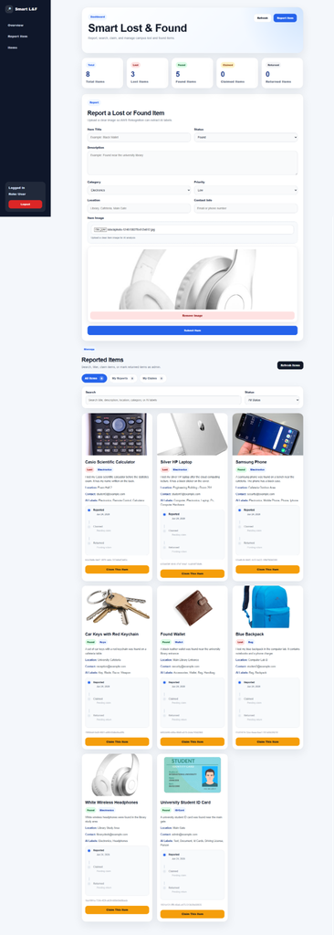
Live demo — User workflow
Show the regular user path: sign in, report item, browse, and claim.
Demo workflow
1
Open landing page and go to auth page
2
Login as regular User
3
Add a found item with image preview
4
Show AI labels and item card
5
Use search and filters
6
Submit claim request with modal
7
Open My Claims and show status timeline
Notes:
10

Slide 11
Live demo — Admin workflow
Show role-based control and backend security.
1
Claimed item
2
Admin Queue
3
Mark returned
4
Timeline updated
User submitted claim
Admin reviews details
Admin confirms action
ReturnedAt is stored
Admin credentials
Security proof
Login using a user assigned to the Cognito Admin group. Confirm that Admin Queue and Delete/Return actions appear only for Admin.
Backend Lambda checks cognito:groups. If a normal user calls the admin endpoint manually, Lambda returns 403 Forbidden.
Notes:
11

Slide 12
Application
AWS Console
Bonus Evidence
Landing, Auth, Dashboard, Claim Modal, Admin Queue, Timeline
DynamoDB, S3, Lambda, API Gateway, IAM, Cognito, SNS
CloudWatch Alarm/Logs, EventBridge Rule, S3 private/pre-signed URLs
Thank you — Questions?
Notes:
12

