Slide 1

CS21003 Algorithms I Project Segmented Least Squares Problem
Alisha Parvez (19EC30057) Anik Mandal (19EC30052)

Slide 2
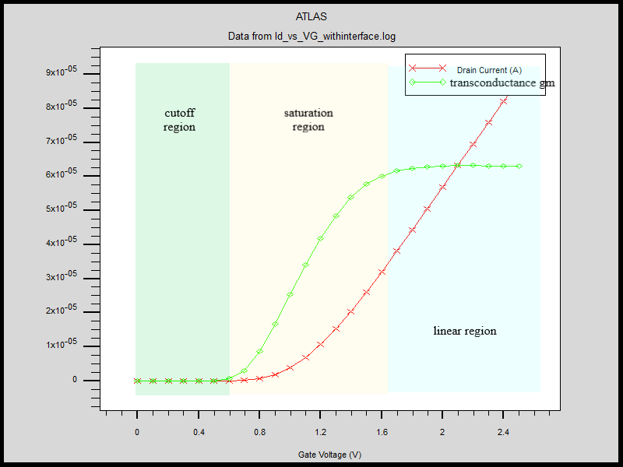
Motivation
Often while observing graphs in electronics and other disciplines, we find that various sections of the graph have different ‘behavior’. We often find that there exist certain points of change e.g. threshold voltages, saturation points, etc. where the device switches from one mode of operation to another.
The simplest version of this problem is to try and fit a number of straight lines through a given set of data points. This problem is known as the Segmented Least Squares problem and is the one we have attempted to solve in this presentation.
The transconductance and drain current of a MOSFET clearly show points of change. The transconductance can be approximated as 3 linear sections

Slide 3
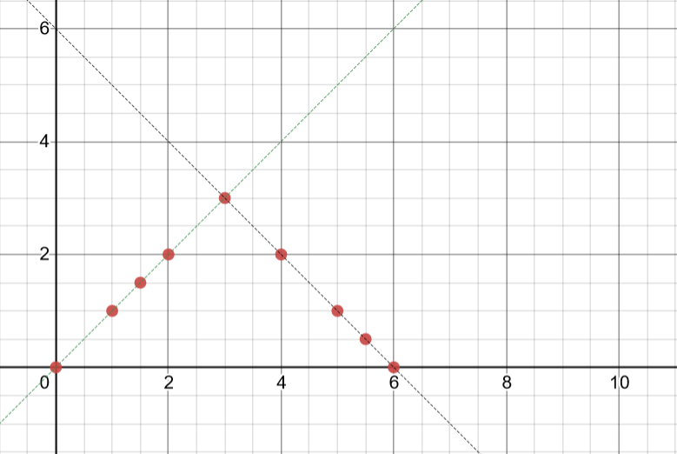
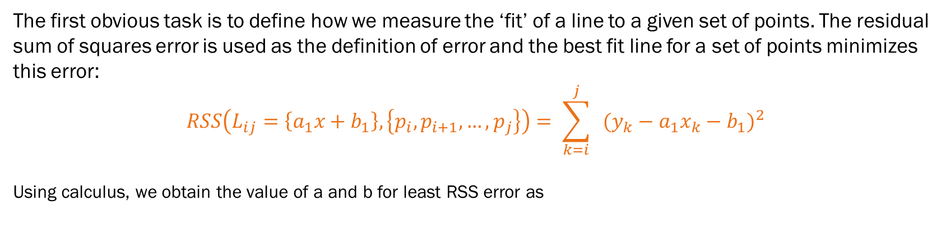
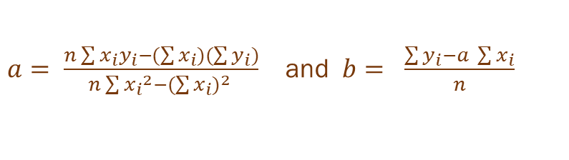
The first obvious task is to define how we measure the ‘fit’ of a line to a given set of points. The residual sum of squares error is used as the definition of error and the best fit line for a set of points minimizes this error:
$$RSS\left(L_{ij}=\left\{a_{1}x+b_{1}\right\}, \left\{p_{i},p_{i+1},…,p_{j}\right\}\right)= \sum_{k=i}^{j}{{ (y_{k}−a_{1}x_{k}−b_{1})}^{2}}$$
Using calculus, we obtain the value of a and b for least RSS error as
$a= \frac{n\sum{x_{i}y_{i}−(\sum{x_{i}})(\sum{y_{i}})}}{n\sum{{x_{i}}^{2}−{(\sum{x_{i}})}^{2} }}$ and $b= \frac{\sum{y_{i}−a \sum{x_{i}}}}{n}$
Example:
In the following figure, it is obvious that the given points lie on approximately two straight lines. Any one line would give a horrible error. However, there is a need for a penalty on each new line that we add. Otherwise, the trivial solution would be to pass n lines through the n points.
Thus, apart from the Residual Sum of Squares to see how well a line ‘fits’ a certain set of points, there also needs to be a penalty c (which the user enters) as a cost for adding one line.

Slide 4
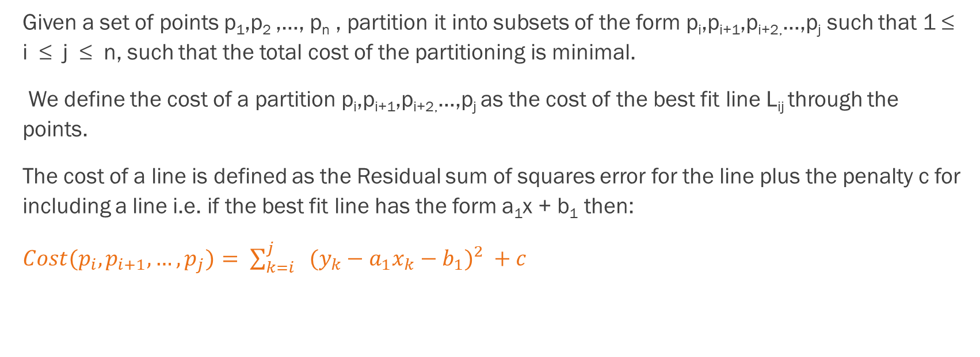
Formal Problem Definition
Given a set of points p₁,p₂ ,…, p_{n} , partition it into subsets of the form p_{i},p_{i+1},p_{i+2,}…,p_{j} such that 1 ≤ i ≤ j ≤ n, such that the total cost of the partitioning is minimal.
We define the cost of a partition p_{i},p_{i+1},p_{i+2,}…,p_{j} as the cost of the best fit line L_{ij} through the points.
The cost of a line is defined as the Residual sum of squares error for the line plus the penalty c for including a line i.e. if the best fit line has the form a₁x + b₁ then:
$Cost(p_{i},p_{i+1},…,p_{j})= \sum_{k=i}^{j}{{ (y_{k}−a_{1}x_{k}−b_{1})}^{2}} +c$

Slide 5
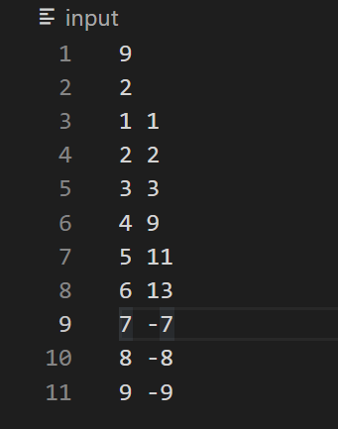
Input
The first line of the input contains the number of points, n. The second line of the input contains the penalty c for each line.
The following n lines contain the coordinates of the n points in the form x_{i} y_{i} in arbitrary order

Slide 6
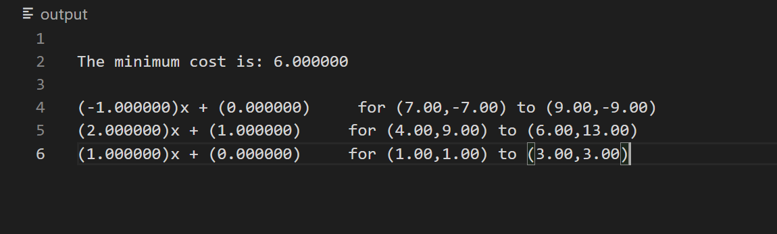
Output
The output contains the minimum cost for the partition followed by the lines in ax+b form along with the respective partition, in decreasing order of x-coordinates for the partitions.

Slide 7
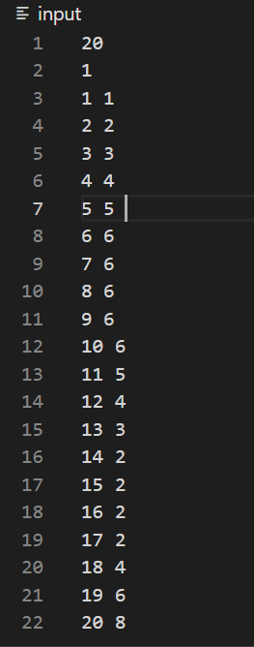
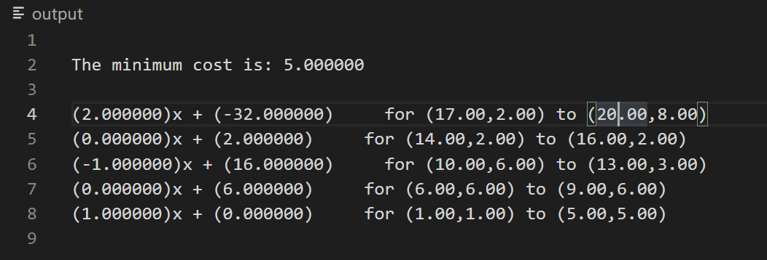
Sample input and output for c=1

Slide 8
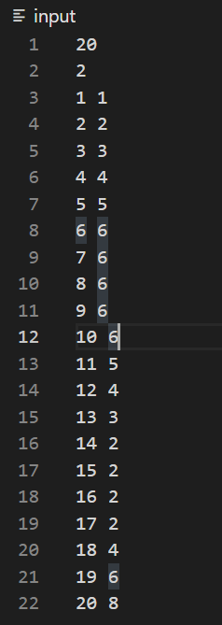
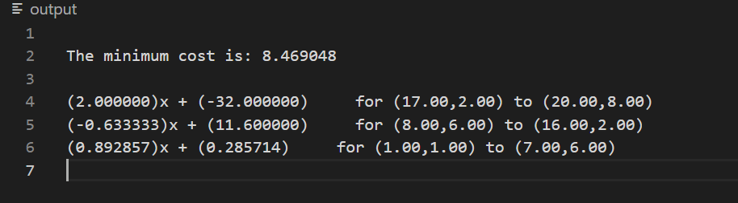
Sample input and output for c=2

Slide 9
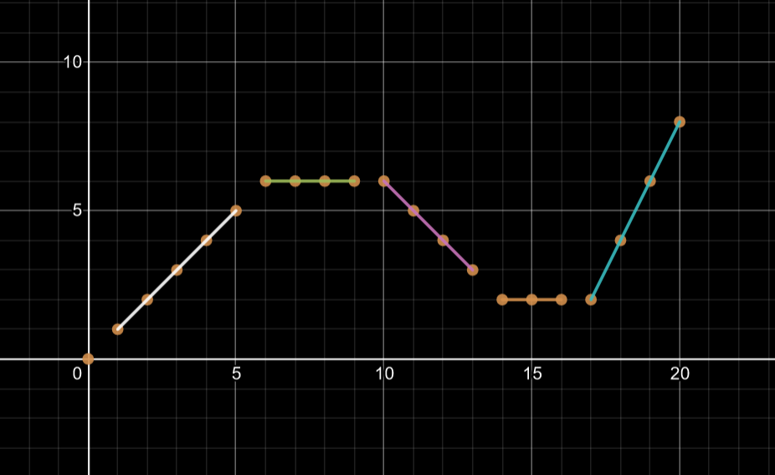
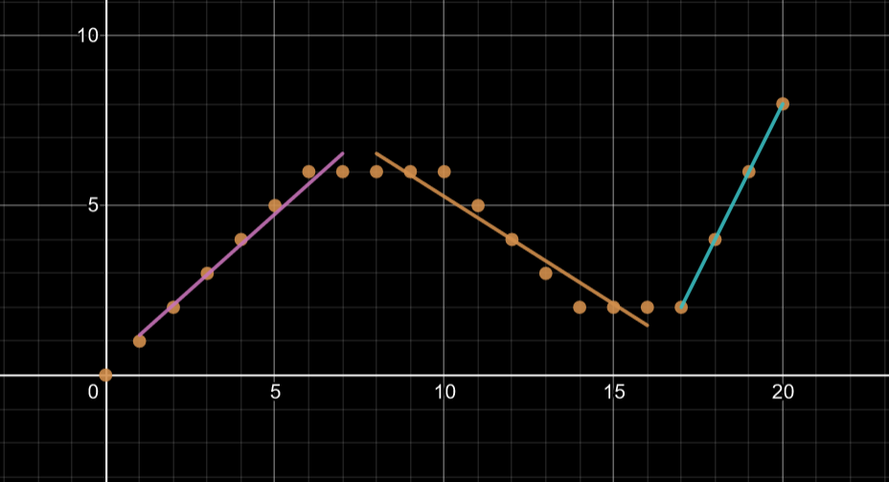
Output shown in terms of graphs for clarity:
Output for c= 1
Output for c= 2

Slide 10
Pseudocode
find_error_matrix(P = {p₁ ,p₂ ,…, p_{n}})
{
for i = 1 to n:
{
for j = i to n:
{
L_{ij} = line through points p_{i}, p_{i+1},..., p_{j}
e_{ij} = RSS error for line L_{ij} , points p_{i}, p_{i+1},...p_{j}
}
}
return e_{ij}
}

Slide 11
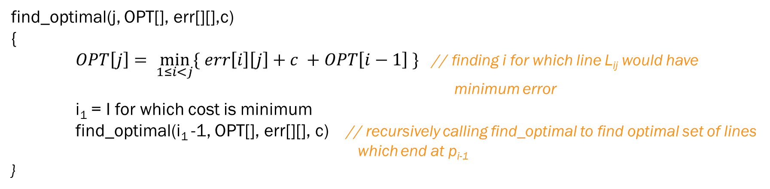
Pseudocode for the function which finds minimum cost subsets:
find_optimal(j, OPT[], err[][],c)
{
$OPT\left[j\right]= \min_{1≤i<j}{\{ err\left[i\right]\left[j\right]+c +OPT\left[i−1\right] \}}$ // finding i for which line L_{ij} would have minimum error
i₁ = I for which cost is minimum
find_optimal(i₁ -1, OPT[], err[][], c) // recursively calling find_optimal to find optimal set of lines which end at p_{i-1}
}

Slide 12
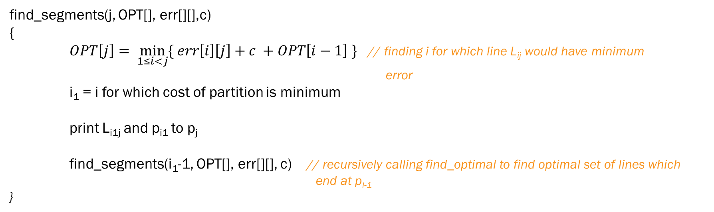
Pseudocode for the function which finds minimum cost subsets:
find_segments(j, OPT[], err[][],c)
{
$OPT\left[j\right]= \min_{1≤i<j}{\{ err\left[i\right]\left[j\right]+c +OPT\left[i−1\right] \}}$ // finding i for which line L_{ij} would have minimum error
i₁ = i for which cost of partition is minimum
print L_{i1j} and p_{i1} to p_{j}
find_segments(i₁-1, OPT[], err[][], c) // recursively calling find_optimal to find optimal set of lines which end at p_{i-1}
}

Slide 13
Time Complexity Analysis
Detailed time complexity analysis:
input() – accepts all points in (x,y) pairs and stores all cumulative sums in O(n) time
find_line() – accepts a set of points and cum_sum[][] and returns best fit line in O(1) time
error() – accepts a set of points and a line and returns the RSS error in O(n) time
merge() and sort() – sort accepts a set of points and sorts them acc to x coordinates in O(n log n) time
find_error_matrix() – finds RSS error for all possible L_{ij} 1 ≤ i ≤ j ≤ n
loop for all (i,j) pairs is a doubly nested loop
each iteration calls find_line() [ O(1) ] and error [ O(n) ]
Overall time complexity = O(n³)

Slide 14
find_optimal() – the algorithm finds the value of OPT[] for n values. For each of these values, it has a loop which runs in O(n) time. Once the value of OPT[i] is stored, it is reused in the other loops which need it. Thus. the overall time complexity is O(n²)
find_segments() – the algorithm finds the segment values for at most n values. For each of these n values, it has a loop which runs in O(n) time [the loop accesses OPT in O(1) time] . For each segment, it also finds the line in O(1) time. Thus, the overall time complexity is O(n²)
Thus, the overall time complexity of the program is O(n³)
The most time consuming part of the program or, the bottleneck is finding the error matrix

Slide 15
Space Complexity Analysis
point_list – An array of points stored as an array of structures O(n)
cum_sum – A 2d array storing the cumulative sums x,y, xy and x² of dimension 4*n so O(n)
error matrix err – A 2d array of n rows and n columns which stores the error for the best fit line for the points p_{i},p_{i+1},…, p_{j} for every 1 ≤ i ≤ j ≤ n so O(n²)
optimal OPT – A 1d array of size n which stores the optimal i.e. least cost for points upto n so O(n)
Thus, the overall space complexity of the program is O(n²)
The most space consuming part of the program is storing the error matrix

Slide 16
Implementation
Structures used to store point and line:
typedef struct line_struct{
//form of line: ax + b
double a;
double b;
} Line;
typedef struct pt{
double x;
double y;
} Point;

Slide 17
Primary Functions which implement the pseudocode
Functions which find and store the error for each subset of points p_{i} to p_{j}, find the minimum cost subsets and find and print the minimum cost lines

Slide 18
Function which finds the error matrix i.e. the error for all possible L_{ij} 1 ≤ i ≤ j ≤ n:
double **find_error_matrix(Point *point_list, double *cum_sum[], int n)
{
double **err = (double **)malloc((n+1)*sizeof(double *));
for (int i=1; i<=n; i++)
err[i] = (double *)malloc((n+1) * sizeof(double));
Line temp;
for(int i = 1; i<= n; i++)
{
for(int j=i; j<=n;j++)
{
if(i==j)
{
err[i][j] = 0;
continue;
}
temp = find_line(point_list, i,j,cum_sum);
err[i][j] = error(point_list, i,j,temp.a,temp.b);
}
}
return err;
}

Slide 19
Function which finds the minimum cost segment which ends at j and recursively calls itself to find the next segment and line:
void find_optimal(int j, double **err, double OPT[], double c)
{
if(j == 0)
{
OPT[0] = 0;
return;
}
int min_i = 1;
double min_cost = err[1][j] + c + OPT[0];
double temp;
for(int i=2;i<=j;i++)
{
if(OPT[i-1] == -1) find_optimal(i-1,err,OPT,c);
temp = err[i][j] + c + OPT[i-1];
if(temp < min_cost)
{
min_cost = temp;
min_i = i;
}
}
OPT[j] = min_cost;
}

Slide 20
Function which uses the OPT matrix to identify the points of change and prints out all the minimum cost lines along with their respective subsets of points:
void find_segments(int j, Point *point_list, double *cum_sum[], double **err, double OPT[], double c)
{
if(j == 0)
return;
int min_i = 1;
double min_cost = err[1][j] + c + OPT[0];
double temp;
for(int i=2;i<j;i++)
{
temp = err[i][j] + c + OPT[i-1];
if(temp < min_cost)
{
min_cost = temp;
min_i = i;
}
}
Line l = find_line(point_list,min_i,j,cum_sum);
if(!isnan(l.a) && !isnan(l.b))
printf("(%lf)x + (%lf) for (%.2lf,%.2lf) to (%.2lf,%.2lf)\n",l.a, l.b, point_list[min_i].x,point_list[min_i].y,point_list[j].x,point_list[j].y );
find_segments(min_i-1, point_list, cum_sum, err, OPT,c);
}

Slide 21
Main function:
int main()
{
int n;
double c;
scanf("%d",&n);
scanf("%lf",&c);
//variable creation
Point *point_list = (Point *)malloc((n+1)*sizeof(Point));
double *cum_sum[5];
for (int i=1; i<=4; i++)
cum_sum[i] = (double *)malloc((n+1) * sizeof(double)); //variable creation ends
input(n, point_list, cum_sum);
sort(point_list, n);
double **err = find_error_matrix(point_list,cum_sum,n);
double *OPT = (double *)malloc((n+1)*sizeof(double));
OPT[0] = 0;
for(int i=1; i<= n; i++) OPT[i] = -1;
find_optimal(n, err, OPT,c);
printf("\nThe minimum cost is: %lf\n\n", OPT[n]);
find_segments(n,point_list,cum_sum,err, OPT,c);
free(point_list);
free(OPT);
free(err);
}

Slide 22
Auxillary Functions
Functions needed to accept input, find the least error line, find the error of a line, etc.

Slide 23
void input(int n, Point *point_list, double *cum_sum[]) //function which accepts input and stores cum_sum
{
for(int i=1;i<=n;i++)
{
scanf("%lf %lf",&point_list[i].x,&point_list[i].y); if(i==0)
{
cum_sum[1][i] = 0;
cum_sum[2][i] = 0;
cum_sum[3][i] = 0;
cum_sum[4][i] = 0;
} if(i==1)
{
cum_sum[1][i] = point_list[i].x;
cum_sum[2][i] = point_list[i].y;
cum_sum[3][i] = (point_list[i].x)*(point_list[i].y);
cum_sum[4][i] = (point_list[i].x)*(point_list[i].x);
}
else
{
cum_sum[1][i] = cum_sum[1][i-1] + point_list[i].x;
cum_sum[2][i] = cum_sum[2][i-1] + point_list[i].y;
cum_sum[3][i] = cum_sum[3][i-1] + (point_list[i].x)*(point_list[i].y);
cum_sum[4][i] = cum_sum[4][i-1] + (point_list[i].x)*(point_list[i].x);
}
}
}

Slide 24
Function to calculate the RSS error, given a line and a set of points:
double error(Point P[],int st,int end,double a,double b) //error function { if(st == end)
return 0;
double error=0.0;
for(int i=st;i<=end;i++)
{
error+=(P[i].y- a*P[i].x - b)*(P[i].y- a*P[i].x - b);
}
return error;
}

Slide 25
Function to find the best fit line through a set of points:
//finds line through p(i,i+1,...,j) O(1)
Line find_line(Point *point_list, int i, int j, double *cum_sum[])
{
Line l;
double num = (j-i+1)*(cum_sum[3][j]-cum_sum[3][i-1]) - (cum_sum[1][j]-cum_sum[1][i-1])*(cum_sum[2][j]-cum_sum[2][i-1]);
double den = (j-i+1)*(cum_sum[4][j]-cum_sum[4][i-1]) - (cum_sum[1][j]-cum_sum[1][i-1])*(cum_sum[1][j]-cum_sum[1][i-1]);
l.a = num/den;
num = (cum_sum[2][j]-cum_sum[2][i-1]) - (l.a)*(cum_sum[1][j]-cum_sum[1][i-1]) ;
l.b = num/(j-i+1);
return l;
}

Slide 26
Function which merges two arrays of points (sorted in increasing order of x coordinates):
//merges two sorted arrays
void merge(Point *l1, Point *l2, Point *final_list, int s1, int s2)
{
int a=1,b=1,c=1;
while(a<=s1 && b<=s2)
{
if(l1[a].x < l2[b].x) // change condition acc to need !!!
final_list[c++] = l1[a++];
else
final_list[c++] = l2[b++];
}
while(a<=s1)
final_list[c++] = l1[a++];
while(b<=s2)
final_list[c++] = l2[b++];
}

Slide 27
Merge sort function to sort an array of points in increasing order of x coordinates:
//sorts an array of points using merge sort
void sort(Point pt_list[], int n)
{
if(n==1)
return;
int s1 = n/2;
Point *l1 = (Point *)malloc((s1+1)*sizeof(Point));
Point *l2 = (Point *)malloc((n-s1+1)*sizeof(Point));
int j=1;
for(int i=1;i<=s1;i++,j++)
l1[i] = pt_list[j];
for(int i=1;i<=n-s1;i++,j++)
l2[i] = pt_list[j];
sort(l1, s1);
sort(l2,n-s1);
merge(l1,l2,pt_list,s1,n-s1);
free(l1);
free(l2);
}

Slide 28
Thank You
~Anik mandal and alisha parvez

