Slide 1
Mega Deals

Slide 2
Name : Sharmin Akter Toma
ID: 011 151 009

Slide 3
About Mega Deals
In today’s era electronics device is like oxygen. People must buy electronics product to cope up with the society.
That’s why my website is about selling the electronics products to customers. User can easily search and buy their daily necessary electronics product.
The purpose of our project is to seek the attention of the users, to buy electronics device with interesting discounts.

Slide 4
Benefits
User can easily improve their knowledge about electronics device using my website.
My website will carry latest and advanced products so that user can know and learn about improvised and new products.

Slide 5
Features:
Logged in and sign up of user and admin
Details products information
Compare between two products to find out which one is good
User can order products to purchase that products.
Some products will carry different type of discounts based on limits.

Slide 6
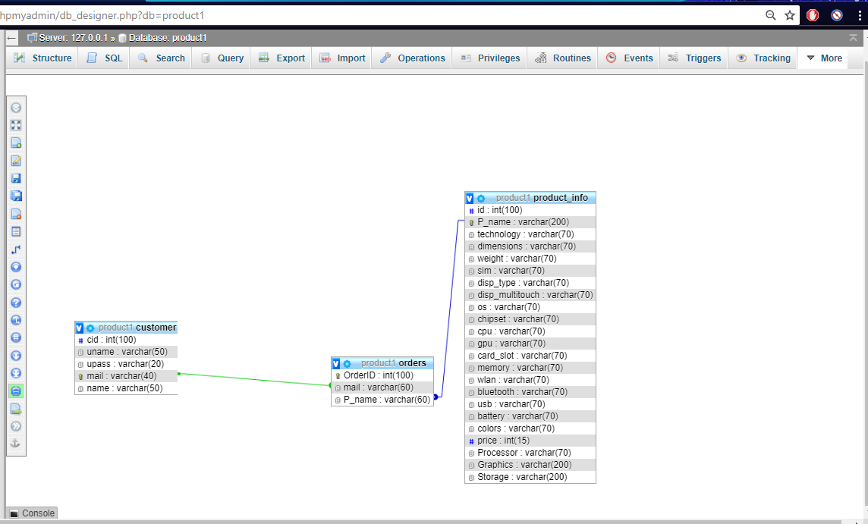

Slide 7


