Slide 1
DNA Replication
An Accessible and Inaccessible Slide Design Demo

Slide 2
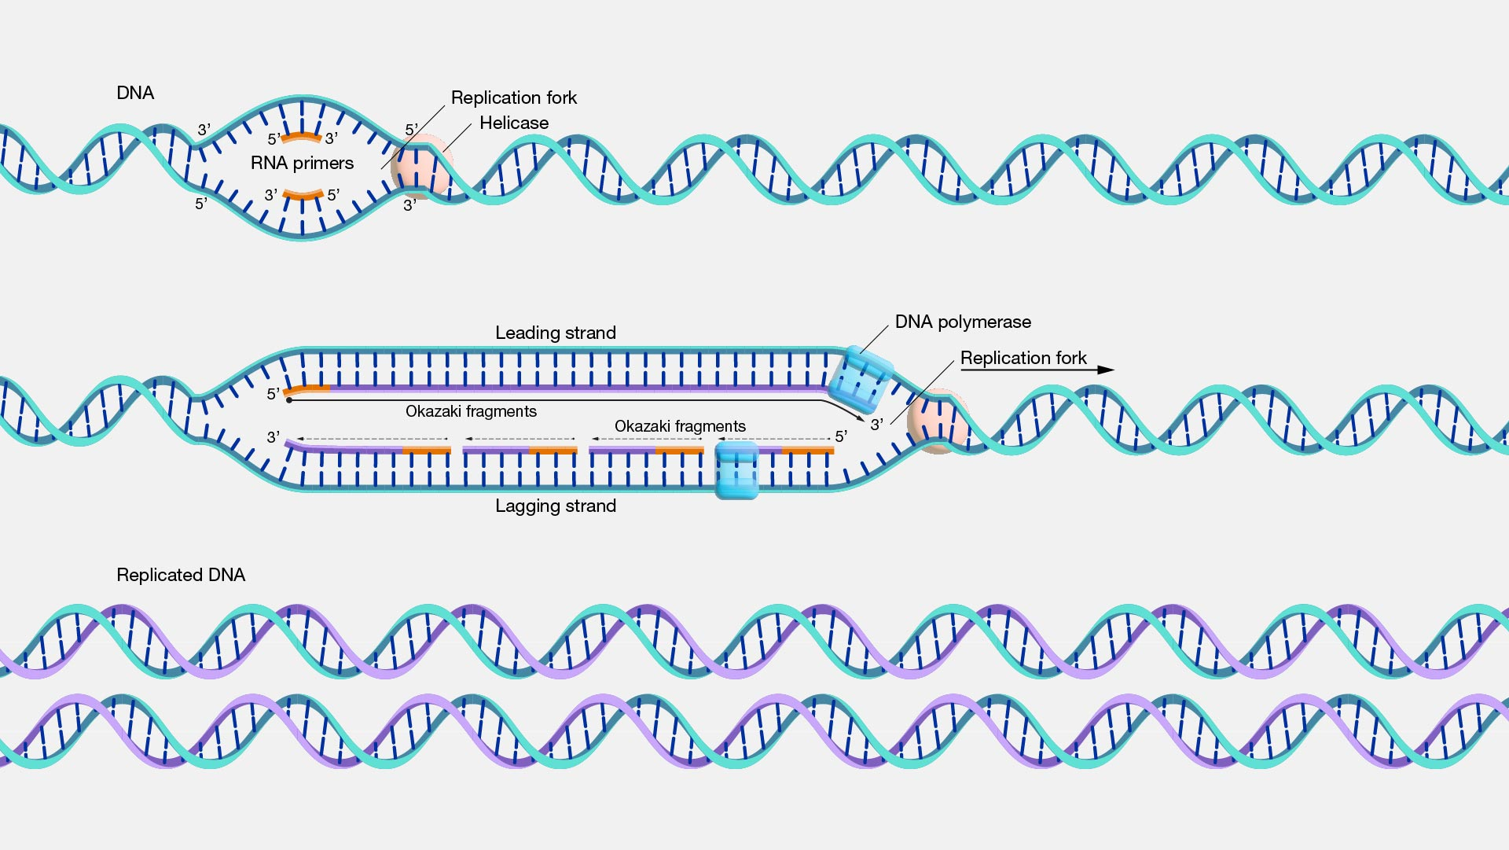
What is DNA Replication?
DNA replication is the process by which a double-stranded DNA molecule is copied to produce two identical DNA molecules.

Slide 3
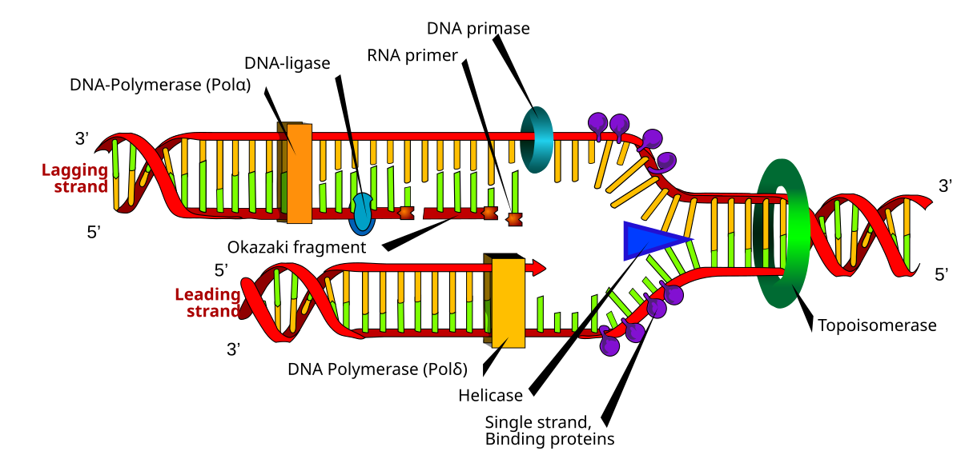
Replication Fork
The replication fork is a structure that forms within the long helical DNA during replication.
White text on white background

Slide 4
E. coli Gene | Enzyme/Protein Function | Description
dnaA | Initiator Protein | Melts DNA at oriC, exposing two template ssDNA strands
dnaB | Helicase | Unwinds the DNA helix at the front end of each replication fork during replication
dnaC | Helicase Loader | Loads the DnaB Helicase onto the ssDNA template strands
dnaG | Primase | Synthesizes RNA primers used to initiate DNA synthesis
dnaE | α-Catalytic Subunit of DNA Polymerase III | Catalytic subunit of the main replicative polymerase during DNA replication
dnaQ | ε-Editing Subunit of DNA Polymerase III | Editing subunit of the main replicative polymerase during DNA replication
dnaN | β-Clamp Subunit of DNA Polymerase III | Clamping subunit of the main replicative polymerase during DNA replication
polA | DNA Polymerase I | Processes Okazaki fragments and fills in gaps during DNA repair
polB | DNA Polymerase II | Proofreading and editing, especially on lagging strand synthesis and some involvement in DNA repair
ssb | Single-Stranded Binding Proteins (SSB) | Bind to single-stranded DNA in the replication fork and prevent rejoining
gyrA & gyrB | DNA Gyrase | Type II Topoisomerase that relieves positive supercoiling caused by Helicase
parC & parE | Topoisomerase IV | Type II Topoisomerase involved in decatenation of daughter chromosomes
ligA | DNA Ligase | Fixes nicks in the DNA backbone during replication and repair
Click here

Slide 5
It uses a decorative font and lacks spacing. The elucidation of the structure of the double helix by James Watson and Francis Crick in 1953 provided a hint as to how DNA is copied during the process of DNA replication. Separating the strands of the double helix would provide two templates for the synthesis of new complementary strands, but exactly how new DNA molecules were constructed was still unclear. In one model, semiconservative replication, the two strands of the double helix separate during DNA replication, and each strand serves as a template from which the new complementary strand is copied. After replication in this model, each double-stranded DNA includes one parental or “old” strand and one daughter or “new” strand. This slide contains too much text in a single textbox without structure or headings.

