Slide 1
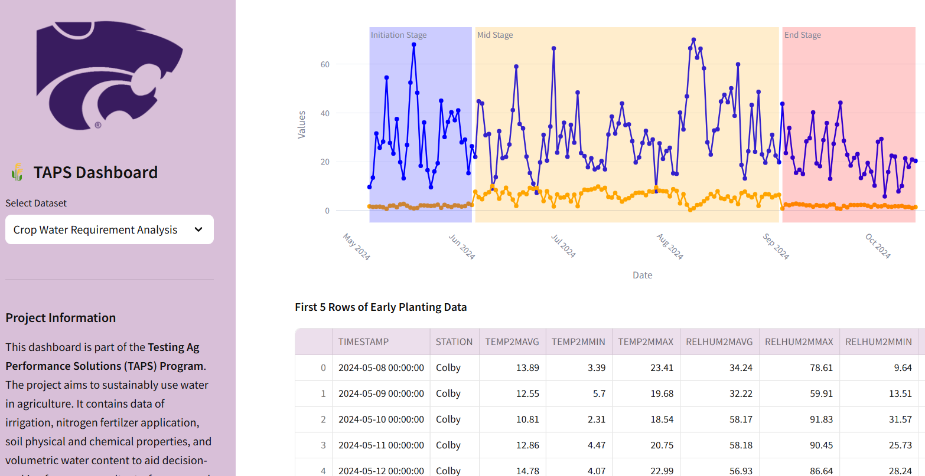
SustainAqua Solutions
WildCat Hackathon 2024
Harsimran Singh Sodhi
(Geography and Geospatial Sciences)
Muhammad Ali Shafique
(Electrical and Computer Engineering)
Kansas State University
Dated: 10/31/2024

Slide 2
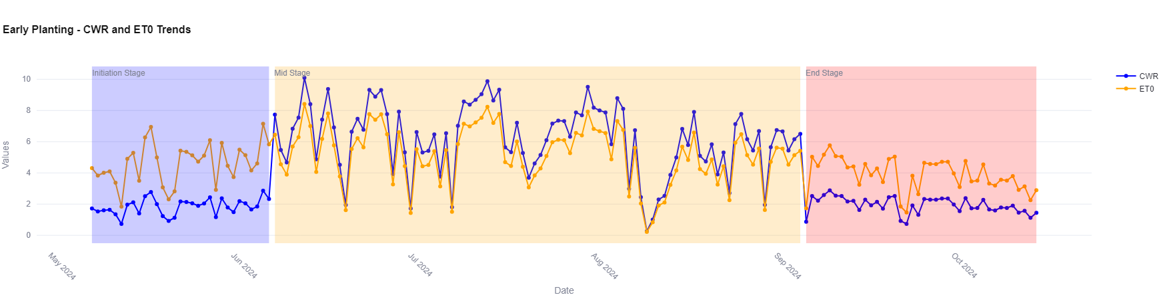
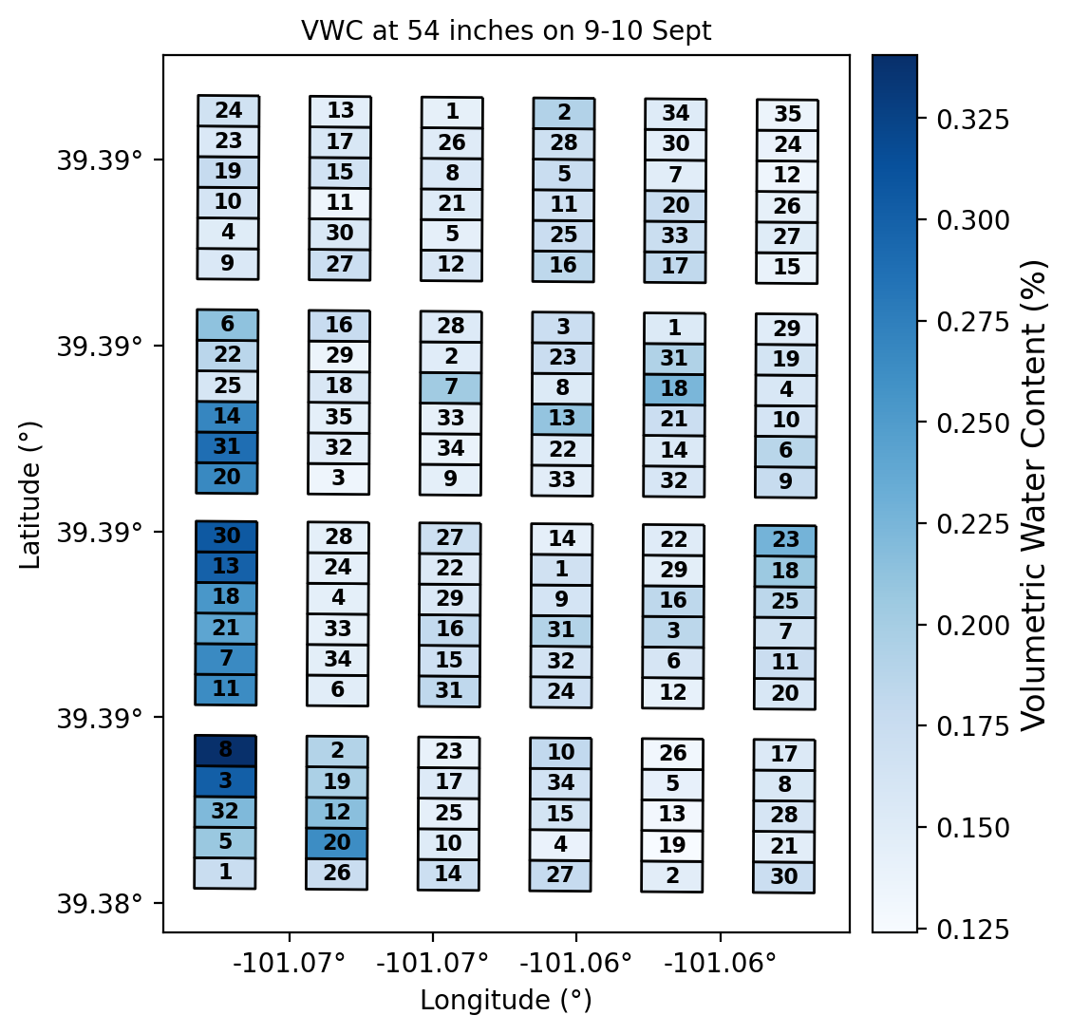
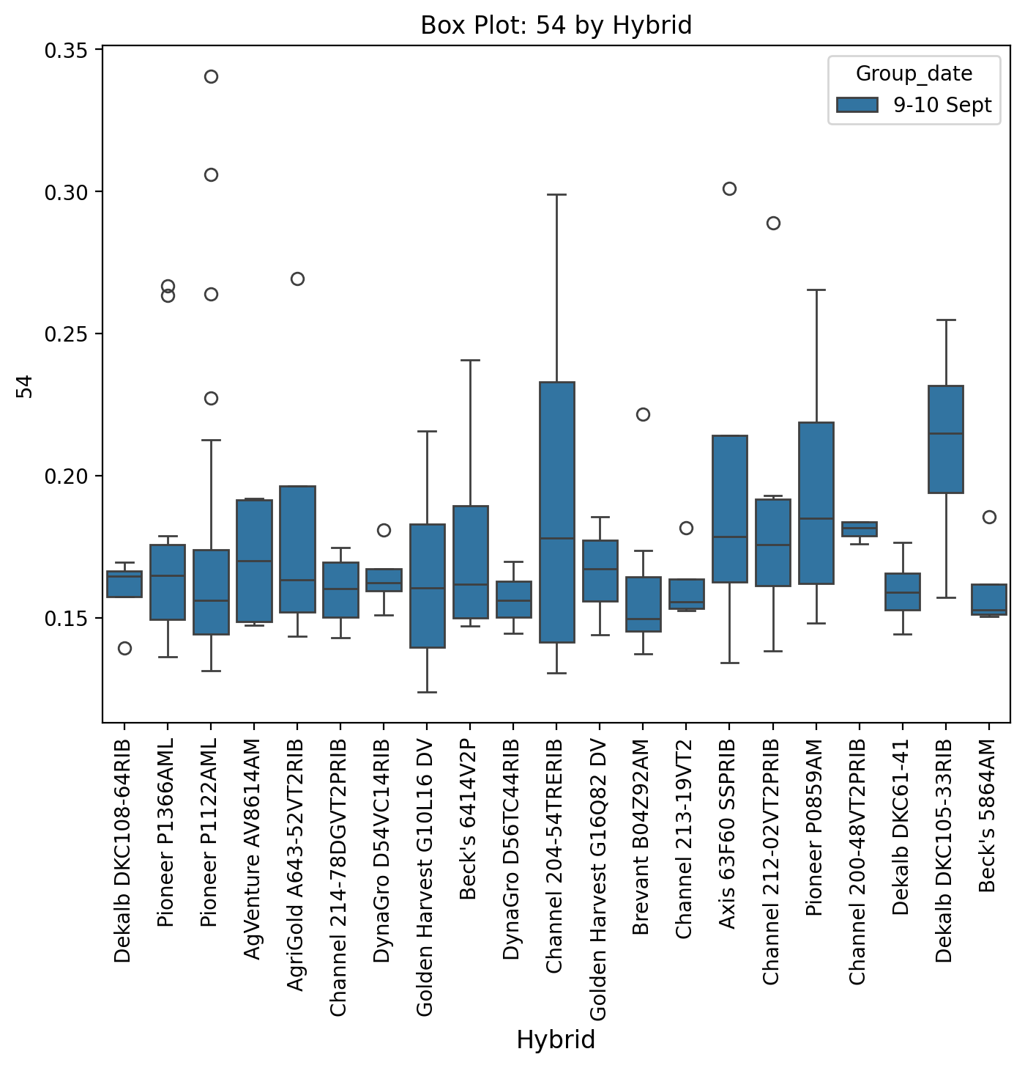
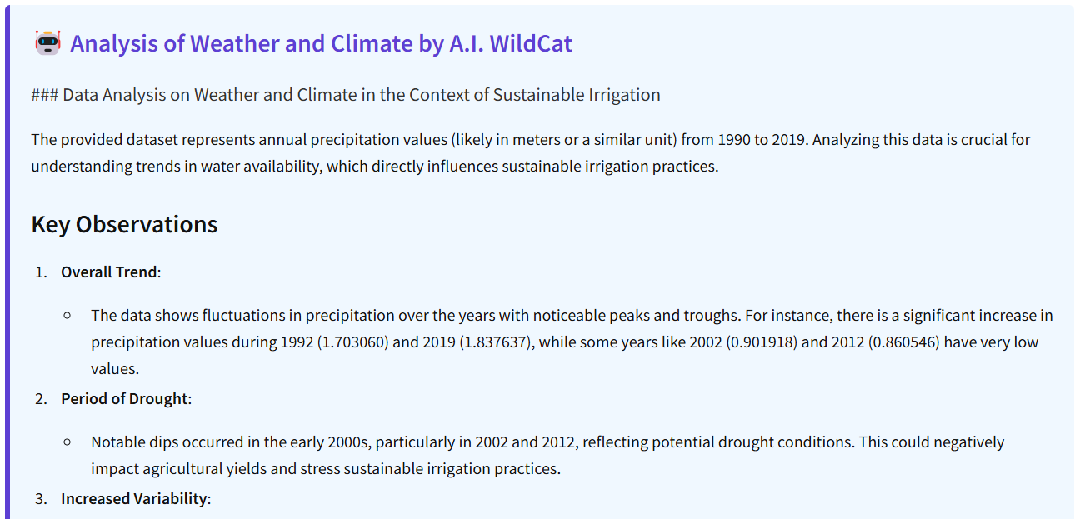

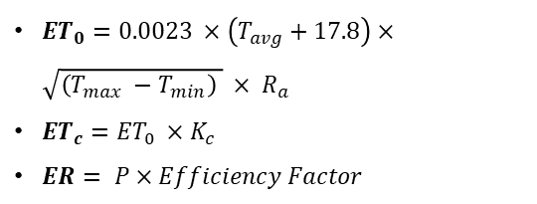
Input Parameters
Dashboard Features and Results
Datasets
Streamlit Parameters
1) Nitrogen Fertilizer: Treatments, Hybrids, Spatial and Box Plots + A.I.
2) Irrigation Applied: Treatments, Hybrids, Spatial and Box Plots + A.I.
3) Electrical Conductivity and pH: Depthwise, Spatial and Box plots + A.I.
4) Volumetric Water Content: Depthwise, Spatial and Box Plots + A.I.
5) Weather and Climate: Values of Variables like Temperature, Precipitation + A.I.
6) NDVI_Ceres: Spatial and Box Plots in time series + A.I.
7) Crop Water Requirement: Customized Relationship between Variables + A.I.
Methods and Calculations
${ET}_{0}=0.0023 ×\left(T_{avg}+17.8\right)×\sqrt{\left(T_{max} −T_{min}\right) } × R_{a}$
${ET}_{c}={ET}_{0} ×K_{c}$
$ER= P×Efficiency Factor$
1) Ceres Image
2) Climate and Weather
3) Electrical Conductivity
4) TAPS management
5) Neutron Probe dataset
6) Plot boundaries
1) Nitrogen Fertilizer: datewise
2) Irrigation Applied: datewise
3) Electrical Conductivity and pH: depth wise
4) Volumetric Water Content: CWR, ER, planting date, ET₀
5) Weather and Climate: Climatic Parameters
6) NDVI_Ceres: datewise
7) Crop Water Requirement Analysis: Datewise, climate dates, Planting and Growth Stage wise
${ET}_{0}$ = Reference Evapotranspiration,
$T_{avg}$ = Average Temperature,
$T_{max}$ = Maximum temperature,
$T_{min}$ = Minimum Temperature,
$R_{a}$ = extraterrestrial Radiation,
${ET}_{c}$ = Crop Evapotranspiration or Crop water requirement,
$ER$ = Effective Rainfall, $P$ = Precipitation
A.I. Wildcat
1) Statistical Analysis: Mean, Maximum, Minimum Values
2) Trend Analysis: Data Analysis using timeseries
3) Expert Opinion: Gives the expert opinion based on the given inputs
Data Preprocessing
1) Data Filtering: dropping rows, Computing Statistics while Ignoring NA
2) Data merging: TRT_ID, Plot_ID, Block_ID wise
3) Feature Engineering: Creating new variables for data analysis
4) Spatial averaging: Taking means for plotting and data analysis
5) Spatial Data enrichment: Adding spatial information to Non-spatial Data

