Slide 1


Pre-Owned Cars Visual Analytics

Slide 2
Contents
Background/Motivation
Problem Statement
Analyzing Questions
Data Description
Tableau Visualizations
Conclusions
Recommendations

Slide 3

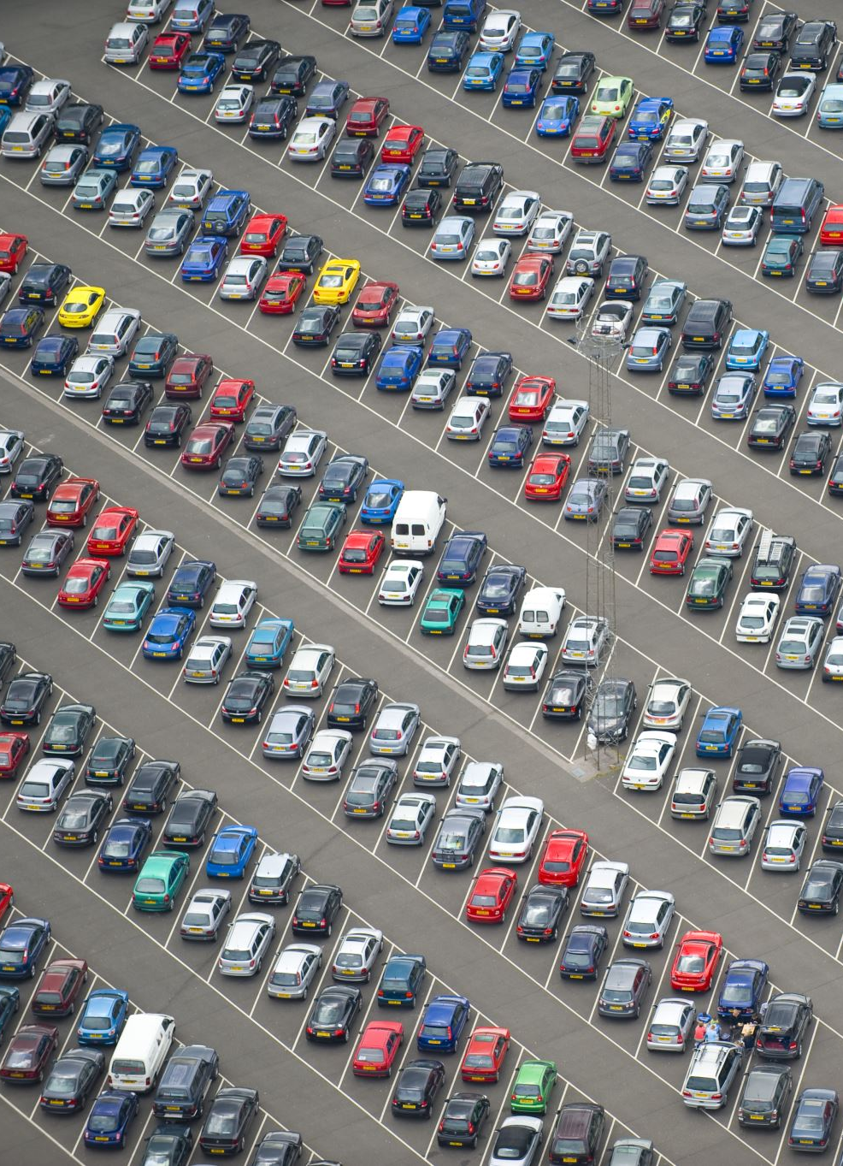




Motivation
The used car market has witnessed tremendous expansion in the previous few years as the price competitiveness among the new players has been one sparkling point in the automobile sector. The difficulty of customers acquiring new automobiles became one of the reasons for the expanding used cars sales volume, which is matched by the investments made by the industry participants to establish their dealership network in the market. These dealership networks aided in market branding and the viability of used car options. The global used car market size was assessed at USD 1.57 trillion in 2021 and is predicted to develop at a compound annual growth rate (CAGR) of 6.1% from 2022 to 2030. The used automobile shipment was recorded at 120.3 million units in 2021.
Sources :
https://www.grandviewresearch.com/industry-analysis/used-car-market
https://www.businesswire.com/news/home/20220527005208/en/Global-Used-Car-Market-2022-to-2030---Size-Share-Trends-Analysis-Report---ResearchAndMarkets.com

Slide 4
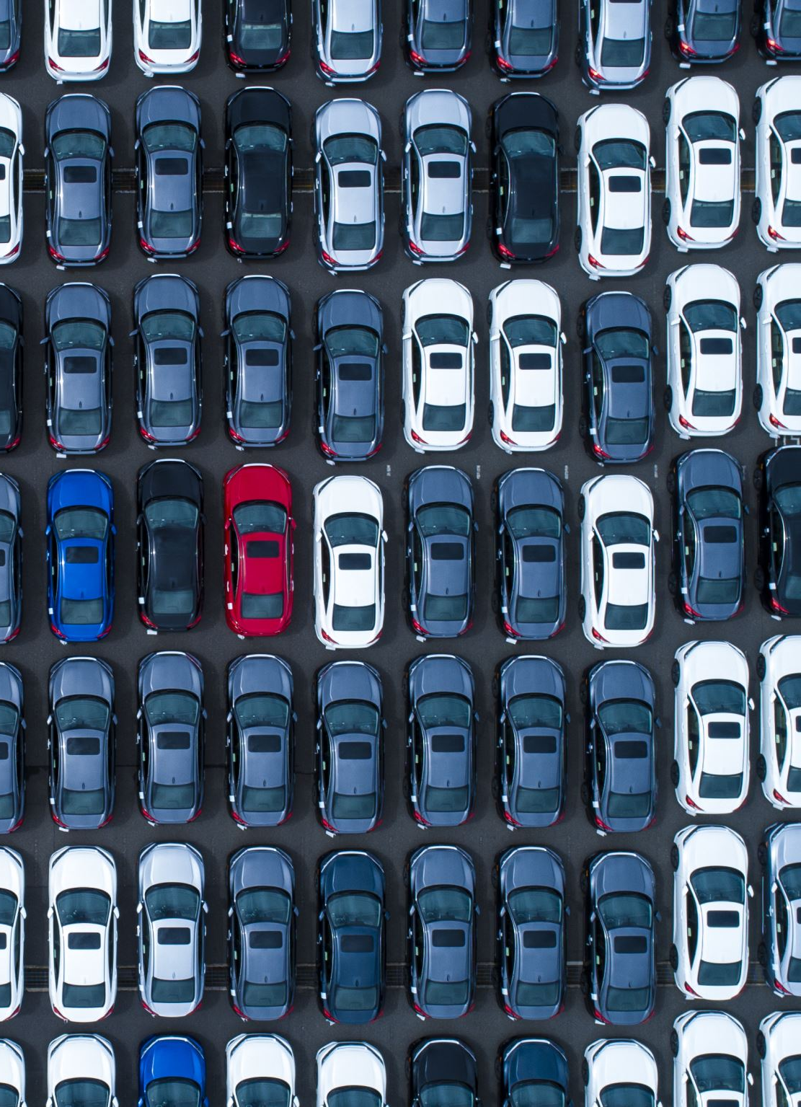
Problem Statement
Our primary target audience is the second-hand car dealers who would profit from our project's EDA. This enables them to accomplish their goal of offering their client the finest deal possible. For this, they need to know the insights into what the car’s likely to resell, which car brand has huge demand and high resell value, and what car specifications a buyer demands the most. This will help the dealer to accomplish their client purchasing goals, expand their business, and have a clear and obvious profit play.

Slide 5
Analysis Questions
Which car brand generates maximum profit when a car is resold?
Which car brand has the highest resell price for used cars?
Which age group is more inclined towards purchasing used cars?
Which is the most profitable brand country-wise (for used cars)?
Which feature is most preferred by the buyers while buying a used car?

Slide 6
Data Description
Dataset Link: https://data.world/vizwiz/car-sales-mock-data
Automobile World
Categorical | Data types
Make | Object
Model | Object
Car Gender | Object
Country | Object
City | Object
Buzzword | Object
Colour | Object
New car | Bool
Purchase Date | Object
Numerical Variables | Data types
Buyer age | int64
Dealer Latitude | float64
Dealer longitude | float64
Top speed | float64
0-60 time | float64
Discount | float64
Sale price | float64
Resale price | float64

Slide 7

Data Cleaning
1. The datatype of Purchase_Date columns was converted from object to Date Time.
2. There are some columns in our data set that could not be used to gain insight that would be beneficial for automobile dealers so few of the columns were removed from the original data set and a new data set was created the columns that were deleted are as follows:
Car Gender
Nickname

Slide 8
Data Transformation
The name of the columns in the original dataset had spaces between them which were replaced by an underscore for ease of coding.
Average Sale and Resell Price was calculated for each maker using a group by and aggregate function and a scatter plot was created with a trend line to observe the relationship between sale and resell price for different car companies.
The Buyer Age column in the original dataset had discrete values which were converted into bins (continuous) so that the bar chart could be plotted to observe which age group is more inclined towards buying cars.

Slide 9

Tableau Visualizations

Slide 10
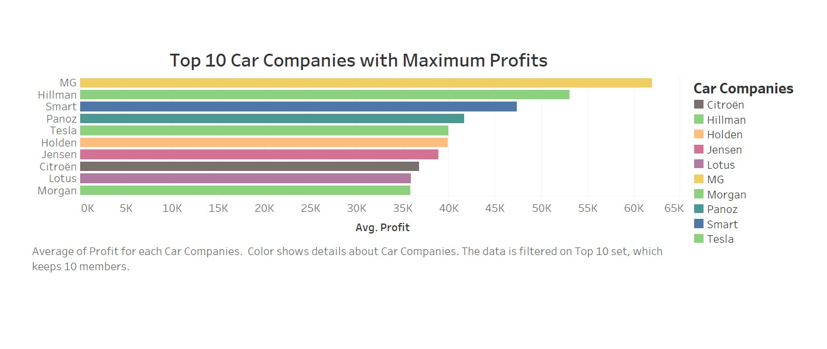
Which car brand generates maximum profit when a car is resold?
The plot here represents the car companies that made the maximum profit when the car of that brand was resold.
MG is the automaker with the highest profit margin for used cars.

Slide 11
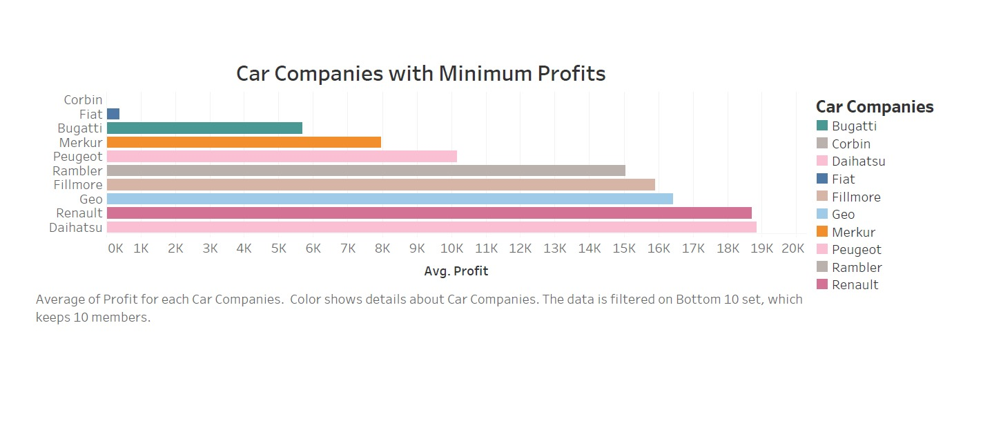
Similarly, we could also see the companies that generated least profit. Corbin is the car brand that hardly made any profit when a car was resold.

Slide 12
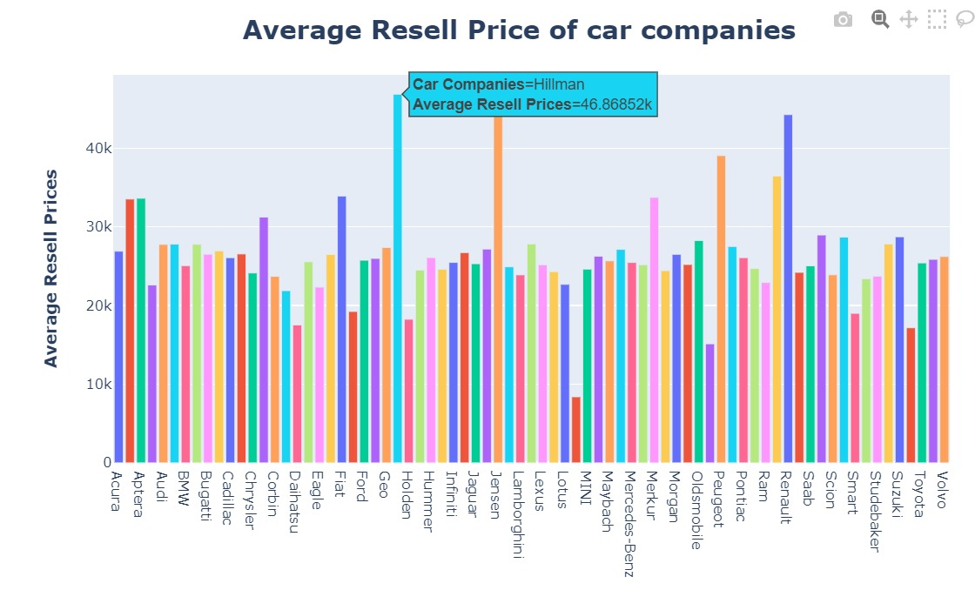
Which car brand has the average highest resell price for used cars?
The bar chart above clearly shows that the Hillman car company has the highest average resell value.

Slide 13
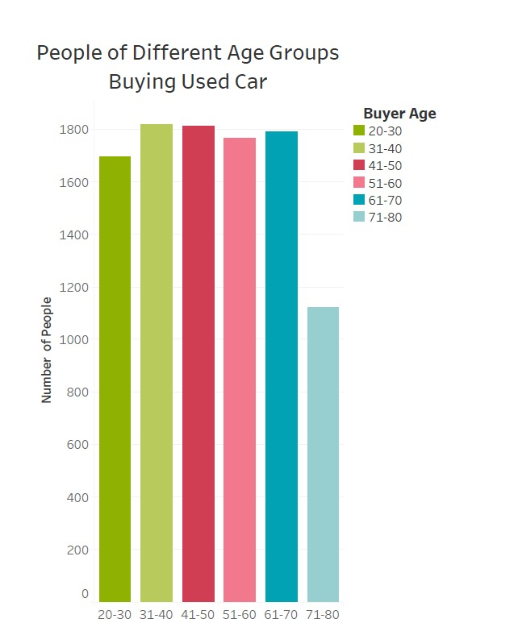
Which age group is more inclined towards purchasing used cars?
The age group which is more inclined towards buying used cars is 31-40, leading the age group 41-50 by a very small margin while the people between the age group 71-80 have the least interest in buying a used car.

Slide 14
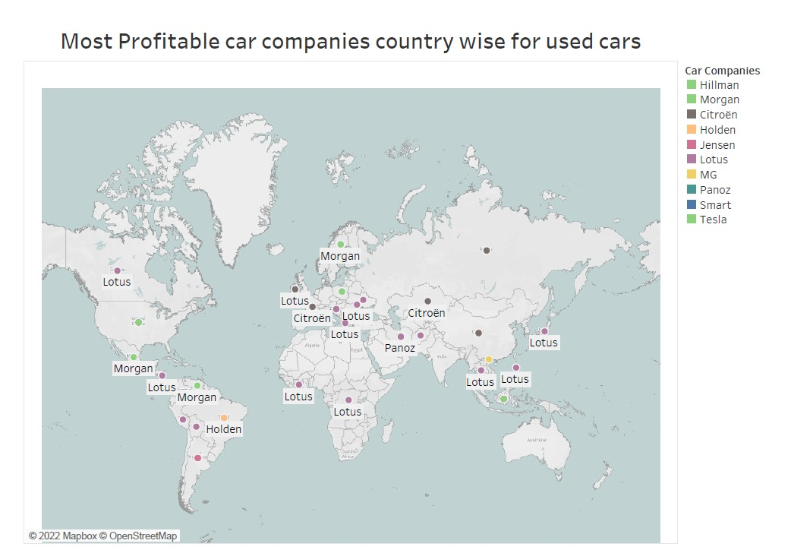
Which is the most profitable brand country-wise (for used cars)?
The map shows the countries with the car companies that have the highest average profit for used cars. Morgan is the most profitable in Sweden while Lotus generates the most profit in Canada.

Slide 15
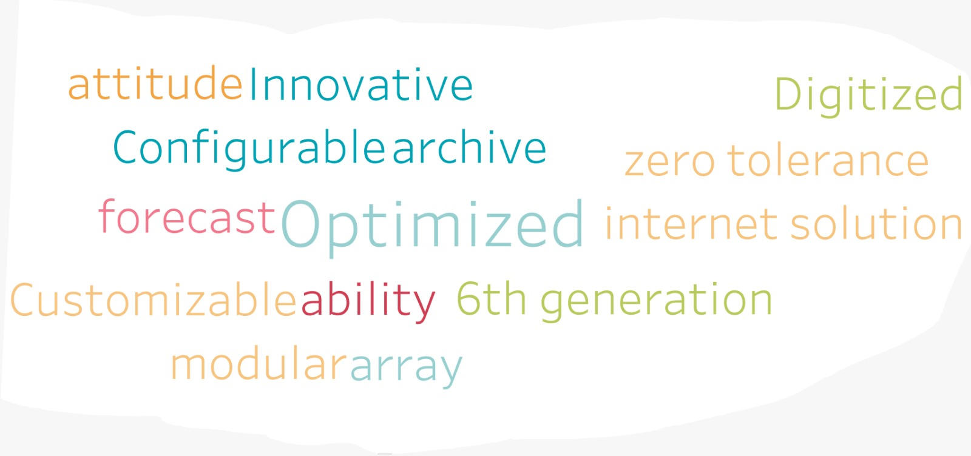
Which feature is most preferred by the buyers while buying a used car?
The word cloud shows the top 10 features that the buyers prefer the most while buying a used car. In general, all these words fall under the technology umbrella. Thus, we can say that people prefer cars that are tech-efficient.

Slide 16
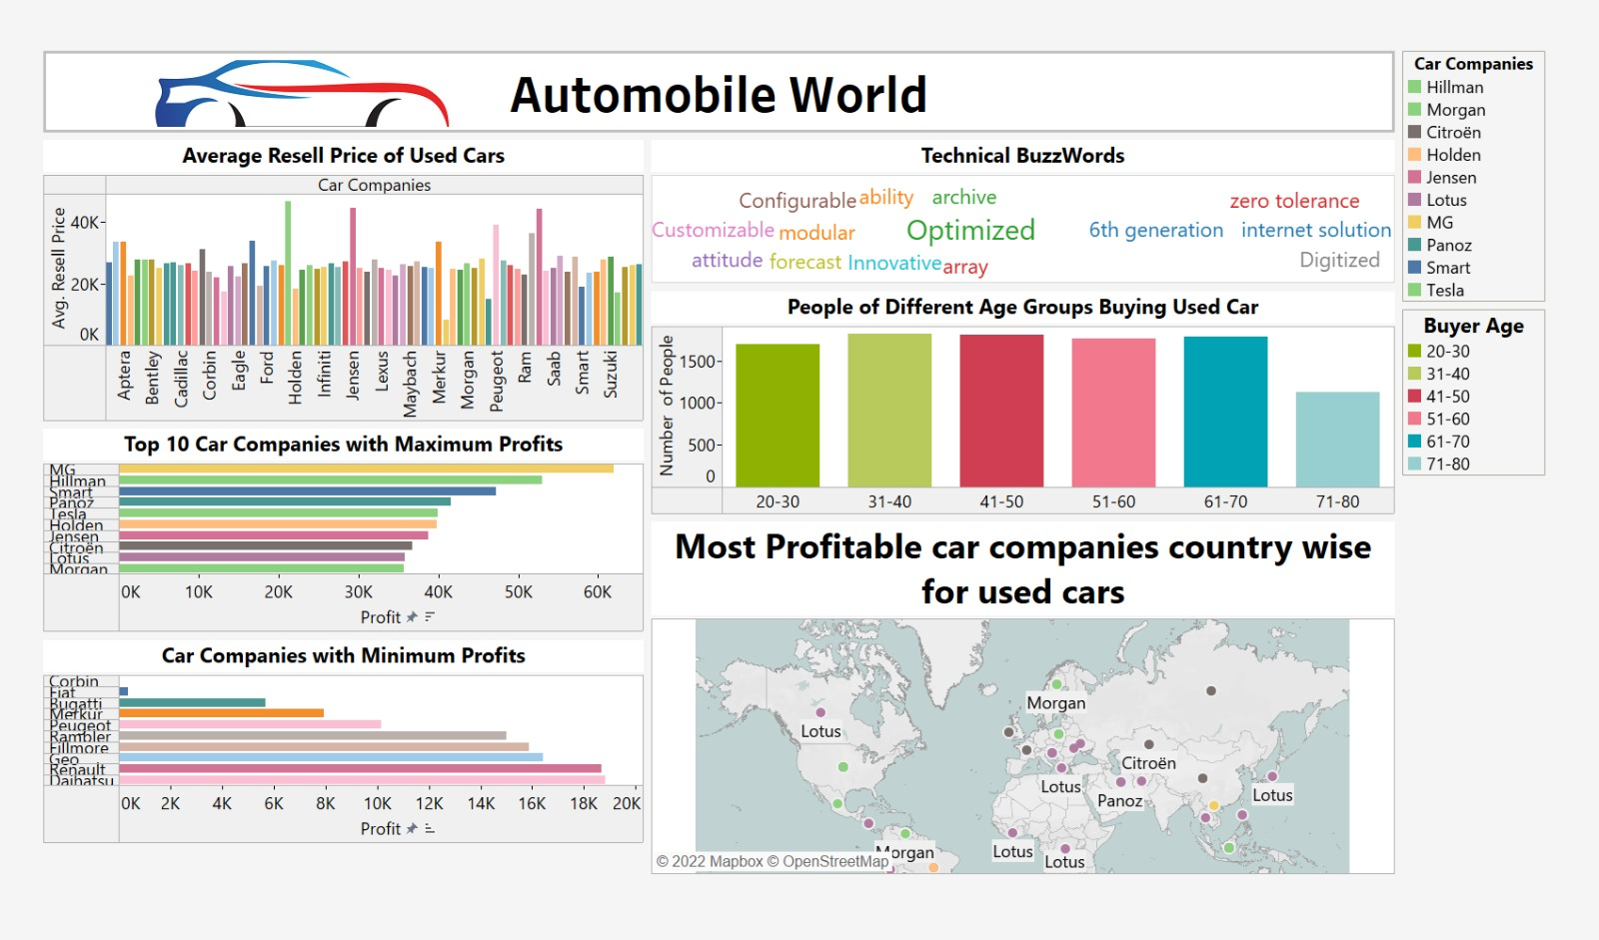
Tableau Dashboard

Slide 17
Conclusion
MG, Hillman, and Smart are the top-3 profitable car companies for second-hand car dealers whereas Corbin and Bugatti are among the companies that generated low profits.
Car company Hillman has the most resell value in the second-hand market with an average resell price of $46,869.
The age group that is more likely to purchase used cars is between the ages of 31 and 40, narrowly leading the age group 41 to 50, while those between the ages of 71 and 80 show the least interest in doing so.
Comparison of countrywide sales can be done with the map we created in EDA. For example, if we compare Sweden and Canada in terms of the used car sale, Morgan is the most profitable in Sweden while Lotus generates the most profit in Canada.
The top 10 technological terms that attract people while buying used cars include AttitudeInnovative, Digitize, ConfigurableArchve, ZeroTolerance, Forcast, Optimized, InternetSolution, CustomizableAbility, 6thGeneration, and ModularArray.

Slide 18
Recommendations
The resellers or used car dealers should focus on expanding their inventories on used car companies Hillman and MG where both of them have strong resell value with maximum profit.
Additionally, used car dealers ought to develop a campaign for selling cars that focuses on the age brackets of 31–40 and 41–50, who are especially inclined to buy used cars.
The word cloud we created advises that the reseller should concentrate on restocking or selling the technologically advanced car.
However, another strategic choice for used vehicle dealers can be successful if they concentrate on the model that is more popular in their area. For instance, Morgan generates the most money in Sweden, whereas Lotus does so in Canada.

Slide 19
References
[1] https://www.forbes.com/sites/davekeating/2020/09/29/covid-causing-shift-from-public-transport-to-cars/?sh=671609725aea
[2] https://www.businesswire.com/news/home/20220527005208/en/Global-Used-Car-Market-2022-to-2030---Size-Share-Trends-Analysis-Report---ResearchAndMarkets.com

Slide 20
Thank You !

