Slide 1

Pharmaceutical Management System
Aamrah Aamrah (002109107)
Alisha Angalan (002102014)
Ankur Thakur(002927572)
Sai Tarun Movva(002922800)

Slide 2
Overview
In this project we have implemented the following design patterns :
Adapter
Builder
Bridge
Decorator
Singleton
Factory
Strategy
Facade
Observer
Command
State
Prototype

Slide 3
Contributions
Aamrah implemented the following design patterns :
State
Strategy
Command
Alisha implemented the following design patterns :
Builder
Bridge
Singleton
Factory
Façade

Slide 4
Contributions
Ankur implemented the following design patterns :
Decorator
Prototype
Tarun implemented the following design patterns:
Adapter
Observer

Slide 5
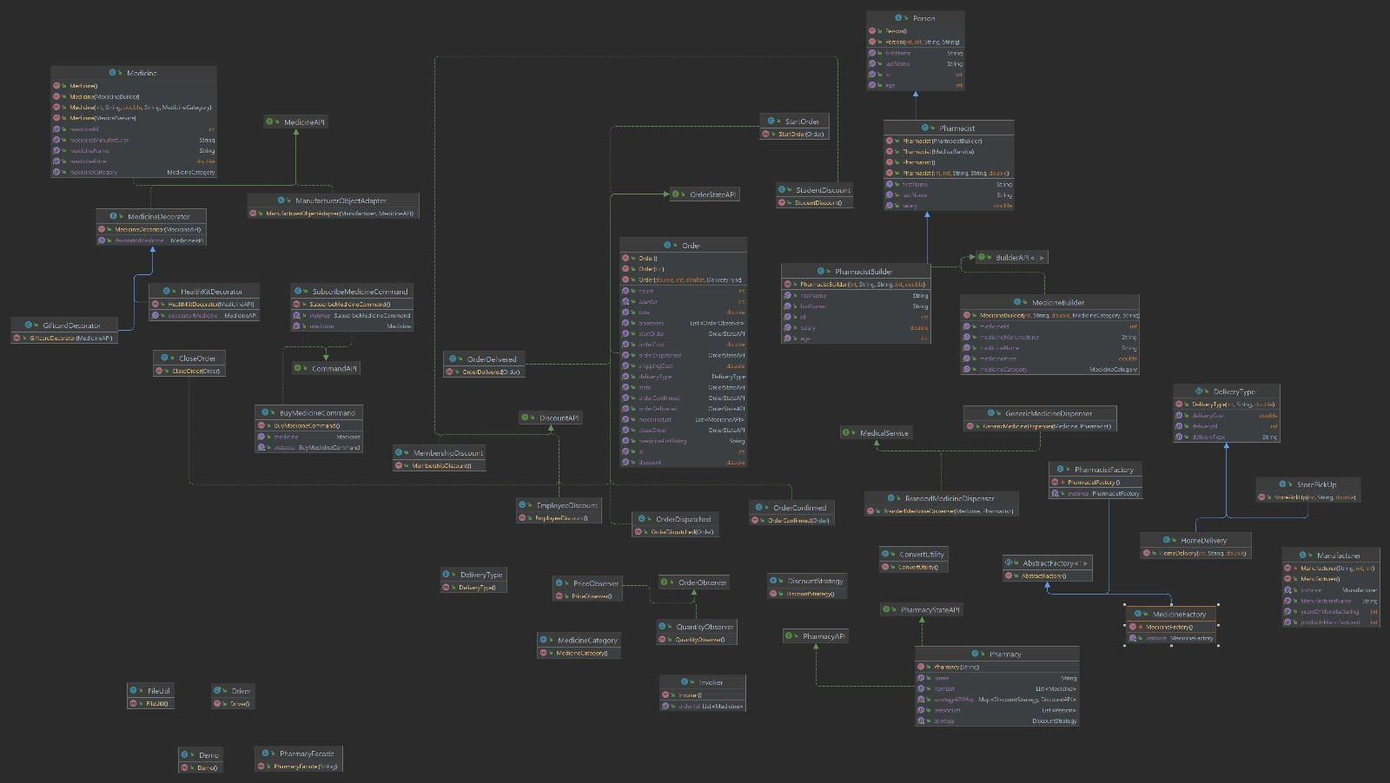
Class diagram

Slide 6
Builder Design Pattern
Designed the BuilderAPI to be implemented by the MedicineBuilder and PharmacyBuilder.
This design pattern is used to create an object in a flexible manner and when its subject to change.
BuilderAPI: This is an interface for the Builder design pattern. It defines a single method called buildObject() that returns an object of type T. The T is a type parameter, which allows the interface to be used with different types of objects.
MedicineBuilder: The MedicineBuilder class is a concrete builder that implements the BuilderAPI interface, which defines a method for building an object of type T. The buildObject() method returns a new Medicine object that is created by calling the getObject() method of the MedicineFactory class, passing in the MedicineBuilder object as a parameter.
PharmacyBuilder: The PharmacistBuilder class implements the BuilderAPI interface and overrides the buildObject() method to create a Pharmacist object using a PharmacistFactory.

Slide 7
Factory Design Pattern
Designed the AbstractFactory class to be extended by MedicineFactory and PharmacyFactory.
The Factory design pattern is a creational design pattern that provides an interface for creating objects in a superclass, but it allows subclasses to alter the type of objects that will be created.
AbstractFactory: An abstract class that defines a common interface for creating objects of a particular type. It declares an abstract method getObject which takes an object of type BuilderAPI as a parameter and returns an object of type T.
MedicineFactory: A singleton class that has a static method getInstance() that returns the single instance of the MedicineFactory.
PharmacistFactory: A singleton class that has a static method getInstance() that returns the single instance of the PharmacistFactory.

Slide 8

Facade design pattern
Facade is a structural design pattern that provides a simplified interface to a complex system of classes, objects, and subsystems.
PharmacyFacade acts as a simplified interface to the complex Pharmacy.
PharmacyFacade hides the complexity of the Pharmacy system and provides a simple interface to the clients to perform the required operations.

Slide 9
Bridge Design Pattern
MedicalService: It is an interface with dispenseMedicine() method in it.
BrandedMedicineDispenser: This class acts as a bridge between the Medicine and Pharmacist classes, allowing them to vary independently. The dispenseMedicine() method can be used to dispense a branded medicine by a pharmacist.
GenericMedicineDispenser: This class acts as a bridge between the Medicine and Pharmacist classes, allowing them to vary independently. The dispenseMedicine() method can be used to dispense a generic medicine by a pharmacist.
Pharmacist class has a constructor that takes in a MedicalService object. This is used in the Bridge design pattern implementation to specify which type of medicine dispenser to use. The "dispense" method takes in a Medicine object and prints a message indicating that the medicine is being dispensed along with information about the medicine's name and manufacturer.
Bridge design pattern is a structural design pattern that decouples an abstraction from its implementation so that both can be modified independently. It allows the abstraction and implementation to vary independently by providing a bridge between them.

Slide 10
State Design Pattern
Created an interface OrderStateAPI which tracks the states of the order.
Start
Order
Order Confirmed
Order Dispatched
Order Delivered
Close
Order
Derived 5 classes from it which implement the following methods to change the state of the order.
orderConfirmed(); orderDispatched(); orderDelivered(); closeOrder();
Order implements the OrderStateAPI.

Slide 11
Command Design Pattern
Designed a CommandAPI which includes an execute() method.
We have two implementing classes that when invoked would be responsible for :
Buying the medicine
Subscribing to the medicine
We also have an Invoker class which would facilitate in firing the commands we need.
BUY
command
SUBSCRIBE

Slide 12
Strategy Design Pattern
Created DiscountAPI which has the following method to calculate discounts:
calculatePrice()
Derived 3 classes which implement discounts :
Member
ship Discount
10%
Student Discount
20%
Employee Discount
15%

Slide 13
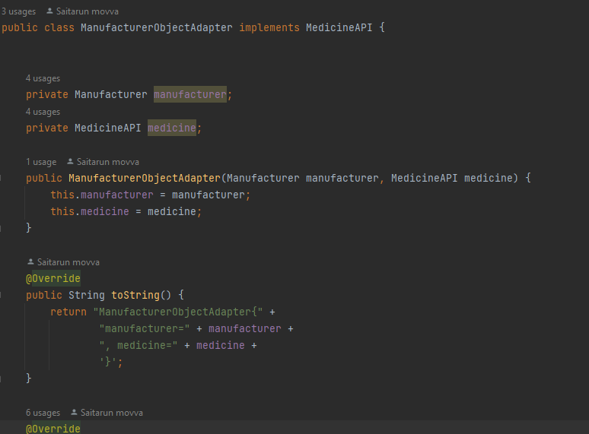
Adapter
In this code, the Adapter Design Pattern is used to make the Manufacturer class compatible with the MedicineAPI interface.
The ManufacturerObjectAdapter class is the Adapter that adapts the Manufacturer class to the MedicineAPI interface. It implements the MedicineAPI interface and contains an instance of Manufacturer and MedicineAPI as its member variables.
The methods of the ManufacturerObjectAdapter class call the corresponding methods of Manufacturer to get the required information and return it in the expected format defined in the MedicineAPI interface.
By using the Adapter Design Pattern, the Manufacturer class can be used with the MedicineAPI interface without modifying the Manufacturer class itself, thus promoting the principle of Open-Closed design.
MedicineAPI
Adapter
Manufacturer

Slide 14
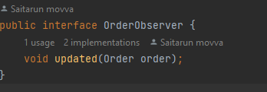
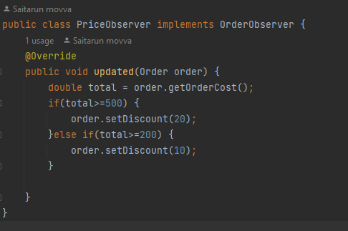
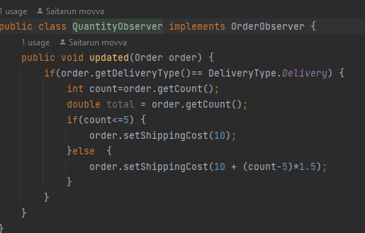
Observer
OrderObserver interface: This interface defines the method updated(Order order) which will be called when the state of the Order object changes. Concrete observer classes will implement this interface to provide their specific update logic.
PriceObserver class: This is a concrete observer class that implements the OrderObserver interface. It overrides the updated method to apply discounts based on the total cost of the order. If the total cost is above a certain threshold, the discount is applied accordingly.
QuantityObserver class: This is another concrete observer class that implements the OrderObserver interface. It overrides the updated method to calculate the shipping cost based on the number of items in the order. The shipping cost increases when the count of items exceeds a certain threshold.
Order class: This class represents the subject in the Observer pattern. It has a list of observers (List<OrderObserver> observers) that are interested in the state changes of an Order object. The Order class provides methods to add (attach) and remove (detach) observers.
When the state of the Order object changes, such as when a medicine is added to the order (addMedicine method), the Order class iterates through the list of observers and calls their updated method, passing the updated Order object as a parameter. The observers then update their internal state based on the new state of the Order.

Slide 15
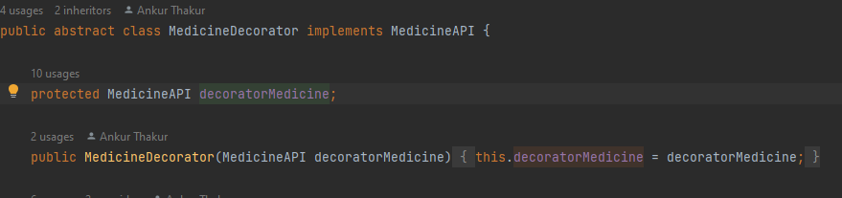

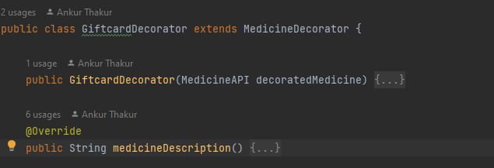


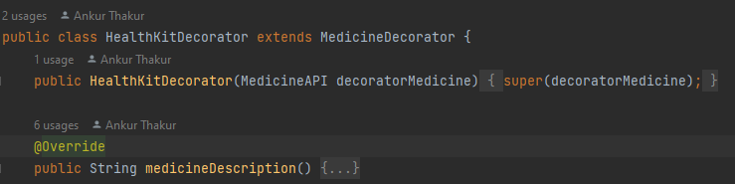
Decorator
Designed abstract class MedicineDecorator implements MedicineAPI
Main purpose of this Design Pattern is to wrap up the existing object
Created GiftcardDecorator and HealthKitDecorator which inherites MedicineDecorator to add functionality to existing medicine object.

Slide 16
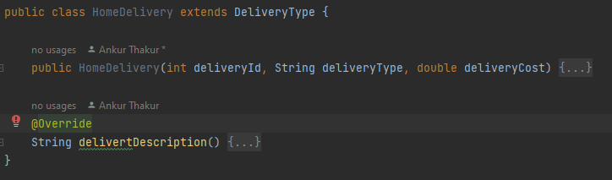
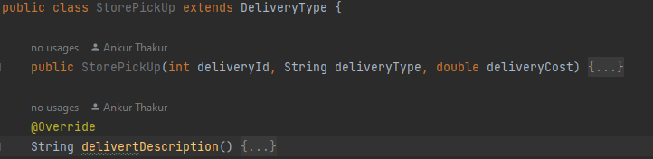
Prototype
Created Delivery Service to demonstrate the use of Prototype Pattern
Designed abstract DeliveryType class which implements Cloneable and having following attributes:
deliveryType
deliveryId
deliveryCost
Derived two classes named HomeDelivery and StorePickUp extending DeliveryType and overriding deliveryDescription()

Slide 17

Thank You

