Slide 1
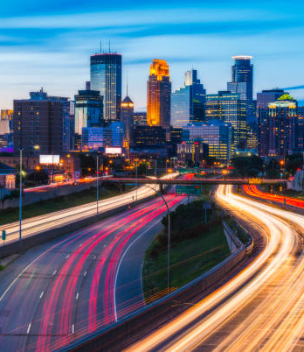
Minnesota Interstate Traffic Volume
An In-Depth Analysis of Traffic Patterns

Slide 2
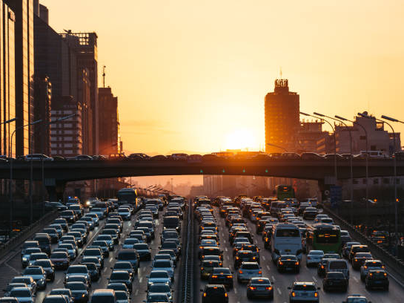
The Challenge of Traffic Congestion
Traffic congestion continues to grow with no end in sight.
This analysis seeks to uncover patterns in traffic volume to inform strategies for managing congestion.

Slide 3

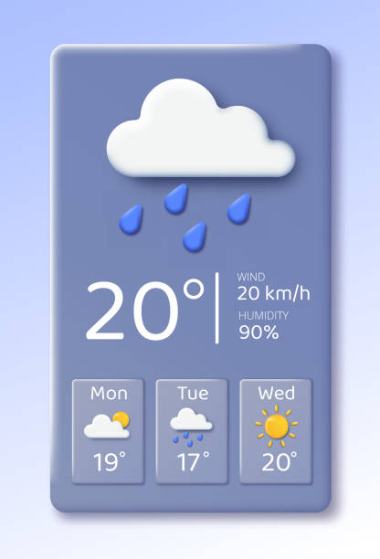

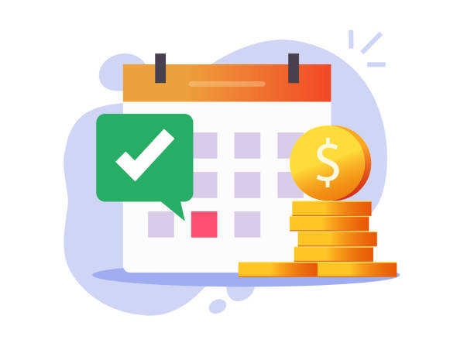
Analyzing Traffic Patterns
Monthly Volumes
Viewing the monthly traffic patterns allows us to find any potential trends by month.
Weather
Weather can have an impact on many things, including traffic.
Holiday Travel
Our roads may see more travelers (including out of state) than expected.

Slide 4

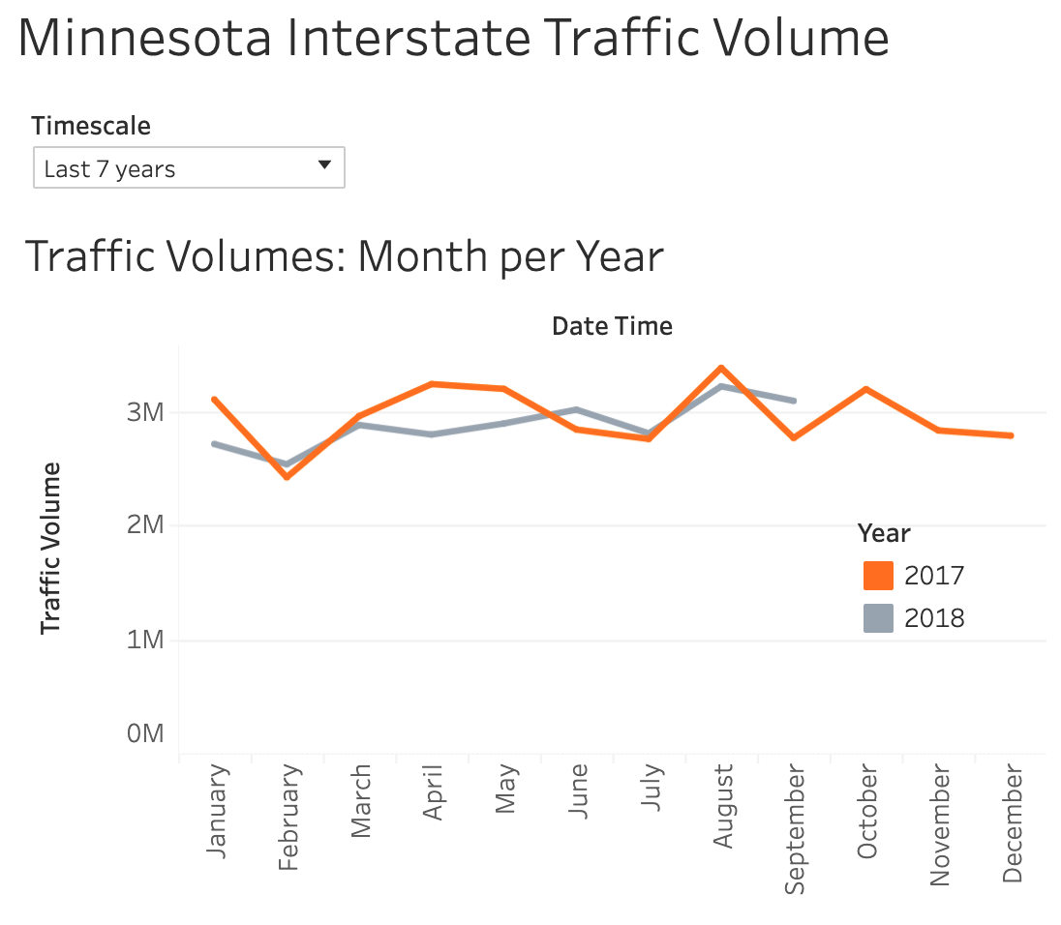
Monthly traffic volumes
August - Highest volume, possible end of summer seasonal traffic
February - Lowest volume, best possible month for construction changes
April - Significant decrease in 2018
Fairly consistent/ predictable patterns

Slide 5
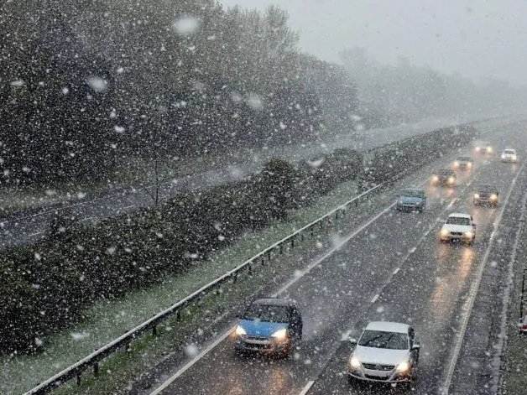
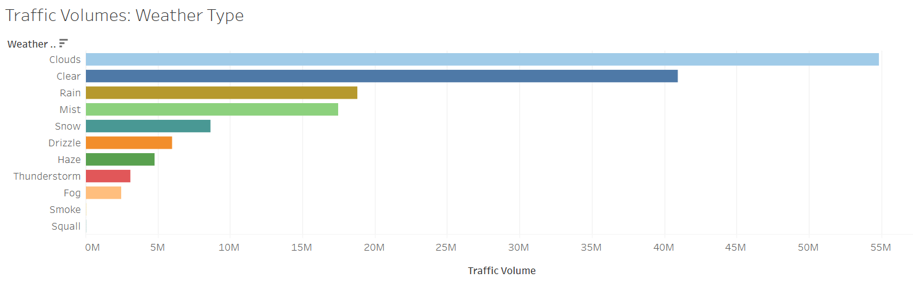
Weather-Driven Traffic Trends
Clear/cloudy conditions result in the highest traffic volume.
Low-visibility conditions result in the lowest traffic volume.
Precipitation has a significant impact on traffic volume, though a surprising number of motorists continue to drive in rain.
What can we do to alleviate traffic issues on rainy days?

Slide 6

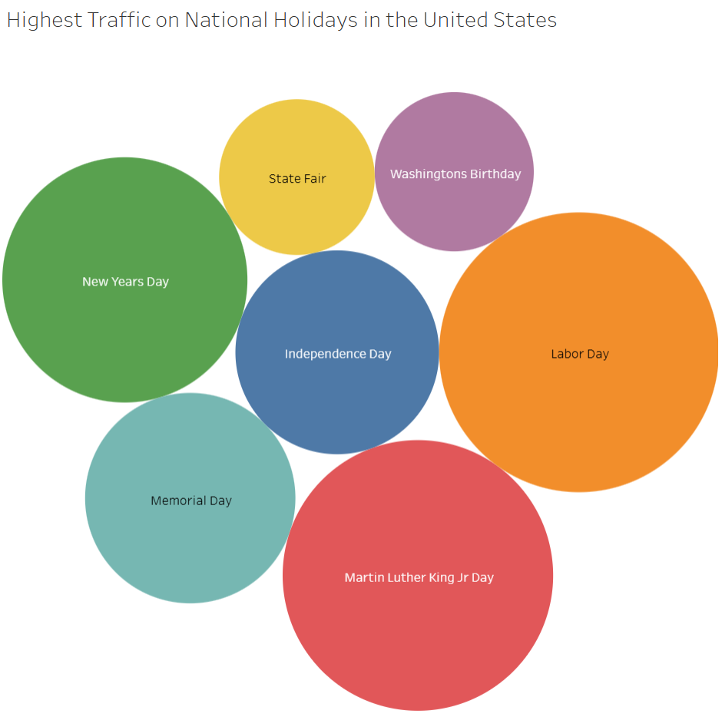
Holiday Travel Trends
January - High traffic on New Years and Martin Luther King Jr. Day contribute to most of January’s total.
August - State fair starting in August
Most holidays have little impact on total traffic volume.

Slide 7

Thank You

