Slide 1
CS 699 Data Mining Final Project
Alisha Peermohamed and Xi You
Spring 2019

Slide 2
Project Proposal
Our Dataset: ‘America’s Favorite Global Cuisine’
A Collection of Survey responses with individual preferences in various international cuisines by country such as Belgium, Herzegovina, Brazil, Mexico, United States, China, etc.
Survey asks respondents about 40 different countries.
Respondents are also asked general demographic information:
Age, Gender, Household Income, Education, Location (Geographic Region)
Respondents could enter preferences from 1 to 5 or N/A.
1 represents: ‘I hate this country’s traditional cuisine’
5 represents: ‘I love this country’s traditional cuisine’
N/A represent: ‘I am unfamiliar with this country’s traditional cuisine’
Original size: 49 attributes and 1373 tuples.
Data Source: https://github.com/fivethirtyeight/data/tree/master/food-world-cup

Slide 3
Data Mining Goal: Predicting a Person’s Household Income
Our goal for this project is to develop a classification model based on a person’s favorite international cuisines, age, education, and location and be able to predict his/her household income bracket.
Class Attribute: Household Income Bracket
$0 – $24,999
$25, 000 - $49,999
$50,000 - $99,999
$100,000 - $149,999
$150,000+
Analytical Tool Used: Weka

Slide 4
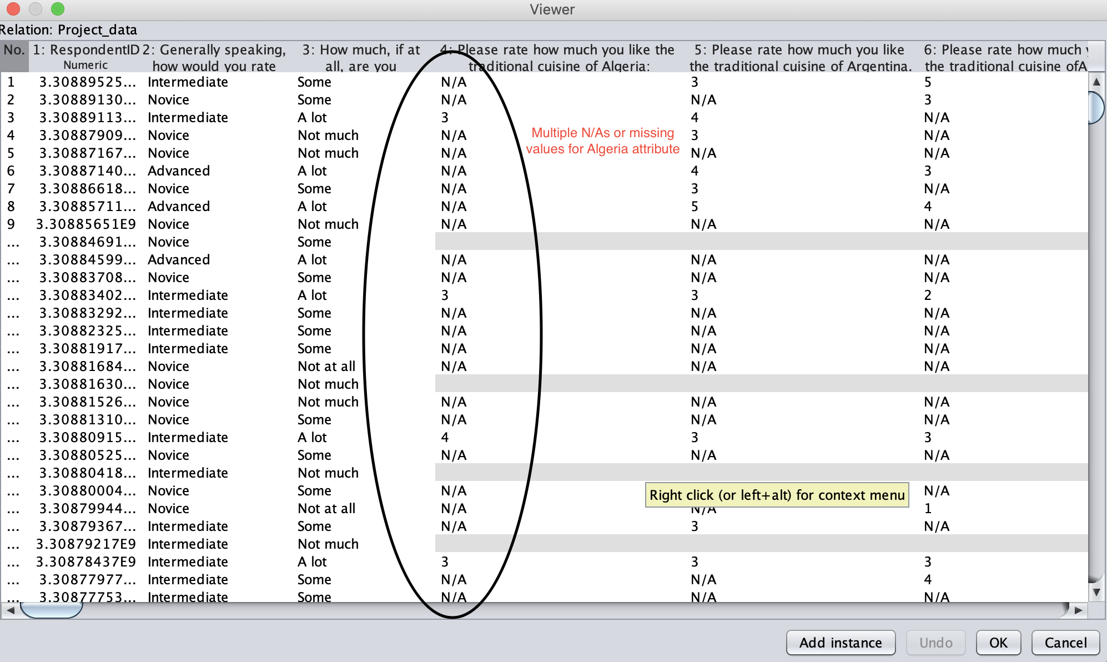
Data Preprocessing Phase
Data Reduction:
Attribute Reduction:
Some cuisine attributes had several missing or N/A values: e.g. Algeria.
Not useful as they do not indicate information on respondent's preference.
Counted the # of N/A’s or missing values for all country attributes and removed attributes with 500 /+ N/A or missing values (Removed 28 attributes).
Removed location attribute
Different location regions had different costs of living, which are reflected in average household incomes. Thus, location attribute would skew classification result based on geographic region instead of cuisine preference.
New Dataset: 20 attributes and 1373 tuples

Slide 5
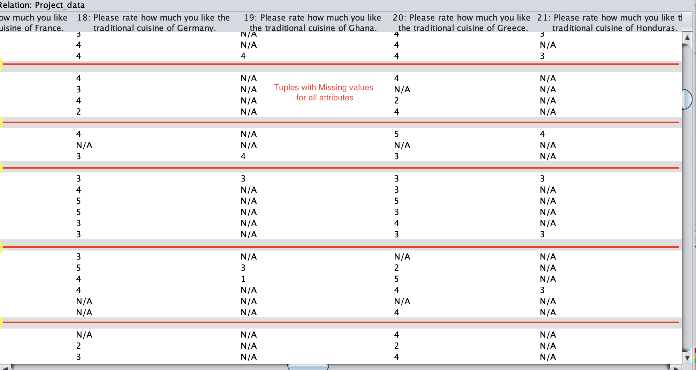
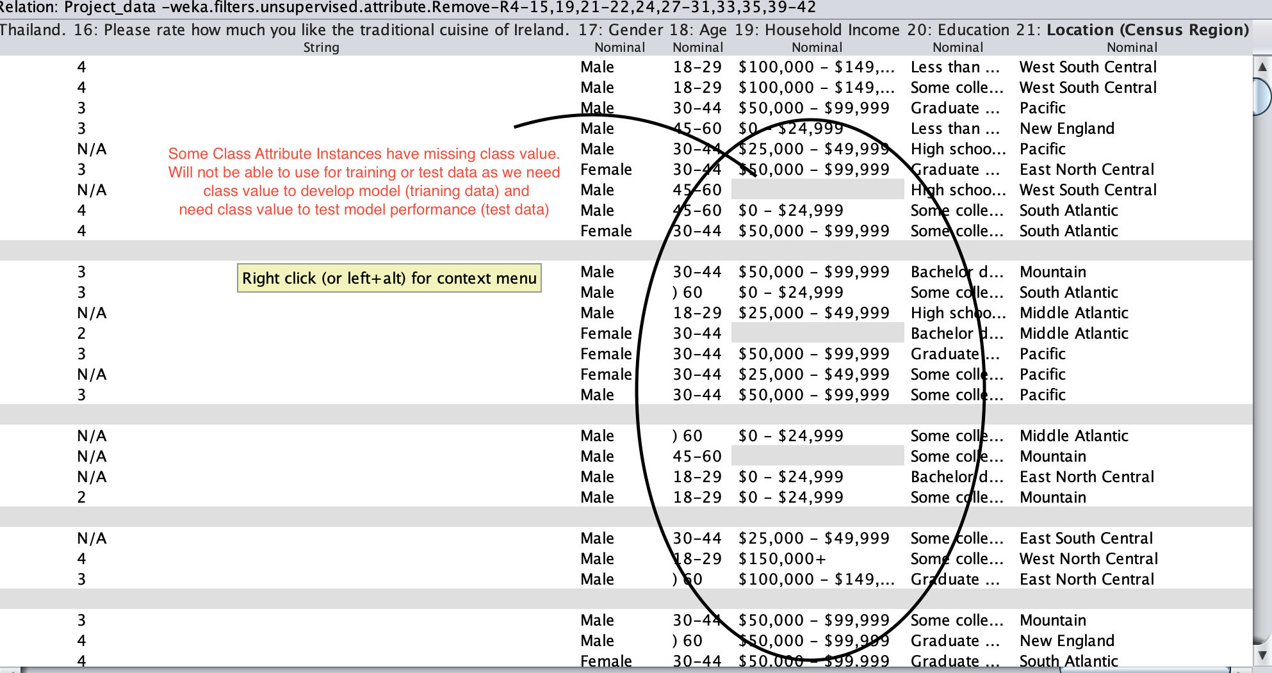
Data Reduction(…continued)
Tuple Reduction
Several tuples with all/many missing values.
Possibly because a respondent had started the survey but abandoned it early on in the survey.
Not useful as they do not indicate information on respondent's preference.
Removed 129 tuples from dataset.
New Dataset: 20 attributes, 1241 tuples
Tuples with Missing Class Value
Several tuples with missing values in the class attribute.
Not useful as we cannot use in training dataset nor test dataset
Removed all tuples with Missing Class value (287 tuples removed).
Final Dataset: 20 attributes and 954 tuples

Slide 6
_
Data Cleaning
General Tidying
Renamed each of our country attributes from “Please rate how much you like the traditional cuisine of <country>.” to that country’s name.
E.g. ‘Please rate how much you like the traditional cuisine of Ireland’ → Ireland
Values for country attributes incorrectly categorized as Numeric instead of Nominal.
Converted all country attributes to Nominal form using the NumerictoNominal filter
Each value could be 1 to 5 or N/A and each represent a distinct preference.
In terms of replacing missing values for each attribute, wanted to replace with attribute mode, not mean as respondents were not allowed to respond with float values.
Replaced remaining missing values and N/A’s with attribute mode to arrive at complete final dataset.
Please see a screenshot of the final dataset on the next slide
Divided our complete final dataset into training set and test set using a 66/33 ratio split, respectively.

Slide 7
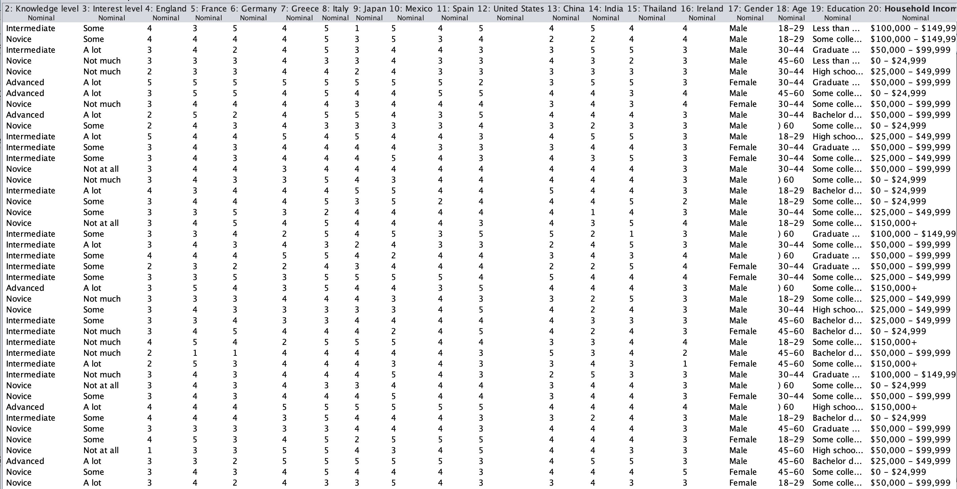

Slide 8
Attribute Selection
We ran the following four attribute selection algorithms on Weka and selected the top eight highest ranking attributes from each attribute selection algorithm. Results below:
Lastly, developed our own attribute set based on the most frequently occurring countries among previous four attribute selection sets.
Attribute Selection Algorithm | Attributes Selected
CorrelationAttributeEval | United States, France, Italy, Japan, Ireland, Spain, India, Gender
GainRatioAttributeEval | United States, France, Japan, Ireland, Spain, Italy, China, Germany.
OneRAttributeEval | China, England, United States, Japan, Greece, Gender, France, Thailand
InfoGainAttributeEval | United States, France, Japan, Ireland, China, Germany, Spain, Mexico
Our Own Attribute Set | US, France, Spain, Japan, Germany, Gender, Age, and Education

Slide 9
Classification Models
Used our training set data to build 5 different classification models for each of our 5 attribute sets (total 25 models).
Using the following classification algorithms:
Naïve Bayes
J48
Simple Logistic
OneR
RandomForest
Attribute Set:
CorrelationAttributeEval
GainRatio AttributeEval
OneR AttributeEval
InfoGain Attribute Eval
Our Own Attribute Set

Slide 10
Comparing Model Performance
We decided to choose one classification model for each attribute set that has the highest model performance based on accuracy rate:
Random Forest models results in substantially higher accuracy levels across all attribute sets:
Attribute Set | Best Classification Model | Accuracy
CorrelationAttributeEval | Random Forest | 87.38%
OneRAttributeEval Set | Random Forest | 91.12%
GainRatioAttributeEval Set | Random Forest | 85.51%
InfoGainAttribute Set | Random Forest | 87.85%
Our Own Attribute Set | Random Forest | 92.99%
Additionally, for all Random Forest classification models, the area under the ROC curve was at least 0.987
Indicates that the Random Forest models predicted far more True Positives for every False Positive.
Random Forest models’ superior prediction performance supported by very high TP and low FP rates.

Slide 11
True Positive and False Positive Rates for the
Random Forest Models for all Attribute Sets
Attribute Set | TP Rate | FP Rate
CorrelationAttributeEval Set | 0.874 | 0.045
OneRAttributeEval Set | 0.911 | 0.026
GainRatioAttributeEval Set | 0.855 | 0.047
InfoGain AttributeEval Set | 0.879 | 0.043
Our Own Attribute Set | 0.930 | 0.021
Comparing Performance with Other Classification Models:
TP rates across all other classification models fell between 0.3 and 0.5, which is significantly lower than those for the Random Forest classification models.
FP rates across all other classification models fell between 0.15 and 0.35, which is significantly higher than those of the Random Forest models.
Random Forest models correctly classified far greater tuples than the other classification models.

Slide 12
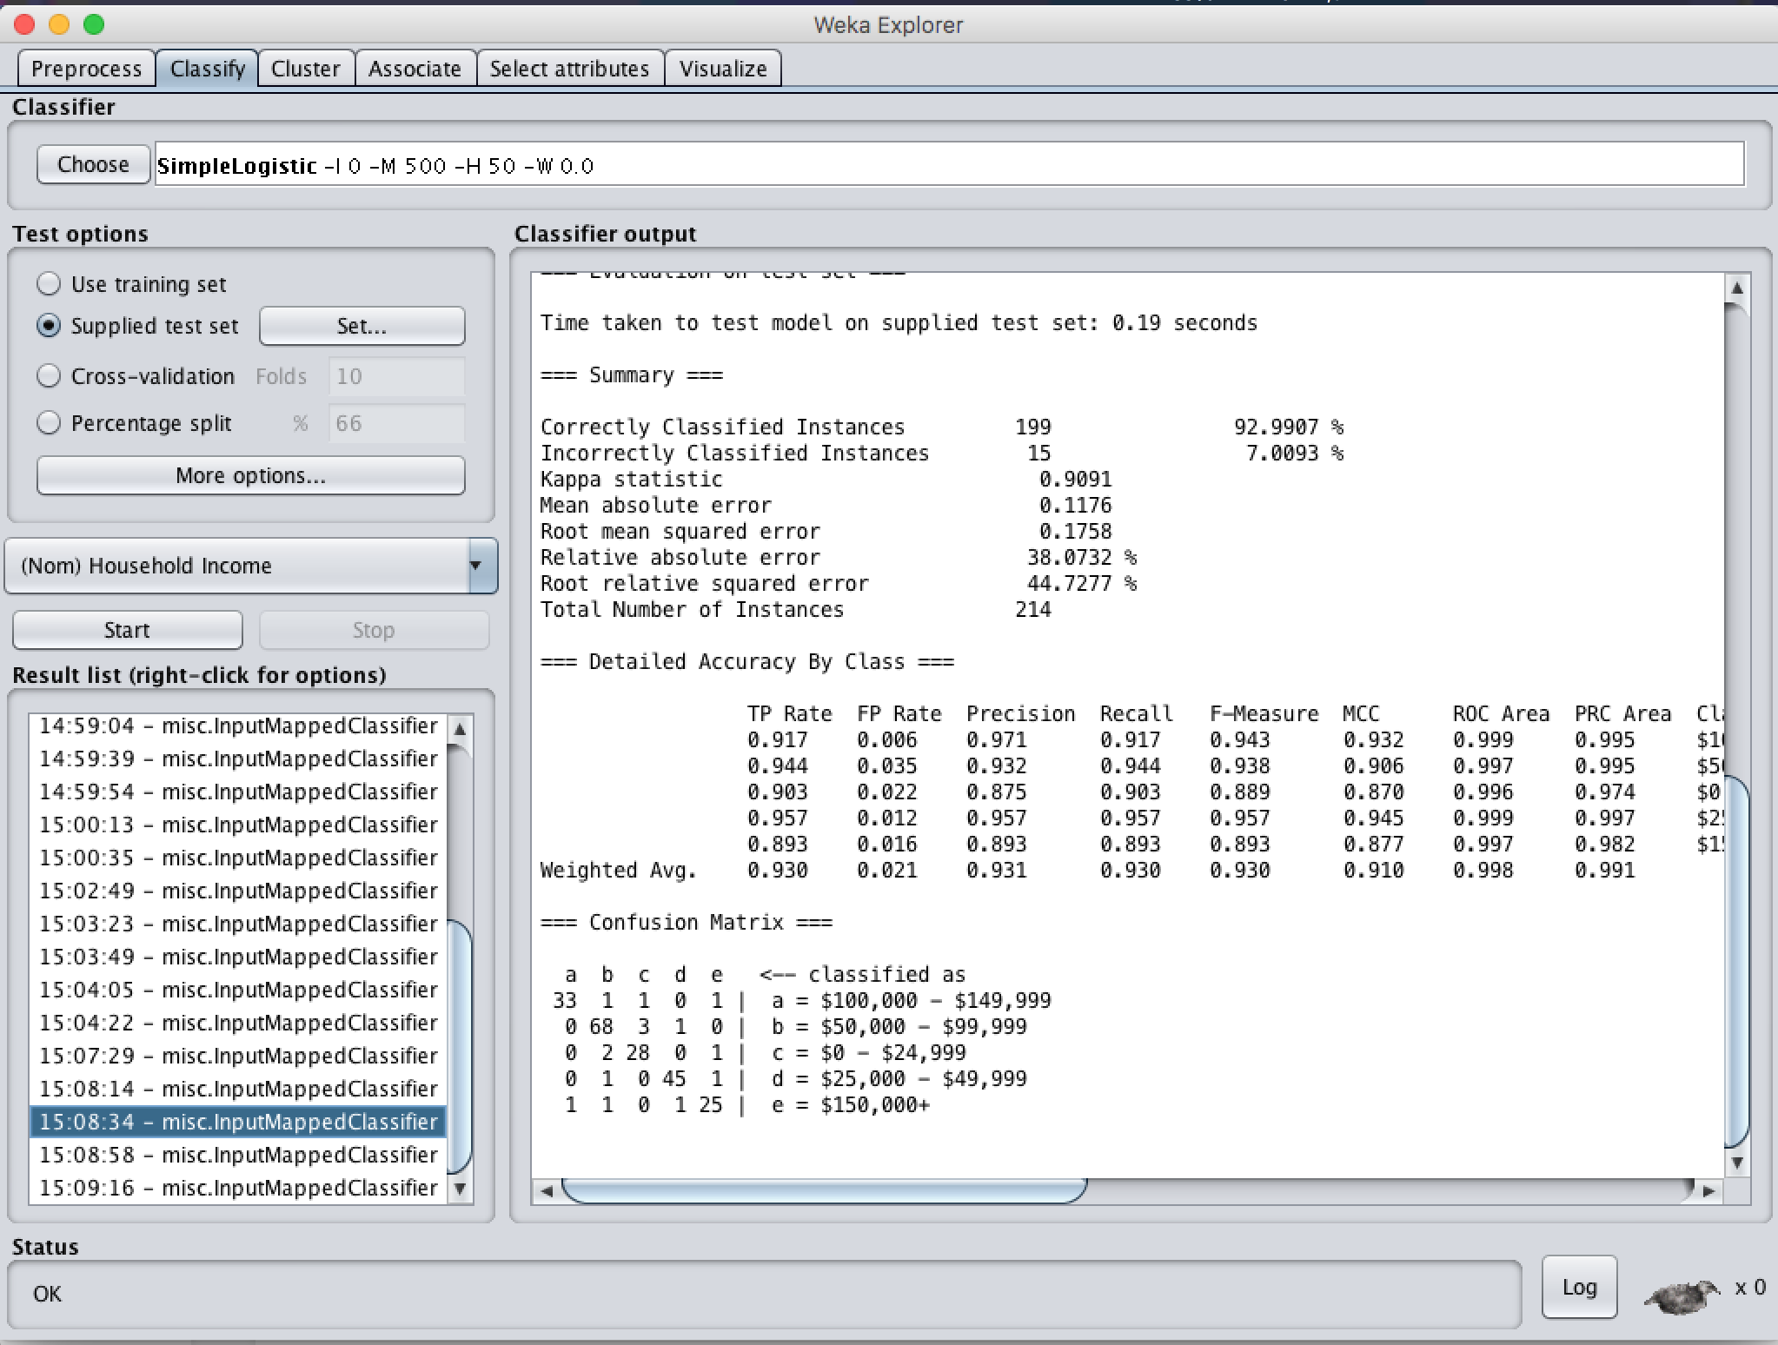
Our Best Performing Classification Model
The Random Forest Classification Model using Our Own selected attribute set offers superior performance over all other models for our data mining goal.
Our Own Attribute set: US, France, Spain, Japan, Germany, Gender, Age, and Education
This model offers the highest performance measure across all 25 models of 93% accuracy and a weighted ROC Area of 0.998.

Slide 13
Conclusion
Lessons Learned:
This Practical use of various classification algorithms on real-world data
Not all datasets will be ‘pretty’ - Working with real-world datasets often involves lots of pre-processing, cleaning, handling of missing attribute or class values before beginning model development.
This Model’s Real World Applications:
This model can be quite useful to cities, retail centers, or communities that are trying to plan what types of restaurants they should include in their malls or cities based on the type of customer demographic they are trying to attract.
Eg. a mall is looking to attract wealthier visitors, it can use this classification model to determine which cuisines to include in their mall such that wealthier visitors will be most compelled to visit.

Slide 14
Thank You!
Questions?

