Slide 1
Baseline model
U-Net with a ResNet34 encoder
Input | One grayscale image channel
Network | ImageNet initialization and a U-Net decoder
Prediction | Filament probability at every pixel
Instances | Probability > 0.5, then connected components
Touching filaments may merge. Broken masks may split.
Person B
1
Notes:
I handled the models, training and controlled comparisons. U-Net predicts a filament probability for each pixel, using a ResNet34 encoder initialized from ImageNet. We threshold those probabilities and label connected regions. This gives separate objects, but touching filaments can merge and broken masks can split. Person C can improve that conversion using our saved probabilities.
Sources
Ronneberger, Fischer & Brox (2015). U-Net.
https://arxiv.org/abs/1505.04597
He et al. (2016). Deep Residual Learning for Image Recognition.
https://arxiv.org/abs/1512.03385
segmentation_models_pytorch, version 0.6.0.
https://github.com/qubvel-org/segmentation_models.pytorch
Project evidence
C:\Users\user-pc\Desktop\COS711_Assig2\AI_Assignment2\models.py
C:\Users\user-pc\Desktop\COS711_Assig2\AI_Assignment2\inference.py
C:\Users\user-pc\Desktop\COS711_Assig2\AI_Assignment2\configs\baseline.yaml

Slide 2
Training and validation
Training input | 512 × 512 crops with foreground sampling
Loss | Binary cross entropy + Dice overlap loss
Optimization | AdamW with a cosine learning-rate schedule
Validation | 122 complete observations, grouped by time blocks
Checkpoint choice | Highest pooled validation Panoptic Quality
Selected setting: added transforms off. Random foreground-biased crops remain.
Person B
2
Notes:
Filaments cover very little of each image. BCE learns pixel classification, while Dice emphasizes foreground overlap. We use AdamW, cosine scheduling and mixed precision. All labels for one observation stay together. Validation scores complete images and pools matching counts across annotation sets, following the organizer's reference. A match requires IoU above 0.5. The selected U-Net/ResNet34 keeps BCE + Dice and random foreground-biased 512 × 512 crops. It disables the added flips, rotations, affine and appearance transforms. Random crop sampling still changes between epochs.
Sources
Milletari, Navab & Ahmadi (2016). V-Net.
https://arxiv.org/abs/1606.04797
Loshchilov & Hutter (2019). Decoupled Weight Decay Regularization.
https://arxiv.org/abs/1711.05101
PyTorch 2.14 documentation. CosineAnnealingLR.
https://docs.pytorch.org/docs/2.14/generated/torch.optim.lr_scheduler.CosineAnnealingLR.html
Kirillov et al. (2019). Panoptic Segmentation.
https://arxiv.org/abs/1801.00868
Ahmadzadeh (2026). Self Evaluation Notebook, version 6.
https://www.kaggle.com/code/azimahmadzadeh/self-evaluation-notebook
Project evidence
C:\Users\user-pc\Desktop\COS711_Assig2\AI_Assignment2\losses.py
C:\Users\user-pc\Desktop\COS711_Assig2\AI_Assignment2\train.py
C:\Users\user-pc\Desktop\COS711_Assig2\AI_Assignment2\data.py
C:\Users\user-pc\Desktop\COS711_Assig2\AI_Assignment2\splits\split_v1.json
C:\Users\user-pc\Desktop\COS711_Assig2\AI_Assignment2\results\evaluation_reference.json
Measured evidence
Frozen selected configuration: no_augmentation
C:\Users\user-pc\Desktop\COS711_Assig2\AI_Assignment2\results\person_b_study\configuration_selection.json

Slide 3
Controlled comparisons
Learning rate | Low, baseline and high settings
Data | 1024 resolution, preprocessing, augmentation and targets
Loss | BCE + Dice compared with BCE + Tversky
Model | U-Net compared with U-Net++
Repeatability | Fresh seeds after configuration selection
Comparisons match sampled images and planned update attempts.
Person B
3
Notes:
We kept the split fixed and matched sample budgets and planned update attempts. The six-epoch screen can favor quick learners, so the strongest candidates received full-budget runs before selection. Fresh seeds then measured variability. A few AMP overflow skips can change applied update counts. The 1024 experiment also changes field of view, and consensus changes observation weighting, so those comparisons have limits.
Sources
Salehi, Erdogmus & Gholipour (2017). Tversky loss.
https://arxiv.org/abs/1706.05721
Zhou et al. (2018). UNet++.
https://arxiv.org/abs/1807.10165
Project evidence
C:\Users\user-pc\Desktop\COS711_Assig2\AI_Assignment2\experiments.py
C:\Users\user-pc\Desktop\COS711_Assig2\AI_Assignment2\configs\
C:\Users\user-pc\Desktop\COS711_Assig2\AI_Assignment2\results\person_b_study\
Measured evidence
Study protocol: {"path":"C:\\Users\\user-pc\\Desktop\\COS711_Assig2\\AI_Assignment2\\results\\person_b_study\\protocol.json","primary_metric":"PQ_dataset","split_sha256":"58245fc1fdc3c39c7e482d703cd4c9e26ebdbcae6e08c6c328149d417284eec3","selection_seed":42,"fresh_seeds":[43,44,45]}

Slide 4
Validation results
Full-budget run | Seed | Epochs | PQ | SQ | RQ
Baseline | 42 | 20 | 0.320127 | 0.675 | 0.474
No added transforms | 42 | 20 | 0.338081 | 0.675 | 0.501
1024 input | 42 | 20 | 0.337451 | 0.669 | 0.505
Near-tie at seed 42: ΔPQ 0.000629. One seed cannot establish superiority.
Fresh-seed PQ: 0.33695 ± 0.00758
3 runs, seeds 43, 44, 45. Sample standard deviation across runs.
Foreground Dice 0.640 ± 0.003 IoU 0.488 ± 0.004
Local PQ measures the frozen validation set. Kaggle uses different images.
Person B
4
Notes:
The full-budget selection runs were a near-tie. We chose the numerical winner, with added transforms off. Across three fresh seeds, pooled PQ averaged 0.33695, with sample standard deviation 0.00758. This describes training variability, not proof of superiority. The displayed seed 45 checkpoint is the best fresh run, not the average. It missed more reference instances than baseline: 507 versus 449. But it produced fewer extras: 1007 versus 1416. Higher PQ therefore came with a tradeoff. We have no Kaggle score.
Sources
Kirillov et al. (2019). Panoptic Segmentation.
https://arxiv.org/abs/1801.00868
Ahmadzadeh (2026). Self Evaluation Notebook, version 6.
https://www.kaggle.com/code/azimahmadzadeh/self-evaluation-notebook
Project evidence
C:\Users\user-pc\Desktop\COS711_Assig2\AI_Assignment2\results\person_b_study\summary.json
C:\Users\user-pc\Desktop\COS711_Assig2\AI_Assignment2\results\person_b_study\configuration_selection.json
Measured evidence
Foreground Dice 0.640 ± 0.003 and IoU 0.488 ± 0.004 are fresh-seed means/sample SDs. Each run first averages semantic foreground-mask scores over annotation sets. These differ from pooled instance PQ and best-per-filament overlap. Good pixel coverage can still merge or split objects.
Pooled counts compare predictions against every available annotation set; they are not unique-image instance totals. Seed 42 selects the configuration and is excluded from the fresh-seed mean. Representative seed 45 has PQ 0.3448101728178549; it is the highest-scoring fresh run, not the mean run. Best-per-reference-filament Dice is 0.6028158367364901 versus 0.6458612145378748 for baseline.
Summary: C:\Users\user-pc\Desktop\COS711_Assig2\AI_Assignment2\results\person_b_study\summary.json
Configuration decision: C:\Users\user-pc\Desktop\COS711_Assig2\AI_Assignment2\results\person_b_study\configuration_selection.json
Plain-language metric guide: PQ combines finding the right objects with tracing their shapes. SQ measures overlap quality for matched objects. RQ penalizes missed and extra objects. Dice and IoU measure how much two foreground masks overlap; they do not by themselves check whether separate filaments stay separate.

Slide 5
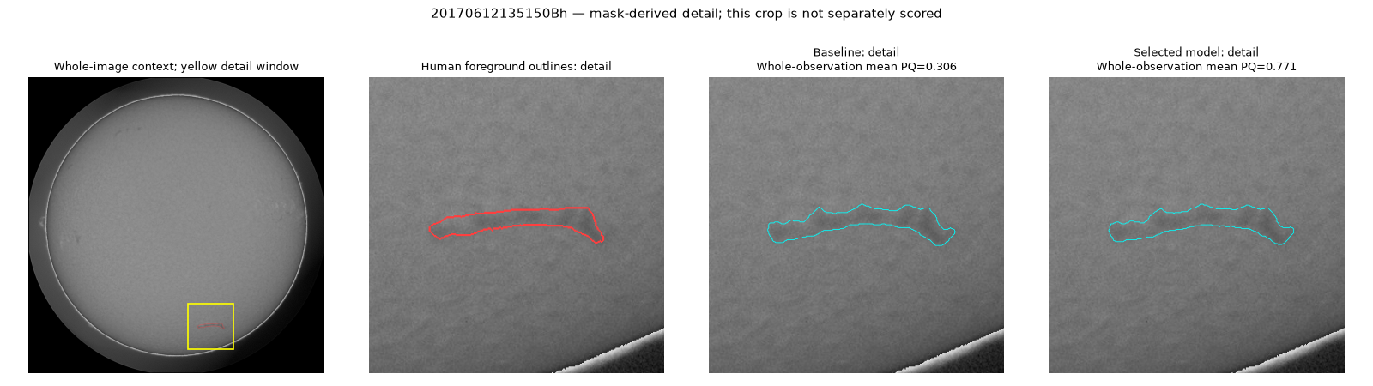
Highest validation score
Red: human outlines. Cyan: predictions. Representative checkpoint: seed 45.
Whole Sun
Human reference
Baseline
Selected model
Whole-observation mean PQ: baseline 0.306 → selected 0.771.
Person B
5
Notes:
This is the highest-scoring validation observation for our representative checkpoint. Both models trace the same filament fairly similarly. Across the whole image, the baseline also has three unmatched extra predictions, while the selected model has none. That helps explain the score increase from 0.306 to 0.771. The detail window is only for visibility; the score is for the whole observation.
Sources
Ahmadzadeh (2026). Self Evaluation Notebook, version 6.
https://www.kaggle.com/code/azimahmadzadeh/self-evaluation-notebook
Project evidence
C:\Users\user-pc\Desktop\COS711_Assig2\AI_Assignment2\report.py
C:\Users\user-pc\Desktop\COS711_Assig2\AI_Assignment2\results\person_b_study\
C:\Users\user-pc\Desktop\COS711_Assig2\AI_Assignment2\runs\person_b_final\
Measured evidence
These are per-observation means, not pooled dataset PQ. Interpret fragmentation/merging alongside recognition quality and TP/FP/FN: missing more filaments can reduce both relation-error counts.
Observation: 20170612135150Bh
Selection rule: Highest selected-model observation mean PQ
Panel: C:\Users\user-pc\Desktop\COS711_Assig2\AI_Assignment2\results\person_b_study\figures\validation_zoom_20170612135150Bh.png

Slide 6
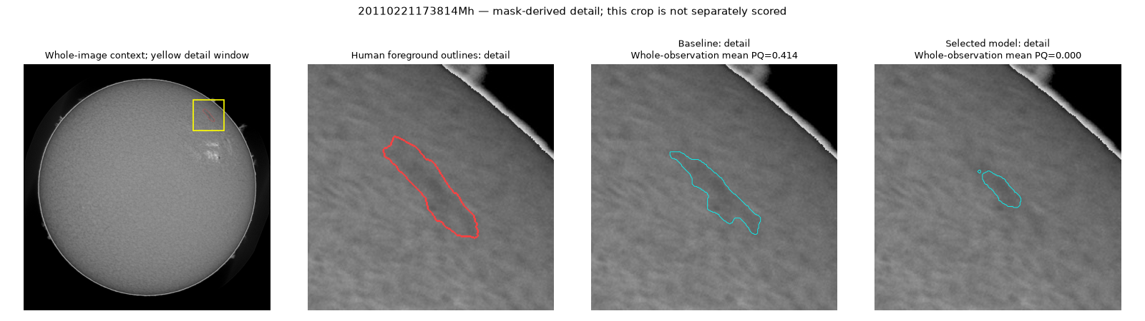
Lowest validation score
Red: human outlines. Cyan: predictions. Representative checkpoint: seed 45.
Whole Sun
Human reference
Baseline
Selected model
Whole-observation mean PQ: baseline 0.414 → selected 0.000.
Person B
6
Notes:
This is the lowest-scoring validation observation. The selected model covers much less of the long human-marked filament and adds a tiny island. None of its predicted objects reaches the required matching overlap, so PQ is zero, compared with 0.414 for the baseline. This is a real regression. The detail window is not scored separately.
Sources
Ahmadzadeh (2026). Self Evaluation Notebook, version 6.
https://www.kaggle.com/code/azimahmadzadeh/self-evaluation-notebook
Project evidence
C:\Users\user-pc\Desktop\COS711_Assig2\AI_Assignment2\study_report.py
C:\Users\user-pc\Desktop\COS711_Assig2\AI_Assignment2\results\person_b_study\
Measured evidence
These are per-observation means, not pooled dataset PQ. Interpret fragmentation/merging alongside recognition quality and TP/FP/FN: missing more filaments can reduce both relation-error counts.
Observation: 20110221173814Mh
Selection rule: Lowest selected-model observation mean PQ
Panel: C:\Users\user-pc\Desktop\COS711_Assig2\AI_Assignment2\results\person_b_study\figures\validation_zoom_20110221173814Mh.png

Slide 7
Efficiency and handoff
Parameters | 24.43 million
Inference weights | 93.4 MiB
Training loop | 12.4 min, excluding validation and setup
Full training run | 24.2 min wall time, latest invocation
Test image to CSV | 536.3 ms/image, without archive saving
Person C receives probabilities, instance maps, weights and the exact configuration.
Person B
7
Notes:
The model has 24.43 million parameters and 93.4 MiB of weights. The training loop took 12.4 minutes; the full invocation took 24.2 minutes including setup, validation and checkpoints. The checked image-to-CSV export averaged 536.3 milliseconds per image on this computer. That includes the first image, but excludes model loading and probability-archive saving. Person C receives the weights, probabilities, instance maps and exact configuration. Advanced post-processing and compression comparisons remain their work.
Sources
segmentation_models_pytorch, version 0.6.0.
https://github.com/qubvel-org/segmentation_models.pytorch
Project evidence
C:\Users\user-pc\Desktop\COS711_Assig2\AI_Assignment2\train.py
C:\Users\user-pc\Desktop\COS711_Assig2\AI_Assignment2\predict.py
C:\Users\user-pc\Desktop\COS711_Assig2\AI_Assignment2\runs\person_b_final\
Measured evidence
Representative: C:\Users\user-pc\Desktop\COS711_Assig2\AI_Assignment2\runs\final\no_augmentation_seed45; seed 45.
Timing: 96.53502770001069 seconds / 180 images; includes read, preprocessing, transfers, model, components, RLE round-trip and complete CSV writing. No warm-up images were removed. Latest training subprocess time is not cumulative resumed-run time.
Summary: C:\Users\user-pc\Desktop\COS711_Assig2\AI_Assignment2\results\person_b_study\summary.json
Benchmark details: C:\Users\user-pc\Desktop\COS711_Assig2\AI_Assignment2\results\person_b_study\inference_benchmarks.json

Slide 8
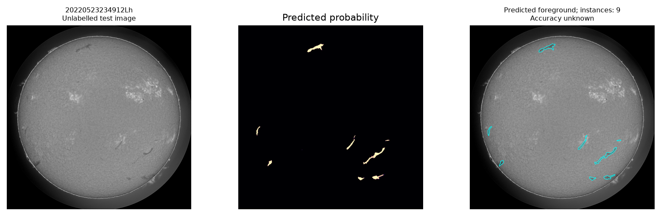
Test image illustration
Unlabelled test illustration. No ground-truth accuracy ranking.
Person B
8
Notes:
This is an unlabelled test image, selected by typical prediction count for its instrument. The exact rule is: Median predicted-instance count for instrument Lh; visual coverage only, accuracy unknown. The panel shows the final probability map and detected regions. We cannot say how accurate these are without labels. The complete export covers 180 test images, with 1831 predicted instances. Three images have no detections; those are recorded in the sidecar. Nothing has been uploaded to Kaggle.
Sources
Ahmadzadeh (2026). Self Evaluation Notebook, version 6.
https://www.kaggle.com/code/azimahmadzadeh/self-evaluation-notebook
Project evidence
C:\Users\user-pc\Desktop\COS711_Assig2\AI_Assignment2\study_report.py
C:\Users\user-pc\Desktop\COS711_Assig2\AI_Assignment2\results\person_b_study\
C:\Users\user-pc\Desktop\COS711_Assig2\AI_Assignment2\runs\person_b_final\
Measured evidence
Observation: 20220523234912Lh
Selection rule: Median predicted-instance count for instrument Lh; visual coverage only, accuracy unknown
Panel: C:\Users\user-pc\Desktop\COS711_Assig2\AI_Assignment2\results\person_b_study\figures\test_20220523234912Lh.png

Slide 9
Model and loss references
Ronneberger, Fischer & Brox (2015). U-Net.
https://arxiv.org/abs/1505.04597
He et al. (2016). Deep Residual Learning for Image Recognition.
https://arxiv.org/abs/1512.03385
Milletari, Navab & Ahmadi (2016). V-Net.
https://arxiv.org/abs/1606.04797
Salehi, Erdogmus & Gholipour (2017). Tversky loss.
https://arxiv.org/abs/1706.05721
Zhou et al. (2018). UNet++.
https://arxiv.org/abs/1807.10165
segmentation_models_pytorch, version 0.6.0.
https://github.com/qubvel-org/segmentation_models.pytorch
Person B
9
Notes:
Bibliography. No narration is needed.
Sources
Ronneberger, Fischer & Brox (2015). U-Net.
https://arxiv.org/abs/1505.04597
He et al. (2016). Deep Residual Learning for Image Recognition.
https://arxiv.org/abs/1512.03385
Milletari, Navab & Ahmadi (2016). V-Net.
https://arxiv.org/abs/1606.04797
Salehi, Erdogmus & Gholipour (2017). Tversky loss.
https://arxiv.org/abs/1706.05721
Zhou et al. (2018). UNet++.
https://arxiv.org/abs/1807.10165
segmentation_models_pytorch, version 0.6.0.
https://github.com/qubvel-org/segmentation_models.pytorch

Slide 10
Evaluation and training references
Ahmadzadeh et al. (2024). A dataset of manually annotated filaments.
https://doi.org/10.1038/s41597-024-03876-y
Kirillov et al. (2019). Panoptic Segmentation.
https://arxiv.org/abs/1801.00868
Ahmadzadeh (2026). Self Evaluation Notebook, version 6.
https://www.kaggle.com/code/azimahmadzadeh/self-evaluation-notebook
Loshchilov & Hutter (2019). Decoupled Weight Decay Regularization.
https://arxiv.org/abs/1711.05101
PyTorch 2.14 documentation. CosineAnnealingLR.
https://docs.pytorch.org/docs/2.14/generated/torch.optim.lr_scheduler.CosineAnnealingLR.html
Person B
10
Notes:
Bibliography. The project uses ordinary cosine annealing without SGDR restarts. The MAGFiLO paper describes the dataset; only the supplied competition training labels enter this project.
Sources
Ahmadzadeh et al. (2024). A dataset of manually annotated filaments.
https://doi.org/10.1038/s41597-024-03876-y
Kirillov et al. (2019). Panoptic Segmentation.
https://arxiv.org/abs/1801.00868
Ahmadzadeh (2026). Self Evaluation Notebook, version 6.
https://www.kaggle.com/code/azimahmadzadeh/self-evaluation-notebook
Loshchilov & Hutter (2019). Decoupled Weight Decay Regularization.
https://arxiv.org/abs/1711.05101
PyTorch 2.14 documentation. CosineAnnealingLR.
https://docs.pytorch.org/docs/2.14/generated/torch.optim.lr_scheduler.CosineAnnealingLR.html

