Slide 1
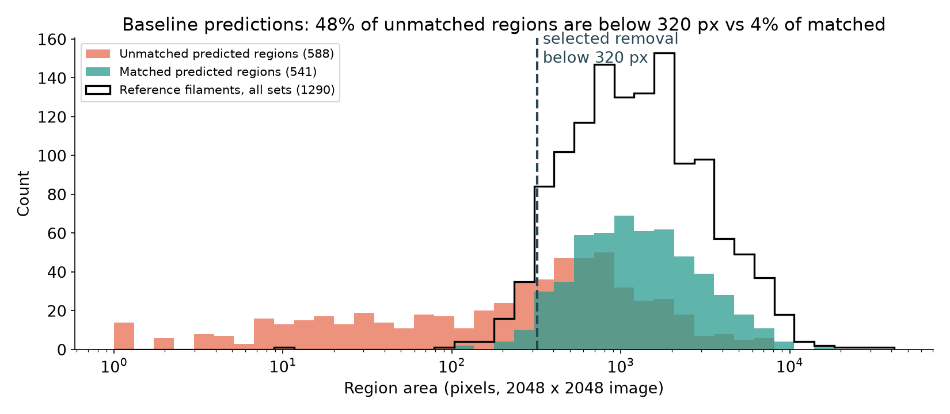
Where the errors were
• Baseline conversion (cutoff 0.5, 8-connected regions): PQ 0.345 = 783 matched, 1,007 extra, 507 missed
• Extra detections outnumber misses 2 : 1; fragmentation (84) is 4x more common than merging (20)
• 48% of unmatched regions are < 320 px, vs 4% of matched and 5% of human filaments
Person C
1
Notes:
I took the seed-45 probabilities from Person B and first asked which errors cost PQ. Pooled over the 200 validation annotation sets there were 783 matched filaments, 1,007 extra predictions and 507 misses, so extra detections outnumber misses two to one. The histogram shows why: 48% of the unmatched predicted regions are smaller than 320 pixels, while only 4% of matched regions and 5% of human-drawn filaments are that small. Fragmentation was 84 cases against 20 merges.

Slide 2
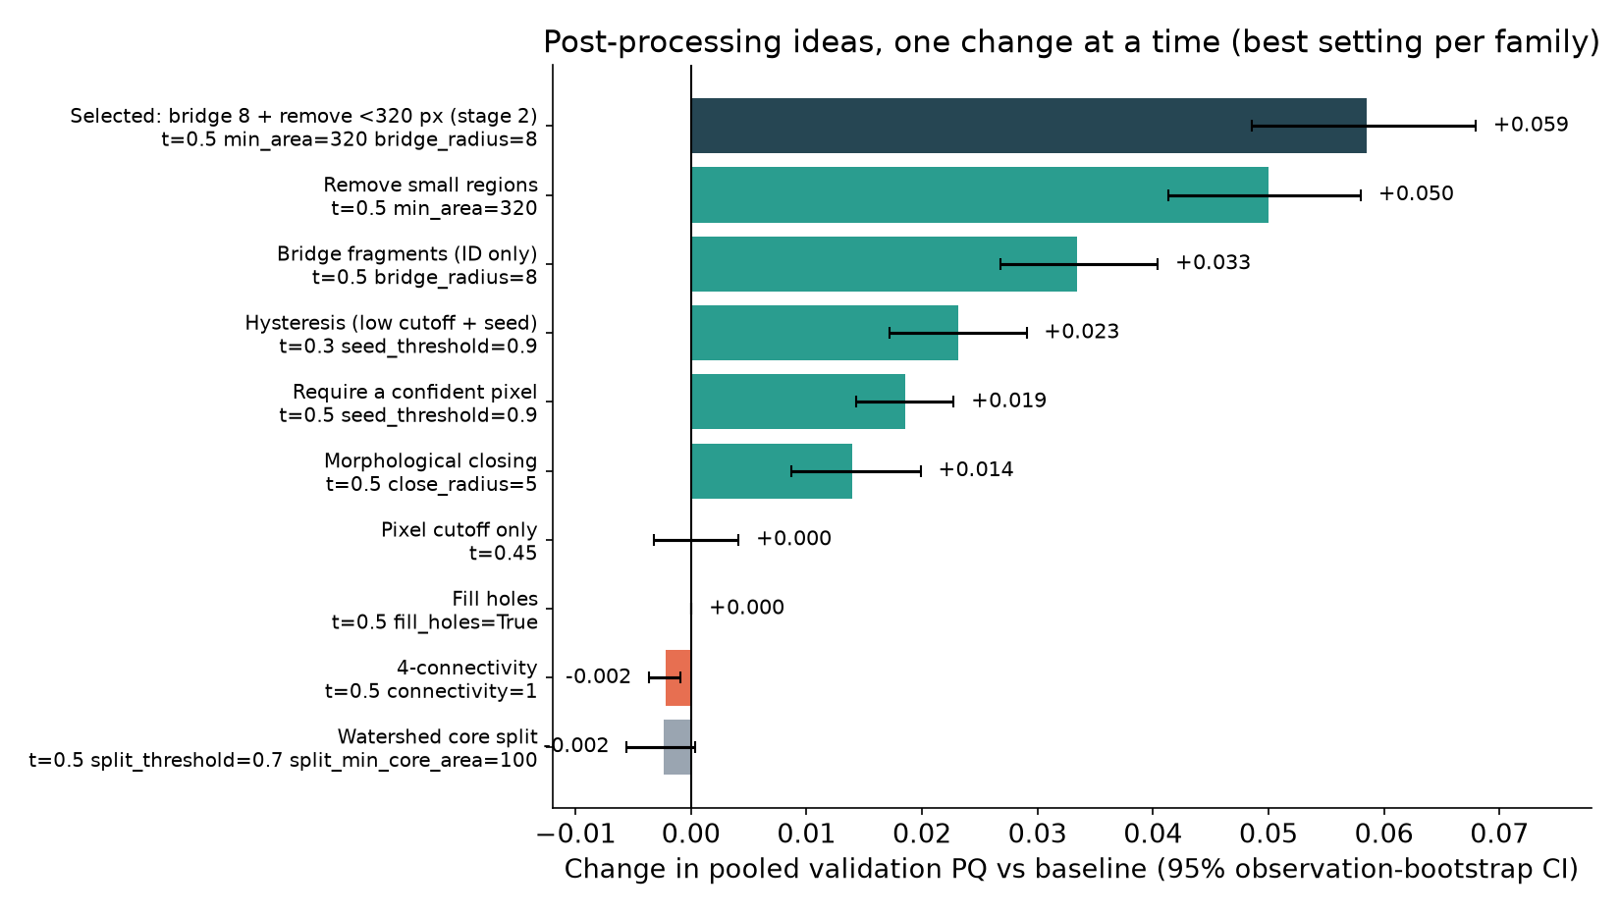
Post-processing study
Same probabilities, same scorer
Offline runner reproduces Person B's PQ exactly (0.3448101728)
Declared grids: 55 + 50 settings
Error bars: 95% bootstrap over validation images
Person C
2
Notes:
Because the probabilities were saved, I built an offline runner that re-scores them with exactly the same evaluator. It first reproduced Person B's PQ of 0.3448101728 bit for bit. I then declared a grid of 55 settings, changing one thing at a time. Removing small regions and bridging nearby fragments helped most; hysteresis and closing helped less. Changing the pixel cutoff alone did nothing, which tells us the misses are not just faint pixels below 0.5. Splitting regions at confident cores with a watershed made things worse. The error bars are 95 percent bootstrap intervals over images.

Slide 3
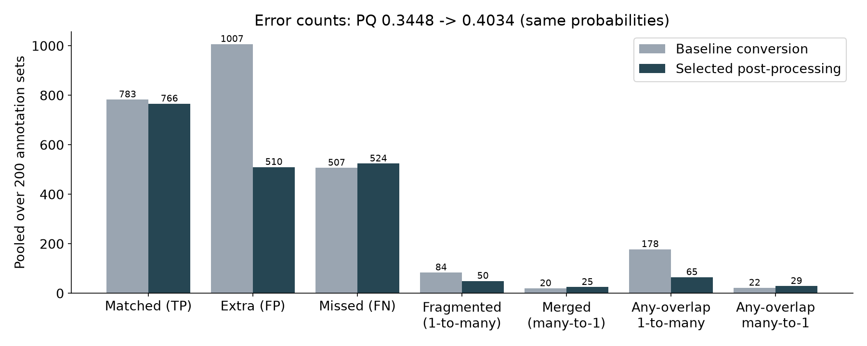
Selected post-processing
Bridge fragments up to 16 px apart (one ID, no pixels added), then drop regions < 320 px
PQ 0.345 → 0.403 (+0.059; 95% CI +0.049 to +0.068)
Tuned on half of the validation blocks, tested on the other half: +0.056 and +0.059
Trade-off
Extra regions 1,007 → 510
Fragmented 84 → 50
Lost matches: 17 small filaments
Merges 20 → 25
Person C
3
Notes:
The selected rule has two steps. First, fragments separated by at most 16 pixels get the same instance ID, without adding any pixels. Then regions smaller than 320 pixels are removed. PQ rises from 0.345 to 0.403. To check that we did not just fit the validation set, I tuned on one half of the validation time blocks and tested on the other half: the gain held at +0.056 and +0.059. Extra predictions halve and fragmentation drops, at a cost of 17 matched small filaments and a few more merges.

Slide 4
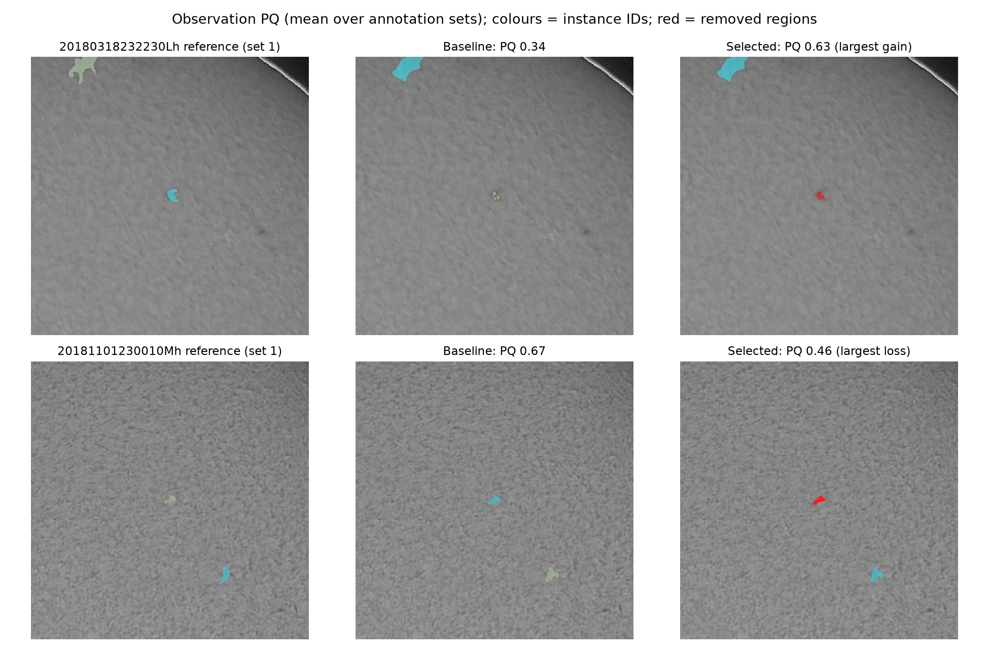
Best and worst cases
Best case
PQ 0.34 → 0.63: a tiny partial detection (IoU < 0.5) only counted as an extra object
Worst case
PQ 0.67 → 0.46: a real filament smaller than 320 px was removed
Red = removed region; colours = instance IDs
Person C
4
Notes:
These are the validation images that changed most. In the best case, a tiny partial detection of a real filament was removed: it never reached the IoU of 0.5 needed for a match, so it only counted as an extra object. In the worst case, a small real filament below 320 pixels was removed, which is the price of the size filter. Bridged fragments appear as one colour.

Slide 5
What did not help
Idea | Change in PQ | Why
Pixel cutoff 0.3 to 0.7 (alone) | best +0.000 | Misses are not just faint pixels below 0.5
Watershed split at confident cores | -0.002 to -0.010 | Cuts single filaments; merges were rare (20)
Flip test-time augmentation | -0.004 | 3.8x model time; best re-tuned cutoff only +0.0007
Fill holes | +0.000 | Predicted regions have no holes
4-connectivity | -0.002 | Breaks thin diagonal filaments
Hysteresis (+0.023) and closing (+0.014) helped alone but were subsumed by the selected pair.
Person C
5
Notes:
Negative results matter too. Moving the pixel cutoff between 0.3 and 0.7 never beat 0.5. Watershed splitting at confident cores made PQ worse because single filaments have uneven confidence and get cut into pieces, and merges were rare anyway. Flip test-time augmentation lowered PQ at our selected setting and, even after re-tuning the cutoff, gained almost nothing while costing nearly four times the model time. Filling holes and four-connectivity did not help either.

Slide 6
Compression
Same validation split, selected post-processing, complete image-to-CSV timing on one RTX 3070 (batch 1, model loading excluded)
Variant | Params | File | Val PQ | ms / image | Training
Teacher FP32 | 24.4 M | 93 MB | 0.4034 | 491 | -
Teacher mixed precision (B default) | 24.4 M | 93 MB | 0.4034 | 456 | -
Teacher FP16 weights | 24.4 M | 47 MB | 0.4033 | 445 | -
KD student ResNet18 | 14.3 M | 55 MB | 0.4012 | 489 | 11 min
Label-only ResNet18 (control) | 14.3 M | 55 MB | 0.3976 | 461 | 8 min
Pruned 50% channels + fine-tune | 6.1 M | 23 MB | 0.3652 | 494 | 4 min
Pruned 30% channels + fine-tune | 11.9 M | 46 MB | 0.4028 | 478 | 4 min
Pruned 30% + FP16 weights | 11.9 M | 23 MB | 0.4031 | 475 | 4 min
CPU deployment (first 20 test images, per image): PyTorch FP32 2.5 s, 93 MB; ONNX Runtime FP32 1.7 s, 93 MB; ONNX Runtime INT8 1.2 s, PQ 0.407, 24 MB
FP16 weights: PQ change -0.00001 at 47 vs 93 MB; distillation 0.401 vs label-only 0.398 (ResNet18, 14.3 M params); 50% channel pruning 0.365 (6.1 M params); 30% channel pruning 0.403 (11.9 M params). Chosen by the declared rule: Pruned 30% + FP16 weights.
Person C
6
Notes:
For compression I compared every variant on the same validation split, the deployable file size, and the complete test pipeline time from reading the image to writing the CSV, on the same RTX 3070. Storing the weights in half precision halves the file with no measurable loss in PQ. Removing 30 percent of the channels in every layer and fine-tuning for ten epochs kept PQ at 0.403 against 0.403 with half the parameters; removing 50 percent was too destructive for the same short fine-tune (0.365). The distilled ResNet18 student scored 0.401 and the label-only control 0.398; before post-processing the order was reversed, so with one run each, distillation's effect is within run-to-run noise. The network itself takes only about 96 of the 456 milliseconds per image: reading the image, post-processing and checking the encoding dominate, so a smaller network barely changes total time. For CPU-only deployment, ONNX Runtime with INT8 weights is four times smaller and faster than PyTorch, without losing PQ.

Slide 7
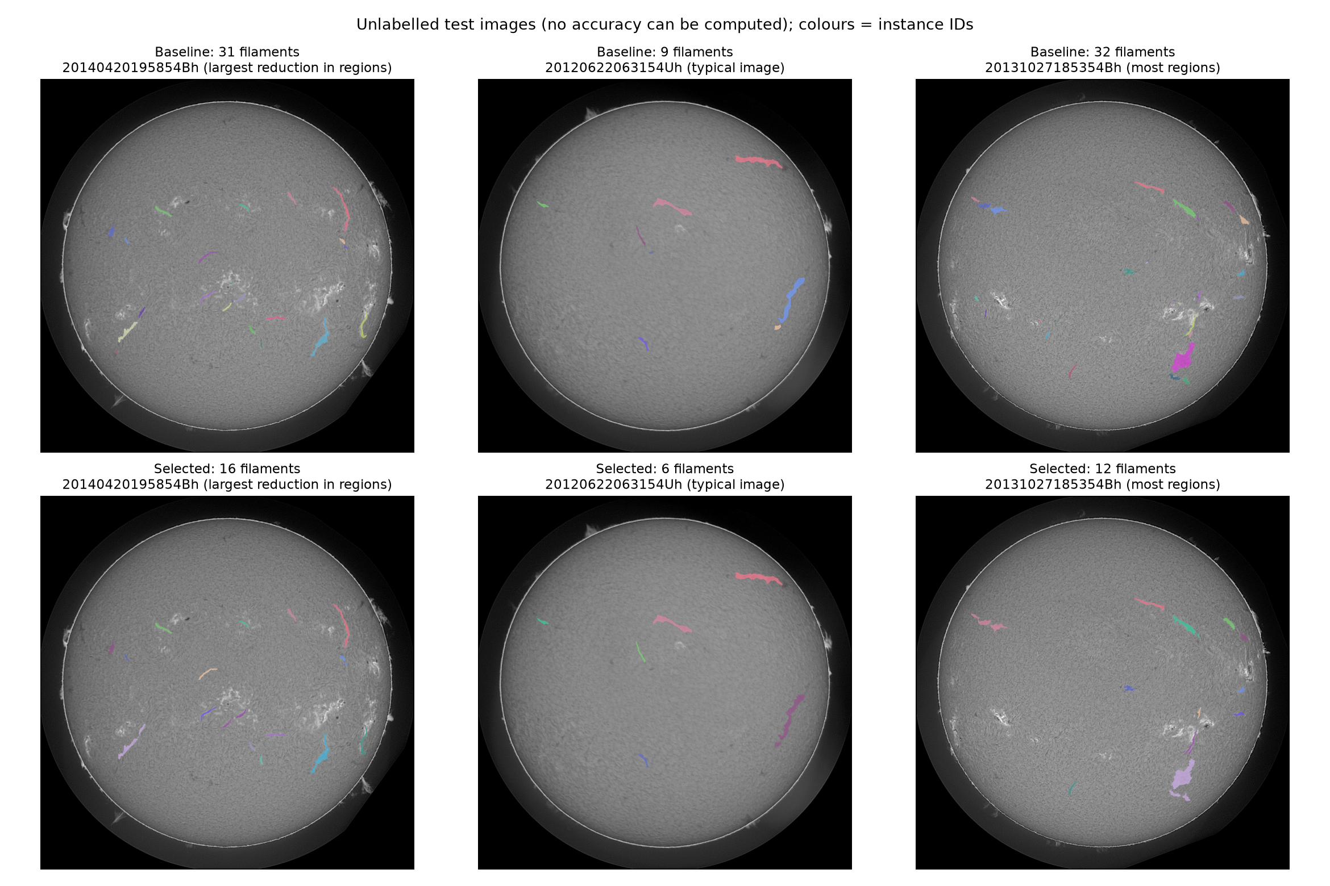
Final pipeline and submission
Item | Value
Final model | U-Net / ResNet34, seed 45 (Pruned 30% + FP16 weights)
Size | 11.93 M parameters, 22.9 MB weights file
Training time | 12.4 min teacher training loop (20 epochs, RTX 5060 Ti) + 4.0 min fine-tuning after pruning (RTX 3070)
End-to-end inference | 475 ms/image over 180 test images (476 ms excluding the first), RTX 3070
Validation PQ | 0.4031 (selected post-processing; baseline conversion 0.3288)
Test output | 1421 filaments, 180 images, 3 empty
Kaggle PQ | add after upload (not yet submitted)
Person C
7
Notes:
The final pipeline runs whole-image inference, the selected post-processing, and checked RLE encoding. It produced 1421 filaments on the 180 test images. Model size, training time and end-to-end time are on the slide. The images are unlabelled test predictions, shown as illustrations only. The Kaggle score is added after the upload.

Slide 8
Conclusions
Take-aways
• Instance conversion mattered as much as the network: +0.059 PQ from post-processing alone, more than the training-configuration study
• Small extra detections, not misses, dominated the errors; let the data choose the filter
• Pruning + FP16 storage kept validation PQ at a fraction of the size (11.93 M parameters, 22.9 MB weights file); the network is a small part of end-to-end time
• Labels are noisy: annotator vs annotator PQ is about 0.34; validation is a reference, not a leaderboard guarantee
Roadblocks
• Many settings, one validation split: declared grids, split-half and bootstrap checks
• Limited GPU time: single-seed compression runs; 50% pruning needed longer fine-tuning
Next time
• Train for instances (boundary or skeleton targets) instead of repairing them afterwards; prune gradually; repeat compression with more seeds; submit to Kaggle early
Person C, then all
8
Notes:
Our main take-away is that turning probabilities into separate objects mattered as much as the network: post-processing alone added more PQ than the whole training-configuration study. Errors were dominated by small extra detections, and a data-driven size filter plus fragment bridging targeted them. For efficiency, pruning and half-precision storage shrank the model a lot at the same validation PQ, but the network is only a small part of the end-to-end time. Our biggest roadblocks were tuning many settings on one validation split, which we handled with declared grids, split-half and bootstrap checks, and limited GPU time, so compression runs used one seed and aggressive pruning needed more fine-tuning than we had. Next time we would train for instances directly, for example with a boundary or skeleton target, prune gradually, repeat compression with several seeds, and submit to Kaggle early to compare local and leaderboard scores.

Slide 9
Enhancement references
Kirillov et al. (2019). Panoptic Segmentation. CVPR. https://doi.org/10.1109/CVPR.2019.00963
Canny (1986). A Computational Approach to Edge Detection (hysteresis thresholding). IEEE TPAMI.
Beucher & Meyer (1993). The morphological approach to segmentation: the watershed transformation.
van der Walt et al. (2014). scikit-image: image processing in Python. PeerJ. https://doi.org/10.7717/peerj.453
Hinton, Vinyals & Dean (2015). Distilling the Knowledge in a Neural Network. https://arxiv.org/abs/1503.02531
Fang et al. (2023). DepGraph: Towards Any Structural Pruning. CVPR. https://arxiv.org/abs/2301.12900
Li et al. (2017). Pruning Filters for Efficient ConvNets (L1 channel importance). https://arxiv.org/abs/1608.08710
Micikevicius et al. (2018). Mixed Precision Training. ICLR. https://arxiv.org/abs/1710.03740
Efron & Tibshirani (1993). An Introduction to the Bootstrap. Chapman & Hall.
Iakubovskii. segmentation_models_pytorch. https://github.com/qubvel-org/segmentation_models.pytorch
Person C
9
Notes:
Bibliography slide; not spoken.

